Slide 1
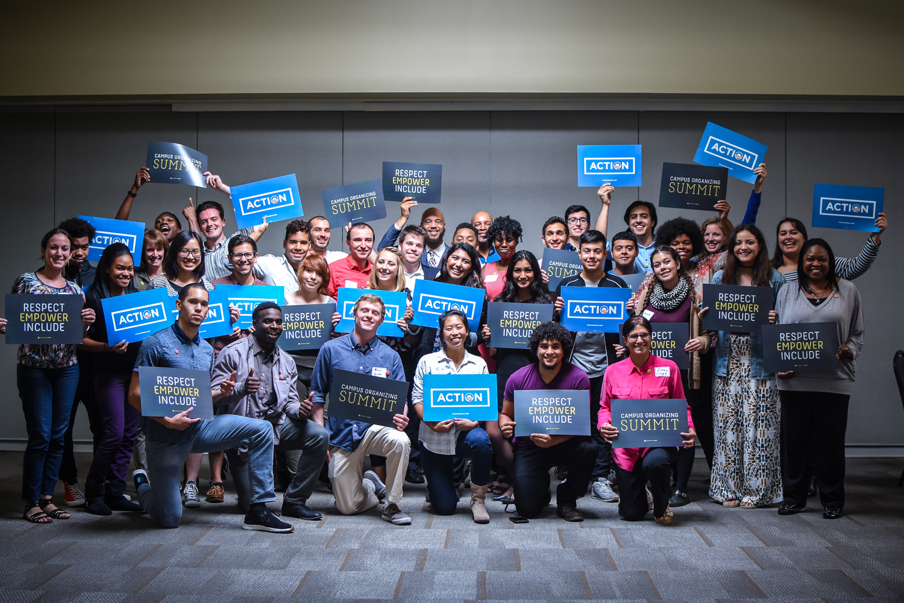

Issue Organizing
Workshop
Notes:
This work is licensed under the Creative Commons Attribution-NonCommercial 4.0 International License. To view a copy of this license, visit http://creativecommons.org/licenses/by-nc/4.0/ or send a letter to Creative Commons, PO Box 1866, Mountain View, CA 94042, USA

Slide 2
Welcome & Intro

Slide 3
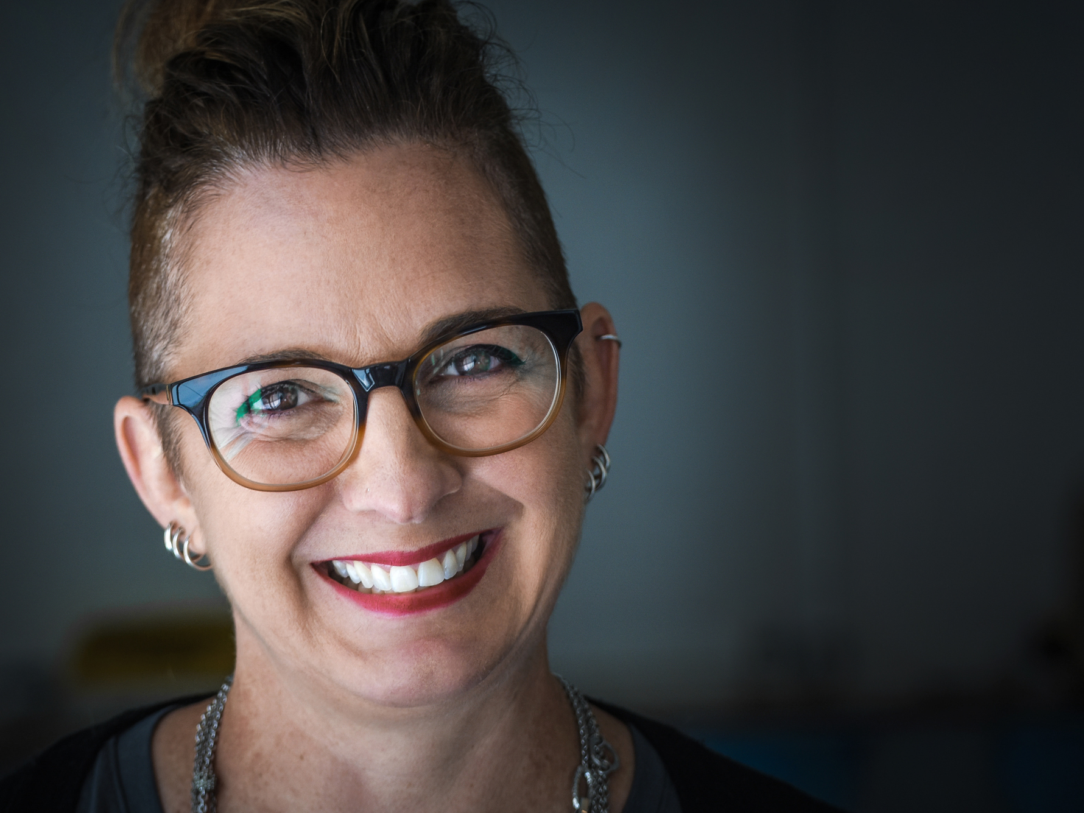
Instructor Name
TITLE & INSTITUTION

Slide 4
Ice Breaker

Slide 5
Organizer Clap
Share your name, location, and your people

Slide 6
Agenda
00:00 Welcome & Intro
00:00 Issue Campaigns 101:
Identifying a Goal
00:00 Issue Campaigns 102:
Creating a Strategy
00:00 Issue Campaigns 103:
Planning Tactics
00:00 Sponsor Games
00:00 Debrief & Close

Slide 7
Goals
1
Understand best practices and key elements of issue organizing
Be able to develop a campaign plan for a campus issue
Feel confident approaching issue organizing in an effective and strategic way
2
3

Slide 8
What do you hope
to get out of today?

Slide 9
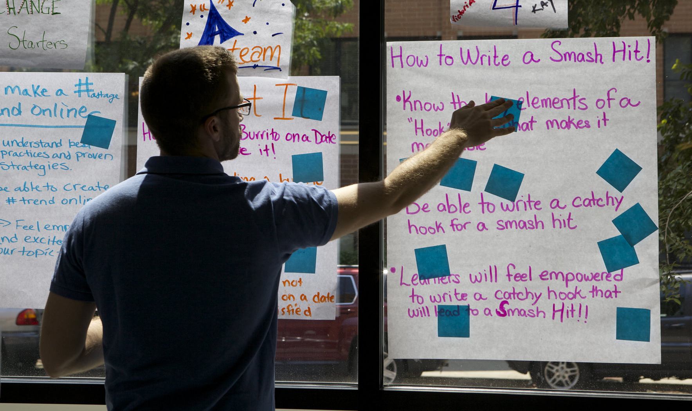
Norms
Parking Lot
We will answer as many questions as possible, but we will “parking lot” questions if we run out of time, or need to investigate an answer.

Slide 10
Norms
RESPECT
EMPOWER
INCLUDE

Slide 11
Norms
RESPECT
EMPOWER
INCLUDE

Slide 12
Norms
RESPECT
EMPOWER
INCLUDE

Slide 13
Norms
Here are a few housekeeping items…

Slide 14
Agenda
00:00 Welcome & Intro
00:00 Issue Campaigns 101:
Identifying a Goal
00:00 Issue Campaigns 102:
Creating a Strategy
00:00 Issue Campaigns 103:
Planning Tactics
00:00 Sponsor Games
00:00 Debrief & Close

Slide 15
Identifying a Goal
Issue Campaigns 101

Slide 16

Session goals
1
Understand what issue advocacy is and the key elements to building an issue campaign
Be able to identify and select an ideal goal for your issue campaign
Feel confident in goal setting and creating a mission for your campaign
2
3
OFA CAMPUS ORGANIZING SUMMIT

Slide 17
Session agenda
Issue Campaigns 101:
Identifying a Goal
Issue Advocacy
Intro to Issue Campaigns
Establishing Your
Ideal Goal
Debrief

Slide 18
What issues do you care about?
What are some ways we can impact
change on an issue?
How do we make sure all these
actions are working together?

Slide 19
What issues do you care about?
What are some ways we can impact
change on an issue?
How do we make sure all these
actions are working together?

Slide 20
What issues do you care about?
What are some ways we can impact
change on an issue?
How do we make sure all these
actions are working together?

Slide 21
The best way to
make progress on issues is by running
an issue campaign.

Slide 22
Session agenda
Issue Campaigns 101:
Identifying a Goal
Issue Advocacy
Intro to Issue Campaigns
Establishing Your
Ideal Goal
Debrief

Slide 23
Goal
Strategy
Tactics
Building capacity and resources
Issue Campaign

Slide 24
Session agenda
Issue Campaigns 101:
Identifying a Goal
Issue Advocacy
Intro to Issue Campaigns
Establishing Your
Ideal Goal
Debrief

Slide 25
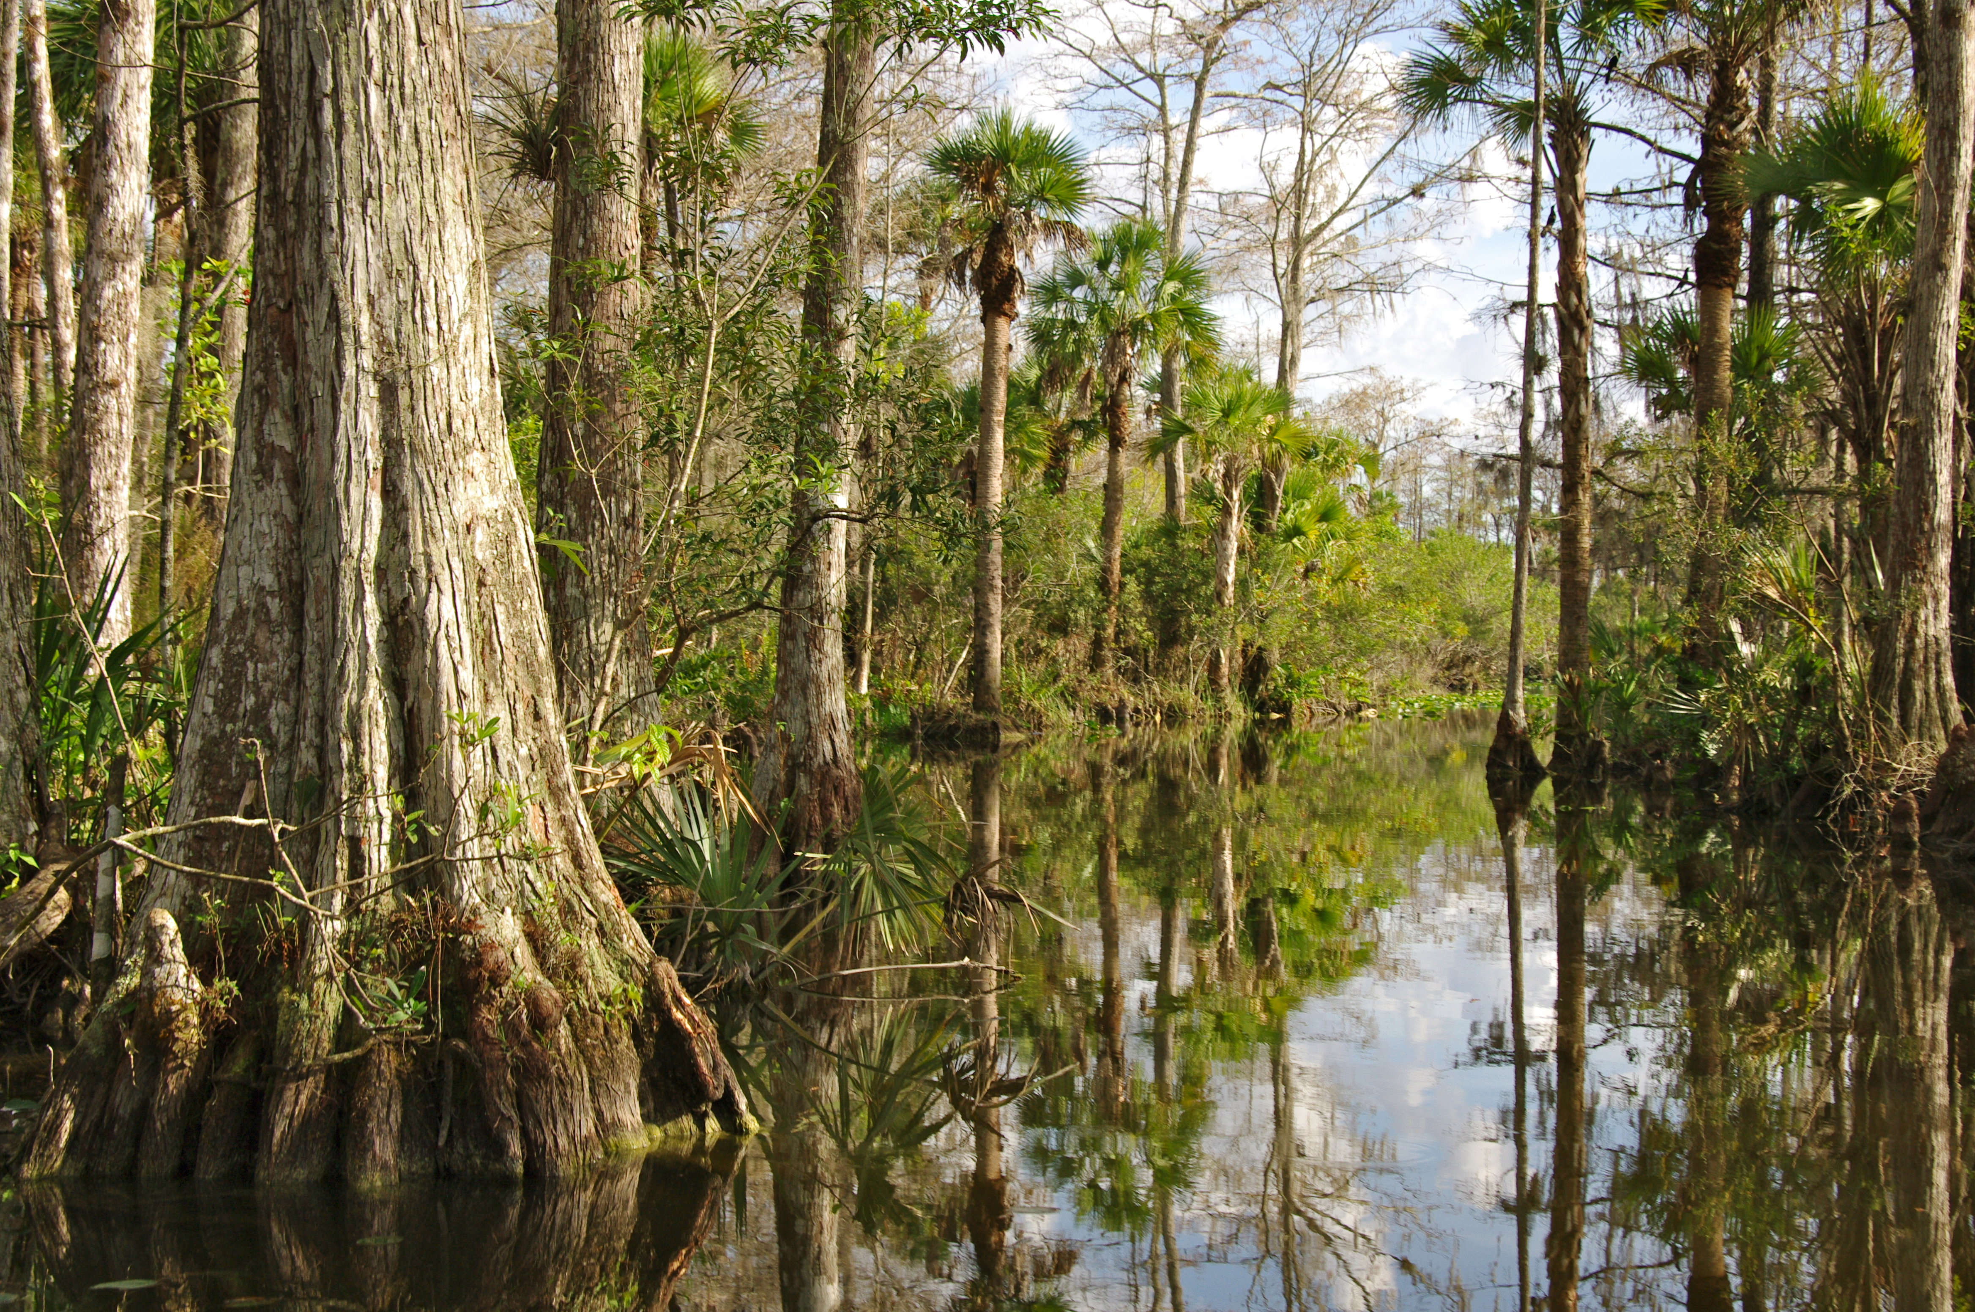
Welcome to
Everglades College
Workbook Page 1

Slide 26
Report back

Slide 27
Experiential Activity 1A
Workbook Page 2

Slide 28
12 minutes
Your turn! Work with your group to determine the
overall strengths and weaknesses of each goal.
Based on your analysis, choose a goal for your
group to achieve.
Refer to your worksheet on page 2.

Slide 29
Report back

Slide 30
Establishing Your Ideal Goal
Establishing your ideal goal
1
The college will start a program encouraging students to use less energy to reduce the campus’ carbon footprint
Get the college to immediately divest from fossil fuel industry
The college will transition to using 100% clean energy like wind and solar
The college will create a public report of it’s carbon footprint and a plan to achieve a goal of a zero carbon campus
2
3
4

Slide 31
Establishing Your Ideal Goal
Establishing your ideal goal
Goals are
realistic
Goals solve
challenges
Goals can be measured

Slide 32
Establishing Your Ideal Goal
Establishing your ideal goal
Goals are
realistic
Goals solve
challenges
Goals can be measured

Slide 33
Establishing Your Ideal Goal
Establishing your ideal goal
Goals are
realistic
Goals solve
challenges
Goals can be measured

Slide 34
Experiential Activity 1B
Workbook Page 3

Slide 35
12 minutes
Your turn! With your group, use this time to analyze your chosen goal. Answer the following questions for the goal:
Is it realistic? Does it solve a challenge? Is it measurable?
Refer to your worksheet on page 3.

Slide 36
Report back

Slide 37
Establishing Your Ideal Goal
Establishing your ideal goal
1
The college will start a program encouraging students to use less energy to reduce the campus’ carbon footprint
Get the college to immediately divest from fossil fuel industry
The college will transition to using 100% clean energy like wind and solar
The college will create a public report of it’s carbon footprint and a plan to achieve a goal of a zero carbon campus
2
3
4

Slide 38
Session agenda
Issue Campaigns 101:
Identifying a Goal
Issue Advocacy
Intro to Issue Campaigns
Establishing Your
Ideal Goal
Debrief

Slide 39
DEBRIEF
What are your
biggest takeaways?

Slide 40
DEBRIEF
How will you use
what you’ve learned?

Slide 41
Agenda
00:00 Welcome & Intro
00:00 Issue Campaigns 101:
Identifying a Goal
00:00 Issue Campaigns 102:
Creating a Strategy
00:00 Issue Campaigns 103:
Planning Tactics
00:00 Sponsor Games
00:00 Debrief & Close

Slide 42
Creating a Strategy
Issue Campaigns 102

Slide 43
Session goals
1
Understand what a strategy is and how it relates to your issue campaign
Be able to create a strategy based on the available knowledge and resources
Feel confident in being able to select a strategy that allows you to achieve your campaign’s main goal
2
3
OFA CAMPUS ORGANIZING SUMMIT

Slide 44
Session agenda
Issue Campaigns 102:
Creating a Strategy
What is a strategy?
Creating a proper strategy
Targeting decision makers
Debrief

Slide 45
A good strategy is the roadmap to success and answers the question of how we will achieve our goal.

Slide 46
Creating a strategy
An effective strategy must answer three basic questions.
What institutions have the ability to enact the change you wish to see?
Notes:
You all are here b/c you care about a certain issues and want to effect change.
What are some ways you think you can make change on an issue?
What are some tactics you use in issue advocacy?
[graph on ways to make change → issue ecosystem]
How do we make sure that all these tactics are correlated? Creating a strategic plan / issue campaign
All of these tactics are effecting the issue ecosystem. (define ecosystem). To do this correctly you need issue campaign
Issue campaign has 4 components: goals, strategy, etc

Slide 47
Creating a strategy
An effective strategy must answer three basic questions.
What institutions have the ability to enact the change you wish to see?
What decision makers will you target?
Notes:
You all are here b/c you care about a certain issues and want to effect change.
What are some ways you think you can make change on an issue?
What are some tactics you use in issue advocacy?
[graph on ways to make change → issue ecosystem]
How do we make sure that all these tactics are correlated? Creating a strategic plan / issue campaign
All of these tactics are effecting the issue ecosystem. (define ecosystem). To do this correctly you need issue campaign
Issue campaign has 4 components: goals, strategy, etc

Slide 48
Creating a strategy
An effective strategy must answer three basic questions.
What institutions have the ability to enact the change you wish to see?
What decision makers will you target?
What messages will you use to motivate these decision makers to action?
Notes:
You all are here b/c you care about a certain issues and want to effect change.
What are some ways you think you can make change on an issue?
What are some tactics you use in issue advocacy?
[graph on ways to make change → issue ecosystem]
How do we make sure that all these tactics are correlated? Creating a strategic plan / issue campaign
All of these tactics are effecting the issue ecosystem. (define ecosystem). To do this correctly you need issue campaign
Issue campaign has 4 components: goals, strategy, etc

Slide 49
Session agenda
Issue Campaigns 102:
Creating a Strategy
What is a strategy?
Creating a proper strategy
Targeting decision makers
Debrief

Slide 50
Welcome back to
Everglades College
Workbook Pages 4 & 5

Slide 51
REPORT BACK
What institutions
can we target to pass legislation?

Slide 52
Board of Trustees
Student Government Assoc.

Slide 53
REPORT BACK
For each institution,
in what ways can we
pass legislation?

Slide 54
Board of Trustees:
Simple majority vote, with approval from the College President
The Student Government Association:
Simple majority vote, with approval from the College President

Slide 55
Session agenda
Issue Campaigns 102:
Creating a Strategy
What is a strategy?
Creating a proper strategy
Targeting decision makers
Debrief

Slide 56
To enact change for
an issue campaign,
we need to influence decision makers.

Slide 57
In order to influence decision makers, we must target their
self interests.

Slide 58
Our message must resonate with decision makers based on their self interests.

Slide 59
Decision makers have certain motivations
What are some things that motivate decision makers?

Slide 60
Reelection
Decision makers have certain motivations
Their Legacy
Finances
Future of the Organization
Constituent Base

Slide 61
Experiential Activity 2
Workbook Page 6-9

Slide 62
20 minutes
Your turn! On your own, spend 8 minutes reading the biography of each potential target decision maker.
Then spend 12 minutes as a group analyzing how you might target each decision maker.

Slide 63
DEBRIEF
What are some potential motivators
for each decision maker?

Slide 64
Recap: Goals & strategy
Step 1: Identify Our Goal
Achievable
Solves a challenge
Can be measured

Slide 65
Recap: Goals & strategy
Step 1: Identify Our Goal
Achievable
Solves a challenge
Can be measured
Step 2: Create a Strategy
Answer three key questions:
What institutions?
What decision makers?
What message?

Slide 66
Experiential Activity 3
Workbook Page 10

Slide 67
10 minutes
Your turn! Work with your group to select your strategy.
Determine whether to target the
Board of Trustees or SGA.
2. Then, decide what messages you’ll use to influence them based on their self-interested motivations.
3. Finally, summarize your campaign strategy
in a short paragraph.

Slide 68
Session agenda
Issue Campaigns 102:
Creating a Strategy
What is a strategy?
Creating a proper strategy
Targeting decision makers
Debrief

Slide 69
DEBRIEF
What strategy did
you pick and why?

Slide 70
DEBRIEF
What was your
Biggest takeaway?

Slide 71
Ice Breaker

Slide 73
Pair up!

Slide 74
Agenda
00:00 Welcome & Intro
00:00 Issue Campaigns 101:
Identifying a Goal
00:00 Issue Campaigns 102:
Creating a Strategy
00:00 Issue Campaigns 103:
Planning Tactics
00:00 Sponsor Games
00:00 Debrief & Close

Slide 75
Planning Tactics
Issue Campaigns 103

Slide 76
Session goals
1
Understand how tactics relate to strategy within an issue campaign
Be able to identify effective tactics based on your goal and strategy
Feel excited applying what you learned to build an issue campaign
2
3
OFA CAMPUS ORGANIZING SUMMIT

Slide 77
Session agenda
Tying tactics to strategy
Effective tactics
Persuading decision makers
Debrief

Slide 78
Tactics are strategic actions you can use
to persuade targeted decision makers to make the change you want to see.

Slide 79

Tying tactics to strategy

Slide 80
DEBRIEF
What do you think
Ali’s goal was in fighting George Foreman?

Slide 81
DEBRIEF
How did Ali’s tactics
reinforce that strategy?

Slide 82
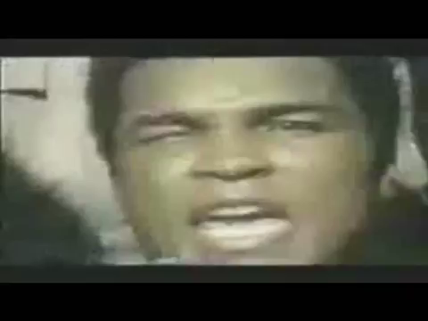
Tying tactics to strategy

Slide 83
Session agenda
Tying tactics to strategy
Effective tactics
Persuading decision makers
Debrief

Slide 84
What are some ways
we can influence decision makers with our message?

Slide 85
Effective tactics
Signature Drives
Press Conferences
& Rallies
Letters to the Editor
Digital Organizing
Office Visits
& Phone Calls
Speaker Series
& Film Screenings

Slide 86
Effective tactics
An effective tactic appeals to a
decision maker’s motivations.
There are three ways to communicate with decision makers:
Press
Online
Directly

Slide 87
Persuading David Menendez
on marriage equality
Moderate
No previous public statements
Pro-business
Positive, mainstream image in the state
Represent a high share of independents

Slide 88
Persuading David Menendez
on marriage equality
Letters to the Editor
“Marriage equality will
put our state on the right
side of history.”

Slide 89
Persuading David Menendez
on marriage equality
61
against
Phone Calls
Calls to office regarding same sex marriage.
184 support

Slide 90
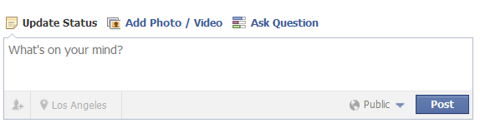
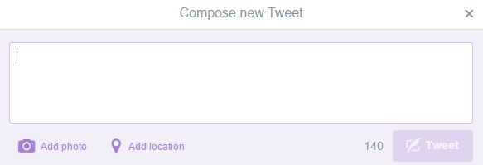
Persuading David Menendez
on marriage equality
Digital
Social media posts supporting same sex marriage.
“Marriage equality will help our economy. Vote yes!”
“Will you side with extremists or with the people you represent?”

Slide 91
Persuading David Menendez
on marriage equality
Earned media
“We want equality.
It’s good for
the economy!”

Slide 92
Persuading David Menendez
on marriage equality
Earned media
“Passing marriage equality will bring jobs to our state and help my business, so I hope my State Senator supports it.”
—Small Business Owner

Slide 93

Issue Ecosystem
An issue ecosystem is the array of people, organizations, and competing agendas surrounding a decision maker around a given issue.

Slide 94
A strong issue campaign creates an ecosystem surrounding decision makers.

Slide 95
Experiential Activity 4A
Workbook Page 11-13

Slide 96
10 minutes
Your turn! Now that you have a goal and strategy,
work with your group to determine three tactics for
each decision maker.
These tactics should broadcast your message
through different mediums in order to create an
effective issue ecosystem.

Slide 97
Session agenda
Tying tactics to strategy
Effective tactics
Persuading decision makers
Debrief

Slide 98
One tactic alone
does not persuade
a decision maker.

Slide 99
It takes a combination
of strategically-planned tactics to ensure your message is heard.

Slide 100
Experiential Activity 4B
Workbook Page 14

Slide 101
10 minutes
Your turn! Now that you have identified tactics you
want to use in your campaign, work with your group
to think through how you would sequence these
events to maximize their impact.

Slide 102
REPORT BACK
What are some tactics
you planned? How did
you sequence them?

Slide 103
Session agenda
Tying tactics to strategy
Effective tactics
Persuading decision makers
Debrief

Slide 104
DEBRIEF
What was your biggest
“aha” moment?

Slide 105
Break

Slide 106
Agenda
00:00 Welcome & Intro
00:00 Issue Campaigns 101:
Identifying a Goal
00:00 Issue Campaigns 102:
Creating a Strategy
00:00 Issue Campaigns 103:
Planning Tactics
00:00 Sponsor Games
00:00 Debrief & Close

Slide 107
Sponsor Games
Tying it all together

Slide 108
Sponsor games
Your climate group was unable to come to an agreement with a fellow student group on the best approach for action by the sponsorship deadline.
Professor Sharp and your groups have decided that the best way to select who to sponsor is to judge the strength of your campaign plans through the Sponsor Games.
Each group will pitch their campaign plan, emphasizing the goal, strategy, and tactics you will execute in order to achieve your mission.

Slide 109
Sponsor games
Rules of the Games:
You have 25 minutes to prepare a six-minute pitch of your campaign
You must write the goal, strategy, and tactics on the butcher paper provided
Every member of your team must speak during the presentation
Judging Criteria:
Content
Feasibility (will it win?)
Group Contribution
Presentation

Slide 110
Sponsor games
Group Campaign Plan Prep | 25 Min
Group 1 Pitch | 6 Min
Group 2 Pitch | 6 Min
Feedback | 8 Min
Winner is Chosen!

Slide 111
Agenda
00:00 Welcome & Intro
00:00 Issue Campaigns 101:
Identifying a Goal
00:00 Issue Campaigns 102:
Creating a Strategy
00:00 Issue Campaigns 103:
Planning Tactics
00:00 Sponsor Games
00:00 Debrief & Close

Slide 112
Debrief & Close

Slide 113
Magazine Debrief

Slide 114


