Slide 1
Welcome!
We will begin at 7:30 PM Central Time.
One more thing—call in for audio.
Check your email for phone number and pin.
ACCESS WORKBOOK

Slide 2





LOGISTICS
We will meet for 90 minutes
You will work in pairs today.
A recording of this video and call will be available following this meeting
It’s cool if you Tweet --
#OFAFellows

Slide 3
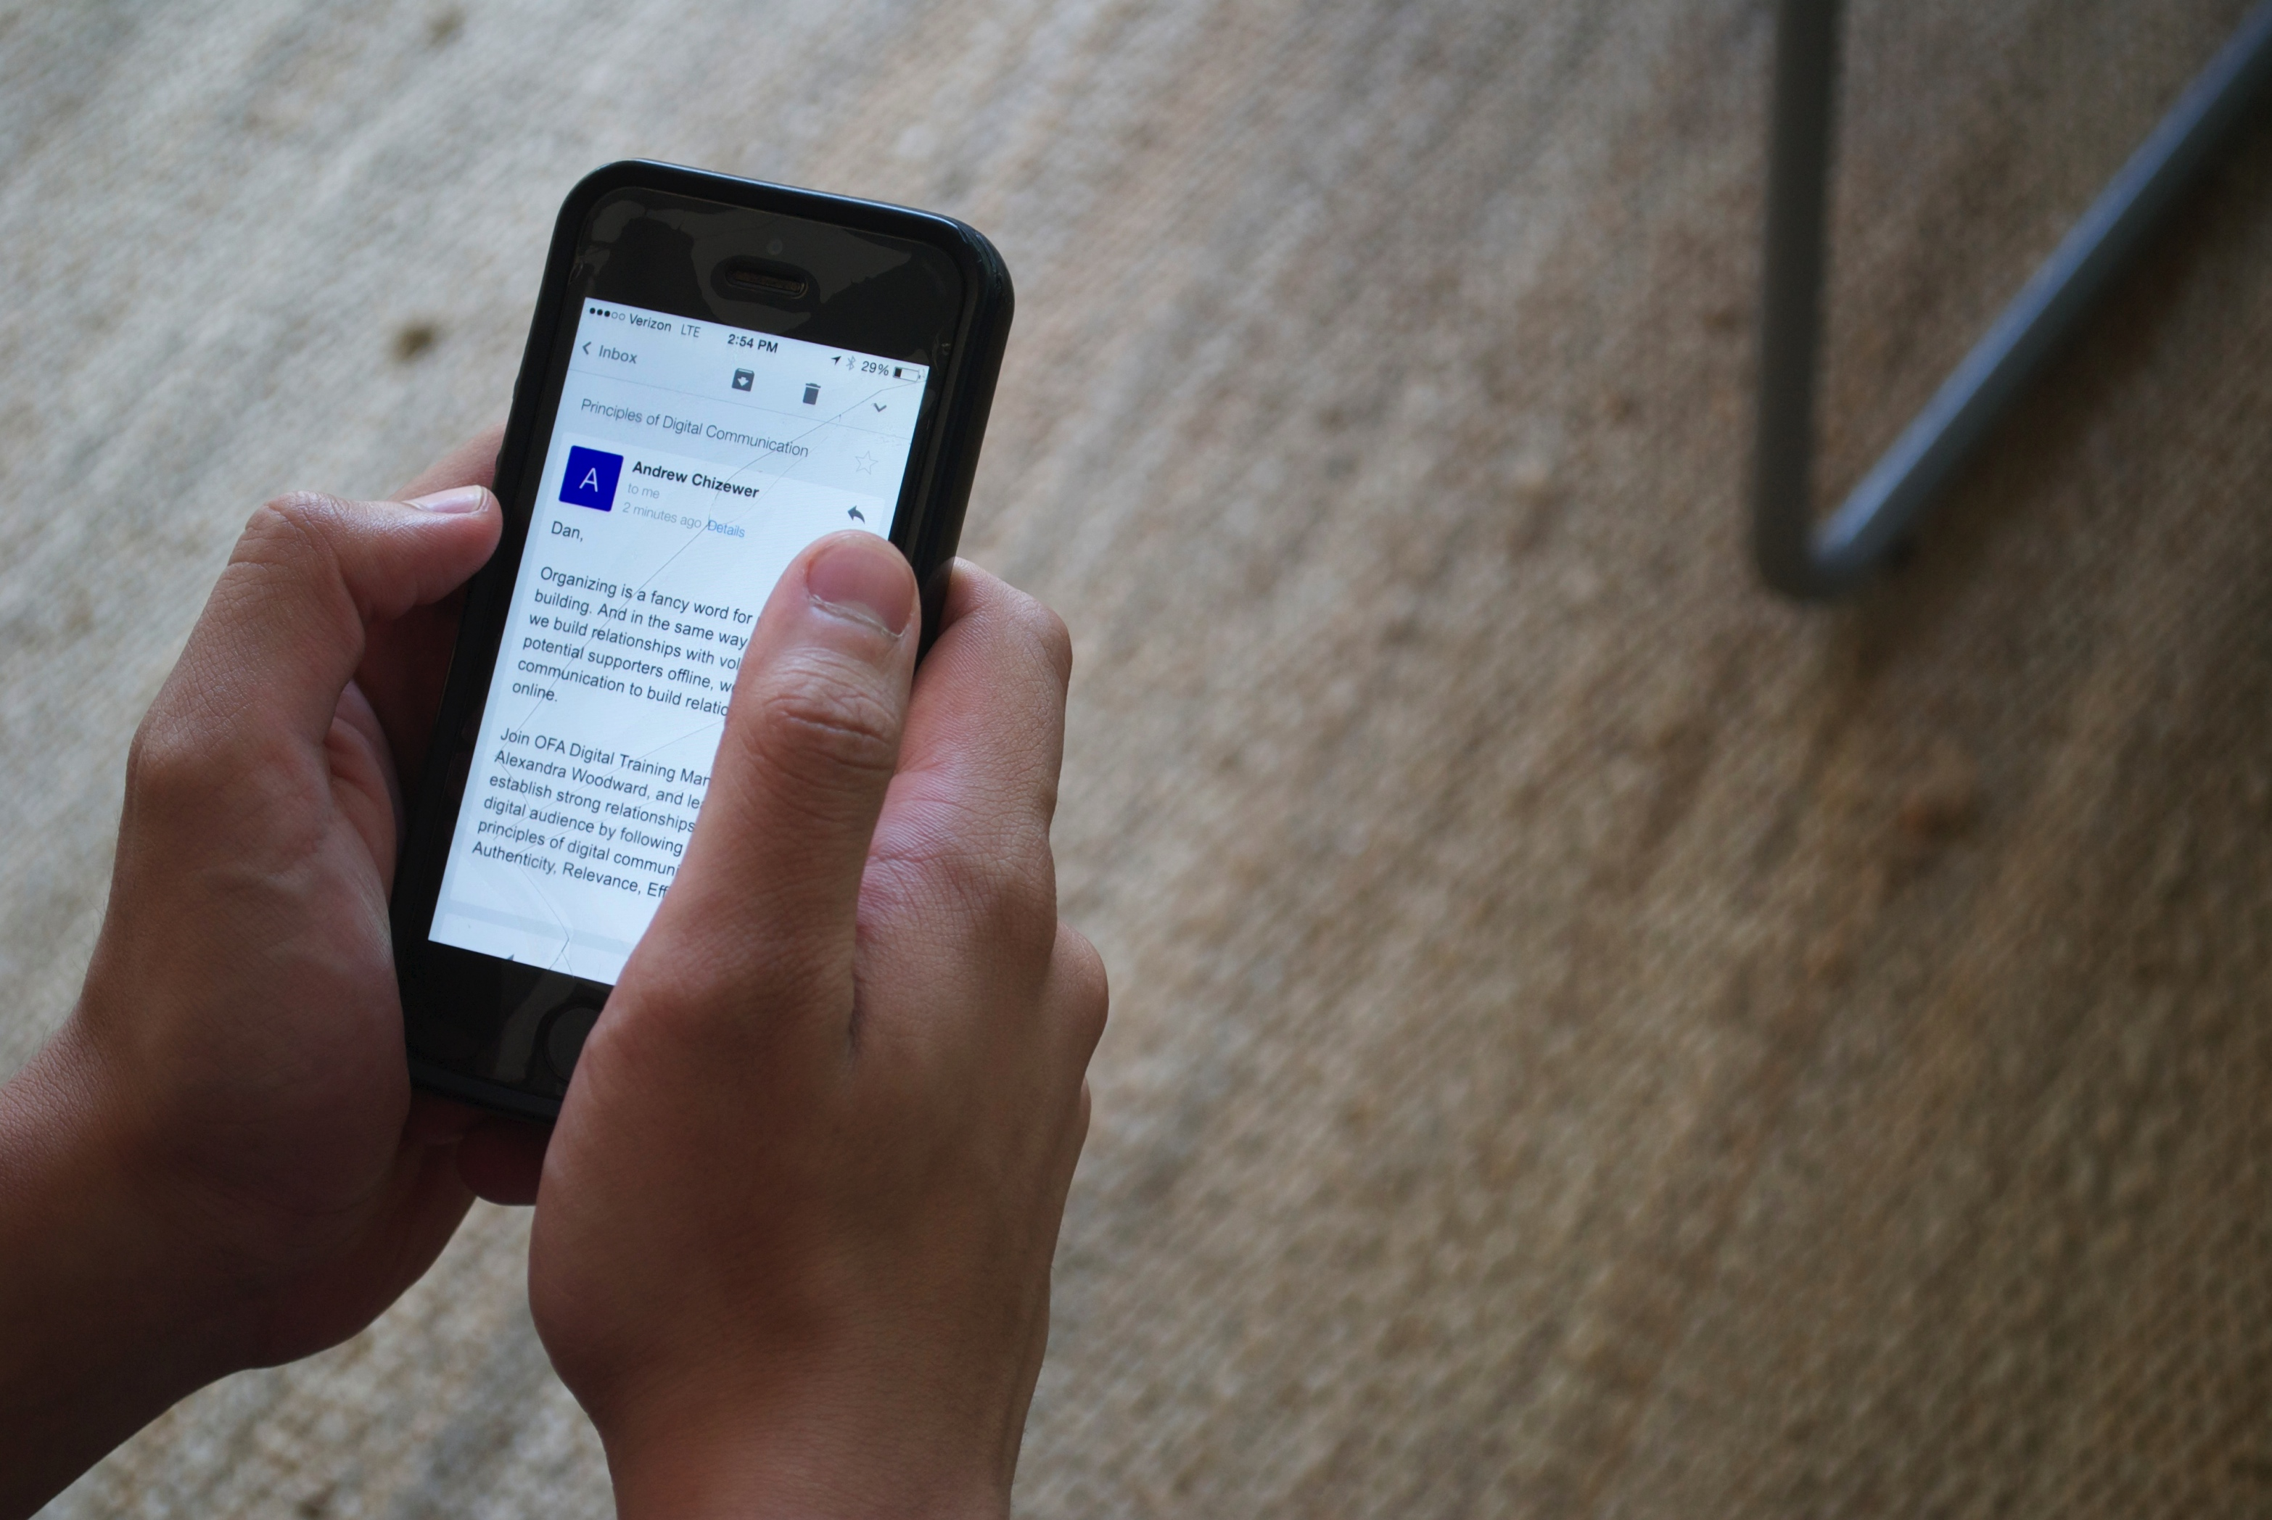

Email Campaign Strategy
W/ Abby Boyle

Slide 4
GOALS FOR TODAY
1
Understand the value of email campaigns
2
Be able to create an email campaign strategy that inspires your audience to respond to the ask
3
Become a true believer that emails are a useful and effective digital organizing tool

Slide 5

AGENDA FOR TODAY
Why Email
Email Strategy Brainstorm
Email Asks
Email Angles
Debrief and Close

Slide 6
Email Campaign Strategy
W/ Abby Boyle

Slide 7
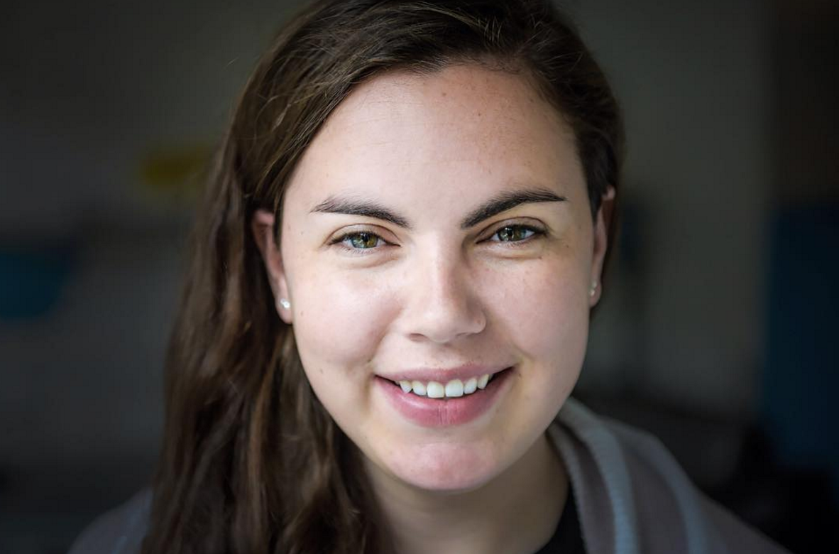
Abby Boyle
Content Producer

Slide 8
AGENDA FOR TODAY
Why Email
Email Strategy Brainstorm
Email Asks
Email Angles
Debrief and Close

Slide 9


How do you feel about email as a digital organizing tool?
OR
Press 1 on the phone
Type in chat box

Slide 10
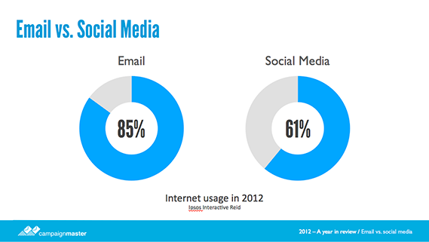
In 2012, more people used Email over Social Media

Slide 11
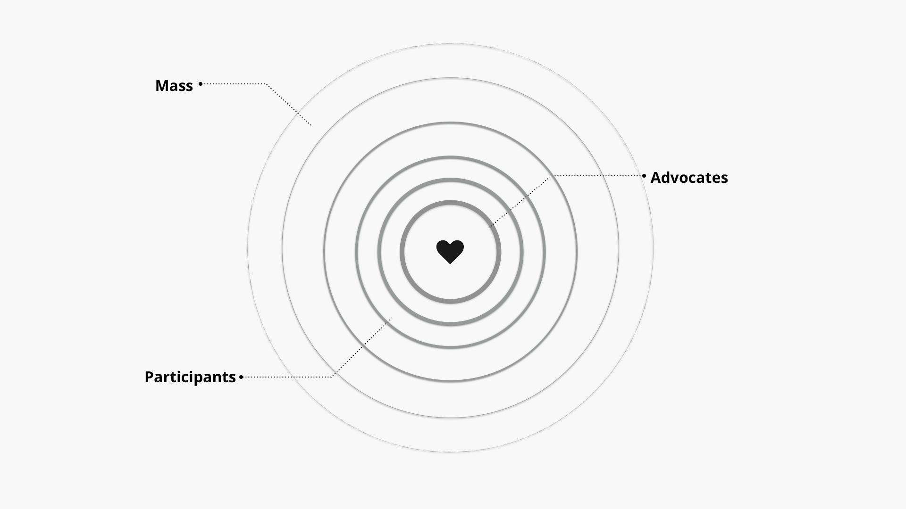
Digital Ladder of Engagement
SOCIAL MEDIA
MOST BASIC ENTRY POINT.

Slide 12
Were do you think email lives?
EMAIL
CLOSER TO YOUR MISSION.

Slide 13

Goals of a Digital Department: 3 M’s
WHICH ARE……….?
OR
Press 1 on the phone
Type in chat box

Slide 14
Goals of a Digital Department: 3 M’s
MESSAGE
MOBILIZE
MONEY

Slide 15
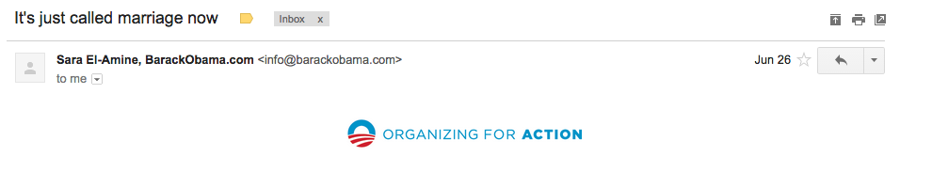
Friend --
Excited about today's Supreme Court ruling? Me too.
This morning the Supreme Court ruled that discriminatory, anti-gay marriage bans across the country violated the Constitution, and struck them down.
All of them.
Make no mistake -- we're here today because of people like you who fought long and hard to overturn discriminatory laws, challenge prejudice, and change hearts and minds.
This is something we can all be proud of. Today, join OFA supporters across the country in saying you're proud of the progress we've made:
https://my.barackobama.com/Marriage-Ruling
Days like today should remind everyone why we do the work we do. The big, important fights sometimes take a long time to win, but they're always worth it.
Love is love.
Sara
Sara El-Amine
Executive Director
Organizing for Action

Slide 16
M
MESSAGE
What did we want members to know?
Friend --
Excited about today's Supreme Court ruling? Me too.
This morning the Supreme Court ruled that discriminatory, anti-gay marriage bans across the country violated the Constitution, and struck them down.
All of them.
Make no mistake -- we're here today because of people like you who fought long and hard to overturn discriminatory laws, challenge prejudice, and change hearts and minds.
This is something we can all be proud of. Today, join OFA supporters across the country in saying you're proud of the progress we've made:
https://my.barackobama.com/Marriage-Ruling
Days like today should remind everyone why we do the work we do. The big, important fights sometimes take a long time to win, but they're always worth it.
Love is love.
Sara
Sara El-Amine
Executive Director
Organizing for Action

Slide 17
M
MESSAGE
What did we want member to know?
Friend --
Excited about today's Supreme Court ruling? Me too.
This morning the Supreme Court ruled that discriminatory, anti-gay marriage bans across the country violated the Constitution, and struck them down.
All of them.
Make no mistake -- we're here today because of people like you who fought long and hard to overturn discriminatory laws, challenge prejudice, and change hearts and minds.
This is something we can all be proud of. Today, join OFA supporters across the country in saying you're proud of the progress we've made:
https://my.barackobama.com/Marriage-Ruling
Days like today should remind everyone why we do the work we do. The big, important fights sometimes take a long time to win, but they're always worth it.
Love is love.
Sara
Sara El-Amine
Executive Director
Organizing for Action

Slide 18
M
MESSAGE
M
MOBILIZE
Friend --
Excited about today's Supreme Court ruling? Me too.
This morning the Supreme Court ruled that discriminatory, anti-gay marriage bans across the country violated the Constitution, and struck them down.
All of them.
Make no mistake -- we're here today because of people like you who fought long and hard to overturn discriminatory laws, challenge prejudice, and change hearts and minds.
This is something we can all be proud of. Today, join OFA supporters across the country in saying you're proud of the progress we've made:
https://my.barackobama.com/Marriage-Ruling
Days like today should remind everyone why we do the work we do. The big, important fights sometimes take a long time to win, but they're always worth it.
Love is love.
Sara
Sara El-Amine
Executive Director
Organizing for Action
What did we want members to do?

Slide 19
M
MESSAGE
M
MOBILIZE
Friend --
Excited about today's Supreme Court ruling? Me too.
This morning the Supreme Court ruled that discriminatory, anti-gay marriage bans across the country violated the Constitution, and struck them down.
All of them.
Make no mistake -- we're here today because of people like you who fought long and hard to overturn discriminatory laws, challenge prejudice, and change hearts and minds.
This is something we can all be proud of. Today, join OFA supporters across the country in saying you're proud of the progress we've made:
https://my.barackobama.com/Marriage-Ruling
Days like today should remind everyone why we do the work we do. The big, important fights sometimes take a long time to win, but they're always worth it.
Love is love.
Sara
Sara El-Amine
Executive Director
Organizing for Action
What did we want members to do?

Slide 20
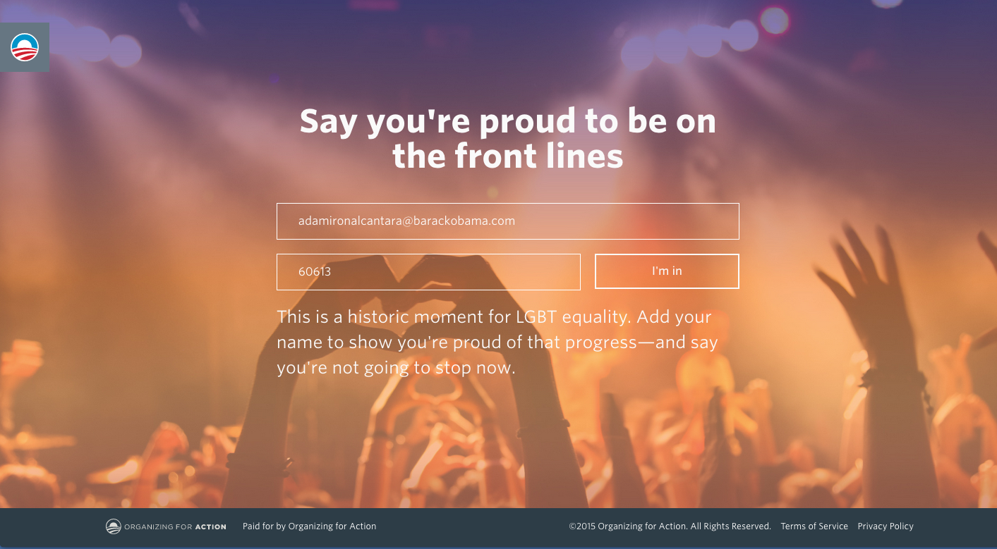
M
MESSAGE
M
MOBILIZE
What did we want members to do?

Slide 21
M
MESSAGE
M
MOBILIZE
Friend --
Excited about today's Supreme Court ruling? Me too.
This morning the Supreme Court ruled that discriminatory, anti-gay marriage bans across the country violated the Constitution, and struck them down.
All of them.
Make no mistake -- we're here today because of people like you who fought long and hard to overturn discriminatory laws, challenge prejudice, and change hearts and minds.
This is something we can all be proud of. Today, join OFA supporters across the country in saying you're proud of the progress we've made:
https://my.barackobama.com/Marriage-Ruling
Days like today should remind everyone why we do the work we do. The big, important fights sometimes take a long time to win, but they're always worth it.
Love is love.
Sara
Sara El-Amine
Executive Director
Organizing for Action
M
MONEY
What is the argument to donate?

Slide 22
M
MESSAGE
M
MOBILIZE
M
MONEY
What is the argument to donate?

Slide 23
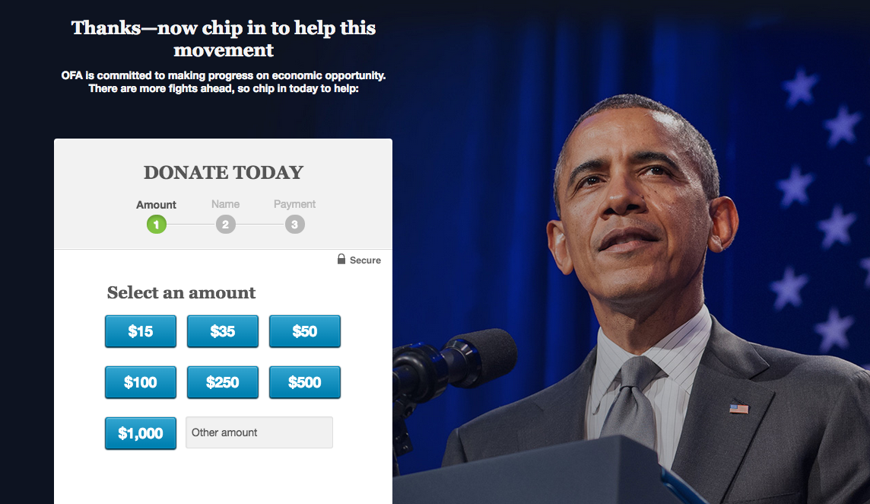
M
MESSAGE
M
MOBILIZE
M
MONEY
What is the argument to donate?

Slide 24
M
MESSAGE
M
MOBILIZE
M
MONEY
What is the argument to donate?
People are more likely to donate through a Sign-On than direct ask.

Slide 25


M
MESSAGE
M
MOBILIZE
M
MONEY
BETWEEN 80-90% OF DIGITAL FUNDRAISING COMES THROUGH EMAIL.

Slide 26
AGENDA FOR TODAY
Why Email
Email Strategy Brainstorm
Email Asks
Email Angles
Debrief and Close

Slide 27
CHECKLIST: Email Campaign
Brainstorm Goals
Craft Asks
Design Angles
Begin Writing
Theory of Change
Why us? Why Now?

Slide 28

Your Turn!
Become familiar with the digital campaign we have been running at Climate STRONG. Then brainstorm your vision for your email campaign by answering the following questions:
Experiential Activity #1
10 Minutes
What is the goal of your email campaign?
Who is your audience?
What do you want your members to know?
What do you want your members to do?
Why should your members donate to the goal?
ACCESS WORKBOOK

Slide 29

Your Turn!
Experiential Activity #1
DEBRIEF
OR
Press 1 on the phone
Type in chat box

Slide 30
AGENDA FOR TODAY
Why Email
Email Strategy Brainstorm
Email Asks
Email Angles
Debrief and Close

Slide 31

CHECKLIST: Email Campaign
Brainstorm Goals
Craft Asks
Design Angles
Begin Writing
Theory of Change
Why us? Why Now?

Slide 32
Emails always have an ask.

Slide 33
Emails always have an ask.
OTHERWISE, THE ONLY LINK IS YOUR UNSUBSCRIBE LINK.

Slide 34
HIGH
LOW
Emails always have an ask.

Slide 35
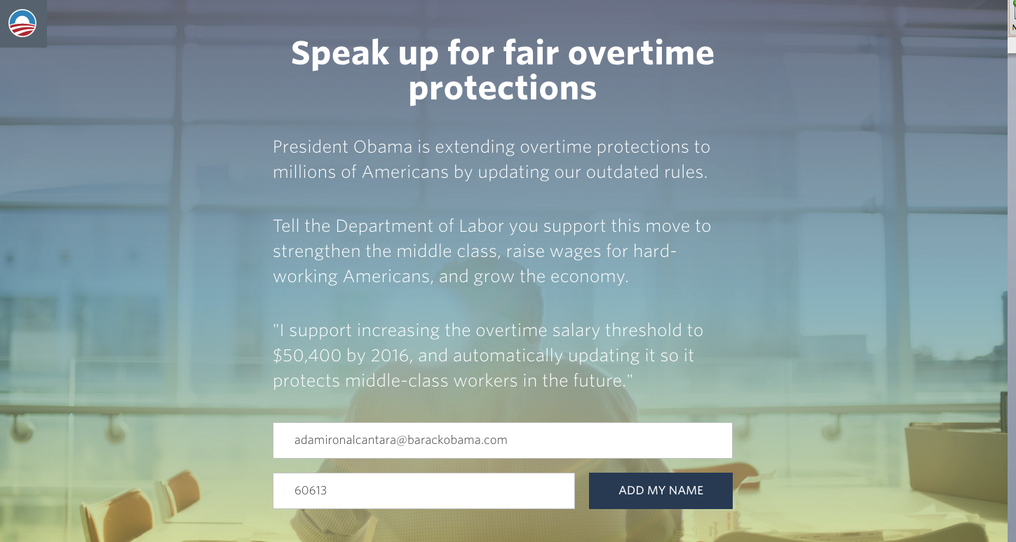
LOW ASK: Sign-On

Slide 36
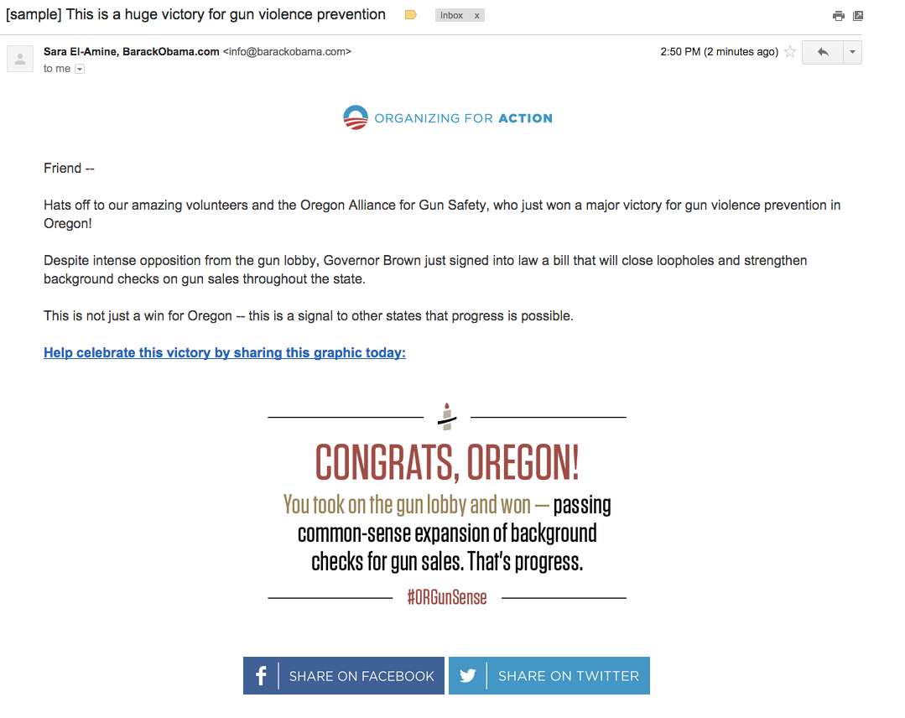
LOW ASK: Share

Slide 37
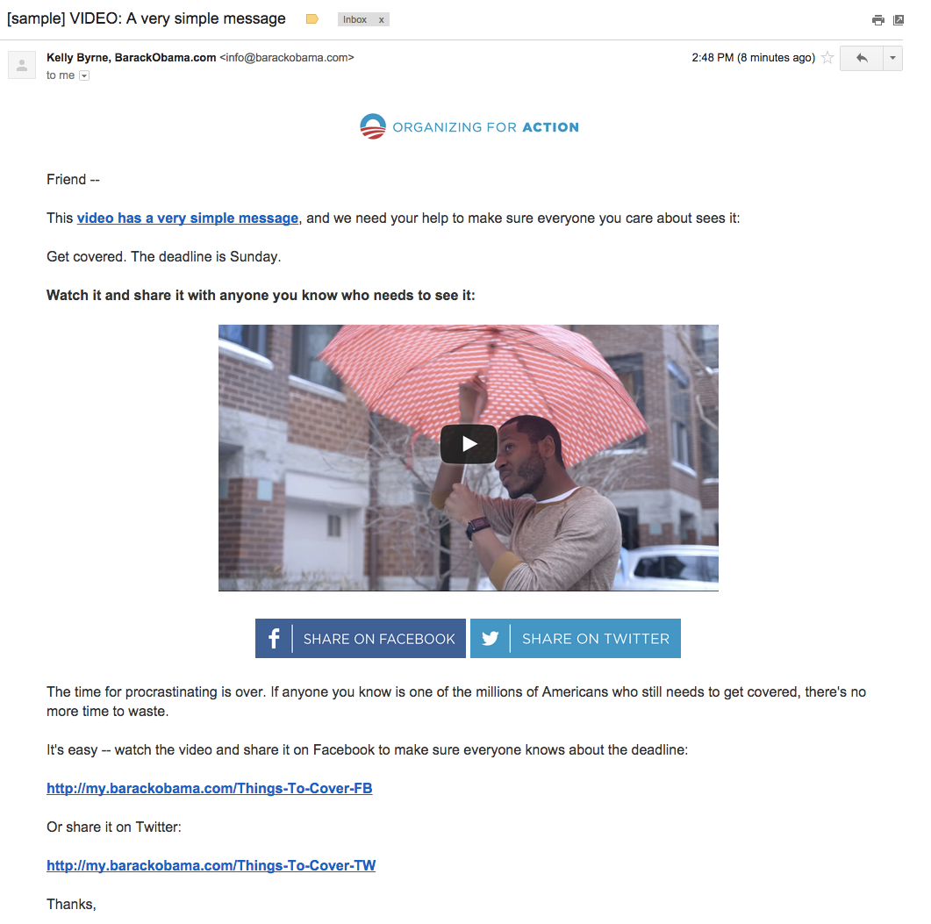
LOW ASK: Video

Slide 38
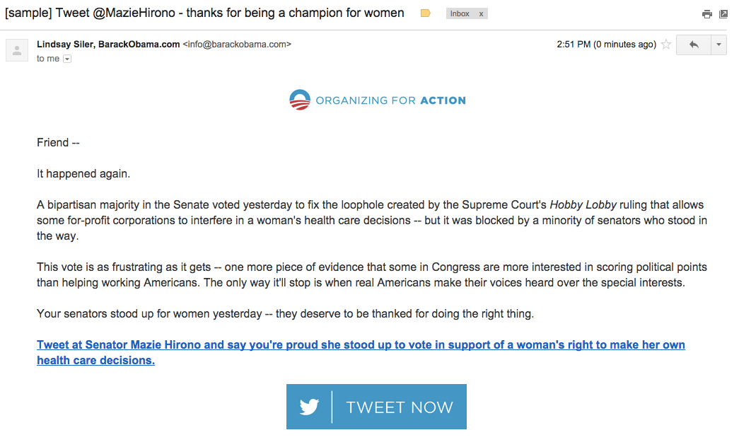
HIGH ASK: Tweet at Your Rep.

Slide 39
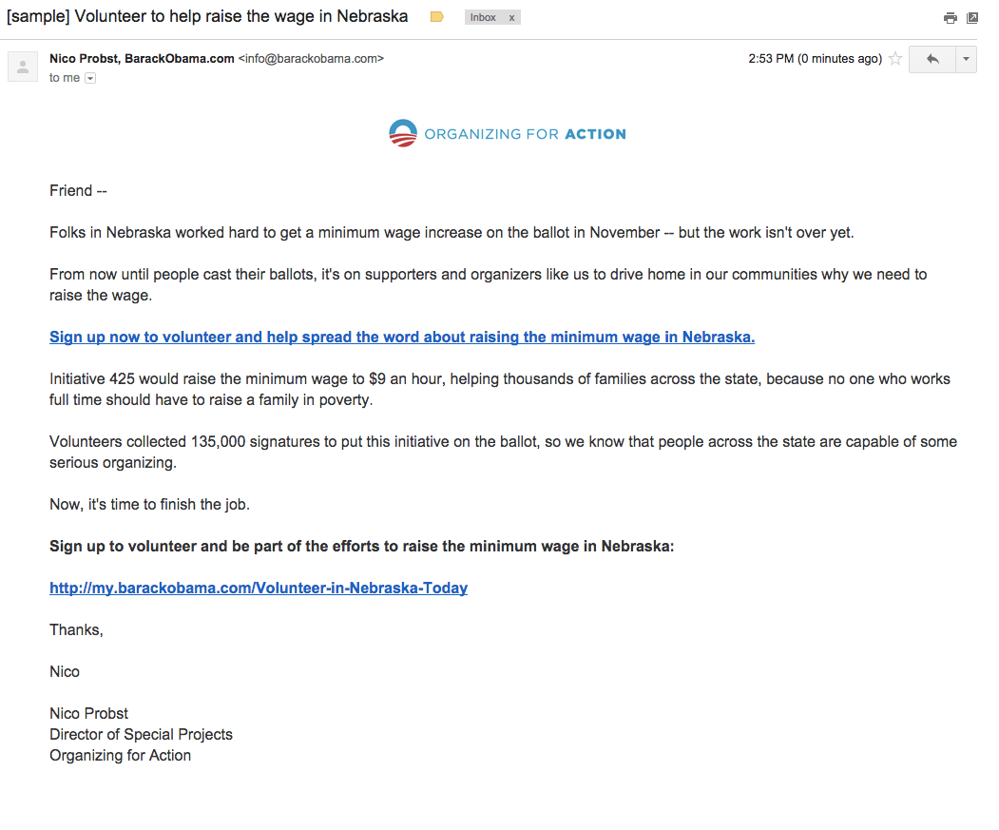
HIGH ASK: Volunteer

Slide 40
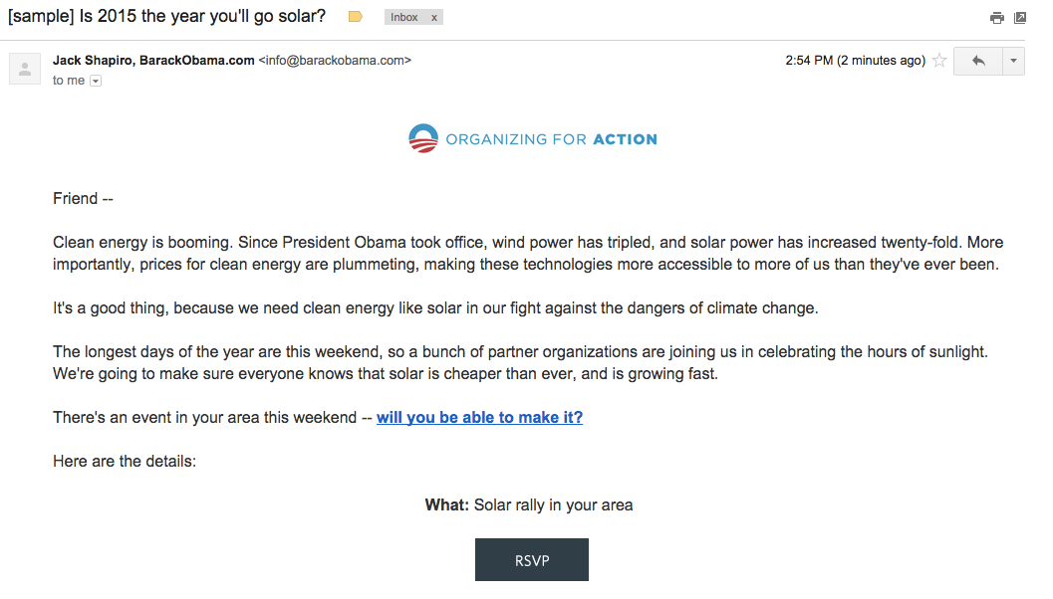
HIGH ASK: Attend an Event

Slide 41
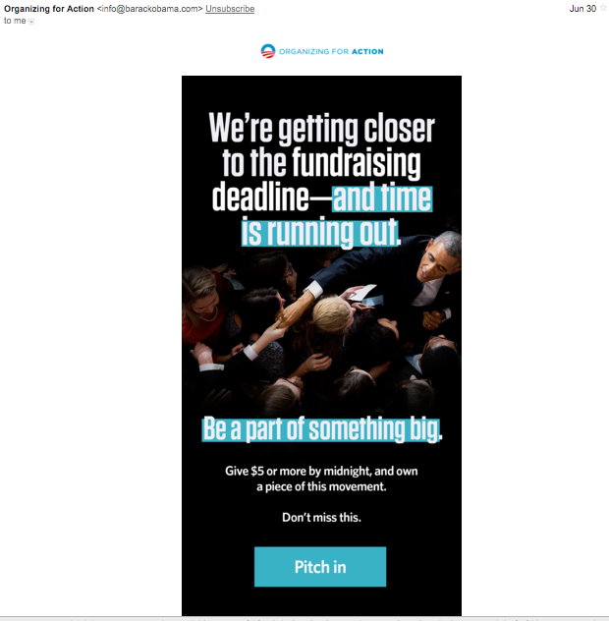
HIGH ASK: Direct Fundraiser

Slide 42
Your Turn!
Now that you know your campaigns goals, determine your asks. Come up with three asks you would like to make in chronological order. To complete your work, consider the following questions:
What are you asking your audience to do?
Where are you linking them to?
Which ask comes first?
Experiential Activity #2
5 Minutes
ACCESS WORKBOOK

Slide 43
Your Turn!
Experiential Activity #2
DEBRIEF
OR
Press 1 on the phone
Type in chat box

Slide 44
AGENDA FOR TODAY
Why Email
Email Strategy Brainstorm
Email Asks
Email Angles
Debrief and Close

Slide 45
CHECKLIST: Email Campaign
Brainstorm Goals
Craft Asks
Design Angles
Begin Writing
Theory of Change
Why us? Why Now?

Slide 46
ANGLES
Authentic
Relevant
Effective

Slide 47
CAMPAIGN
HAWAII CONTEST

Slide 48
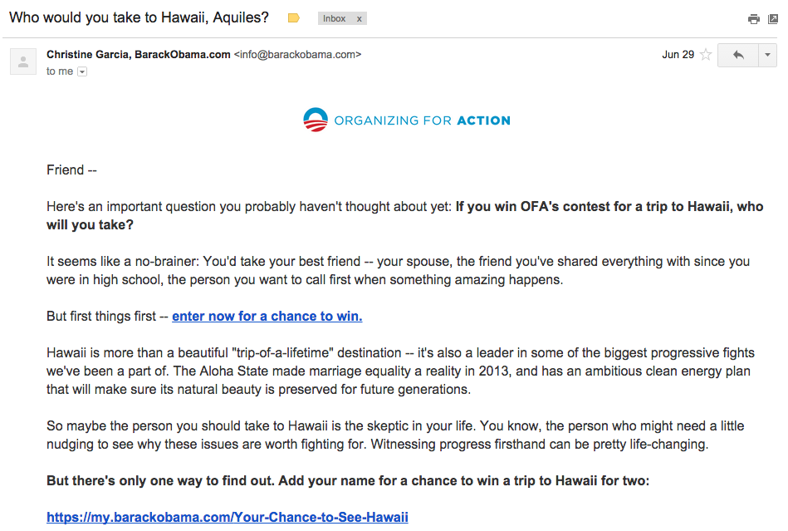
ANGLE 1
Who would you take?

Slide 49
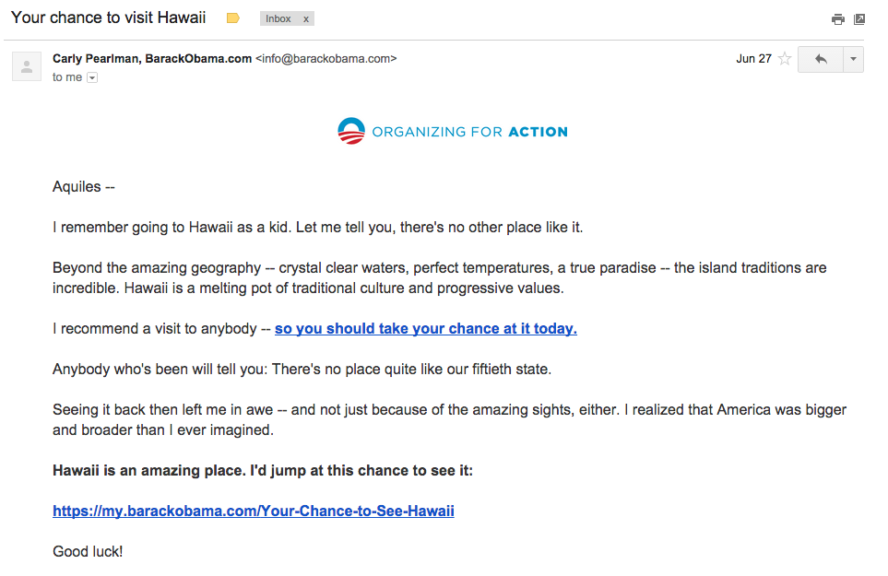
ANGLE 2
Let me share my story.

Slide 50
CAMPAIGN
CLEAN POWER PLAN

Slide 51
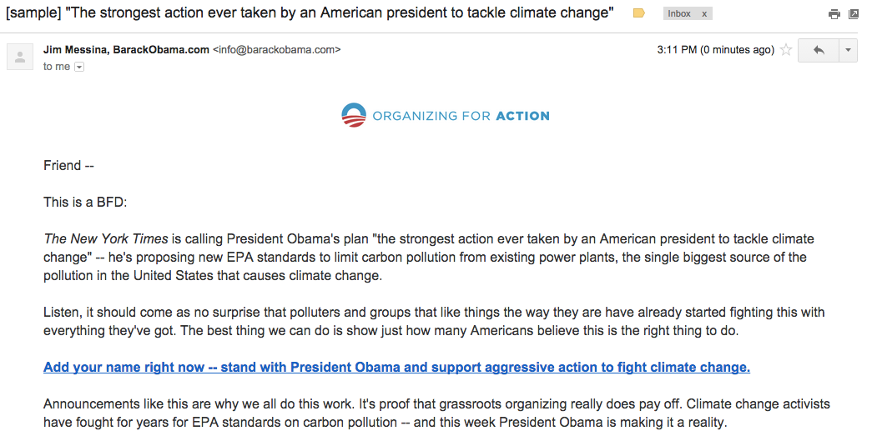
ANGLE 1
The Launch

Slide 52
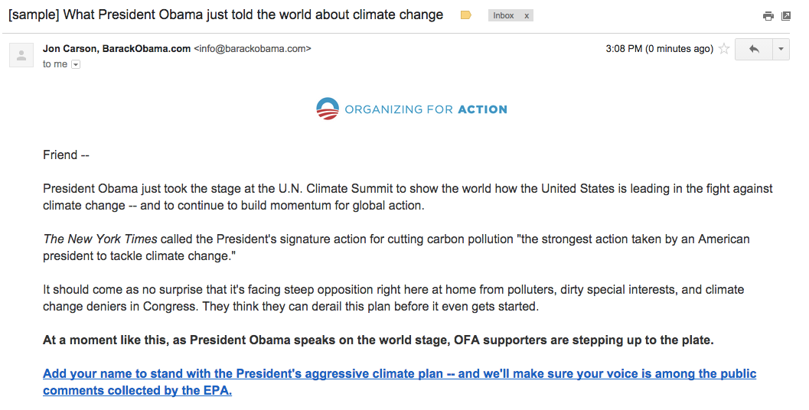
ANGLE 2
This just happened – get POTUS back.

Slide 53
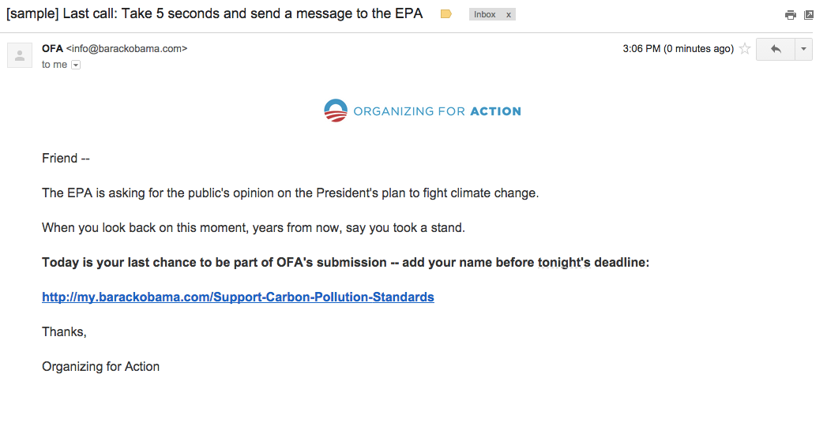
ANGLE 2
Last chance.

Slide 54
Your Turn!
Come up with three angles for your three asks. Keep in mind that your angle provides a different viewpoint for why someone should respond to your ask.
Experiential Activity #3
10 Minutes
ACCESS WORKBOOK

Slide 55
AGENDA FOR TODAY
Why Email
Email Strategy Brainstorm
Email Asks
Email Angles
Debrief and Close

Slide 56
CHECKLIST: Email Campaign
Brainstorm Goals
Craft Asks
Design Angles
Begin Writing
Theory of Change
Why us? Why Now?

Slide 57
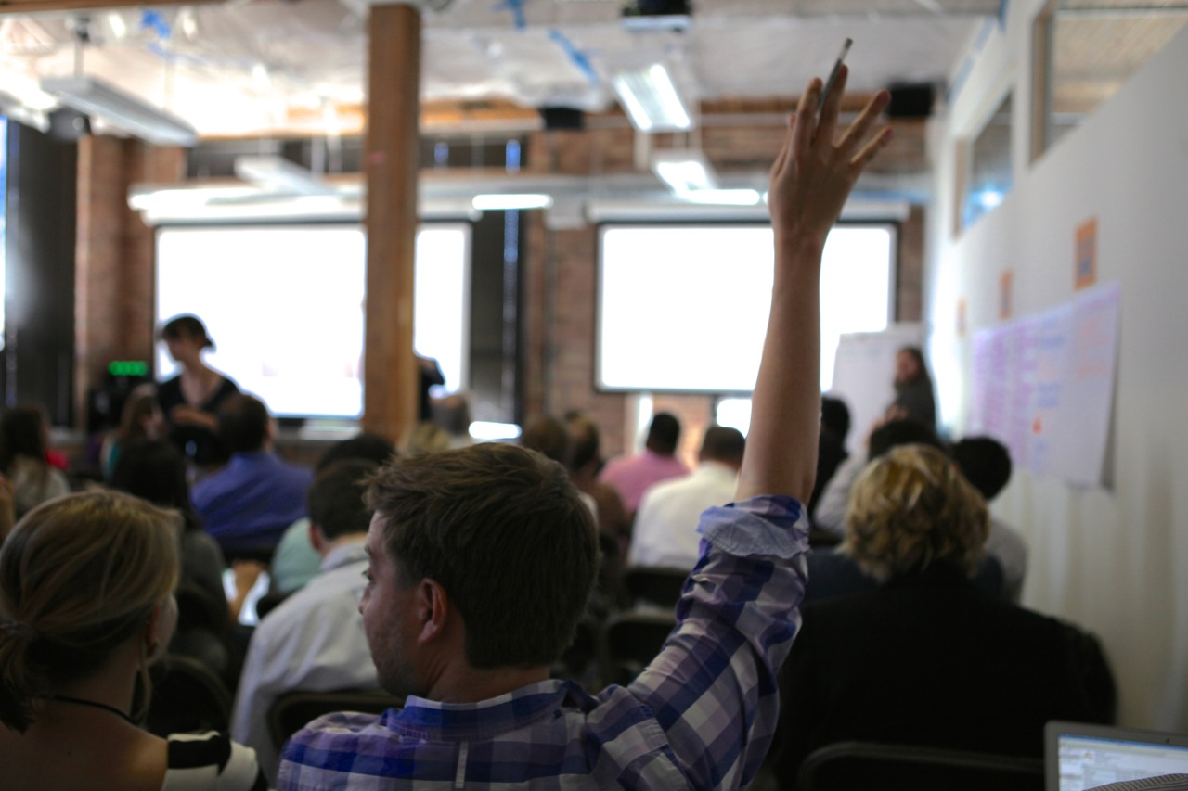
What questions do you have?

Slide 58
GOALS FOR TODAY
1
Understand the value of email campaigns
2
Be able to create an email campaign strategy that inspires your audience to respond to the ask
3
Become a true believer that emails are a useful and effective digital organizing tool

Slide 59
Class Review and Additional Reading
Review concepts and skills learned today
Complete the workbook assignment on the Bookshelf and in the recap email, available tomorrow, by Thursday, October 6
IMPORTANT- Don’t forget to secure your accommodations in Chicago!

Slide 60

Debrief
Using #OFAFellows, tweet your biggest takeaway
#OFAFellows

Slide 61
THURSDAY
7:30 PM CT
Email Content Production

Slide 62
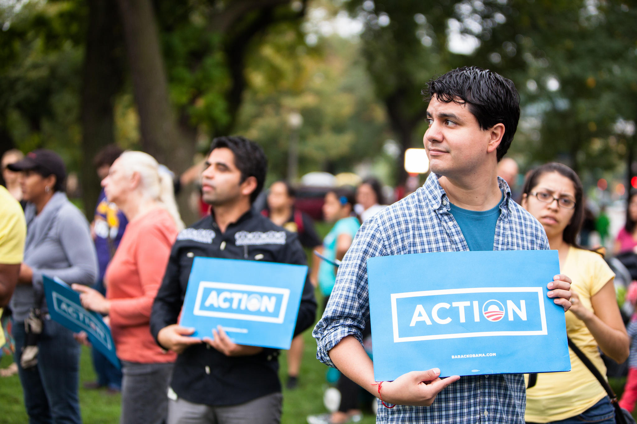
OFA TRAINING
Thank you for joining today’s webinar.
Find the materials we covered, including a video and audio recording of the webinar on the bookshelf.
SEE BOOKSHELF
Notes:
00:00 – 00:00 [General Closing Slide]

