Slide 1
LOGISTICS
We will meet for 90 minutes
This is an interactive meeting.
A recording of this video and call will be available following this meeting
It’s cool if you Tweet --
#OFAFellows
Notes:
00:01 – 00:03 [2 min] – Aquiles
Before we get started, let’s review some logistics

Slide 2
Planning a Digital Campaign
W/ ALEX WOODWARD
Notes:
00:03 – 00:04 [1 min] – Aquiles
Tonight’s module is Planning a Digital Campaign
The module will be led by Ryanne Brown, OFA’s Digital Strategist
Before I introduce her, let’s review what we learned yesterday

Slide 3
Review: Email Content Production
What are the components of an email and which ones are the most important?
OR
Press 1 on the phone
Type in chat box
Notes:
00:04 – 00:06 [2 min] – Aquiles
Ask up to three learners
Lead them into answering: 3 Ms (Message, Mobilize, and Money)

Slide 4
AN EMAIL DRAFT LOOKS SOMETHING LIKE THIS
Greeting/Salutation/Whitelist/”Friend”
Friend --
Excited about today's Supreme Court ruling? Me too.
This morning the Supreme Court ruled that discriminatory, anti-gay marriage bans across the country violated the Constitution, and struck them down.
All of them.
Make no mistake -- we're here today because of people like you who fought long and hard to overturn discriminatory laws, challenge prejudice, and change hearts and minds.
This is something we can all be proud of. Today, join OFA supporters across the country in saying you're proud of the progress we've made:
https://my.barackobama.com/Marriage-Ruling
Days like today should remind everyone why we do the work we do. The big, important fights sometimes take a long time to win, but they're always worth it.
Love is love.
Sara
Sara El-Amine
Executive Director
Organizing for Action
The Lede
Above the fold (ATF)
The Ask
Naked URL
Below the fold (BTF)
Closing

Slide 5
OFA PROFESSIONAL
FELLOWSHIP
Planning a Digital Campaign
W/ ALEX WOODWARD
Notes:
00:07– 00:08 [1 min] – Aquiles
Tonight we are going to focus on digital campaigns
In order to meet the 3Ms, a digital department plans and execute digital campaigns
These are our goals…

Slide 6
GOALS FOR TODAY
1
Learn what a digital campaign is and how digital departments use digital campaigns to meet their mission, vision, and specific quarterly goals
2
Be able to plan a digital campaign by considering goals, message, and timeline
3
Feel comfortable meeting your digital campaign goals by managing an achievable timeline
Notes:
00:08 – 00:09 [1 min] – Aquiles
We have three key goals tonight

Slide 7
AGENDA FOR TODAY
What is a Digital Campaign?
The Process to Plan a Campaign
Managing a Digital Campaign
Debrief and Close
Notes:
00:09 – 00:10 [1 min] – Aquiles
We will accomplish these goals by following this agenda

Slide 8
OFA PROFESSIONAL
FELLOWSHIP
Planning a Digital Campaign
W/ ALEX WOODWARD
Notes:
00:09 – 00:10 [1 min] – Aquiles
Let’s get started!
Tonight we are joined by Ryanne Brown

Slide 9
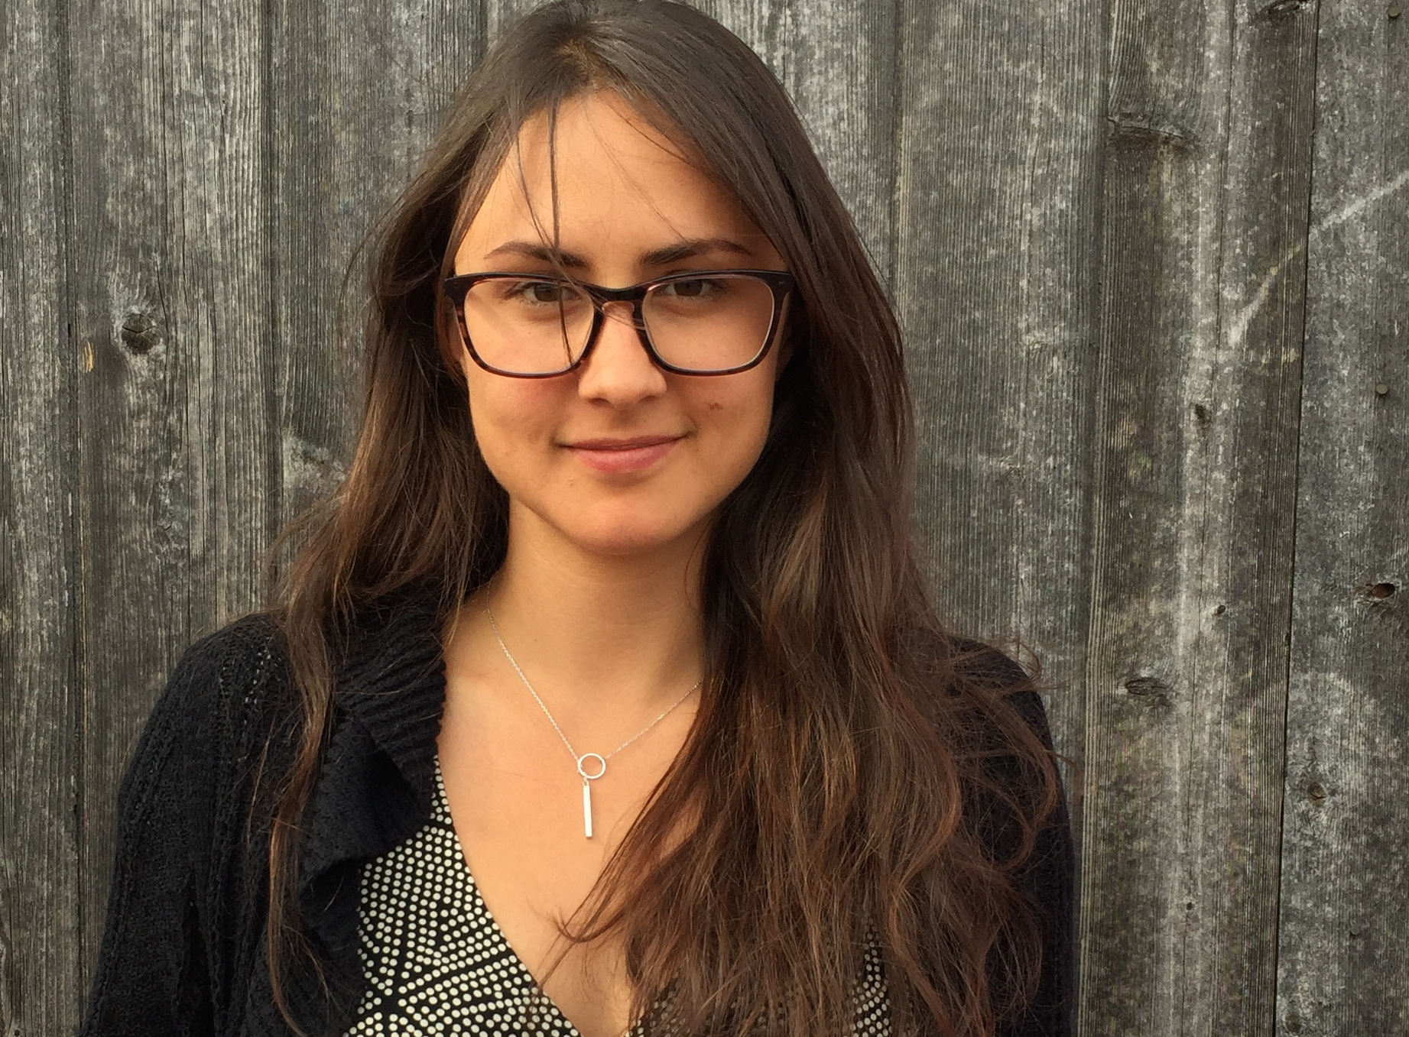
ALEX WOODWARD
Digital Director

Slide 10
AGENDA FOR TODAY
What is a Digital Campaign?
The Process to Plan a Campaign
Managing a Digital Campaign
Debrief and Close
Notes:
00:13 – 00:13 [0 min] – Ryanne
To begin, let’s define what is a digital campaign

Slide 11
Your Turn!
Together as a class we will review a total of 5 of digital products one at a time. On your Workbook, determine what audience each product is targeting, what message the products broadcast/present, and what is consistent across all products.
Experiential Activity #1
5 Minutes
ACCESS WORKBOOK
Notes:
00:13 – 00:15 [2 min] – Ryanne
Trainer’s Notes: The goal of this activity is to introduce the characteristics of a digital campaign. By not telling learners what these characteristics are, and allowing them to figure it out on their own based on their previous knowledge, we will meet them where they are. Following this activity, we will review the key characteristics of a digital campaign and answer remaining questions
Introduce activity
Instructions:
Together, we will review a total of 5 digital products one at a time
You will have one minute per product to determine:
What is the target audience?
What is the message?
What is consistent?

Slide 12
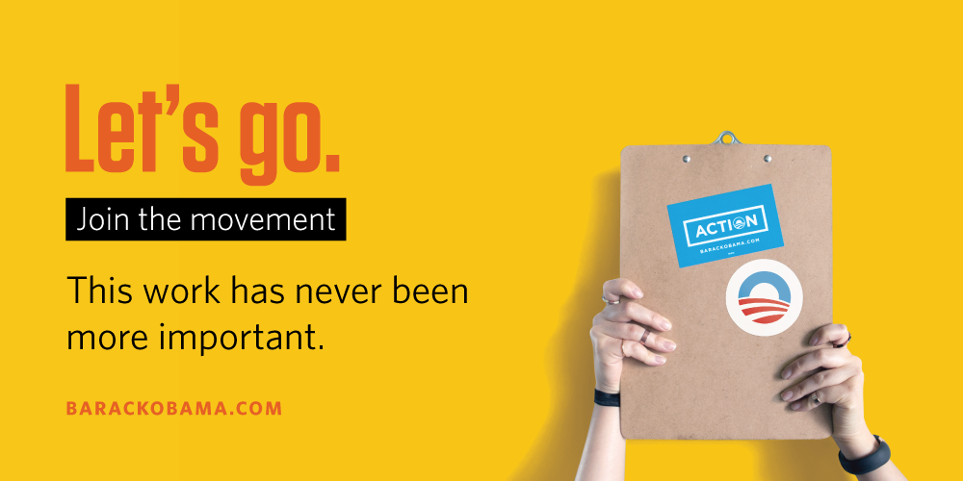
Product #1: Advertisement
Notes:
00:15 – 00:16 [1 min] – Ryanne
Trainer’s Notes: Do not reveal much besides that this is a digital ad for a campaign we developed last year. Let the learners catch their own breath as we throw them in the deep end of the pool.
This is a digital ad for a campaign we developed last year
You have one minute to complete this portion of the activity

Slide 13
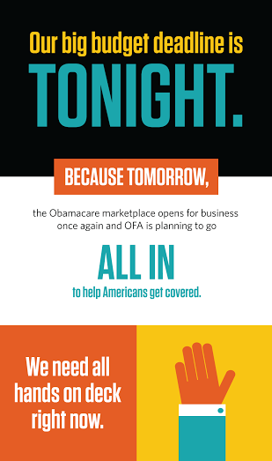
Product #2: Email
Notes:
00:16 – 00:17 [1 min] – Ryanne
This is an email that went out last year as part of the same campaign
You have one minute to complete this portion of the activity

Slide 14
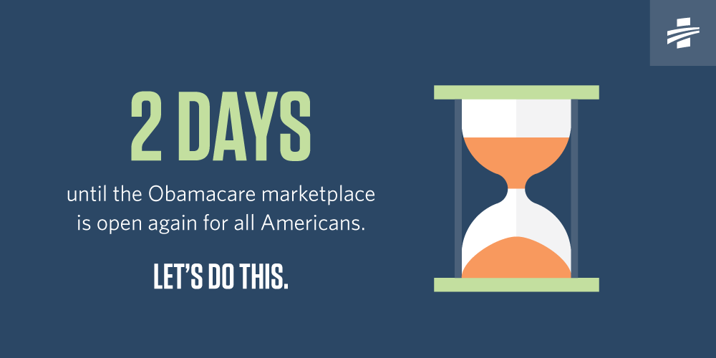
Product #3: Social Media
Notes:
00:17 – 00:18 [1 min] – Ryanne
This is a social media banner we posted as part of the same campaign
You have one minute to complete this portion of the activity

Slide 15
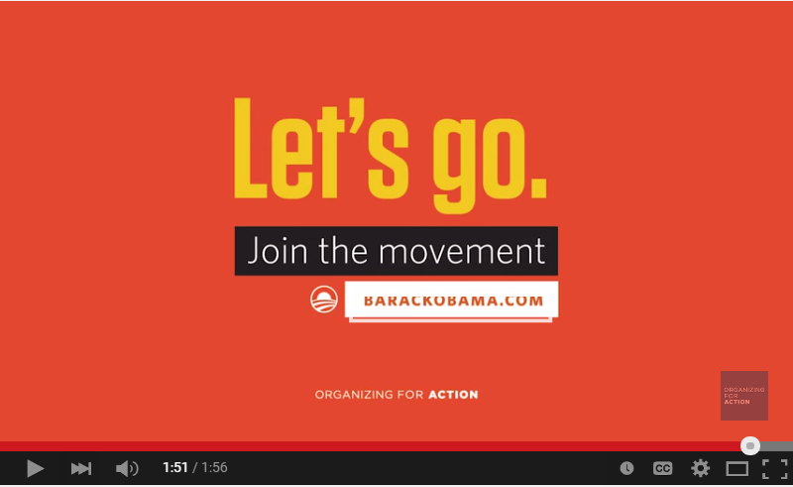
Product #4: Video
Notes:
00:19 – 00:20 [1 min] – Ryanne
This is a video we produced as part of the same campaign
You have one minute to complete this portion of the activity

Slide 16
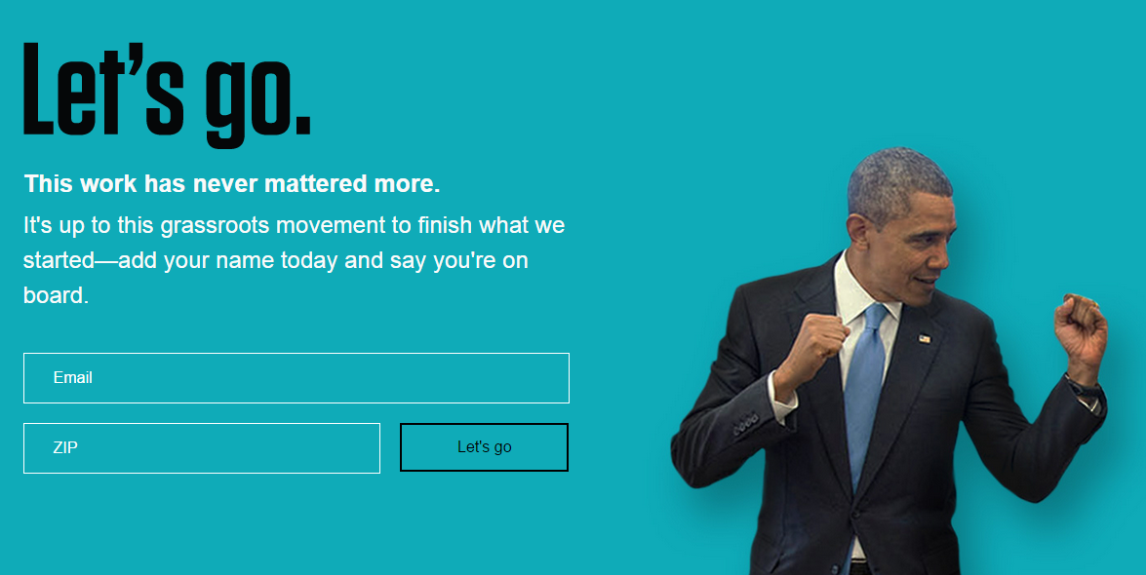
Product #5: Website
Notes:
00:20 – 00:21 [1 min] – Ryanne
This is a web site sign-on page we developed as part of the same campaign
You have one minute to complete this portion of the activity

Slide 17
Your Turn!
Experiential Activity #1
ACTIVITY DEBRIEF
OR
Press 1 on the phone
Type in chat box
Notes:
00:21 – 00:24 [3 min] – Ryanne
Alright, now that we have reviewed all five products, lets hear from at least 3 of you
Please outline the products and what you see as the audience, message, and what is consistent across the board

Slide 18
Characteristics of Digital Campaigns
Measurable Goals
Goals determine the direction for the entire campaign
Goals should be specific, measurable, realistic, and purposeful
Notes:
00:24 – 00:26 [2 min] – Ryanne
Trainer’s Notes: Use the following slides to close the loop on the activity by outlining four key characteristics of a digital campaign
Mesurable Goals: Goals are the most fundamental component of any digital campaign. Goals will determine the direction for the entire campaign, from the general strategy to specific tactics. Campaign goals should not only be specific, measurable and realistic, but they should be purposeful and align with real organizational objectives. Getting more “likes” is great, but to be truly valuable it must deliver more meaningful results – (provide an example of measurable goals)

Slide 19
Characteristics of Digital Campaigns
Measurable Goals
Notes:
00:24 – 00:26 [2 min] – Ryanne
Review one of the measurable goals from the Let’s Go campaign as an example

Slide 20
Characteristics of Digital Campaigns
Measurable Goals
Relevant Messaging
Digital campaigns are only impactful if your target audience can relate to the message
Notes:
00:26 – 00:28 [2 min] – Ryanne
Relevant Messaging: In order for your digital campaign to be impactful, it must be relevant to your target audience. Digital campaigns effectively present and broadcast a message that your audience can relate to, and as a result of, take action on

Slide 21
Characteristics of Digital Campaigns
Measurable Goals
Relevant Messaging
Notes:
00:26 – 00:28 [2 min] – Ryanne
As part of the same campaign, we used relevant messaging
On one digital product, we talked to people who cared about the ACA
On the other, to people in general who wanted to join the movement
In both cases, we wanted to attract new people after 2014

Slide 22
Characteristics of Digital Campaigns
Measurable Goals
Relevant Messaging
Integrate W/ All Digital Platforms
Your audience is everywhere – social media, email, website, blogs
A digital campaign must integrate all digital platforms
Notes:
00:28 – 00:30 [2 min] – Ryanne
Integrate with all digital platforms: Your audience does not only live on social media, or email. Your audience is everywhere – email, blog, articles, search engine optimization, ads, social media, video. An effective campaign integrate all digital platforms. It would be a real miss if a well-produced social media post could only be consumed by your social media audience, and not your email audience, or blog audience.

Slide 23
Characteristics of Digital Campaigns
Measurable Goals
Relevant Messaging
Integrate W/ All Digital Platforms
Notes:
00:28 – 00:30 [2 min] – Ryanne
And the Let’s Go campaign – we used all the platforms!

Slide 24
Characteristics of Digital Campaigns
Measurable Goals
Relevant Messaging
Integrate W/ All Digital Platforms
Consistency
Consistent messaging and branding across all platforms affect your credibility and authority
Notes:
00:30 – 00:32 [2 min] – Ryanne
Consistency: Can you imagine if your social media post linked to a page on your Web site that was inconsistent in terms of messaging and branding? Consistency within a campaign is absolutely critical. While consistency will affect your credibility and authority – there is also a big difference between seeing a message, and actually receiving it. Streamlining your campaign elements across all channels will support awareness, as well as ensure that your audience gets the message.

Slide 25
Characteristics of Digital Campaigns
Measurable Goals
Relevant Messaging
Integrate W/ All Digital Platforms
Consistency
Notes:
00:30 – 00:32 [2 min] – Ryanne
Across the board we used the same language – Join the movement. Let’s go.

Slide 26
AGENDA FOR TODAY
What is a Digital Campaign?
The Process to Plan a Campaign
Managing a Digital Campaign
Debrief and Close
Notes:
00:32 – 00:32 [0 min] – Ryanne
Now that we have established the key characteristics of a digital campaign, let’s review the step by step process we follow the take the campaign from a vision to a reality

Slide 27
To launch a campaign, your team must come together to brainstorm strategy and agree on expectations, goals, and timeline.
Notes:
00:32 – 00:33 [1 min] – Ryanne
Developing a digital campaign is a creative effort by everyone in a digital team
You must come together to brainstorm a strategy and agree on expectations, goals, and a timeline
Let’s review each step our team follows when we gather to brainstorm a campaign

Slide 28
Establish Campaign Overview
What should the campaign accomplish/do?
Establish Specific Goals
Broad Goals of the Campaign are presented by the Digital Director in partnership with the senior staff at the organization. You will use these pre-determined goals to give life and breath to the campaign
Determine Your Message
Outline Timeline
Notes:
00:34 – 00:37 [3 min] – Ryanne
The direction and spirit of a digital campaign is set by the digital director and leadership of the organization
They see a “problem” worth solving through a digital campaign – in other words, what should the campaign do?
As a digital team, we then begin working on how to meet the goals set forth by the org. leadership \
For instance, let’s analyze our most recent contest campaign – Hawaii

Slide 29
Establish Campaign Overview
What should the campaign accomplish/do?
Establish Specific Goals
Digital Campaign: Hawaii Contest
End of quarter is approaching, which means your organization has a big fundraising deadline ahead. As a result, your Digital Director and senior leadership have asked the digital team to plan a contest around this time that helps the organization raise money:
Goals:
Raise $75,000
Send a winner and a guest to Hawaii
Launch campaign on June 23rd
Talk to supporters, but also broad network
Integrate all digital platforms available
Determine Your Message
Outline Timeline
Is there a measurable goal?
Notes:
00:34 – 00:37 [3 min] – Ryanne
The direction and spirit of a digital campaign is set by the digital director and leadership of the organization
They see a “problem” worth solving through a digital campaign – in other words, what should the campaign do?
As a digital team, we then begin working on how to meet the goals set forth by the org. leadership \
For instance, let’s analyze our most recent contest campaign – Hawaii

Slide 30
Establish Campaign Overview
What should the campaign accomplish/do?
Establish Specific Goals
Digital Campaign: Hawaii Contest
End of quarter is approaching, which means your organization has a big fundraising deadline ahead. As a result, your Digital Director and senior leadership have asked the digital team to plan a contest around this time that helps the organization raise money:
Goals:
Raise $75,000
Send a winner and a guest to Hawaii
Launch campaign on June 23rd
Talk to supporters, but also broad network
Integrate all digital platforms available
Determine Your Message
Outline Timeline
Is there an opportunity to craft a relevant message?
Notes:
00:34 – 00:37 [3 min] – Ryanne
The direction and spirit of a digital campaign is set by the digital director and leadership of the organization
They see a “problem” worth solving through a digital campaign – in other words, what should the campaign do?
As a digital team, we then begin working on how to meet the goals set forth by the org. leadership \
For instance, let’s analyze our most recent contest campaign – Hawaii

Slide 31
Establish Campaign Overview
What should the campaign accomplish/do?
Establish Specific Goals
Digital Campaign: Hawaii Contest
End of quarter is approaching, which means your organization has a big fundraising deadline ahead. As a result, your Digital Director and senior leadership have asked the digital team to plan a contest around this time that helps the organization raise money:
Goals:
Raise $75,000
Send a winner and a guest to Hawaii
Launch campaign on June 23rd
Talk to supporters, but also broad network
Integrate all digital platforms available
Determine Your Message
Outline Timeline
Are all digital platforms integrated?
Notes:
00:34 – 00:37 [3 min] – Ryanne
The direction and spirit of a digital campaign is set by the digital director and leadership of the organization
They see a “problem” worth solving through a digital campaign – in other words, what should the campaign do?
As a digital team, we then begin working on how to meet the goals set forth by the org. leadership \
For instance, let’s analyze our most recent contest campaign – Hawaii

Slide 32
Establish Campaign Overview
What audience will the campaign target?
Establish Specific Goals
Your target audience is at the heart of your campaign, and thus determines your strategy, messaging, tactics, digital platforms.
Determine Your Message
Outline Timeline
Thinking about the Hawaii contest, who should we target?
OR
Press 1 on the phone
Type in chat box
Notes:
00:37 – 00:39 [2 min] – Ryanne
As part of the campaign overview, your senior leadership and the digital team will brainstorm the audience your campaign will target
For instance, on this campaign we targeted (insert audience)

Slide 33
Establish Campaign Overview
What audience will the campaign target?
Establish Specific Goals
Your target audience is at the heart of your campaign, and thus determines your strategy, messaging, tactics, digital platforms.
Determine Your Message
Outline Timeline
PREVIOUS DONORS
ENGAGED W/ OFA BEFORE
ACTIVELY ENGAGED
BROAD AUDIENCE
Notes:
00:37 – 00:39 [2 min] – Ryanne
As part of the campaign overview, your senior leadership and the digital team will brainstorm the audience your campaign will target
For instance, on this campaign we targeted (insert audience)

Slide 34
Establish Campaign Overview
What assets/resources are available?
Establish Specific Goals
What assets and/or resources are available at your organization, which includes time and capacity, will largely determine your campaign plan.
Determine Your Message
Outline Timeline
Design
Social/ Email
Digital Director
Digital Director
Digi Org.
Dev.
Ads
Notes:
00:39 – 00:41 [3 min] – Ryanne
Lastly, as part of the campaign overview, you must have a clear understanding of the resources and assets available to you so you can plan effectively
Yesterday you learned about one type of digital department structure
Other departments are bigger and others are smaller
Based on that, determine what platforms you can use, and what types of products you can develop with the time available to you
For our Hawaii contest, we had these five arms of our dpt available to us.

Slide 35
Establish Campaign Overview
What assets/resources are available?
Establish Specific Goals
What assets and/or resources are available at your organization, which includes time and capacity, will largely determine your campaign plan.
Determine Your Message
Outline Timeline
Design
Social/ Email
Digital Director
Digital Director
Digi Org.
Dev.
Ads
Notes:
00:39 – 00:41 [3 min] – Ryanne
Lastly, as part of the campaign overview, you must have a clear understanding of the resources and assets available to you so you can plan effectively
Yesterday you learned about one type of digital department structure
Other departments are bigger and others are smaller
Based on that, determine what platforms you can use, and what types of products you can develop with the time available to you
For our Hawaii contest, we had these five arms of our dpt available to us.

Slide 36
Establish Campaign Overview
What assets/resources are available?
Establish Specific Goals
What assets and/or resources are available at your organization, which includes time and capacity, will largely determine your campaign plan.
Determine Your Message
Outline Timeline
Design
Social/ Email
Digital Director
Digital Director
Digi Org.
Dev.
Ads
Notes:
00:39 – 00:41 [3 min] – Ryanne
Lastly, as part of the campaign overview, you must have a clear understanding of the resources and assets available to you so you can plan effectively
Yesterday you learned about one type of digital department structure
Other departments are bigger and others are smaller
Based on that, determine what platforms you can use, and what types of products you can develop with the time available to you
For our Hawaii contest, we had these five arms of our dpt available to us.

Slide 37
Establish Campaign Overview
What assets/resources are available?
Establish Specific Goals
What assets and/or resources are available at your organization, which includes time and capacity, will largely determine your campaign plan.
Determine Your Message
Outline Timeline
Design
Social/ Email
Digital Director
Digital Director
Digi Org.
Dev.
Ads
Notes:
00:39 – 00:41 [3 min] – Ryanne
Lastly, as part of the campaign overview, you must have a clear understanding of the resources and assets available to you so you can plan effectively
Yesterday you learned about one type of digital department structure
Other departments are bigger and others are smaller
Based on that, determine what platforms you can use, and what types of products you can develop with the time available to you
For our Hawaii contest, we had these five arms of our dpt available to us.

Slide 38
Establish Campaign Overview
What assets/resources are available?
Establish Specific Goals
What assets and/or resources are available at your organization, which includes time and capacity, will largely determine your campaign plan.
Determine Your Message
Outline Timeline
Design
Social/ Email
Digital Director
Digital Director
Digi Org.
Dev.
Ads
Notes:
00:39 – 00:41 [3 min] – Ryanne
Lastly, as part of the campaign overview, you must have a clear understanding of the resources and assets available to you so you can plan effectively
Yesterday you learned about one type of digital department structure
Other departments are bigger and others are smaller
Based on that, determine what platforms you can use, and what types of products you can develop with the time available to you
For our Hawaii contest, we had these five arms of our dpt available to us.

Slide 39
Establish Campaign Overview
What assets/resources are available?
Establish Specific Goals
What assets and/or resources are available at your organization, which includes time and capacity, will largely determine your campaign plan.
Determine Your Message
Outline Timeline
Design
Social/ Email
Digital Director
Digital Director
Digi Org.
Dev.
Ads
Notes:
00:39 – 00:41 [3 min] – Ryanne
Lastly, as part of the campaign overview, you must have a clear understanding of the resources and assets available to you so you can plan effectively
Yesterday you learned about one type of digital department structure
Other departments are bigger and others are smaller
Based on that, determine what platforms you can use, and what types of products you can develop with the time available to you
For our Hawaii contest, we had these five arms of our dpt available to us.

Slide 40
Establish Campaign Overview
How will your campaign meet its goals?
Establish Specific Goals
Based on the resources and assets available to you, establish specific goals for each member of the team.
Determine Your Message
Outline Timeline
Design
Social/ Email
Digital Director
Digital Director
Digi Org.
Dev.
Ads
Notes:
00:46 – 00:48 [2 min] – Ryanne
It is critical to determine a message that both frames your position well, but also inspires action
We like to think of message in this way = Hook + Call to Action = Message
Let’s review each of these at a time

Slide 41
Establish Campaign Overview
What is your message?
Establish Specific Goals
Your campaign can only be effective if it is relevant to your audience. Effective messaging shows your position, and incites an emotional response.
Determine Your Message
Outline Timeline
HOOK
CALL TO ACTION
MESSAGE
Notes:
00:46 – 00:48 [2 min] – Ryanne
It is critical to determine a message that both frames your position well, but also inspires action
We like to think of message in this way = Hook + Call to Action = Message
Let’s review each of these at a time

Slide 42
Establish Campaign Overview
What is your message?
Establish Specific Goals
Your campaign can only be effective if it is relevant to your audience. Effective messaging shows your position, and incites an emotional response.
Determine Your Message
Outline Timeline
HOOK
A hook is what will attract your audience to your campaign. Generally something that everyone understands.
Notes:
00:48 – 00:49 [1 min] – Ryanne
A hook is what attracts people to your campaign
It is that first line or theme that tells your audience why they should explore further within

Slide 43
Establish Campaign Overview
Establish Specific Goals
Determine Your Message
Friend -- For many progressives and organizers across the country, President Obama is an inspiration. But he's not a unicorn. (I believe the fact-checkers out there can confirm that.) Our president got his start as a community organizer on the South Side of Chicago. Right now, the next Barack Obamas are already out there in communities all across the country, looking to get their start. OFA's mission is to find those great organizers and provide the training needed to be great. This is about the future, but it depends on people like you stepping up today to help fund it -- will you chip in today?
Outline Timeline
Notes:
00:49 – 00:50 [1 min] – Ryanne
This is a sample of a Hook – to make the point that we are training future organizers, like the President, we went with: Barack Obama is not a unicorn

Slide 44
Establish Campaign Overview
Establish Specific Goals
Determine Your Message
Outline Timeline
Notes:
00:50 – 00:51 [1 min] – Ryanne
This is another exsample of a Hook – in the Let’s Go campaign: This work has never been more important.

Slide 45
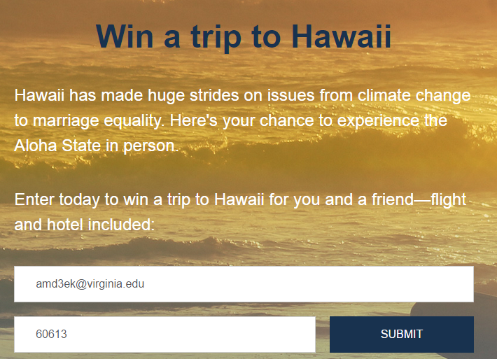
Establish Campaign Overview
Establish Specific Goals
Determine Your Message
Outline Timeline
Notes:
00:51 – 00:52 [1 min] – Ryanne
And in the Hawaii contest: Hawaii has made huge strides on issues from climate change to marriage equality. Here’s your chance to experience the Aloha state in person.

Slide 46
Establish Campaign Overview
Establish Specific Goals
Determine Your Message
Outline Timeline
Notes:
00:52 – 00:53 [1 min] – Ryanne
And in the Hawaii contest: See how organizing works.

Slide 47
Establish Campaign Overview
What is your message?
Establish Specific Goals
Your campaign can only be effective if it is relevant to your audience. Effective messaging shows your position, and incites an emotional response.
Determine Your Message
Outline Timeline
CALL TO ACTION
Clear and concise – what exactly do you want your audience to do?
Notes:
00:53 – 00:55 [2 min] – Ryanne
But a hook also needs a call to action that is clear and concise.
What do you want your audience to do?

Slide 48
Establish Campaign Overview
Establish Specific Goals
Determine Your Message
Friend -- For many progressives and organizers across the country, President Obama is an inspiration. But he's not a unicorn. (I believe the fact-checkers out there can confirm that.) Our president got his start as a community organizer on the South Side of Chicago. Right now, the next Barack Obamas are already out there in communities all across the country, looking to get their start. OFA's mission is to find those great organizers and provide the training needed to be great. This is about the future, but it depends on people like you stepping up today to help fund it -- will you chip in today?
Outline Timeline
Notes:
00:55 – 00:56 [1 min] – Ryanne
For example, back to that unicorn email, the ask was: Chip in today.

Slide 49
Establish Campaign Overview
Establish Specific Goals
Determine Your Message
Outline Timeline

Slide 50
Establish Campaign Overview
Establish Specific Goals
Determine Your Message
Outline Timeline
Notes:
00:55 – 00:56 [1 min] – Ryanne
And on the Hawaii contest: Enter today to win a trip to Hawaii.

Slide 51
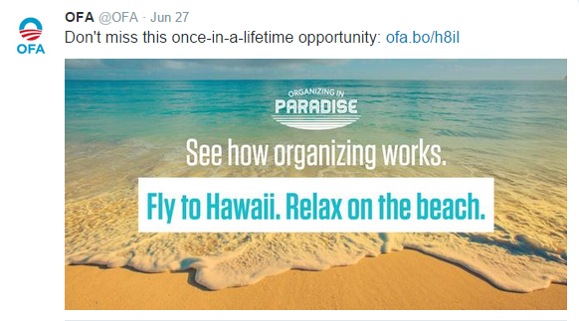
Establish Campaign Overview
Establish Specific Goals
Determine Your Message
Outline Timeline
Notes:
00:55 – 00:56 [1 min] – Ryanne
Or: Do not miss this once-in-a-lifetime opportunity

Slide 52
Establish Campaign Overview
What is your message?
Establish Specific Goals
Your campaign can only be effective if it is relevant to your audience. Effective messaging shows your position, and incites an emotional response.
Determine Your Message
Outline Timeline
MESSAGE
It explains the Why – It provides a justification for the hook and the call to action.

Slide 53
Establish Campaign Overview
Establish Specific Goals
Determine Your Message
Friend -- For many progressives and organizers across the country, President Obama is an inspiration. But he's not a unicorn. (I believe the fact-checkers out there can confirm that.) Our president got his start as a community organizer on the South Side of Chicago. Right now, the next Barack Obamas are already out there in communities all across the country, looking to get their start. OFA's mission is to find those great organizers and provide the training needed to be great. This is about the future, but it depends on people like you stepping up today to help fund it -- will you chip in today?
Outline Timeline

Slide 54
Establish Campaign Overview
Establish Specific Goals
Determine Your Message
Outline Timeline

Slide 55
Establish Campaign Overview
Establish Specific Goals
Determine Your Message
Outline Timeline

Slide 56
Establish Campaign Overview
Establish Specific Goals
Determine Your Message
Outline Timeline

Slide 57
What questions do you have?

Slide 58
Your Turn!
Come up with four messages for the Hawaii campaign. Think about the hook, and the call to action, and message. After completing the activity, you will debrief with a partner.
Experiential Activity #2
10 Minutes
ACCESS WORKBOOK
Notes:
00:56 – 00:58 [2 min] – Ryanne
Introduce the activity:
Learners will use what they learned about hooks and call to action to develop their proposed messaging for the Hawaii campaign
00:58 – 00:63 [5min] – Ryanne

Slide 59
Your Turn!
Experiential Activity #2
5 Minutes
PAIR AND SHARE
Notes:
00:63 – 00:65 [2 min] – Ryanne
Pair and Share

Slide 60
Your Turn!
Experiential Activity #2
ACTIVITY DEBRIEF
OR
Press 1 on the phone
Type in chat box
Notes:
00:65 – 00:67 [2 min] – Ryanne
Debrief

Slide 61
AGENDA FOR TODAY
What is a Digital Campaign?
The Process to Plan a Campaign
Managing a Digital Campaign
Debrief and Close
Notes:
00:67 – 00:68 [2 min] – Ryanne
We covered what is a digital campaign, the process we follow to plan a campaign. Now, lets take a look at how we manage a campaign.

Slide 62
Establish Campaign Overview
What is your plan of action?
Establish Specific Goals
Calendaring is key. The more your prepare, the better you are able to handle any challenges along the way. When calendaring, answer the following questions:
Determine Your Message
Outline Timeline
WHAT
WHEN
WHO
Notes:
00:67 – 00:70 [3 min] – Ryanne
No campaign plan is completed until you have a calendar in hand
Your timeline should address What, When, and Who

Slide 63
Establish Campaign Overview
What is your plan of action?
Establish Specific Goals
Calendaring is key. The more your prepare, the better you are able to handle any challenges along the way. When calendaring, answer the following questions:
Determine Your Message
Outline Timeline
WHAT
WHEN
WHO
ACCESS TASKMASTER
Notes:
00:70 – 00:72 [2 min] – Ryanne
Let’s take a look at the Let’s Go campaign timeline and taskmaster

Slide 64
STRATEGIC USER FLOW

Slide 65
Meet Dan

Slide 66
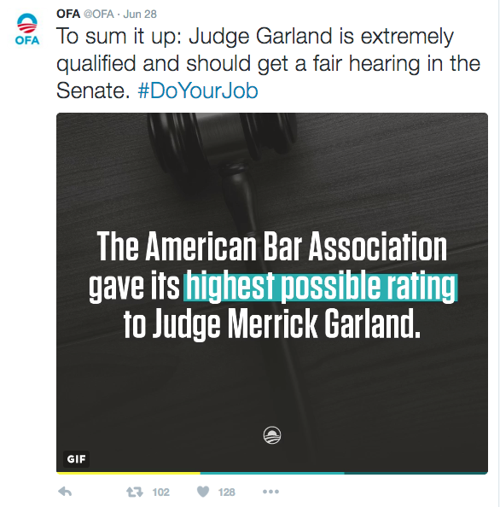
Dan sees a tweet someone in his network Retweeted.

Slide 67
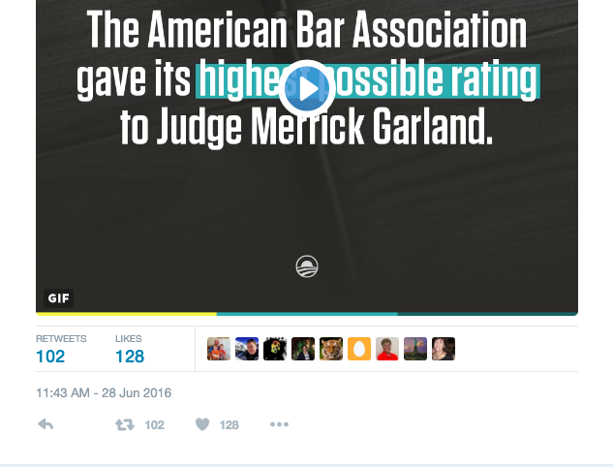
Message resonates w/ Dan and he Retweets.

Slide 68
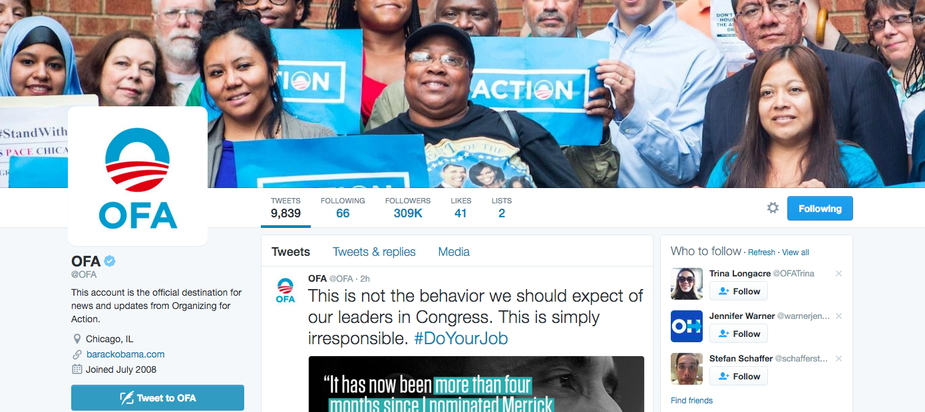
Dan looks through the page and starts following.

Slide 69
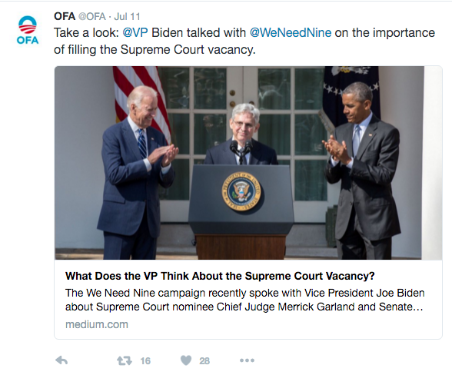
1 week later, Dan runs into an information post about the issue he Retweeted.

Slide 70
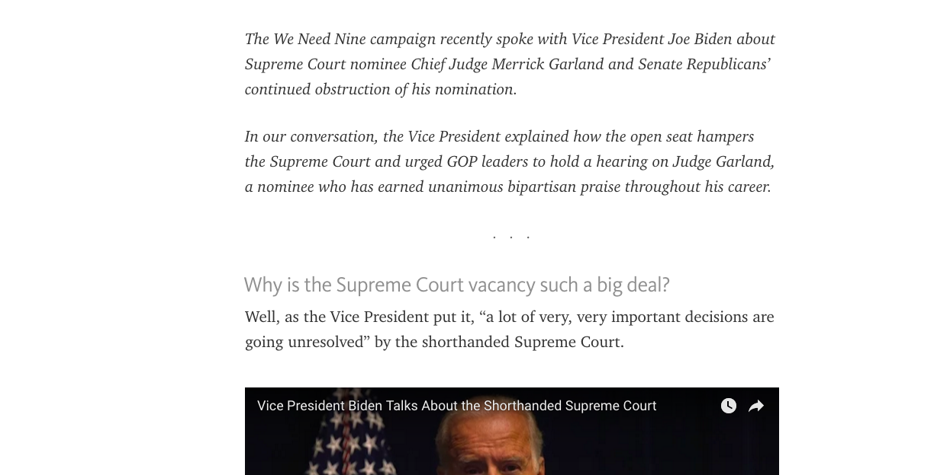
Dan reads the article.

Slide 71
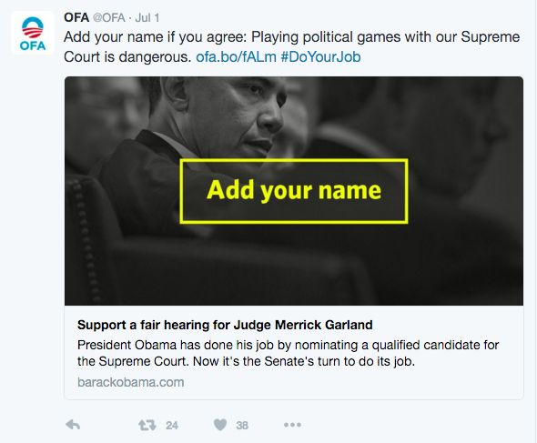
A few hours later, he sees another post -- with sign-on ask.

Slide 72
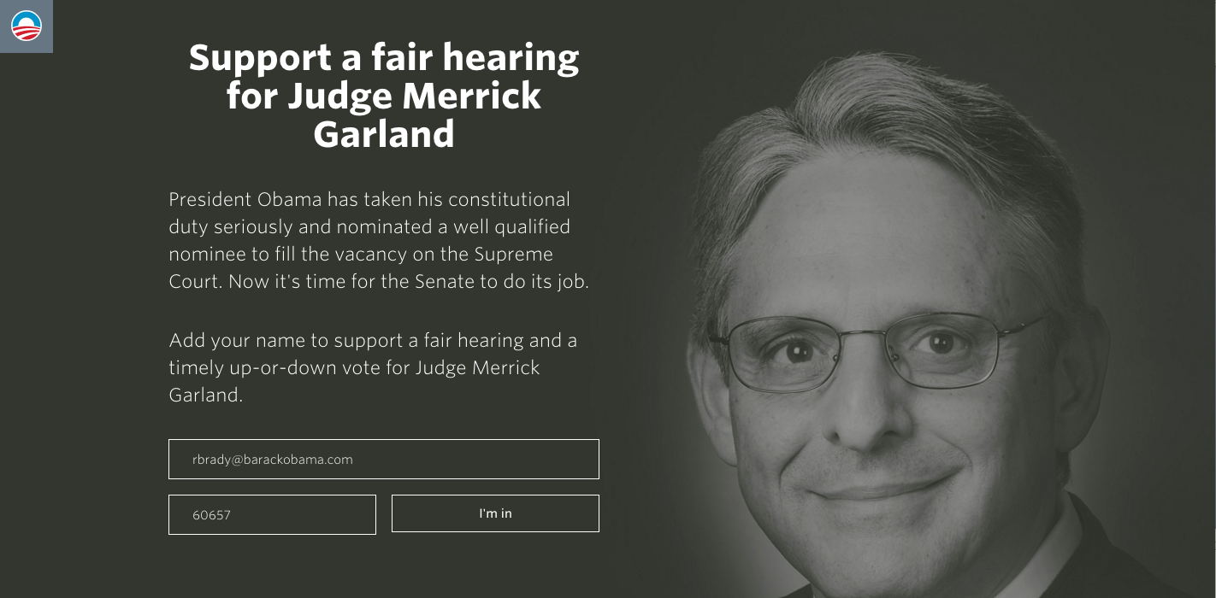
Dan goes to the sign-on page.

Slide 73
He is now on the email list.

Slide 74
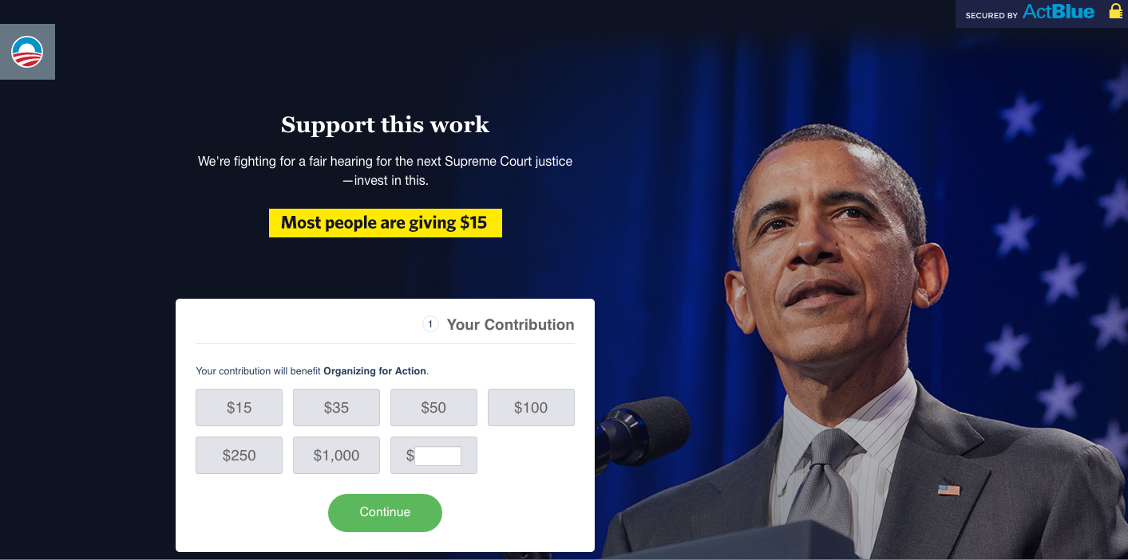
Donate daisy.

Slide 75
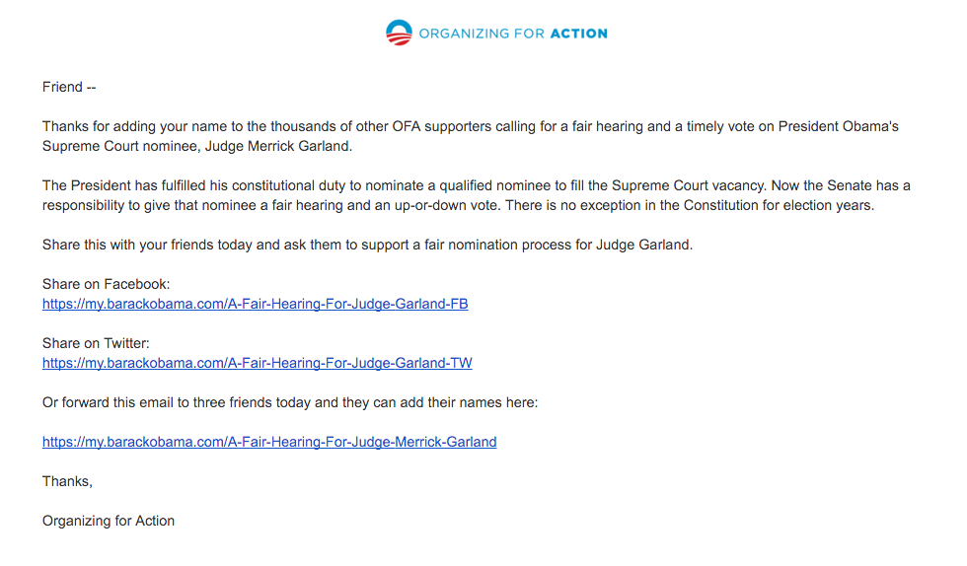
Autoreply with ask.

Slide 76
AGENDA FOR TODAY
What is a Digital Campaign?
The Process to Plan a Campaign
Managing a Digital Campaign
Debrief and Close
Notes:
00:72 – 00:72 [1 min] – Aquiles
Alright let’s debrief and close. But first, let’s review this week’s assignment

Slide 77
Debrief
What was your biggest “aha” moment?
Press 1 on the phone
OR
Type in chat box
Notes:
00:73 – 00:75 [2 min] – Ryanne
What was your biggest “aha” moment?

Slide 78
Debrief
What was your biggest “aha” moment?
How does this campaign development process contrast your previous notion of digital production?
Press 1 on the phone
OR
Type in chat box
Notes:
00:73 – 00:75 [2 min] – Ryanne
How does this campaign development process contrast your previous notion of digital production?

Slide 79
Key Takeaways
Digital campaigns achieve measurable goals, broadcast relevant messaging, integrate all digital platforms, and are consistent.
Notes:
00:74 – 00:75 [1 min] – Ryanne
Digital campaigns achieve measurable goals, broadcast relevant messaging, integrate all digital platforms, and are consistent.

Slide 80
Key Takeaways
Digital campaigns achieve measurable goals, broadcast relevant messaging, integrate all digital platforms, and are consistent.
A successful digital campaign is guided by a solid planning process that considers clear goals, relevant messaging with call to action, and manageable timeline.
Notes:
00:74 – 00:75 [1 min] – Ryanne
A successful digital campaign is guided by a solid planning process that considers clear goals, relevant messaging with call to action, and manageable timeline.

Slide 81
Key Takeaways
Digital campaigns achieve measurable goals, broadcast relevant messaging, integrate all digital platforms, and are consistent.
A successful digital campaign is guided by a solid planning process that considers clear goals, relevant messaging with call to action, and manageable timeline.
Effective management plans outline tasks (What), assign specific responsibilities (Who), and present achievable deadlines (When).
Notes:
00:74 – 00:75 [1 min] – Ryanne
Effective management plans outline tasks (What), assign specific responsibilities (Who), and present achievable deadlines (When).

Slide 82
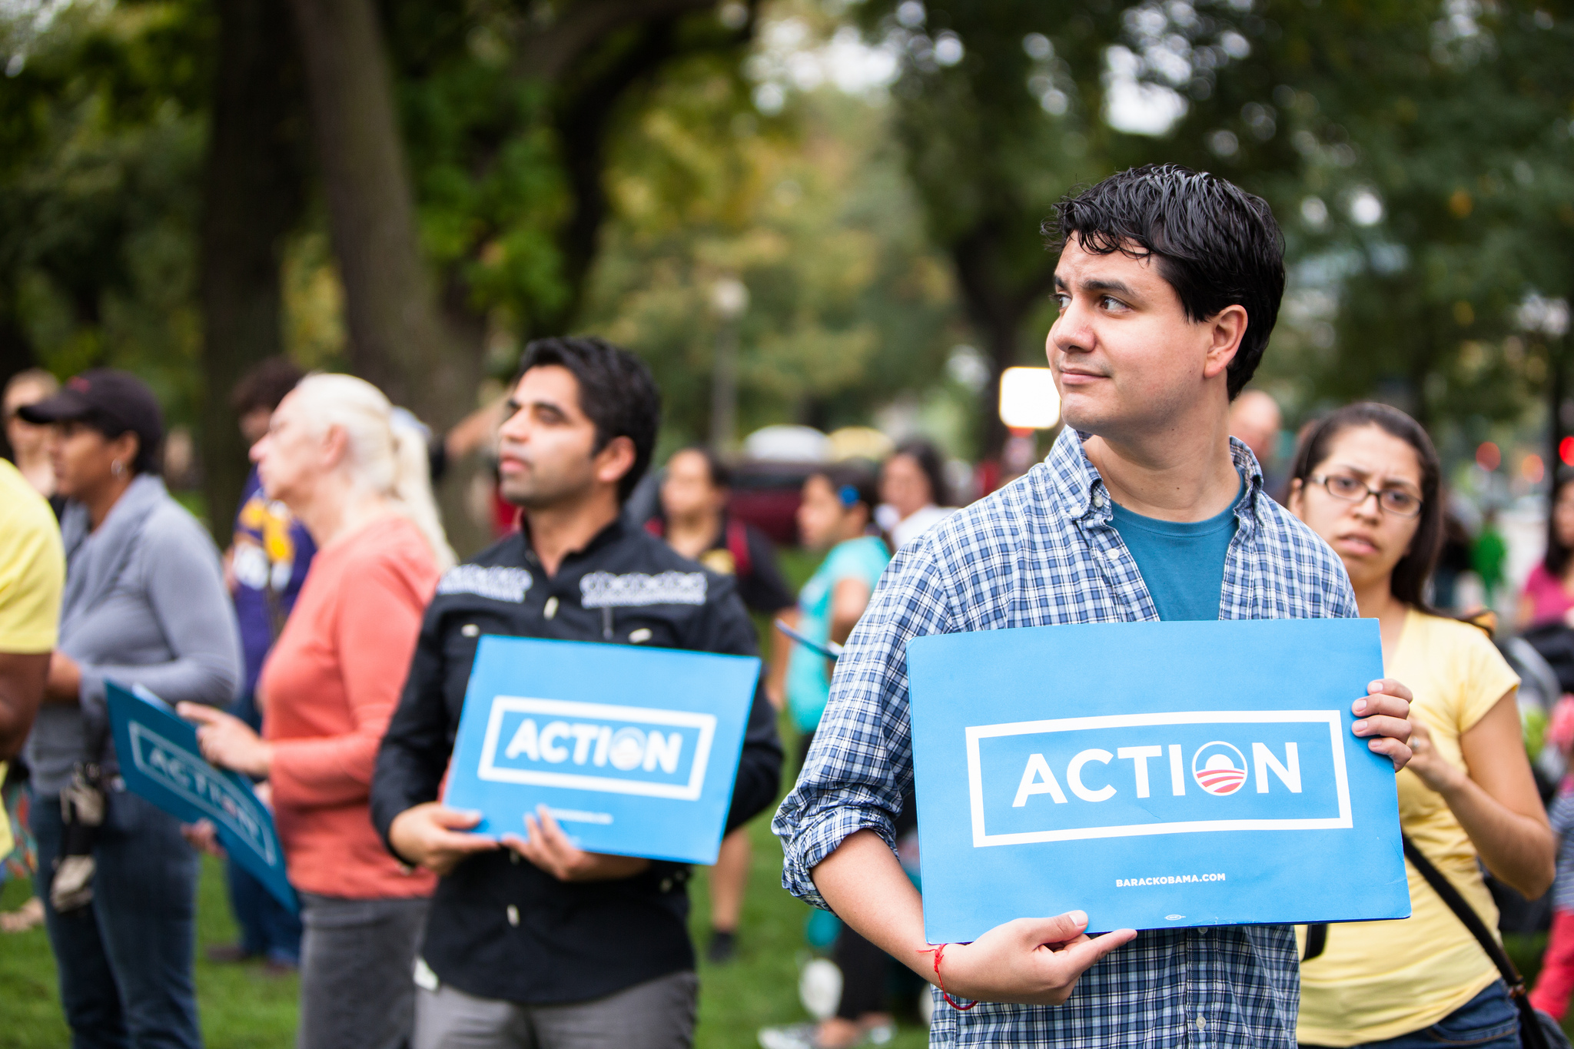
OFA TRAINING
Thank you for joining today’s webinar.
Find the materials we covered, including a video and audio recording of the webinar on the bookshelf.
SEE BOOKSHELF
Notes:
00:00 – 00:00 [General Closing Slide]

