Slide 1
Welcome!
We will begin at 7:30 PM Central Time.
One more thing—call in for audio.
Check your email for phone number and pin.
ACCESS WORKBOOK

Slide 2





LOGISTICS
We will meet for 90 minutes
You will work in pairs today.
A recording of this video and call will be available following this meeting
It’s cool if you Tweet --
#OFAFellows

Slide 3
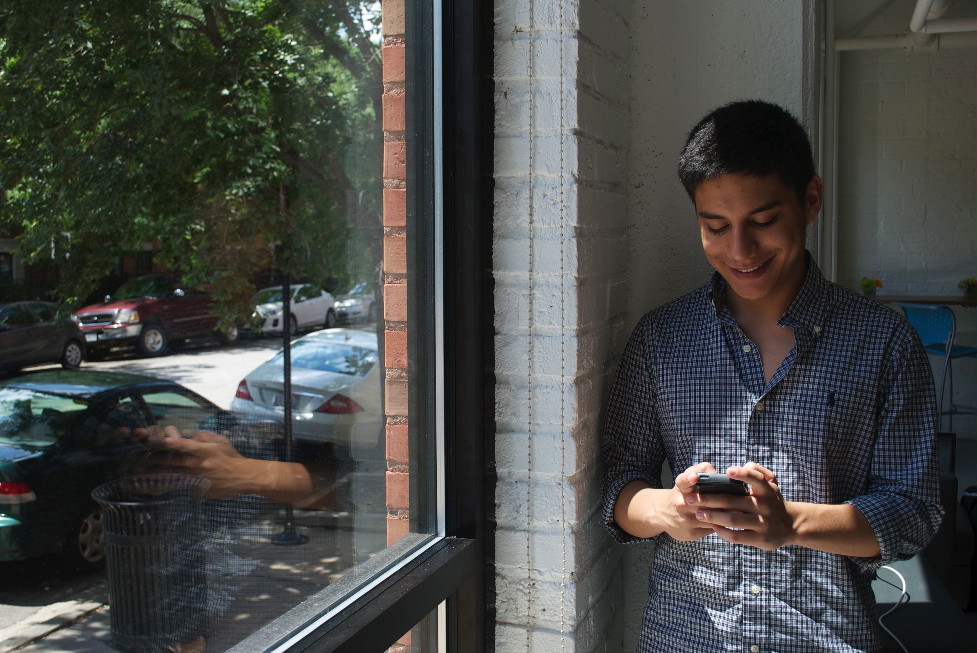

Social Media Content Production
W/ MEG BRETT

Slide 4

REVIEW
Social Media Strategy
W/ JONATHAN KIBORT

Slide 5
Digital content producers not only help frame the message, but they engage an audience with the ultimate goals of the campaign in mind.
FRAME THE MESSAGE
ACQUISITION
Notes:
Cover strategic user flow. The ultimate goal is to bring new people into your list that will broadcast your message to their networks.

Slide 6




TODAY
Tweets
FB Posts
Sign-On Page
Auto Responder

Slide 7
PEER REVIEW

Slide 8
GOALS FOR TODAY
1
Know best practices to produce digital content for social media platforms
2
Be able to produce digital content for a social media campaign: social media post to sign-on page
3
Feel confident developing digital content that follows the social media strategic user flow

Slide 9

AGENDA FOR TODAY
Brainstorm
Producing a Sign-On Page
Producing Metadata
Producing Tweets
Producing FB Posts
Debrief and Close

Slide 10
Social Media Content Production
W/ MEG BRETT

Slide 11

MEG BRETT
Social Media Manager

Slide 12
AGENDA FOR TODAY
Brainstorm
Producing a Sign-On Page
Producing Metadata
Producing Tweets
Producing FB Posts
Debrief and Close

Slide 13
Before writing, what should you do?

Slide 14
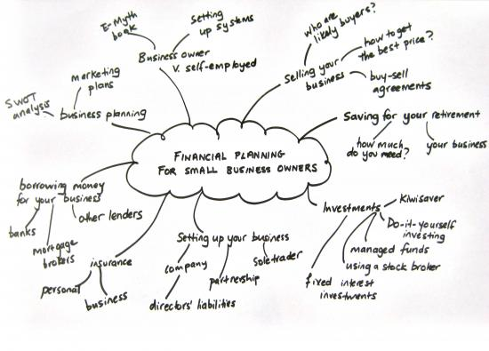

Slide 15
BRAINSTORMING
Before writing, think about the following:
What is your goal?
Notes:
What is the goal of your campaign? Are you trying to raise money, raise awareness, get your message out, mobilize, list build (back to basics 3M’s)→ You can think about this for an individual or in terms of the entire user flow

Slide 16
BRAINSTORMING
Before writing, think about the following:
What is your goal?
What is your message?
Notes:
It’s important to communicate first and foremost why your message is important. Part of that is explaining how your audience can get involved -- a hook and a call-to-action helps to achieve this. It is also asking yourself why this audience should hear this message. Why should they care?

Slide 17
BRAINSTORMING
Before writing, think about the following:
What is your goal?
What is your message?
Who is your audience? Authentic, Relevant, Effective
Notes:
Which leads us to knowing your audience- Is what I’m about to write authentic, relevant, effective– something that they would or should actually care about.

Slide 18
BRAINSTORMING
Before writing, think about the following:
What is your goal?
What is your message?
Who is your audience? Authentic, Relevant, Effective
What is your platform?
Notes:
Are you writing for facebook, twitter, instagram, blog?

Slide 19

Your Turn!
Brainstorm a social media campaign around a climate change article that just came out. Your campaign will have three components: Sign-On page, Twitter message, Facebook post.
FIRST: Brainstorm
Experiential Activity #1
15 Minutes
What is the goal of your campaign?
What do you want your members to do?
What is your message?
Who is your audience?
YOU WILL SUBMIT YOUR PRODUCT AT THE END OF CLASS.
ACCESS WORKBOOK

Slide 20
AGENDA FOR TODAY
Brainstorm
Producing a Sign-On Page
Producing Metadata
Producing Tweets
Producing FB Posts
Debrief and Close

Slide 21
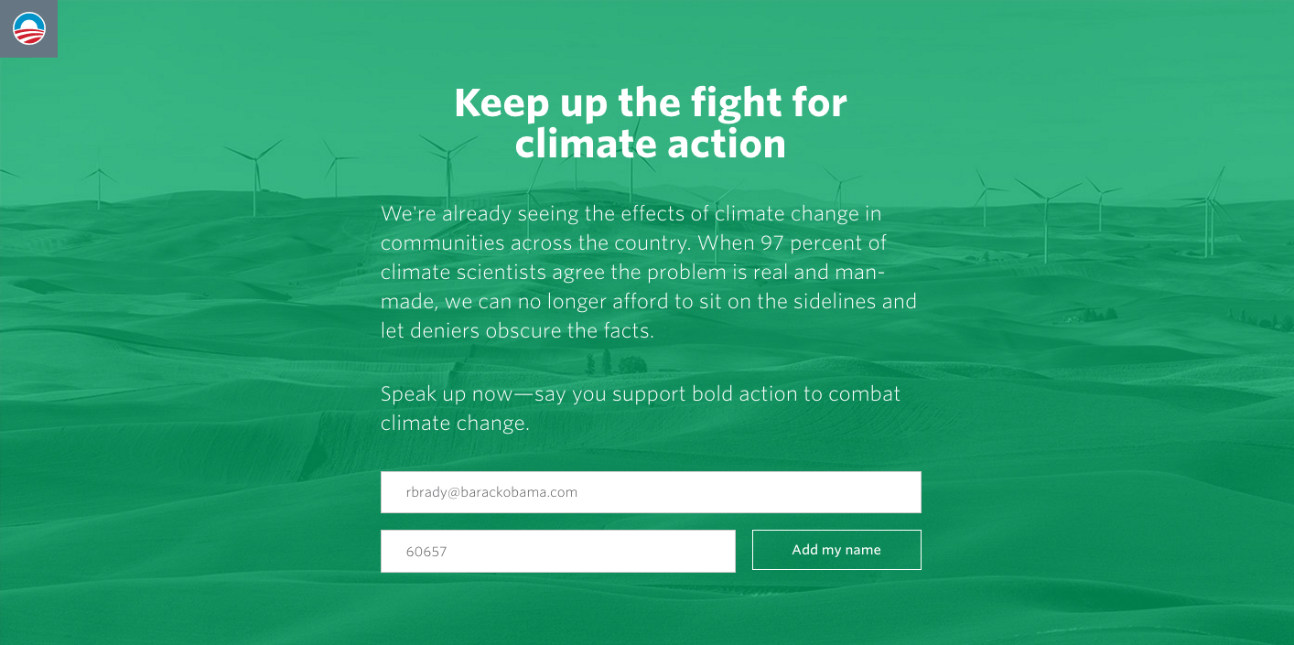
Sign-On Page: What is it?
Notes:
A couple sentences of what they’re signing on to, why it’s important, and a direct call to action with the minimum requirements to add them onto your email list

Slide 22
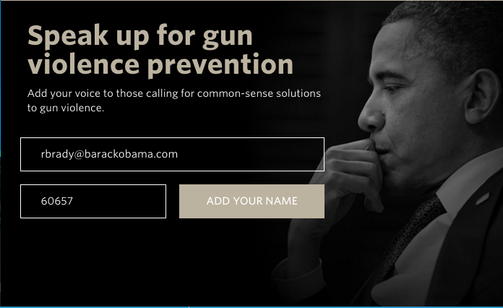
Sign-On Page: What is it?

Slide 23
Sign-On Page: Characteristics
The header should be a clear call to action.

Slide 24
Sign-On Page: Characteristics
What is the least amount of information you have to give someone in order for them to take an action?
Notes:
People have short-attention spans. The more you put on there, the less likely they’ll pay attention to it. You should also clearly explain WHAT you are asking someone to do.

Slide 25
Sign-On Page: Characteristics
Provide space to collect the information you need from your audience.
Notes:
We only have email and zipcode for a reason– very quick and easy and people don’t feel like they have to give us too much information

Slide 26
Your Turn!
Produce a Sign-On page for your social media campaign. Draft a title, content, and space to provide information.
PRO-TIP:
Title is your call to action
Provide the least amount of information someone needs to sign-on
Provide space to collect information
Experiential Activity #2
15 Minutes
ACCESS WORKBOOK

Slide 27
AGENDA FOR TODAY
Brainstorm
Producing a Sign-On Page
Producing Metadata
Producing Tweets
Producing FB Posts
Debrief and Close

Slide 28

What is metadata?
OR
Press 1 on the phone
Type in chat box

Slide 29
Includes the images and intro-text that tease an article. In short- it is data that is a brief description of other data.
METADATA

Slide 30
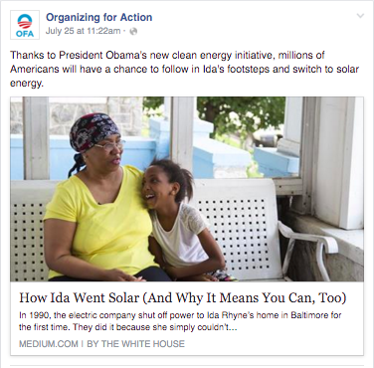
Metadata: Title + Description
Keep it short
Notes:
Metaimage may or may not be included in metadata.

Slide 31
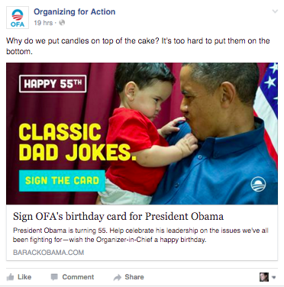
Metadata with image and graphic copy
Notes:
Metaimage may or may not be included in metadata.

Slide 32
Your Turn!
Produce the metadata for your sign-on page: Title, Text.
PRO-TIP:
Title same as Sign-On page
Use text as a description
Less than 350 characters
Experiential Activity #1
5 Minutes
ACCESS WORKBOOK

Slide 33
AGENDA FOR TODAY
Brainstorm
Producing a Sign-On Page
Producing Metadata
Producing Tweets
Producing FB Posts
Debrief and Close

Slide 34
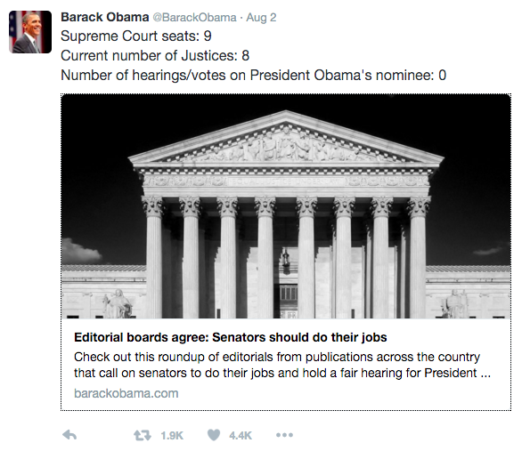
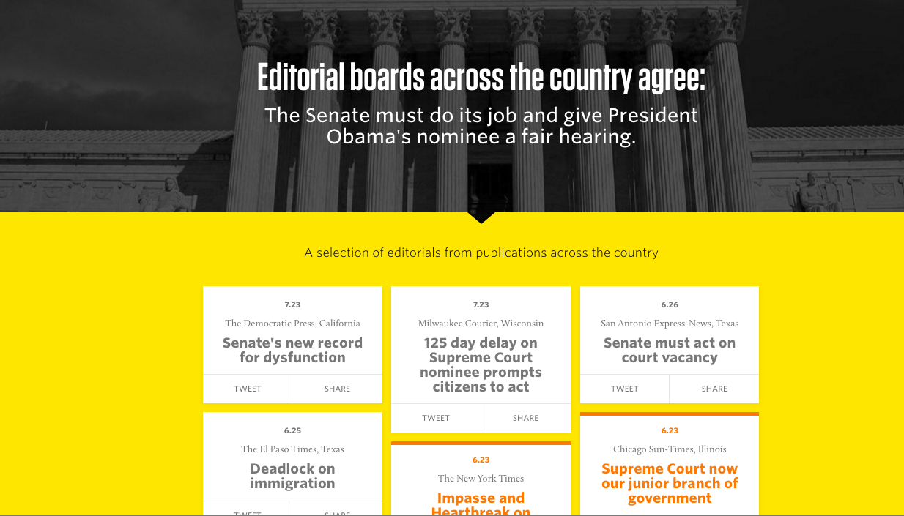
TYPES OF TWEETS: Informational

Slide 35
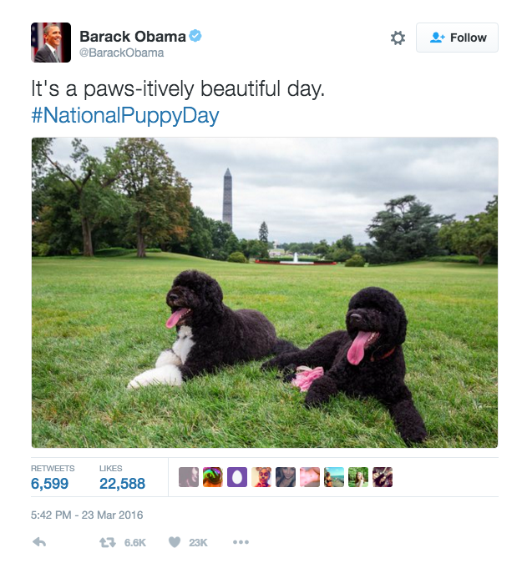
TYPES OF TWEETS: Smile – No Call to Action
Notes:
FYO posts- F yeah Obama posts! These are basically dessert content – it’s fun, everyone loves it, crowd pleaser. These are great to follow up with vegetables (good for you). These are things that are important, that you care about.

Slide 36
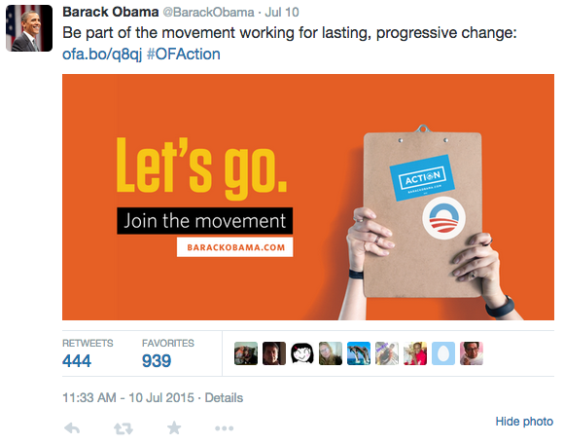
TYPES OF TWEETS: Call to Action

Slide 37
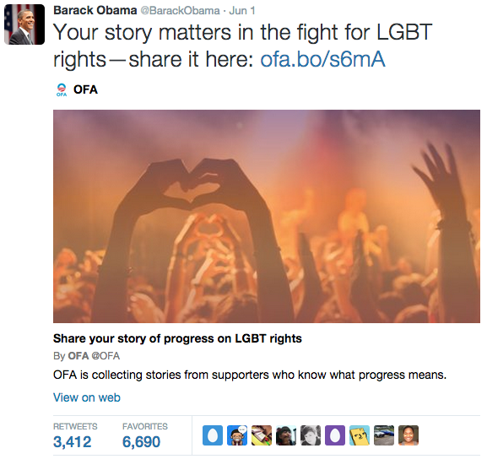
TYPES OF TWEETS: Call to Action

Slide 38
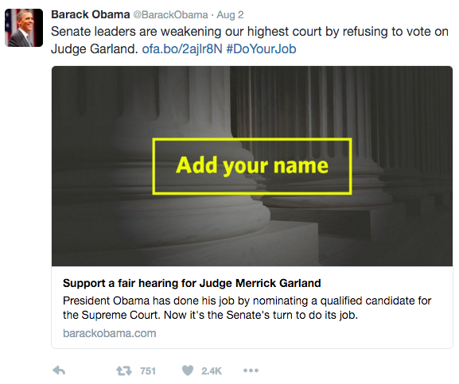
Some key points on tweets--
Provide more context
Notes:
Metadata again– helps to provide context to what the user is going to read, or do…

Slide 39
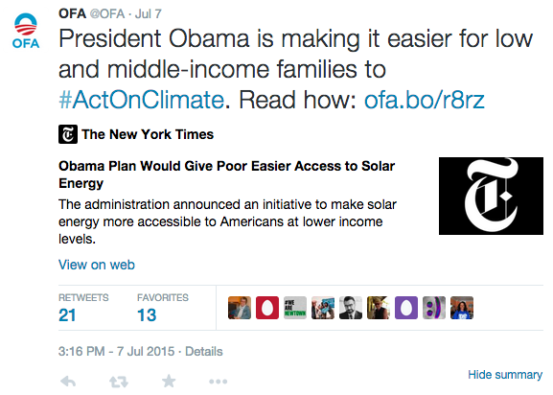
Some key points on tweets--
Do not bury your ask
Notes:
Your call to action is right before the link: You want to make very explicit what you’re asking and how you’re asking. Don’t bury it in the middle– put it in the beginning or the end.

Slide 40
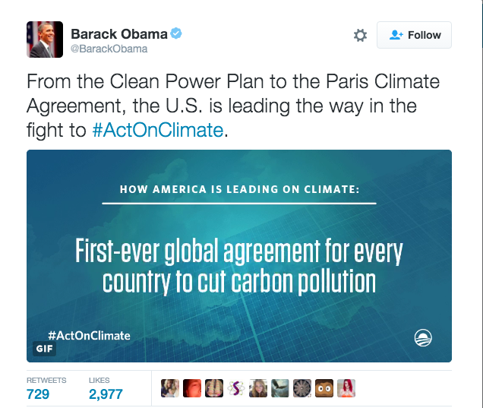
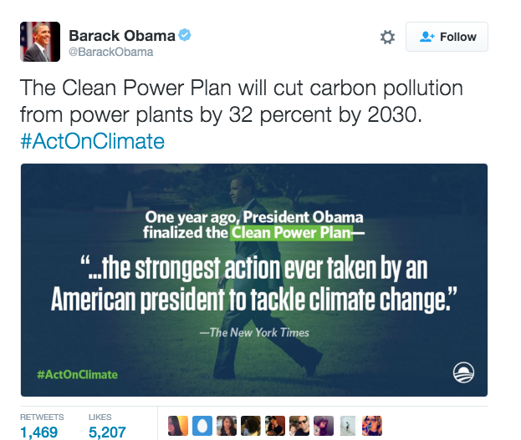
Some key points on tweets--
Organic Hashtags
Notes:
Try to include the hashtag in the sentence if we can, but if it doesn’t make sense, don’t force it – it needs to be natural. DON’T OVERUSE hastags – it muddles your message.

Slide 41
Your Turn!
Produce three Tweets to accompany your social media campaign.
Smile Tweet
Informational Tweet
Tweet W/ Sign-On Page and Call to Action
Experiential Activity #4
10 Minutes
ACCESS WORKBOOK

Slide 42
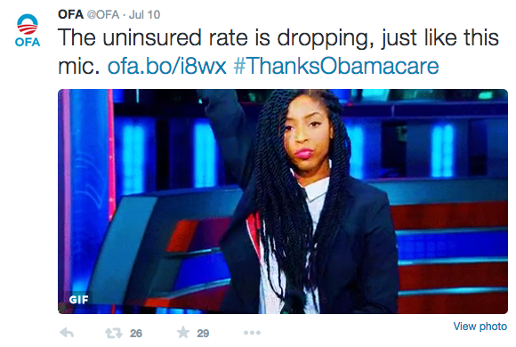
ACCOUNT: OFA TW
TWEET:
The uninsured rate is dropping, just like this mic. LINK GIF
Article: www.articlegoeshere.com

Slide 43
AGENDA FOR TODAY
Brainstorm
Producing a Sign-On Page
Producing Metadata
Producing Tweets
Producing FB Posts
Debrief and Close

Slide 44


Notes:
They’re both social media, with similarities, but they do have differences.
Get information across, share images,
Twitter audience: Younger
Facebook audience: Older

Slide 45
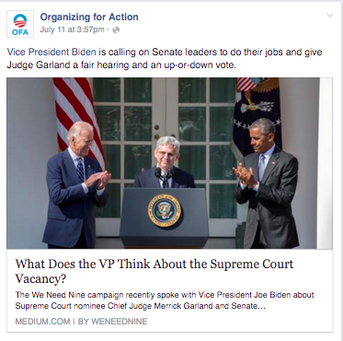
FACEBOOK POSTS: Let the metadata do the talking.
Notes:
Don’t repeat the metadata or yourself. Add to the metadata or make a comment about it.

Slide 46
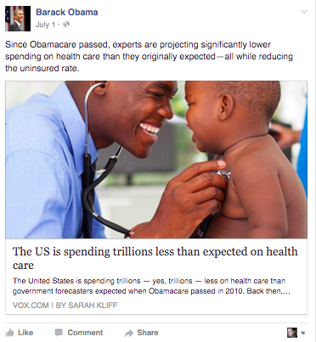
FACEBOOK POSTS: Informational
Notes:
Don’t repeat the metadata or yourself. Add to the metadata or make a comment about it.

Slide 47
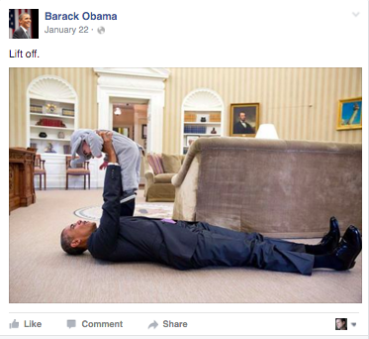
FACEBOOK POSTS: Smile

Slide 48
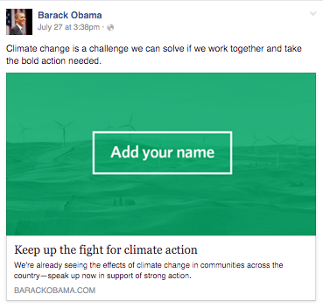
FACEBOOK POSTS: Call-to-Action
Notes:
The call to action is in the metadata- which is what we were talking about. Facebook algorithm doesn’t filter out of people’s feeds.

Slide 49
Your Turn!
Produce three Facebook posts to accompany your social media campaign.
Smile FB Post
Informational FB Post W/ No Call to Action
FB Post W/ Sign-On Page and Call to Action
Experiential Activity #5
HW ASSIGNMENT
DUE TUESDAY, SEPTEMBER 27 (9:00 AM)

Slide 50
AGENDA FOR TODAY
Why Social Media
Social Media Strategy
Strategic User Flow
Debrief and Close

Slide 51
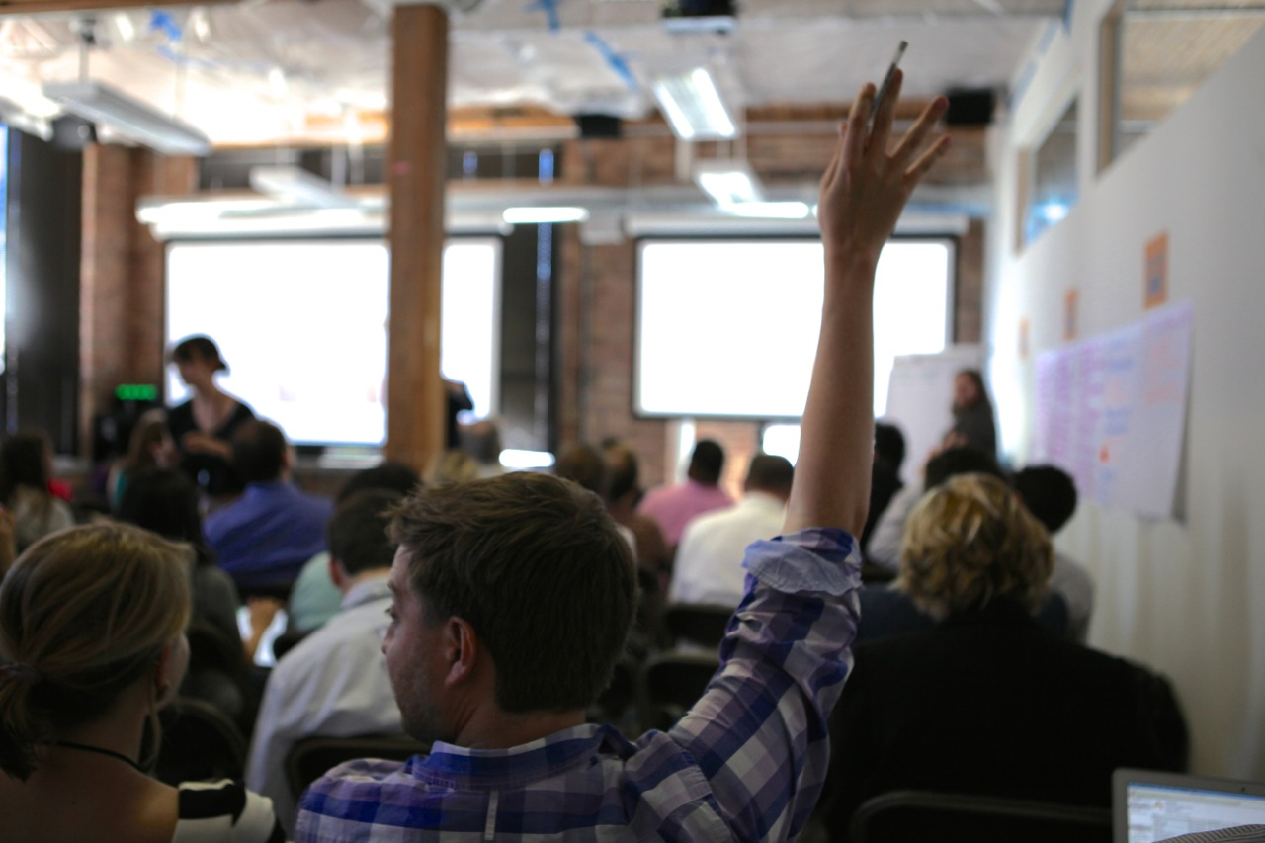
What questions do you have?

Slide 52
GOALS FOR TODAY
1
Know writing techniques to produce digital content for social media platforms
2
Be able to produce digital content for a social media campaign – post to sign-on page
3
Feel confident developing digital content that follows the social media strategic user flow

Slide 53

Debrief
Using #OFAFellows, tweet your biggest takeaway
#OFAFellows

Slide 54

THURSDAY
7:30 PM CT
Email Campaign Strategy
W/ Abby Boyle

