Slide 1

Welcome!
We will begin at 7:30 PM Central Time.
One more thing—call in for audio.
Check your email for phone number and pin.
ACCESS WORKBOOK
Notes:
This work is licensed under the Creative Commons Attribution-NonCommercial 4.0 International License. To view a copy of this license, visit http://creativecommons.org/licenses/by-nc/4.0/ or send a letter to Creative Commons, PO Box 1866, Mountain View, CA 94042, USA.

Slide 2
Week 1
Digital Organizing 101
Amazing things ahead:
Our learning journey
Week 2
Principles of Digital Communication
Week 3
Social Media Strategy
Week 4
Social Media Content Production
Week 5
Email Campaign Strategy
Week 6
Email Content Production
Week 7
Planning a Digital Campaign

Slide 3

LOGISTICS
We will meet every Thursday for 90 minutes.
If you cannot attend, email fellows@barackobama.com

Slide 4



LOGISTICS
We will meet every Thursday for 90 minutes.
This is an interactive training. (Mute your computers and listen on the phone)
OR
Press 1 on the phone
Type in chat box

Slide 5

LOGISTICS
We will meet for 90 minutes
This is an interactive training.
A recording of this video and call will be available on the Fellows Bookshelf tomorrow afternoon.

Slide 6

LOGISTICS
We will meet for 90 minutes
This is an interactive training.
A recording of this video and call will be available on the Fellows Bookshelf tomorrow afternoon.
It’s cool if you Tweet --
#OFAFellows

Slide 7


Social Media Strategy
W/ JONATHAN KIBORT

Slide 8

Principles of Digital Communication
W/ ALEX WOODWARD

Slide 9

Review: Principles of Digital Communication
What can you do to craft digital content that helps you build trust with your online audience?
OR
Press 1 on the phone
Type in chat box
Notes:
00:04 – 00:06 [2 min] – Aquiles
Ask up to three learners
Lead them into answering: 3 Ms (Message, Mobilize, and Money)

Slide 10
Review: Principles of Digital Communication
AUTHENTICITY
RELEVANCE
EFFICACY
Notes:
00:04 – 00:06 [2 min] – Aquiles
Ask up to three learners
Lead them into answering: 3 Ms (Message, Mobilize, and Money)

Slide 11
Social Media Strategy
W/ JONATHAN KIBORT

Slide 12
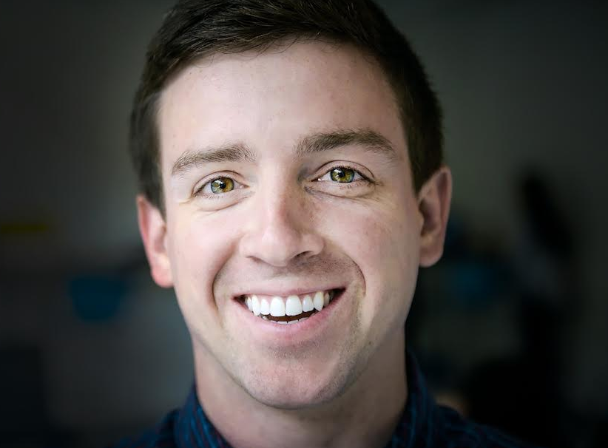
JONATHAN KIBORT
Digital Strategist and Special Projects Manager

Slide 13
GOALS FOR TODAY
1
Understand the value of social media at a digital department
2
Be able to create a social media strategy that effectively reaches your overall campaign goals
3
Feel confident following the social media user flow to meet your audience where they are and bring them to your email list

Slide 14

AGENDA FOR TODAY
Why Social Media
Social Media Strategy
Strategic User Flow
Debrief and Close

Slide 15
AGENDA FOR TODAY
Why Social Media
Social Media Strategy
Strategic User Flow
Debrief and Close

Slide 16
How do you engage with social media?
OR
Press 1 on the phone
Type in chat box
Notes:
Kibo: EX- “I like to complain about airlines being late on twitter,” I use Facebook for family photos, I use twitter for the Bachelor. I use instagram.
Press 1 if you want to speak, or type in the chat box

Slide 17
A DIGITAL DEPARTMENT HAS THREE MAIN GOALS: 3 M’S
MESSAGE
MOBILIZE
MONEY

Slide 18
But, where does social media fit in?

Slide 19
MESSAGE
But, where does social media fit in?
Notes:
It is largely message, but we and other organizations use it for mobilization as well.
That’s not to say that people can’t raise money through social media, but it’s primarily Message→ Mobilization → Money
Every organization’s audience is different: Ice-bucket challenge example

Slide 20
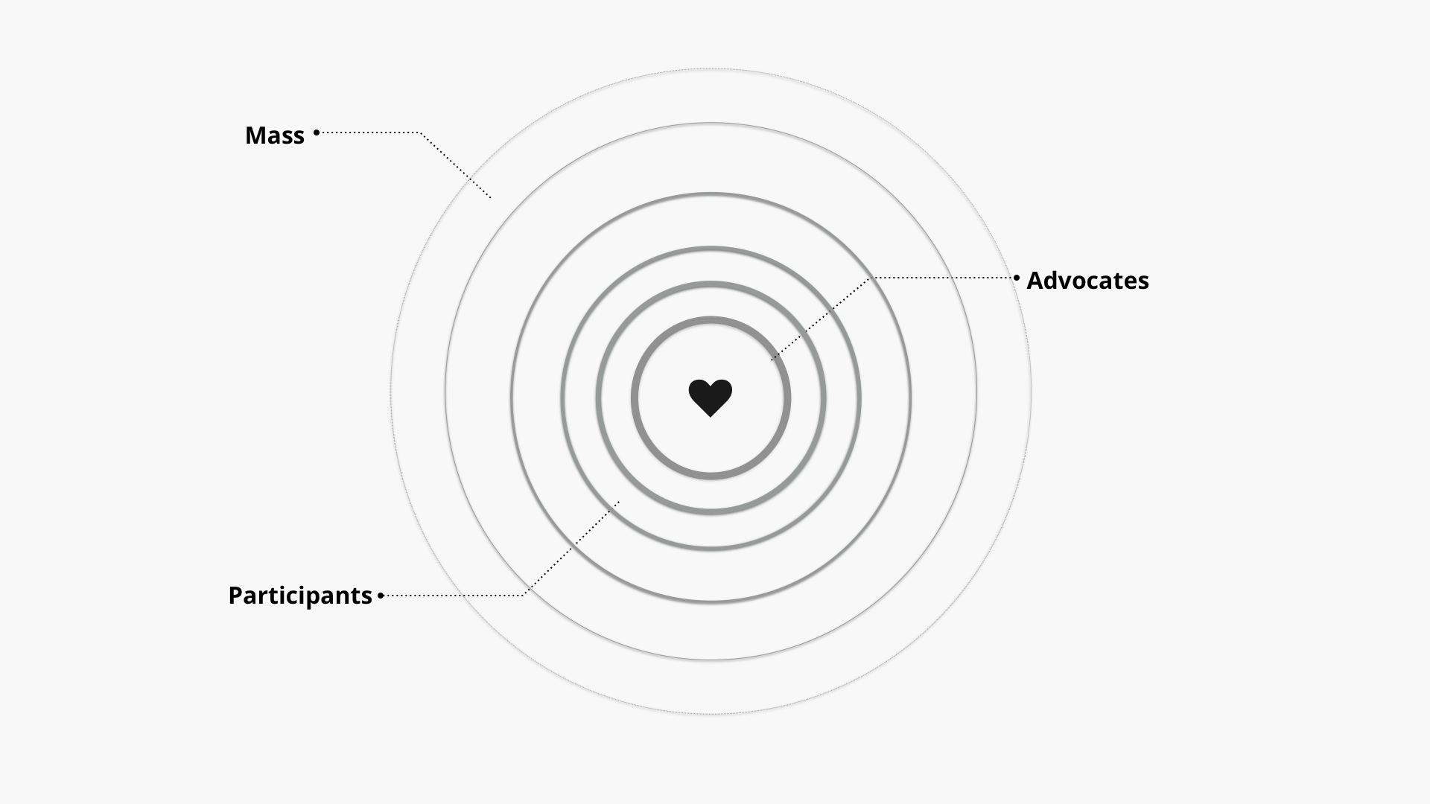
Remember the digital ladder of engagement?

Slide 21
Digital Ladder of Engagement
SOCIAL MEDIA
MOST BASIC ENTRY POINT.
Notes:
Social media is the most basic entry point. It is easy to observe. You can be a passive observer and it can be in your periphery. Even before you like a page, you may see it on the periphery to actual conversations. People you know are introducing other conversations.
^{You’re meeting} people where they are– fishing where the fish are.

Slide 22
Were do you think email lives?
EMAIL
Notes:
Email – Your inbox – Is more personal than social media
The consumer has give you permission and opportunity to communicate your message
There is more room to make your case here

Slide 23
SOCIAL MEDIA STRENGTHS
Social media helps us frame our message and engage our audience b/c:
Allows you to join a conversation that is already happening

Slide 24
SOCIAL MEDIA STRENGTHS
Social media helps us frame our message and engage our audience b/c:
Allows you to join a conversation that is already happening
Low-level engagement is easier

Slide 25
SOCIAL MEDIA STRENGTHS
Social media helps us frame our message and engage our audience b/c:
Allows you to join a conversation that is already happening
Low-level engagement is easier
Followers and users become broadcasters of your message

Slide 26
SOCIAL MEDIA STRENGTHS
Social media helps us frame our message and engage our audience b/c:
Allows you to join a conversation that is already happening
Low-level engagement is easier
Followers and users become broadcasters of your message
Reach people who are not a part of your network yet

Slide 27
SOCIAL MEDIA WEAKNESSES
Not great for raising money, especially with direct fundraising asks

Slide 28
SOCIAL MEDIA WEAKNESSES
Not great for raising money, especially with direct fundraising asks
Not as much room to get a message across on most platforms

Slide 29
SOCIAL MEDIA WEAKNESSES
Not great for raising money, especially with direct fundraising asks
Not as much room to get a message across on most platforms
Social Media has a shorter lifespan

Slide 30

SOCIAL MEDIA WEAKNESSES
Not great for raising money, especially with direct fundraising asks
Not as much room to get a message across on most platforms
Social Media has a shorter lifespan
Everything is very public: Trolls on trolls on trolls

Slide 31
AGENDA FOR TODAY
Why Social Media
Social Media Strategy
Strategic User Flow
Debrief and Close

Slide 32
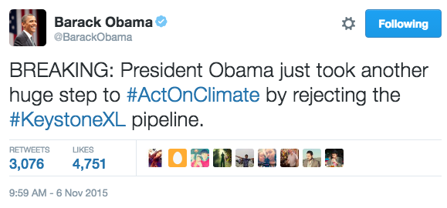
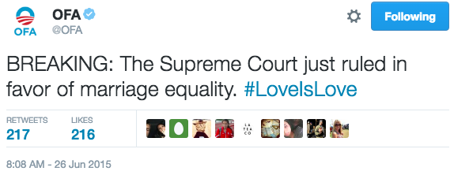
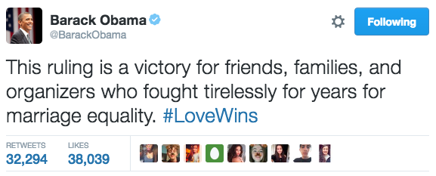
Differences in platforms: Twitter
Great for rapid response moments
Tweets have a shorter shelf life

Slide 33
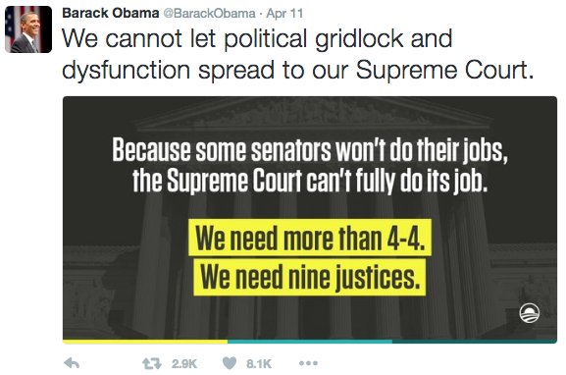

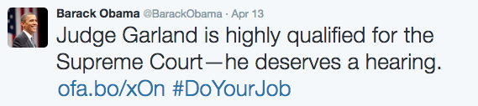
Differences in platforms: Twitter
Concise messages that get a point across quickly/calls to action
Notes:
Saying as few words necessary to get your message across

Slide 34
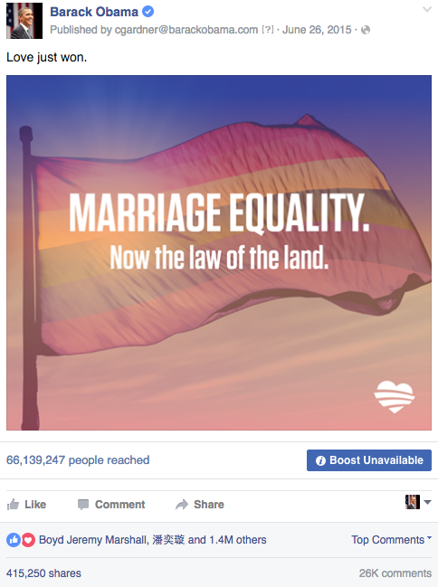
Differences in platforms: Facebook
Posts have a longer shelf life than tweets, which typically translates to higher engagement rates
Notes:
Talk about FB algorithm. Unlike TW, Facebook tailors content specifically to you. So what you see in your newsfeed, isn’t in real time. It’s based on what you engage with on FB.

Slide 35
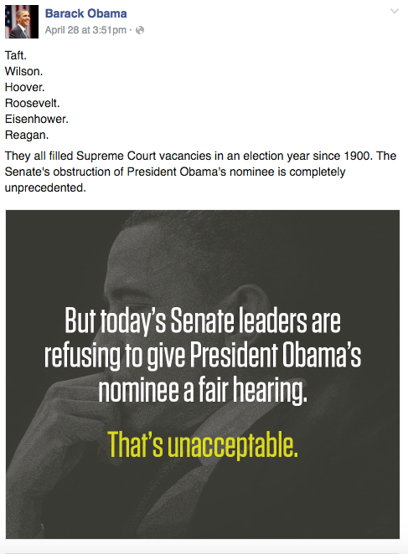
Differences in platforms: Facebook
More space means more room for explanation or longer form posts

Slide 36
Digital content producers not only help frame the message, but they engage an audience with the ultimate goal of bringing them into an email list.
FRAME THE MESSAGE
ACQUISITION
Notes:
Acquisitions are valuable because you’re reaching new people and potential new income sources
Reminder: Sign-on: Someone who is already on the list signs on to the new thing
Acquisition: Totally new sign on
Once people are signed up on your email list, the likelihood of them seeing your message increases. You’re pushing them up the ladder of engagement from observer→ action taker→ subscriber→to advocate of your message. Once they’re an advocate, they, in turn, help to acquire new acquisitions.

Slide 37

What questions do you have?

Slide 38
AGENDA FOR TODAY
Why Social Media
Social Media Strategy
Strategic User Flow
Debrief and Close

Slide 39



STRATEGIC USER FLOW

Slide 40

Meet Dan

Slide 41

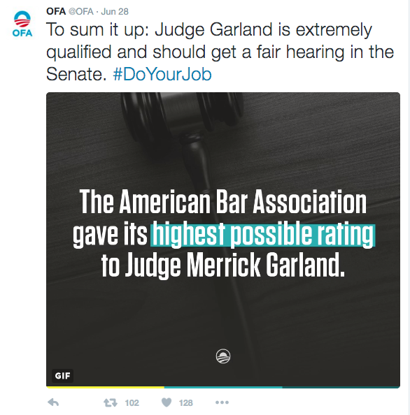
Dan sees a tweet someone in his network Retweeted.

Slide 42
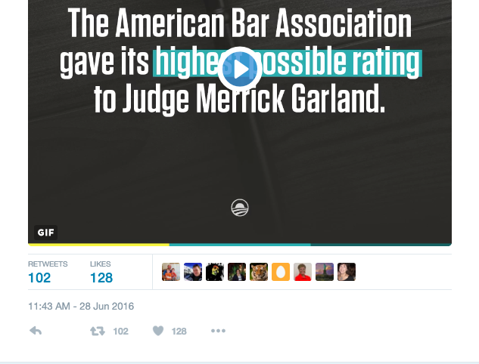
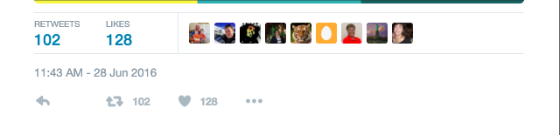
Message resonates w/ Dan and he Retweets.

Slide 43
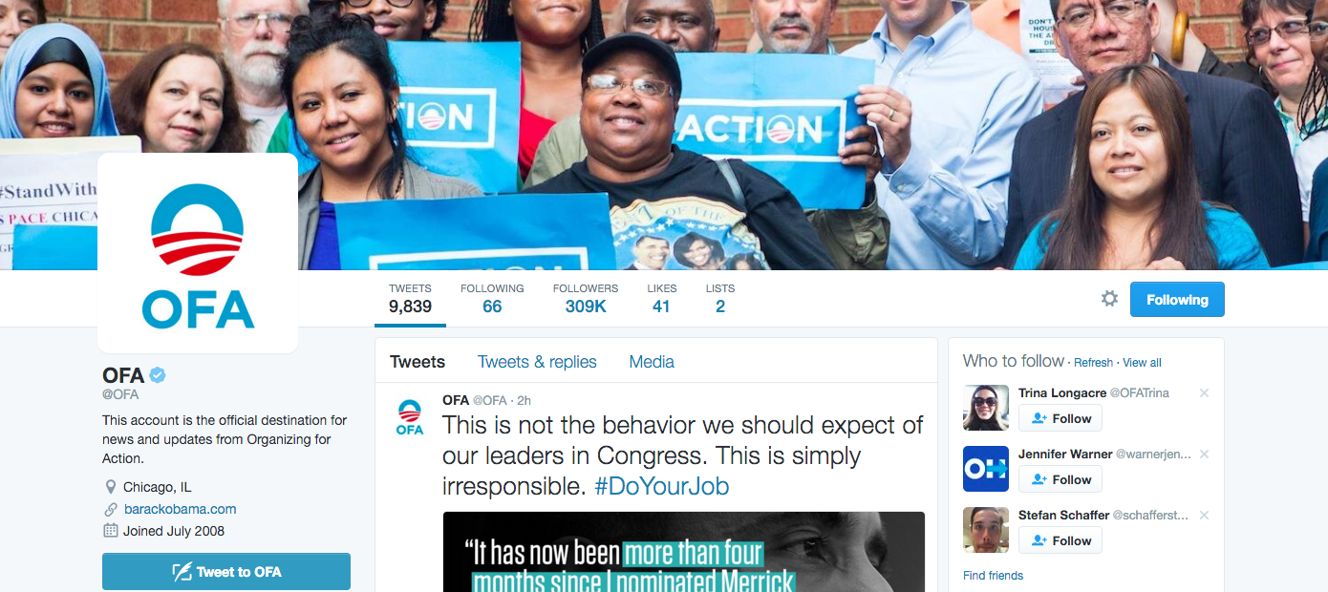
Dan looks through the page and starts following.

Slide 44
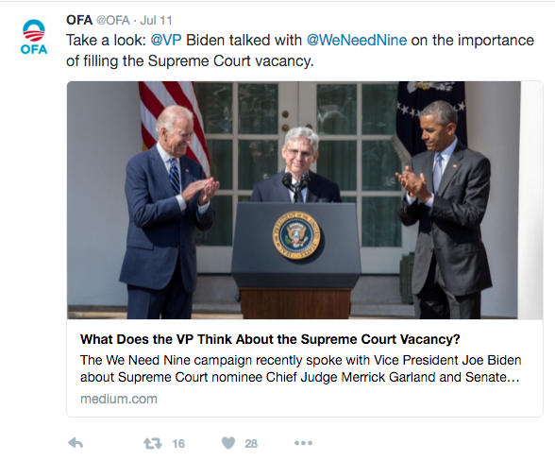
1 week later, Dan runs into an information post about the issue he Retweeted.

Slide 45
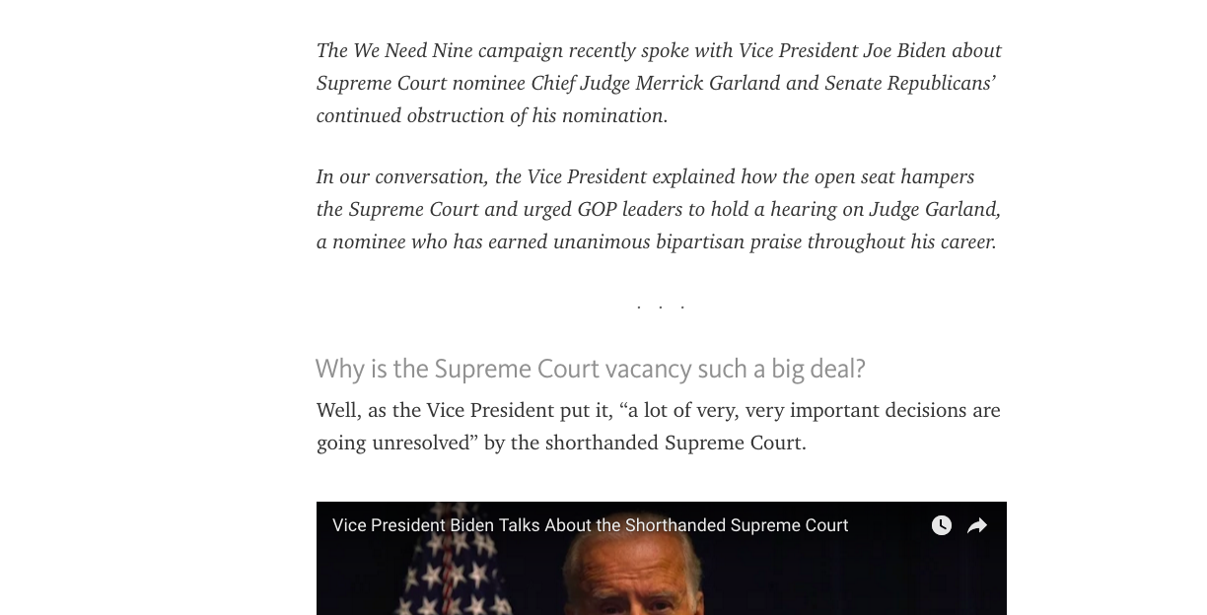
Dan reads the article.

Slide 46
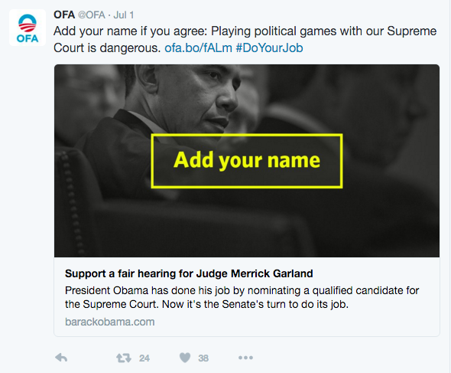
A few hours later, he sees another post -- with sign-on ask.

Slide 47
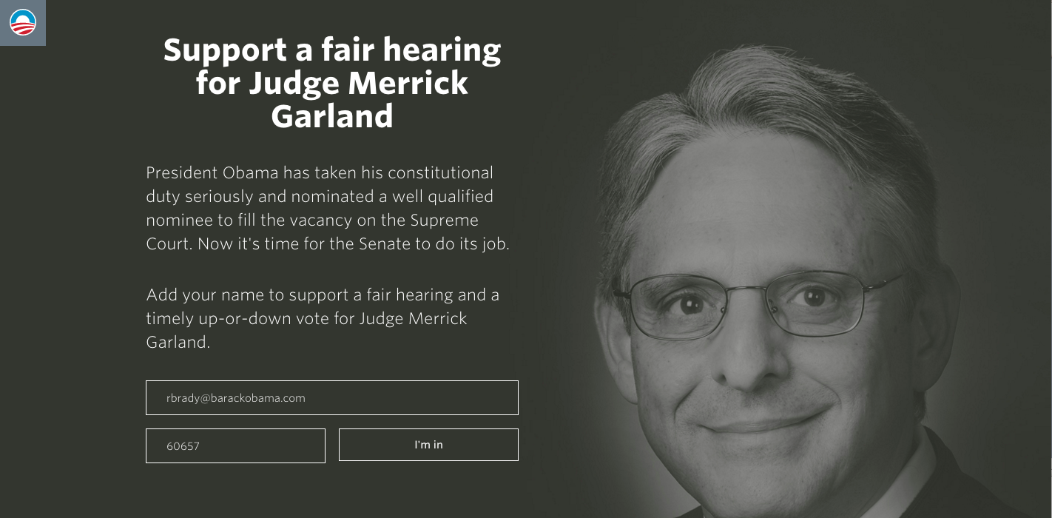
Dan goes to the sign-on page.

Slide 48

He is now on the email list.

Slide 49
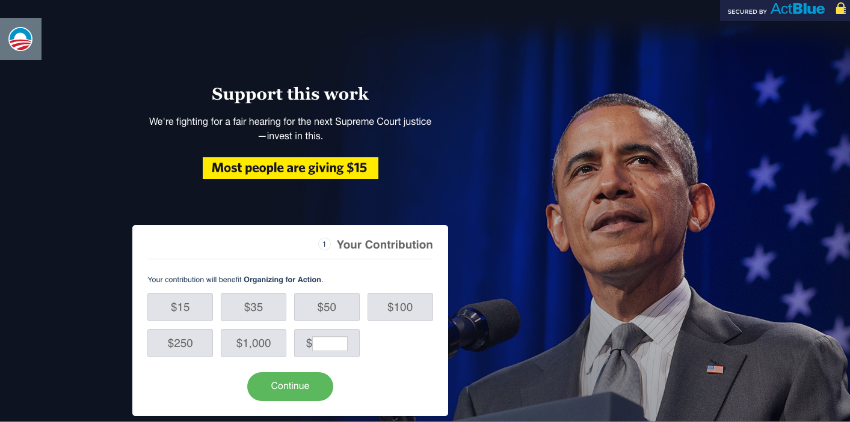
Donate daisy.

Slide 50
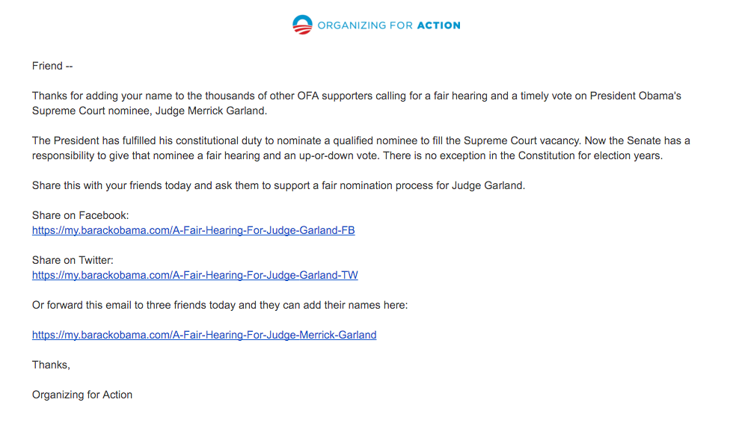
Autoreply with ask.

Slide 51

Your Turn!
1
Review the Strategic User Flow
2
Determine how this process helps the department frame its message, but also leads to mobilization and money asks
Experiential Activity #1
10 Minutes
ACCESS WORKBOOK

Slide 52
Your Turn!
Experiential Activity #1
DEBRIEF
OR
Press 1 on the phone
Type in chat box

Slide 53
Dan sees a tweet someone in his network retweeted.
This is why your message, hook, and call to action must be relevant to different audiences.
Not all post have a direct call to action

Slide 54
1 week later, Dan runs into an information post about an issue.
Your social media account does not live in a vacuum. Post vetted sources that contribute to your message.

Slide 55
A few hours later, he sees another post -- with sign-on ask.
If your reader reads about the issue, and understands it, then he/she is more likely to respond to your call to action.

Slide 56
Dan reads more about issue and signs-on.
What are they signing up for
What information you need from them

Slide 57
Donate daisy.
Dependent on your organizational goals
Other options include: volunteer page, share graph

Slide 58
Autoreply with ask.
Another opportunity to make another ask

Slide 59
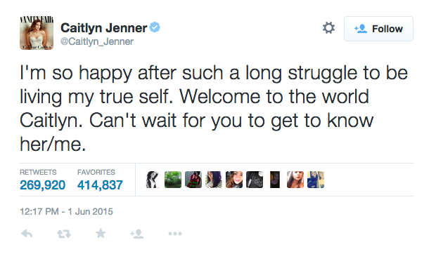
FIRST POST: @Caitlyn_Jenner

Slide 60
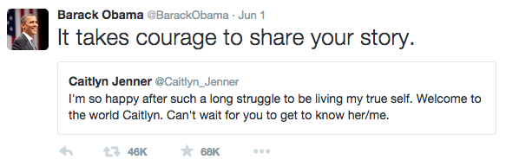
SECOND POST: @BarackObama

Slide 61
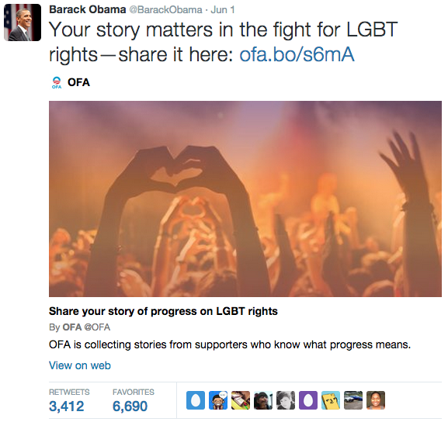
THIRD POST: @BarackObama

Slide 62
Your Turn!
Develop a strategy that follows the social media strategic user flow to ask your audience to call out elected officials who are climate change deniers. This is part of your original climate change campaign.
Experiential Activity #2
10 Minutes
ACCESS WORKBOOK

Slide 63
Your Turn!
Experiential Activity #2
DEBRIEF
OR
Press 1 on the phone
Type in chat box

Slide 64
What questions do you have?

Slide 65
AGENDA FOR TODAY
Why Social Media
Social Media Strategy
Strategic User Flow
Debrief and Close

Slide 66
DEBRIEF
What are your biggest takeaways from tonight’s session?
How does this change the way your approached your assignment, or social media in general?

Slide 67
KEY TAKEAWAYS
Social media is the most basic point of entry, as it reaches a wide audience for little money.
Your social media strategy engages your audience with your message.
The social media strategic user flow helps you meet new users and bring them into your email list.

Slide 68
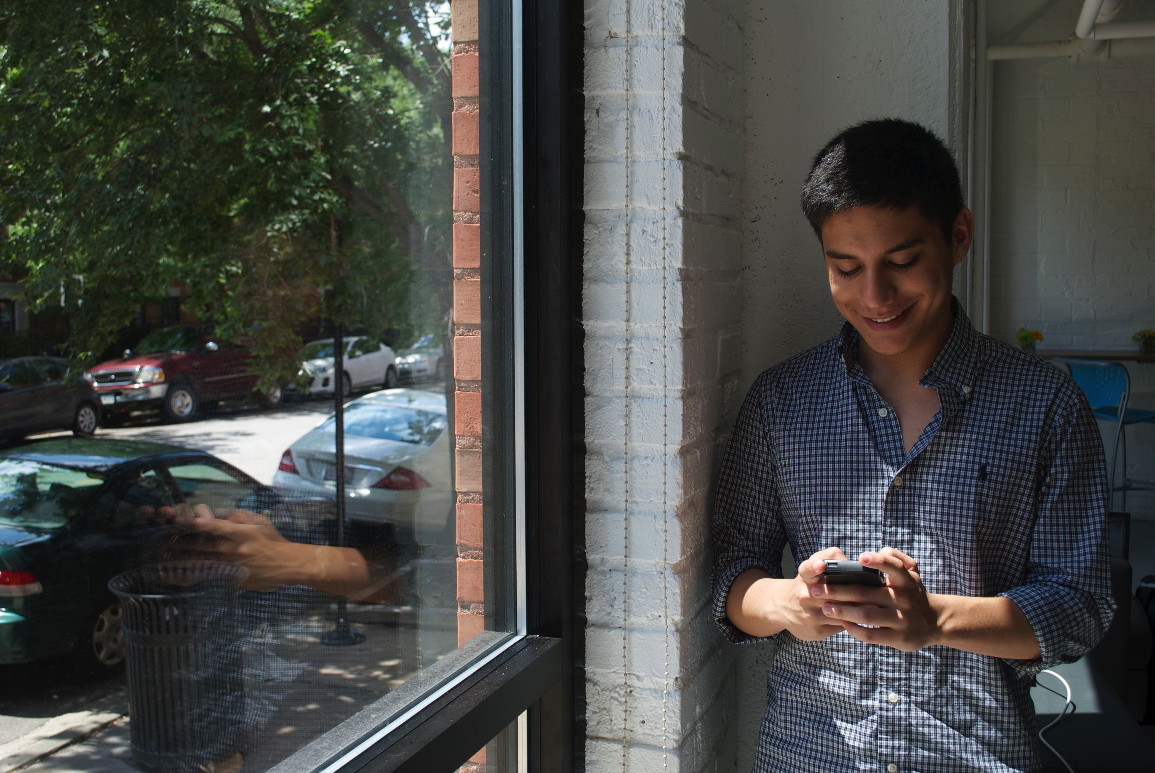
THURSDAY
7:30 PM CT
Social Media Content Production
W/ Meg Brett

Slide 69
Class Review and Additional Reading
Review concepts and skills learned today
Complete the assignment on the bookshelf – due Tuesday, 9/20 at 5:00pm CT
Complete the reading assignment this week and post your key takeaways on Connect
IMPORTANT- Update your travel needs by Monday at 9:00am if you have any changes. We will be booking flights to Chicago on Monday.
Notes:
00:72 – 00:73 [2 min] – Aquiles
Review assignment

Slide 70
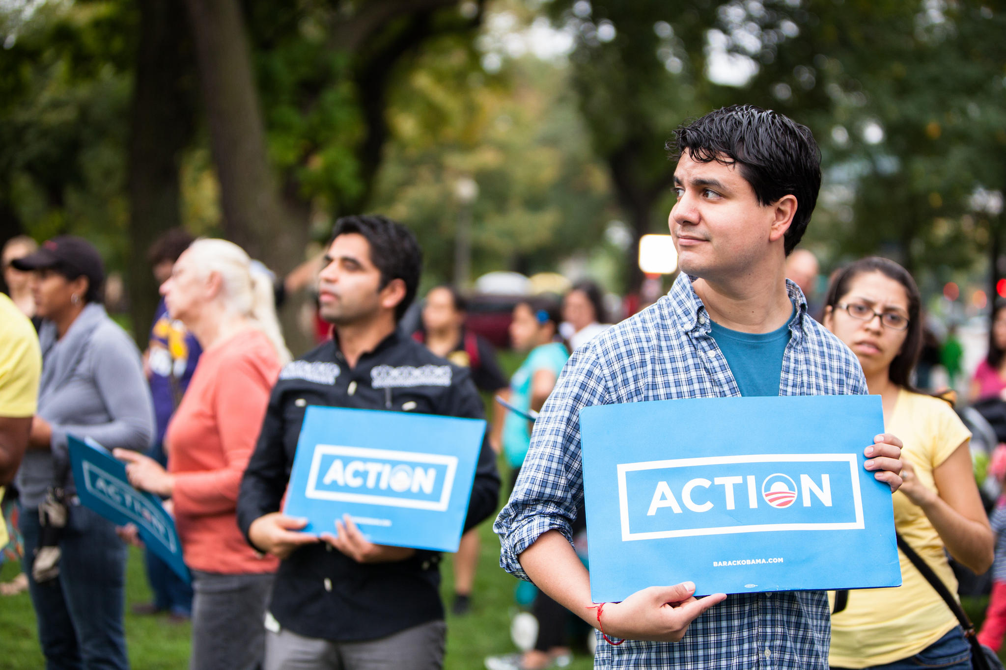
OFA TRAINING
Thank you for joining today’s webinar.
Find the materials we covered, including a video and audio recording of the webinar on the bookshelf.
SEE BOOKSHELF
Notes:
00:00 – 00:00 [General Closing Slide]

