Slide 1
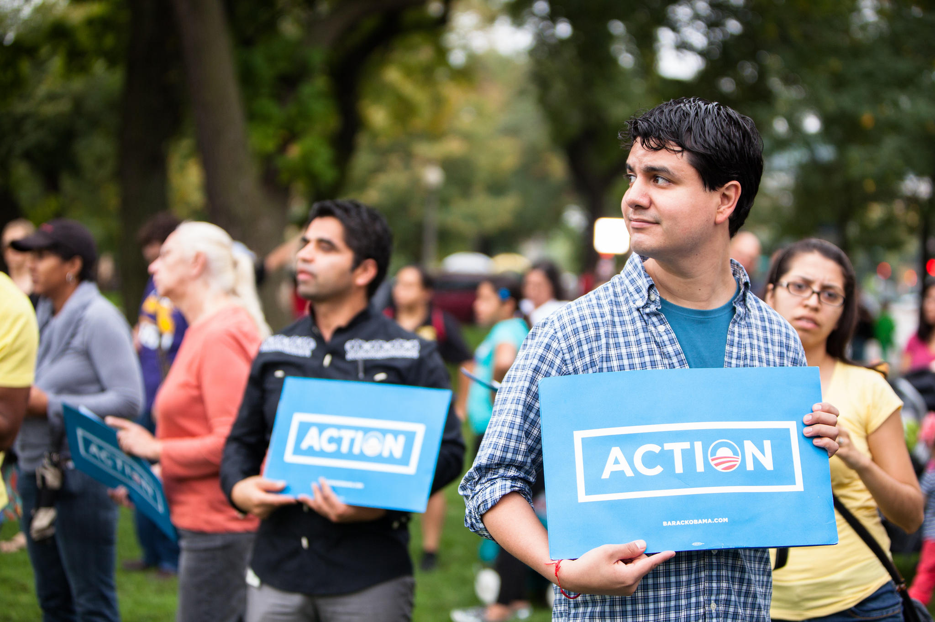


OFA TRAINING
Welcome to today’s webinar.
We will begin shortly.
For audio, please make sure to also join the call.
DIAL-IN HERE
Notes:
This work is licensed under the Creative Commons Attribution-NonCommercial 4.0 International License. To view a copy of this license, visit http://creativecommons.org/licenses/by-nc/4.0/ or send a letter to Creative Commons, PO Box 1866, Mountain View, CA 94042, USA
00:00 – 00:00 [General Opening Slide]

Slide 2
WELCOME TO THE PROGRAM: OUR GOALS
1
Understand the role that a training manager plays at a progressive organization, and the strategic goals of a training department
2
Be able to start developing training modules, designing learning journeys, and managing training programs
3
Feel confident using adult learning theory to manage meaningful and exciting learning experiences

Slide 3


Slide 4



Pair and Share
5 MINUTES
What do you hope to get from this Fellowship?
Notes:
00:13 – 00:15 [2 min] – Ryanne
Trainer’s Notes: The goal of this activity is to introduce the characteristics of a digital campaign. By not telling learners what these characteristics are, and allowing them to figure it out on their own based on their previous knowledge, we will meet them where they are. Following this activity, we will review the key characteristics of a digital campaign and answer remaining questions
Introduce activity
Instructions:
Together, we will review a total of 5 digital products one at a time
You will have one minute per product to determine:
What is the target audience?
What is the message?
What is consistent?

Slide 5


Pair and Share
5 MINUTES
OR
Press 1 on the phone
Type in chat box
Notes:
00:13 – 00:15 [2 min] – Ryanne
Trainer’s Notes: The goal of this activity is to introduce the characteristics of a digital campaign. By not telling learners what these characteristics are, and allowing them to figure it out on their own based on their previous knowledge, we will meet them where they are. Following this activity, we will review the key characteristics of a digital campaign and answer remaining questions
Introduce activity
Instructions:
Together, we will review a total of 5 digital products one at a time
You will have one minute per product to determine:
What is the target audience?
What is the message?
What is consistent?

Slide 6

OUR LEARNING JOURNEY
TWICE A WEEK LIVE WEBINARS
WEEKLY ASSIGNMENTS
CHICAGO PRACTICUM
CLASS CALENDAR
BOOKSHELF

Slide 7



LOGISTICS
We will meet for 75 minutes
This is an interactive training. We have time allocated for questions. Please press 1 on your phone, or use the chat!
A recording of this video and call will be available following this meeting
It’s cool if you Tweet --
#OFAFellows
Notes:
00:01 – 00:03 [2 min] – Aquiles
Before we get started, let’s review some logistics

Slide 8
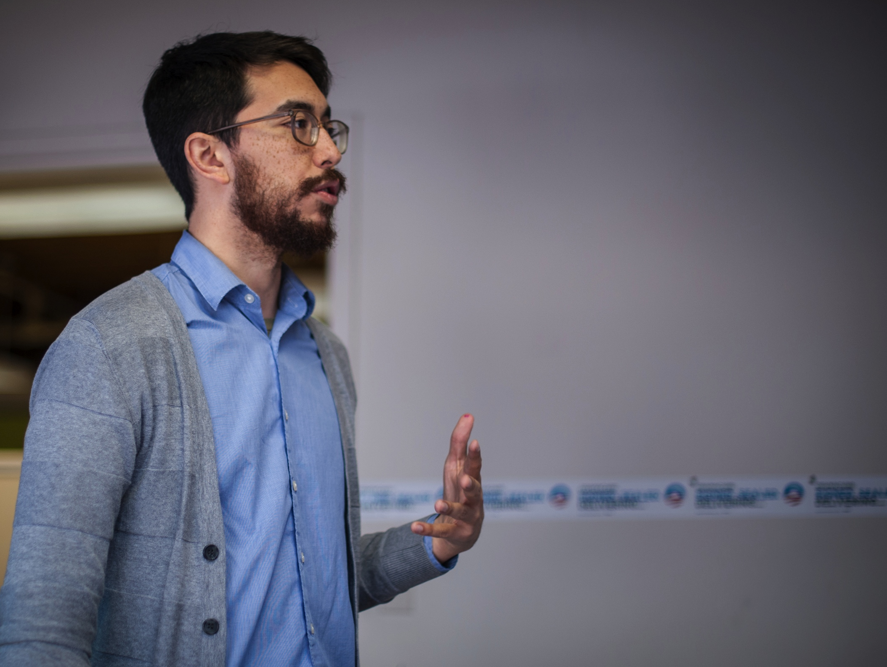
YOUR ROLE AS A TRAINING MANAGER
W/ ASHLEY PINEDO
Notes:
00:03 – 00:04 [1 min] – Aquiles
Tonight’s module is Planning a Digital Campaign
The module will be led by Ryanne Brown, OFA’s Digital Strategist
Before I introduce her, let’s review what we learned yesterday

Slide 9
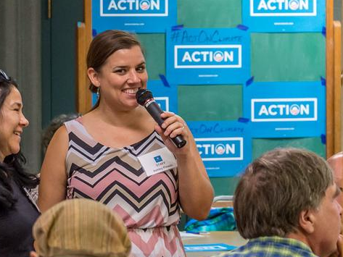
ASHLEY PINEDO
National Training Director

Slide 10
GOALS FOR TODAY
1
Understand the role of training at a progressive organization
2
Be able to assess/analyze organizational needs and propose training solutions
3
Feel comfortable advocating for training solutions to help meet the strategic goals of the organization

Slide 11

AGENDA FOR TODAY
Why Training
Training as a Solution
Solving the Problem
Debrief and Close

Slide 12
Your Turn!
5 MINUTES
From your experience, what are the responsibilities or main goals of a training department?
OR
Press 1 on the phone
Type in chat box
Notes:
00:13 – 00:15 [2 min] – Ryanne
Trainer’s Notes: The goal of this activity is to introduce the characteristics of a digital campaign. By not telling learners what these characteristics are, and allowing them to figure it out on their own based on their previous knowledge, we will meet them where they are. Following this activity, we will review the key characteristics of a digital campaign and answer remaining questions
Introduce activity
Instructions:
Together, we will review a total of 5 digital products one at a time
You will have one minute per product to determine:
What is the target audience?
What is the message?
What is consistent?

Slide 13
FD

Slide 14
FD
DFD
DFD
DFD

Slide 15
FD
DFD
DFD
DFD
RFD
RFD
RFD
RFD
RFD
RFD

Slide 16
FD
DFD
DFD
DFD
RFD
RFD
RFD
RFD
RFD
RFD
What happens w/o a training department?

Slide 17
Key Goals of a Training Department
Build a consistent curriculum for the organization.
Notes:
00:74 – 00:75 [1 min] – Ryanne
Digital campaigns achieve measurable goals, broadcast relevant messaging, integrate all digital platforms, and are consistent.

Slide 18
Key Goals of a Training Department
Build a consistent curriculum for the organization.
Work directly with other departments to help meet the goals of the organization.
Notes:
00:74 – 00:75 [1 min] – Ryanne
Digital campaigns achieve measurable goals, broadcast relevant messaging, integrate all digital platforms, and are consistent.

Slide 19
Key Goals of a Training Department
Build a consistent curriculum for the organization.
Work directly with other departments to help meet the goals of the organization.
Help bring on added capacity – staff or volunteers.
Notes:
00:74 – 00:75 [1 min] – Ryanne
Digital campaigns achieve measurable goals, broadcast relevant messaging, integrate all digital platforms, and are consistent.

Slide 20
AGENDA FOR TODAY
Why Training
Training as a Solution
Solving the Problem
Debrief and Close

Slide 21

Diagnosis and Treatment

Slide 22
Types of Performance Problems
CONDITIONS PROBLEM
Access to necessary tools to meet goals

Slide 23
Types of Performance Problems
CONDITIONS PROBLEM
ATTITUDE PROBLEM
Team members underperform because they are not bought into the mission or vision of the program or organization

Slide 24
Types of Performance Problems
CONDITIONS PROBLEM
ATTITUDE PROBLEM
TRAINING PROBLEM
There is a pattern of team members lacking specific skills to meet goals
Team members were trained on problem previously, but problem persists
Preventive solution

Slide 25
Your Turn!
1
Read four scenarios, which present management problems at fictional non-profit, Climate STRONG.
Determine what type of management problem each scenario presents and how training can help solve the problem
2
Experiential Activity #1
8 Minutes
ACCESS WORKBOOK

Slide 26
Pair and Share
Experiential Activity #1
DEBRIEF
OR
Press 1 on the phone
Type in chat box
Notes:
00:13 – 00:15 [2 min] – Ryanne
Trainer’s Notes: The goal of this activity is to introduce the characteristics of a digital campaign. By not telling learners what these characteristics are, and allowing them to figure it out on their own based on their previous knowledge, we will meet them where they are. Following this activity, we will review the key characteristics of a digital campaign and answer remaining questions
Introduce activity
Instructions:
Together, we will review a total of 5 digital products one at a time
You will have one minute per product to determine:
What is the target audience?
What is the message?
What is consistent?

Slide 27

What questions do you have?

Slide 28
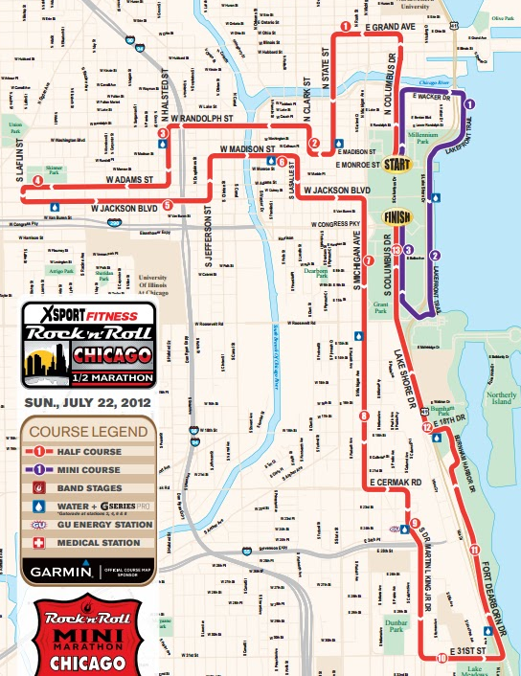
Narrowing the Problem
Learning is incremental.

Slide 29
Narrowing the Problem
Learn where your learners are and trace a journey that takes them from point A to point B.

Slide 30
Needs Assessments: Definition
A series of questions designed to understand what learners know and don’t know, and thus what they need training on.

Slide 31
Needs Assessments: Purpose
Identify a problem and form a hypothesis.

Slide 32

Needs Assessments: Purpose
Identify a problem and form a hypothesis.
Test your hypothesis and forma a more specific diagnosis.

Slide 33

Needs Assessments: Purpose
Identify a problem and form a hypothesis.
Test your hypothesis and forma a more specific diagnosis.
Recommendation based on results.

Slide 34
Needs Assessments: Purpose
Training Manager identifies a problem and forms a hypothesis.
Needs assessment sheds light on hypothesis – confirms or refines.
Design training as a direct solution to the problem.

Slide 35



Needs Assessments: Format

Slide 36
What questions do you have?

Slide 37
Your Turn!
Thinking about your training problem at Climate STRONG, what questions would you ask participants to determine what your training will cover/focus on.
Experiential Activity #1
5 Minutes
ACCESS WORKBOOK

Slide 38
Your Turn!
Experiential Activity #1
DEBRIEF
OR
Press 1 on the phone
Type in chat box

Slide 39
AGENDA FOR TODAY
Why Training
Training as a Solution
Solving the Problem
Debrief and Close

Slide 40
Training Solutions
Module
Journey
Program

Slide 41


Training Solutions: Module
ONE SKILL
ONE CONCEPT
60-75 MINS

Slide 42
Training Solutions: Journey
SEVERAL SKILLS
BUILD ON ONE ANOTHER
4 TO 6 HOURS (4-6 MODULES)

Slide 43
Training Solutions: Program
CLEAR LEARNING PATH
REPORTING AND ACCOUNTABILITY
MORE THAN JUST TRAINING

Slide 44
AGENDA FOR TODAY
Why Training
Training as a Solution
Solving the Problem
Debrief and Close

Slide 45

Debrief
Using #OFAFellows, Tweet your biggest takeaway
#OFAFellows
Notes:
00:73 – 00:74 [1 min] – Caleb
Knowing what you know now, how does this change your perspective of the role a digital department plays at a progressive organization?

Slide 46
GOALS FOR TODAY
1
Understand the role of training at a progressive organization
2
Be able to identify training problems and use needs assessments to narrow down training problems
3
Feel comfortable advocating for training solutions to help meet the strategic goals of the organization

Slide 47
KEY TAKEAWAYS
Training departments develop educational programs that enhance the ability of other departments to meet their goals.
Training Managers identify skill gap problems that can be solved through trainings: modules, journeys, programs. WE DON’T JUST TRAIN FOR THE SAKE OF TRAINING.
It is the responsibility of Training Managers to help key decision makers understand the value of training as a management solution.
Notes:
00:74 – 00:75 [1 min] – Ryanne
Digital campaigns achieve measurable goals, broadcast relevant messaging, integrate all digital platforms, and are consistent.

Slide 48
KEY TAKEAWAYS
Training departments develop educational programs that enhance the ability of other departments to meet their goals.
Training Managers identify skill gap problems that can be solved through trainings: modules, journeys, programs. We don’t just train for the sake of training.
It is the responsibility of Training Managers to help key decision makers understand the value of training as a management solution.
Notes:
00:74 – 00:75 [1 min] – Ryanne
Digital campaigns achieve measurable goals, broadcast relevant messaging, integrate all digital platforms, and are consistent.

Slide 49
KEY TAKEAWAYS
Training departments develop educational programs that enhance the ability of other departments to meet their goals.
Training Managers identify skill gap problems that can be solved through trainings: modules, journeys, programs. WE DON’T JUST TRAIN FOR THE SAKE OF TRAINING.
It is the responsibility of Training Managers to help key decision makers understand the value of training as a management solution.
Notes:
00:74 – 00:75 [1 min] – Ryanne
Digital campaigns achieve measurable goals, broadcast relevant messaging, integrate all digital platforms, and are consistent.

Slide 50
What questions do you have?

Slide 51

WEDNESDAY
7:30 PM CT
Adult Learning Theory
W/ Ashley Pinedo

Slide 52
OFA TRAINING
Thank you for joining today’s webinar.
Find the materials we covered, including a video and audio recording of the webinar on the bookshelf.
SEE BOOKSHELF
Notes:
00:00 – 00:00 [General Closing Slide]

