Slide 1
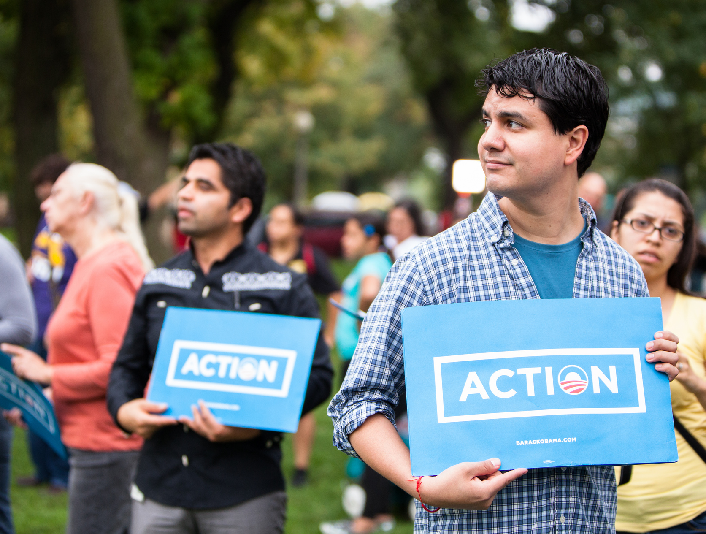
ORGANIZING
FELLOWS
We are community organizers, and we’re proud of it.
Notes:
This work is licensed under the Creative Commons Attribution-Non Commercial 4.0 International License. To view a copy of this license, visit http://creativecommons.org/licenses/by-nc/4.0/ or send a letter to Creative Commons, PO Box 1866, Mountain View, CA 94042, USA

Slide 2
TELLING YOUR PERSONAL STORY
W/ NAME OF TRAINER

Slide 3
STORIES CONNECT US
you

Slide 4
Goals for this Session
1
Understand the key principle of building relationships and trust through story
2
Know how to move people to action by telling your story
3
Feel comfortable sharing your personal story

Slide 5
Agenda
Introduction and Agenda
Structure of an Effective Story
Personal Story Exercise
Debrief, Next Steps and Closing

Slide 6
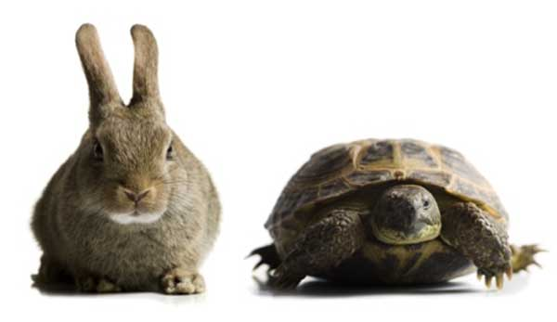
KEY ELEMENTS OF A STORY
Characters
Plot
Conflict
Resolution
Theme

Slide 7
KEY ELEMENTS OF AN ORGANIZING STORY
Challenge: A critical moment that drives your story
Choice: The decision you made in response to the challenge
Outcome: The result of the decision
Ask: Make an ask that gets the audience involved

Slide 8
Agenda
Introduction and Agenda
Structure of an Effective Story
Personal Story Exercise
Debrief, Next Steps and Closing

Slide 9
PERSONAL STORY EXERCISE
Step 1
Reflection
Step 2
Write your own organizing story
Step 3
Share with partner(s)
Step 4
Share your story with the full group

Slide 10
Agenda
Introduction and Agenda
Structure of an Effective Story
Personal Story Exercise
Debrief, Next Steps and Closing

Slide 11
Debrief
What did you learn today that surprised you?
Why do you think personal stories are an effective organizing tool?
How do you see yourself using your personal story in the work ahead?

Slide 12
Key Takeaways
1
Personal story is a powerful organizing tool because it helps you move others to action on an issue they care about
2
Challenge, Choice, Outcome, Ask
3
You will hone and develop your story over time, and you will become more confident as you practice

Slide 13
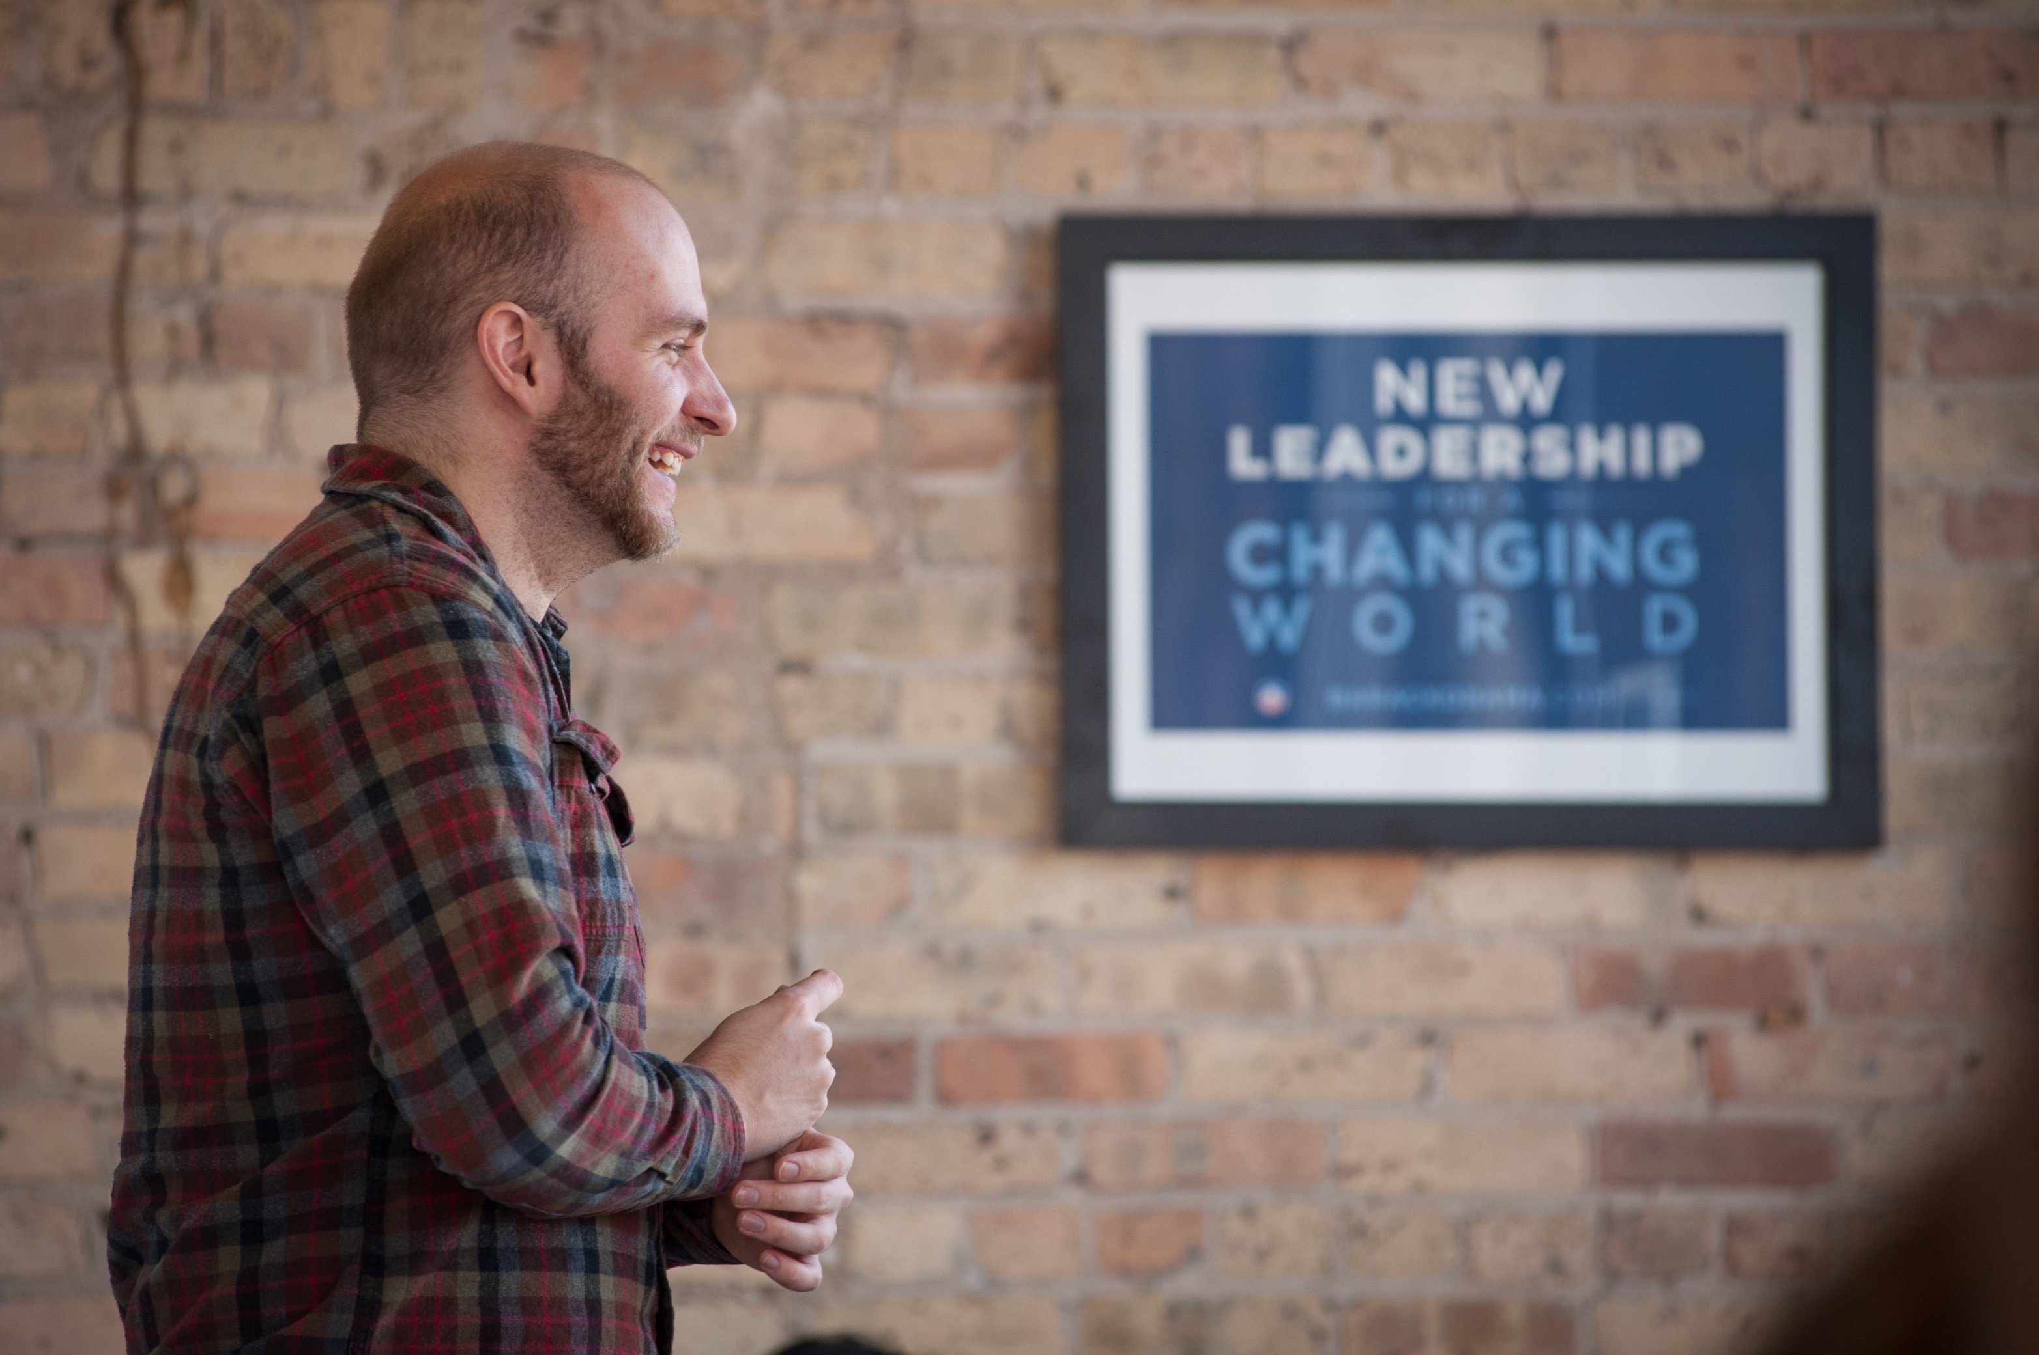
WHAT’S YOUR PERSONAL STORY?
OR
Press 1 on the phone
Type in chat box

