Slide 1
Welcome!
We will begin at 7:30 PM Central Time.
One more thing—call in for audio.
Check your email for phone number and pin.

Slide 2
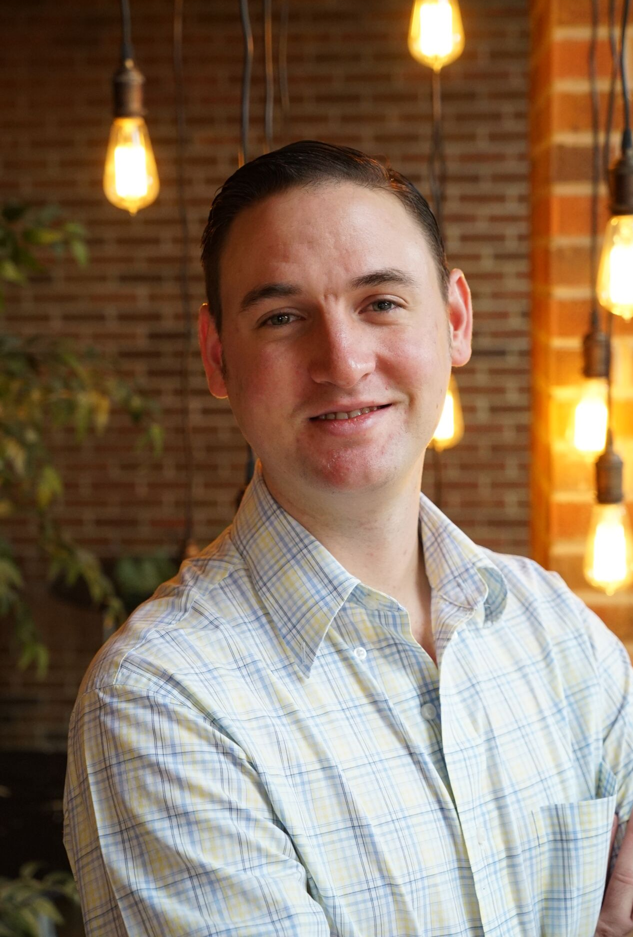

Bobby Brady-Sharp
Program Manager
@bobbyhtx
Notes:
00:00 – 00:01 [1 min]

Slide 3


Pair and Share
1
In the next activity, you will be randomly paired to talk with two other fellows.
You must be dialed in on your phone to participate.
When the breakout begins, start with a “role call” – each introducing yourself.
2
10 Minutes
3

Slide 4
Pair and Share
In groups of three:
Share your name, where you live, and what you want to gain from the Digital Content Fellowship.
10 Minutes
Notes:
00:11 – 00:16 [5 min] – Caleb
Trainer’s Notes: Learners will have 3 minutes to complete the activity. The facilitator will lead a pop-corn debrief for 2 minutes.
Review activity instructions
Set timer (Aquiles)
Debrief activity for 3 minutes (Caleb)
What was one of your key goals?
How would you accomplish that goal online?
Trainer’s Notes: Learners will likely provide wrong answers, since they have not been trained on digital tactics yet. But by throwing them in the deep end of the pool, they are realizing that there is a connection of sorts, which we will further explore throughout the training.

Slide 5


Pair and Share
In groups of three:
Share your name, where you live, and what you want to gain from the Digital Content Fellowship
10 Minutes
OR
Press 1 on the phone
Type in chat box
Notes:
00:11 – 00:16 [5 min] – Caleb
Trainer’s Notes: Learners will have 3 minutes to complete the activity. The facilitator will lead a pop-corn debrief for 2 minutes.
Review activity instructions
Set timer (Aquiles)
Debrief activity for 3 minutes (Caleb)
What was one of your key goals?
How would you accomplish that goal online?
Trainer’s Notes: Learners will likely provide wrong answers, since they have not been trained on digital tactics yet. But by throwing them in the deep end of the pool, they are realizing that there is a connection of sorts, which we will further explore throughout the training.

Slide 6
LOGISTICS
We will meet every Thursday for 90 minutes.
If you cannot attend, email fellows@barackobama.com. As a reminder, you cannot miss more than one webinar.
Notes:
00:01 – 00:03 [2 min] – Aquiles
Before we get started, let’s review some logistics

Slide 7

LOGISTICS
We will meet every Thursday for 90 minutes.
This is an interactive training. (Mute your computers and listen on the phone)
OR
Press 1 on the phone
Type in chat box
Notes:
00:01 – 00:03 [2 min] – Aquiles
Before we get started, let’s review some logistics

Slide 8

LOGISTICS
We will meet for 90 minutes
This is an interactive training.
A recording of this video and call will be available on the Fellows Bookshelf tomorrow afternoon.
Notes:
00:01 – 00:03 [2 min] – Aquiles
Before we get started, let’s review some logistics

Slide 9

LOGISTICS
We will meet for 90 minutes
This is an interactive training.
A recording of this video and call will be available on the Fellows Bookshelf tomorrow afternoon.
It’s cool if you Tweet --
#OFAFellows
Notes:
00:01 – 00:03 [2 min] – Aquiles
Before we get started, let’s review some logistics

Slide 10
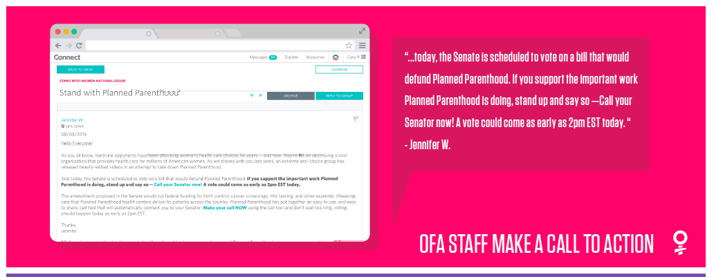
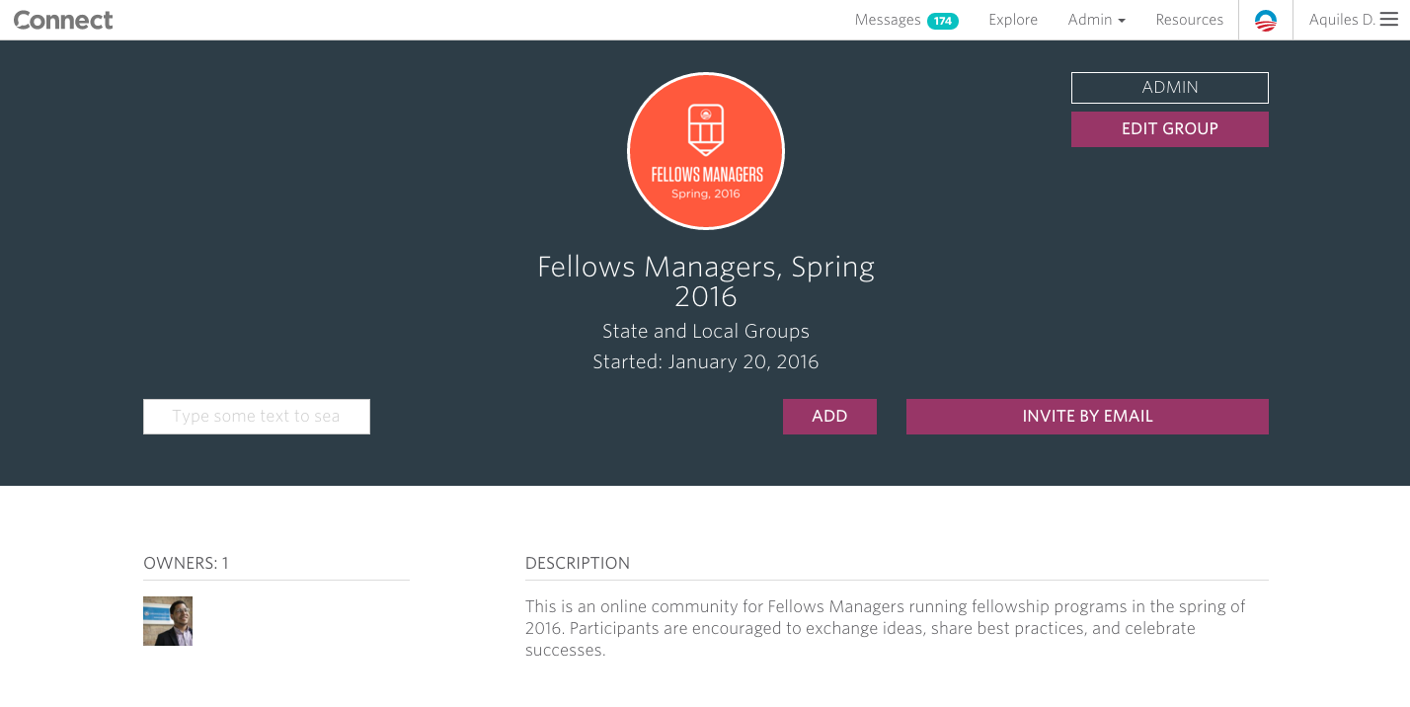
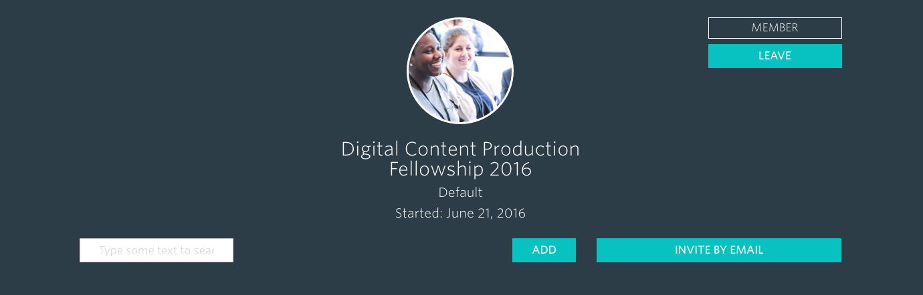
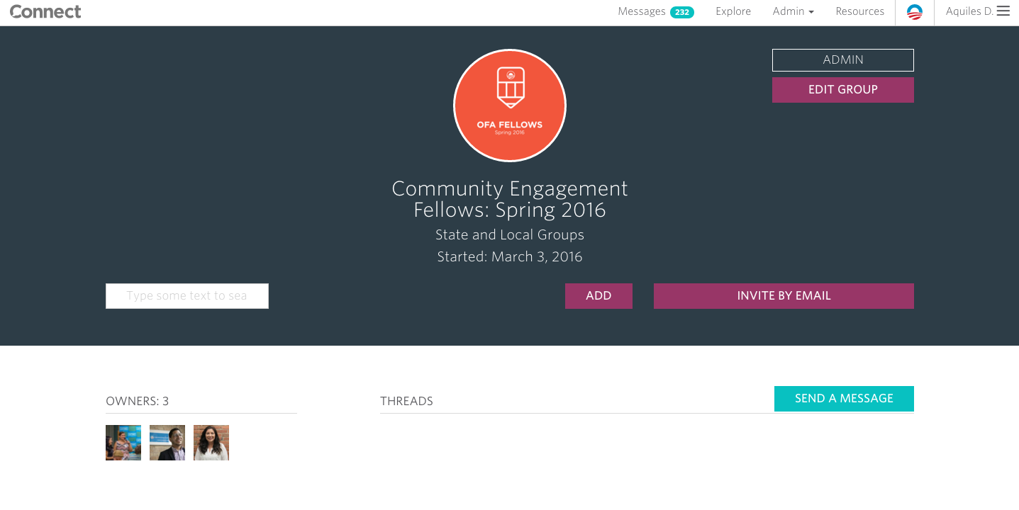
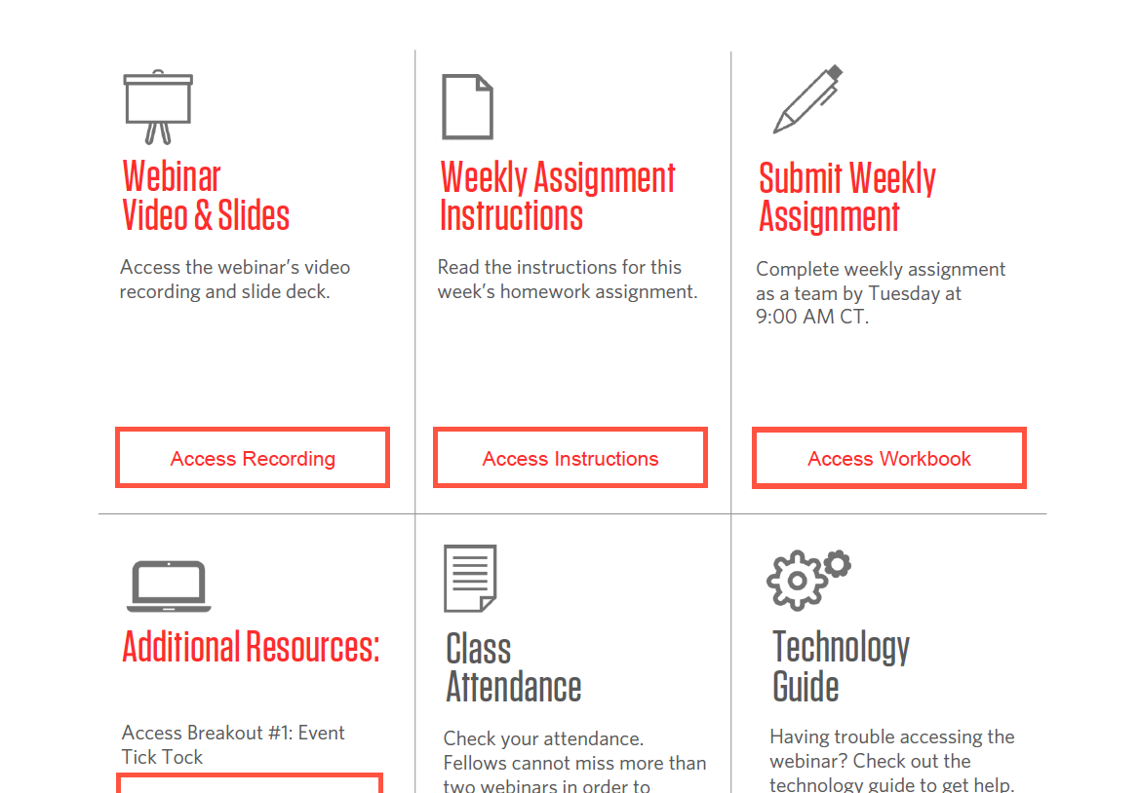
RESOURCES
CONNECT
What is it? An online social group for organizers.
When to use it: To review program updates, exchange ideas, download resources.
Access Connect
FELLOWS BOOKSHELF
What is it? Your one-stop-shop to viewing past webinars, downloading assignments, and viewing all resources related to your fellowship.
When to use it: To access assignments, review materials, review the training calendar, and review resources.
Access Bookshelf
Notes:
00:01 – 00:03 [2 min] – Aquiles
Before we get started, let’s review some logistics

Slide 11
Week 1
Digital Organizing 101
Amazing things ahead:
Our learning journey
Week 2
Principles of Digital Communication
Week 3
Social Media Strategy
Week 4
Social Media Content Production
Week 5
Email Campaign Strategy
Week 6
Email Content Production
Week 7
Planning a Digital Campaign

Slide 12

What questions do you have?
OR
Press 1 on the phone
Type in chat box
Notes:
00:11 – 00:16 [5 min] – Caleb
Trainer’s Notes: Learners will have 3 minutes to complete the activity. The facilitator will lead a pop-corn debrief for 2 minutes.
Review activity instructions
Set timer (Aquiles)
Debrief activity for 3 minutes (Caleb)
What was one of your key goals?
How would you accomplish that goal online?
Trainer’s Notes: Learners will likely provide wrong answers, since they have not been trained on digital tactics yet. But by throwing them in the deep end of the pool, they are realizing that there is a connection of sorts, which we will further explore throughout the training.

Slide 13



OFA PROFESSIONAL
FELLOWSHIP
Digital 101
W/ ALEX WOODWARD
Notes:
00:07– 00:08 [1 min] – Aquiles
Tonight we are going to focus on digital campaigns
In order to meet the 3Ms, a digital department plans and execute digital campaigns
These are our goals…

Slide 14
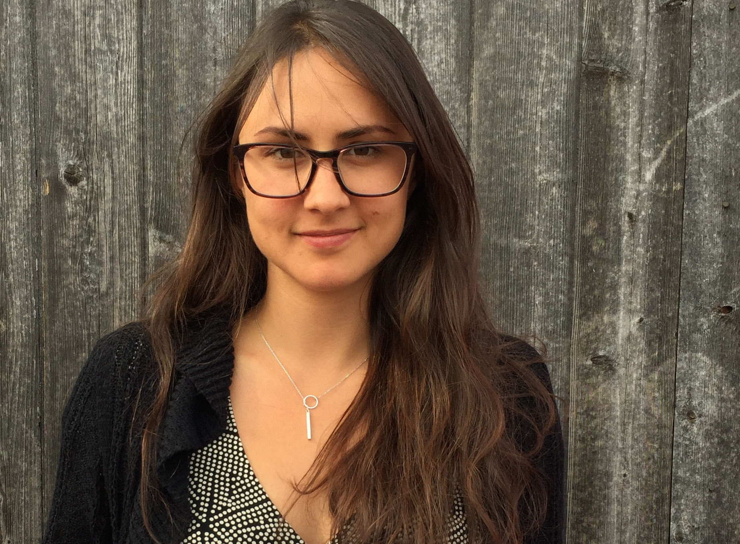
ALEX WOODWARD
OFA Deputy Digital Director

Slide 15




GOALS FOR TO DAY
Learn the overall goals of a digital department at a progressive organization
Be able to fulf ill your role as a digital content producer by understanding everyone's role in the team
Feel confident bringing off line organizing tactics to the digital world

Slide 16
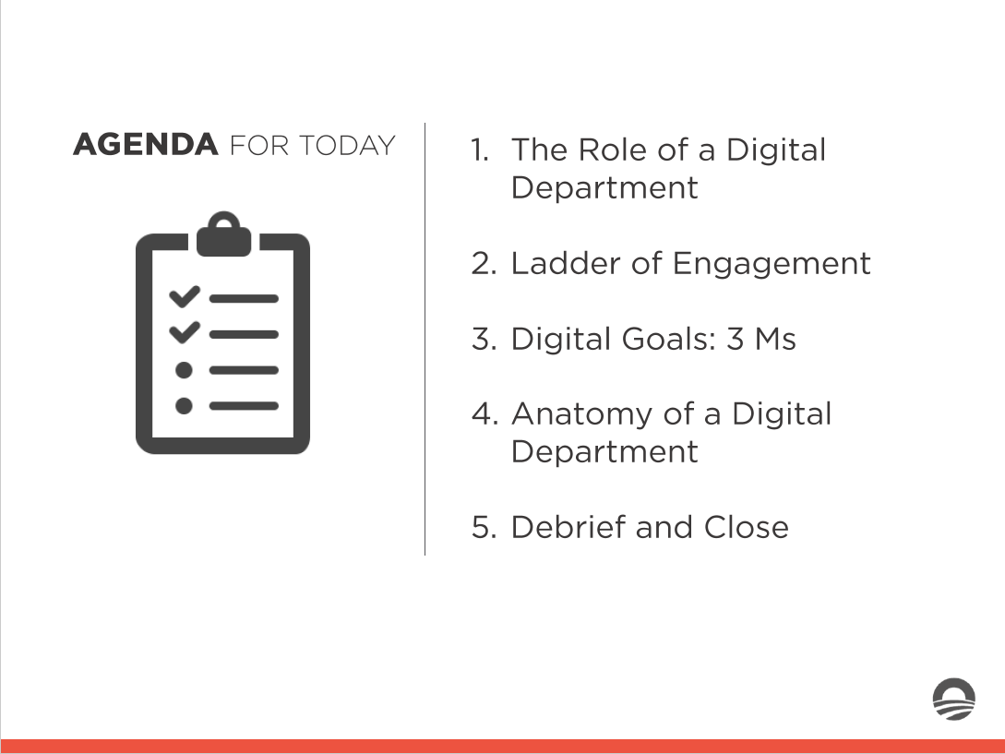

1. The Role of a Digital Department
AGENDA FOR TO DAY
.,..._
Ladder of Engagement
Digital Goals: 3 Ms
A natomy of a Digital Department
Debrief and Close
.,,......_
_ ......_
_ ....._

Slide 17
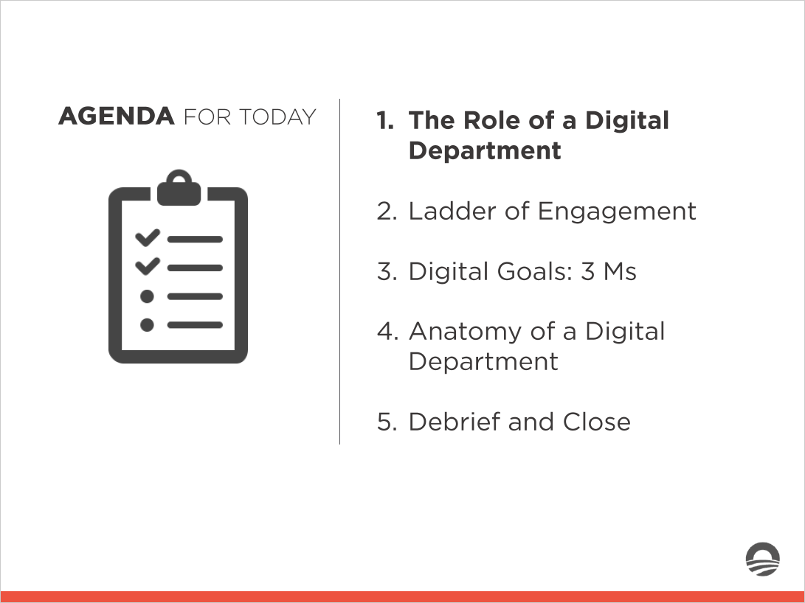

AGENDA FOR TO DAY
1. The Role of a Digital Department
.,,......_
2. Ladder of Engagement
.,,......_
_ ......_
_ ......_
3. Digital Goals: 3 Ms
4. A natomy of a Digital Department
5. Debrief and Close

Slide 18








1. Access the workbook, and find the tab with your name to complete Activity #1
Think of three times you have used digital platforms for a progressive cause (or like cause)
List which digital platforms you used, what message you shared, and what asks (if any) you made
Experiential Activity # 1
5 Minutes

Slide 19
Digital organizers build relationships at scale
People's behaviors, needs, desires, and motivations do not change when they are online.

Slide 20
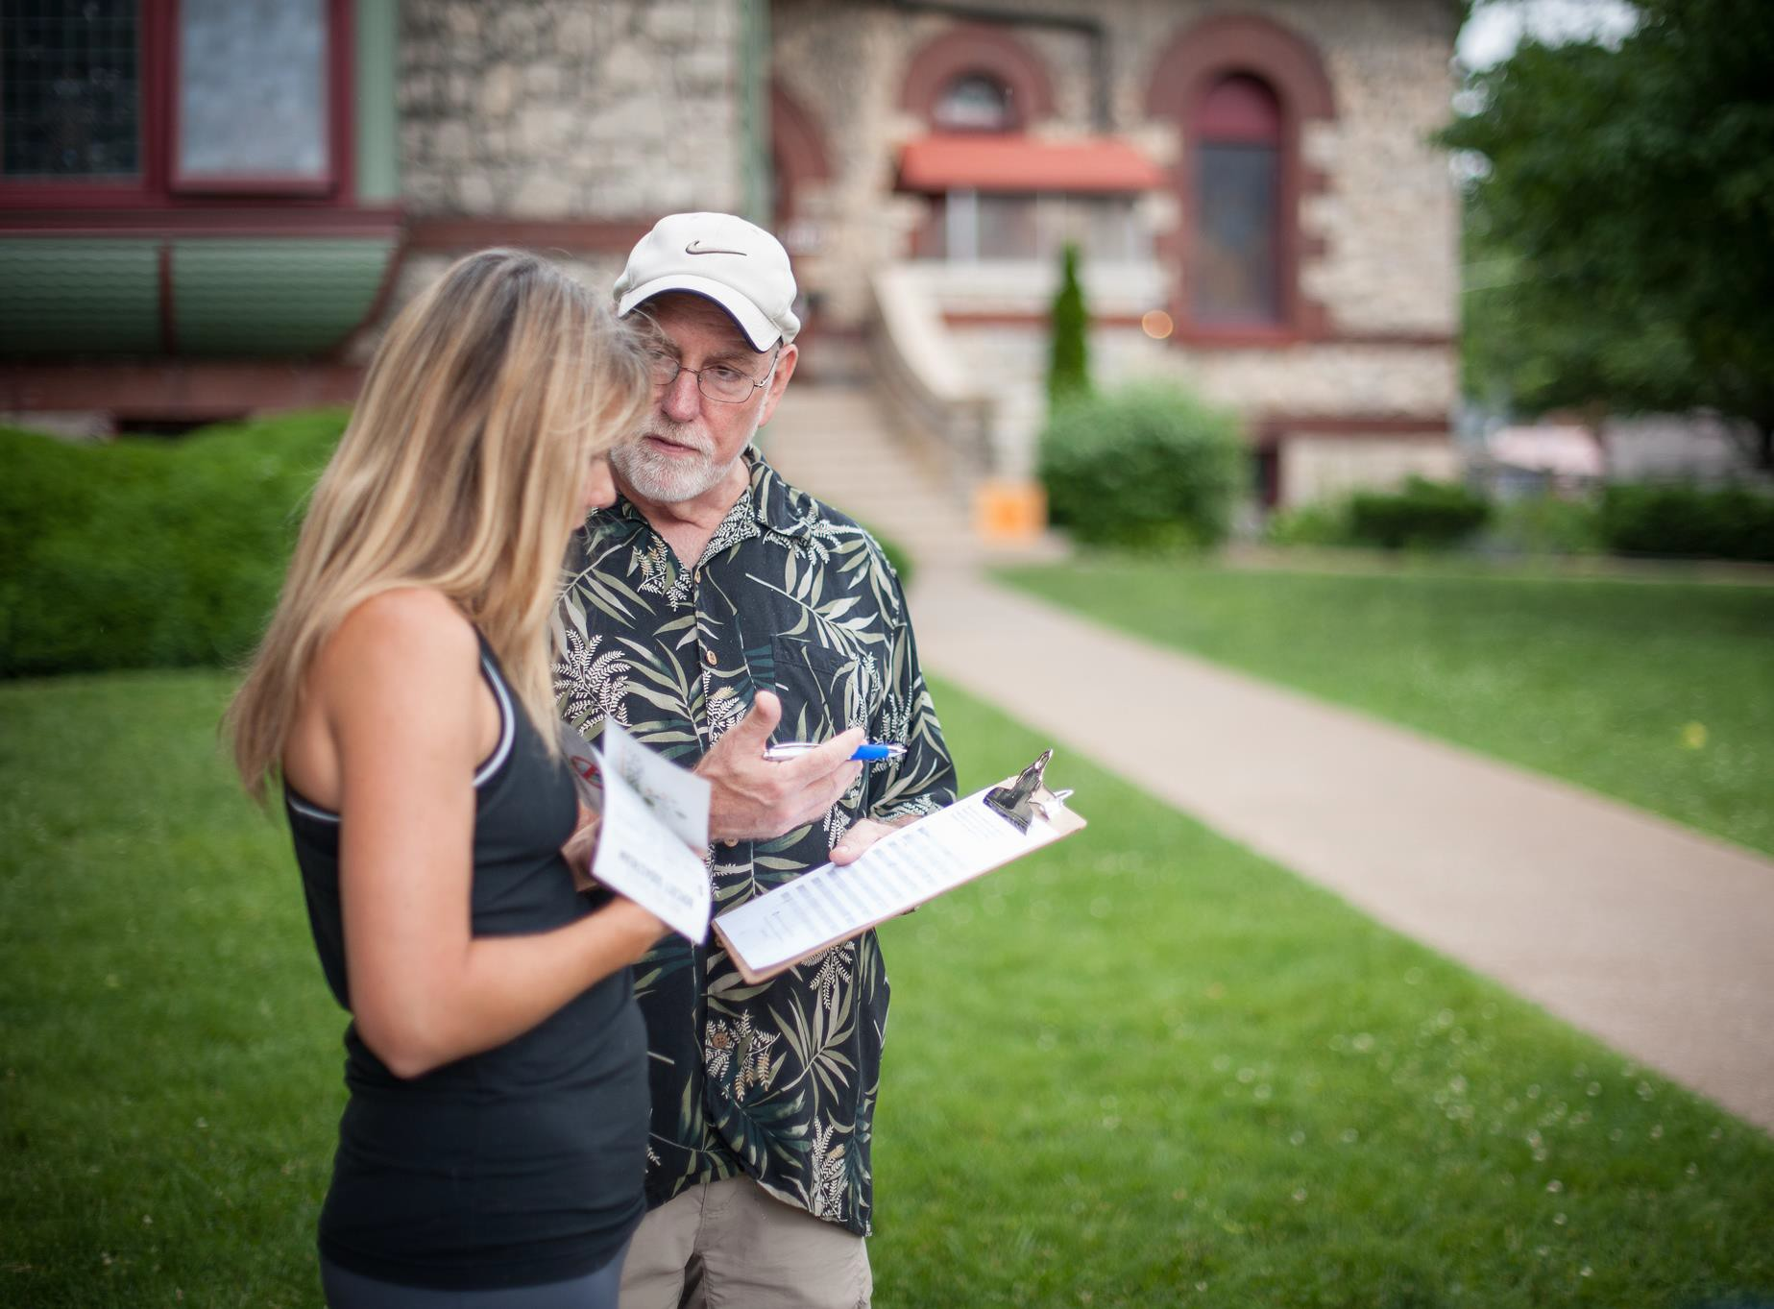


Slide 21
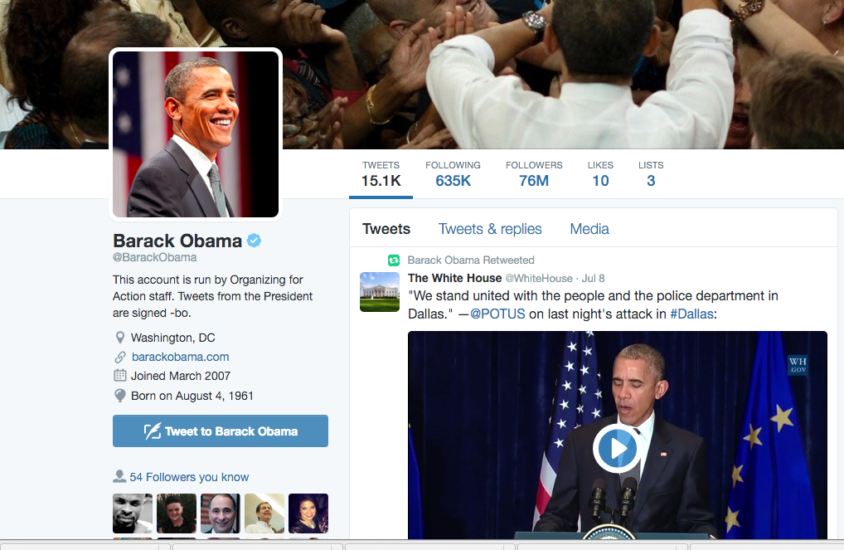
In a time when many constituents are skeptical of political communication but trust the views of their own friends, effective digital outreach is important.

Slide 22
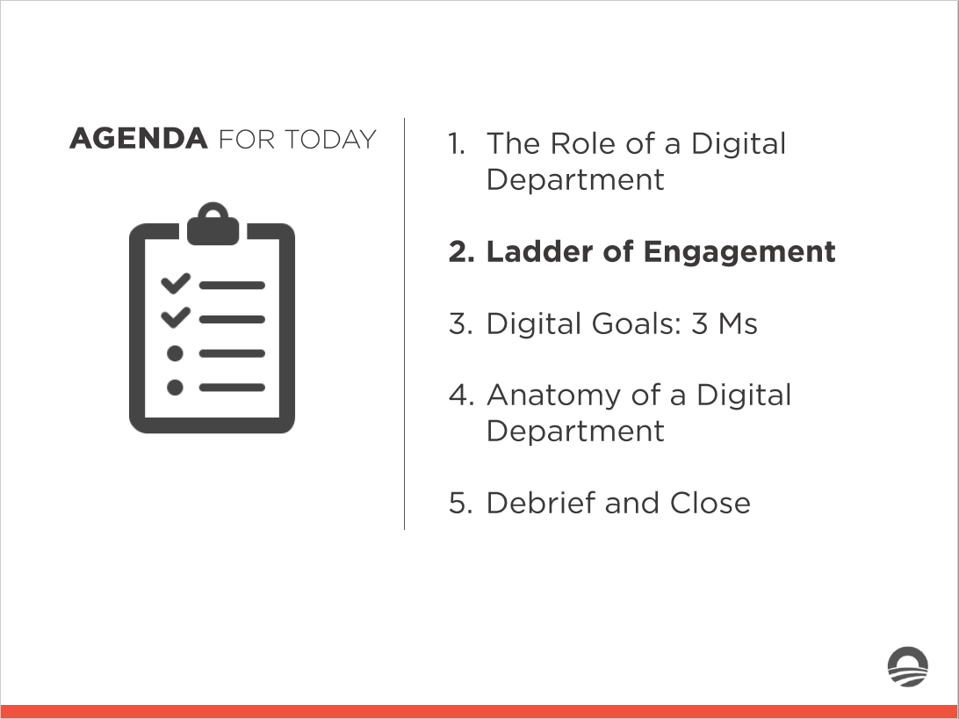
AGENDA FOR TO DAY
1. The Role of a Digital Department
.,,......_
2. Ladder of Engagement
.,,......_
_ ......_
_ ......_
3. Digital Goals: 3 Ms
4. A natomy of a Digital Department
5. Debrief and Close

Slide 23




Ladder of Engagement
How do you define ladder of engagement?
OR
Press 1 on the phone
Type in chat box

Slide 24
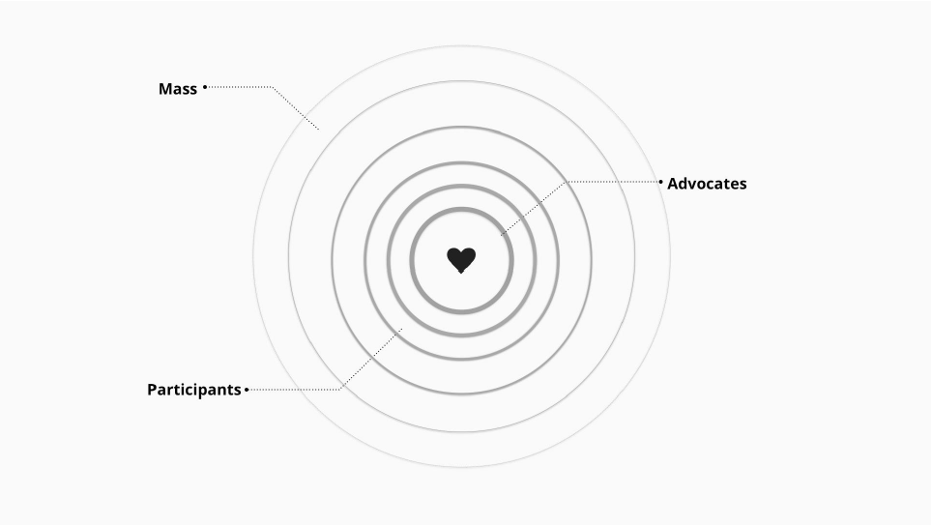
Digital Ladder of Engagement

Slide 25
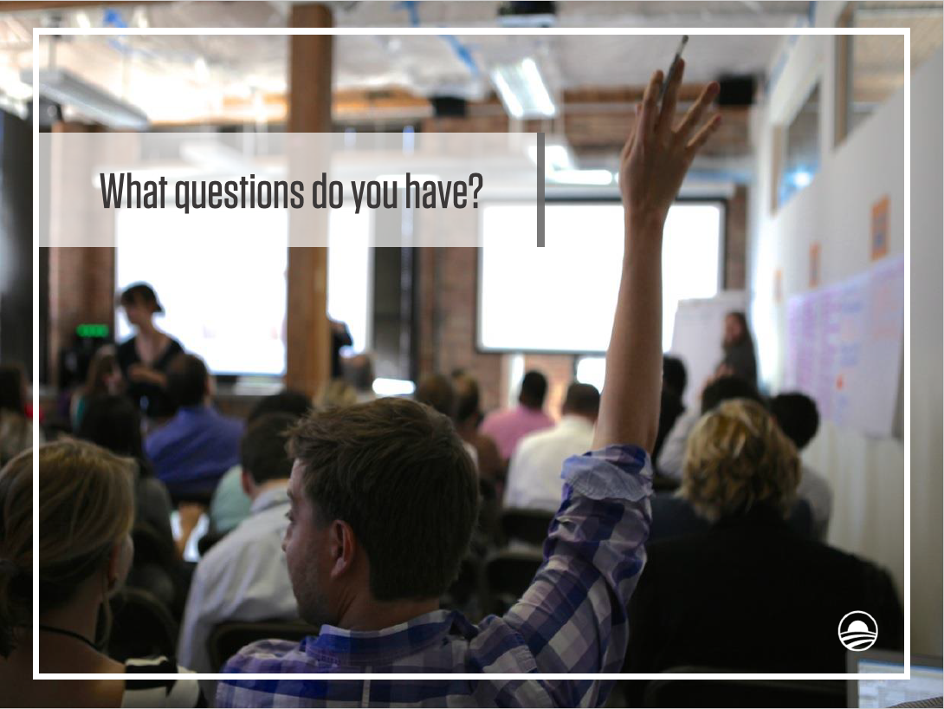
What Questions do you have?

Slide 26
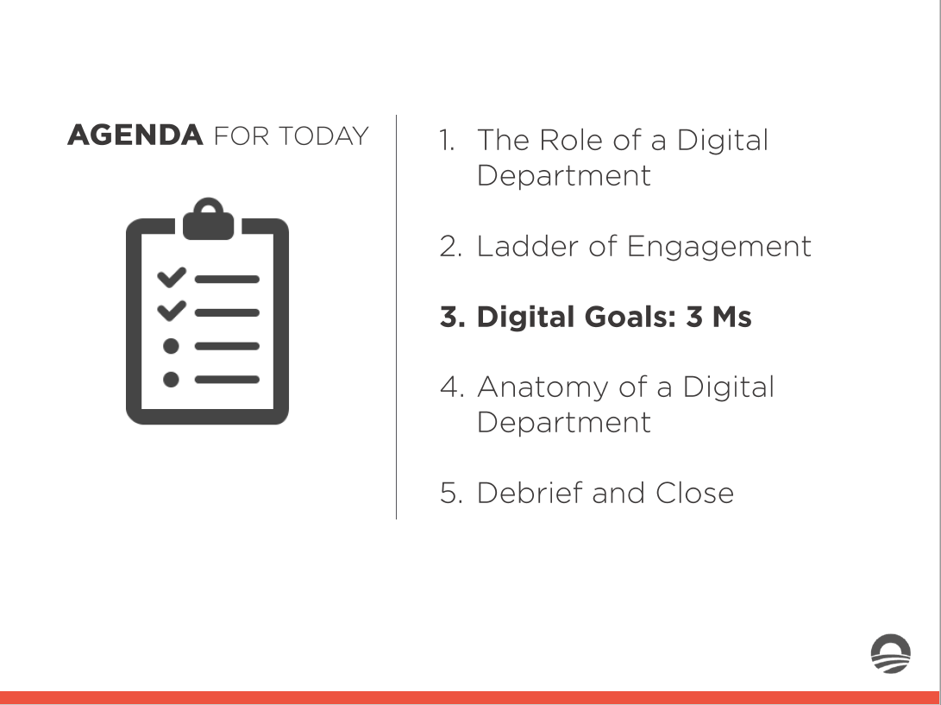
AGENDA FOR TO DAY
1. The Role of a Digita l Department
.,,......_
2. Ladder of Engagement
.,,......_
_ ......_
_ ......_
3. Digital Goals: 3 Ms
4. A natomy of a Digital Department
5. Debrief and Close

Slide 27



Goals of a Digital Department: 3 M's

Slide 28


.
MESSAGE
When crafting a message, your digital platforms become the megaphone for one side of the issue
MOBILIZE
Digital elevates your narrative. There is one story, many views, and YOUR narrative
MONEY
Digital content helps communicate a consistent message that frames the issue

Slide 29
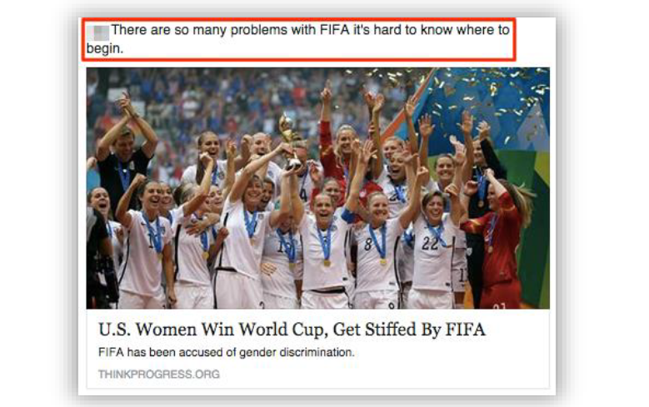
.
MESSAGE
Messaging is not just about informing your audience about your side of the issue. It is also an effort to get them ready to take action.
MOBILIZE
MONEY

Slide 30

.
MESSAGE
Messaging is not just about informing your audience about your side of the issue. It is also an effort to get them ready to take action.
MOBILIZE
MONEY

Slide 31
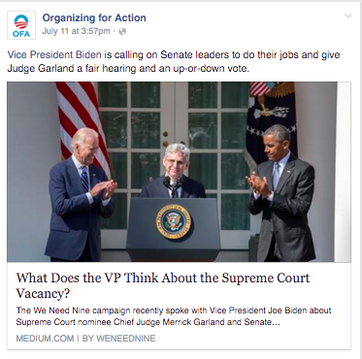
.
MESSAGE
Messaging is not just about informing your audience about your side of the issue. It is also an effort to get them ready to take action
MOBILIZE
MONEY

Slide 32



.
MESSAGE
When a messaging tactic succeeds, the community of supporters serve as further amplification: they in turn help broadcast the campaign’s messaging to their own networks.
MOBILIZE
MONEY

Slide 33
MESSAGE
A digital team not only helps frame the narrative, but helps the organization mobilize supporters around the issue and up the ladder of engagement.
MOBILIZE
MONEY

Slide 34


MESSAGE
A digital team not only helps frame the narrative, but helps the organization mobilize supporters around the issue and up the ladder of engagement.
MOBILIZE
MONEY
When was the last time you took action for a cause you cared about? What were you asked to do?
OR
Press 1 on the phone
Type in chat box

Slide 35
When was the last time you took action for a cause you cared about? What were you asked to do?
MESSAGE
MOBILIZE
MONEY
OR
Press 1 on the phone
Type in chat box

Slide 36
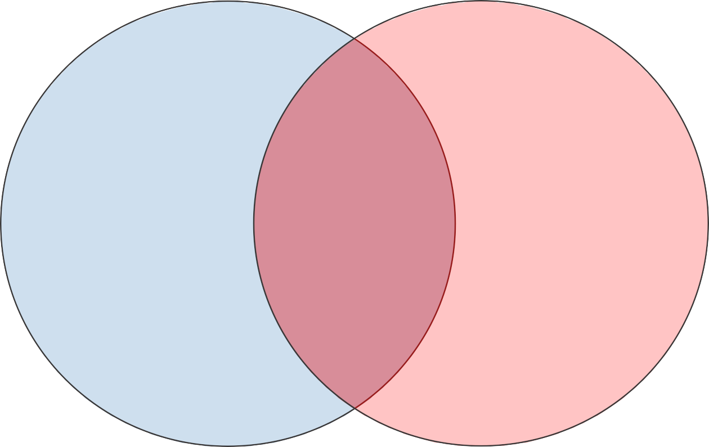



Online to Offline Mobilization
MESSAGE
MOBILIZE
MONEY
Digital tactics begin the mobilization process, connecting grassroots organizers to potential volunteers
In general, the further right, the higher the ask
The further right you go, the stronger your program, because you’re using digital to mobilize action

Slide 37
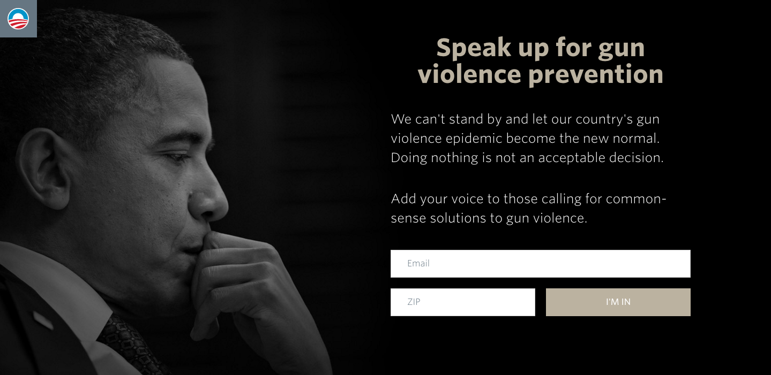
Digital Mobilization Tactics
MESSAGE
SIGN-ON
MOBILIZE
MONEY
ACCESS SIGN-ON

Slide 38
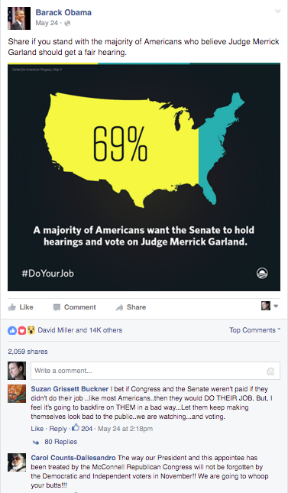
Digital Mobilization Tactics
MESSAGE
SHARE
MOBILIZE
MONEY

Slide 39
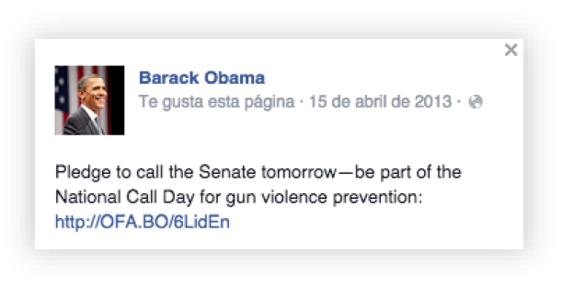
Digital Mobilization Tactics
MESSAGE
VOLUNTEER
MOBILIZE
MONEY

Slide 40
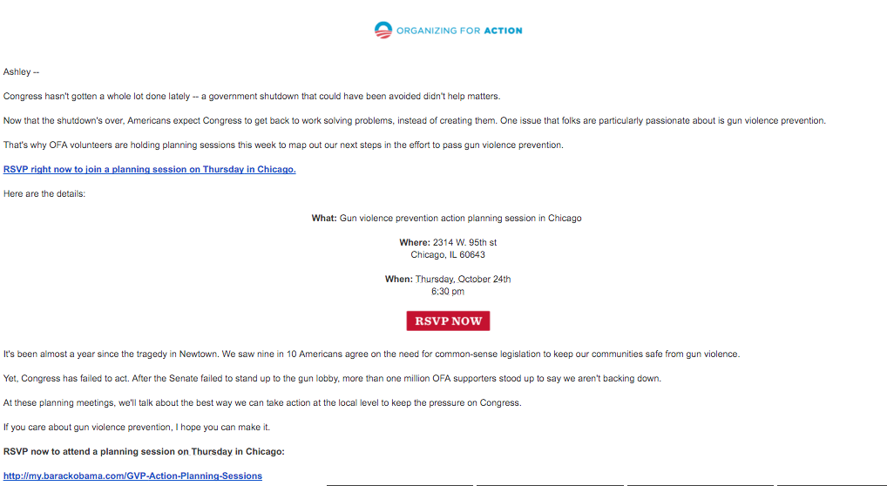
Digital Mobilization Tactics
MESSAGE
VOLUNTEER
MOBILIZE
MONEY

Slide 41
Digital Mobilization Tactics
MESSAGE
VOLUNTEER
MOBILIZE
MONEY

Slide 42
Digital Mobilization Tactics
MESSAGE
VOLUNTEER
MOBILIZE
MONEY

Slide 43
.
MESSAGE
Digital teams are more and more responsible for contributing to the organization’s fundraising goals
MOBILIZE
Email is the most effective digital fundraising platform for small-dollar donors
MONEY

Slide 44
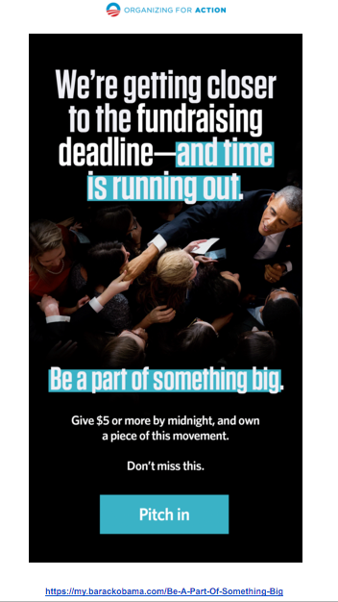
.
MESSAGE
MOBILIZE
MONEY

Slide 45
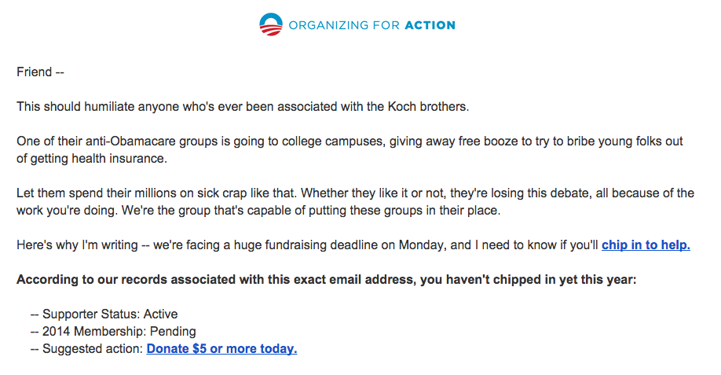
.
MESSAGE
MOBILIZE
MONEY

Slide 46
What Questions do you have?

Slide 47
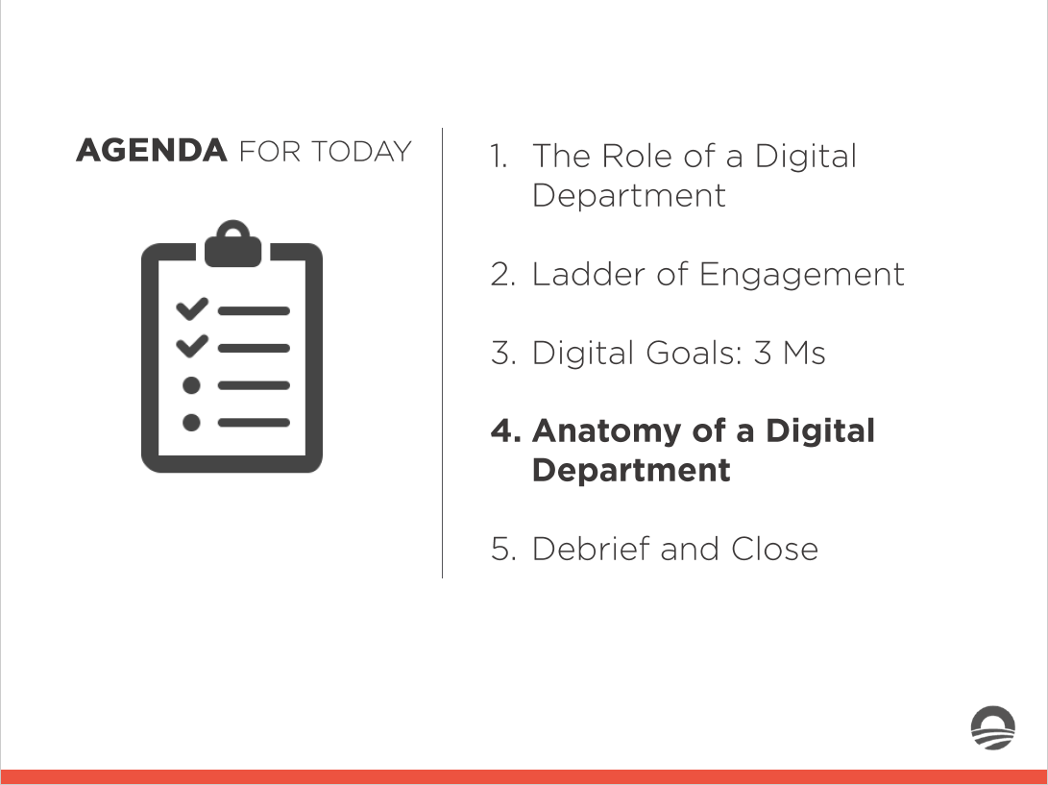
AGENDA FOR TO DAY
1. The Role of a Digita l Department
.,,......_
2. Ladder of Engagement
.,,......_
_ ......_
_ ......_
3. Digita l Goa ls: 3 Ms
4. Anatomy of a Digital Department
5. Debrief and Close

Slide 48
Anatomy of a Digital Department
Videos
Design
Social
Digital
Director
Development
Email
Ads
Digi Org.
Analytics

Slide 49
Anatomy of a Digital Department
Videos
Design
Social
Digital
Director
Development
Email
Ads
Digi Org.
Analytics

Slide 50




Your Turn!
You are a member of OFA’s digital team.
As a member of the team, you are working to craft a digital campaign regarding the Supreme Court vacancy, and nomination to the court of Merrick Garland by President Obama. Keeping in mind the 3 M’s, where would you focus?
Experiential Activity # 2
10 Minutes

Slide 51
Your Turn!
On March 16, 2016, Merrick Garland – the Chief Judge for the United States Court of Appeals for the District of Columbia Circuit – was nominated to the Supreme Court by President Obama.
Despite a majority of Americans wanting a fair nominating process for Judge Garland, a hearing and an up-or-down vote have not yet been scheduled in the Senate, and it doesn’t appear there will be one any time soon.
Experiential Activity # 2
10 Minutes
Organizational Stand: When the vacancy on the Supreme Court opened earlier this year, the court was left with only eight justices – which means their rulings on some disputed cases can be handed down as a tie. The Senate’s refusal to schedule a hearing is truly unprecedented. An overwhelming majority of Americans want a fair process.

Slide 52
Your Turn!
Keeping the 3 Ms in mind, craft an outline of a digital campaign around the nomination of Judge Merrick Garland to the Supreme Court. Describe which members of your digital team will handle what.
Experiential Activity # 2
10 Minutes

Slide 53


Your Turn!
Experiential Activity # 2
ACTIVITY DEBRIEF
OR
Press 1 on the phone
Type in chat box

Slide 54
Your Turn!
Experiential Activity # 2
ACTIVITY DEBRIEF
OR
Press 1 on the phone
Type in chat box

Slide 55
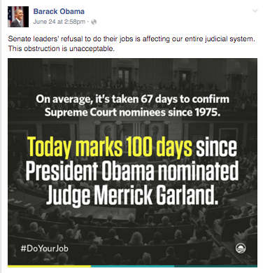
Your Turn!
.
MESSAGE
MOBILIZE
MONEY

Slide 56
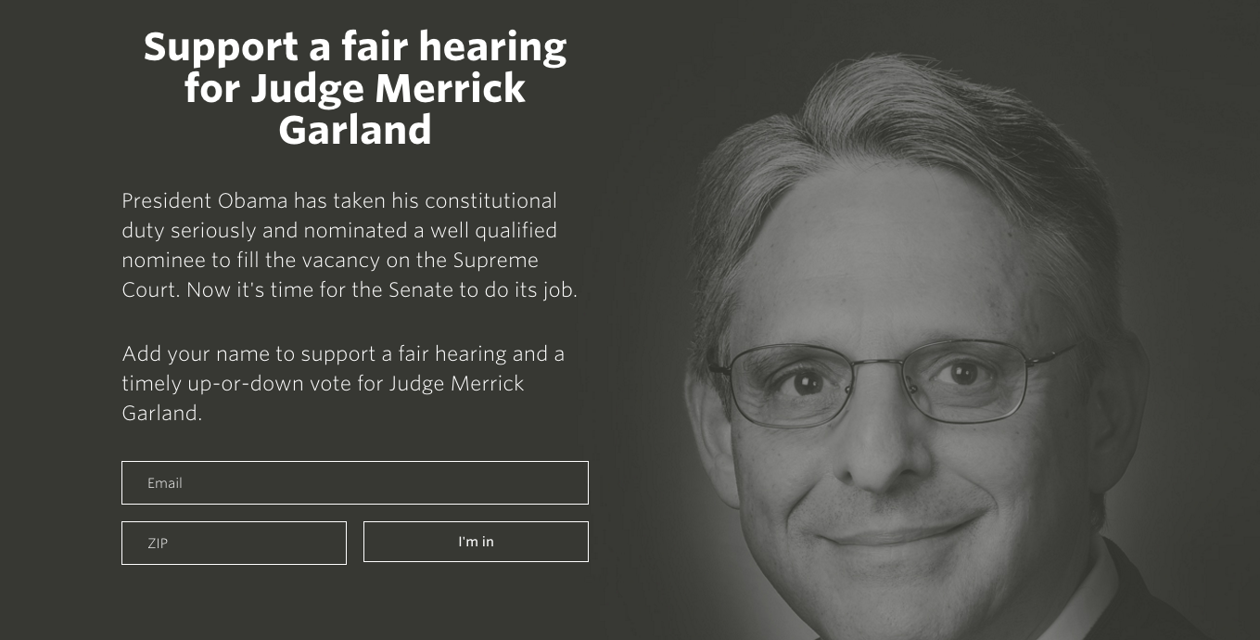
Your Turn!
MESSAGE
.
MOBILIZE
MONEY

Slide 57

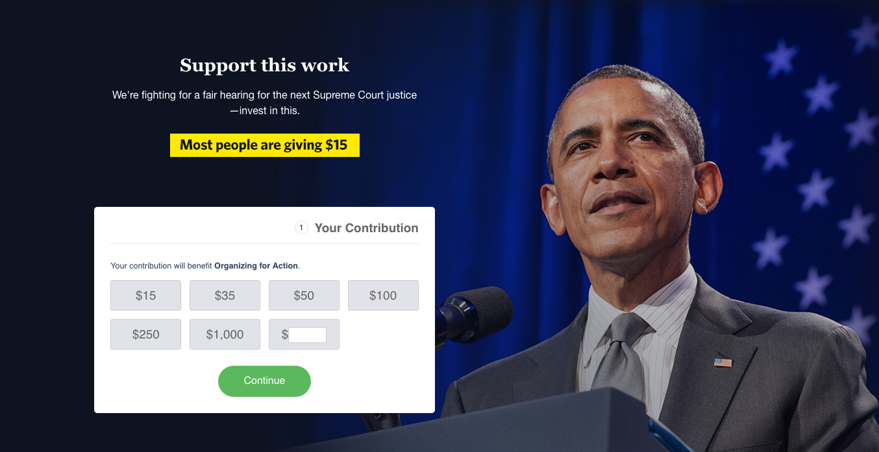

Your Turn!
MESSAGE
MOBILIZE
.
MONEY

Slide 58
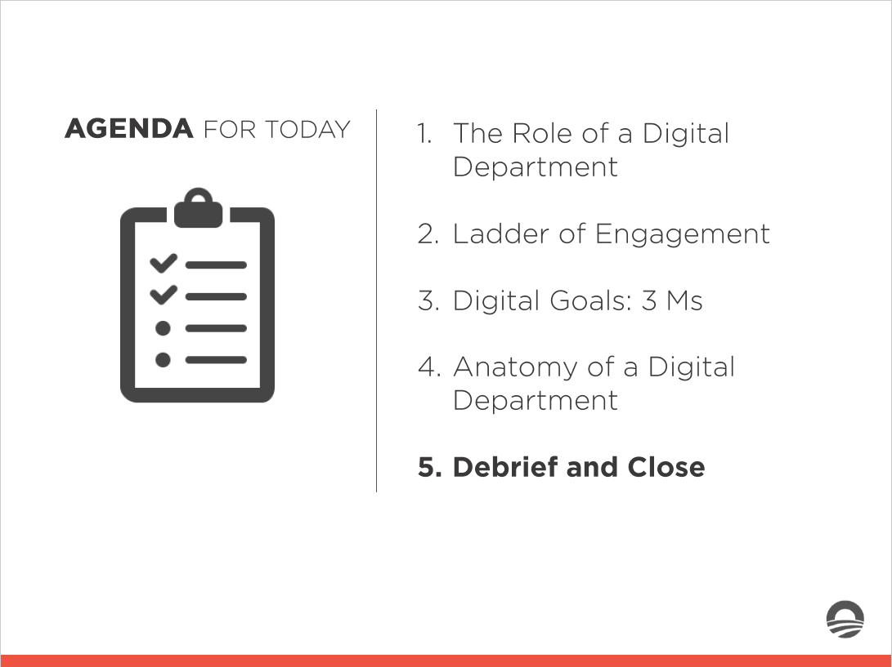
AGENDA FOR TO DAY
1. The Role of a Digita l Department
.,,......_
2. Ladder of Engagement
.,,......_
_ ......_
_ ......_
3. Digita l Goa ls: 3 Ms
4. A natomy of a Digital Department
5. Debrief and Close

Slide 59
Debrief
What was your biggest takeaway?
Press 1 on the phone
OR
Type in chat box

Slide 60
Debrief
What was your biggest takeaway?
Knowing what you know now, how does this change your perspective of the role a digital department plays at a progressive organization?
Press 1 on the phone
OR
Type in chat box

Slide 61
Key Takeaways
In an age when 88.5% of Americans are online, all communications, program operations, and fundraising should include a digital focus.

Slide 62
Key Takeaways
In an age when 88.5% of Americans are online, all communications, program operations, and fundraising should include a digital focus.
A digital department helps an organization with: framing its issue positions online (Messaging), building a structure to activate and mobilize supporters online (Mobilizing), and fundraising among supporters online (Money).

Slide 63
Key Takeaways
In an age when 88.5% of Americans are online, all communications, program operations, and fundraising should include a digital focus.
A digital department helps an organization with: framing its issue positions online (Messaging), building a structure to activate and mobilize supporters online (Mobilizing), and fundraising among supporters online (Money).
It is digital’s role to meet people where they are.

Slide 64
Class Review and Additional Reading
Complete the reading assignment in preparation for next week’s class.
Join the Digital Content Fellowship group on Connect.
Pay Attention to all Emails
Notes:
00:72 – 00:73 [2 min] – Aquiles
Review assignment

Slide 65
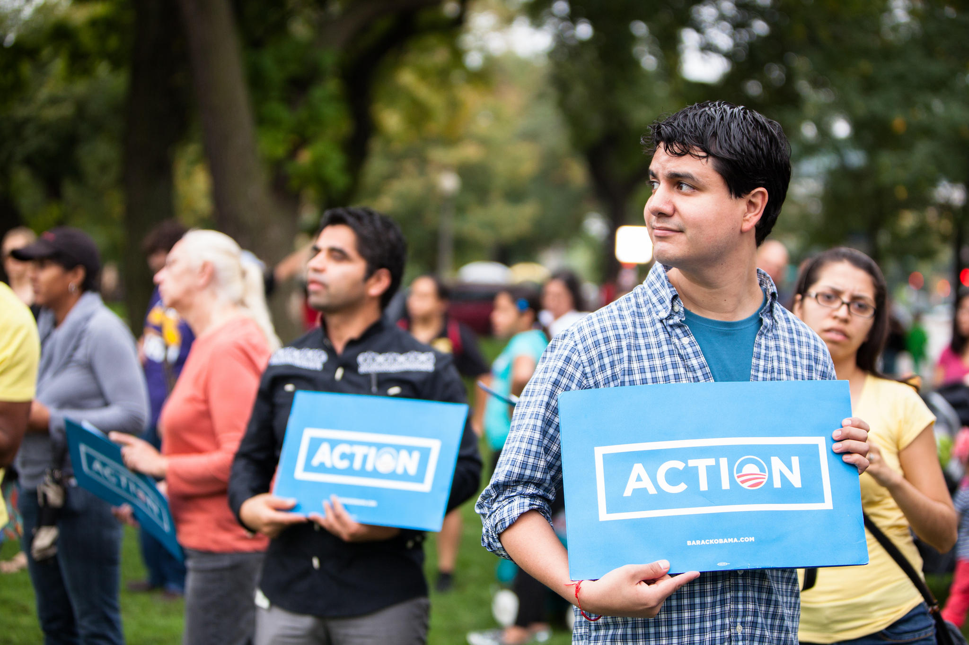
OFA TRAINING
Thank you for joining today’s webinar.
Find the materials we covered, including a video and audio recording of the webinar on the bookshelf.
SEE BOOKSHELF
Notes:
00:00 – 00:00 [General Closing Slide]

