Slide 1
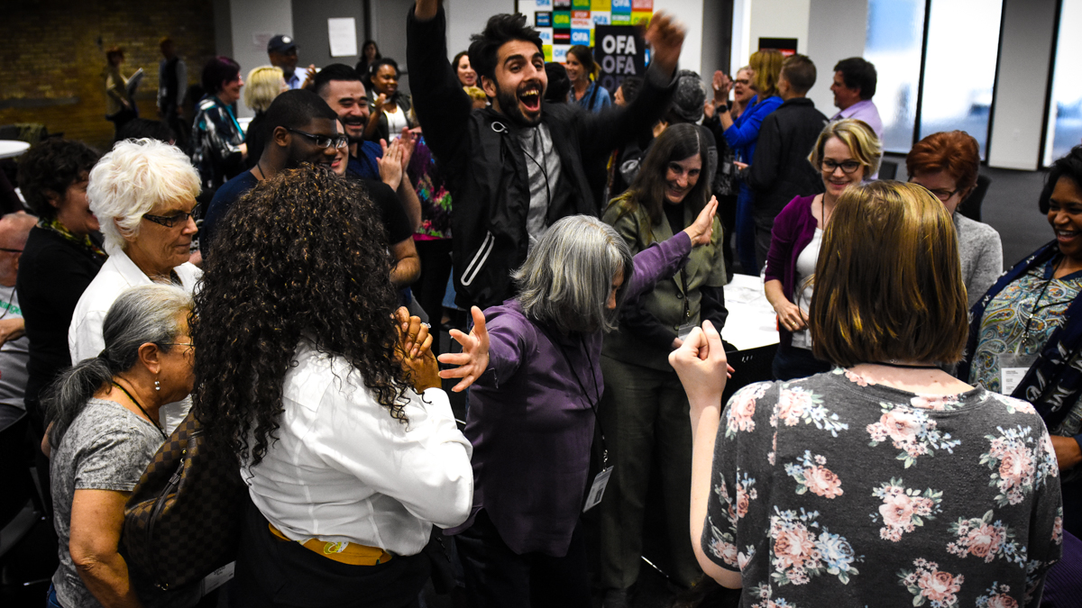


SPRING 2018 OFA FELLOWS LEADERS
Part 2: Emotional intelligence
Bobby Brady-Sharp / OFA Training Projects Manager
We will begin the training at 8 p.m. ET / 7 p.m. CT
Notes:
This work is licensed under the Creative Commons Attribution-NonCommercial 4.0 International License. To view a copy of this license, visit http://creativecommons.org/licenses/by-nc/4.0/ or send a letter to Creative Commons, PO Box 1866, Mountain View, CA 94042, USA

Slide 2

SPRING 2018
Fellows Leaders

Slide 3


Guided worksheet
Week 2
Bit.ly/training2worksheet

Slide 4
GOALS FOR THIS SESSION
Understand the concepts
of emotional intelligence
and agility and how they
relate to leadership

Slide 5
GOALS FOR THIS SESSION
Apply these concepts to
your own self-awareness
and identify growth opportunities as a leader

Slide 6
GOALS FOR THIS SESSION
Feel prepared to stretch
your comfort zone as you practice applying these concepts in your life

Slide 7

Agenda
Introduction
Defining emotional intelligence
12 competencies—Daniel Goleman
Emotional agility
Key takeaways and close

Slide 8




Logistics
We will meet for 90 minutes
You will need a pen and paper or means of taking notes
A recording of this call will be
available later this week.
Please tweet -- #OFAFellows

Slide 9
Housekeeping items

Slide 10

Defining emotional intelligence

Slide 11
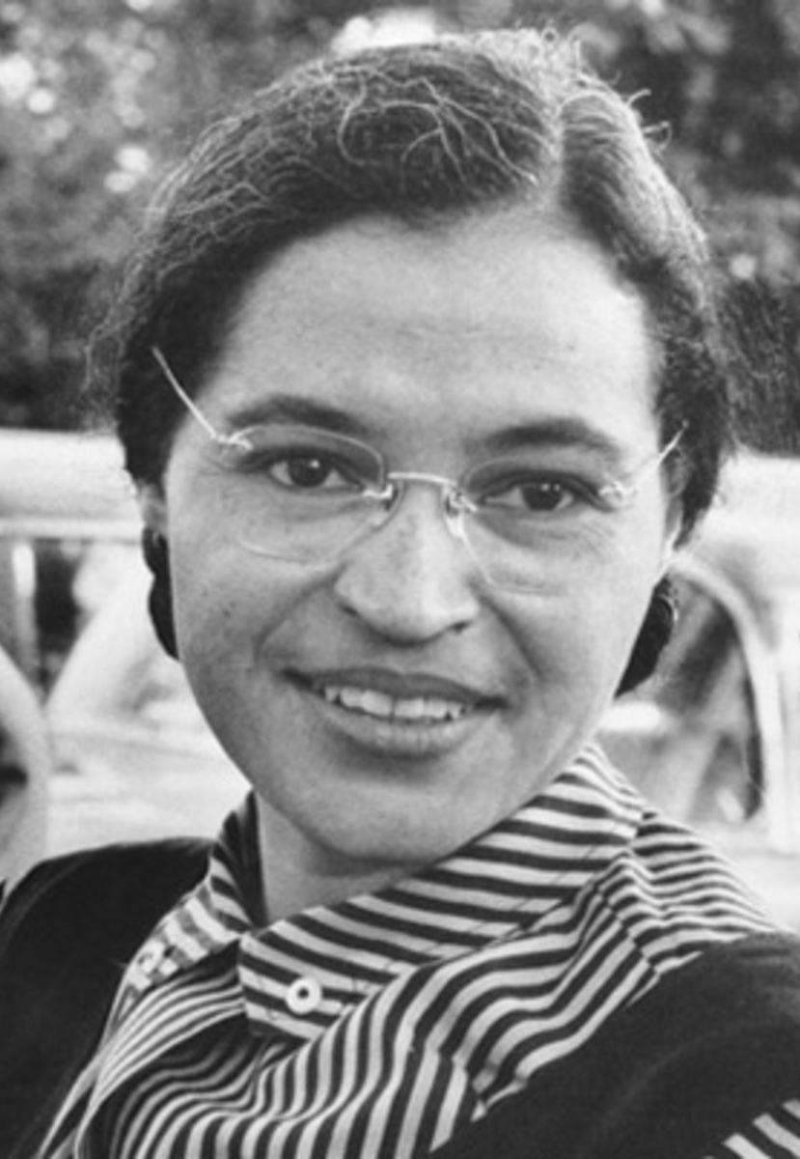
“
I have learned over the years that when one’s mind is made up, this diminishes fear; knowing what must be done does away with fear.”
ROSA PARKS
Notes:
Coercion induces change, while leadership influences change

Slide 12
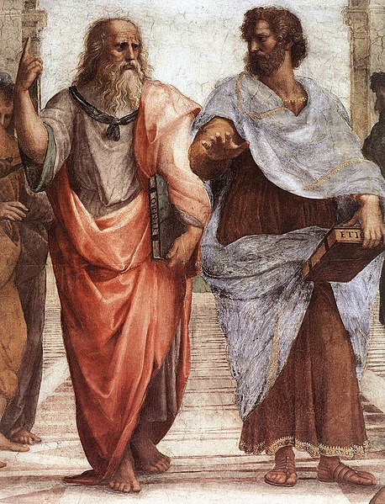
Anyone can become angry—that is easy.”
“
Notes:
Coercion induces change, while leadership influences change

Slide 13
But to be angry with the right person, to the right degree, at the right time, for the right purpose and in the right way—that is not easy.”
“
ARISTOTLE
Notes:
Coercion induces change, while leadership influences change

Slide 14
The word “emotion”
It comes from the latin verb, motere
Motere = “to move”
The prefix e connotes “to move away”

Slide 15
Emotion:
Feelings, thoughts, psycological/biological states, and a range of propensities to act.
(Goleman, Emotional Intelligence, 289, 1995)

Slide 16
Ranges and basic families of emotion
(Goleman, 289-290)
Anger
Sadness
Fear
Enjoyment
Love
Surprise
Disgust
Shame

Slide 17
Emotional intelligence:
The ability to perceive and express emotions to facilitate thinking…
(Mayer, Salovey, & Caruso, 2000)

Slide 18
Emotional intelligence:
to understand and reason with emotions …
(Mayer, Salovey, & Caruso, 2000)

Slide 19
Emotional intelligence:
and to effectively manage emotions within oneself and in relationship with others
(Mayer, Salovey, & Caruso, 2000)

Slide 20
Why is this important to leadership?
Notes:
Type in the chat box

Slide 21
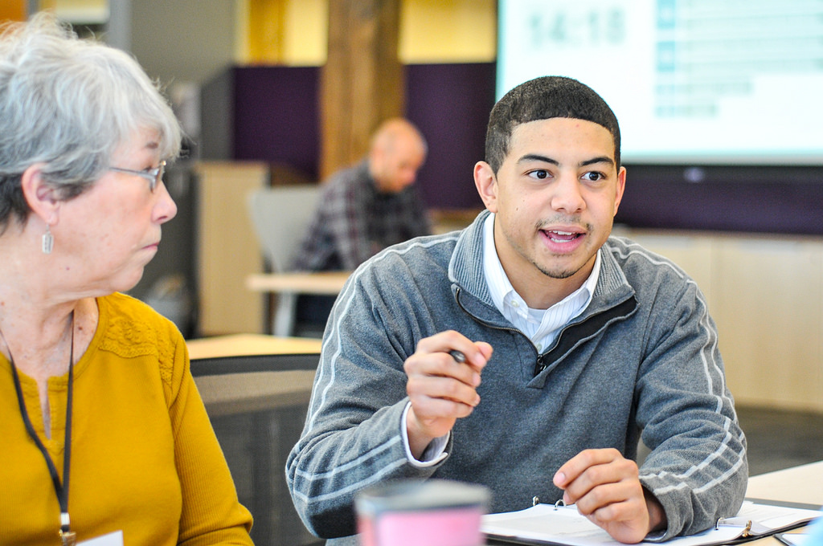
12 COMPETENCIES
Emotional intelligence

Slide 22
Self-Awareness
Emotional Self-Awareness
12 competencies of emotional intelligence – Daniel Goleman

Slide 23
Self-Awareness
Emotional Self-Awareness
12 competencies of emotional intelligence – Daniel Goleman
Self-Management
Emotional Self-Control
Achievement Orientation
Positive Outlook
Adaptability

Slide 24
Self-Awareness
Emotional Self-Awareness
12 competencies of emotional intelligence – Daniel Goleman
Self-Management
Emotional Self-Control
Achievement Orientation
Positive Outlook
Adaptability
Social Awareness
Empathy
Organizational awareness

Slide 25
Self-Awareness
Emotional Self-Awareness
12 competencies of emotional intelligence – Daniel Goleman
Self-Management
Emotional Self-Control
Achievement Orientation
Positive Outlook
Adaptability
Social Awareness
Empathy
Organizational awareness
Relationship Management
Coach and Mentor
Conflict Management
Inspirational Leadership
Teamwork
Influence

Slide 26
15 minutes
Take 5 minutes to read through the definitions of each competency
Take 10 minutes to list and discuss which competencies you need to improve in order to become more emotionally intelligent and a better leader (write them on your worksheet)
Breakout: Read, reflect, discuss
Worksheet: Bit.ly/training2worksheet

Slide 27
Discussion
What competencies do you need to improve in?
Which ones do you excel at?

Slide 28
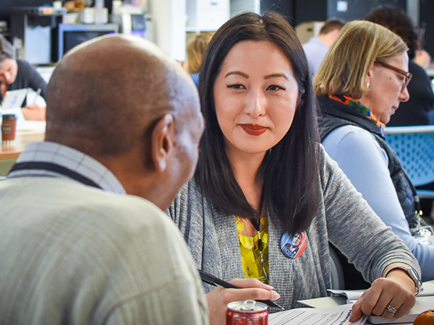
Emotional agility

Slide 29
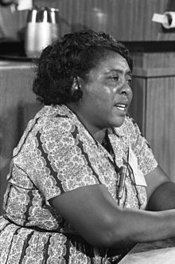
I am sick and tired of being sick and tired.”
“
FANNIE LOU HAMER
Notes:
Coercion induces change, while leadership influences change

Slide 30
Emotional agility
In 2016, Susan David, PHD, wrote the book “Emotional Agility,” building off of emotional intelligence
In it, she theorized that people become hooked by their emotions, leading to bad decisions

Slide 31
Hooked:
Internal chatter +
technicolor memory +
emotional punch
(Susan David, Emotional Agility, 2006)

Slide 32
Emotional agility
Being hooked leads to emotional rigidity, which plays out in our heads as
  “I’m not cut out for this…”
  “I’m ugly…”
  Biases
  Even racism

Slide 33
Emotional rigidity:
Patterns/ways in which our thoughts, emotions, and stories drive our actions in rigid ways.
(Susan David, Emotional Agility, 2006)

Slide 34
Emotional agility
Being hooked leads to emotional rigidity, which plays out in our heads
It is with emotional intelligence and the process of emotional agility that we can become unhooked!

Slide 35
Emotional agility:
The process that allows you be present in the moment and feeling…
(Susan David, Emotional Agility, 2006)

Slide 36
Emotional agility:
And change/maintain your behavior in response to feelings in the moment…
(Susan David, Emotional Agility, 2006)

Slide 37
Emotional agility:
So that you can live
in ways that align
with you intentions
and values.
(Susan David, Emotional Agility, 2006)

Slide 38
The process of
emotional agility

Slide 39
THE PROCESS OF EMOTIONAL AGILITY:
Step 1: Show up

Slide 40
Show up
Don’t run!—Face emotions and behaviors willingly
Be curious as to what you’re feeling and thinking
Learn to work with your thoughts
Recognize your patterns—know when you’re rigid or have repetitive thinking

Slide 41
THE PROCESS OF EMOTIONAL AGILITY:
Step 2: Step-out

Slide 42
Step-out
Become an anthropologist – detach from your thoughts and emotions
Name the emotion and the thoughts it is causing you to have
Recognize your emotion as “critical data”—recognize that it may not be leading you to the right conclusion

Slide 43
THE PROCESS OF EMOTIONAL AGILITY:
Step 3: Walk Your Why

Slide 44
Walk your why
Focus on your core values and most important goals by asking these questions:
  Is my response going to serve me and my organization in the long-term as well as short- term?

Slide 45
Walk your why
Focus on your core values and most important goals by asking these questions:
  Will it help me steer others in a direction that furthers our collective purpose?

Slide 46
Walk your why
Focus on your core values and most important goals by asking these questions:
  Am I taking a step toward being the leader I most want to be and living the life I most want to live?

Slide 47
THE PROCESS OF EMOTIONAL AGILITY:
Step 4: Make tweaks, Move on

Slide 48
12 minutes
Take 2 minutes and think of a situation that “hooks” you
Write that situation down on your worksheet
Share the situation with you partner – walk through the 4-steps of emotional agility with your situation in mind and come up with a response
Breakout: Practice
Resources:
Worksheet: Bit.ly/training2worksheet
4-STEPS:
SHOW UP
STEP OUT
WALK YOUR WHY
MOVE ON

Slide 49
Debrief
What is your biggest takeaway?

Slide 50
Debrief
How do you think your biggest key takeaway applies to how you’ve been applying leadership in your organizing work?

Slide 51
Debrief
How will you begin to actively work on revising your responses to situations this week and through this program?

Slide 52
HOMEWORK ASSIGNMENT
Week 2
Bit.ly/training2worksheet

Slide 53
OFA Training
Thank you for joining today’s webinar.
Check the Fellows Leader website for a copy of the material covered
today, including a video and audio recording of the webinar.
Email fellows@ofa.us with any questions.
Bit.ly/eintelligence2

