Slide 1
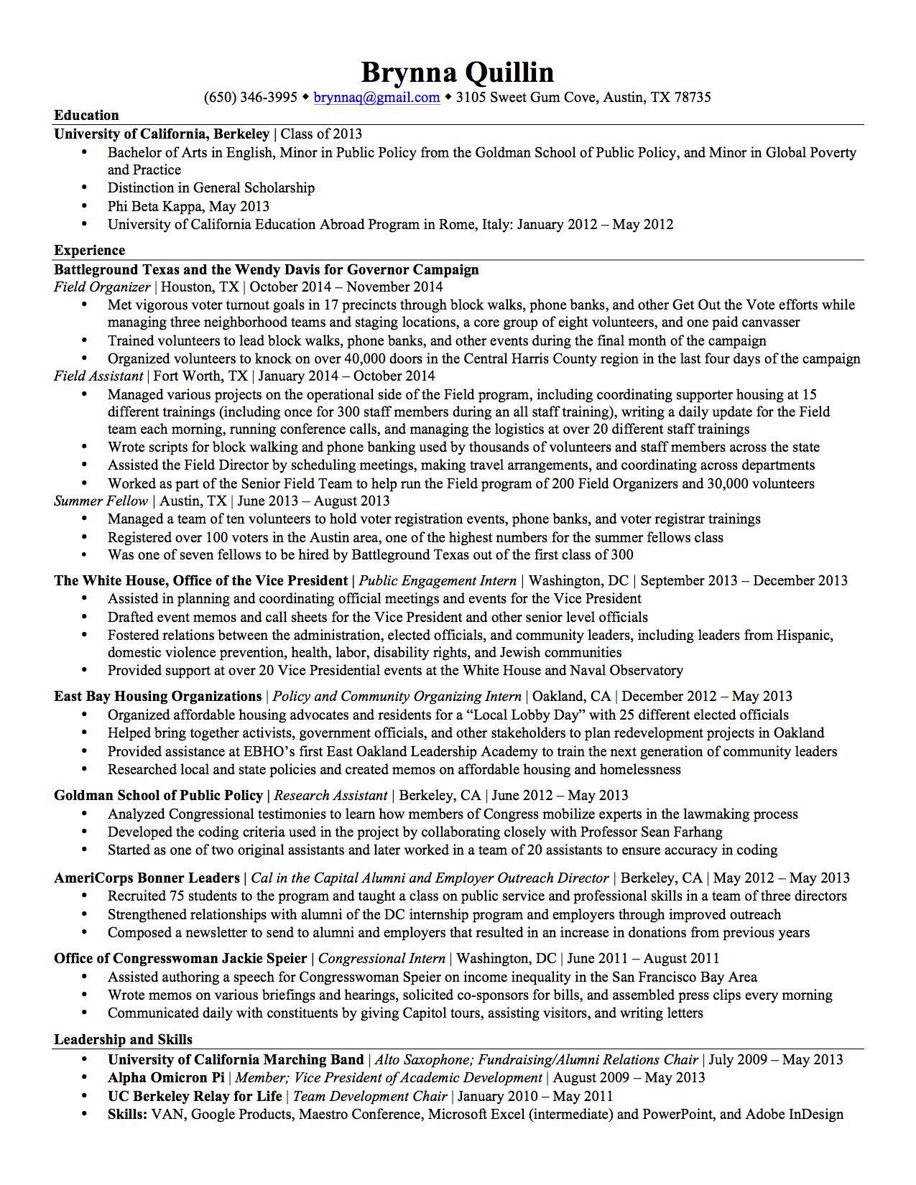

Lesley
Field Organizer Candidate
January 2014 – November 2014
Notes:
This work is licensed under the Creative Commons Attribution-NonCommercial 4.0 International License. To view a copy of this license, visit http://creativecommons.org/licenses/by-nc/4.0/ or send a letter to Creative Commons, PO Box 1866, Mountain View, CA 94042, USA

