Slide 1




ORGANIZING DIRECTOR SUMMIT
#OFATraining
Notes:
This work is licensed under the Creative Commons Attribution-NonCommercial 4.0 International License. To view a copy of this license, visit http://creativecommons.org/licenses/by-nc/4.0/ or send a letter to Creative Commons, PO Box 1866, Mountain View, CA 94042, USA

Slide 2
GOALS OF THE SUMMIT
1
Understand new intersections for data and organizing and best practices for creating and cultivating a culture of data in your program
2
Be able to create a data program that enables you to make smart and effective decisions about your organizing program
3
Feel confident integrating the ideas and best practices shared at the Summit into your organizing program

Slide 3

10:00 – 10:30
Welcome and Introductions
10:30 – 12:30
Intersection: Organizing and Data
Agenda for today
12:30 – 1:30
Networking Lunch
1:30 – 3:30
How to Distinguish Good Data from Noisy Data
3:30 – 4:00
Debrief and Close

Slide 4
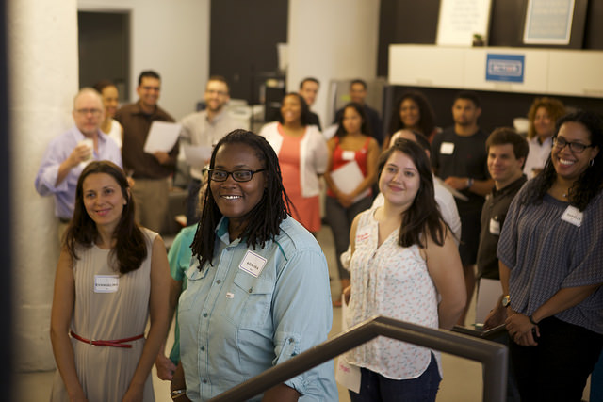
Hi there,
it’s great to meet you!

Slide 5
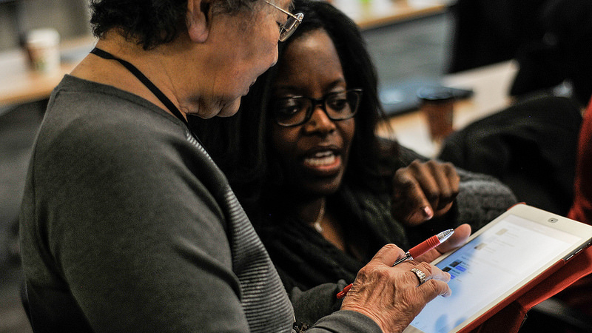
Respect. Empower. Include.

Slide 6


Intersection:
Organizing and Data

Slide 7
GOALS OF THIS SESSION
1
Understand new intersections for data and organizing and best practices for creating and cultivating a culture of data in your program
2
Be able to create a data program that enables you to make smart and effective decisions about your organizing program

Slide 8

LET’S DISCUSS
What data were you asked to collect, report out,
or otherwise be judged on when you were an organizer?
How were you asked to collect this data?
How do you remember feeling about it?

Slide 9
Worst Practice:
Not creating a culture of data.

Slide 10
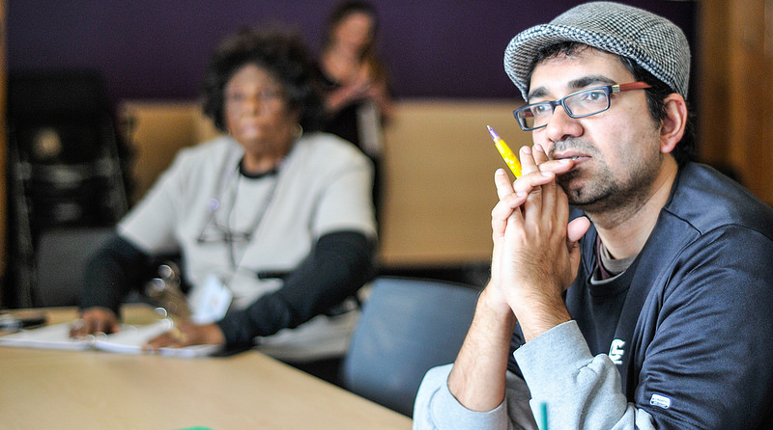
A culture of data can set up your organizing program for success.

Slide 11

LET’S DISCUSS
How can we, as Organizing Directors, create a culture of data within our programs that will make our work easier?
Report back the ideas and best practices your group comes up with.
Small Group Discussion

Slide 12
KEY TAKEAWAYS

Slide 13
KEY TAKEAWAYS
Create a culture where good data is valued
Give larger context to the organizers or volunteers reporting data
Set meaningful metrics and goals

Slide 14
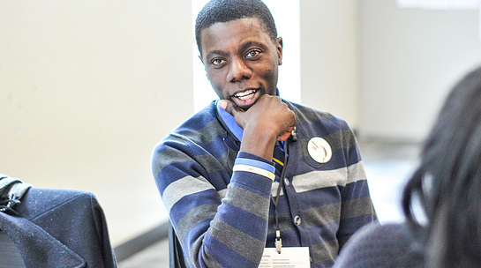
How do you set up
your data program to set up
your organizing program for success?

Slide 15
MY METRIC MUST-HAVES
1
Have a central volunteer management system that everyone actually uses

Slide 16
MY METRIC MUST-HAVES
1
Have a central volunteer management system that everyone actually uses
2
Regularly check in on your data and hold volunteers and
organizers accountable

Slide 17
MY METRIC MUST-HAVES
1
Have a central volunteer management system that everyone actually uses
2
Regularly check in on your data and hold volunteers and
organizers accountable
3
Have a way to track flake rates

Slide 18
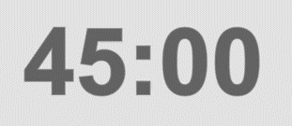
LET’S DISCUSS
What specific tools are you using to manage volunteers, check in on your data, and track flake rates?
How has tracking these three data must-haves impacted your organizing work?
Are there data must-haves that are missing from this list? What are they?
Small Group Discussion

Slide 19
KEY TAKEAWAYS

Slide 20


LUNCH
#OFATraining

Slide 21
How to Distinguish
Good Data from Noisy Data

Slide 22
GOALS OF THIS SESSION
1
Understand which data takeaways to take away– and which ones are just noise
2
Be able to use data to make a case for your organizing program to stakeholders

Slide 23
BE A DATA DETECTIVE
1
Don’t take away the wrong takeaway– anecdotes are great, but what is the data actually telling you?

Slide 24
BE A DATA DETECTIVE
1
Don’t take away the wrong takeaway– anecdotes are great, but what is the data actually telling you?
2
Big numbers don’t necessarily tell big stories– which data shows the impact of your work?

Slide 25
BE A DATA DETECTIVE
1
Don’t take away the wrong takeaway– anecdotes are great, but what is the data actually telling you?
2
Big numbers don’t necessarily tell big stories– which data shows the impact of your work?
3
Good data entry = good data– data-driven decisions are made with
quality data

Slide 26
LET’S DISCUSS
Think about a time when, after looking at data, a previous assumption you held about your organizing program was challenged.
At what point do you change course on your organizing program based on your data? Should you always change the course of your work if the data says to do so?
Small Group Discussion

Slide 27
KEY TAKEAWAYS

Slide 28

WHAT DO STAKEHOLDERS LOOK FOR
IN YOUR ORGANIZING PROGRAM?

Slide 29
PITCHING YOUR PROGRAM
1
Share data you can stand by– What might be a good number now might not be so good under close scrutiny

Slide 30
PITCHING YOUR PROGRAM
1
Share data you can stand by– What might be a good number now might not be so good under close scrutiny
2
Always be prepared– understand what stakeholders want to see and collect that data– but not just that data– throughout your organizing program

Slide 31
PITCHING YOUR PROGRAM
1
Share data you can stand by– What might be a good number now might not be so good under close scrutiny
2
Always be prepared– understand what stakeholders want to see and collect that data– but not just that data– throughout your organizing program
3
TMI– select data that tells the story of your impact

Slide 32
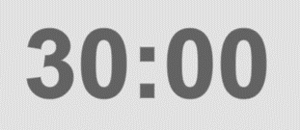
LET’S DISCUSS
What data do you collect to promote your organizing program?
What data do you wish you collected?
What data do you include in a program pitch and what do you leave out?
Small Group Discussion

Slide 33
KEY TAKEAWAYS

Slide 34

YOUR TURN
Pretend you are making a pitch about your field program to your organization’s board of directors (your fellow group members).
You have 3 minutes to talk about your organizing program
When you’re done with your pitch, your group members should give feedback.
Role Play

Slide 35
KEY TAKEAWAYS

Slide 36
DEBRIEF AND CLOSE

Slide 37
GOALS OF THE SUMMIT
1
Understand new intersections for data and organizing and best practices for creating and cultivating a culture of data in your program
2
Be able to create a data program that enables you to make smart and effective decisions about your organizing program
3
Feel confident integrating the ideas and best practices shared at the Summit into your organizing program

Slide 38
10:00 – 10:30
Welcome and Introductions
10:30 – 12:30
Intersection: Organizing and Data
Agenda for today
12:30 – 1:30
Networking Lunch
1:30 – 3:30
How to Distinguish Good Data from Noisy Data
3:30 – 4:00
Debrief and Close

Slide 39
GOALS OF THE SUMMIT
What was your ‘aha’ moment from today’s Summit?

Slide 40
GOALS OF THE SUMMIT
What was your ‘aha’ moment from today’s Summit?
What is a best practice that you heard today that you commit to testing out when you return home?

Slide 41
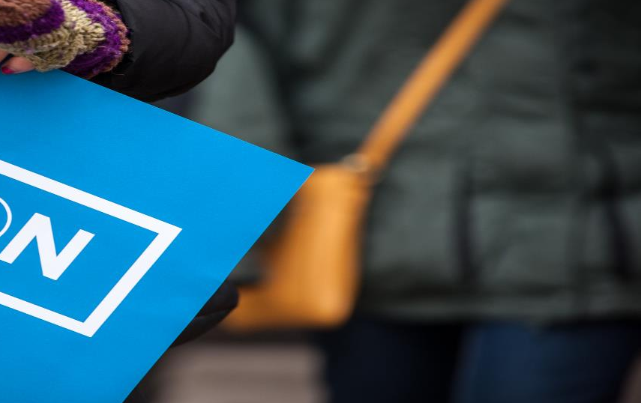
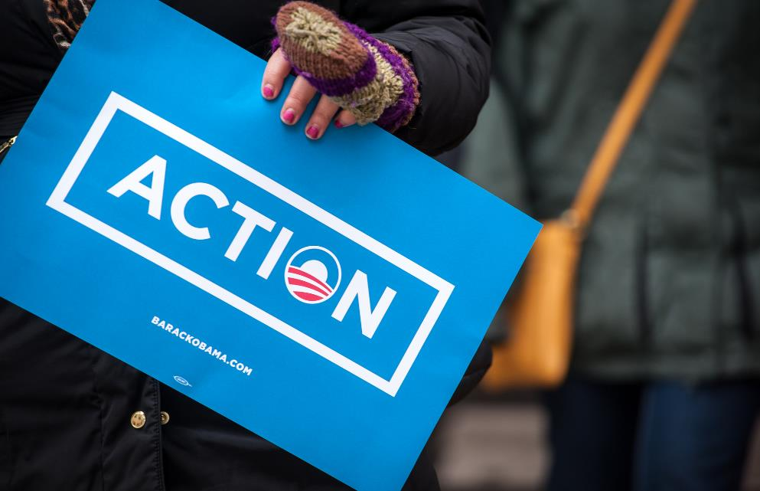

HOW DID IT GO?
bit.ly/OrgDirSummit2016

Slide 42
ORGANIZING DIRECTOR SUMMIT
#OFATraining

