Slide 1
Planning A Field Program
Steve Preston
Field Director
@StevePrest

Slide 2



Goals for This Session
    Understand how to use past voting data to make a target universe
    Assess size and capacity of a program based on staff/volunteers
    Understand different aspects of targeting frequently used in a campaign
Notes:
Start with a broad number. Everything we do will be narrowing this down into the smallest group we can win with.

Slide 3

Agenda for This Session
Finding Your Universe
Assessing your abilities
Targeting
Passes Through Universe
Debrief/Closing

Slide 4
Planning The Universe
What does “universe” mean?
What’s the first thing we need to figure out to plan our universe?
Notes:
Using historical data – of SIMILAR ELECTIONS.
City commissioner has this information. Google docs will be your best friend here.

Slide 5
Planning The Universe
Things to consider:
  When was there last a similar election?
      You can’t use presidential data for a municipal rate
      If there was another special kind of election, your data may not be as valuable.
      Was there any other reason turnout could’ve been low?
  Voter Participation is on the decline
    But expecting a lower turnout is worse than higher
Polling consultants may have this info!
Notes:
Using historical data – of SIMILAR ELECTIONS.
City commissioner has this information. Google docs will be your best friend here.

Slide 6
Planning The Universe - Tips
Don’t get this info from VAN!
  Votebuilder removes people who die/aren’t registered in PA anymore
Break it down as much as you can! Get this information by ward at minimum.
You can get this information from the City Commissioner’s website
  You can make an average of the turnout % or average the general turnout.
Notes:
Using historical data – of SIMILAR ELECTIONS.
City commissioner has this information. Google docs will be your best friend here.

Slide 7
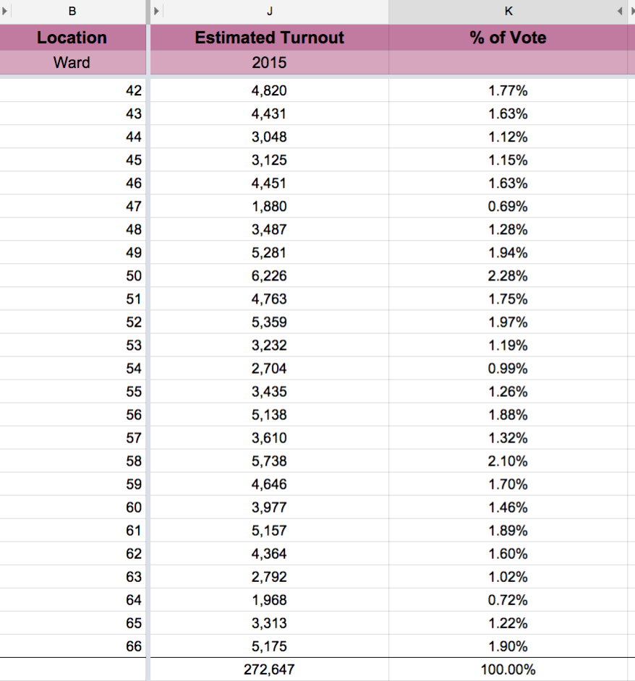

Slide 8
Win Number
After finding out the expected turnout of the election – you find your real goal
Often teams polling teams will have this as well.
  If not, you have to figure this out yourself.
  What percent do we think our opponent(s) can get at most?
***This is constantly changing

Slide 9
Assessing Your Abilities
What are some resources you may have at your disposal?
  How many organizers/fellows?
  What will your volunteer base be like?
  What elected office is your candidate running for?
  Is your race high profile?
  Do you have an e-mail list already?
These will all affect how you determine your goals and the size of your program.

Slide 10
Assessing Your Abilities
Divide your win number by organizer!
  What’s reasonable per organizer?
    How many volunteers will they be able to get?
    How many people will they be able to contact?
    If this number is too high per organizer, you need to narrow your universe further.
Afterwards, divide this by geographic region (this is why dividing by ward is important). Try to give everyone a similar number.

Slide 11
Tier Your Targets!
  Voting history
    VAN lets you divide people by their past election participation.
    Choose how many past elections you want to consider. I don’t go back more than 5 or 6.
    Check out the sizes of your tiers and see what you can work with!
    You don’t need to talk to people who are 5/5. They are likely decided and definitely going to vote.
Notes:
-Likely supporters (base

Slide 12
Targeting 101
    Likely supporters
      If your opponent has been elected in the past, you can look at wards they’ve done well in, or their old district
      Polling will come in handy here as well.
    Moderately Likely Supporters
      People who will likely require a little persuasion
      From your candidate’s district, unlikely to support some of the messaging
    Unlikely Supporters
      Maybe in an opponents district, or people who won’t likely support your messaging
Notes:
-Likely supporters (base

Slide 13
Targeting by Polling
Who is receptive to your message?
  Often broken down by region
  Target regions where your message is stronger
Which messages work in which regions?
  Also target your script based on the information you get from polling!

Slide 14
Passes Through Universe
If you have the resources, you should do 2+ rounds of calls through your universe.
First Pass:
  DVC – Direct Voter Contact
    1st Pass
    Weighing support (1-5 cand supp)
    Light persuasion (nothing too specific)
    Short calls – none more than 1-2 minutes
    Also can identify which issues matter to voters

Slide 15
Passes Through Universe
Second Pass:
  Persuasion
  Calling people who identified as undecided/leaning towards you or opponent
  More in-depth conversations about policy
  Longer conversations occur (2-4 minutes)
  Use IDed issues to facilitate these conversations

Slide 16
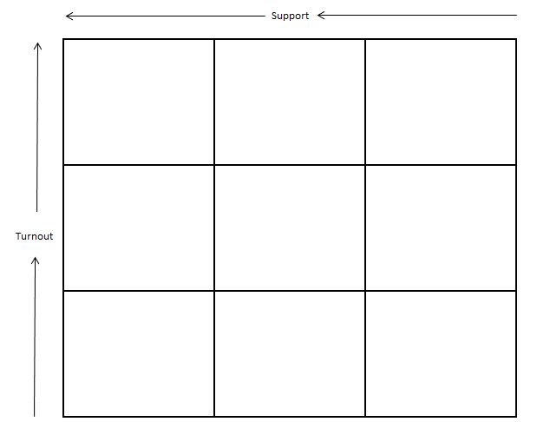
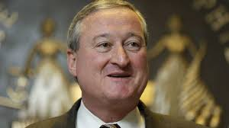
Persuasion

Slide 17
Next Steps?
GOTV (GOYV) – Which boxes do we GOTV?

Slide 18
Questions?

