Slide 1



Motivational interviewing
Identifying uncertainty and moving towards change
Notes:
This work is licensed under the Creative Commons Attribution-NonCommercial 4.0 International License. To view a copy of this license, visit http://creativecommons.org/licenses/by-nc/4.0/ or send a letter to Creative Commons, PO Box 1866, Mountain View, CA 94042, USA
What brings you here today?
I want to invite you all to lean in to this training

Slide 2

Welcome.
We’re excited to be here with you!

Slide 3


Alexis Conavay
@AlexConavay
Notes:
Alexis
Share one thing that you love about your job (or one fun fact)

Slide 4
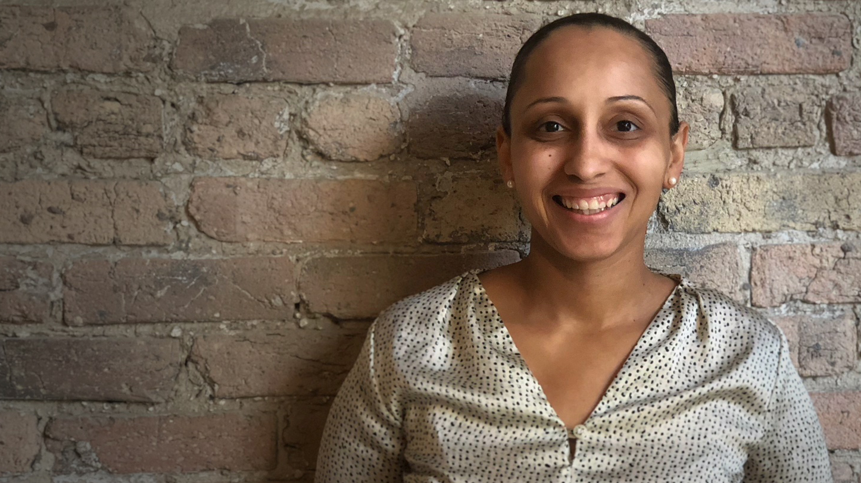
Bianca Yarborough
Notes:
Bianca
Share one thing that you love about your job (or one fun fact)

Slide 5
2 Goals
Notes:
So with this – let’s talk about our goals for the session

Slide 6
1
Understand the key aspects
of the motivational interviewing framework.
Notes:
Share your name and where you are from - Can someone read out the first goal

Slide 7
2
Use the motivational interviewing framework in order to have more effective conversations with family, friends, and neighbors.
Notes:
Share your name and where you are from - Can someone read out the second goal

Slide 8
Agenda
Welcome and introductions
What is motivational interviewing?
Motivational interviewing framework
Debrief & close

Slide 9
#OFAction
#PowerOfPink18
Notes:
Community of learners.
Conference members are your people.

Slide 10

We’re OFA
Notes:
We know that real, lasting change requires more than righteous anger—it requires a program, and it requires ordinary people coming together to fight for the issues that matter to them. We believe that by acknowledging and nurturing the inherent power in all of us, we can work toward a more tolerant, just, and fair America.

Slide 11
OFA’s core purpose is to create
a more accessible and participatory democracy
Notes:
This is our work at OFA – we want to build civic participation because we believe that when people are involved at every level of governing, we are stronger and more represented.

Slide 12
Respect
Empower
Include
Notes:
1. RESPECT -- We take a respectful approach to everything we do, including talking to our elected officials. When we’re respectful, our concerns are taken more seriously. We make sure that we’re respectful of people’s time for those who engage in our organization. We’re not asking folks to do things that we don’t think will actually help move the needle forward or will actually help you build your organization. It means that we respect everyone who comes into this organization, no matter how they get here. Not everyone is a die-hard democrat or progressive, but they still have a place here.
2. EMPOWER – that means that we make sure that we’re not just asking people to take actions, but that we’re training and supporting folks to be leaders in their communities. That doesn’t necessarily mean that you have to be in charge of running everything, but maybe when you talk with your friends, your family, and your neighbors about issues, that you know what those issues are about, you know what’s at stake, and you’re empowered to be a leader in that way.
3. INCLUDE -- We include anyone and everyone who wants to make a difference in the progressive movement. OFA welcomes you, no matter your skill level or income. It is our job to find the ways that people can give—whether they have 5 hours or 5 minutes—whether they have lots of resources or none—everyone has a place in this organization and everyone has a role to play in working to make their communities better.
You will receive all of our training and coaching at no cost to you. And, it doesn’t matter if you’ve never taken action before or if you’re a seasoned community organizer, we have a place for everyone at OFA.
4. Organize! – We’re not just building all of this infrastructure so we can fight today’s fights, but so that we’re here for the long term. Because we know that some of these fights will take years or even decades of work.
We organize because that is how we build long term power.

Slide 13
Agenda
Welcome and introductions
What is motivational interviewing?
Motivational interviewing framework
Debrief & close
Notes:
Let’s dig in!

Slide 14
GUIDED WORKSHEET
Motivational Interviewing
Bit.ly/MIworksheet
Notes:
We’ll be using a worksheet as we move forward today – we have printed versions but if you’d love a digital copy, please go to this bit.ly link

Slide 15
Can you think of an example
in your own life?
Notes:
Think about a time that you changed your mind about something that was deeply important to you. What were the circumstances? (Key hook -- change comes from having conversations with people we trust that are emotionally resonant -- not primarily from facts and figures)
What surrounded that experience
GRAD SCHOOL
What does this tell us?

Slide 16
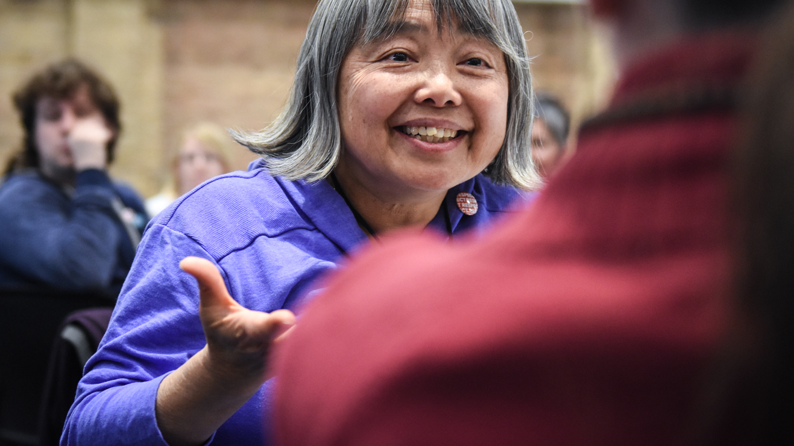
Motivational interviewing
Notes:
People’s opinions are on top of our experiences (iceberg!) - asking us to go back on how we learned how things are - asking folks to reframe early experience and we have to be about hitting emotionally resonant points to invite folks to shift their thinking. It is extremely hard and slow.
Motivational interviewing is a way for people to state, on their own, how their actions don’t always align with their beliefs. Building critical thinking skills (Backlash effect)
We’ll see a video later on a project of David Fliesher - There is a body of research (deep canvassing) – can you change bias or predigious within a single conversation

Slide 17
True or false?
The average gap between self-identified Democrats and Republicans on values has increased by 20% since 1994.
Notes:
Raise your hand if you think that’s true – narrator what I’m seeing
Ground ourselves in research

Slide 18
False
Notes:
False – we’ve actually become more polarized

Slide 19
The average gap between self-identified Democrats and Republicans on values has increased by 33% since 1994.
Pew Research Center
Notes:
Over the last 25 years we’ve become more polarized, meaning that the center is actually moving towards the polls.
Study from PEW research center asked questions where you can infer values underneath
Values questions -- on government regulations to benefits for the poor to racial discrimination
The gap between Democrats and Republicans continues to expand on questions about the role of government, race, immigration — even where they prefer to live. Each party has become more ideologically homogeneous, and more hostile toward the opinions of members of the other party.

Slide 20
Research show that politics
has become an identity.
Notes:
Politics itself has become an identity built on experiences people have had for a long time.
Politics are on the surface of deeply rooted things like experiences and identity
We just heard the statistic that our country is getting more polarized. There are a few reasons why this happens – INSULAR Associating our identity with folks around us who also believe those things
We are moving away from saying that a political belief is part of my identity and we are shifting to my political belief shows my identity. When I say I am feminist, I’m signaling that a lot of things about myself -

Slide 21
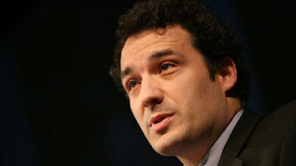
Ziad Munson
Lehigh University
Sociologist
Notes:
The sociologist Ziad Munson has found that almost half of the activists on the front lines of the anti-abortion movement — those who protest outside abortion clinics — were not anti-abortion when they attended their first event. They attended because a friend asked them, they had just joined a new church, or they retired and had more free time. They stayed, however, because at these events, they found things we all want: friends, responsibility, a sense that what they are doing matters. By finding fellowship and responsibility, these people changed not only their views on abortion but also their commitment to act.
However, studies have also found that people with polarized views also concede the nuance of their beliefs after a few questions, much more than they initially let on
Signaling my identity and not, this is an act I disagree with. Stayed for the community

Slide 22
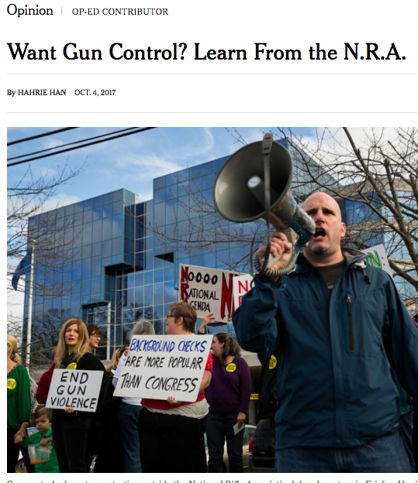
“… their views evolved after joining these gun groups. So did their identities.”
Hahrie Han
Notes:
This affects actions (identity shift → e.g. NRA)
"The gun-rights groups were not just persuading them to support gun rights; they were also helping my friends rearticulate their own lives in terms of a broader vision of the future. They were no longer just hunters. They were protectors of a way of life. That is why the N.R.A.’s version of gun rights is so intimately tied to questions of race and identity"
We know this intuitively because it also affects our believes about people who engage in those actions – we assume we know more about their identity and who they are
What are we to do with that? We know that politics have become an identity, groups see each other as other, we are becoming more polarized in this country.
We care about change really deeply, we are at the conference because we deeply believe in specific things. We get that this is urgent. But there is hope. At the core of motivational interviewing, we want to tease out cognitive dissonance . We know this intuitively - there are many beliefs that we hold that go against our actions- for instance, I deeply believe in doing everything I can to combat excessive waste.. However, I bought a drink today in a disposable cup
Because politics has become an identity, our actions don’t always align and we don’t always see that connection. We live in contradiction all the time → cognitive dissonance. We need people to bring that up for us.
Motivational interviewing Is a way for people to state, on their own, how their actions don’t always align with their beliefs. Asks them what they are going to do next about that
Past any election cycle
My identity is not always revealed with my actions (empathy for others) – for myself

Slide 23
Therefore, we have to
be good listeners…
Notes:
Some keys to being a good listener:
Reflecting statements “what I hear you saying is…”
Asking exploratory questions: To more deeply understand the landscape of a person’s beliefs
Probing: We do this in order to get to the root of what an individual is saying to us -- at the root is typically a value or belief
Search for, what is calling folks in …

Slide 24
…and ask questions that
reveal biases and beliefs in
a nonjudgmental way.

Slide 25
What is a way we can do this?
Notes:
If you want to keep someone you know in mind. This training is for folks who are on the fence about an issue – people who will likely align to your side if pushed to sit with the contradictions between their values and actions.
A practice in discipline, we tend to do to the extremes – this is for family and friends or someone you have a connection with
BROTHER

Slide 26
MOTIVATIONAL INTERVIEWING:
A person centered method
of guiding to elicit and strengthen personal motivation for change
Notes:
One way to do this is through a framework called ‘motivational interviewing’. Motivational Interviewing is a counseling style typically used to treat addictions
It is defined as “a person centered method of guiding to elicit and strengthen personal motivation for change”
It encourages individuals to work through their discrepancy between their current behavior and broader life goals and values – critical thinking, a more lasting shift
Interviewing – asking questions!

Slide 27
Motivational interviewing is…
Notes:
Something used during deep canvassing or with friends--not something we do at all times. It is a tool.

Slide 28
A counseling style typically used to treat addictions
Motivational interviewing is

Slide 29
A counseling style typically used to treat addictions
Encourages individuals to work through their resistance to behavior change in relation to their broader life goals and values
Motivational interviewing is

Slide 30
A counseling style typically used to treat addictions
Encourages individuals to work through their resistance to behavior change in relation to their broader life goals and values
Does not directly challenge another person’s irrationality or denial–rather, helps to expose contradictions
Motivational interviewing is

Slide 31
A counseling style typically used to treat addictions
Encourages individuals to work through their resistance to behavior change in relation to their broader life goals and values
Does not directly challenge another person’s irrationality or denial–rather, helps to expose contradictions
Effective when individuals express their own contradictions
Motivational interviewing is
Notes:
Practitioners generally make no direct attempt to dismantle denial or confront irrational or inappropriate beliefs. Instead they may subtly help people detect possible contradictions in their thoughts and actions; to experience discrepancy between their current actions and who they ideally want to be.
So, we’re NOT trying to win an argument here or get this person to agree with our system of beliefs. We’re attempting to build trust through listening a guide the other person to talk through their own belief system so as to confront any conflicts or discrepancy.
Through motivational interviewing, people are able to voice assumptions they are making that were previously unexamined, clarify their beliefs, and make a choice to change their behavior
It is more effective for people to verbally express their own contradictions than for you to tell them → leads to longer lasting behavior change
Discrepancy between actions and ideally who they want to be

Slide 32
Motivational interviewing is not…

Slide 33
Motivational interviewing
is not
Judgmental

Slide 34
Motivational interviewing
is not
Judgmental
Coercive—or forcing people to think in a certain way

Slide 35
Motivational interviewing
is not
Judgmental
Coercive—or forcing people to think in a certain way
Manipulative

Slide 36
Motivational interviewing
is not
Judgmental
Coercive—or forcing people to think in a certain way
Manipulative
Persuasive
Notes:
Judgmental, forcing people to think a certain way, manipulation, “gotcha”, clap-back, persuasive
Online
PERSON DESTROYED

Slide 37
Many of us are not professional counselors.
Notes:
We are not counselors (most of us- shout out to counselors in the room). This framework isn’t taking the place of professional counseling, nor is it saying that we should act as counselors when we talk to people

Slide 38
That said, most of us are seeking deep change in our country.
Notes:
However, most of us here on this call are seeking deep change in our country- we desire to see more people voting, more people civically engaged in their communities, more communities being represented by people who vote the way that their constituents put them in office to vote

Slide 39
And we can make that change—with the right tools!
Notes:
However, most of us here on this call are seeking deep change in our country- to bridge a divide, to see more people voting, more people civically engaged in their communities, communities being able to have more respectful and fruitful discussions and the reality is, we have to use all the tools of effective conversations that we can to begin to see the behavioral changes we seek. We need to try to overcome the polarized barriers people are putting up. And this type of listening is just one way to begin to do that.
Organizers borrow from anywhere – we know this

Slide 40
Agenda
Welcome and introductions
What is motivational interviewing?
Motivational interviewing framework
Debrief & close
Notes:
Now let’s dig into the framework motivational interviewing uses
Here is the motivational interviewing framework for an effective conversation that helps to lead someone towards behavior change
There are three pieces to this training

Slide 41
Motivational interviewing framework
1
Exploring
Notes:
EXPLORING - listen to story, build rapport, obtain history — listening, reflections (think anthropologist)

Slide 42
Motivational interviewing framework
1
Exploring
Guiding
2
Notes:
GUIDING - values clarification exercise, summarizing, putting assumptions on the surface

Slide 43
Motivational interviewing framework
1
Exploring
Guiding
Choosing
2
3
Notes:
CHOOSING- ask them to join in further conversation, join a group

Slide 44
WHAT WE STRIVE FOR IN THIS FRAMEWORK:
Are your questions …
Notes:
This is a question centered framework

Slide 45
Nonjudgmental
Notes:
Quickest way to close someone off or shutdown someone
I am so guilty of this and it robs me of relationship

Slide 46
Using their language
Notes:
People want to feel seen and heard. Sense of belonging.
We heard that in the research at beginning

Slide 47
Loving
Notes:
We want to create a world that holds and centers are values – I deeply believe that in this framework you want to be loving

Slide 48
Expansive vs. reductionist
Notes:
People are not wholly what you believe they are

Slide 49

Your experience
$$≠$$
Others experience
Notes:
Our opinions are build our experience and we would never want to assume that we all have the same experience – informed by our identity, systemic factors operating in our lives, our families, where we grew up

Slide 50
MOTIVATIONAL INTERVIEWING FRAMEWORK
Exploring
Notes:
In this beginning phase of the framework, you are establishing rapport with the person you are speaking with
Think anthropologist

Slide 51
Exploring
Listen to the individual’s story

Slide 52
Exploring
Listen to the individual’s story
Build rapport

Slide 53
Exploring
Listen to the individual’s story
Build rapport
Obtain history

Slide 54
Exploring
Listen to the individual’s story
Build rapport
Obtain history
Listen and give a reflective statement
Notes:
TRUST

Slide 55
Offer reflective response

Slide 56
CONTENT REFLECTION:
“Given what you said,
it sounds like you…”

Slide 57
MEANING/FEELING REFLECTION:
“It seems that you felt … is that right?”
Notes:
Note: Even when reflections are inaccurate, though the act of correcting the listener, people clarify their thoughts and feelings and move the discussion forward
Opportunity to clarify

Slide 58
CAUTIONARY TRAPS
Responding
With questions that are biased in what you want to hear.

Slide 59
CAUTIONARY TRAPS
Responding & Premature advice
With questions that are biased in what you want to hear.
Giving advice based
on biases without first listening to the individual.
Notes:
TRAPS: responding with questions/ premature advice, questions are biased in what the person is interested in hearing about and not what the person sharing is saying
EXAMPLE: This can be used to talk to folks don’t believe voting will have an impact.
Can be used to explore conversations with folks who believe parties are all the same, or even fellows progressives/democrats that are not living their identity
Predicting and assuming

Slide 60
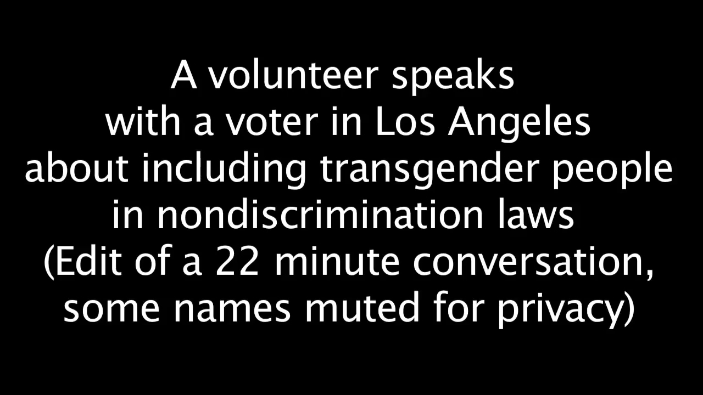
Notes:
Organizing time together – raise your hand if you have ever done door-to-door or high-traffic canvassing – great, so you know that it is quick and all about numbers.
There is research coming out that a framework of deep canvassing that priorities different things – it is much longer and its goal is to build trust and rapport
Study – can a single conversation at the door reduce bias
This is one of those results.
Warning

Slide 61
2 minutes
Reflection
If you were the person at the door canvassing this women, what would you ask or say at this point?

Slide 62
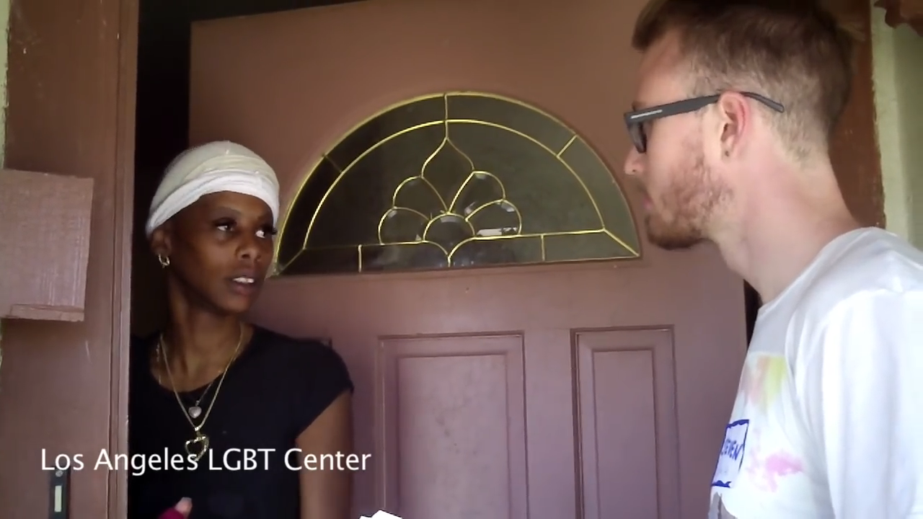

Slide 63
3 minutes
Reflection
What exploring questions did you hear the canvasser say?

Slide 64
MOTIVATIONAL INTERVIEWING FRAMEWORK
Guiding
Notes:
In this middle stage, you have had the chance to build rapport and state a few reflective responses and are now pushing to areas of conversation that they feel undecided, conflicted about
As you enter this part of the discussion, you are rolling with resistance

Slide 65
Guiding
Clarification of values

Slide 66
Guiding
Clarification of values
Summarize

Slide 67
Guiding
Clarification of values
Summarize
Bring assumptions to the surface
Notes:
Goal of this phase: Be listening for values, be listening for how values are contradicting with actions, and begin surfacing them for people

Slide 68
More on
guiding
Confronting people can cause them to shutdown
Notes:
Couple of things to keep in mind

Slide 69
More on
guiding
Confronting people can cause them to shutdown
Therefore, we can “pull up alongside them”…
Notes:
Not cosigning

Slide 70
More on
guiding
Confronting people can cause them to shutdown
Therefore, we can “pull up alongside them”…
EVEN IF their statements are factually incorrect or blames others unfairly

Slide 71
Two techniques for guiding

Slide 72
Double-sided reflection
On the one hand, you feel X, and on the other hand, you feel Y”
Two techniques

Slide 73
Double-sided reflection
On the one hand, you feel X, and on the other hand, you feel Y”
Invert barrier
“It sounds like, in order to move forward, you might want to address barriers A, B, C”
Two techniques
Notes:
EXAMPLE
Think someone who you talk to and that you love
Invert barrier,
Brother and mom with gun control

Slide 74
CAUTIONARY TRAPS
Biases & Assigning values
Letting your biases and prejudices creep into to your efforts in the conversation.
Assigning value to the statements that the individual is stating.
Notes:
Right, wrong, good, bad

Slide 75
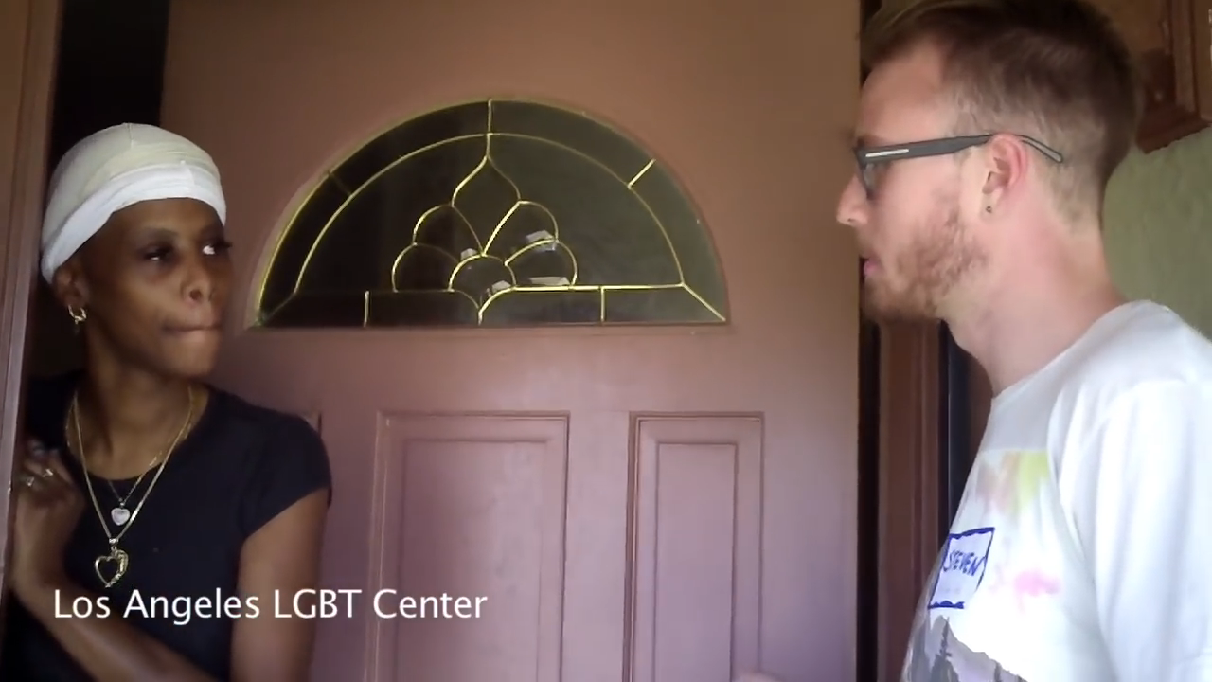

Slide 76
3 minutes
Reflection
What examples of guiding questions did you hear the canvasser say?
Notes:
what double-sided reflective response or invert barrier you would be giving in this conversation

Slide 77
MOTIVATIONAL INTERVIEWING FRAMEWORK
Choosing
Notes:
Individuals are more likely to accept and act upon opinions that they voice themselves

Slide 78
Choosing
Asking the individual to continue conversations

Slide 79
Choosing
Asking the individual to continue conversations
Exploring next steps and options with the individual
Notes:
Goal of this phase: after you have surfaced values and contradictions, it is time to ask them if they would like to do anything to change to be closer to their values
Love the opportunity here – asking folks to show up for the vision they have of themselves and the world

Slide 80
Two
Techniques
Ask
“On a scale of 1-10, how important is it to you that you change XYZ? What would it take to get you to a higher number? Why did you not choose a lower number?”

Slide 81
Two
Techniques
Ask
“On a scale of 1-10, how important is it to you that you change XYZ? What would it take to get you to a higher number? Why did you not choose a lower number?”
Invite
To join a community organization, go to an event, have a further conversation, or support a cause.
Notes:
Ask: Invite them to take certain steps that you have thought about during the conversation; ask to join in further conversation, Join a group : “If a vote came up about this issue, would you choose to vote any differently?”

Slide 82
CAUTIONARY TRAPS
Moving to this stage too soon!

Slide 83
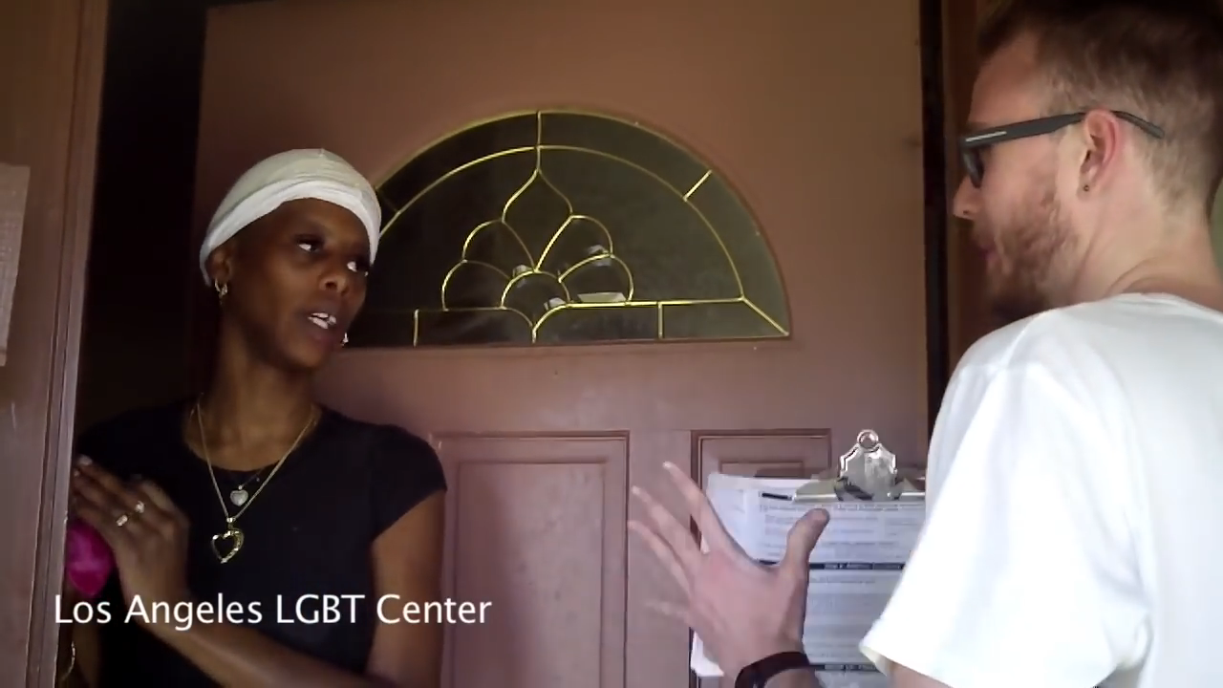

Slide 84
3 minutes
Reflection
How did the canvasser ask the woman to choose? What else might you do in this choosing phase?
Notes:
What types of ‘asks’ do you think would be appropriate for this conversation?

Slide 85
Let’s synthesize
Notes:
When people get entrenched, how do we handle it? Usually people get entrenched when their historic thinking is challenged. Easier to retreat to position than change it.
Because our opinions or politics have become who we are we are asking a big ask
Connect on shared values – this is a slow process but big change is slow and we are recommending you use this framework with folks that you are already in relationship with or folks that are on the fence

Slide 86
What do you feel complex about?
Notes:
Think of an issue that you don’t feel totally resolved about
Examples: criminal legal system, climate change, personal question of eating, leather, brother (I get very cagey about this very fast)

Slide 87
Motivational interviewing framework
1
Exploring
Guiding
Choosing
2
3
Notes:
3 key pieces
Exploring: you are establishing rapport with the person you are speaking with
Guiding: In this middle stage, you have had the chance to build rapport and state a few reflective responses and are now pushing to areas of conversation that they feel ambivalent about
Choosing: Opening up an opportunity - Individuals are more likely to accept and act upon opinions that they voice themselves
Keep in mind active listening and trying to stay nonjudgmental

Slide 88
Agenda
Welcome and introductions
What is motivational interviewing?
Motivational interviewing framework
Debrief & close

Slide 89
Debrief
What phase of the framework comes easily to you?
Which trap do you fall into?

Slide 90
Debrief
What situation do you think this motivational interviewing framework would work best in?
Who do you commit to trying this with?

Slide 91
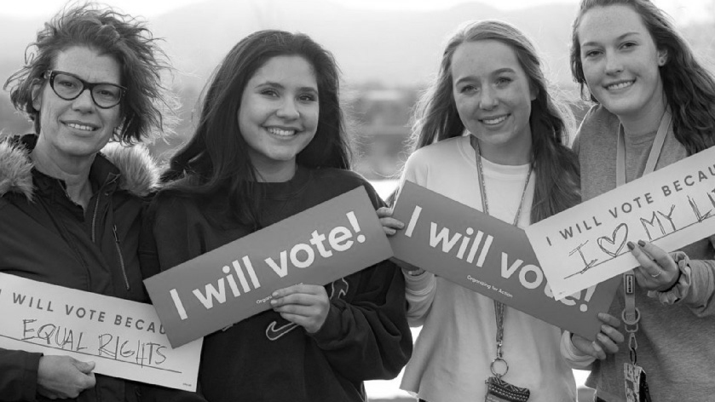
Connecting to OFA
Notes:
We have a lot of ways for you to connect with OFA and apply these skills!

Slide 92
Upcoming
In 2018
1
Organizing for ’18
2
  Commit to vote program
3
Online training series
3
Chapter involvement

Slide 93
Thank you for joining
today’s training.
Please fill out the survey below and give us
your feedback on today’s training.
bit.ly/effectiveconvosMI
Notes:
Reminder to fill out survey; reminder to sign the sign in sheet

