Slide 1

Welcome
We will begin at 7:30 p.m. Central Time.
Notes:
This work is licensed under the Creative Commons Attribution-NonCommercial 4.0 International License. To view a copy of this license, visit http://creativecommons.org/licenses/by-nc/4.0/ or send a letter to Creative Commons, PO Box 1866, Mountain View, CA 94042, USA

Slide 2
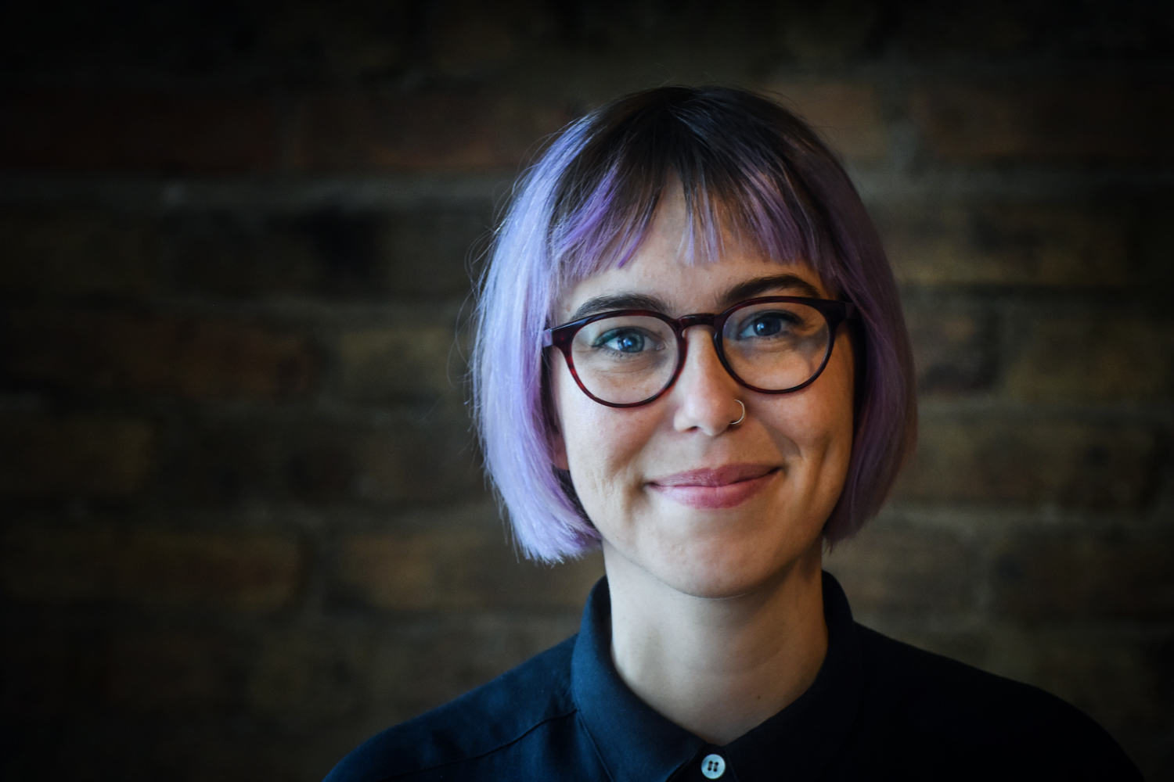
Alexis Conavay
Organizing Coordinator

Slide 3
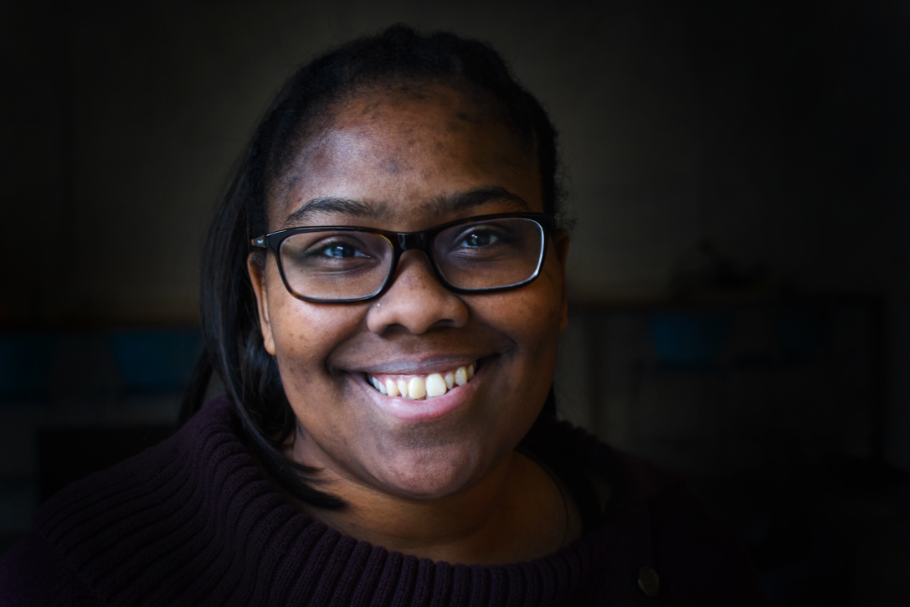
Jalakoi Solomon
Regional Organizing Manager

Slide 4
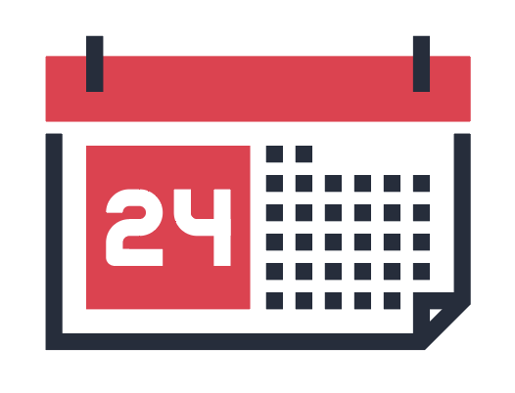



Logistics
We will meet every Wednesday for 90 minutes. If you cannot attend, inform your fellows manager and email fellows@ofa.us
This is an interactive training.
A recording of this video and call will be available on the Fellows Bookshelf following this training.
Tweet using #OFAFellows

Slide 5

Last week
We introduced the various types of community engagement events and asked you to work with your team to begin planning your event.
This week you’ll take the next step towards working with your team and hammering out the event details.

Slide 6
OFA aims to share grassroots
organizing best practices with you, regardless of your experience
planning events.

Slide 7
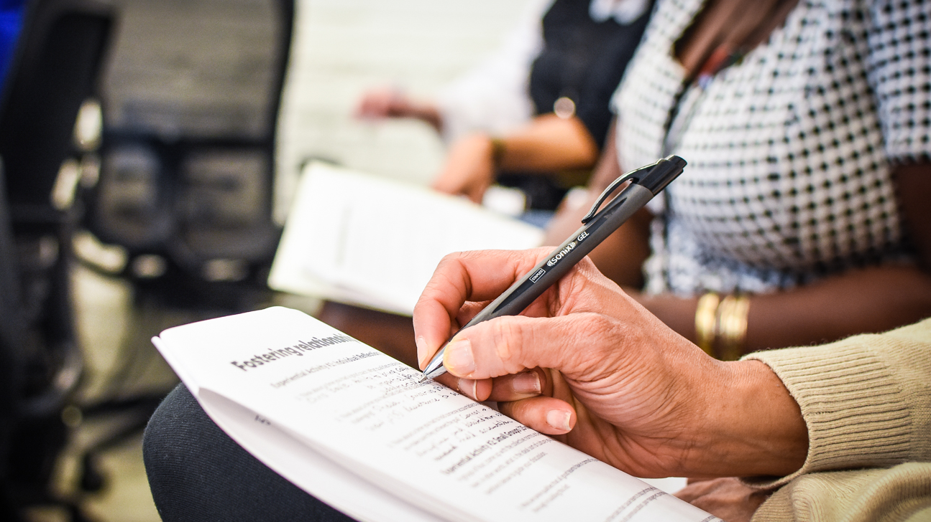

Leading an Action
Planning Session

Slide 8
Goals for today
1
Understand how organizers use action planning sessions
Be able to plan and lead an action planning session where you determine what type of organizing event you will host
Feel confident inspiring others to take action through an action planning session
2
3

Slide 9
Agenda
Purpose of an APS
Developing an APS agenda
Action-driven facilitation
Debrief and next steps
Notes:
00:18 – 00:19 [1 min] – Aquiles
[Broad Goals] Review post-training agenda
We cannot cover everything you will need to know today.
That is why we have a post-training agenda for you
Review key dates and webinars

Slide 10
Action planning sessions provide a space
for people to meet, discuss recent actions taken by Congress and the administration, and determine next steps as a group.

Slide 11
Think of an event that you went to that you considered a failure. What made it unsuccessful? What was the audience’s reaction?
Type in the chat box

Slide 12
What could have been done differently to make it successful?
Type in the chat box

Slide 13
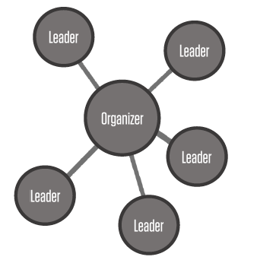
Organizers empower others to learn
and build strong relationships.
Organizers identify, recruit, and develop leaders around a specific issue or cause.
Organizers bring people together challenging them to act on behalf of their shared values and interests.

Slide 14
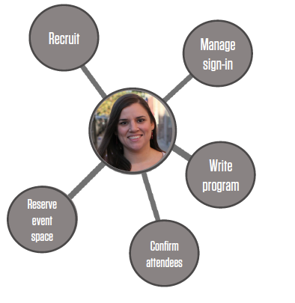
Organizers get
things done by empowering
groups of people
to work together
to accomplish
a goal.
Organizers do not do it all themselves.

Slide 15
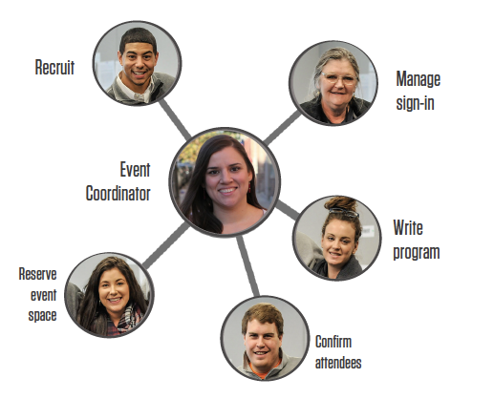
Organizers get
things done by empowering
groups of people
to work together
to accomplish
a goal.
Organizers do not do it all themselves.

Slide 16
Action planning sessions create the opportunity for organizers to:
Build the relationships required for any team to work well together
Agree on what outcome your team will achieve
Define responsibilities

Slide 17
Action planning sessions create the opportunity for organizers to:
Build the relationships required for any team to work well together
Agree on what outcome your team will achieve
Define responsibilities
… in order to achieve a shared goal

Slide 18
Agenda
Purpose of an APS
Developing an APS agenda
Action-driven facilitation
Debrief and next steps
Notes:
00:18 – 00:19 [1 min] – Aquiles
[Broad Goals] Review post-training agenda
We cannot cover everything you will need to know today.
That is why we have a post-training agenda for you
Review key dates and webinars

Slide 19
Framework: Action planning
session core agenda
1
What: What do we want to do? What does success look like?

Slide 20
Framework: Action planning
session core agenda
1
What: What do we want to do? What does success look like?
Why: Purpose—why are we organizing this event?
2

Slide 21
Framework: Action planning
session core agenda
1
What: What do we want to do? What does success look like?
Why: Purpose—why are we organizing this event?
When: When will this event happen? Plan A, B, C, D
2
3

Slide 22
Framework: Action planning
session core agenda
1
What: What do we want to do? What does success look like?
Why: Purpose—why are we organizing this event?
When: When will this event happen? Plan A, B, C, D
Where: Where will this event take place? Plan A, B, C, D
2
3
4

Slide 23
Framework: Action planning
session core agenda
1
What: What do we want to do? What does success look like?
Why: Purpose—why are we organizing this event?
When: When will this event happen? Plan A, B, C, D
Where: Where will this event take place? Plan A, B, C, D
Who: Assign roles—who will do what? Who should be involved?
2
3
4
5

Slide 24
Framework: Action planning
session core agenda
1
What: What do we want to do? What does success look like?
What issue will we focus on?
What type of event will we host?
What is the goal of our event?
What do we want attendees to do at the event?
What will the key takeaways be?

Slide 25
Framework: Action planning
session core agenda
2
Why: Purpose—why are we organizing this event?
Why is this issue important?
Why here?
Why now?
Why should people care?
What do people have to gain or lose from not taking action?

Slide 26
Framework: Action planning
session core agenda
3
When: When will this event happen? Plan A, B, C, D
When is my organizing team available to host the event?
When are other community events that might compete with our event?
When is related legislation being voted on?
When is Congress in session?
When is the next congressional recess?
When are partner coalitions available to contribute?

Slide 27
Framework: Action planning
session core agenda
Where: Where will this event take place? Plan A, B, C, D
Where is there space available on my date of choice?
Is the space large enough to hold my event?
How many people do I need to accommodate?
Is the space easy for attendees to get to?
Is the space ADA accessible?
Does the space have audio/visual equipment?
4

Slide 28
Framework: Action planning
session core agenda
5
Who: Assign roles—who will do what? Who should be involved?
Who is on my organizing team?
How will we communicate with each other?
Which partner coalitions will be involved?
Who will I invite to my event?
How will I get the word out to potential attendees?
Will I invite guest speakers or panelists? If so, who?
Who’s voice is typically missing from this issue?

Slide 29
Framework: Action planning
session core agenda
1
What: What do we want to do? What does success look like?
Why: Purpose—why are we organizing this event?
When: When will this event happen? Plan A, B, C, D
Where: Where will this event take place? Plan A, B, C, D
Who: Assign roles—who will do what? Who should be involved?
2
3
4
5

Slide 30
Which of the 5 W’s do you think will be the hardest to align with a large group of people on?
Type in the chat box

Slide 31
Agenda
Purpose of an APS
Developing an APS agenda
Action-driven facilitation
Debrief and next steps
Notes:
00:18 – 00:19 [1 min] – Aquiles
[Broad Goals] Review post-training agenda
We cannot cover everything you will need to know today.
That is why we have a post-training agenda for you
Review key dates and webinars

Slide 32
What is effective facilitation?
Type in the chat box

Slide 33
5 key elements of action-driven facilitation
1
Establish clear agenda and goals

Slide 34
5 key elements of action-driven facilitation
1
Establish clear agenda and goals
Set norms at the top of your meeting
2

Slide 35
5 key elements of action-driven facilitation
1
Establish clear agenda and goals
Set norms at the top of your meeting
Do not lecture, engage
2
3

Slide 36
5 key elements of action-driven facilitation
1
Establish clear agenda and goals
Set norms at the top of your meeting
Do not lecture, engage
Do not shut down ideas, encourage creativity
2
3
4

Slide 37
5 key elements of action-driven facilitation
1
Establish clear agenda and goals
Set norms at the top of your meeting
Do not lecture, engage
Do not shut down ideas, encourage creativity
Organize – “Can you take the lead on that?”
2
3
4
5

Slide 38
Agenda
Purpose of an APS
Developing an APS agenda
Action-driven facilitation
Debrief and next steps
Notes:
00:18 – 00:19 [1 min] – Aquiles
[Broad Goals] Review post-training agenda
We cannot cover everything you will need to know today.
That is why we have a post-training agenda for you
Review key dates and webinars

Slide 39
Weekly assignment:
Due Wednesday, October 11
Complete an action planning session and report back on your 5 Ws.
If you have a fellows leader do this as a team during your weekly check-in

Slide 40
OFA Training
Thank you for joining today’s webinar.
Check the Fellow Bookshelf for a copy of the material covered today,
including a video recording of the webinar.
Email fellows@ofa.us with any questions.
bit.ly/cefweek2

