Slide 1
Welcome
We will begin at 7:30 p.m. Central Time.
Notes:
This work is licensed under the Creative Commons Attribution-NonCommercial 4.0 International License. To view a copy of this license, visit http://creativecommons.org/licenses/by-nc/4.0/ or send a letter to Creative Commons, PO Box 1866, Mountain View, CA 94042, USA

Slide 2
OFA Community
Engagement Fellows
Fall 2017 / #OFAFellows

Slide 3
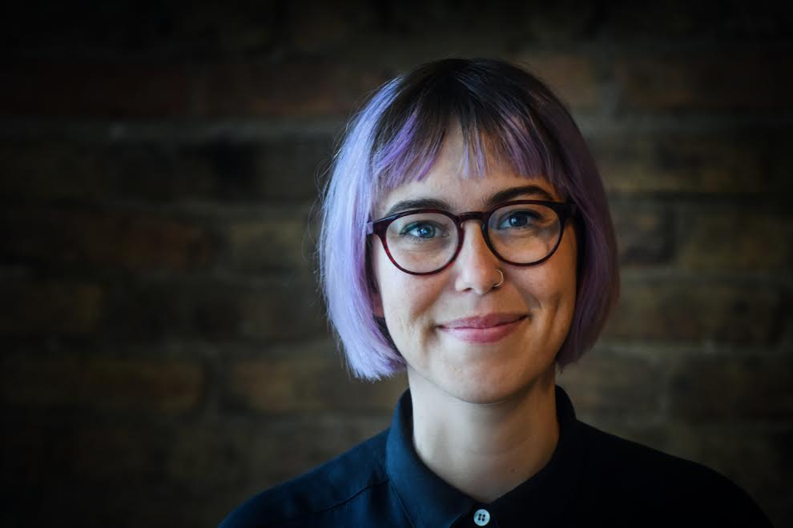
Alexis Conavay
Organizing Coordinator

Slide 4
Goals for today
1
Understand the important role that events can play in helping organizers engage their community
Be able to begin planning your community engagement event
Feel confident and eager to begin organizing and engaging your community
2
3

Slide 5
Agenda
Intro and Welcome
Community Organizing 101
Your fellowship event
Review learning journey
Review program logistics and norms
Debrief and close
Notes:
00:18 – 00:19 [1 min] – Aquiles
[Broad Goals] Review post-training agenda
We cannot cover everything you will need to know today.
That is why we have a post-training agenda for you
Review key dates and webinars

Slide 6
In the chat box, share your name, where you live, and which issues you are most passionate about. What do you hope to achieve during the fellowship?

Slide 7
Agenda
Intro and Welcome
Community Organizing 101
Your fellowship event
Review learning journey
Review program logistics and norms
Debrief and close
Notes:
00:18 – 00:19 [1 min] – Aquiles
[Broad Goals] Review post-training agenda
We cannot cover everything you will need to know today.
That is why we have a post-training agenda for you
Review key dates and webinars

Slide 8
How are these leaders different and what do they have in common?

Slide 9
They were organizers!

Slide 10
Organizers are change-makers. They are leaders who take action.

Slide 12
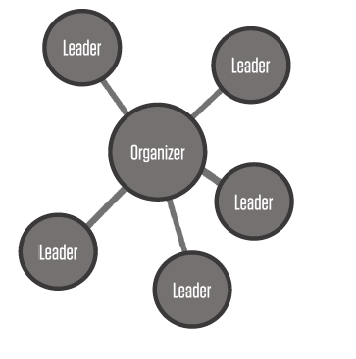
Organizers empower others to learn
and build strong relationships.
Organizers identify, recruit, and develop leaders around a specific issue or cause.

Slide 13
Organizers empower others to learn
and build strong relationships.
Organizers identify, recruit, and develop leaders around a specific issue or cause.
Organizers bring people together challenging them to act on behalf of their shared values and interests.

Slide 14
We utilize everything
we have to organize.
There are many entry
points to organizing.

Slide 15
What qualities do you possess that will make you a good organizer?
Type in the chat box

Slide 16
Agenda
Intro and Welcome
Community Organizing 101
Your fellowship event
Review learning journey
Review program logistics and norms
Debrief and close
Notes:
00:18 – 00:19 [1 min] – Aquiles
[Broad Goals] Review post-training agenda
We cannot cover everything you will need to know today.
That is why we have a post-training agenda for you
Review key dates and webinars

Slide 17
Community Engagement Events
1
Film Screenings

Slide 18
Community Engagement Events
1
Film Screenings
Speaker Series
2

Slide 19
Community Engagement Events
1
Film Screenings
Speaker Series
Community Service
2
3

Slide 20
Community Engagement Events
1
Film Screenings
Speaker Series
Community Service
Civic Dinners
2
3
4

Slide 21
Mobilizing Events
Earned media events
Signature
drives
Phone banks

Slide 22
Mobilizing Events
Office visits
to elected officials
Community action meeting
Town hall meetings

Slide 23
What questions do you have? Have you been to any events that have shifted your thinking?
Type in the chat box

Slide 24
4 Steps to begin planning your
fellowship event
What is a problem that’s affecting the health of your community?
1

Slide 25
4 Steps to begin planning your
fellowship event
What is a problem that’s affecting the health of your community?
What is an issue that can make an impact on this problem?
1
2

Slide 26
4 Steps to begin planning your
fellowship event
What is a problem that’s affecting the health of your community?
What is an issue that can make an impact on this problem?
What are your indicators of success around making progress on this issue?
1
2
3

Slide 27
4 Steps to begin planning your
fellowship event
What is a problem that’s affecting the health of your community?
What is an issue that can make an impact on this problem?
What are your indicators of success around making progress on this issue?
With this in mind – what type of capstone project do you think best fits the problem you’re trying to address?
1
2
3
4

Slide 28
What is a problem you’d like to address in your community?
Type in the chat box

Slide 29
Agenda
Intro and Welcome
Community Organizing 101
Your fellowship event
Review learning journey
Review program logistics and norms
Debrief and close
Notes:
00:18 – 00:19 [1 min] – Aquiles
[Broad Goals] Review post-training agenda
We cannot cover everything you will need to know today.
That is why we have a post-training agenda for you
Review key dates and webinars

Slide 30
Our learning journey
Week 1: Organizing Community Engagement
Events

Slide 31
Our learning journey
Week 1: Organizing Community Engagement
Events
Week 2: Leading an Action Planning Session

Slide 32
Our learning journey
Week 1: Organizing Community Engagement
Events
Week 2: Leading an Action Planning Session
Week 3: Event Management

Slide 33
Our learning journey
Week 1: Organizing Community Engagement
Events
Week 2: Leading an Action Planning Session
Week 3: Event Management
Week 4: Recruitment: Grassroots Tactics

Slide 34
Our learning journey
Week 1: Organizing Community Engagement
Events
Week 2: Leading an Action Planning Session
Week 3: Event Management
Week 4: Recruitment: Grassroots Tactics
Week 5: Recruitment: Digital Tactics

Slide 35
Our learning journey
Week 1: Organizing Community Engagement
Events
Week 2: Leading an Action Planning Session
Week 3: Event Management
Week 4: Recruitment: Grassroots Tactics
Week 5: Recruitment: Digital Tactics
Week 6: Tying it all together

Slide 36
What are you most eager to learn
about during the fellowship?
Type in the chat box

Slide 37
Agenda
Intro and Welcome
Community Organizing 101
Your fellowship event
Review learning journey
Review program logistics and norms
Debrief and close
Notes:
00:18 – 00:19 [1 min] – Aquiles
[Broad Goals] Review post-training agenda
We cannot cover everything you will need to know today.
That is why we have a post-training agenda for you
Review key dates and webinars

Slide 38
Logistics
We will meet every Wednesday for 90 minutes. If you cannot attend, emails fellows@ofa.us (and your Fellows Leader, if you have one)

Slide 39
Logistics
We will meet every Wednesday for 90 minutes. If you cannot attend, emails fellows@ofa.us (and your Fellows Leader, if you have one)
This is an interactive training.

Slide 40
Logistics
We will meet every Wednesday for 90 minutes. If you cannot attend, emails fellows@ofa.us (and your Fellows Leader, if you have one)
This is an interactive training.
A recording of this video will be available on the Fellows Bookshelf following this training.

Slide 41
Logistics
We will meet every Wednesday for 90 minutes. If you cannot attend, emails fellows@ofa.us (and your Fellows Leader, if you have one)
This is an interactive training.
A recording of this video will be available on the Fellows Bookshelf following this training.
Tweet using #OFAFellows

Slide 42
Agenda
Intro and Welcome
Community Organizing 101
Your fellowship event
Review learning journey
Review program logistics and norms
Debrief and close
Notes:
00:18 – 00:19 [1 min] – Aquiles
[Broad Goals] Review post-training agenda
We cannot cover everything you will need to know today.
That is why we have a post-training agenda for you
Review key dates and webinars

Slide 43
Weekly assignment:
Due Wednesday, October 5
You will find a link to these questions on the Bookshelf.
1
What is a problem that’s affecting the health of your community?
What is an issue that can make an impact on this problem?
What your indicators of success around making progress on this issue?
With this in mind – what type of capstone project do you think best fits the problem you’re trying to address?
2
3
4

Slide 44
What questions do you have?
Type in the chat box

Slide 45
OFA Training
Thank you for joining today.
Please fill out the evaluation on today’s training using the link below.
Email fellows@ofa.us with any questions.
bit.ly/cefeval1

