Slide 1




Effective conversations
Part 5: Deep Canvassing
Elizabeth Erickson OFA Training Director / Adrienne Lever Swing Left Campaign Director
Brandyn Keating United Citizen Power Founding Director / Michelle Villegas Regional Organizing Manager
We will begin the training at 8 p.m. ET / 7 p.m. CT
Notes:
This work is licensed under the Creative Commons Attribution-NonCommercial 4.0 International License. To view a copy of this license, visit http://creativecommons.org/licenses/by-nc/4.0/ or send a letter to Creative Commons, PO Box 1866, Mountain View, CA 94042, USA
Welcome to this training – one sentence of OFA, what I do with OFA
Introduce self
Introduce Michelle Introduce Adrienne, Introduce Brandyn – founding director of UCP and will tell you more about herself as she opens the training, main facilitator for the evening – trains orgs nationally on deep canvassing

Slide 2
Our learning journey
Week 1: Effective listening
Week 2: Motivational interviewing
Week 3: Identifying your why
Week 4: Your theory of change
Week 5: Introduction to deep canvassing
Notes:
We are going to learn how to operationalize the concepts taught through the first four sessions through the lens of deep canvass

Slide 3


GUIDED WORKSHEET
Deep Canvassing
bit.ly/deepcanvassing
Notes:
http://bit.ly/deepcanvassing

Slide 4
#OFAction
#SwingLeft
#UnitedCitizenPowerAction

Slide 5
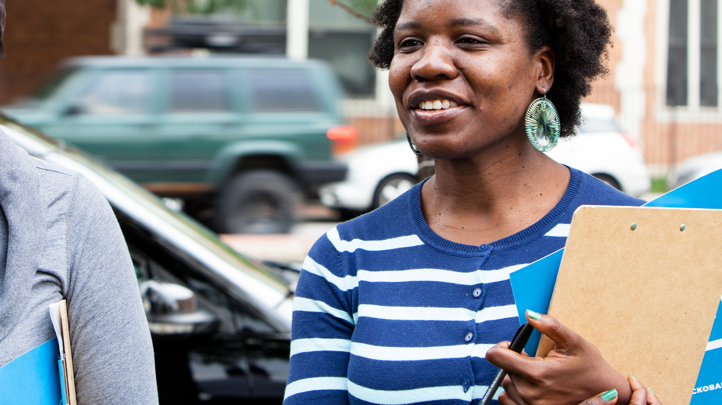
Introduction to deep canvassing
Notes:
7:10- 7:11
Why we need to have effective conversations – the time is NOW to understand our neighbors and understand the things that compel them

Slide 6

@UnitedCP
@BrandynKeating

Slide 7
Agenda
Defining
Application
Synthesis
Close & next steps
Notes:
You must know your why; there are various ways to start figuring that out

Slide 8
GOAL FOR THIS SESSION
Understand the basics on how to operationalize skills we have learned in sessions 1-4.
Notes:
7:11- 7:12
Note--- this is a TYPE of personal story

Slide 9
GOAL FOR THIS SESSION
Understand what deep canvassing is, why it works, and how we can use it.
Notes:
7:11- 7:12
Note--- this is a TYPE of personal story

Slide 10
QUESTION:
When was the last time
you changed your mind about something that really mattered to you?
Notes:
MICHELLE – lead question and write in the chat box, Michelle reads answers
9 times out of 10 people answer what Brandyn is looking for – doesn’t convince them – looking for an EXPERIENCE
Pull something out of chat box that is relevant (Michelle has a response, pulls something relevant out of the chat box)

Slide 11
Deep canvassing:
Candid two-way conversations in which canvassers ask voters to share their own emotionally significant experiences and reflect on them aloud.

Slide 12
Goal:
Uncover real, lived experience with emotional weight.

Slide 13
QUESTION
How is deep canvass
different from other canvasses
you have experienced?
Notes:
What is deep canvass? How is it different from other kinds of conversations?
Unpacking definitions (ex. Cognitive dissonance)

Slide 14
Why deep canvass?

Slide 15
Persuasion is hard.
(Also, you are weird.)

Slide 16
Dramatic effects
Lasting effects
Penetrate a saturated environment
Develop an unlikely ally (persuasion!)

Slide 17
Psychological theories
Backlash effect
Self-persuasion
Cognitive dissonance
Recipe examples: analogic perspective-taking, out-group threat

Slide 18
Agenda
Defining
Application
Synthesis
Close & Next Steps
Notes:
You must know your why; there are various ways to start figuring that out

Slide 19


Slide 20
KEY SKILL #1
Non-judgment
Helper skill: Curiosity
Notes:
You are talking to someone, and realize they are not aligned politically with you. You may be canvassing, you may be talking to your neighbor, you may be at a city council meeting

Slide 21
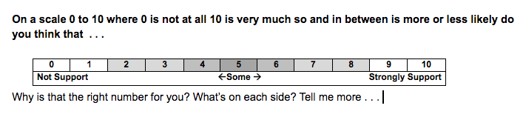
RATING SCALE
Notes:
You are talking to someone, and realize they are not aligned politically with you. You may be canvassing, you may be talking to your neighbor, you may be at a city council meeting

Slide 22
KEY SKILL #2
Active Listening
Helper skill: Repeat Backs
Notes:
You are talking to someone, and realize they are not aligned politically with you. You may be canvassing, you may be talking to your neighbor, you may be at a city council meeting

Slide 23
KEY SKILL #3
Vulnerability
(story sharing)
Helper skill: Share at the level of values
Notes:
You are talking to someone, and realize they are not aligned politically with you. You may be canvassing, you may be talking to your neighbor, you may be at a city council meeting

Slide 24
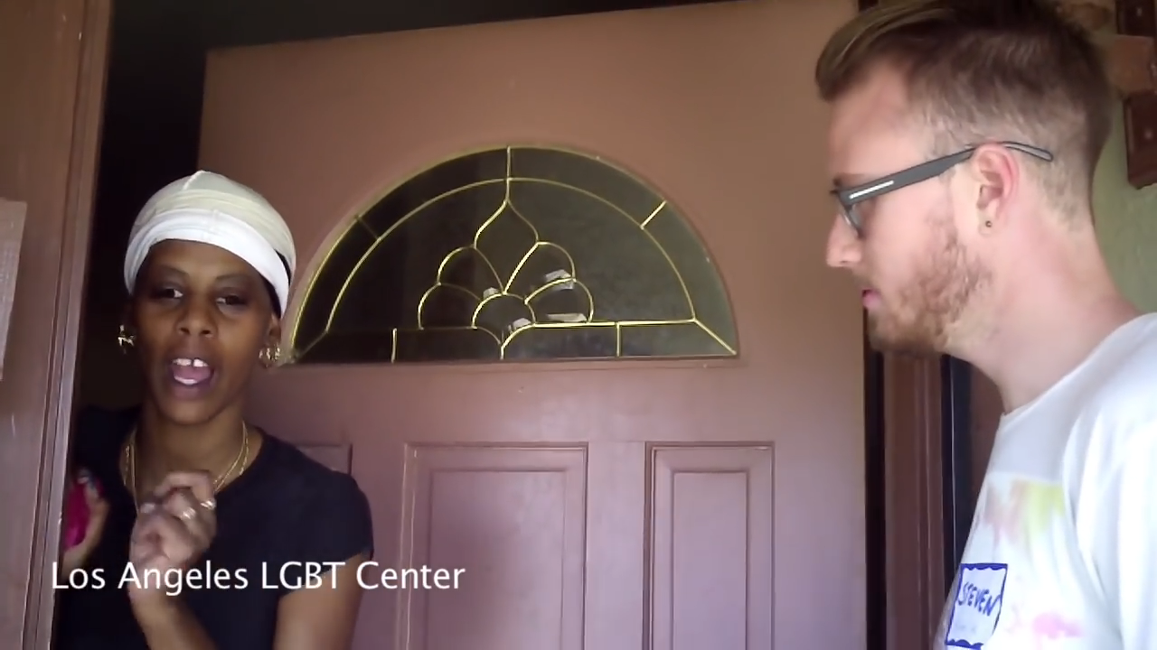
Notes:
Put in canvassing video

Slide 25
TRANSITION TO STORY
We don’t often talk about
our [topic] but when I think about [topic], I think about [person you care about] …
Notes:
You are talking to someone, and realize they are not aligned politically with you. You may be canvassing, you may be talking to your neighbor, you may be at a city council meeting

Slide 26
KEY SKILL #4
Pro tip for connecting
values and lived experiences
Notes:
You are talking to someone, and realize they are not aligned politically with you. You may be canvassing, you may be talking to your neighbor, you may be at a city council meeting

Slide 27
It sounds like you really care about [value]. Do you remember a time when that crystallized for you?
Notes:
You are talking to someone, and realize they are not aligned politically with you. You may be canvassing, you may be talking to your neighbor, you may be at a city council meeting

Slide 28
Agenda
Defining
Application
Synthesis
Close & Next steps
Notes:
You must know your why; there are various ways to start figuring that out

Slide 29
Putting it all together
→ Education, connection, second rating, ask, data collection
Story sharing
→ Introduction and first rating

Slide 30
Using these skills in the wild
At the door
In water cooler conversations
In 1:1s
In group meetings

Slide 31
Recap – Knowing your why
Why, how, what (and when to use it)
Synthesis
Close & Next steps
Agenda
Notes:
You must know your why; there are various ways to start figuring that out

Slide 32
Debrief
What is your biggest take-away?
What outstanding questions do you have?

Slide 33
Thanks!

Slide 34
OFA + Swing Left
Thank you for joining today’s webinar.
Please fill out the survey below and give us
your feedback on today’s training.
bit.ly/effectiveconvos5

