Slide 1

Welcome
We will begin at 7:30 pm Central Time
Notes:
This work is licensed under the Creative Commons Attribution-NonCommercial 4.0 International License. To view a copy of this license, visit http://creativecommons.org/licenses/by-nc/4.0/ or send a letter to Creative Commons, PO Box 1866, Mountain View, CA 94042, USA

Slide 2





Logistics
We will meet every Wednesday for 90 minutes. If you cannot attend, inform your fellows leader, if you have one, and email fellows@ofa.us
This is an interactive training.
A recording of this video and slides will be available on the Fellows Bookshelf following this training.
Tweet using #OFAFellows

Slide 3
Our learning journey:
Where we’ve been and where we’re going
Week 1: Organizing Community Engagement
Events
Week 2: Leading an Action Planning Session
Week 3: Event Management
Week 4: Recruitment: Grassroots Tactics

Slide 4
Our learning journey:
Where we’ve been and where we’re going
Week 1: Organizing Community Engagement
Events
Week 2: Leading an Action Planning Session
Week 3: Event Management
Week 4: Recruitment: Grassroots Tactics
Week 5: Recruitment: Digital Tactics
Week 6: Tying it all together

Slide 5
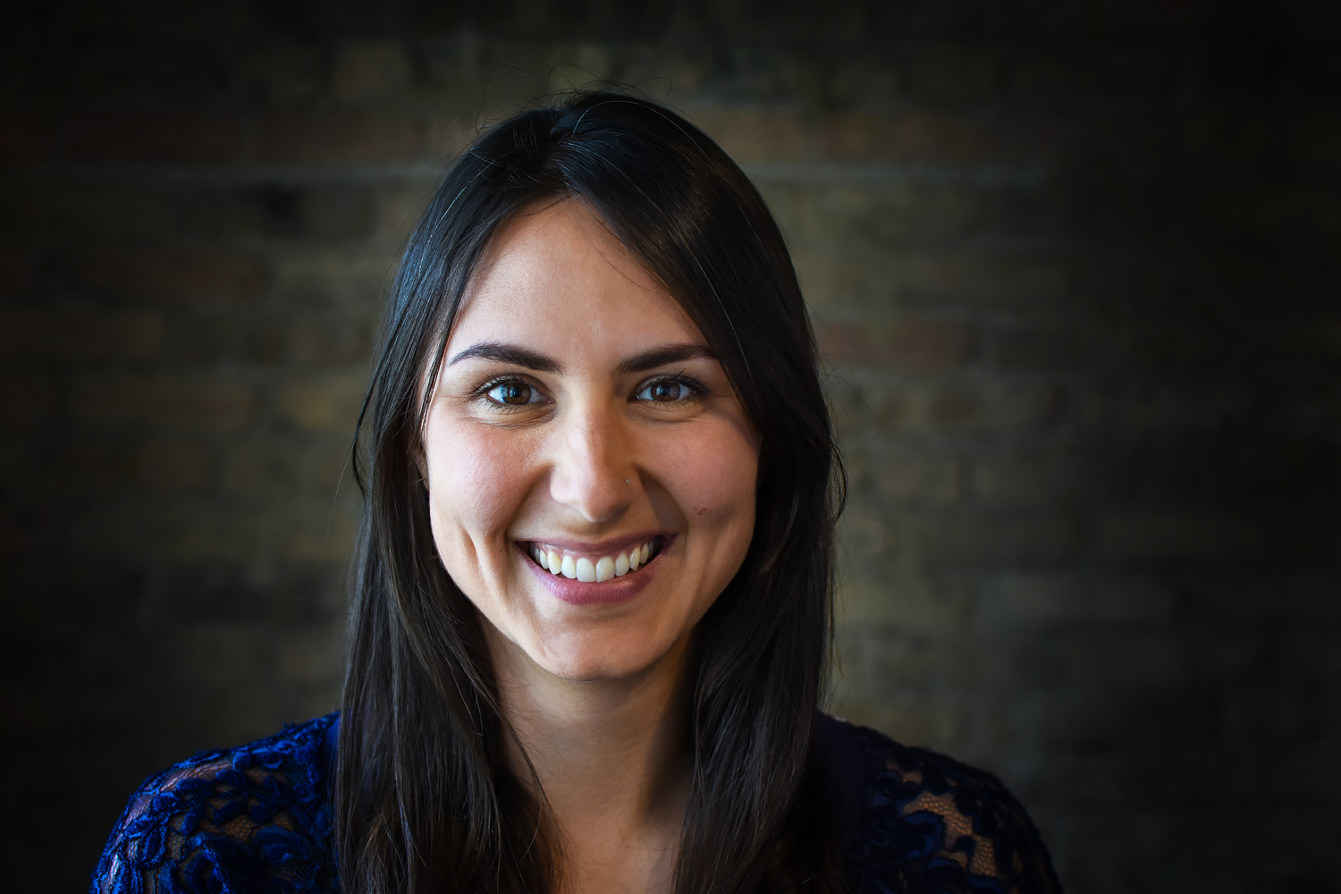

Alex Woodward
Digital Organizing Director
@alex_woodward

Slide 6
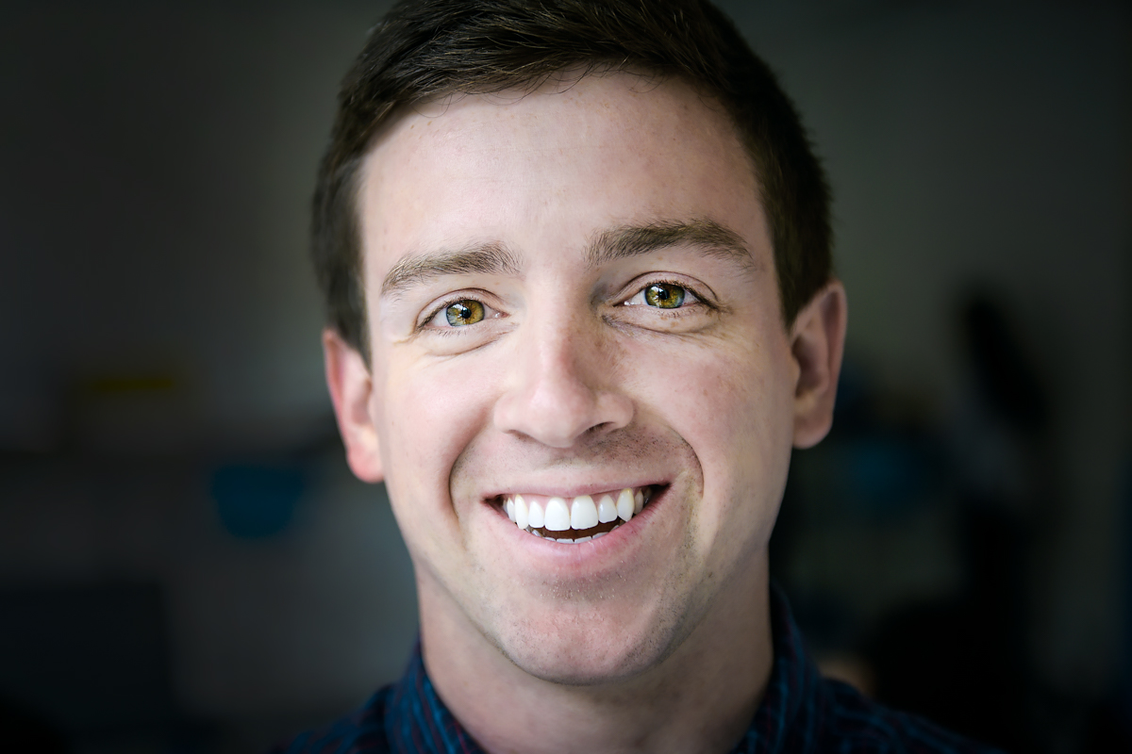
Jonathan Kibort
Digital Organizing Strategist
@jmkibort

Slide 7
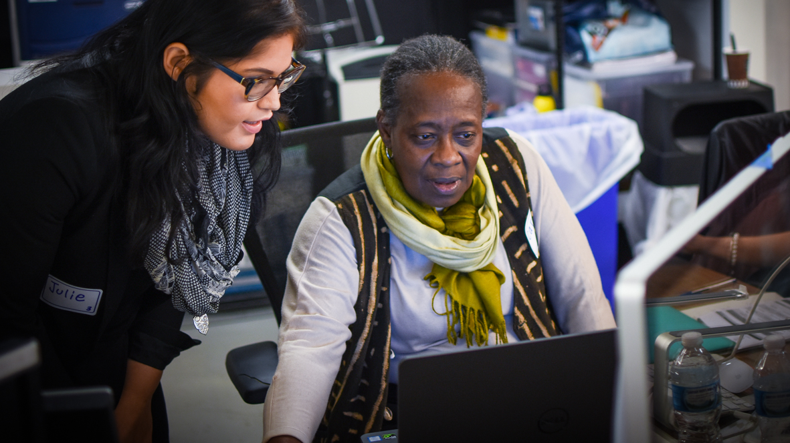
Digital Tactics:
Recruitment & storytelling

Slide 8
Goals for today
Understand the role social media plays in sharing the story of your event online
Be able to tell the story of your event on social media
Feel comfortable using Twitter
1
2
3

Slide 9
Agenda
Why digital?
Producing content
Peer review
Debrief and next steps
Notes:
00:18 – 00:19 [1 min] – Aquiles
[Broad Goals] Review post-training agenda
We cannot cover everything you will need to know today.
That is why we have a post-training agenda for you
Review key dates and webinars

Slide 10
What’s the power of social media?
Type in the chat box

Slide 11
How do you use Facebook?
Type in the chat box
Notes:
How do you use it?

Slide 12
How do you use Twitter?
Type in the chat box

Slide 13
Facebook has 1.86 billion users in the world.

Slide 14
Twitter reports having more than 300 million monthly active users
and 500 million Tweets sent daily.

Slide 15
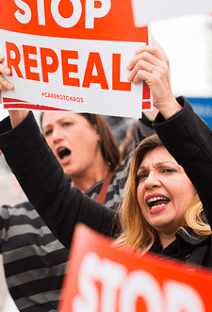
Organizing feeds mobilizing & vice versa
As organizers, your strongest asset is the number of people you can mobilize to advocate your message.
To mobilize effectively, we need a dependable and large list of people highly willing to take action with us.
Digital organizing allows you to a grow a vast list of supporters so that you can mobilize to broadcast your message.
Notes:
Mobilizing is all about turning important moments into action. You’ve seen this around Obamacare– Along with other organizations working locally an nationally, OFA will bring in new people to take action when it’s most needed, ask them to take meaningful action, train them on how to do it well. These organizing moments are important to winning on the issues.

Slide 16
KEY PRINCIPLES OF DIGITAL ORGANIZING
Authenticity
Relevance
Impact

Slide 17
Your message matters

Slide 18
At the core of any relationship is one thing:

Slide 19
At the core of any relationship is one thing:
Trust.

Slide 20
If you do not trust a brand, or organization, you are likely not going to take action or respond.

Slide 21
And if your list does not trust you, you have no chance at mobilizing them to action.

Slide 22
Agenda
Why digital?
Producing content
Peer review
Debrief and next steps
Notes:
00:18 – 00:19 [1 min] – Aquiles
[Broad Goals] Review post-training agenda
We cannot cover everything you will need to know today.
That is why we have a post-training agenda for you
Review key dates and webinars

Slide 23
KEY PRINCIPLES OF DIGITAL CONTENT
Keep it short
Show, don’t tell
Interact with your networks

Slide 24
Let’s review two social
media posts.
What do you like about
them? What do you think
the goal of each post is?

Slide 25
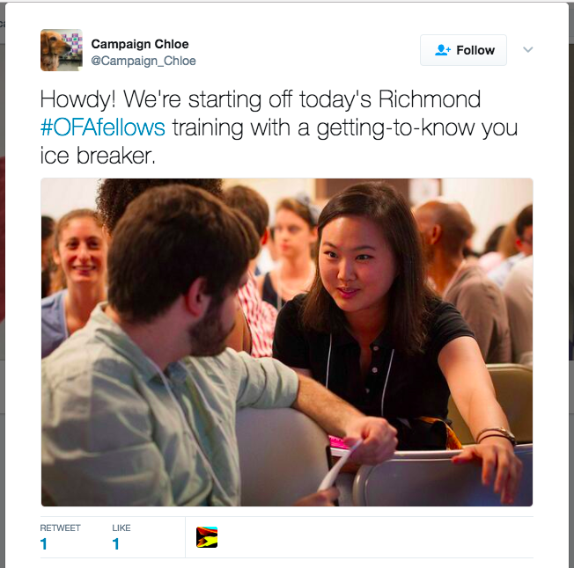
Post 1

Slide 26
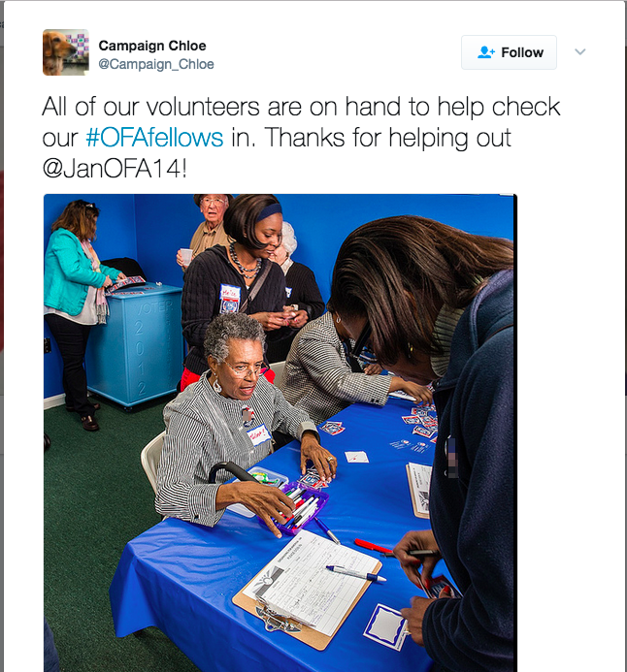
Post 2

Slide 27
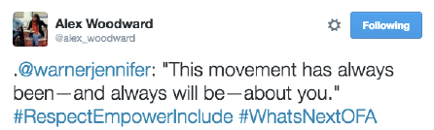
Keep it short
What do you want to say?
Pick one point per post.

Slide 28
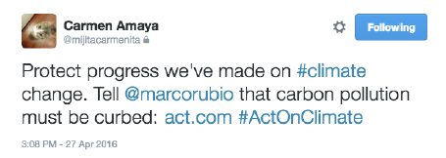
Keep it short
What’s the point of this post?

Slide 29
Keep it short
What’s the point of this post?
Action: Tell Marco Rubio to act on climate.

Slide 30
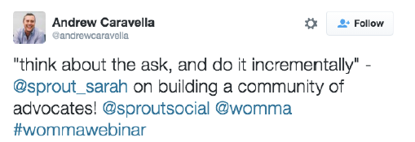
Keep it short
What’s the point of this post?

Slide 31
Keep it short
What’s the point of this post?
Share content of training.

Slide 32
What do you want to say?
Pick one point per post.

Slide 33
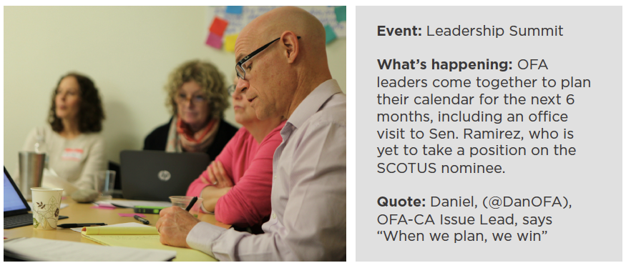
5 minutes
You are at this action planning meeting. Write a tweet that is
short and that shows what is happening at the meeting.

Slide 34
You might not be a
professional photographer
But you can be a good one
Notes:
You might not be a professional photographer, but you can be a good photographer—and you don’t need a fancy camera. Combined with free apps, today’s camera phones are convenient enough and perform well enough to capture excellent photos.

Slide 35
The photographer’s mantra
1
Fill the frame
Notes:
These three rules should guide the photos you take
Make sure the frame (what you see through your viewfinder or on your phone screen) is filled with the elements you want a viewer to see. If an element doesn’t need to be in the photo, make sure it’s out of the frame

Slide 36
The photographer’s mantra
1
Fill the frame
2
Control the background
Notes:
Make sure the background doesn’t distract from the message you’re trying to convey in the image. The background should enhance the image—it should provide a viewer with more information about the place, time, story, or emotion of the scene.

Slide 37
The photographer’s mantra
1
Fill the frame
2
Control the background
3
Wait for moments
Notes:
Once your frame is filled and the background is controlled, wait to take the perfect shot. This could be when a crowd erupts in cheers, when two people hug, or when a speaker passionately raises their arms. If there’s a lot of action in your frame, take multiple shots—or bursts of photos—to increase your chances of catching that perfect freeze-frame.

Slide 38
Adjust for the
lighting in your surroundings.
Notes:
If they’re in front of a window or lamp they’ll come out dark. Move to the side to another angle where they will be better lit. If they’re in front of a window or lamp—or the sun—they’ll come out dark. So you should move to get another angle where they will be better lit. The number one reason by photos turn out blurry is because there isn’t enough light. So if your photos are blurry see what you can do to get where there is more light.

Slide 39
Adjust for the
lighting in your surroundings.
Move yourself to
get varied shots or compose a scene.
Notes:
“Crop with your feet”
Instead of using the zoom functionality of your camera—which can result in grainy or blurry photos—move your feet to get closer to your subject. If there’s something distracting on the side of the frame or in the background, move yourself up, down, le , or right to try to eliminate the distracting element.
Change your angles
Take photos from different heights and different angles. Get low and photograph a crowd of protesters from below. Get up high to show all the contents on a table of letter-writers during a letter-writing event.
Vary your head sizes
One good indicator of photo variety is if head sizes are different between your shots. Focus on getting a mix of detail, medium, and wide shots, crop with your feet, and change your angles to allow for more variety.

Slide 40
Take your best shot
Notes:
The type of photo you take can speak volumes about the action you’re documenting

Slide 41
Detail shots
These are close-up images where the frame is filled with a limited amount of information.
It could be a close-up of rally signs, hands folded in someone’s lap, or pens and petition forms on a table.
Use case: during event set up, before much of the action takes place

Slide 42
Medium shots
These shots show a wider frame of view than details shots, and may include a single subject or a small group. These are shots of conversations, moments between individuals, or interaction amongst a small group.
Use case: these should feel intimate, like the viewer is in the midst of the action.

Slide 43
Wide shots
These shots convey the scale and scope of an event or moment. The size of a crowd, the flurry of action at an event, the energy of the group. They are used to provide context—time of day, season, and geographic and physical location.
Use case: These are less intimate than medium shots, but can convey a sense of awe that medium shots might not.

Slide 44
Portraits
These shots show who the people at your event are. These can be OFA volunteers, community members you’re interacting with, guest speakers, or even members of the media conducting interviews. Portraits focus on a single individual or a small group. A viewer should be immediately drawn to the individual in the photo, and not to other elements in the frame.

Slide 45
Rule of thirds
Imagine your frame is divided into nine equal boxes by two equally spaced vertical and two equally spaced horizontal lines. Placing the subject of your photo at the intersections of these lines (where the orange dots are) can create more visual interest—which helps hold a viewer’s attention.

Slide 46
Agenda
Why digital?
Producing content
Peer review
Debrief and next steps
Notes:
00:18 – 00:19 [1 min] – Aquiles
[Broad Goals] Review post-training agenda
We cannot cover everything you will need to know today.
That is why we have a post-training agenda for you
Review key dates and webinars

Slide 47
5 minutes
For this activity, draft a tweet to your social media network about your upcoming event.
Remember:
  Keep it short
  Show don’t tell
  Interact with your network

Slide 48
Let’s check twitter

Slide 49
Agenda
Why digital?
Producing content
Peer review
Debrief and next steps
Notes:
00:18 – 00:19 [1 min] – Aquiles
[Broad Goals] Review post-training agenda
We cannot cover everything you will need to know today.
That is why we have a post-training agenda for you
Review key dates and webinars

Slide 50
Using your Twitter account,
tweet your biggest takeaway from tonight using #OFAFellows

Slide 51
Weekly assignment Due Nov 1
This week, you will fill out and submit a project proposal. This will include many of the plans that you have developed over the past 5 weeks. This is going to tell us a little bit more about what your most current and updated plan is for your event.

Slide 52
Wrapping up the fellowship

Slide 53
OFA Training
Thank you for joining today’s webinar.
Check the Fellow Bookshelf for a copy of the material covered today,
including a video of the webinar.
Email fellows@ofa.us with any questions.
bit.ly/cefweek5

