Slide 1


Welcome
We will begin at 7:30 p.m. Central Time.
Notes:
This work is licensed under the Creative Commons Attribution-NonCommercial 4.0 International License. To view a copy of this license, visit http://creativecommons.org/licenses/by-nc/4.0/ or send a letter to Creative Commons, PO Box 1866, Mountain View, CA 94042, USA

Slide 2
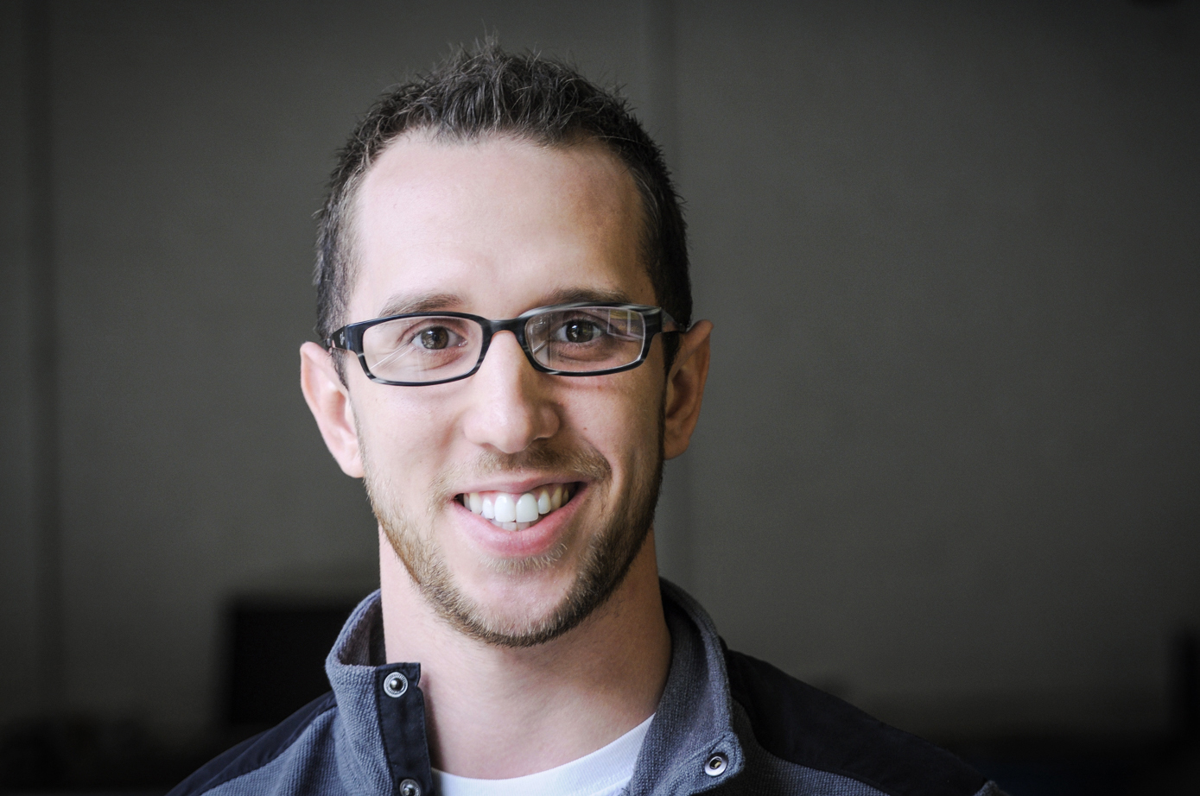
Kevin Lane
Training Projects Manager

Slide 3





Logistics
We will meet every Wednesday for 90 minutes. If you cannot attend, inform your fellows leader, if you have one, and email fellows@ofa.us
This is an interactive training.
A recording of this video and slides will be available on the Fellows Bookshelf following this training.
Tweet using #OFAFellows

Slide 4
Our learning journey:
Week 1: Organizing Community Engagement
Events
Week 2: Leading an Action Planning Session
Week 3: Event Management

Slide 5
Our learning journey:
Week 1: Organizing Community Engagement
Events
Week 2: Leading an Action Planning Session
Week 3: Event Management
Week 4: Recruitment: Grassroots Tactics
Week 5: Recruitment: Digital Tactics
Week 6: Tying it all together

Slide 6
Goals for today
Understand the different components of event management
Be able to write a tick tock and checklist for your event
Feel confident preventing and solving problems that will arise before, during, and after your event
1
2
3

Slide 7
Agenda
Event management overview
Tools for event management
Preventing and solving
Debrief and next steps
Notes:
00:18 – 00:19 [1 min] – Aquiles
[Broad Goals] Review post-training agenda
We cannot cover everything you will need to know today.
That is why we have a post-training agenda for you
Review key dates and webinars

Slide 8
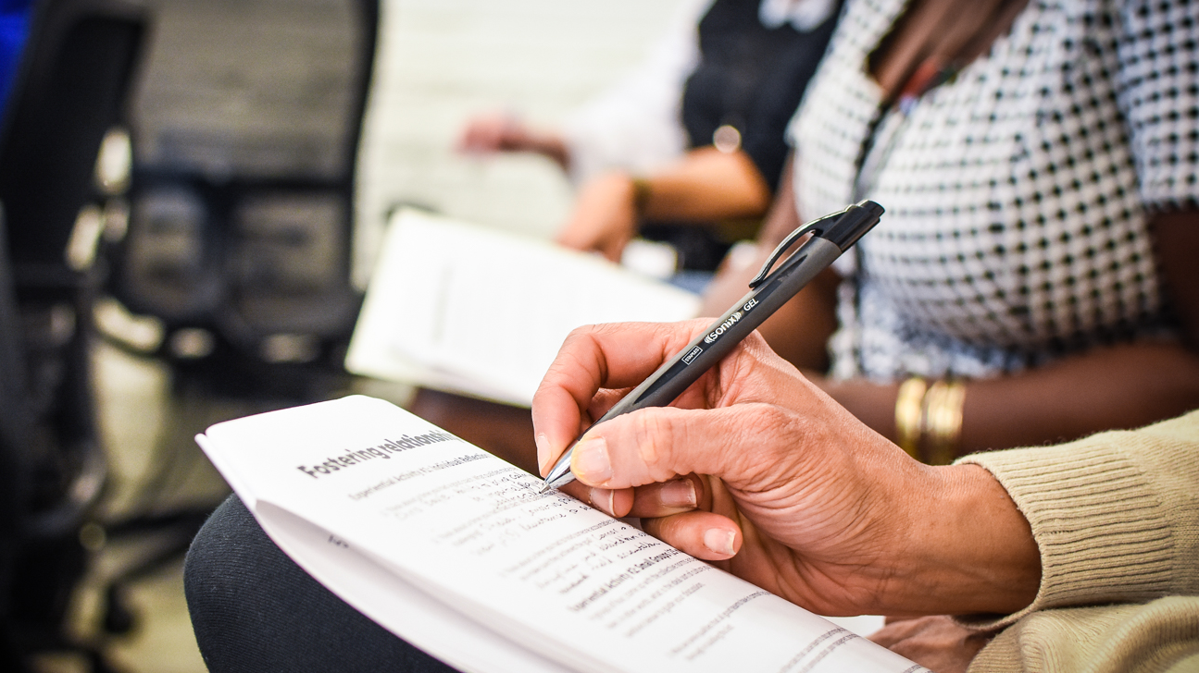
Event management

Slide 9
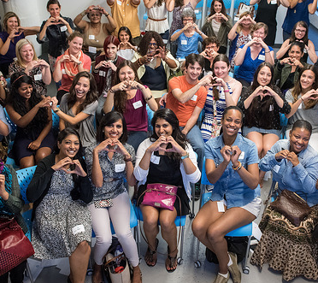
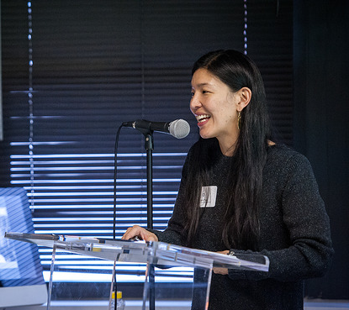
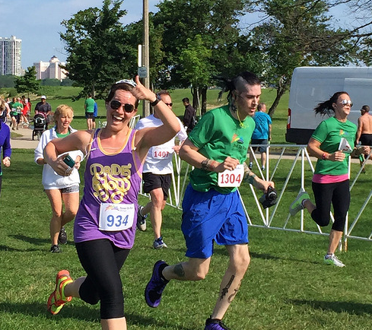
Film Screening
The Empowerment Project
August 2015
Speaker Series
Caring Across America
March 2015
Community Service
Proud to Run
June 2015

Slide 10
Event goals
1
Why: Purpose—why are we organizing this event?
What: What do we want to do? What does success look like?
When: When will this event happen? Plan A, B, C, D
Where: Where will this event take place? Plan A, B, C, D
Who: Assign roles—who will do what? Who should be involved?
2
3
4
5

Slide 11
Event goals: The next step
You always want to make an ask to your audience during or at the end of your event.
Organizing is hard work, and the best way for us to grow and achieve more is to make use of the great people we have in the room.
Always be ready with the next step for your audience for how they can stay engaged and take more action!

Slide 12
What do you think a good ask might be for the issue you’re focusing on?
Type in the chat box

Slide 13
MANAGING YOUR EVENT
Organizing events is complex, challenging work. Their success depends on smooth logistics, high-quality content, and a clear vision for how the event fits into the bigger picture.

Slide 14
MANAGING YOUR EVENT
At OFA, we rely on two important tools to help manage the success of our events: the tick tock and event checklist.

Slide 15
Agenda
Event management overview
Tools for event management
Preventing and solving
Debrief and next steps
Notes:
00:18 – 00:19 [1 min] – Aquiles
[Broad Goals] Review post-training agenda
We cannot cover everything you will need to know today.
That is why we have a post-training agenda for you
Review key dates and webinars

Slide 16
WHAT IS A TICK TOCK?
A detailed rundown of what will happen at your event from start to finish.

Slide 17
In what ways do you think a tick tock is useful for managing an event?
Type in the chat box

Slide 18
Components of a tick tock:
Flow
Start with welcome and introduction, sharing goals and reviewing agenda
Order of speaking program (film panel, community service)
Finish with close and next steps

Slide 19
Components of a tick tock:
Time
Think through the timing of each portion of event – i.e. intro/welcome, Q&A, event evaluation
Account for transition time
Account for buffer time
Be respectful of your audience’s time

Slide 20
What questions do you have regarding the
flow and time of an event tick tock?
Type in the chat box

Slide 21
WHAT IS A CHECKLIST?
A document that takes into account all of the resources, materials, and logistics needed in order to run an event

Slide 22
Components of a checklist:
Buckets
Supplies
AV needs
Food/refreshments
Accessibility

Slide 23
Sample checklist

Slide 24
What are some items on your checklist that are immediate next steps?
Type in the chat box

Slide 25
Agenda
Event management overview
Tools for event management
Writing an event tick tock
Preventing and solving
Debrief and next steps
Notes:
00:18 – 00:19 [1 min] – Aquiles
[Broad Goals] Review post-training agenda
We cannot cover everything you will need to know today.
That is why we have a post-training agenda for you
Review key dates and webinars

Slide 26
Preventive Solution
Adaptive
Solution
Before
What can you do before the event to prevent a problem
from happening?
During
What can you do during the event to manage a problem by adapting?

Slide 27
Scenario # 1:
You are hosting a film screening. For this event you plan to present a movie, followed by a panel discussion and a Q & A. But during the actual event, panelists are talking over each other and the Q & A is going longer than expected. Moreover, the same three audience members are asking questions and controlling the conversation.

Slide 28
Scenario # 1:
Preventative
Solution:
You are hosting a film screening. For this event you plan to present a movie, followed by a panel discussion and a Q & A. But during the actual event, panelists are talking over each other and the Q & A is going longer than expected. Moreover, the same three audience members are asking questions and controlling the conversation.
Assign and prepare an event moderator or Emcee.

Slide 29
Scenario # 1:
Preventative
Solution:
Adaptive
Solution:
You are hosting a film screening. For this event you plan to present a movie, followed by a panel discussion and a Q & A. But during the actual event, panelists are talking over each other and the Q & A is going longer than expected. Moreover, the same three audience members are asking questions and controlling the conversation.
Assign and prepare an event moderator or Emcee.
Moderator/Emcee should use facilitation skills to keep control of the tick tock, audience, and content.

Slide 30
Scenario # 2:
You are hosting a speaker series about gun violence prevention in your community. Your VIP speaker, a city council member, begins the speaking program and largely focuses on the new housing project the Council proposed last week.

Slide 31
Scenario # 2:
Preventative
Solution:
You are hosting a speaker series about gun violence prevention in your community. Your VIP speaker, a city council member, begins the speaking program and largely focuses on the new housing project the Council proposed last week.
Write a memo to prepare your speaker. Include event goals, suggested talking points, and logistics.

Slide 32
Scenario # 2:
Preventative
Solution:
Adaptive
Solution:
You are hosting a speaker series about gun violence prevention in your community. Your VIP speaker, a city council member, begins the speaking program and largely focuses on the new housing project the Council proposed last week.
Write a memo to prepare your speaker. Include event goals, suggested talking points, and logistics.
Find a pause and ask the speaker something that closely relates to your actual event theme.

Slide 33
Scenario # 3:
You planned a community service event. You recruited and scheduled 21 community members to attend your event. However, only 5 people showed up to the event.

Slide 34
Scenario # 3:
Preventative
Solution:
You planned a community service event. You recruited and scheduled 21 community members to attend your event. However, only 5 people showed up to the event.
Confirmation calls and reminders.

Slide 35
Scenario # 3:
Preventative
Solution:
Adaptive
Solution:
You planned a community service event. You recruited and scheduled 21 community members to attend your event. However, only 5 people showed up to the event.
Confirmation calls and reminders.
Keep up a good spirit and give your audience who did attend the best event possible.

Slide 36
What questions do you have regarding preventative and adaptive solutions?
Type in the chat box

Slide 37
Agenda
Event management overview
Tools for event management
Writing an event tick tock
Preventing and solving
Debrief and next steps
Notes:
00:18 – 00:19 [1 min] – Aquiles
[Broad Goals] Review post-training agenda
We cannot cover everything you will need to know today.
That is why we have a post-training agenda for you
Review key dates and webinars

Slide 38
Debrief
What are your key takeaways?
Type in the chat box

Slide 39
Weekly assignment, due October 18:
Part 1: Work individual or with your team to develop a tick tock for your event. You might not have all the data you need to complete your tick tock. However, use what you have thus far.
Part 2: Work individual or with your team to write a check-list of what you need to do before, during, and after your event in order to meet your goals. This will be a work in progress.

Slide 40
OFA Training
Thank you for joining today’s webinar.
Check the Fellow Bookshelf for a copy of the material covered today,
including a video of the webinar.
Email fellows@ofa.us with any questions.
bit.ly/cefweek3

