Slide 1
Welcome
We will begin at 7:30 p.m. Central Time.
Notes:
This work is licensed under the Creative Commons Attribution-NonCommercial 4.0 International License. To view a copy of this license, visit http://creativecommons.org/licenses/by-nc/4.0/ or send a letter to Creative Commons, PO Box 1866, Mountain View, CA 94042, USA

Slide 2
Tweet today using #OFAFellows

Slide 3
Week 4: Digital organizing
Key takeaways

Slide 4
Strengths of
Social Media
Uses for
Organizers
Millions of people communicating, sharing, ready to engage.
Public forum, real-time conversations, trending topics, and breaking news.
Low-level engagement like sharing and liking is easy.
An easy point-of-entry for potential supporters.
Gives organizers a platform to tell our stories, make our case, and find shared values.
Connect with folks, build networks, lift each other up, share resources, organize.
Notes:
In review

Slide 5
At the core of any relationship is one thing:
Trust.
Notes:
Keep the principles of Authenticity/Relevance/Impact in mind while crafting your message, because the online relationships you have are built on trust.

Slide 6
THE IMPACT OF SOCIAL MEDIA:
“Using the internet and social media to try to effect change, it really started because I felt like I had...a countdown. I had roughly six months to live. And if they didn’t change their minds in that amount of time, that was it.”
Notes:
This is a direct quote from Kendall. (She’s still here btw)

Slide 7
ofa.us/resources
Notes:
More resources available here to make your work even better – we think about these things a lot, okay?

Slide 8
Goals for today
Identify areas that, based on our conceptions, highlight how we want to grow as a leader
Understand the different components of event management
Feel confident preventing and solving problems that will arise before, during, and after your event
1
2
3

Slide 9
Agenda
Leadership vs. management
Event management overview
Tools for event management
Preventing and solving
Debrief and next steps
Notes:
To start, I want us to dig into a big concept – the difference between leadership and management. You’re in the Fellowship because you want deep change in your community and in order to bring this change we need to think about who is at the table and what is inspiring that change. That’s where this comes in.
BOOK CLUB

Slide 10
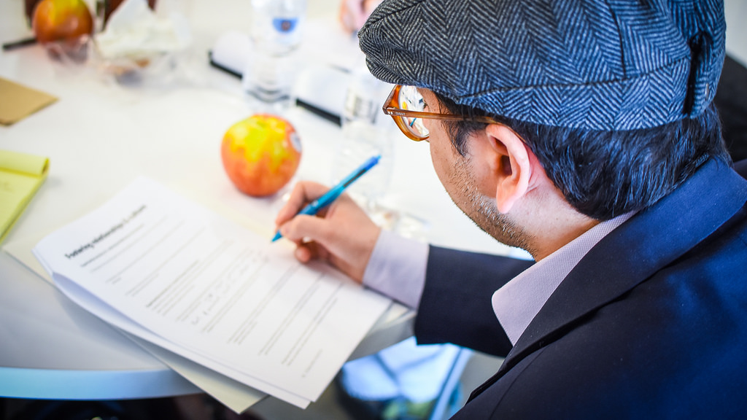
What leadership is
(and is not)
Notes:
So we are going to dig into what leadership is and what it is not.

Slide 11
Our conception of what leadership is can be limiting.
Notes:
What would make our conception of leadership limiting?
Questions to think about:
Who hold power historically in this county?
Do we see people who look like us when we think about which leaders inspire us?

Slide 12
Assigned Leadership:
Leadership that is based on occupying a position in an organization.
(Northouse, ”Leadership: Theory and Practice”, 08)
Notes:
Two different types of leadership
Assigned or positional leadership:
Example, executive director at OFA, Katie Hogan – she is a positional leader

Slide 13
Emergent Leadership:
Perceiving an individual as the most influential member of a group, regardless of their title.
(Northouse, ”Leadership: Theory and Practice”, 08)
Notes:
Emergent leaders don’t need to have positional authority but they still hold leadership.
Think about folks that might be emergent leaders? (Parkland students)
We see this all the time in community organizing
Can be particularly powerful to speak truth
Neither one is either good or bad
This just expands are definition of what a leader looks like

Slide 14
Management
Leadership
Notes:
We often conflate management and leadership so let’s actually dig into what these mean
They are intertwined with one another
You can have really good management but if there isn’t good leadership OR vice verse

Slide 15
Management
(Abraham Zaleznik, 1977)
Leadership
Impersonal about goals
Relate more in-line with role
Authority granted from above (authorized)
Transactional
Conditional

Slide 16
Management
(Abraham Zaleznik, 1977)
Leadership
(Abraham Zaleznik, 1977)
Impersonal about goals
Relate more in-line with role
Authority granted from above (authorized)
Transactional
Conditional
Personal about org goals
Relate more intuitively
Authority granted from below from within
Persistent
Notes:
Leaders are comfortable in ambiguity

Slide 17
“You manage things; you lead people.”
-Grace Murray Hopper,
U.S. Navy Rear Admiral
Notes:
More than anything though, we believe that you have to see yourself as part of the community you want to improve/organize – this is the only way you will know the needs, the resources, who is missing from the table
This gets us to…

Slide 18
Leadership is not…
Notes:
What leadership is not

Slide 19
Coercive or
telling people what to do.
Notes:
Coercion is not leadership because it is forceful. Coercion induces change, while leadership influences change

Slide 20
Trait-based or born
that way.
Notes:
Anybody has the ability to engagement in the process of becoming a leader.
Naturally there are societal factors that give folks the space to be good leaders – it is a muscle you build and flex

Slide 21
Leadership is a process by which an individual uses influence with a group for positive change.
Notes:
So many definitions of leadership but that the root of where we want to start in the context of community organizing
Love that this definition includes that it is a process
Three things to underline, pull out of this definition
1. Process, not static
2. Group, leadership doesn’t happen in a vacuum – we need to work with people
3. Positive change, the outcome of leadership
Build upon this!

Slide 22
Now it’s
your turn
Question: How do you define the difference between leadership and management? What examples can you point to in your own life or experience?
Type in the chat box to share your thoughts

Slide 23
“As we look ahead into the next century, leaders will be those who empower others.”
-Bill Gates
Notes:
Leaders look ahead; leaders build other folks up!

Slide 24
“If your actions create a legacy that inspires others to dream more, learn more, do more and become more, then, you are an excellent leader.”
-Dolly Parton
Notes:
Having an eye on a vision for the future and the world we want to create – rooting ourselves in our why and the values that call us to show up… saying I want more of that in the wrold

Slide 25
“Leadership is a series of behaviors rather than a role for heroes.”
-Margaret Wheatley
Notes:
dailynessof leadership– what it looks like, feels like for the people around you

Slide 26
Now it’s
your turn
Question: How do we inspire others to follow us?
Type in the chat box to share your thoughts
Notes:
7:47- 7:53 [6 minutes]
It’s ok if that takes a second – this is hard! Really think about the FIRST time that happened because that was when you likely solified your belief around a particular value.
This is hard and takes a lot of practice, so some
This is very personal, so if you feel comfortable sharing, we would love to thear

Slide 27
Agenda
Leadership vs. management
Event management overview
Tools for event management
Preventing and solving
Debrief and next steps
Notes:
To apply and practice who we want to be as leaders it is a daily practice. What is most exciting for me about leadership is that I believe a huge part of it is how folks feel around you. How you live out your values

Slide 28
Event management
Notes:
We want you to be: able to delegate responsibilities and ensure tasks are completed on time as your team prepares for your event
So we are going to discuss the different components of event management: How do you keep track of everything that needs to be accomplished? How do you meet all deadlines?
This might seem like a silly question but I want us to root ourselves in the why of events… what purpose do they serve?
These are the events where we flex our orgganizing muscle and take action in an effort to bring about change. We will bring in new people in critical moments around issues, ask them to take meaningful action, and train them to do it well. Again, these are types of events that we host in hopes of bring about action on a certain issues.We want to show decision-makers that we have people who stand with us in wanting to bring about change.These events are great points of entry where we hook people in and get then interested in the issue we care about.Community engagement events are great examples of organizing events because they are typically low bar asks (i.e. come to a movie, come to a panel event) but they spark people's curiosity on an issue and hopefully inspire them to do more.

Slide 29
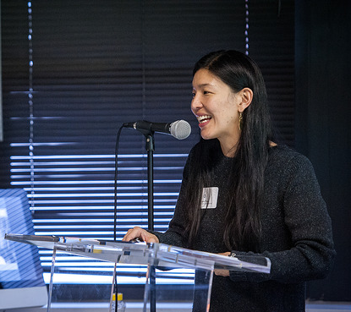
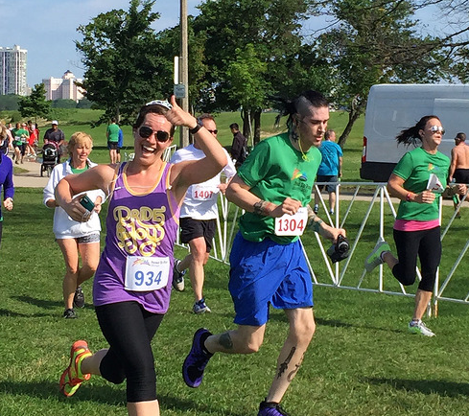
Film Screening
The Empowerment Project
August 2015
Speaker Series
Caring Across America
March 2015
Community Service
Proud to Run
June 2015
Notes:
Events can broadly be separated into 2 buckets: mobilizing events and organizing events. At OFA we do both. You can choose to do either type for your community engagement event. Let's briefly review.
FELLOWS!
I’ll email out more events for you to browse so you can see how leadership is operating in OFA organizing

Slide 30
Event goals
1
Why: Purpose—why are we organizing this event?
What: What do we want to do? What does success look like?
When: When will this event happen? Plan A, B, C, D
Where: Where will this event take place? Plan A, B, C, D
Who: Assign roles—who will do what? Who should be involved?
2
3
4
5
Notes:
Now that you know the basics of your event, it is time to start managing all of the pieces that incorporate your event. What do we mean by managing an event? It means that as an organizer, you are working with your group to make sure you outline and do everything that needs to happen before, during, and after you event in order to meet your goals.

Slide 31
Event goals: The next step
You always want to make an ask to your audience during or at the end of your event.
Organizing is hard work, and the best way for us to grow and achieve more is to make use of the great people we have in the room.
Always be ready with the next step for your audience for how they can stay engaged and take more action!

Slide 32
What do you think a good ask might be for the issue you’re focusing on?
Type in the chat box

Slide 33
MANAGING YOUR EVENT
Organizing events is complex, challenging work. Their success depends on smooth logistics, high-quality content, and a clear vision for how the event fits into the bigger picture.

Slide 34
MANAGING YOUR EVENT
At OFA, we rely on two important tools to help manage the success of our events: the tick tock and event checklist.

Slide 35
Agenda
Leadership vs. management
Event management overview
Tools for event management
Preventing and solving
Debrief and next steps
Notes:
00:18 – 00:19 [1 min] – Aquiles
[Broad Goals] Review post-training agenda
We cannot cover everything you will need to know today.
That is why we have a post-training agenda for you
Review key dates and webinars

Slide 36
WHAT IS A TICK TOCK?
A detailed rundown of what will happen at your event from start to finish.
Notes:
What is a tick tock? An outline of what will happen at your event, from start to finish. Generally your tick tock will change depending on the type of event you are hosting. However, there are two criterias every tick tock should consider: Flow and Time.

Slide 37
In what ways do you think a tick tock is useful for managing an event?
Type in the chat box

Slide 38
Components of a tick tock:
Flow
Start with welcome and introduction, sharing goals and reviewing agenda
Order of speaking program (film panel, community service)
Finish with close and next steps
Notes:
Tick Tock Flow: There should be a natural flow to your tick tock. For instance, always start with a welcome an intro that incorporates goals and agenda review. If you are having a speaker, your q+a should follow after. You should always have a close and next steps.

Slide 39
Components of a tick tock:
Time
Think through the timing of each portion of event – i.e. intro/welcome, Q&A, event evaluation
Account for transition time
Account for buffer time
Be respectful of your audience’s time
Notes:
Tick Tock Time: Time is very important to keeping your audience engaged. Your event should not be more than 2 hours. As you build your tick tock, build in transition time. You should also build buffer time.

Slide 40
What questions do you have regarding the
flow and time of an event tick tock?
Type in the chat box

Slide 41
WHAT IS A CHECKLIST?
A document that takes into account all of the resources, materials, and logistics needed in order to run an event

Slide 42
Components of a checklist:
Buckets
Supplies
AV needs
Food/refreshments
Accessibility

Slide 43
Agenda
Leadership vs. management
Event management overview
Tools for event management
Preventing and solving
Debrief and next steps
Notes:
As an organizer, you are always preventing challenges that might arise before and during your event, as well as solving challenges that arrise during your event, and which you could not see coming. Preventive solutions: Control the controllables. Adaptive solutions: Be proactive and carry-on

Slide 44
Preventive Solution
Adaptive
Solution
Before
What can you do before the event to prevent a problem
from happening?
During
What can you do during the event to manage a problem by adapting?

Slide 45
Scenario # 1:
You are hosting a film screening. For this event you plan to present a movie, followed by a panel discussion and a Q & A. But during the actual event, panelists are talking over each other and the Q & A is going longer than expected. Moreover, the same three audience members are asking questions and controlling the conversation.

Slide 46
Scenario # 1:
Preventative
Solution:
You are hosting a film screening. For this event you plan to present a movie, followed by a panel discussion and a Q & A. But during the actual event, panelists are talking over each other and the Q & A is going longer than expected. Moreover, the same three audience members are asking questions and controlling the conversation.
Assign and prepare an event moderator or Emcee.

Slide 47
Scenario # 1:
Preventative
Solution:
Adaptive
Solution:
You are hosting a film screening. For this event you plan to present a movie, followed by a panel discussion and a Q & A. But during the actual event, panelists are talking over each other and the Q & A is going longer than expected. Moreover, the same three audience members are asking questions and controlling the conversation.
Assign and prepare an event moderator or Emcee.
Moderator/Emcee should use facilitation skills to keep control of the tick tock, audience, and content.

Slide 48
Scenario # 2:
You are hosting a speaker series about gun violence prevention in your community. Your VIP speaker, a city council member, begins the speaking program and largely focuses on the new housing project the Council proposed last week.

Slide 49
Scenario # 2:
Preventative
Solution:
You are hosting a speaker series about gun violence prevention in your community. Your VIP speaker, a city council member, begins the speaking program and largely focuses on the new housing project the Council proposed last week.
Write a memo to prepare your speaker. Include event goals, suggested talking points, and logistics.

Slide 50
Scenario # 2:
Preventative
Solution:
Adaptive
Solution:
You are hosting a speaker series about gun violence prevention in your community. Your VIP speaker, a city council member, begins the speaking program and largely focuses on the new housing project the Council proposed last week.
Write a memo to prepare your speaker. Include event goals, suggested talking points, and logistics.
Find a pause and ask the speaker something that closely relates to your actual event theme.

Slide 51
Scenario # 3:
You planned a community service event. You recruited and scheduled 21 community members to attend your event. However, only 5 people showed up to the event.

Slide 52
Scenario # 3:
Preventative
Solution:
You planned a community service event. You recruited and scheduled 21 community members to attend your event. However, only 5 people showed up to the event.
Confirmation calls and reminders.

Slide 53
Scenario # 3:
Preventative
Solution:
Adaptive
Solution:
You planned a community service event. You recruited and scheduled 21 community members to attend your event. However, only 5 people showed up to the event.
Confirmation calls and reminders.
Keep up a good spirit and give your audience who did attend the best event possible.

Slide 54
What questions do you have regarding preventative and adaptive solutions?
Type in the chat box

Slide 55
Agenda
Leadership vs. management
Event management overview
Tools for event management
Preventing and solving
Debrief and next steps

Slide 56
Now it’s
your turn
Question: What are the types and examples of leadership you see exemplified in your community?
Type in the chat box to share your thoughts
Notes:
Look for examples in your community – push your thinking around whois a leader around you
What values are driving those folks

Slide 57
Tweet your key takeaway
#OFAFellows
Notes:
Over the span of this week hundreds of fellows will be starting this journey along with you! Using social media to share out your learning and what you are excited about is a great way to build connections that span the country. It is also a super great way to show your personal networks what you’re working on. Who knows, maybe someone will be inspired by you and begin their own organizing journey!

Slide 58
What to expect next week

Slide 59
Thanks for joining the training!
Please fill out the evaluation on today’s training using the link below:
Bit.ly/Summer5-2018

