Slide 1


Grassroots Fundraising:
Making a Hard Ask
Trainer, Role
@TwitterHandle
Notes:
This work is licensed under the Creative Commons Attribution-NonCommercial 4.0 International License. To view a copy of this license, visit http://creativecommons.org/licenses/by-nc/4.0/ or send a letter to Creative Commons, PO Box 1866, Mountain View, CA 94042, USA
Use this pencil whenever a slide needs customization!

Slide 2
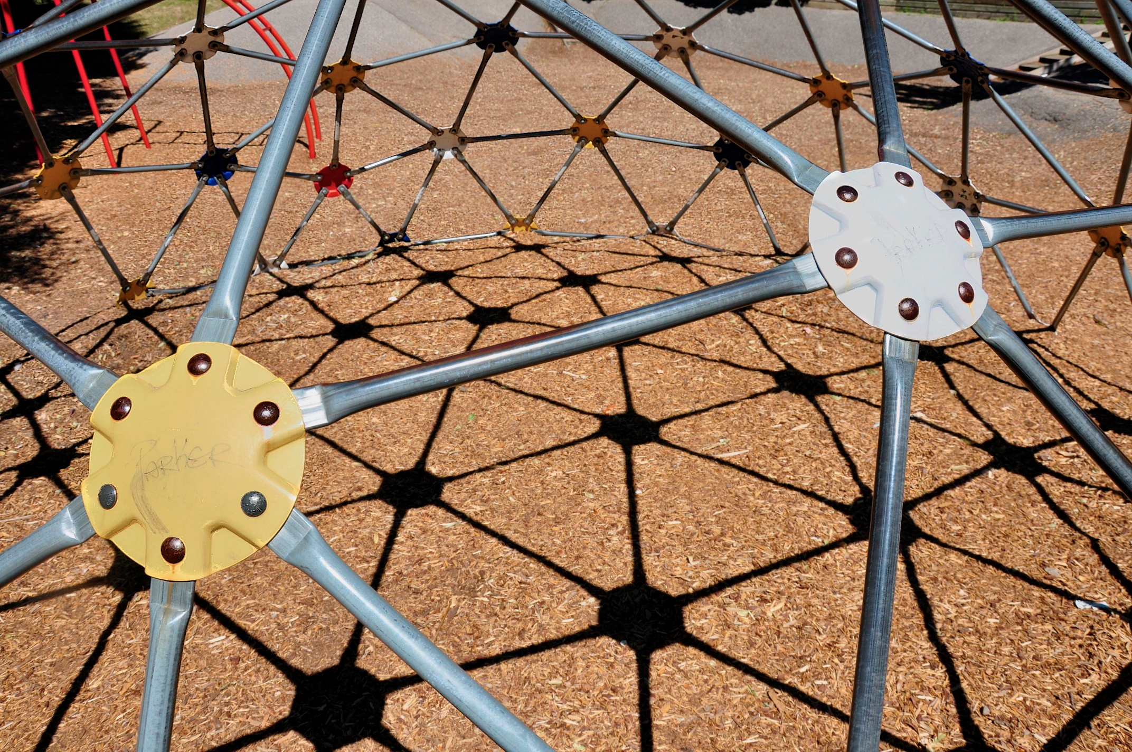
Why Grassroots Fundraising?
Notes:
0:05 – 0:10 Grassroots Fundraising Overview
Why is grassroots fundraising important?
[Slide 2] Put simply, grassroots fundraising will allow us to run successful organizing programs in your state. But who can think of a few other reasons why including grassroots fundraising as part of our field program might be important?
[Take responses from a few of the audience about why GRF is important. Seek to elicit the below responses:
Expands our donor base to people who wouldn’t otherwise give
Gives local community ownership over organizing
Demonstrates popular support
Opens other paths for engagement with OFA]
Great. A key point that you just mentioned is that grassroots fundraising opens other paths for engagement with OFA. Think of the jungle gym on the slide – we can approach it from a number of different ways, right? Unlike a slide, people can come on from different sides at the same time. So while some people will take action with OFA by attending a rally, others will take action with OFA by making a financial contribution or hosting a fundraiser.
One of the biggest barriers to leading a successful grassroots fundraising program is the taboo about asking for money -- It’s important to note that this is a learned behavior. We can overcome this barrier by recognizing that people give when they are asked. People who give money are going to give it somewhere, so it is up to us to invite them to give to OFA and become involved in our work. We have nothing to lose by making a hard ask so long as we maintain our principles of RESPECT.EMPOWER.INCLUDE.ACT.With that being said, let’s jump into our goals for this session.

Slide 3
Goals
Understand the importance of grassroots fundraising to our organizing work
Learn best practices for making a hard fundraising ask
Feel prepared when you make a hard fundraising ask
Notes:
0:10 – 0:12 Introduce session and goals
[Slide 3]
The most efficient way to fundraise for any cause is to include a “hard” ask when soliciting supporters. At the end of this session our goal is that you [read from slide]:
Understand the importance of Grassroots Fundraising to our organizing work
Learn best practices to making a hard ask.
Feel comfortable making a hard ask and are ready to start raising money to help your state achieve its goals

Slide 4

Agenda slide
Introductions & Goals
Circles of Benefit
The Anatomy of a Hard Ask
Practice Rounds
Debrief and Closing
Notes:
0:12 – 0:13 Agenda review
[Slide 4]
So let’s go over what we’re going to do in this session.
After we get through introductions, we’ll go through a brief overview of Grassroots Fundraising and its place in our state programs.
We’ll put fundraising in context by discussing the “Circles of Benefit” and why people donate to different causes
We’ll dive deep into making a hard ask.
Practice fundraising conversations with a hard ask.
And then we’ll debrief and wrap up.
Ok, let’s jump in!

Slide 5
Agenda slide
Introductions and Goals
Circles of Benefit
The Anatomy of a Hard Ask
Practice Rounds
Debrief and Closing
Notes:
0:14 – 0:15 Agenda review
[Slide 5]
So now that we’re past Introductions and Goals, let’s jump into the “Circles of Benefit” which will help us better understand prospective donors. Adding context to prospective donors will, of course, help us make a hard ask.

Slide 6
Why do people donate?
Because they’re inspired by a specific person on your team or by a specific action
Because they believe in what your organization stands for
Because they disagree with your opposition
They want to be part of a community
To receive recognition
Because they’re asked to.
Notes:
0:15 – 0:30 Circles of Benefit
0:15 – 0:18 Why do people donate?
[Slide 6]
In order for us to know how to ask for support, we first need to first think about the reasons why someone might contribute to an organization – any organization.
Let’s popcorn style this. What are some reasons why you might donate to an organization?
[Take responses from a few of the audience about why GRF is important. Seek to elicit the following responses:
Because they’re inspired by someone or an something
Because they believe in your cause
Because they disagree with your opposition
To be part of a community
To receive recognition
AND most importantly
Because they’re asked to. ]
Great! This is really at the core of why anyone would contribute to any organization, charity, campaign, etc.

Slide 7
Circles of Benefit
You
Personal
Ideology
Ax to Grind
Power
TIME & RESOURCES
Notes:
0:15 – 0:30 Circles of Benefit
0:18 – 0:25 Circles of Benefit
[Slide 7]
EMILY’s List has a diagram to help candidates put prospective donors into context. It ‘s a great diagram and is applicable to our grassroots fundraising at OFA. As a volunteer fundraiser, YOU can put yourself at the center of the diagram.
A few key things to note:
The kinds of donors who give – and when they give – is determined by the kind of donor they are. So what does this mean? Picture yourself at the center of this diagram. You are the fundraiser. And donors are all broken into these different circles or categories.
Personal – Your personal contacts.
Ideology – People that care about your organization’s mission.
Ax to Grind – People or organizations that care about stopping your opposition.
Power – Institutional organizations that have a formal solicitation process.
What this means is that the donors closest to you, require less resources and less convincing, so they are likely to contribute to your cause faster than all of these other groups. Why? Because they care about you and want to support YOU.
For instance, if I asked a personal contact like my older brother for a donation, he is more likely to give quickly because when I convey the importance of his gift and the urgency behind giving now, he will likely go ahead and do it. When he donates, he’ll be doing it because he cares about me and he will do it quickly because he knows it will help me.
Someone that I don’t know personally, but that I know cares about the cause, will likely require more convincing. You will need to provide concrete examples about your team’s work and why that work moves the cause forward.
With limited resources, we will be most successful as grassroots fundraisers if we focus on the Personal circle and the Ideology circle. Other departments at OFA HQ are responsible for these other groups.

Slide 8

Personal & Ideological Circles
Notes:
0:15 – 0:30 Circles of Benefit
0:25 – 0:30 Personal & Ideological Circles
[Slide 8]
What kind of people would fall into the personal category? Remember, these are people that will likely give first.
[Have an assistant come up and jot down responses from the group onto two sheets of butcher paper – 1 for personal circle and 2 for the ideological circle]
First Circle of Benefit: Personal
Take a few responses and try to elicit the following:
Family and friends
Friends of family and friends
Holiday list
Neighbors
Former employers, employees, colleagues
Fellow parishioners
Alumni
Second Circle of Benefit: Ideological
What kind of people would make up the second?
Take a few responses and try to elicit the following:
Donors
Activists
Members of allied organizations

Slide 9
Agenda slide
Welcome and Introductions
Circles of Benefit
The Anatomy of a Hard Ask
Practice Rounds
Debrief and Closing
Notes:
0:30 – 0:31 Agenda review
[Slide 9]
So now that we know the motivation behind our prospective donors, let’s talk about making a great hard ask for support.

Slide 10
Fundraising = Organizing = Asking
Fundraising
Organizing
Asking
Asking is:
a key organizing tactic
deliberate, specific, confident and not apologetic
Asking is about presenting an opportunity to be a part of our organization
Notes:
0:31 – 0:40 The Anatomy of a Hard Ask
0:31 – 0:33 Fundraising is Organizing is Asking
[Slide 10]
Whether you are asking for:
one-on-ones
house meetings
phone banks
housing
or any of the other things we ask for as organizers, there is one truth above all others:
In sum: You get what you ask for, and not much of what you don’t ask for. A hard fundraising ask is just like a hard press ask. It’s just like a hard volunteer ask.

Slide 11
The Anatomy of a Great Ask
Ask questions about what the donor cares about
Share your personal story
Give the donor reasons why they should give and the impact it will make.
Give concrete accomplishments
Share how funds will be used, and especially how they will help your local chapter.
Share what we do together
Join our team
Explain the goal for the fundraiser or fundraising cycle.
Ask for a specific amount. If unsuccessful, ask what amount the donor can afford.
Tell the donor OFA mission statement, the work you are doing locally, and how it advances what they care about.
Notes:
0:31 – 0:40 The Anatomy of a Hard Ask
0:33 – 0:38 Steps for GFR conversations
[Slide 11 + handout: Making a successful ask]
So, just like you’ve learned best practices for how to structure a conversation in organizing, we can identify similar best practices for how to have fundraising conversations.
Starting with the red box, the first step is to tell the donor about the OFA mission statement, the work you are doing locally with OFA, and how it advances what the donor cares about. As the red arrow says, this is a really important time to start asking the donors leading questions about how they feel about policy issues or the President’s policy agenda, because it can give you insight into how to frame OFA’s work in the context of the donor’s values and interests.
The next step, seen in the green box, is to give the donor reasons why they should give, and the impact it will make. This is a great time to start weaving in your personal story because the donor is more likely to care about the policy issue if he hears about how it impacts a real person, and especially the real person they are talking to!
After that, let’s move to the purple box. Here you give the donor context about how their donation will be used. Especially let it know the impact their donation will have on the state and local OFA organization. This is a good time to share OFA’s concrete accomplishments in issue organizing, prioritizing local accomplishments of your chapter and team. This will make your donor realize he’s making an investment that’s going to pay off with results!
Looking now at the blue box, the next part of your conversation should explain the goal for the fundraiser or fundraising cycle you’re working on. This puts your donation ask in context and lets your donor know that his donation will work with many others to build to a substantial goal. Together, many small donors can raise a lot of funds!
Finally, note at the orange box, your conversation should end with an ask for a specific amount. Ask the donor for an amount you think they’ll be able to give, based on what you know of their history. If they say that’s too much, ask for a smaller amount. If that is also too much, ask them what amount they can afford to invest in OFA. No amount is too small, and everyone who donates is joining the OFA team and contributing to our success as an organization.
Think of this grid not as a script or a pitch, but as a through-line to your conversation. You should be asking questions and engaging the prospective donor in a back-and-forth conversation throughout your ask. These are points to hit as you guide your conversation, but not bullet points in a monologue!

Slide 12

Best Practices of any Ask
Know Your Audience
Pick an Effective Attitude
Build Urgency
Use Strong Language
Ask for Something Specific
WAIT for an answer
Be Persistent
Notes:
0:31 – 0:40 The Anatomy of a Hard Ask
00:38 – 00:40 Best Practices of Any Ask
[Slide 12]
So we have these bullets here that are best practices for making any kind of ask.
[Give an example of a weak volunteer ask that your audience may be familiar with in your state. Then, ask your audience why it was bad and how it could be better. Have them draw on the bullets above to make your ask stronger.]
Know Your Audience
Pick an Effective Attitude
Build Urgency
Use Strong Language
Ask for Something Specific
WAIT for an answer
Be Persistent

Slide 13
Agenda slide
Welcome and Introductions
Grassroots Fundraising Overview
Circles of Benefit
The Anatomy of a Hard Ask
Practice Rounds
Debrief and Closing

Slide 14


Practice Your Fundraising Conversation
Let’s Practice

Slide 15
Scenario 1: Personal Circle
The volunteer fundraiser will be calling a family member. The volunteer fundraiser wants to help [your state] meet a fundraising goal at the end of the month.
You
Personal
Ideology
Ax to Grind
Power

Slide 16
Best Practices of any Ask
Know Your Audience
Pick an Effective Attitude
Build Urgency
Use Strong Language
Ask for Something Specific
WAIT for an answer
Be Persistent

Slide 17
Scenario 2: Ideology
The volunteer fundraiser will be calling a past campaign donor. This past donor gave every month to the campaign. There is a fundraising goal at the end of the month.
You
Personal
Ideology
Ax to Grind
Power

Slide 18
Best Practices of any Ask
Know Your Audience
Pick an Effective Attitude
Build Urgency
Use Strong Language
Ask for Something Specific
WAIT for an answer
Be Persistent

Slide 19

Debrief Your Fundraising Conversation
Notes:
00:42 – 00:60 Practice your Fundraising Conversation,
0:50 – 0:60 Debrief
[Slide 16]
Before we debrief, who had a partner that made a really great ask in the first scenario – when making an ask of a donor in the Personal Circle?
[When someone is nominated, have the pair go up to the front of the room and re-enact their conversation]
Who had a partner that made a really great ask in the second scenario – when making an ask of a donor in the Ideological Circle?
[When someone is nominated, have the pair go up to the front of the room and re-enact their conversation]
OK. Great. Thank you for sharing!
Let’s have an open conversation. How did you feel when you were being asked to donate?
Was it more difficult to say no when the person making a hard ask hit all of these points?
What are some of the points you feel you need to work on in order to make a great, hard fundraising ask?

Slide 20
Agenda slide
Welcome and Introductions
Grassroots Fundraising Overview
Circles of Benefit
The Anatomy of a Hard Ask
Practice Rounds
Debrief and Closing
Notes:
0:60 – 0:61 Agenda review
[Slide 16] So now that we know the motivation behind our prospective donors and have practiced, let’s go over our key takeaways.

Slide 21
Key Takeaways
Making a hard grassroots fundraising ask is just like making a hard organizing ask
We have nothing to lose by making a hard ask when we remember to Respect. Empower. Include. Act.
The success and growth of our organization depends on our ability to make a hard ask. Donors will not give if we do not ask.
Notes:
0:61 – 0:65 Key Takeaways
[Slide 18]
Making a hard grassroots fundraising ask is just like making a hard organizing ask
We have nothing to lose by making a hard ask when we remember to Respect. Empower. Include. Act.
The success and growth of our organization depends on our ability to make a hard ask. Donors will not give if we do not ask.
Consider this: What is the worst thing that can happen?
Now consider what you and the organization stand to gain from a simple, direct, and effective ask.

