Slide 1
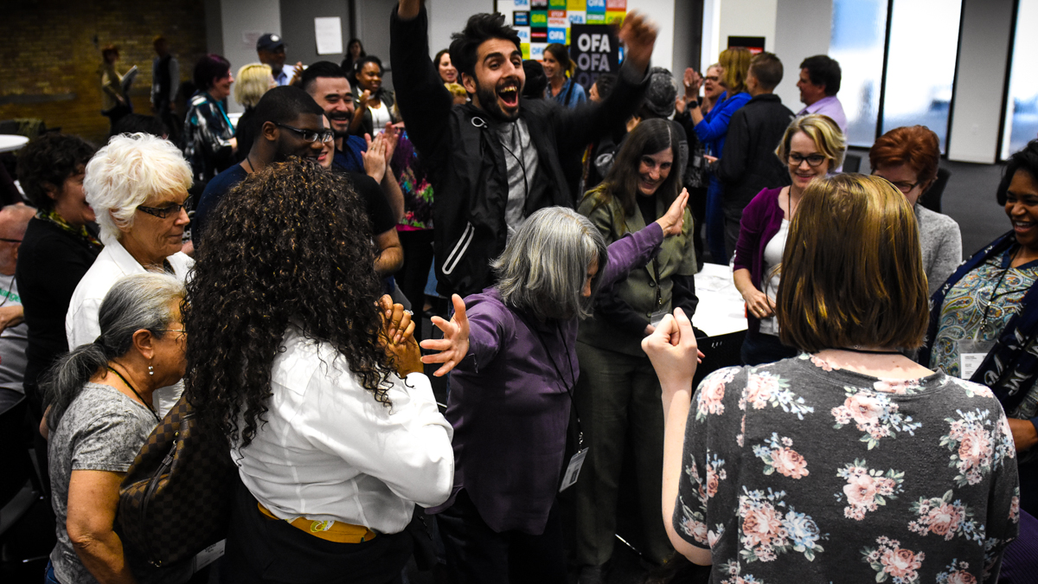


CAMPAIGN ORGANIZING BOOT CAMP
Staging locations
Bobby Brady-Sharp / OFA Field Director / @bobbyhtx
Notes:
This work is licensed under the Creative Commons Attribution-NonCommercial 4.0 International License. To view a copy of this license, visit http://creativecommons.org/licenses/by-nc/4.0/ or send a letter to Creative Commons, PO Box 1866, Mountain View, CA 94042, USA.

Slide 2
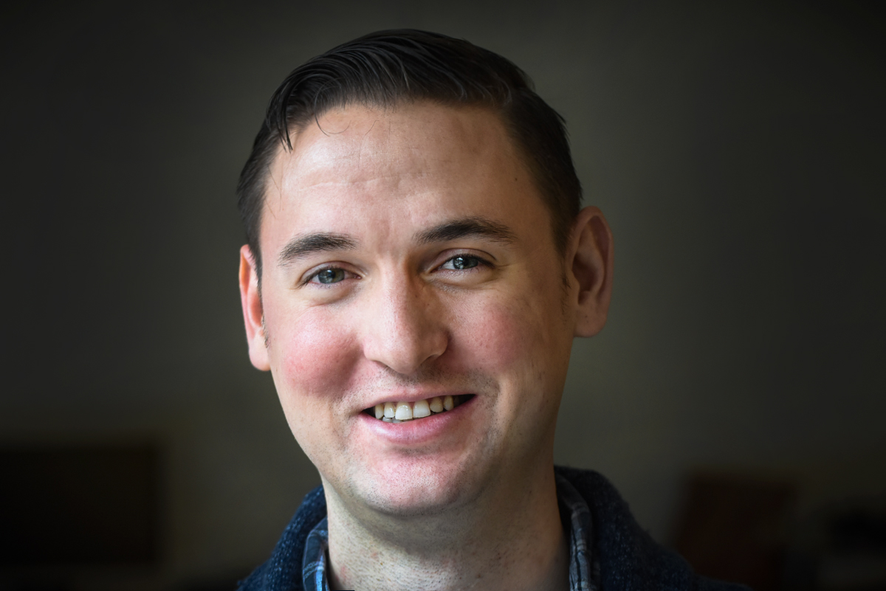

Bobby Brady-Sharp
OFA Field Director
@bobbyhtx

Slide 3
#OFAction
#OrganizingFor18
Notes:
As we go through this training, don’t be shy and tweet throughout the session using our hashtag. Let us know what you are taking away from this training, what is motivating you to organize, and follow me on twitter at @GriffenSaul

Slide 4

1
Identify and internalize best practices for running an effective staging location
Goals for this session

Slide 5
1
Identify and internalize best practices for running an effective staging location
Recognize the importance of a well-run staging location for success
Goals for this session
2

Slide 6
1
Identify and internalize best practices for running an effective staging location
Recognize the importance of a well-run staging location for success
Feel prepared to lead a get-out-the-vote canvass in your community this year
Goals for this session
2
3

Slide 7
Agenda
Intro to staging locations
12 rules for a great staging location
Simulations!
Debrief

Slide 8
First of all…what is GOTV, or “get-out-the-vote”?
Notes:
Ask the audience and write on a piece of butcher paper

Slide 9
Pause for group share

Slide 10
Get-out-the-vote
It is a formalized campaign that includes vote-by-mail, early vote, and election day

Slide 11
Get-out-the-vote
It is a formalized campaign that includes vote-by-mail, early vote, and election day
Depending on your community, it lasts anywhere from the final 4 days of the election to the entire last two months

Slide 12
Get-out-the-vote
It is a formalized campaign that includes vote-by-mail, early vote, and election day
Depending on your community, it lasts anywhere from the final 4 days of the election to the entire last two months
The most important tactics are vote-planning and voter education—through canvassing and phonebanking

Slide 13
What is a GOTV staging location?
Notes:
Ask the audience and write on a piece of butcher paper

Slide 14
Pause for group share

Slide 15
Staging locations
Are temporary field offices for a campaign—either at a home, business, or public space
Used to launch GOTV voter contact activities—canvassing and phonebanking
Operated by a team of volunteers
Provides a location close to voters you want to talk to

Slide 16
What are some roles at a staging location?
Notes:
Ask the audience and write on a piece of butcher paper

Slide 17
Pause for group share

Slide 18
Canvass Captain

Slide 19
Canvass Captain
Responsible for training all canvassers who come through the staging location
Point-of-contact between canvassers in the field and the staging location

Slide 20
Packet Captain

Slide 21
Packet Captain
Ensures that all canvass packets are prepared with the correct literature
Ensures packets are being checked-out and check-in, and are being tracked in an organized way
Reports to the staging location director for priority of how packets should be prioritized

Slide 22
Comfort Captain

Slide 23
Comfort Captain
Helps recruit donations and distributes food, water/beverages, and comfort items (ponchos, etc..) to canvassers throughout the shift and throughout the day

Slide 24
Staging Location Director

Slide 25
Staging Location Director
Carries responsibility for all GOTV activities through the staging location
Manages volunteers who lead voter contact activities (Canvass captain/Packet captain), logistical support activities (comfort captain)
Is the contact for the staging location to campaigns

Slide 26
Who has worked at a great staging location? What made it great? How about not so great?
Notes:
Ask the audience and write on a piece of butcher paper

Slide 27
Pause for group share

Slide 28
Agenda
Intro to staging locations
12 rules for a great staging location
Simulations!
Debrief

Slide 29
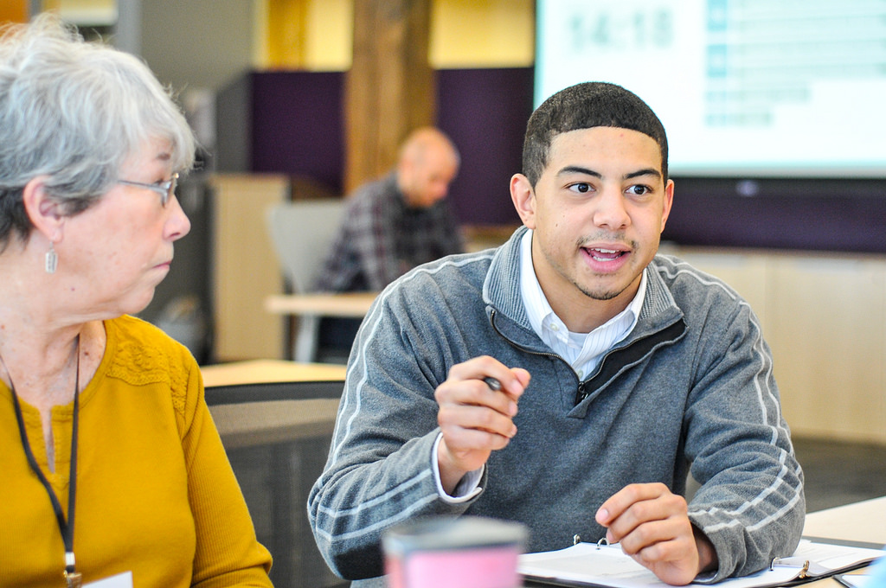
12 rules for great staging locations

Slide 30
12 RULES FOR GREAT STAGING LOCATIONS
1. Your canvass location is like an assembly line

Slide 31
3. Canvass training area
2. Bullpen
(this is where folks will wait for the next training)
4. Materials table
(packets, literature, pens, and supplies)
5. Snacks/water station
1. Check-in table
(everyone should stop here first!)
6. Canvass breakdown
(this is returning canvassers return their packets))
EXIT
ENTER

Slide 32
3. Canvass training area
2. Bullpen
(this is where folks will wait for the next training)
4. Materials table
(packets, literature, pens, and supplies)
1. Check-in table
(everyone should stop here first!)
5. Snacks/water station
6. Canvass breakdown
(this is returning canvassers return their packets))
ENTER
EXIT

Slide 33
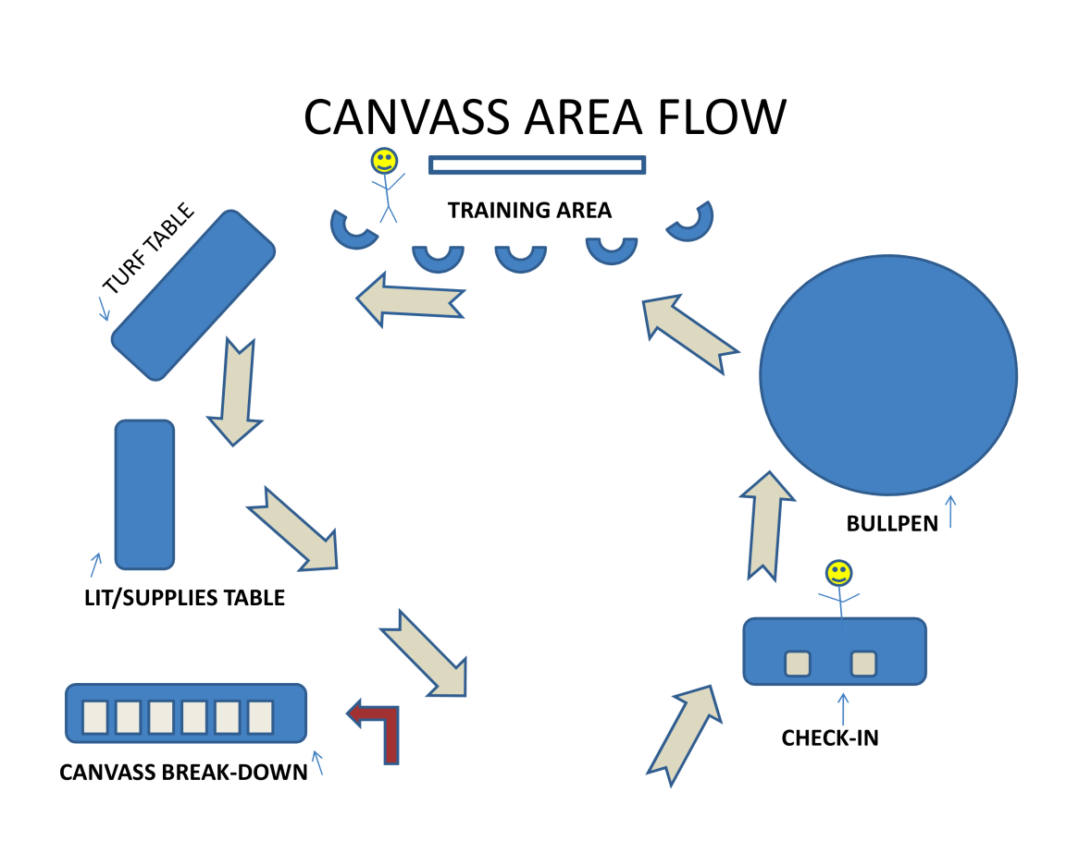

Slide 34
12 RULES FOR GREAT STAGING LOCATIONS
2. Canvass launch should be separate from returning canvasser intake

Slide 35
Canvass launch separate from intake
If your space allows, you should have the intake of returning canvassers be outside or have a separate entrance than people coming into canvass.
As volunteer numbers increase, canvassers returning from shifts and arriving for shifts coming through the same entrance can make things unorganized

Slide 36
12 RULES FOR GREAT STAGING LOCATIONS
3. Phone bank locations should also be set-up like an assembly line

Slide 37
12 RULES FOR GREAT STAGING LOCATIONS
4. No couches or chairs in a canvass launch staging location area

Slide 38
No couches or chairs in canvassing locations
Your location should be designed for people to get in and out fast—chairs invite lounging.
You can have chairs in the canvass breakdown area—but this should be a totally separate area than for arriving canvassers and the training area.

Slide 39
12 RULES FOR GREAT STAGING LOCATIONS
5. Label everything

Slide 40
Label everything
Volunteers entering your staging location may not know the flow of where things are so over-label everything!
This includes: entrances and exits, having clear arrows on the floors/walls to show the flow, labeling what each station’s purpose is, and have large nametags for your director, trainers, and sign-in.

Slide 41
12 RULES FOR GREAT STAGING LOCATIONS
6. Practice—and practice seriously

Slide 42
Practice
A good GOTV operation means practicing the way it operates and debriefing your practice at least twice beforehand.
That means you should begin practicing by running your own canvasses now!
Local campaigns will announce their staging location and dry-run needs, so look to them for guidance.

Slide 43
12 RULES FOR GREAT STAGING LOCATIONS
7. Always follow the chain of command!

Slide 44
Chain of command
Chain of command at a staging location exists for a reason—even if you’re tempted to break it…don’t!
This is how problems, mistakes, and miscommunication happen. Your staging location team should know beforehand who should respond to what requests
For example, your canvass trainer cannot get stuck distributing yard signs.

Slide 45
12 RULES FOR GREAT STAGING LOCATIONS
8. Learn from each day

Slide 46
Learn from each day
Learn from your dry-runs! You should have an intentional debrief meeting to discuss what worked and what did not.
Learn from each day you’re implementing GOTV. The staging location team should gather each day to assess what worked and make any needed changes. Assess how the flow of the location went, training, and organization.

Slide 47
12 RULES FOR GREAT STAGING LOCATIONS
9. Confirmation calls, confirmation calls…and more confirmation calls!

Slide 48
Confirmation calls
You should be confirming canvassers the day before and the day of.
Even if canvassers don’t show up, you should call canvassers and try and re-shift them that day.

Slide 49
12 RULES FOR GREAT STAGING LOCATIONS
10. Great training = great canvassers

Slide 50
Great training = great canvassers
Staging location trainers should be trained well in advance to train effectively.
This is very important during GOTV and should happen with every single shift.
Trainings should last no more than 15-20 minutes at most (but your campaigns will give more guidance on this).

Slide 51
Great training = great canvassers
  Trainings should include:
  Introductions
  Why the work we’re doing is important
  Overview of script (have a blow-up script on the wall!)
  Role-play conversations
  Important reminders and best practices

Slide 52
12 RULES FOR GREAT STAGING LOCATIONS
11. Be “like a duck on water”

Slide 53
“Duck on water”
No matter how busy things or how stressed you feel—always act calm. You’re the barometer!
Focus on your body language, tone of voice, speed of movement as you go through the day.

Slide 54
12 RULES FOR GREAT STAGING LOCATIONS
12. Have fun, and make it fun for others!

Slide 55
Have fun!
Volunteer experience is equally, and if not more important, during GOTV. Make sure you’re focusing on making people feel good about volunteering.
Have fun!

Slide 56

Staging locations –
What would you do?

Slide 57
20 minutes
1
Take 2 minutes and split into groups of 2-4
For each scenario, your group should discuss and make a list of how you would react to the situation.
2

Slide 58
Scenario 1:
You open your staging location at 9AM to intake volunteers for your first canvass shift. You are pleasantly surprised that your recruitment over the last week has resulted in a huge amount of volunteers showing up. Unfortunately, you’re not quite prepared!
The canvassers have overrun the staging location—no one is signed in!
The trainer is not able to get the group’s attention.
Some walk lists have yet to be printed, and volunteers are commenting on how unorganized it is and begin to leave.
WHAT WOULD YOU DO?

Slide 59
Pause for scenario 1

Slide 60
Scenario 2:
You open your staging location at 9AM to intake volunteers for your first canvass shift. Even though you recruited 15 canvass shifts, only 1 person shows up.
The staging location is all prepared and ready.
Your trainer and packet captain are ready to go.
The canvasser who shows up is worried because they thought they would have someone to partner up with—they’ve never done this before.
WHAT WOULD YOU DO?

Slide 61
Pause for scenario 2

Slide 62
Scenario 3:
Everything is prepared and you’re expecting 30 people who have confirmed their canvass shift. A bunch of volunteers come in and begin training…but then some other volunteers come in late and begin to interrupt the training.
One volunteer interrupts the training to begin talking specifically about really nuanced and in-the-weeds policy surrounding climate change and how it applies to the state of the midterms.
Another volunteer simply wants to deliver yard signs and begins telling the group that canvassing just isn’t effective.
WHAT WOULD YOU DO?

Slide 63
Pause for scenario 3

Slide 64
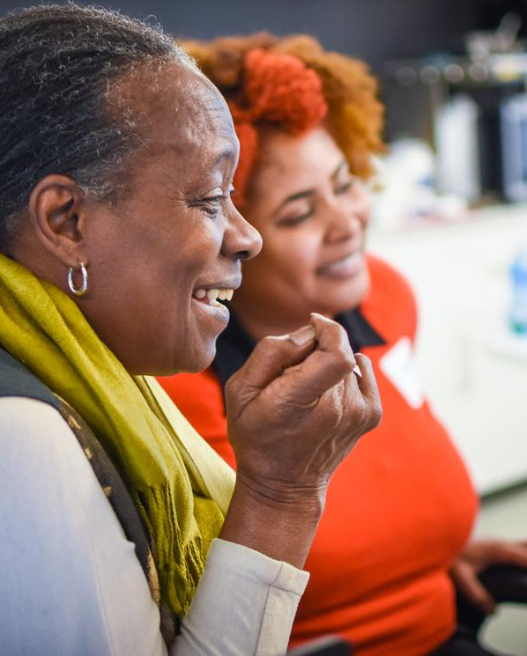
REPORT-BACK:
What
did you
come up
with?
Share your thoughts out loud!
Notes:
Take some time to share your thoughts with the group. What did you come up with? What was challenging? What did you or your partner do well?

Slide 65
Thank you!

