Slide 1
Welcome
We will begin at 7:30 pm Central Time.
Notes:
This work is licensed under the Creative Commons Attribution-NonCommercial 4.0 International License. To view a copy of this license, visit http://creativecommons.org/licenses/by-nc/4.0/ or send a letter to Creative Commons, PO Box 1866, Mountain View, CA 94042, USA

Slide 2
OFA Community
Engagement Fellowship
Spring 2018 / #OFAFellows

Slide 3
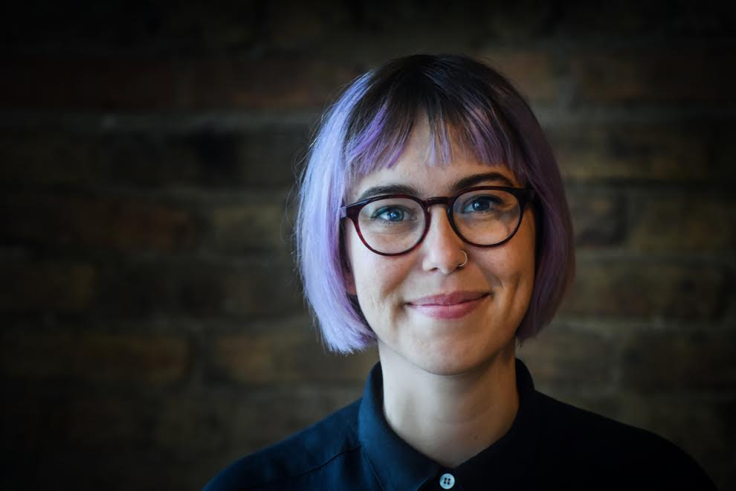
Alexis Conavay
@AlexConavay
Organizing Project Manager
Notes:
Fun facts –
I’m from Jupiter Florida
Master’s in WGS
Before coming to OFA – I organized young people in CPS; worked in the education dept of IHMEC; worked as a researcher for DePaul university

Slide 4
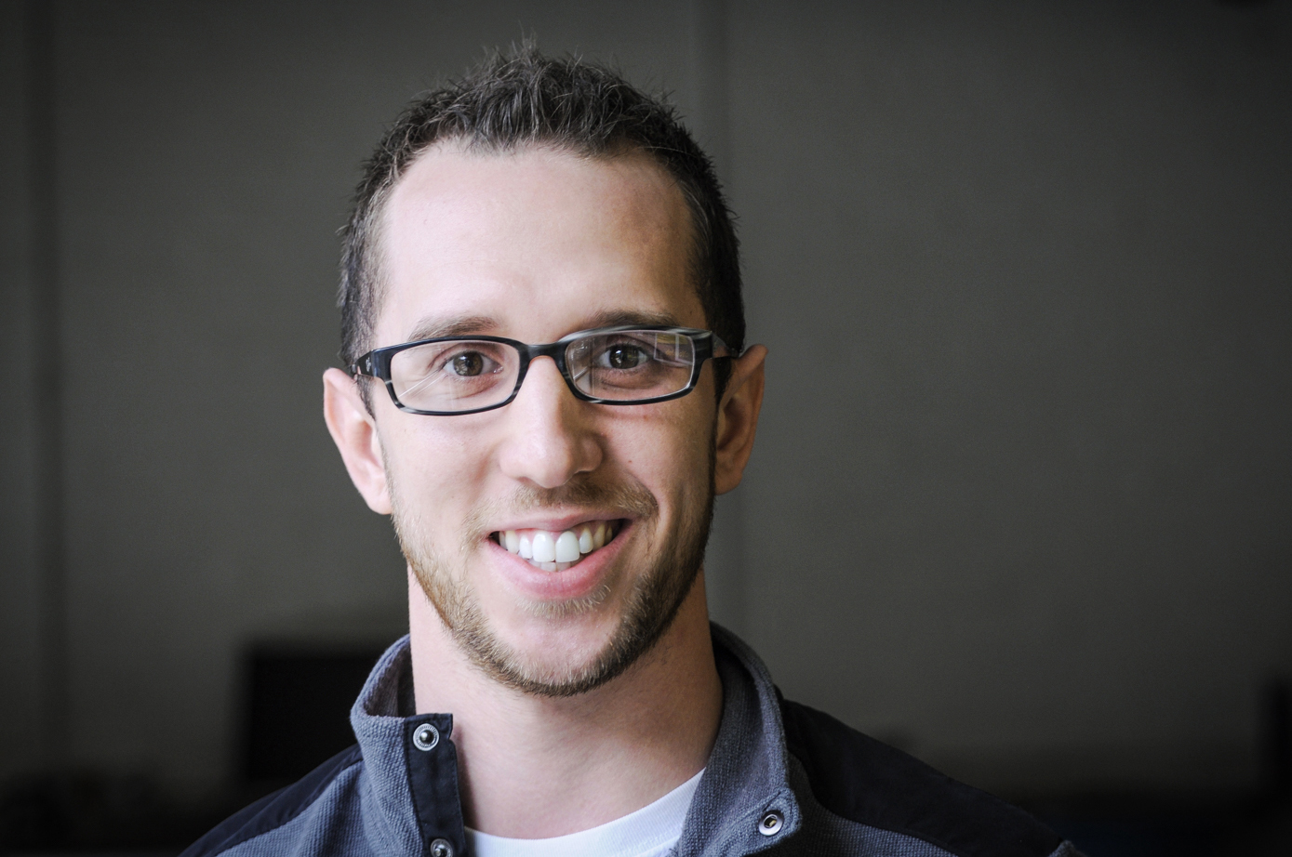
Kevin Lane
@klane228
Training Project Manager
Notes:
Fun facts!

Slide 5
Goals for today
1
Develop a sense of belonging with each other, OFA, and the communities we are forming.
Align on the purpose, scale, and scope for the Fellowship, and the resources you’ll have at your disposal.
Analyze root problems in our community and propose a way to address it.
2
3

Slide 6
Agenda
Intro and welcome
Framing the learning journey
Your fellowship resources
Seeing ourselves as change-makers
Identifying root challenges
Debrief and close

Slide 7
Share out!
In the chat box, share your name, where you live, and which issues you are most passionate about.

Slide 8
Icebreaker: Let’s caucus

Slide 9
Icebreaker: Let’s caucus
Scenario 1:
1.) I prefer hiking in the mountains.
2.) I prefer relaxing on the beach.
3.) Undecided.

Slide 10
Icebreaker: Let’s caucus
Scenario 2:
1.) I prefer coffee.
2.) I prefer tea.
3.) Undecided.

Slide 11
Icebreaker: Let’s caucus
Scenario 3:
1.) I prefer ketchup as a condiment.
2.) I prefer mustard as a condiment.
3.) Undecided.

Slide 12
Agenda
Intro and welcome
Framing the learning journey
Your fellowship resources
Seeing ourselves as change-makers
Identifying root challenges
Debrief and close

Slide 13
You’re joining something big.
We accepted nearly 400 applicants from across the country for the spring fellowship.
Fellows represent 43 states.
Over 45% of fellows are new to organizing (less than 1 year of experience).
Notes:
You are part of something bigger
2 Mins
But accomplishing these goals will only happen if you know that you are part of something bigger
Alongside you, this week, we are onboarding fellows in 28 programs and we have fellows from 24 states across the country. Together you make up the spring 2018 OFA Fellowship Class.
Even though you will work locally here, you will join weekly online trainings with the rest of your class.

Slide 14
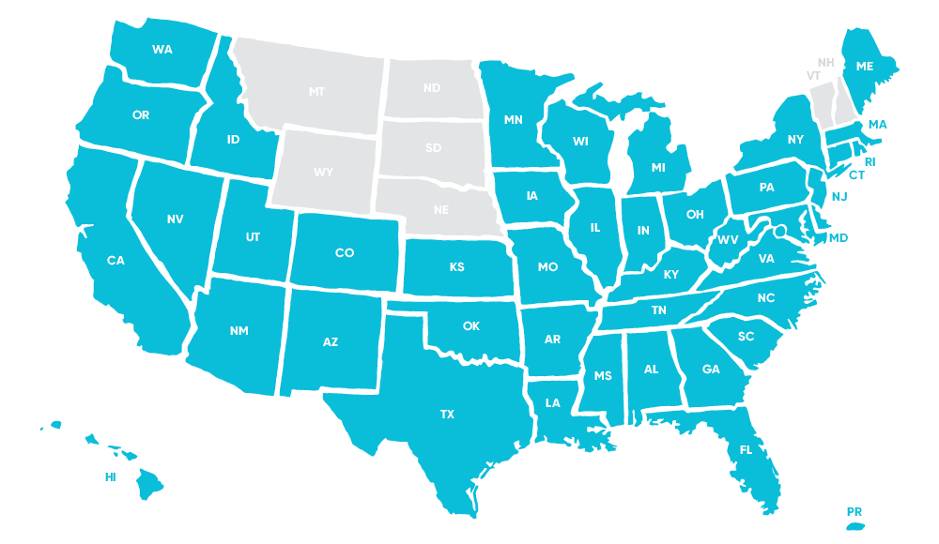
State map – fellows stats

Slide 15
Tweet today using #OFAFellows
Notes:
Over the span of this week hundreds of fellows will be starting this journey along with you! Using social media to share out your learning and what you are excited about is a great way to build connections that span the country. It is also a super great way to show your personal networks what you’re working on. Who knows, maybe someone will be inspired by you and begin their own organizing journey!

Slide 16
OFA’s core purpose

Slide 17
To create a more accessible and participatory democracy

Slide 18
Your learning journey
Week 1: Identifying root problems

Slide 19
Your learning journey
Week 1: Identifying root problems
Week 2: Strategies for local impact

Slide 20
Your learning journey
Week 1: Identifying root problems
Week 2: Strategies for local impact
Week 3: Leadership in action

Slide 21
Your learning journey
Week 1: Identifying root problems
Week 2: Strategies for local impact
Week 3: Leadership in action
Week 4: Cultivating community

Slide 22
Your learning journey
Week 1: Identifying root problems
Week 2: Strategies for local impact
Week 3: Leadership in action
Week 4: Cultivating community
Week 5: Building coalitions and partnerships

Slide 23
Your learning journey
Week 1: Identifying root problems
Week 2: Strategies for local impact
Week 3: Leadership in action
Week 4: Cultivating community
Week 5: Building coalitions and partnerships
Week 6: Tying it all together

Slide 24
2018 is an incredibly important year

Slide 25
Fellows projects

Slide 26
Fellows projects
Fellows will identify a root problem facing their community, and will strategize how to make an impact and address these challenges.
The weekly assignments will help fellows build towards this final project. By program’s end, fellows will be ready to take their first steps towards implementing this plan, which typically will be an outreach or mobilizing event to raise awareness or take action on the addressing the issue.
The scale and scope should reflect the capacity of your team.
Notes:
You are part of something bigger
2 Mins
But accomplishing these goals will only happen if you know that you are part of something bigger
Alongside you, this week, we are onboarding fellows in 28 programs and we have fellows from 24 states across the country. Together you make up the spring 2018 OFA Fellowship Class.
Even though you will work locally here, you will join weekly online trainings with the rest of your class.

Slide 27
What are you most eager to learn
about during the fellowship?
Type in the chat box and tweet using #OFAFellows

Slide 28
What are you most nervous about in the fellowship?
Type in the chat box

Slide 29
Agenda
Intro and welcome
Framing the learning journey
Your fellowship resources
Seeing ourselves as change-makers
Identifying root challenges
Debrief and close

Slide 30
Fellows program webpage:
https://www.ofa.us/get-trained/fellows-2018-spring-fellows/

Slide 31
Want to talk to us?
fellows@ofa.us

Slide 32
Logistics
We will meet every Wednesday for 90 minutes. If you cannot attend, emails fellows@ofa.us (and your Fellows Leader, if you have one).

Slide 33
Logistics
We will meet every Wednesday for 90 minutes. If you cannot attend, emails fellows@ofa.us (and your Fellows Leader, if you have one)
This is an interactive training.

Slide 34
Logistics
We will meet every Wednesday for 90 minutes. If you cannot attend, emails fellows@ofa.us (and your Fellows Leader, if you have one)
This is an interactive training.
A recording of this video will be available on the Fellows website following this training.

Slide 35
Logistics
We will meet every Wednesday for 90 minutes. If you cannot attend, emails fellows@ofa.us (and your Fellows Leader, if you have one).
This is an interactive training.
A recording of this video will be available on the Fellows website following this training.
Tweet using #OFAFellows.

Slide 36
Agenda
Intro and welcome
Framing the learning journey
Your fellowship resources
Seeing ourselves as change-makers
Identifying root challenges
Debrief and close

Slide 37
How are these leaders different and
what do they have in common?

Slide 38
They were organizers!

Slide 39
Organizers are change-
makers. They are leaders
who take action.
Notes:
More than anything though, we believe that you have to see yourself as part of the community you want to improve/organize – this is the only way you will know the needs, the resources, who is missing from the table

Slide 41
We utilize everything
we have to organize.
There are many entry
points to organizing.

Slide 42
What qualities do you possess that make
you a good organizer?
What skills do you have that makes you able
to address the health of your community?
Type in the chat box

Slide 43
Agenda
Intro and welcome
Framing the learning journey
Your fellowship resources
Seeing ourselves as change-makers
Identifying root challenges
Debrief and close

Slide 44
Four steps to identify a root problem
1
How do we define a healthy community? How do we know it when we see it?

Slide 45
Four steps to identify a root problem
1
How do we define a healthy community? How do we know it when we see it?
What resources are our communities currently lacking? What challenges are they facing?
2

Slide 46
Four steps to identify a root problem
1
How do we define a healthy community? How do we know it when we see it?
What resources are our communities currently lacking? What challenges are they facing?
Why do they lack these resources? Why are they facing these challenges?
2
3

Slide 47
Four steps to identify a root problem
1
How do we define a healthy community? How do we know it when we see it?
What resources are our communities currently lacking? What challenges are they facing?
Why do they lack these resources? Why are they facing these challenges?
What can we do about it? What resources do we have?
2
3
4

Slide 48
What is a problem you want to address
in your community? Who is missing from
the conversation?
Type in the chat box

Slide 49
Agenda
Intro and welcome
Framing the learning journey
Your fellowship resources
Seeing ourselves as change-makers
Identifying root challenges
Debrief and close

Slide 50
What questions do you have?
Type in the chat box

Slide 51
Weekly assignment:
Due Wednesday, April 4
https://www.ofa.us/get-trained/fellows-2018-spring-fellowship/
1
What is a problem that’s affecting the health of your community?
What is an issue that can make an impact on this problem?
What your indicators of success around making progress on this issue?
With this in mind – what type of capstone project do you think best fits the problem you’re trying to address?
2
3
4

Slide 52
Thanks for joining the call!
Please fill out the evaluation on today’s training using the link below.
bit.ly/Spring1-2018
Email fellows@ofa.us with any questions.

