Slide 1
Intro to One-on-One Meetings
Trainer, Trainer Role
@twitterhandle
Notes:
This work is licensed under the Creative Commons Attribution-NonCommercial 4.0 International License. To view a copy of this license, visit http://creativecommons.org/licenses/by-nc/4.0/ or send a letter to Creative Commons, PO Box 1866, Mountain View, CA 94042, USA
0:00 – 0:06 Introduction, Goals & Agenda
0:00 – 0:03 Personal Story Introduction
[Slide 1] [Trainer should tell a 2-minute version of his or her personal story, tying it back to the value of grassroots organizing and relationship-building as an integral part of that.]
Today we’re going to learn about one of the greatest and most effective tools for any organizer: one-on-one meetings.

Slide 2
Goals for this session
1
Define One-on-one meetings (1:1s) in an organizing context
Discuss why we hold 1:1 meetings as organizers
Review the mechanics of 1:1 meetings
Introduce you to the “Hard Ask” as a component of 1:1 meetings
2
3
4
Notes:
0:03 – 0:06 Session Goals and Agenda
[Slide 2] By the end of this session, you will be able to…
[Animation Cue] Define one-on-one meetings (1:1s) in an organizing context
[Animation Cue] Discuss why we hold 1:1 meetings as organizers
[Animation Cue] Review the mechanics of 1:1 meetings
[Animation Cue] Introduce you to the “Hard Ask” as a component of 1:1 meetings
[Animation Cue] Practice and debrief!

Slide 3
Agenda
Introduction, Goals & Agenda
Defining a One-on-One Meeting
Mechanics of a 1:1
Practice and Discussion
Debrief and Q/A
Notes:
[Slide 3] And so, to accomplish these goals, let’s take a look at our agenda…
We’re just about to finish up our introduction
Then we’re going to define what we mean when we say, “one-on-one”
After that, we’ll break down the specific mechanics, or makeup, of a standard 1:1 meeting.
Then, it wouldn’t be an OFA training if we didn’t give everyone a chance to learn by doing. We’re going to get into pairs and practice our 1:1s and hard asks with our partners. Sound good?
[Animation Cue] With that, let’s dive into our first session of the day.

Slide 4
Building Relationships Through One-on-Ones (1:1s)
What do you think 1:1 meetings are?
Why would we want to connect with others 1:1 instead of in bigger groups?
Notes:
0:06 – 0:21 Defining a One-on-One Meeting
0:06 – 0:10 Discussion: What is a 1:1?
[Slide 4] Let’s start by spit-balling some ideas for what – without ever having heard of a 1:1 – you would guess a 1:1 meeting is. What do you think? [Best practice: give audience at least 5 seconds before breaking the silence by clarifying/rephrasing question. Repeat back and encourage answers that describe a 1:1 as any of the following: Face-to-Face, scheduled in advance, deliberate/purposeful, educational, personal, etc.]
Excellent. And why would we want to connect with others one-on-one instead of bigger groups like this one? [Correct: they’re more personal, fewer distractions, dedicated, purposeful – many of the same things that define a 1:1. We also want to build relationships – the title gives this away, but it’s okay]

Slide 5
Five key traits of a 1:1
Face-to-Face
Scheduled
Purposeful
Educational
Rigorous Follow-Up
Notes:
0:10 – 0:17 What a 1:1 is/What a 1:1 isn’t.
[Slide 5] When thinking about 1:1s, how do you think of them as different from the times we see a friend at the supermarket and ask them to come to a phonebank next week? [Probe for answers like: not deliberate, distractions of grocery store, short, not structured and there are other things to talk about, etc.]
OFA defines a 1:1 using five key criteria.
[Animation Cue] First, they’re face to face. 1:1s are conducted in person at either someone’s home, an office, or a quiet public space such as a coffee shop. Why not over the phone?
[Animation Cue] They’re also scheduled in advance for 30-45 uninterrupted minutes.
[Animation Cue] They’re also purposeful. What do you think that means? That’s right, they have an agenda and a purpose. They’re not about chit-chat, but rather about introducing, maintaining or escalating a volunteer. They involve probing discussion that leads to tangible commitments. They’re also an opportunity to make volunteers feel like part of OFA’s overarching strategy on the key issues we’re organizing around. It’s the best way to get them bought into our mission.
[Animation Cue] Then, they’re educational. You have two ears and one mouth, which means you should listen more than you talk. Absorb where the other person is coming from patiently. Then think about how to guide the conversation toward your ask.
[Animation] Lastly – and most importantly – they involve rigorous follow-up. The onus is on the organizer to follow-up with the volunteer after the 1:1 meeting, to be sure that they are engaged in future events or following through with the commitments they made during the 1:1 meeting.

Slide 6
Modeling a 1:1 Meeting
“Now that we have gotten to know each other and I’ve told you a bit about our work, I would love to see you at one of our phone-banks. Are you free Wednesday at 7 or Thursday at 8pm?”
“Hearing your story, I really feel like we are impassioned about politics for the same reasons, and I would love to continue to work with you. Can I count on you to come register voters with me next Sunday at 2pm?”
“I like that we both care about immigration reform. We’re only going to be able to pass immigration reform if we organize now to pass it. I need a go-getter like you in my team. When’s a good time for us to co-host a house meeting?”
Notes:
0:17 – 0:21 Why hold 1:1s?
[Slide 6] What does this look like in practice?
[Animation Cue] To start, let’s take a look at a few hard asks to demonstrate how a 1:1 meeting leads to stronger chapters and teams and more volunteers at your events. Is there a volunteer in the audience who can read the first example? [Ask different volunteers to read each. Then ask the audience why those asks are effective.]

Slide 7
Modeling a 1:1 Conversation
Notes:
[Slide 7] Now we’re going to take a few minutes to model a 1:1. [Don’t ask for a volunteer – narrow down to a specific month, asking if any volunteer has a birthday close to that month. If multiple, narrow to a week and then to a day until you’ve narrowed it down to one person. Ask the volunteer to come to the front of the room to join facilitator for a fishbowl modeling of an abbreviated 1:1]
[Practice this to the extent possible. Facilitator should be prepared for volunteers who are harder nuts to crack, or on the flip side, are overly talkative and possibly distracting. Model the mechanics of a 1:1 that are in the section to follow. They are: Describe purpose, share stories, connection, connect to strategy, hard ask]
[Have audience give volunteer a round of applause, and have him/her return to his/her seat. Pull participants’ attention back to front of the room]

Slide 8
Fishbowl Debrief
Notes:
[Slide 8] What just happened? How did that go? Describe our conversation step-by-step. What was effective? What could have been better?

Slide 9
Agenda
Introduction, Goals & Agenda
Defining a One-on-One Meeting
Mechanics of a 1:1
Practice and Discussion
Debrief and Q/A
Notes:
0:21 – 0:36 Mechanics of a 1:1
0:21 – 0:25 Basics: Introductory 1:1
[Slide 9] Every 1:1 conversation should follow the same basic structure. You just saw it modeled, but let’s dive a little deeper into the mechanics of a 1:1 conversation.

Slide 10
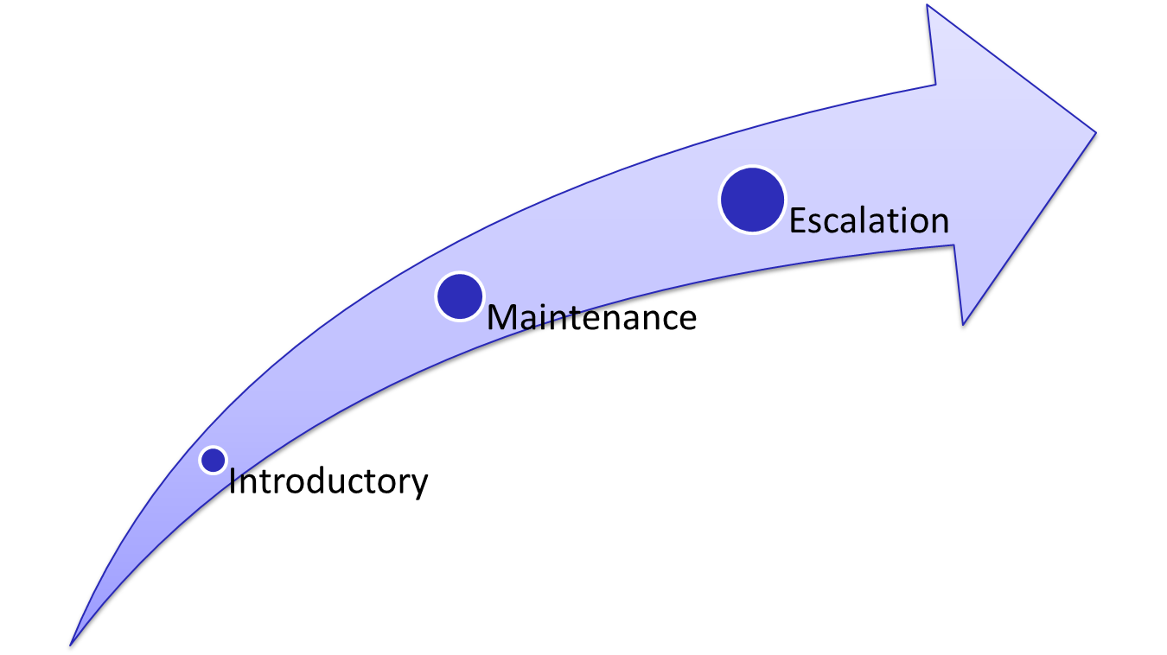
There are three types of 1:1
Notes:
[Slide 10] We now know that we hold 1:1s to build relationships, relationships are central to organizing, and we build relationships by asking people the right questions and identifying our common ground.
Let’s get into the weeds a bit more about the mechanics of 1:1s: What types of 1:1s we hold, when we hold them, and what the typical agenda for a 1:1 is.
There are three types of 1:1s that we hold as organizers, and if you think about this in terms of friendships or romantic relationships, we probably develop them the same way!
Introductory 1:1s: Your first chance to meet someone, identify shared interests, make an ask and agree on some next steps. These are the type we are really going to dig deep into today.
Maintenance 1:1s: The purpose of these meetings are to deepen your relationship with your volunteer leader or coalition partner, check in on their challenges and needs, update each other on progress, develop further shared strategy and tactics, and determine next steps.
Escalation 1:1s: These are not used as frequently, but are essential to developing leadership. Like the marriage proposals of the organizing world, relationship escalation 1:1s happen when you need to smoothly ask someone to take on more responsibility within the organization.

Slide 11
Logistics of a 1:1 Meeting
Timing:
30 minutes – 45 mins long
Location:
In a quiet, sit-down location (café, office)
Firm Commitment:
Get a time and a place; don’t just invite the person to “drop by” without a scheduled time
Confirmation:
Give them a call the day before
Grouping:
Schedule your 1:1s in blocks to maximize the amount you’re able to have
Notes:
[Slide 11] In addition to the different types of 1:1 we hold, we’ll also need to be aware of the simple logistics of a 1:1.
First, the timing. A typical 1:1 should last between 30 and 45 minutes. Not a whole lot shorter, not a lot longer.
Location is critical. Choose a place that is quiet, sit-down and distraction-free, like a café or an office.
Every 1:1 is a firm time commitment from the person you’re talking to. Get a time and a place; don’t just invite the person to “drop by” without a scheduled time.
One organizing pro-tip: group your 1:1 meetings in blocks to maximize the amount you’re able to have in one block of time.

Slide 12
Sample Agenda for a 1:1 Meeting
Explain purpose of the meeting
“When I talked to you on the phone…”
Personal Story
Share your Story
Make Connection
Tease out their story. What do you have in common? What is your shared vision?
Share the Strategy
How does our work help you achieve your shared vision?
Ask
Connect Ask to strategy and shared vision. Phone Bank/Team Meeting/Other Event
Notes:
0:25 – 0:31 Building Your 1:1 Meeting
[Slide 12] Taking a look at our sample agenda on the slide here, we have a more clear picture of the key points we want to make sure to touch on when conducting 1:1s.
Every 1:1 should start with the organizer explaining the purpose of the meeting. This part of the conversation might sound something like, “When I talked to you on the phone…”
Once expectations for the conversation are set with the purpose clearly laid out, the most effective way to build a connection with the person on the other side of the table is to share your story. You’ll learn about personal stories in another module, but it’s the best way to immediately build trust. Remember, this is a two-way street, so probe for them to share their personal story – or at least why they decided to come sit down with you and consider getting involved.
Next, remember that this meeting is an opportunity to bring the volunteer into the fold by sharing the strategy of this movement with them. How does out work help you achieve your shared vision?
Finally – and most importantly – every 1:1 meeting builds to support the final component: the hard ask. You want to make a direct ask for something concrete. Connect your ask to the strategy and shared vision you outlined earlier in the meeting. A successful 1:1 ends with a commitment that includes a specific date, time and goal for that action.

Slide 13
Introductory 1:1 – Volunteer Recruitment
Establish a personal connection by sharing your story
Give your ASK context. What is your group up to?
Create a sense of urgency: Why now and not next month?
Present a challenge: Share your goal! (How many calls do you need to make? How many letters to the editor do you need to write? How many events do you need to hold?)
Present a solution: The volunteer is always the solution.
Be specific, direct, and action oriented: Ask for a commitment to a specific action at a specific time & place.
Notes:
0:31 – 0:36 Volunteer Recruitment using 1:1s: Best Practices
[Slide 13] When conducting these 1:1s, we want to keep a few best practices in mind to help increase our chances of success.
First, establish a personal connection by sharing your personal story.
Make sure to give your ask some context. Why should the volunteer get involved now vs. next month? In the realm of issue organizing, communicating urgency is tough, but so important!
Present a challenge. Share your goal with the volunteer. So, how many calls do you need to make? How many letters to the editor do you and your team need to write? How many events do you need to hold. Most importantly, tell them why those goals are important.
Present a solution that involves them getting involved. What’s our challenge? We need to make 1,000 phone calls. What’s the solution? The volunteer comes and makes 150 of those calls.
Finally, remember to always be specific, direct and action-oriented with your ask. Make a commitment to a specific action at a specific time & place.

Slide 14
Choosing Language Carefully
Which ask are you more likely to say yes to?
“John, is there any possible way I could get you to do me the favor of attending just this one phonebank at some point down the line?”
“John, will you come to a phonebank sometime?”
John, can I count on you to come to a phonebank this Friday at 6pm?
John, I want to give you the exciting opportunity to phonebank on Wednesday at 5pm or Thursday at 6pm! Can I count on you?
Soft Ask Hard Ask
Notes:
[Slide 14] In order for any ask to be effective, we all have to be mindful and precise about the language we use to make them more likely to say yes. What does that language sound like? [Facilitator should bring up one participant and read each of the asks out loud to them and ask them how they feel after each. The goal is to demonstrate that a hard ask (on the right of the slide) is more effective in persuading a prospective volunteer to take the action you’re asking of them.]

Slide 15
Agenda
Introduction, Goals & Agenda
Defining a One-on-One Meeting
Mechanics of a 1:1
Practice and Discussion
Debrief and Q/A
Notes:
0:36 – 0:45 Practice & Discussion
0:36 – 0:38 Breakout Instructions
[Slide 15] Now that we’ve modeled a 1:1 and gone through the mechanics of an ideal 1:1, we’re going to get some practice!

Slide 16
Practice
You are meeting Nancy, who you came across calling through phone-banking. She has attended one press conference but is retired and now looking for more. You want her to host a house meeting to begin to build a neighborhood team.
In pairs, role play your introductory 1:1 with Nancy—then switch roles. How will you use your personal story and shared vision to motivate her to action? What parts of our strategy will you share with her?
When you’re done, share two things that went well and two things that could have gone better.
Notes:
[Slide 16] [Facilitator should ask volunteers to read the scenario out loud. Break the large group into pairs and practice with the scenario on the slide]

Slide 17
Agenda Refresher
Explain purpose of the meeting
“When I talked to you on the phone…”
Personal Story
Share your Story
Make Connection
Tease out their story. What do you have in common? What is your shared vision?
Share the Strategy
How does our work help you achieve your shared vision?
Ask
Connect Ask to strategy and shared vision. Phone Bank/Team Meeting/Other Event
Notes:
0:38 – 0:45 Practice in Pairs + Debrief
[Slide 17] To help guide your 1:1 practice, here’s a refresher on the agenda. Get into pairs. One participant should role play Nancy, the other should role-play the organizer making the hard ask and conducting the 1:1.

Slide 18
Group Discussion
What went well?
What did you struggle with?
Best Practices?
Notes:
[Slide 18] [Facilitator should bring participants back together] What did everyone think of that exercise? What went well? What did you struggle with? Were there any best practices you or your partner thought of after doing this exercise that you’d like to share with the group?

Slide 19
Agenda
Introduction, Goals & Agenda
Defining a One-on-One Meeting
Mechanics of a 1:1
Practice and Discussion
Debrief and Q/A
Notes:
0:45 – 1:00 Debrief and Q/A
0:45 – 0:46 Data Entry
[Slide 19] We’re just wrapping up for the day and we want to get everyone a chance to have their question answered.

Slide 20
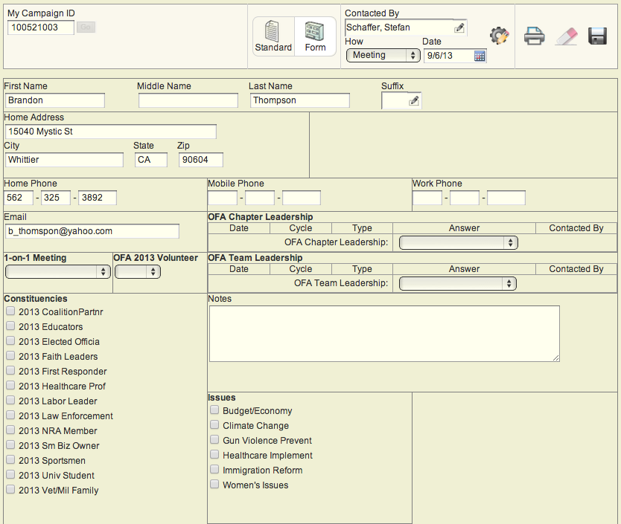
Keeping track of 1:1 meetings
Form View in My Campaign
Notes:
[Slide 20] Before we debrief, I want to make a plug for data entry. We like to say that if it isn’t in VAN, it didn’t happen. It’s important to track 1:1s in VAN using form view in MyCampaign. It’s the only sure way to make sure we’re tracking these critical conversations.

Slide 21
Q & A
Notes:
0:46 – 1:00 Question and Answer
[Slide 21] We probably won’t get to all of your questions, but we’ll take a few and place the rest in a “parking lot” of questions we can hopefully follow-up with later on – after this training.

Slide 22
Thank you!
Notes:
[Slide 21] Thank you!

