Slide 1


Welcome
We will begin at 7:30 pm Central Time.
Notes:
This work is licensed under the Creative Commons Attribution-NonCommercial 4.0 International License. To view a copy of this license, visit http://creativecommons.org/licenses/by-nc/4.0/ or send a letter to Creative Commons, PO Box 1866, Mountain View, CA 94042, USA

Slide 2

OFA Community
Engagement Fellowship
Spring 2018 / #OFAFellows

Slide 3

Leadership in action

Slide 4
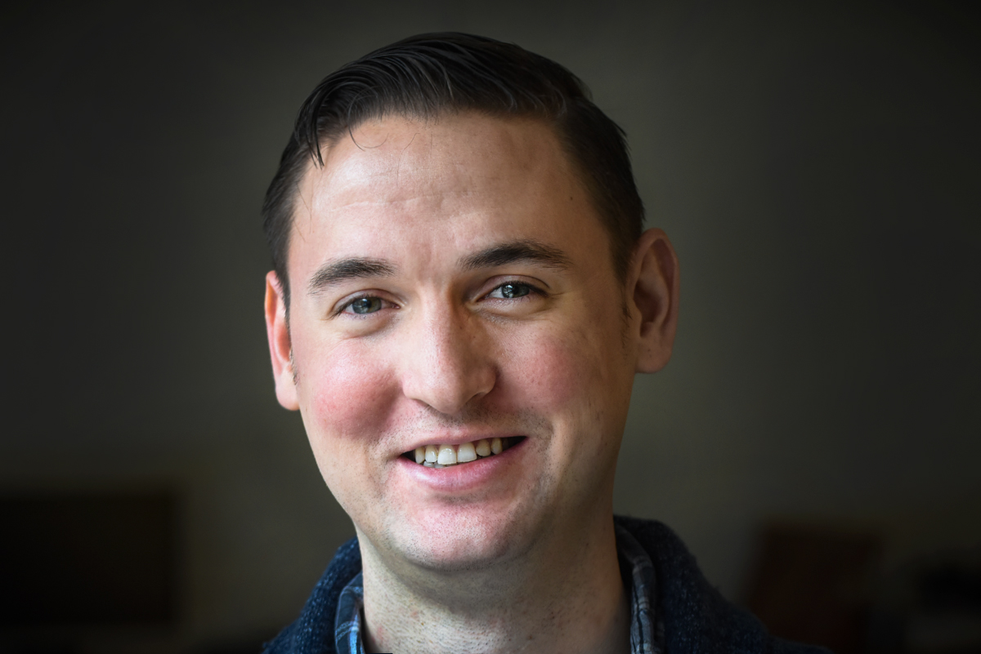
Bobby Brady-Sharp
Field Director, @bobbyhtx

Slide 5
#OFAFellows
Notes:
Over the span of this week hundreds of fellows will be starting this journey along with you! Using social media to share out your learning and what you are excited about is a great way to build connections that span the country. It is also a super great way to show your personal networks what you’re working on. Who knows, maybe someone will be inspired by you and begin their own organizing journey!

Slide 6

Goals for
today
1
Develop self-awareness and knowledge about our conceptions of leadership.
2
Identify areas that, based on our conceptions, highlight how we want to grow as a leader.
3
Be able to apply new ideas of leadership in our organizing and issue work.
Notes:
7:09- 7:10 (1 MINUTE)
[LIZ]
Note--- this is a TYPE of personal story

Slide 7
Agenda
Recap of previous week
Archetypes of leadership
Leadership vs. management
Being a leader in organizing
Debrief & next steps
Notes:
7:10- 7:11 (1 MINUTE)
[LIZ]

Slide 8
Week 2: Key takeaways

Slide 9
We must address the
root challenge if we are
to affect change.

Slide 10
Public value
Strategic triangle
Operational capacity
Legitimacy & support
Notes:
https://sites.hks.harvard.edu/m-rcbg/CSRI/publications/workingpaper_3_moore_khagram.pdf

Slide 11
Goal, strategy, tactics, framework
1
An achievable, measurable, and problem-solving goal.
A strategy that provides the roadmap for success.
Effective tactics that accomplish your goal through the strategy you’ve developed.
2
3

Slide 12







An issue ecosystem is the environment
surrounding a decision maker.
Notes:
Elected officials and other decision makers are constantly surrounded by messages from people asking them to take one stand or another on an issue. They receive these messages through a variety of mediums and from a variety of voices.
Decision makers are surrounded by many issue ecosystems every day. If you and your partner organizations are not part of an issue ecosystem around a decision maker, the opposition is filling that space with their message or the issue is not on the target’s radar.

Slide 13
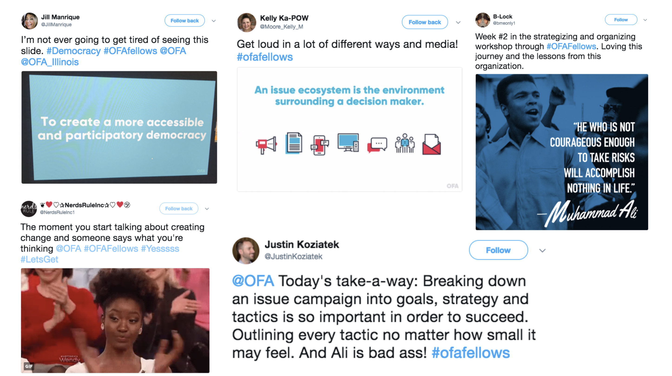

Slide 14
Agenda
Recap of previous week
Archetypes of leadership
Leadership vs. management
Being a leader in organizing
Debrief & next steps
Notes:
7:10- 7:11 (1 MINUTE)
[LIZ]

Slide 15

Archetypes of
leadership

Slide 16
There are many definitions….
In the past 60 years, as many as
65 different classification systems have been developed to define leadership (Fleishman, et. Al, 1991)

Slide 17
3 minutes
List the top five leaders you admire on a piece of paper.
Identify why you chose these five leaders—think:
  Attributes
  Demographics
  What makes them a good leader?
Reflection and writing

Slide 18
What values are present in
your list of leaders?

Slide 19
FDR
Fannie Lou Hamer
Bobby Kennedy
Cesar Chavez
Nelson Mandela

Slide 20
What potential leadership
blind-spots do you see?

Slide 21
FDR
Fannie Lou Hamer
Bobby Kennedy
Cesar Chavez
Nelson Mandela

Slide 22
Debrief

Slide 23
Archetype:
A recurrent symbol or motif of something, particularly in reference to your thoughts.

Slide 24
Stereotype:
A widely held but fixed and oversimplified image or idea of a particular type of person or thing.

Slide 25
Archetype of a plumber

Slide 26
Archetype of a teacher

Slide 27
Archetype of a businessperson

Slide 28
2 minutes
On a notepad, write down your answers to these questions:
  What is your archetype of leadership?
Individual reflection

Slide 29
2 minutes
On a notepad, write down your answers to these questions:
  What is your archetype of leadership?
  How does your leadership archetype differ from you?
Individual reflection

Slide 30
2 minutes
On a notepad, write down your answers to these questions:
  What is your archetype of leadership?
  How does your leadership archetype differ from you?
  Give an example of someone who has challenged your archetype.
Individual reflection

Slide 31
Agenda
Recap of previous week
Archetypes of leadership
Leadership vs. management
Being a leader in organizing
Debrief & next steps
Notes:
7:10- 7:11 (1 MINUTE)
[LIZ]

Slide 32

What leadership is
(and is not)

Slide 33
Our conception of what leadership is can be limiting.

Slide 34
Assigned Leadership:
Leadership that is based on occupying a position in an organization.
(Northouse, ”Leadership: Theory and Practice”, 08)

Slide 35
Emergent Leadership:
Perceiving an individual as the most influential member of a group, regardless of their title.
(Northouse, ”Leadership: Theory and Practice”, 08)

Slide 36
Management
Leadership

Slide 37
Management
(Abraham Zaleznik, 1977)
Leadership
Impersonal about goals
Relate more in-line with role
Authority granted from above (authorized)
Transactional
Conditional

Slide 38
Management
(Abraham Zaleznik, 1977)
Leadership
(Abraham Zaleznik, 1977)
Impersonal about goals
Relate more in-line with role
Authority granted from above (authorized)
Transactional
Conditional
Personal about org goals
Relate more intuitively
Authority granted from below from within
Persistent

Slide 39
“You manage things;
you lead people.”
GRACE MURRAY HOPPER / U.S. NAVY REAR ADMIRAL
Notes:
More than anything though, we believe that you have to see yourself as part of the community you want to improve/organize – this is the only way you will know the needs, the resources, who is missing from the table

Slide 40
Leadership is not…

Slide 41

Coercive or
telling people what to do.
Notes:
Coercion induces change, while leadership influences change

Slide 42
Trait-based or
born that way.

Slide 43
Leadership is a process by which an individual uses influence with a group for positive change.

Slide 44

Now it’s
your turn
Question: How do you define the difference between leadership and management? What examples can you point to in your own life or experience?
Type in the chat box to share your thoughts
Notes:
7:47- 7:53 [6 minutes]
It’s ok if that takes a second – this is hard! Really think about the FIRST time that happened because that was when you likely solified your belief around a particular value.
This is hard and takes a lot of practice, so some
This is very personal, so if you feel comfortable sharing, we would love to thear

Slide 45
Agenda
Recap of previous week
Archetypes of leadership
Leadership vs. management
Being a leader in organizing
Debrief & next steps
Notes:
7:10- 7:11 (1 MINUTE)
[LIZ]

Slide 46
Organizers are change-
makers. They are leaders
who take action.
Notes:
More than anything though, we believe that you have to see yourself as part of the community you want to improve/organize – this is the only way you will know the needs, the resources, who is missing from the table

Slide 48
“As we look ahead into the
next century, leaders will be
those who empower others.”
BILL GATES
Notes:
More than anything though, we believe that you have to see yourself as part of the community you want to improve/organize – this is the only way you will know the needs, the resources, who is missing from the table

Slide 49
“If your actions create a legacy
that inspires others to dream
more, learn more, do more and
become more, then, you are an excellent leader.”
DOLLY PARTON
Notes:
More than anything though, we believe that you have to see yourself as part of the community you want to improve/organize – this is the only way you will know the needs, the resources, who is missing from the table

Slide 50
“Leadership is a series
of behaviors rather than
a role for heroes.”
MARGARET WHEATLEY
Notes:
More than anything though, we believe that you have to see yourself as part of the community you want to improve/organize – this is the only way you will know the needs, the resources, who is missing from the table

Slide 51
Now it’s
your turn
Question: How do we inspire others to follow us?
Type in the chat box to share your thoughts
Notes:
7:47- 7:53 [6 minutes]
It’s ok if that takes a second – this is hard! Really think about the FIRST time that happened because that was when you likely solified your belief around a particular value.
This is hard and takes a lot of practice, so some
This is very personal, so if you feel comfortable sharing, we would love to thear

Slide 52
Now it’s
your turn
Question: What are the types and examples of leadership you see exemplified in your community?
Type in the chat box to share your thoughts
Notes:
7:47- 7:53 [6 minutes]
It’s ok if that takes a second – this is hard! Really think about the FIRST time that happened because that was when you likely solified your belief around a particular value.
This is hard and takes a lot of practice, so some
This is very personal, so if you feel comfortable sharing, we would love to thear

Slide 53
Agenda
Recap of previous week
Archetypes of leadership
Leadership vs. management
Being a leader in organizing
Debrief & next steps
Notes:
7:10- 7:11 (1 MINUTE)
[LIZ]

Slide 54

Debrief
How does our archetype of leadership affect who we define it?
What is the difference between leadership and management?
How do we become the leaders we want to be?
Notes:
3 MINUTES
ADRIENNE
[TRACI pulls out some responses from the chat box]

Slide 55
What are your key takeaways?
Type in the chat and tweet using #OFAFellows

Slide 56
Weekly assignment:
Due Wednesday, April 18
https://www.ofa.us/get-trained/fellows-2018-spring-fellowship/
1
How will you or your fellows group take on leadership in the community?
What is your definition of leadership? How are you thinking about it in terms of the issue you are working on?
How do you want to personally grow as leader in the community?
Optional:
Interview someone that you consider a leader with specific questions around leadership.
Go to a place that is a leader in your community (example: city council) How does leadership play out in that space?
2
3

Slide 57
Thanks for joining the call!
Please fill out the evaluation on today’s training using the link below.
bit.ly/Spring3-2018
Email fellows@ofa.us with any questions.

Slide 58
Thank you!
Notes:
1 MINUTE
TRACI + ADRIENNE
OFA -- TRACI
1) December 7: Redistricting call with NDRC
2) MLK DAY OF SERVICE = VR: Email organizing@ofa.us if you would like to get involved with voter registration
3) JOIN THE NEXT CALL
Link to put in chat box: https://zoom.us/webinar/register/WN_tUkjIhBnTGSSGPhQ1MQgaQ

