Slide 1



Effective conversations
Part 4: Motivational Interviewing
Elizabeth Erickson OFA Training Director @LizzGErickson
Alexis Conavay Training Manager @AlexConavay
We will begin the training at 8 p.m. ET / 7 p.m. CT
Notes:
This work is licensed under the Creative Commons Attribution-NonCommercial 4.0 International License. To view a copy of this license, visit http://creativecommons.org/licenses/by-nc/4.0/ or send a letter to Creative Commons, PO Box 1866, Mountain View, CA 94042, USA.

Slide 2



GUIDED WORKSHEET
Motivational Interviewing
Bit.ly/MIworksheet
Notes:
If you’d like to follow along, here is a guided worksheet to use. We will also email this out in our recap after this training.

Slide 3
Learning series
Week 1: Effective listening
Week 2: Know your ‘why’
Week 3: Your theory of change
Week 4: Motivational interviewing
Week 5: Voter contact best practices
Notes:
Here is where we’ve been and where we are going

Slide 4
#OFAction
Notes:
We’ve often heard that you feel very connected in the chatbox.
There are hundreds of people on this call – tweeting your key takeaways is a great way to continue to meet others from all across the country and stay connected.

Slide 5
True or false?
The average gap between self-identified Democrats and Republicans on values has increased by 20% since 1994.
Notes:
Values questions -- on government regulations to benefits for the poor to racial discrimination

Slide 6

False

Slide 7
“The average gap between self-identified Democrats and Republicans on questions related to values has increased 33% since 1994.”
Pew Research Center
Notes:
Values questions -- on government regulations to benefits for the poor to racial discrimination
The gap between Democrats and Republicans continues to expand on questions about the role of government, race, immigration — even where they prefer to live. Each party has become more ideologically homogeneous, and more hostile toward the opinions of members of the other party.

Slide 8
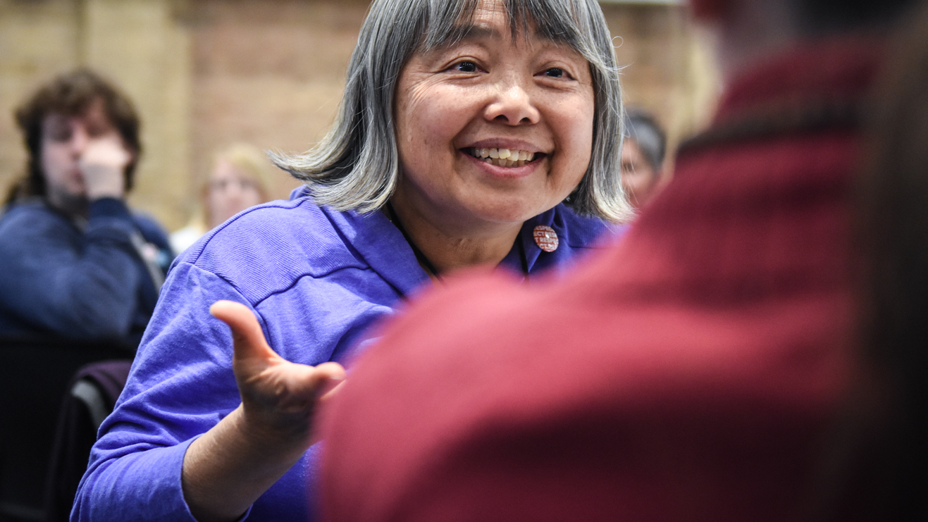
Motivational interviewing

Slide 9
Learning Goals
1
Understand the key aspects of the motivational interviewing framework.
Use the motivational interviewing framework in order to have more effective conversations with family, friends, and neighbors.
2

Slide 10
Agenda
What is motivational interviewing
Motivational interviewing framing
Debrief
Close and next steps

Slide 11
Research show that politics
has become an identity.

Slide 12
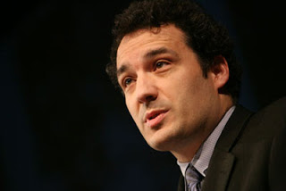
Ziad Munson
Lehigh University
Sociologist
Notes:
The sociologist Ziad Munson has found that almost half of the activists on the front lines of the anti-abortion movement — those who protest outside abortion clinics — were not anti-abortion when they attended their first event. They attended because a friend asked them, they had just joined a new church, or they retired and had more free time. They stayed, however, because at these events, they found things we all want: friends, responsibility, a sense that what they are doing matters. By finding fellowship and responsibility, these people changed not only their views on abortion but also their commitment to act.
However, studies have also found that people with polarized views also concede the nuance of their beliefs after a few questions, much more than they initially let on
We know this intuitively - there are many beliefs that we hold that go against our actions- for instance, I deeply believe in doing everything I can to combat excessive waste.. However, I bought a drink today and it came with a straw, and I know that straws are polluting the ocean.

Slide 13
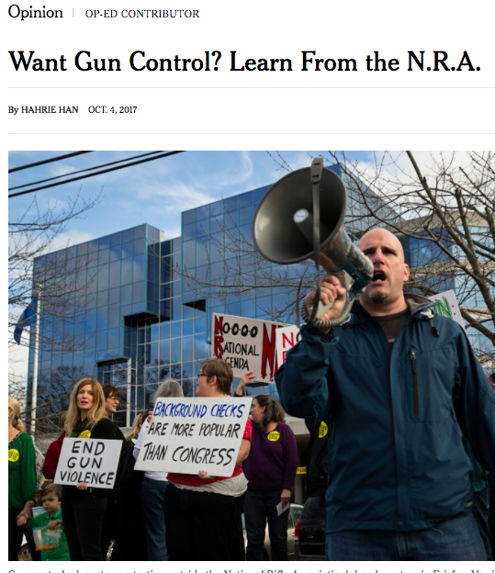
“… their views evolved after joining these gun groups. So did their identities.”
Hahrie Han

Slide 14
Therefore, we have to
be good listeners…

Slide 15
…and ask questions that
reveal biases and beliefs in
a nonjudgmental way.

Slide 16
What is a way
we can do this?

Slide 17
Can you think of an example in your own life?
Notes:
We’ve often heard that you feel very connected in the chatbox.
There are hundreds of people on this call – tweeting your key takeaways is a great way to continue to meet others from all across the country and stay connected.

Slide 18
Motivational interviewing:
A person centered method of guiding to elicit and strengthen personal motivation for change.

Slide 19
Motivational interviewing is …

Slide 20
Motivational interviewing is
A counseling style typically used to treat addictions

Slide 21
Motivational interviewing is
A counseling style typically used to treat addictions
Encourages individuals to work through their resistance to behavior change in relation to their broader life goals and values

Slide 22
Motivational interviewing is
A counseling style typically used to treat addictions
Encourages individuals to work through their resistance to behavior change in relation to their broader life goals and values
Does not directly challenge another person’s irrationality or denial–rather, helps to expose contradictions

Slide 23
Motivational interviewing is
A counseling style typically used to treat addictions
Encourages individuals to work through their resistance to behavior change in relation to their broader life goals and values
Does not directly challenge another person’s irrationality or denial–rather, helps to expose contradictions
Effective when individuals express their own contradictions

Slide 24
Motivational interviewing is not …

Slide 25
Motivational interviewing is not
Judgmental

Slide 26
Motivational interviewing is not
Judgmental
Coercive—or forcing people to think in a certain way

Slide 27
Motivational interviewing is not
Judgmental
Coercive—or forcing people to think in a certain way
Manipulative

Slide 28
Motivational interviewing is not
Judgmental
Coercive—or forcing people to think in a certain way
Manipulative
Persuasive

Slide 29
Many of us are not professional counselors.
Notes:
We are not counselors (most of us- shout out to counselors that are on the call). This framework isn’t taking the place of professional counseling, nor is it saying that we should act as counselors when we talk to people

Slide 30
That said, most of us
are seeking deep change in our country.
Notes:
However, most of us here on this call are seeking deep change in our country- we desire to see more people voting, more people civically engaged in their communities, more communities being represented by people who vote the way that their constituents put them in office to vote

Slide 31
And we can make
that change—with
the right tools!
Notes:
However, most of us here on this call are seeking deep change in our country- we desire to see more people voting, more people civically engaged in their communities, more communities being represented by people who vote the way that their constituents put them in office to vote

Slide 32
Agenda
What is motivational interviewing
Motivational interviewing framing
Debrief
Close and next steps

Slide 33
Motivational interviewing framework
1
Exploring

Slide 34
Motivational interviewing framework
1
Exploring
Guiding
2

Slide 35
Motivational interviewing framework
1
Exploring
Guiding
Choosing
2
3

Slide 36
WHAT WE STRIVE FOR IN THIS FRAMEWORK:
Are your questions ...

Slide 37
Nonjudgmental
Notes:
And at OFA, we do that by applying an old mantra that pretty much guides every interaction we have, REIO. This why you might see our organization choosing different tactics than others.
1. RESPECT -- We take a respectful approach to everything we do, including talking to our elected officials. When we’re respectful, our concerns are taken more seriously. We make sure that we’re respectful of people’s time for those who engage in our organization. We’re not asking folks to do things that we don’t think will actually help move the needle forward or will actually help you build your organization. It means that we respect everyone who comes into this organization, no matter how they get here. Not everyone is a die-hard democrat or progressive, but they still have a place here.
2. EMPOWER – that means that we make sure that we’re not just asking people to take actions, but that we’re training and supporting folks to be leaders in their communities. That doesn’t necessarily mean that you have to be in charge of running everything, but maybe when you talk with your friends, your family, and your neighbors about issues, that you know what those issues are about, you know what’s at stake, and you’re empowered to be a leader in that way.
3. INCLUDE -- We include anyone and everyone who wants to make a difference in the progressive movement. OFA welcomes you, no matter your skill level or income. It is our job to find the ways that people can give—whether they have 5 hours or 5 minutes—whether they have lots of resources or none—everyone has a place in this organization and everyone has a role to play in working to make their communities better.
You will receive all of our training and coaching at no cost to you. And, it doesn’t matter if you’ve never taken action before or if you’re a seasoned community organizer, we have a place for everyone at OFA.
4. Organize! – We’re not just building all of this infrastructure so we can fight today’s fights, but so that we’re here for the long term. Because we know that some of these fights will take years or even decades of work.
We organize because that is how we build long term power.

Slide 38
Using their language
Notes:
And at OFA, we do that by applying an old mantra that pretty much guides every interaction we have, REIO. This why you might see our organization choosing different tactics than others.
1. RESPECT -- We take a respectful approach to everything we do, including talking to our elected officials. When we’re respectful, our concerns are taken more seriously. We make sure that we’re respectful of people’s time for those who engage in our organization. We’re not asking folks to do things that we don’t think will actually help move the needle forward or will actually help you build your organization. It means that we respect everyone who comes into this organization, no matter how they get here. Not everyone is a die-hard democrat or progressive, but they still have a place here.
2. EMPOWER – that means that we make sure that we’re not just asking people to take actions, but that we’re training and supporting folks to be leaders in their communities. That doesn’t necessarily mean that you have to be in charge of running everything, but maybe when you talk with your friends, your family, and your neighbors about issues, that you know what those issues are about, you know what’s at stake, and you’re empowered to be a leader in that way.
3. INCLUDE -- We include anyone and everyone who wants to make a difference in the progressive movement. OFA welcomes you, no matter your skill level or income. It is our job to find the ways that people can give—whether they have 5 hours or 5 minutes—whether they have lots of resources or none—everyone has a place in this organization and everyone has a role to play in working to make their communities better.
You will receive all of our training and coaching at no cost to you. And, it doesn’t matter if you’ve never taken action before or if you’re a seasoned community organizer, we have a place for everyone at OFA.
4. Organize! – We’re not just building all of this infrastructure so we can fight today’s fights, but so that we’re here for the long term. Because we know that some of these fights will take years or even decades of work.
We organize because that is how we build long term power.

Slide 39
Loving
Notes:
And at OFA, we do that by applying an old mantra that pretty much guides every interaction we have, REIO. This why you might see our organization choosing different tactics than others.
1. RESPECT -- We take a respectful approach to everything we do, including talking to our elected officials. When we’re respectful, our concerns are taken more seriously. We make sure that we’re respectful of people’s time for those who engage in our organization. We’re not asking folks to do things that we don’t think will actually help move the needle forward or will actually help you build your organization. It means that we respect everyone who comes into this organization, no matter how they get here. Not everyone is a die-hard democrat or progressive, but they still have a place here.
2. EMPOWER – that means that we make sure that we’re not just asking people to take actions, but that we’re training and supporting folks to be leaders in their communities. That doesn’t necessarily mean that you have to be in charge of running everything, but maybe when you talk with your friends, your family, and your neighbors about issues, that you know what those issues are about, you know what’s at stake, and you’re empowered to be a leader in that way.
3. INCLUDE -- We include anyone and everyone who wants to make a difference in the progressive movement. OFA welcomes you, no matter your skill level or income. It is our job to find the ways that people can give—whether they have 5 hours or 5 minutes—whether they have lots of resources or none—everyone has a place in this organization and everyone has a role to play in working to make their communities better.
You will receive all of our training and coaching at no cost to you. And, it doesn’t matter if you’ve never taken action before or if you’re a seasoned community organizer, we have a place for everyone at OFA.
4. Organize! – We’re not just building all of this infrastructure so we can fight today’s fights, but so that we’re here for the long term. Because we know that some of these fights will take years or even decades of work.
We organize because that is how we build long term power.

Slide 40
Expansive vs. reductionist
Notes:
And at OFA, we do that by applying an old mantra that pretty much guides every interaction we have, REIO. This why you might see our organization choosing different tactics than others.
1. RESPECT -- We take a respectful approach to everything we do, including talking to our elected officials. When we’re respectful, our concerns are taken more seriously. We make sure that we’re respectful of people’s time for those who engage in our organization. We’re not asking folks to do things that we don’t think will actually help move the needle forward or will actually help you build your organization. It means that we respect everyone who comes into this organization, no matter how they get here. Not everyone is a die-hard democrat or progressive, but they still have a place here.
2. EMPOWER – that means that we make sure that we’re not just asking people to take actions, but that we’re training and supporting folks to be leaders in their communities. That doesn’t necessarily mean that you have to be in charge of running everything, but maybe when you talk with your friends, your family, and your neighbors about issues, that you know what those issues are about, you know what’s at stake, and you’re empowered to be a leader in that way.
3. INCLUDE -- We include anyone and everyone who wants to make a difference in the progressive movement. OFA welcomes you, no matter your skill level or income. It is our job to find the ways that people can give—whether they have 5 hours or 5 minutes—whether they have lots of resources or none—everyone has a place in this organization and everyone has a role to play in working to make their communities better.
You will receive all of our training and coaching at no cost to you. And, it doesn’t matter if you’ve never taken action before or if you’re a seasoned community organizer, we have a place for everyone at OFA.
4. Organize! – We’re not just building all of this infrastructure so we can fight today’s fights, but so that we’re here for the long term. Because we know that some of these fights will take years or even decades of work.
We organize because that is how we build long term power.

Slide 41

Your experience
$$≠$$
Others experience
Notes:
And at OFA, we do that by applying an old mantra that pretty much guides every interaction we have, REIO. This why you might see our organization choosing different tactics than others.
1. RESPECT -- We take a respectful approach to everything we do, including talking to our elected officials. When we’re respectful, our concerns are taken more seriously. We make sure that we’re respectful of people’s time for those who engage in our organization. We’re not asking folks to do things that we don’t think will actually help move the needle forward or will actually help you build your organization. It means that we respect everyone who comes into this organization, no matter how they get here. Not everyone is a die-hard democrat or progressive, but they still have a place here.
2. EMPOWER – that means that we make sure that we’re not just asking people to take actions, but that we’re training and supporting folks to be leaders in their communities. That doesn’t necessarily mean that you have to be in charge of running everything, but maybe when you talk with your friends, your family, and your neighbors about issues, that you know what those issues are about, you know what’s at stake, and you’re empowered to be a leader in that way.
3. INCLUDE -- We include anyone and everyone who wants to make a difference in the progressive movement. OFA welcomes you, no matter your skill level or income. It is our job to find the ways that people can give—whether they have 5 hours or 5 minutes—whether they have lots of resources or none—everyone has a place in this organization and everyone has a role to play in working to make their communities better.
You will receive all of our training and coaching at no cost to you. And, it doesn’t matter if you’ve never taken action before or if you’re a seasoned community organizer, we have a place for everyone at OFA.
4. Organize! – We’re not just building all of this infrastructure so we can fight today’s fights, but so that we’re here for the long term. Because we know that some of these fights will take years or even decades of work.
We organize because that is how we build long term power.

Slide 42
MOTIVATIONAL INTERVIEWING FRAMEWORK
Exploring

Slide 43
Exploring
Listen to the individual’s story

Slide 44
Exploring
Listen to the individual’s story
Build rapport

Slide 45
Exploring
Listen to the individual’s story
Build rapport
Obtain history

Slide 46
Exploring
Listen to the individual’s story
Build rapport
Obtain history
Listen and give a reflective statement

Slide 47
Offer reflective responses.
Notes:
We are not counselors (most of us- shout out to counselors that are on the call). This framework isn’t taking the place of professional counseling, nor is it saying that we should act as counselors when we talk to people

Slide 48
Content reflection:
“Given what you said, it sounds like you…”

Slide 49
Meaning/feeling reflection:
“It seems that you felt… is that right?”
Notes:
Note: Even when reflections are inaccurate, though the act of correcting the listener, people clarify their thoughts and feelings and move the discussion forward

Slide 50
CAUTIONARY TRAPS
Responding
With questions that are biased in what you want to hear.

Slide 51
CAUTIONARY TRAPS
&
Responding
Premature advice
With questions that are biased in what you want to hear.
Giving advice based
on biases without first listening to the individual.

Slide 52
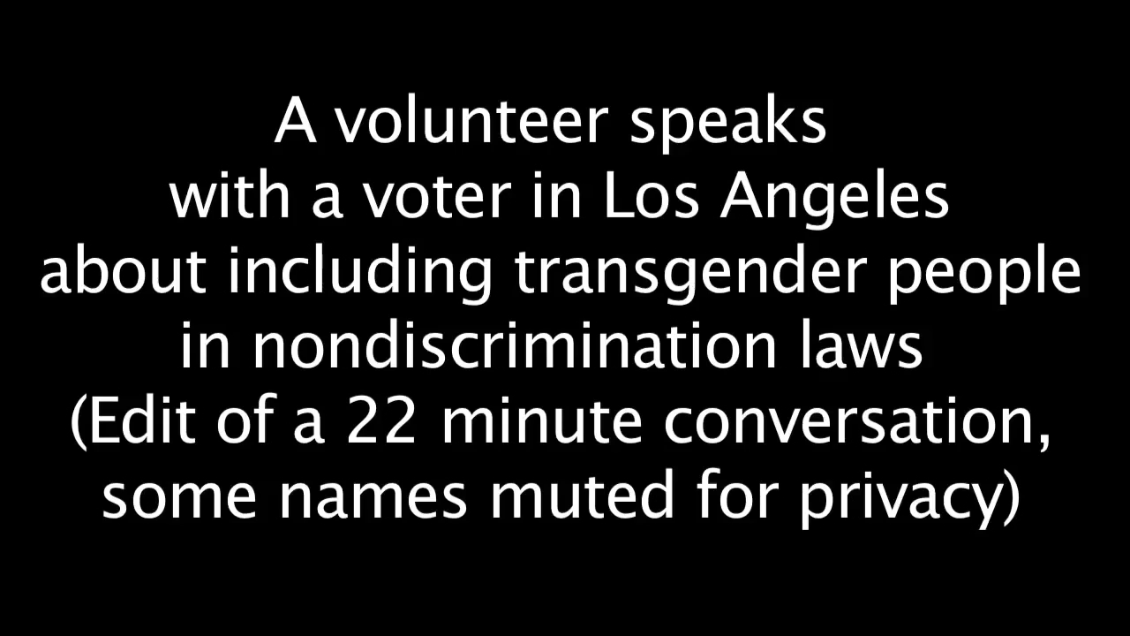

Slide 53
2 minutes
If you were the person at the door canvassing this women, what would you ask or say at this point?
Reflection

Slide 54
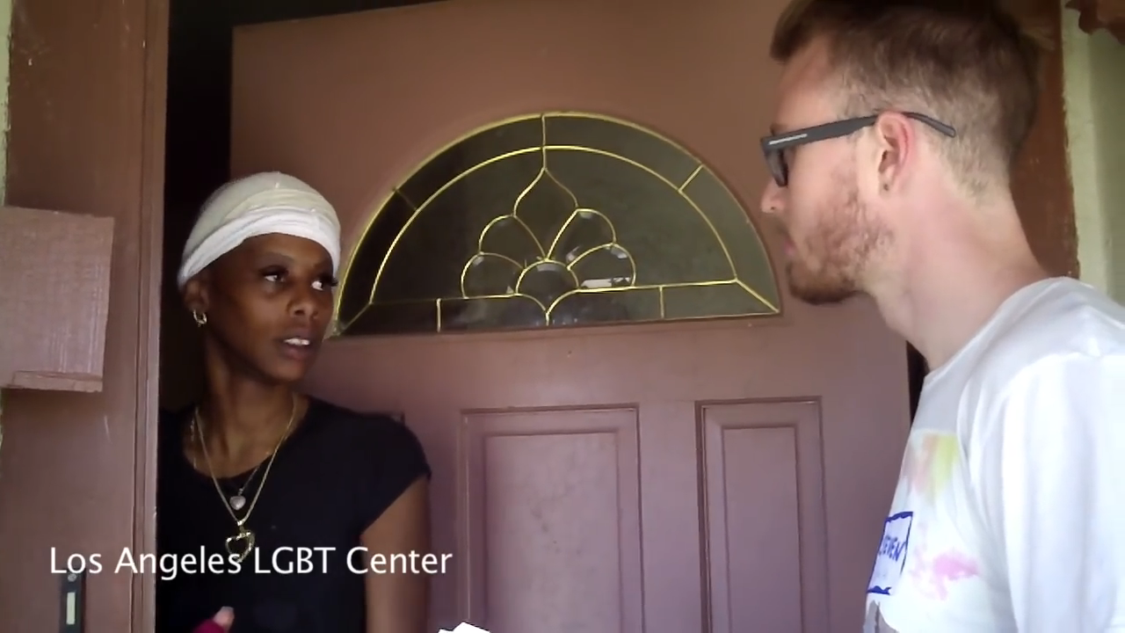

Slide 55
3 minutes
What exploring questions did you hear the canvasser say?
Reflection

Slide 56
MOTIVATIONAL INTERVIEWING FRAMEWORK
Guiding

Slide 57
Guiding
Clarification of values

Slide 58
Guiding
Clarification of values
Summarize

Slide 59
Guiding
Clarification of values
Summarize
Bring assumptions to the surface

Slide 60
More on guiding
Confronting people can cause them to shutdown

Slide 61
More on guiding
Confronting people can cause them to shutdown
Therefore, we can “pull up alongside them”…

Slide 62
More on guiding
Confronting people can cause them to shutdown
Therefore, we can “pull up alongside them”…
EVEN IF their statements are factually incorrect or blames others unfairly

Slide 63
Two techniques for guiding

Slide 64
Double-sided reflection
On the one hand, you feel X, and on the other hand, you feel Y”
Two techniques
Notes:
Two techniques:
Double sided reflection“On one hand you feel X, and on the other hand, you feel Y”
Invert barrier: “Sounds like, in order to move forward, you might want to address barriers A, B, C”
Goal of this phase: Be listening for values, be listening for how values are contradicting with actions, and begin surfacing them for people

Slide 65
Double-sided reflection
On the one hand, you feel X, and on the other hand, you feel Y”
Invert barrier
“It sounds like, in order to move forward, you might want to address barriers A, B, C”
Two techniques
Notes:
Two techniques:
Double sided reflection“On one hand you feel X, and on the other hand, you feel Y”
Invert barrier: “Sounds like, in order to move forward, you might want to address barriers A, B, C”
Goal of this phase: Be listening for values, be listening for how values are contradicting with actions, and begin surfacing them for people

Slide 66
CAUTIONARY TRAPS
Biases
Letting your biases and prejudices creep into to your efforts in the conversation.

Slide 67
CAUTIONARY TRAPS
Biases
Assigning value
&
Letting your biases and prejudices creep into to your efforts in the conversation.
Assigning value to the statements that the individual is sating.

Slide 68
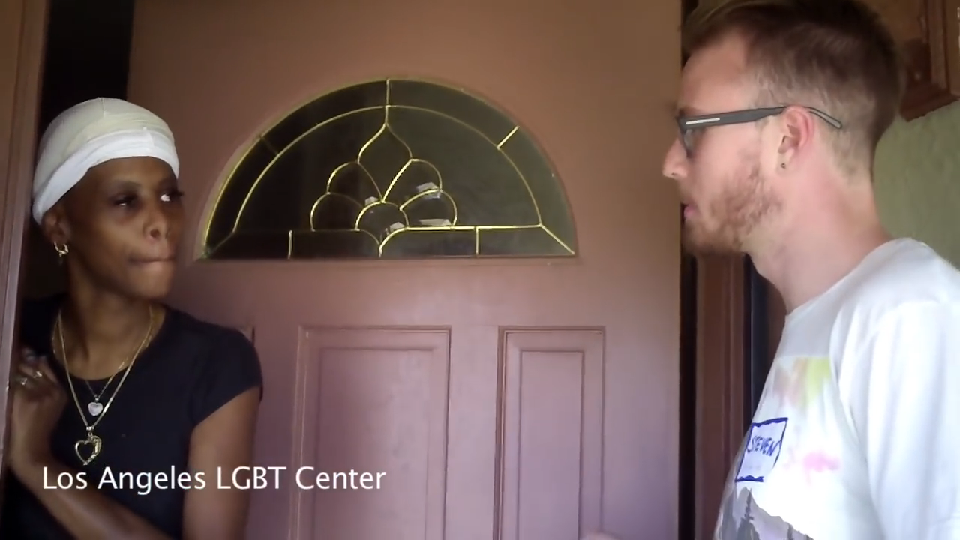

Slide 69
3 minutes
What examples of guiding questions did you hear the canvasser say?
Reflection

Slide 70
MOTIVATIONAL INTERVIEWING FRAMEWORK
Choosing

Slide 71
Choosing
Asking the individual to continue conversation

Slide 72
Choosing
Asking the individual to continue conversation
Exploring next steps and options with the individual

Slide 73
Ask
“On a scale of 1-10, how important is it to you that you change XYZ? What would it take to get you to a higher number? Why did you not choose a lower number?”
Two techniques

Slide 74
Ask
“On a scale of 1-10, how important is it to you that you change XYZ? What would it take to get you to a higher number? Why did you not choose a lower number?”
Invite
To join a community organization, go to an event, have a further conversation, or support a cause.
Two techniques

Slide 75
CAUTIONARY TRAP
Moving to this stage
too soon!

Slide 76
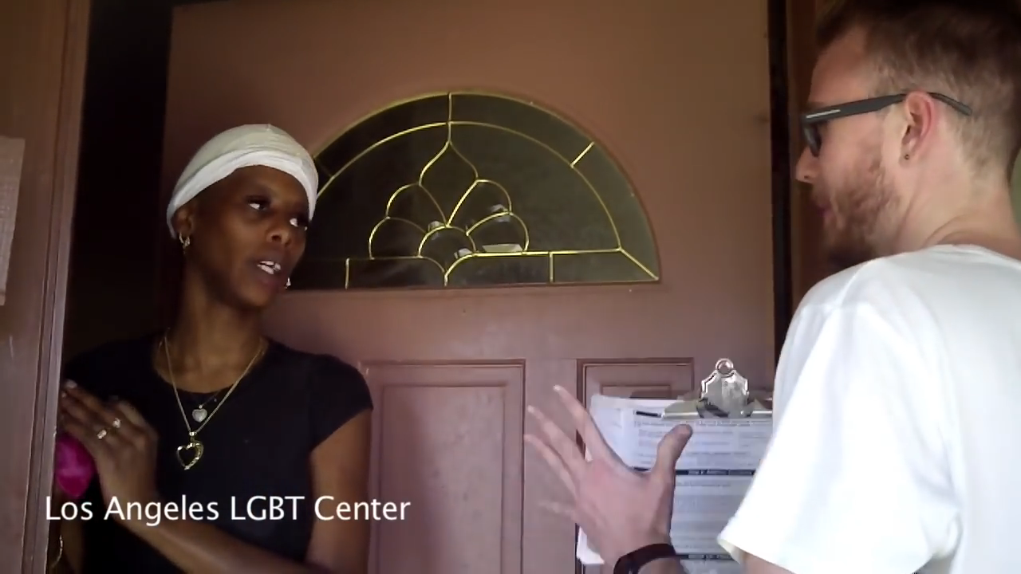

Slide 77
3 minutes
How did the canvasser ask the woman to choose? What else might you do in the choosing phase?
Reflection

Slide 78
Let’s synthesize.

Slide 79
Motivational interviewing framework
1
Exploring
Guiding
Choosing
2
3

Slide 80
Agenda
What is motivational interviewing
Motivational interviewing framing
Debrief
Close and next steps

Slide 81
Debrief
Which phase of the framework comes easily to you?
Which trap do you fall into?

Slide 82
Debrief
What situation do you think this motivational interviewing framework would work best in?
Who do you commit to trying this with?

Slide 83
Next session

Slide 84
Effective conversations
Part 5: Voter contact best practices
Notes:
way to make our assumptions out on the surface in a way that can be analyzed
Give date/time of next training

Slide 85
Team ’18
ofa.bo/team18lead
Notes:
We will also run a Team’ 18 Leadership program, where you will have the opportunity to build volunteer teams on behalf of OFA. You will have the opportunity to coach, mentor, and develop organizers who live in target areas.
OFA will support you in your work by doing what we know best—providing training, coaching, and mentorship to make sure you are prepared to take on this fight.
Sign-up to join Team ‘18 now!!:http://bit.ly/ofa18
Canvassing, phone banking, talking to family and friends

Slide 86
OFA
Thank you for joining today’s webinar.
Please fill out the survey below and give us
your feedback on today’s training.
bit.ly/effectiveconvosMI

