Slide 1

Welcome
We will begin at 7:30 pm Central Time
Notes:
This work is licensed under the Creative Commons Attribution-NonCommercial 4.0 International License. To view a copy of this license, visit http://creativecommons.org/licenses/by-nc/4.0/ or send a letter to Creative Commons, PO Box 1866, Mountain View, CA 94042, USA

Slide 2
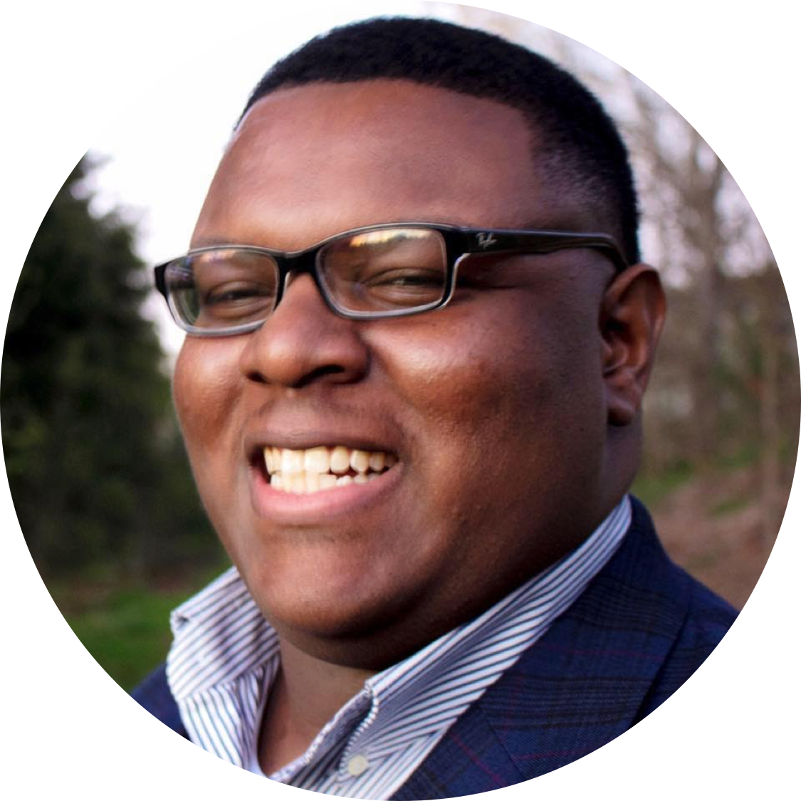

DeAndre Jones
Regional Organizing Manager

Slide 3
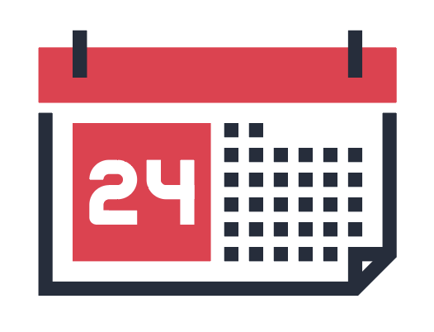




Logistics
We will meet every Wednesday for 90 minutes. If you cannot attend, inform your fellows leader, if you have one, and email fellows@ofa.us
This is an interactive training.
A recording of this video and slides will be available on the Fellows Bookshelf following this training.
Tweet using #OFAFellows

Slide 4
Our learning journey:
Where we’ve been and where we’re going
Week 1: Organizing Community Engagement
Events
Week 2: Leading an Action Planning Session
Week 3: Event Management
Week 4: Recruitment: Grassroots Tactics

Slide 5
Our learning journey:
Where we’ve been and where we’re going
Week 1: Organizing Community Engagement
Events
Week 2: Leading an Action Planning Session
Week 3: Event Management
Week 4: Recruitment: Grassroots Tactics
Week 5: Recruitment: Digital Tactics
Week 6: Tying it all together

Slide 6
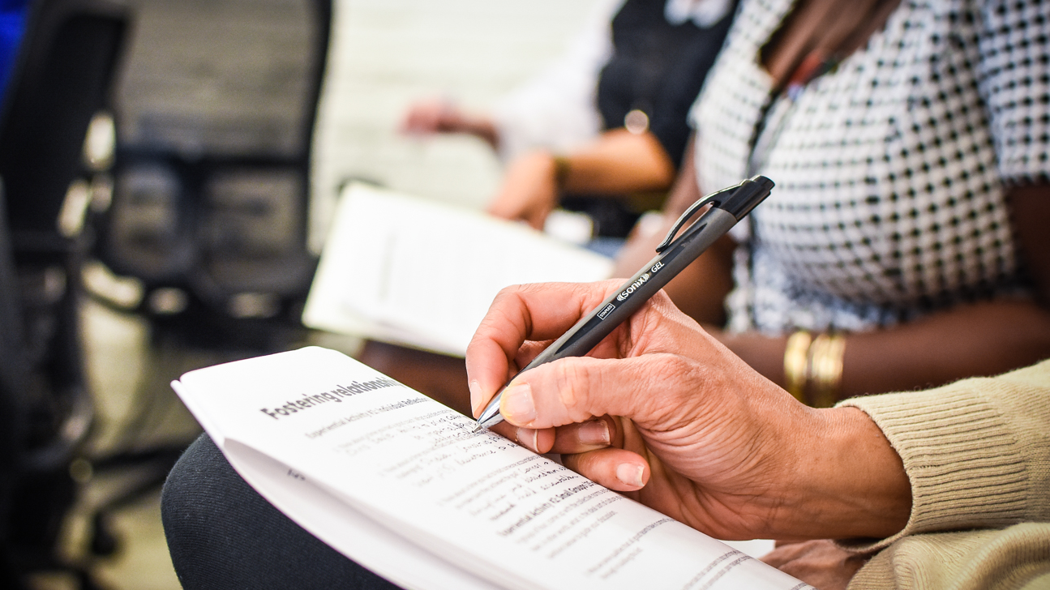
Recruitment: Grassroots Tactics

Slide 7
Goals for today
Learn best practices for recruiting people to attend your event
Be able to develop a Hard Ask
Feel comfortable recruiting for your upcoming event
1
2
3

Slide 8
Agenda
Assessing your audience
The Hard Ask
Debrief
Next steps
Notes:
00:18 – 00:19 [1 min] – Aquiles
[Broad Goals] Review post-training agenda
We cannot cover everything you will need to know today.
That is why we have a post-training agenda for you
Review key dates and webinars

Slide 9
Why should someone attend your event?
Type in the chat box

Slide 10
Why should someone attend your event?
Learn a new skill
Understand a new perspective
Demonstrate commitment to a cause
Keep busy
To be challenged
For fun

Slide 11
Why should someone attend your event?
Learn a new skill
Understand a new perspective
Demonstrate commitment to a cause
Keep busy
To be challenged
For fun
Because they were asked!

Slide 12
You get what you ask for, and not much of what you do not.

Slide 13
Before you ask, assess your audience.
Who are you recruiting to attend your event?

Slide 14
Before you ask, assess your audience.
Who are you recruiting to attend your event?
Personal network of friends
Community people/leadership
Church members
Chapter members

Slide 15
Before you ask, assess your audience.
Who are you recruiting to attend your event?
Personal network of friends
Community people/leadership
Church members
Chapter members
What can you do or say that would attract them?

Slide 16
Before you ask, assess your audience.
Who are you recruiting to attend your event?
What can you do or say that would attract them?
What existing resources can you use to recruit?
Existing networks
OFA networks
Local partner organizations
Social media

Slide 17
5 minute
reflection
Who are you recruiting to attend your event?
What can you do or say that would attract them?
What existing resources can you use to recruit?

Slide 18
How did answering these questions help you
understand your audience?
Type in the chat box

Slide 19
Agenda
Assessing your audience
The Hard Ask
Debrief
Next steps
Notes:
00:18 – 00:19 [1 min] – Aquiles
[Broad Goals] Review post-training agenda
We cannot cover everything you will need to know today.
That is why we have a post-training agenda for you
Review key dates and webinars

Slide 20
1
2
I am so sorry for bothering you. Is there anyway, perhaps, that you can consider coming to an event I am planning for next month? Again, sorry for bothering you.
We are hosting an event with Rep. Gotham on April 20. We will be discussing his gun violence prevention proposal and how our community can get involved to support that. Can you join us?

Slide 21
Which ask do you prefer? Why?

Slide 22
2
3
We are hosting an event with Rep. Gotham on April 20. We will be discussing his gun violence prevention proposal and how our community can get involved to support that. Can you join us?
I know that you care a lot about crime in our community. I do too! Which is why I am organizing an event with Rep. Gotham to better understand his approach on gun violence and what we can do as a community to affect change on the issue. Can you join me and other members of our community for a conversation with the congressman on April 20 at 2 pm?

Slide 23
Which ask do you prefer? Why?

Slide 24
THE HARD ASK: 5-STEP FORMULA
Know your audience
Build urgency
Ask for something specific
Ask and be quiet
Be persistent

Slide 25
The Hard Ask
Know your Audience
  What is at stake for the person being asked?
  What’s in it for them?

Slide 26
The Hard Ask
2. Build urgency
  Do not simply make an ask. Provide context as to why the person should be involved right at this moment.
  Why is attending your event important?

Slide 27
The Hard Ask
3. Ask for something specific
  Specific asks increase chances of a positive response.
  Use either/or questions.

Slide 28
The Hard Ask
4. Ask and be quiet
  Shhhhhhh

Slide 29
The Hard Ask
5. Be persistent
  Ask #1: Can we meet between 2-4pm on Thursday?
  Ask #2: When on Thursday works better for you?
  Ask #3: When in the next three days can we get together?
  Ask #4: When does it work for you?

Slide 30
5 minutes
Independently, think of your own event, draft a hard ask following the framework we just reviewed.

Slide 31
What is your Hard Ask?
Type in the chat box

Slide 32
Agenda
Assessing your audience
The Hard Ask
Debrief
Next steps
Notes:
00:18 – 00:19 [1 min] – Aquiles
[Broad Goals] Review post-training agenda
We cannot cover everything you will need to know today.
That is why we have a post-training agenda for you
Review key dates and webinars

Slide 33
Tweet your biggest takeaway
Type in the chat box

Slide 34
Agenda
Assessing your audience
The Hard Ask
Debrief
Next steps
Notes:
00:18 – 00:19 [1 min] – Aquiles
[Broad Goals] Review post-training agenda
We cannot cover everything you will need to know today.
That is why we have a post-training agenda for you
Review key dates and webinars

Slide 35
Weekly assignment, due Oct 25:
Now that you have a better idea of the type of event you will host and your event program, begin to think about your audience and the people you would like to recruit and invite to your event.
Use this assignment to begin drafting your recruitment plan. Think about your attendance goals, the type of audience you would like to recruit, and the hard ask you can use to recruit your audience.

Slide 36
OFA Training
Thank you for joining today’s webinar.
Check the Fellow Bookshelf for a copy of the material covered today,
including a video and audio recording of the webinar.
Email fellows@ofa.us with any questions.
bit.ly/cefweek4

