Slide 1
Training Title
Trainer Name
@TrainerTwitterHandle
Notes:
This work is licensed under the Creative Commons Attribution-NonCommercial 4.0 International License. To view a copy of this license, visit http://creativecommons.org/licenses/by-nc/4.0/ or send a letter to Creative Commons, PO Box 1866, Mountain View, CA 94042, USA

Slide 2
Goals for this session
By the end of this session, you will...
Understand the basics of issue organizing
Be able to use power mapping to figure out how best to persuade a Member of Congress
Be able to separate effective tactics from ineffective tactics
Notes:
0:02-0:05 Goals and Agenda
[Slide 2] Before we dive into the agenda and the rest of the session, I want to lay out a few objectives.
By the end of this session, our goal is that you
Understand the basics of issue organizing,
That you’re able to use power mapping to figure out how best to persuade a Member of Congress
And that you’re able to separate effective tactics from ineffective tactics, so that you can have as great an impact as possible when you go forth to organize!

Slide 3
Agenda for this session
Introduction and Goals
Issue Organizing Basics
Persuading Members of Congress
Planning Effective Tactics
Debrief, Next Steps and Closing
Notes:
[Slide 3] So to accomplish those goals, here’s a look at our agenda:
We’re about to wrap up the Introduction
Then we’ll talk briefly about the basics of issue organizing
After that, we’ll talk about persuading Members of Congress, and that’s when we’ll introduce this concept of Power Mapping as a way to do that;
Then, we’ll talk about how to plan tactics that are effective in moving your Member of Congress
And then we’ll debrief, talk next steps, and wrap up!
[Animation cue] So with that, let’s dive into Issue Organizing Basics!

Slide 4
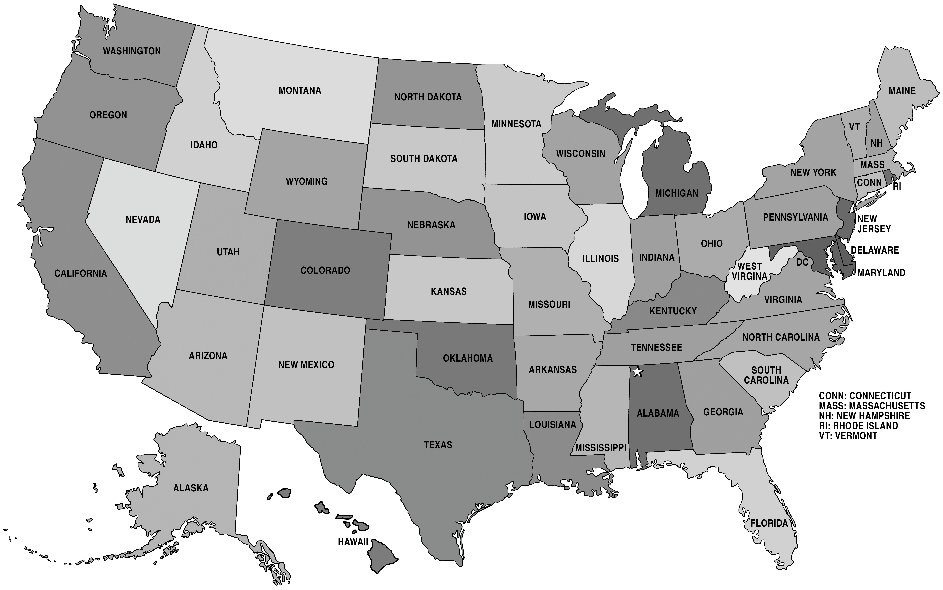
We win issue campaigns by achieving a specific vote goal
218
MOC
60
PERSUADABLE VOTER
Notes:
0:05-0:20 Issue Organizing Basics
0:05-0:08 Issue Campaigns and Vote Goals
[Slide 4] What do we mean when we talk about issue organizing? What is an issue campaign? [Ask the audience and take 1-2 answers.]
An issue campaign is a concerted effort to reach a specific vote goal on a specific piece of legislation. Does anyone know what the vote goals would be for a federal issue campaign? [Ask the audience to shout out their guesses.]
[Animation cue] Every federal issue campaign has two vote goals - 218 votes in the House of Representatives, and 60 votes in the Senate.
Now this is a lot like an election. [Animation cue] There are a bunch of voters - some of whom are definitely with us, some of whom are definitely against us, and a bunch of undecided people in the middle.
[Animation cue] So when we think about our Members of Congress, we are really thinking about Undecided Voters, the people who need us to make a compelling case for why they should vote a certain way on a certain piece of legislation.
So let’s take a minute to talk about persuasion.

Slide 5
Persuasion Case Study: Amy wants a bike
Notes:
0:08-0:15 Persuasion Case Study: Amy wants a bike
[Slide 5] This is Amy and her mom. They were out running errands on a Saturday when Amy saw the most awesome bike in the world in a store window.
We’re going to take some time to flesh out some details together about why Amy wants this bike and how she might go about convincing her mom to buy it for her.
[Use a piece of flip chart to draw a picture of three stick figures, Amy, Mom, and Dad. Leave plenty of space underneath each stick figure to write some notes.]
[Lead participants through the case study using the guidelines below.
Who is the decision maker? Let the audience discuss and come to a consensus, then circle the decision maker - either Amy’s mom or Amy’s dad. Write “Decision Maker” beneath this stick figure.
Now we’re going to imagine we are Amy and form some arguments.
What does the decision maker stand to gain if Amy gets a bike?
Now, if you were Amy, and you’ve made an ask of the decision maker, and you’ve articulated this argument, but the decision maker still says no, what would you do next? Let audience discuss and come to consensus that she would go next to the other parent. Write “Influencer” beneath this other parent’s stick figure.
If you were Amy, what kind of ask would you make to the other parent? What does the other parent stand to gain if Amy gets her bike?]
[The end goal of this exercise is for participants to understand the thought process behind identifying a decision maker, identifying key influencers, and developing a strategy to persuade the decision maker by using key influencers as messengers. See attached sample for a look at what a complete picture should look like.]

Slide 6
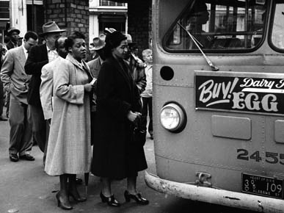
Persuasion Case Study: Montgomery Bus Boycott
Notes:
0:15-0:20 Persuasion Case Study: Montgomery Bus Boycott
[Slide 6] Okay, so now that we’ve talked about identifying decision makers and key influencers, let’s talk about a more macro-level example of achieving social change through strategic thinking.
We like to define strategy as using the resources you have to create the power you need to create the change you want.
The Montgomery Bus Boycott is a perfect example of using this construct of strategy to achieve a goal.
Can someone volunteer to briefly recount for us the facts of the Montgomery Bus Boycott? [Call on a participant to tell the story.]
Great, thank you for that.

Slide 7
Persuasion Case Study: Montgomery Bus Boycott
Resources
Power
Change
Notes:
[Slide 7] So let’s think about the Montgomery bus boycott in terms of strategy.
[Ask the audience the following questions, and ask for people to raise hands or call out the answers. The answers you should be looking for are in brackets below]:
What was the change the boycotters wanted? [Desegregation of the buses.]
What were the resources they had? [Strength in numbers - many people--who were paying customers of the bus authority--wanted this change. ]
How did they turn their resources into power? [They got a bunch of people to withhold their bus fare from the bus authority.]
How did this give them power? [The bus authority wanted to be as profitable as possible, and the boycott made them lose money. They became willing to change their policy in order to get what they wanted: more money.]

Slide 8
Key lessons from each case study
For every goal we wish to achieve, there are decision makers and influencers.
We can persuade decision makers by appealing to their own self-interest.
Notes:
[Slide 8] Excellent, so to recap some key lessons from these two case studies:
What we learned from Amy and her family is that for everything we want, every goal we want to achieve, there are decision makers, and there are influencers.
What we learned from the Montgomery Bus Boycott is that we can persuade decision makers - and deploy influencers to persuade decision makers - by appealing to their own self-interest and showing them that they can get what they want by giving us what we want.
This helps us understand that the people or groups with the most influence on a Member of Congress are usually those who can appeal to that Member’s desire to be reelected.

Slide 9
Agenda for this session
Introduction and Goals
Issue Organizing Basics
Persuading Members of Congress
Planning Effective Tactics
Debrief, Next Steps and Closing
Notes:
0:20-0:55 Persuading Members of Congress
0:20-0:30 Building a Case Study
[Slide 9] So now, we’re going to try and apply these key takeaways to one of our Members of Congress.

Slide 10
Case study: [Insert MOC] on [Insert issue]
Insert photo of Member of Congress here
Notes:
CUSTOMIZE
Insert MOC name and issue in the header, then delete brackets. Insert MOC photo in the body of the slide, and then delete the pencil.
[Slide 10] So for this case study, we’re going to think about how we can get [Insert MOC name] to support [insert issue].
Now, in order to persuade this Member of Congress, we have to figure out what it is s/he wants and who the effective influencers would be.
The first step to figuring this out is just to get to know a bit about them.
So we are going to take 5 minutes to fill in as much of this worksheet as we can, under the section “Knowing the Decision-Maker.” [Hold up the worksheet so participants can see what they should be working on.]
Feel free to work with a partner, and feel free to use your phone or computer to conduct some research.
[While participants brainstorm, prepare a sheet of butcher paper with the following phrases, so that participants can report back on their research:
Where does MOC live?
Previous offices
Prior career
Party affiliation in district
Religious affiliation
Organizational affiliations
Prior actions on issue
Other info
[After 5 minutes, Have participants report back on what they learned from their research, filling in a little bit on each question.]
0:30-0:40 Identifying our Strategy (worksheet and/or discussion)
Okay, now that we have had some time to research the Member of Congress, let’s think about our strategy for this issue. So we’re going to answer three key questions together. [This discussion can take place either in a full group or in breakouts, depending on the size.]
What is the change we want?
What are the resources we have?
How can we leverage our resources and turn them into power?

Slide 11
Case study: [Insert MOC] on [Insert issue]
Steps to Building a Power Map
Brainstorm organizations
Place organizations on the map
Identify priority relationships
Decision-maker
Against us
With us
No influence
Notes:
CUSTOMIZE
Insert MOC name and issue in the header, then delete brackets and delete the pencil.
0:40-0:55 Collaborative Power Mapping
[Slide 11] Okay, so now that we know our strategy and we know our Member of Congress, we’re going to try out this exercise called Power Mapping.
Power mapping helps us identify relationships that we can turn into power through effective tactics.
Using the issue and Member of Congress we’ve selected for our case study, we’ll walk through the 3 steps of power mapping together:
Brainstorm organizations
Assess influence (put them up on the power map)
Identify who you need to build relationships with, and what type
So for starters, go ahead and draw your power map on a sheet of paper, just like the one up here.
At the top, where it says “Decision maker,” we’re going to write the name of our Member of Congress.
Step 1: Brainstorm organizations
Our first step is to brainstorm organizations
Let’s think about the groups who care about this issue and may be able to influence our primary target. We’ll just make a big list of them together.
[Ask participants to shout out names of groups or people. Write them all down on a second piece of butcher paper without any commentary. If the room is quiet, prod by reminding participants that this is just a brainstorm - no bad ideas in a brainstorm!]
Step 2: Place Organizations on the map
Okay, our next step is to place these organizations on a map to assess their level of influence.
[Pick out a few of the groups on the brainstorm sheet and ask the audience where they belong. A few examples around Gun Violence Prevention are listed below - but don’t use them unless they truly apply to your Member of Congress!]
NRA - are they with us or against us? [Against us.] Do they have a lot of influence or no influence? [A lot of influence.] Why do they have a lot of influence? [They have a lot of money and they also have a strong affiliation with the MOC.] So we are going to put them in the upper right part of this map.
Mayors Against Illegal Guns - are they with us or against us? [With us.] Do they have a lot of influence or no influence? [Quite a bit of influence.] Why do they have quite a bit of influence? [They have a lot of money, and they are spokespeople with real followings, many of them bipartisan.] Why do you think the Republican Mayors might have the most influence? [They are voicing their opinion in support of change, and many of the people who respect and listen to them are also this MOC’s voters.] Okay, so we are going to put them in the left part of this map, sort of toward the top.
Step 3: Identify Priority Relationships
Now that we have a sense of who has the most influence on our MOC, we know who our secondary targets are.
With the groups on the left, who are influential and with us, what kind of relationship would you need to build with them? [Ask the audience to raise hands. Call on 1-2 people and guide them toward]: Right, you can build partnerships with them at an organizational level. You can plan events together, and pool resources to show greater strength in numbers. That’s great.
With the groups on the right, who are influential and against us, what kind of relationship would you need to build with them? [ask the audience to raise hands. Call on 1-2 people and guide them toward]: It won’t be easy to build an organizational relationship with these organizations. In fact - it will probably be impossible and thus a poor use of our efforts. But at an individual level, we CAN build relationships. Individual members of this group who support us on this issue would be great validators for your events, because the Member of Congress will see that members of their own voting base may cease to support them if they do not vote the right way on this issue.
Now, it’s great that we understand who we need to build relationships with, but we can only turn those relationships into POWER through effective tactics, which we’ll talk about next.

Slide 12
Agenda for this session
Introduction and Goals
Issue Organizing Basics
Persuading Members of Congress
Planning Effective Tactics
Debrief, Next Steps and Closing
Notes:
0:55-1:20 Planning Effective Tactics
0:55-1:00 Tactic Scenario 1 Breakouts
[Slide 12] In a moment, we’re going to breakout into groups of four, but please don’t move until I say go [depending on the size of the group, you can have people count off, have them just work with the people near them, or breakout in some other fashion].

Slide 13
Tactic scenarios
Break into groups of 4.
Scenario 1
A vote is expected on [insert same issue used previously] within the next week, and your chapter is planning an event to ensure [insert same MOC used previously] votes the right way.
Notes:
CUSTOMIZE
Insert issue and MOC used in slides 10 and 11, and then delete the brackets and delete the pencil.
[Slide 13] Can I get a volunteer to read out this scenario and question for us? [Have a volunteer read the scenario out loud.]
Okay, great, so we’ll break out into groups and discuss this scenario. After that, we’ll discuss it as a group, and then move on to a second scenario. Ready - go!
1:00-1:05 Tactic Scenario 1 Debrief
Which group would like to share their plan? [Call on that group to share, and have a note taker write down toplines on a piece of butcher paper.]
[Lead a discussion on the effectiveness of this tactic. Make sure the following points are hit on:
Does it use strong influencers, or does it use messengers that would actually alienate the MOC?
Does it appeal to the MOC’s self-interest?
Is it realistic to accomplish in the time allotted?
Is it a good use of time and resources?]

Slide 14
Tactic scenarios
Break into groups of 4.
Scenario 2
During Congressional Recess, you learn that [insert same MOC used previously] will be hosting a town hall in two days in a part of your chapter region where there has been very little volunteer interest and no volunteer activity to date in 2013. What kind of tactic can you employ to use this event to make your Member of Congress aware of the will of the people in your district?
Notes:
CUSTOMIZE
Insert issue used in slides 10, 11 and 14, and then delete the brackets and delete the pencil.
1:05-1:10 Tactic Scenario 2 Breakouts
Okay, so now we are going to talk about another scenario.
[Slide 14] Can I get a volunteer to read out this scenario and question for us? [Have a volunteer read the scenario out loud.]
Okay, great, so we’ll do the same thing - discuss the scenario in our groups, and then discuss it as a large group. Ready - go!
1:10-1:15 Tactic Scenario 2 Debrief
Which group feels really great about their plan? [Call on that group to share, and have a note taker write down toplines on a piece of butcher paper.]
[Lead a discussion on the effectiveness of this tactic. Make sure the following points are hit on:
Does it use strong influencers, or does it use messengers that would actually alienate the MOC?
Does it appeal to the MOC’s self-interest?
Is it realistic to accomplish in the time allotted?
Is it a good use of time and resources?]
1:15-1:20 Tactics summary
Great, so as we wrap up our discussion of tactics and get ready to debrief on the session overall, I want to highlight two key takeaways on tactics.

Slide 15
An effective tactic has two important traits
Effective Tactic
Motivates MOC
Worthwhile use of resources
=
+
Notes:
[Slide 15] The first is that, every time we consider using a certain tactic to move a Member of Congress, we have to ask ourselves two questions: does it truly motivate the Member of Congress, and is it a good use of time and resources? If the answer to either question is no, then we shouldn’t be doing it.
The second thing I want to highlight is part of an ongoing conversation we’ll be having as we plan out our calendars.

Slide 16
Strong tactics on a smart calendar create a drumbeat of action with occasional splashes
S
M
T
W
TH
F
S
1
Press conf.
Flyer-ing
Letter writing
Flyer-ing
Office visit
Flyer-ing
DAY OF ACTION
Notes:
[Slide 16] Every action should be part of a broader campaign that has both big splashes and a drumbeat to keep the heat on. If you look at this sample calendar, you’ll see a lot of different tactics, some ongoing, smaller tactics, as well as a big day of action in coordination with the rest of the country.
We should always use lots of different types of tactics to create an ongoing drumbeat that makes us visible to our MOC day in and day out.

Slide 17
Agenda for this session
Introduction and Goals
Issue Organizing Basics
Persuading Members of Congress
Planning Effective Tactics
Debrief, Next Steps and Closing
Notes:
1:20-1:30 Debrief, Next Steps and Closing
1:20-1:30 Debrief, Next Steps and Closing
[Slide 17] This brings us just about to the end of our session, but first, let’s review some key takeaways and talk next steps before we move to Q & A.

Slide 18
Key takeaways
Winning a federal issue campaign means meeting two vote goals (218 and 60) by persuading Members of Congress
Power mapping helps you figure out how to persuade your Member of Congress
Smart tactics are a worthwhile use of resources and motivate your Member of Congress effectively
Notes:
[Slide 18] To review three key takeaways from the past session:
First of all, winning a federal issue campaign means meeting two vote goals by persuading Members of Congress. We are always after those magic numbers on a national legislative issue campaign.
Secondly, remember that Power Mapping helps you figure out how to persuade your particular member of congress
And finally, smart tactics are a worthwhile use of resources, and effectively motivate your Member of Congress.

Slide 19
Next steps
[What would you like your volunteers to do to put these skills to use taking action? Use this slide to provide guidelines.]
Notes:
CUSTOMIZE
What would you like your volunteers to do to put these skills to use taking action? Provide guidance here.
[Slide 19] [Discuss the next steps you’d like participants to take in order to put these skills to use taking action, or talk about additional training opportunities where they can refine their skills.]

Slide 20
Q & A
If you have remaining questions we don’t get to answer, you can follow up with your OFA point of contact or ask them in your evaluation at the end of the day!
Notes:
[Slide 20] Alright, and with that, let’s take some questions! We probably won’t get to every question, but will answer as many as possible.
If you have more, please take a moment to write them down now, and ask them in your evaluation at the end of the day.
[Answer questions for as long as time allows]
Thank you!

