Slide 1


Welcome
We will begin at 7:30 pm Central Time.
Notes:
This work is licensed under the Creative Commons Attribution-NonCommercial 4.0 International License. To view a copy of this license, visit http://creativecommons.org/licenses/by-nc/4.0/ or send a letter to Creative Commons, PO Box 1866, Mountain View, CA 94042, USA

Slide 2

OFA Community
Engagement Fellowship
Spring 2018 / #OFAFellows

Slide 3
Tweet today using #OFAFellows
Notes:
Over the span of this week hundreds of fellows will be starting this journey along with you! Using social media to share out your learning and what you are excited about is a great way to build connections that span the country. It is also a super great way to show your personal networks what you’re working on. Who knows, maybe someone will be inspired by you and begin their own organizing journey!

Slide 4

Goals for today
1
To foster an awareness of the power of local impact, and how it can lead to big change.
Question and come to conclusions about what we truly value in our communities.
Be able to turn our root challenges into organizing issues on which we can take action and make an impact.
2
3
Notes:
So far, you’ve discussed with your fellows group—or on your own—what root challenges you think are facing your community. Hopefully you have come to a consensus on what that challenge is.
Examples are not enough support for education, segregated/fractured communities, little to no access to healthcare, vital resources, or being unfairly represented by decision makers.
The next step is to then turn that root challenge into an issue which you can organize around—what can we do as a fellow or fellows group to make an impact on this challenge. We need to determine if there’s legislation we can act on, or if education and raising awareness is the first step. Do we need to increase public pressure on lawmakers? What allies can we rally around this cause? Who must we convince in order to make the change we want to see?
That is our goal for today, to give you the tools and training you need to turn your challenge into an issue you can take action—and make progress—on.

Slide 5
Agenda
Intro and welcome
Recap from Week 1
Turning challenges into issues
Identifying the right decision makers
Debrief and close

Slide 6
Icebreaker: Politics pop quiz

Slide 7
Icebreaker: Politics pop quiz
How many voting members of U.S. Representatives serve in Congress?
1.) 535
2.) 435
3.) 500
4.) 4
Notes:
Answer is 2.) 435
There are 435 voting U.S. Reps and 100 voting Senators.

Slide 8
Icebreaker: Politics pop quiz
What university did President Josiah Bartlett attend?
1.) University of Michigan
2.) University of Florida
3.) University of Notre Dame
4.) Harvard University
Notes:
3.) University of Notre Dame

Slide 9
Icebreaker: Politics pop quiz
What was the purpose of the 19th amendment?
1.) Granted women the right to vote.
2.) Abolished slavery.
3.) Established Thanksgiving as a national holiday.
4.) Guaranteed the right to free speech.
Notes:
1.) Granted women the right to vote.

Slide 10
Week 1: Key takeaways

Slide 11
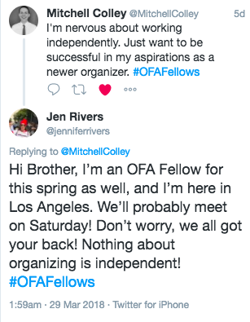
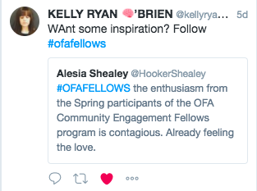
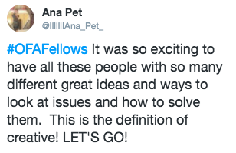

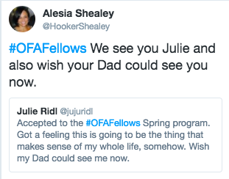
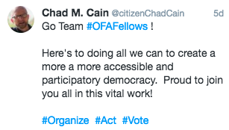
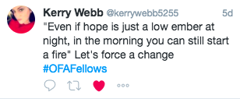

Slide 12
We must address the root challenge if we are to affect change.

Slide 13
Four steps to identify a root problem
1
How do we define a healthy community? How do we know it when we see it?
What resources are our communities currently lacking? What challenges are they facing?
Why do they lack these resources? Why are they facing these challenges?
What can we do about it? What resources do we have?
2
3
4

Slide 14
Agenda
Intro and welcome
Recap from Week 1
Turning challenges into issues
Identifying the right decision makers
Debrief and close

Slide 15
Now that we know the challenge, how do we organize?
Notes:
Now

Slide 16
Turning challenges into issues
It’s not enough to identify the sources of the challenges our communities face.
As organizers, we must figure out a way to take action, to get others involved, and make a measurable impact.
We need to be smart, strategic, and find a way to enact real change.

Slide 17
Turning challenges into issues
At OFA, our theory of change is to develop, plan, and implement an effective issue campaign.
An issue campaign can have many goals, be it legislative victories, increasing public awareness, ballot initiatives, or growing organizational capacity.
But at their heart, every issue campaign aims to achieve a measurable, problem-solving goal.

Slide 18
Two methods to developing issue campaigns

Slide 19
Kennedy School:
Creating public value
Notes:
https://sites.hks.harvard.edu/m-rcbg/CSRI/publications/workingpaper_3_moore_khagram.pdf

Slide 20
Public value
Strategic triangle
Operational capacity
Legitimacy & support
Notes:
https://sites.hks.harvard.edu/m-rcbg/CSRI/publications/workingpaper_3_moore_khagram.pdf

Slide 21
Strategic triangle
Public value: the resource, asset, support, law, behavior, or process you wish to create.
Legitimacy & support: who can authorize you to take action and provide the resources necessary to create and sustain this value?
Operational capacity: the funding, staff, volunteers, infrastructure, technology, resources needed to create the value.
Notes:
The Public Value — this is your ultimate goal, to create a new public value
Legitimacy & Support — this is also called the “authorizing authority”, essentially, who do you need to convince and get on your side in order to authorize this public value being created. This can be new laws and legislation, organizations that grant you the funding, or influential individuals who grant you the access you need; or some combination of all three.
Operational Capacity — this is the buicket of resources you need to accomplish and actually create your public value. This can be partnerships with other organizations, money, grants, knowledge, institutional support, etc. The key questions to answer here are how much capacity do we have, what else do we need, and where can we get it.

Slide 22

Can you think of an example that would fit into this model?
Type in the chat box

Slide 23
Goal, strategy, tactics
Notes:
https://sites.hks.harvard.edu/m-rcbg/CSRI/publications/workingpaper_3_moore_khagram.pdf

Slide 24
Building the framework
1
A goal.
A strategy.
Tactics.
2
3

Slide 25
Building the framework
1
An achievable, measurable, and problem-solving goal.
A strategy.
Tactics.
2
3

Slide 26
Building the framework
1
An achievable, measurable, and problem-solving goal.
A strategy that provides the roadmap for success.
Tactics.
2
3

Slide 27
Building the framework
1
An achievable, measurable, and problem-solving goal.
A strategy that provides the roadmap for success.
Effective tactics that accomplish your goal through the strategy you’ve developed.
2
3

Slide 28
Montgomery Bus Boycotts
Notes:
https://www.youtube.com/watch?v=FE6Yvy--5aw

Slide 29


Slide 30
Debrief
Type in the chat box or raise your hand

Slide 31
Agenda
Intro and welcome
Recap from Week 1
Turning challenges into issues
Identifying the right decision makers
Debrief and close

Slide 32
In finding the right decision makers, what has worked for you? How do you think through who to focus on in a campaign?
Type in the chat box

Slide 33
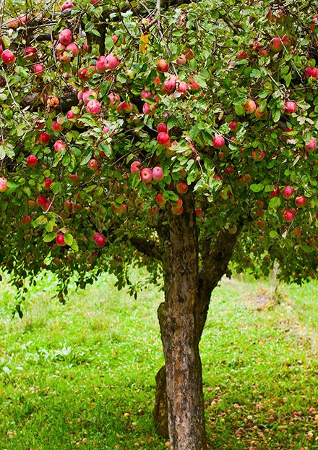
Defining an issue ecosystem
An issue ecosystem is “the cumulative environment surrounding a political issue or candidate.”
The goal of issue campaigns is to create the conditions necessary for decision makers to enact the change you wish to see.

Slide 34
Defining an issue ecosystem
What are the major components of most issue ecosystems?
Let’s list out a few!

Slide 35







An issue ecosystem is the environment
surrounding a decision maker.
Notes:
Elected officials and other decision makers are constantly surrounded by messages from people asking them to take one stand or another on an issue. They receive these messages through a variety of mediums and from a variety of voices.
Decision makers are surrounded by many issue ecosystems every day. If you and your partner organizations are not part of an issue ecosystem around a decision maker, the opposition is filling that space with their message or the issue is not on the target’s radar.

Slide 36
We put issues on decision makers’ radar.
Notes:
So throughout my day, I have taken in all this data that tells me independent voters support marriage equality, that the majority of my constituents want me to support marriage equality, that marriage equality will help local businesses and the economy, and that the best thing I can do to maintain my image as a mainstream, pro-business moderate is to support it.
I’d like to pose a question to you: HOW did that information make it onto my radar? [Call on a few participants to share their thoughts.]
That’s right – it didn’t happen on accident. It came onto my radar because of the issue organizers out there who worked really hard to make sure that the slice of reality I am experiencing throughout my day actually MATCHES with that bigger picture reality of my district. If the issue organizers in support of marriage equality had stayed quiet, then the issue organizers AGAINST marriage equality would have filled that space with deceptive messages to convince me the best thing I can do to maintain my image as a mainstream, pro-business moderate is to vote against it.
Ecosystem metaphor: We call that slice of reality surrounding an elected official an “ecosystem.” It’s all about creating the conditions for the outcome that you want. So if you think about a fruit tree as an example: a tree needs a lot of different conditions to line up in order for it to grow and produce a fruit. It needs the right amount of sunlight and water, and needs the right kind of nutrients in the soil – and it needs all of those things in tandem with one another. Even if it gets PLENTY of water, but no sunlight and the wrong soil, it won’t grow. Even if that water was the best, most perfectly pH balanced water out there.

Slide 37
Our goal:
To create the conditions for decision makers to take action on the issue we care about.

Slide 38
Questions to ask when choosing decision makers:
What is our organizing capacity?
Is there current legislation on this issue?
  If so, what decision makers must we influence to be successful?
  If not, what else can we do to make an impact that matters?
Are there other organizations/groups working on this issue?
Notes:
s

Slide 39
Agenda
Intro and welcome
Recap from Week 1
Turning challenges into issues
Identifying the right decision makers
Debrief and close

Slide 40
What are your key takeaways?
Type in the chat and tweet using #OFAFellows

Slide 41
Weekly assignment:
Due Wednesday, April 11
https://www.ofa.us/get-trained/fellows-2018-spring-fellowship/
1
How will you turn the root challenge in your community into an issue on which to organize?
What is your strategy or theory of change on this issue? (i.e. Strategic triangle or Goals, Strategy, Tactics).
Describe the issue ecosystem surrounding your challenge.
What are your next steps?
2
3
4

Slide 42
Thanks for joining the call!
Please fill out the evaluation on today’s training using the link below.
bit.ly/Spring2-2018
Email fellows@ofa.us with any questions.

