Slide 1

Welcome
We will begin at 7:30 pm Central Time
Notes:
This work is licensed under the Creative Commons Attribution-NonCommercial 4.0 International License. To view a copy of this license, visit http://creativecommons.org/licenses/by-nc/4.0/ or send a letter to Creative Commons, PO Box 1866, Mountain View, CA 94042, USA

Slide 2
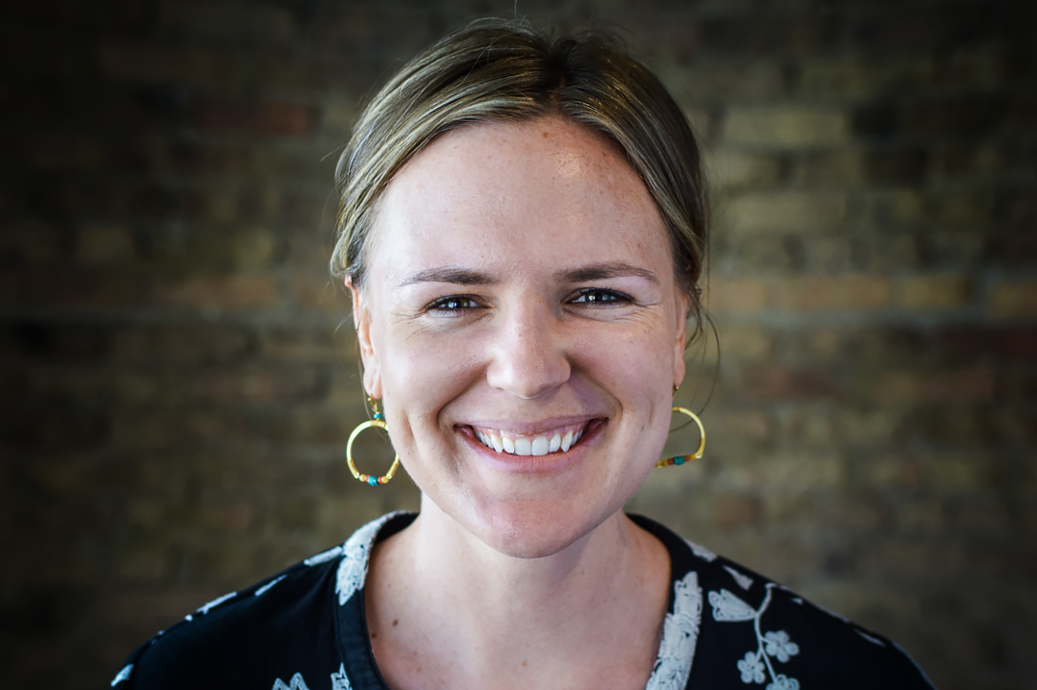

Liz Erickson
Training Director

Slide 3
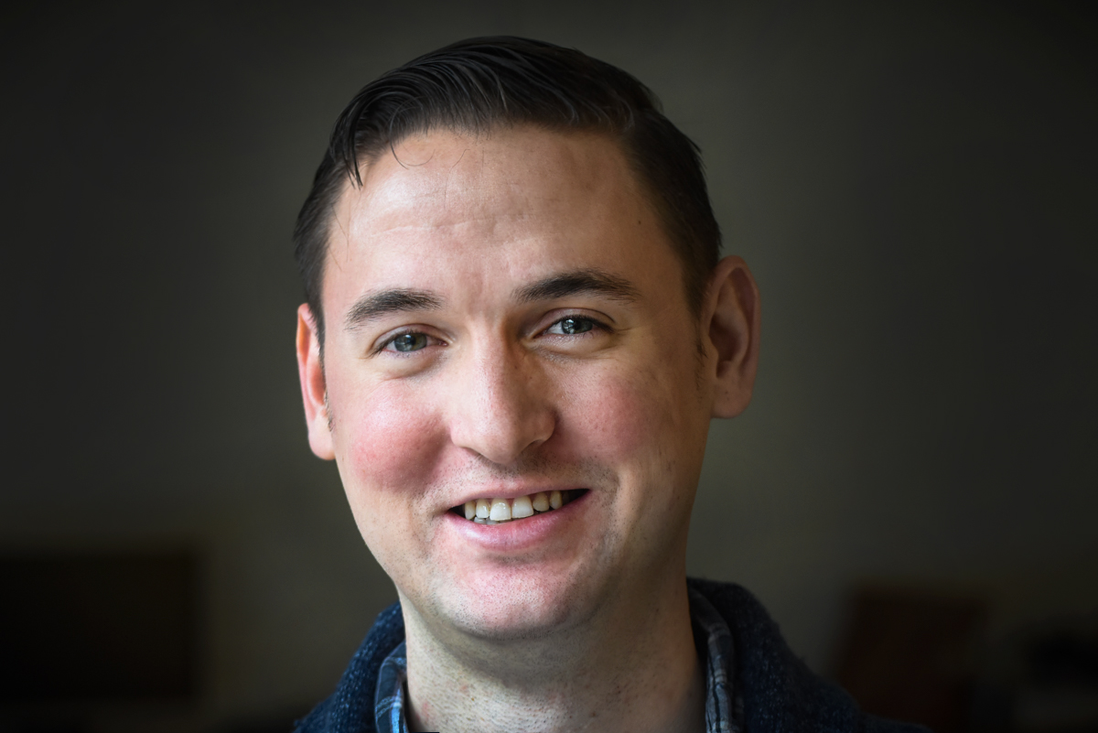
Bobby Brady-Sharp
Training Projects Manager

Slide 4

Goals for today
1
Be able to synthesize the main takeaways of the community engagement fellowship
Feel prepared for the next steps of your event and fellowship
To begin to formulate your plan for staying involved in the progressive movement
2
3

Slide 5
Agenda
Review the fellowship learning journey
Discuss graduation requirements
Explain post event requirements
Staying involved with OFA
Leadership pathways
Debrief and close
Notes:
00:18 – 00:19 [1 min] – Aquiles
[Broad Goals] Review post-training agenda
We cannot cover everything you will need to know today.
That is why we have a post-training agenda for you
Review key dates and webinars

Slide 6

5 minute
reflection
Craft a movie title and plot description that reflects your personal experience during the fellowship?

Slide 7

What’s your movie title?
Type in the chat box

Slide 8
Our learning journey
Week 1: Organizing community engagement
events

Slide 9
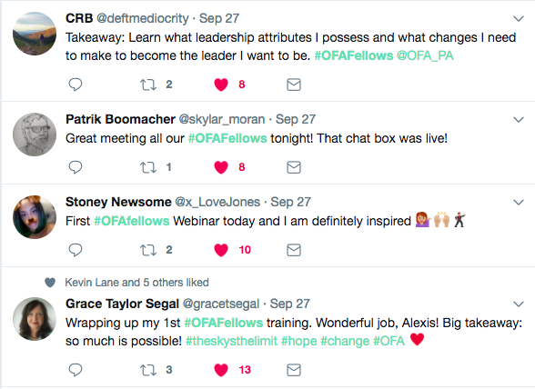
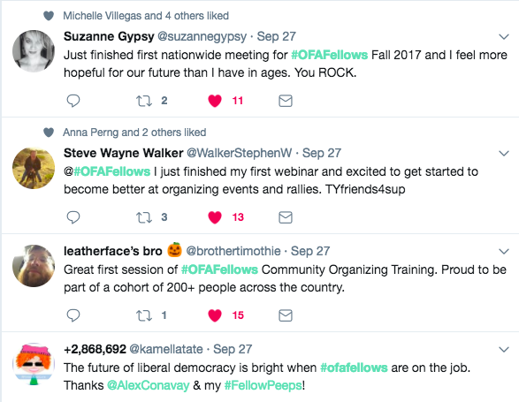
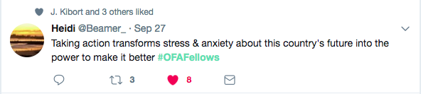
Key takeaways

Slide 10
4 Steps to begin planning your
fellowship event
1
What is a problem that’s affecting the health of your community?
What is an issue that can make an impact on this problem?
What are your indicators of success around making progress on this issue?
With this in mind - what type of capstone project do you think best fits the problem you’re trying to address?
2
3
4

Slide 11
Our learning journey
Week 1: Organizing community engagement
Events
Week 2: Leading an action planning session

Slide 12
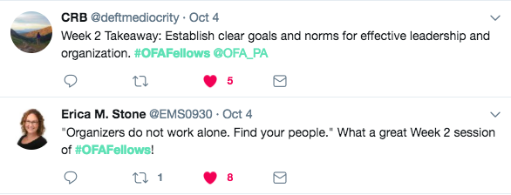
Key takeaways

Slide 13
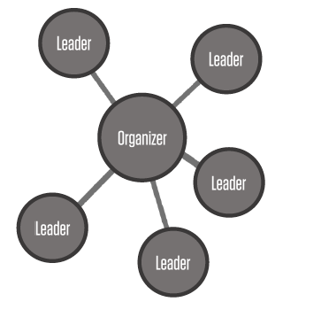
Action planning sessions create the opportunity for organizers to:
Build the relationships required for any team to work well together
Agree on what outcome your team will achieve
Define responsibilities
… in order to achieve a shared goal

Slide 14
Framework: Action planning
session core agenda
1
What: What do we want to do? What does success look like?
Why: Purpose—why are we organizing this event?
When: When will this event happen? Plan A, B, C, D
Where: Where will this event take place? Plan A, B, C, D
Who: Assign roles—who will do what? Who should be involved?
2
3
4
5

Slide 15
Our learning journey
Week 1: Organizing community engagement
events
Week 2: Leading an action planning session
Week 3: Event management

Slide 16
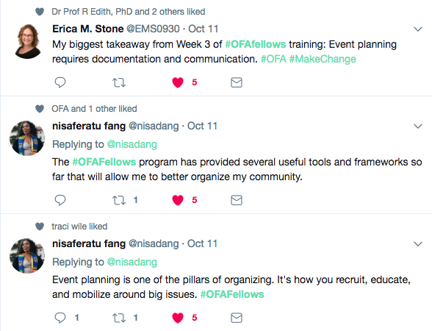
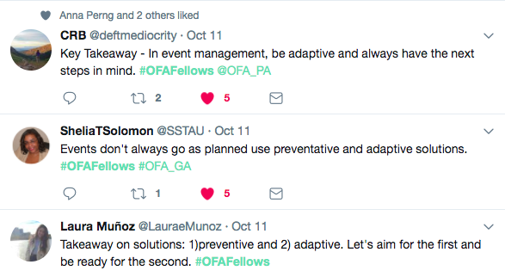
Key takeaways

Slide 17
MANAGING YOUR EVENT
Outline everything that needs to happen before, during, and after your event and align them with your event goals.

Slide 18
WHAT IS A TICK TOCK?
An outline of what will
happen at your event from start to finish.

Slide 19
Flow of
a tick tock
Natural flow: Start with welcome and introduction, sharing goals and reviewing agenda
Order of speaking program (film panel, community service)
Finish with close and next steps

Slide 20
Preventive Solution
Adaptive
Solution
Before
What can you do before the event to prevent a problem
from happening?
During
What can you do during the event to manage a problem by adapting?

Slide 21
Our learning journey
Week 1: Organizing community engagement
events
Week 2: Leading an action planning session
Week 3: Event management
Week 4: Recruitment: Grassroots tactics

Slide 22
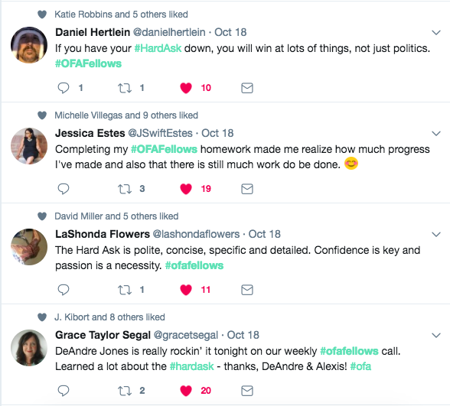
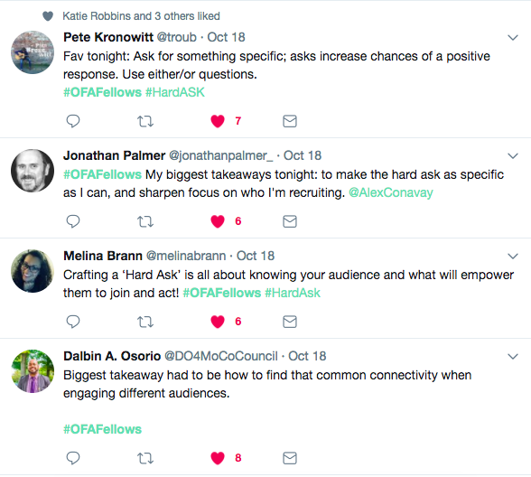
Key takeaways

Slide 23
THE HARD ASK: 5-STEP FORMULA
Know your audience
Build urgency
Ask for something specific
Ask and be quiet
Be persistent

Slide 24
Why should someone attend your event?
Learn a new skill
Understand a new perspective
Demonstrate commitment to a cause
Keep busy
To be challenged
For fun
Because they were asked!

Slide 25
You get what you
ask for, and not much
of what you do not.

Slide 26
Our learning journey
Week 1: Organizing community engagement
events
Week 2: Leading an action planning session
Week 3: Event management
Week 4: Recruitment: Grassroots tactics
Week 5: Recruitment: Digital tactics

Slide 27
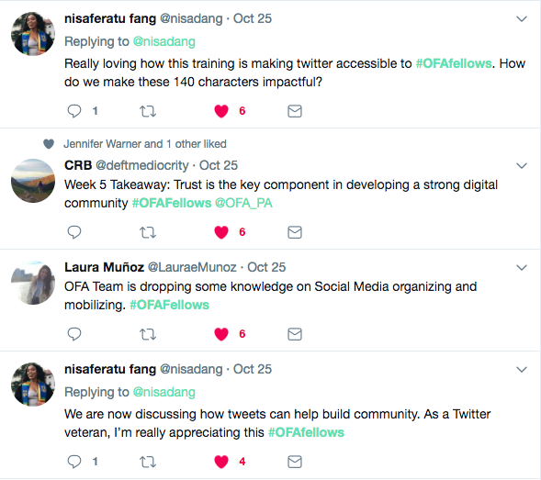
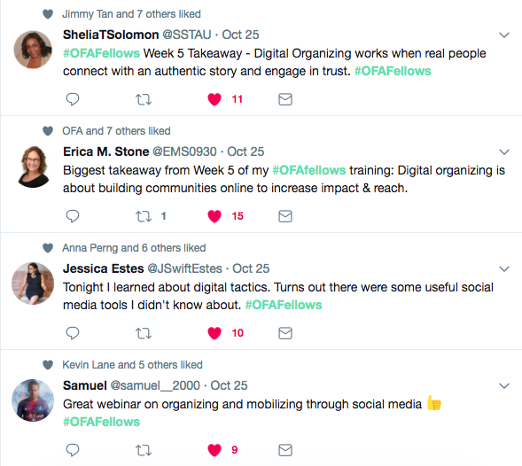
Key takeaways

Slide 28
KEY PRINCIPLES OF DIGITAL ORGANIZING
Authenticity
Relevance
Impact

Slide 29
Our learning journey
Week 1: Organizing community engagement
events
Week 2: Leading an action planning session
Week 3: Event management
Week 4: Recruitment: Grassroots tactics
Week 5: Recruitment: Digital tactics
Week 6: Tying it all together

Slide 30
Agenda
Review the fellowship learning journey
Discuss graduation requirements
Explain post event requirements
Staying involved with OFA
Leadership pathways
Debrief and close
Notes:
00:18 – 00:19 [1 min] – Aquiles
[Broad Goals] Review post-training agenda
We cannot cover everything you will need to know today.
That is why we have a post-training agenda for you
Review key dates and webinars

Slide 31
Graduation requirements:
1
Participate in six fellowship weekly webinars.
Plan and host a community engagement event within a few months of the end of the fellowship.
Complete the Graduation Off Boarding form by the Sunday, November 12 deadline.
2
3

Slide 32
Agenda
Review the components of a community engagement event
Discuss graduation requirements
Explain post event requirements
Staying involved with OFA
Leadership pathways
Debrief and close
Notes:
00:18 – 00:19 [1 min] – Aquiles
[Broad Goals] Review post-training agenda
We cannot cover everything you will need to know today.
That is why we have a post-training agenda for you
Review key dates and webinars

Slide 33
After your event:
Please email a recap and pictures of your event to fellows@ofa.us.
If you have a fellows leader, they will complete a report back form, letting us know about the highlights of your events, the number of attendees present, and other relevant information.
We love seeing fellows events on social media so be sure to share pictures and highlights from your event!

Slide 34
Questions about the graduation
requirements or post event expectations?
Type in the chat box

Slide 35
Agenda
Review the fellowship learning journey
Discuss graduation requirements
Explain post event requirements
Staying involved with OFA leadership pathways
Debrief and close
Notes:
00:18 – 00:19 [1 min] – Aquiles
[Broad Goals] Review post-training agenda
We cannot cover everything you will need to know today.
That is why we have a post-training agenda for you
Review key dates and webinars

Slide 36
OFA is committed to building
a new generation of progressive
leaders to meet the challenges
of today and prepare for the
challenges in decades to come.

Slide 37
Respect
Empower
Include
Organize
Notes:
At OFA, respect, empower, include guides every interaction we have, which is why you see our organization choosing different tactics than others.
1. We take a respectful approach to everything we do, including talking to our elected leaders. When we’re respectful, our concerns are taken seriously
2. We empower volunteers by meeting them where they are and training, coaching, and building them into community leaders. OFA is dedicated to building progressive power over the long run, and that starts by empowering everyday people to do more than they ever thought possible.
3. We include anyone and everyone who wants to make a difference in the progressive movement. OFA welcomes you, no matter your skill level or income. You will receive all of our training and coaching at no cost to you. And, id doesn’t matter if you’ve never taken action before or if you’re a seasoned community organizer, we have a place for everyone at OFA.
4. We organize because that is how we build long term power. When we train and empower people to be leaders in their community, we build

Slide 38
Staying involved with OFA:
Tomorrow you will receive an email that contains a link to a Graduation form.
Parts I & II of that form will ask you questions about your upcoming community engagement event, mailing address, and key takeaways from the fellowship.
Part III of the form will ask you if, and how you would like to stay involved with OFA after the fellowship ends.
Hint: There are a ton of ways to say involved with OFA!

Slide 39
STAYING INVOLVED WITH OFA
Chapter development
Notes:
At OFA, respect, empower, include guides every interaction we have, which is why you see our organization choosing different tactics than others.
1. We take a respectful approach to everything we do, including talking to our elected leaders. When we’re respectful, our concerns are taken seriously
2. We empower volunteers by meeting them where they are and training, coaching, and building them into community leaders. OFA is dedicated to building progressive power over the long run, and that starts by empowering everyday people to do more than they ever thought possible.
3. We include anyone and everyone who wants to make a difference in the progressive movement. OFA welcomes you, no matter your skill level or income. You will receive all of our training and coaching at no cost to you. And, id doesn’t matter if you’ve never taken action before or if you’re a seasoned community organizer, we have a place for everyone at OFA.
4. We organize because that is how we build long term power. When we train and empower people to be leaders in their community, we build

Slide 40
STAYING INVOLVED WITH OFA
Chapter development
Digital communications
Notes:
At OFA, respect, empower, include guides every interaction we have, which is why you see our organization choosing different tactics than others.
1. We take a respectful approach to everything we do, including talking to our elected leaders. When we’re respectful, our concerns are taken seriously
2. We empower volunteers by meeting them where they are and training, coaching, and building them into community leaders. OFA is dedicated to building progressive power over the long run, and that starts by empowering everyday people to do more than they ever thought possible.
3. We include anyone and everyone who wants to make a difference in the progressive movement. OFA welcomes you, no matter your skill level or income. You will receive all of our training and coaching at no cost to you. And, id doesn’t matter if you’ve never taken action before or if you’re a seasoned community organizer, we have a place for everyone at OFA.
4. We organize because that is how we build long term power. When we train and empower people to be leaders in their community, we build

Slide 41
STAYING INVOLVED WITH OFA
Chapter development
Digital communications
Issue campaigns
Notes:
At OFA, respect, empower, include guides every interaction we have, which is why you see our organization choosing different tactics than others.
1. We take a respectful approach to everything we do, including talking to our elected leaders. When we’re respectful, our concerns are taken seriously
2. We empower volunteers by meeting them where they are and training, coaching, and building them into community leaders. OFA is dedicated to building progressive power over the long run, and that starts by empowering everyday people to do more than they ever thought possible.
3. We include anyone and everyone who wants to make a difference in the progressive movement. OFA welcomes you, no matter your skill level or income. You will receive all of our training and coaching at no cost to you. And, id doesn’t matter if you’ve never taken action before or if you’re a seasoned community organizer, we have a place for everyone at OFA.
4. We organize because that is how we build long term power. When we train and empower people to be leaders in their community, we build

Slide 42
STAYING INVOLVED WITH OFA
Chapter development
Digital communications
Issue campaigns
Trainings
Notes:
At OFA, respect, empower, include guides every interaction we have, which is why you see our organization choosing different tactics than others.
1. We take a respectful approach to everything we do, including talking to our elected leaders. When we’re respectful, our concerns are taken seriously
2. We empower volunteers by meeting them where they are and training, coaching, and building them into community leaders. OFA is dedicated to building progressive power over the long run, and that starts by empowering everyday people to do more than they ever thought possible.
3. We include anyone and everyone who wants to make a difference in the progressive movement. OFA welcomes you, no matter your skill level or income. You will receive all of our training and coaching at no cost to you. And, id doesn’t matter if you’ve never taken action before or if you’re a seasoned community organizer, we have a place for everyone at OFA.
4. We organize because that is how we build long term power. When we train and empower people to be leaders in their community, we build

Slide 43
What questions about how to
stay involved with OFA?
Type in the chat box

Slide 44

Notes:
At OFA, respect, empower, include guides every interaction we have, which is why you see our organization choosing different tactics than others.
1. We take a respectful approach to everything we do, including talking to our elected leaders. When we’re respectful, our concerns are taken seriously
2. We empower volunteers by meeting them where they are and training, coaching, and building them into community leaders. OFA is dedicated to building progressive power over the long run, and that starts by empowering everyday people to do more than they ever thought possible.
3. We include anyone and everyone who wants to make a difference in the progressive movement. OFA welcomes you, no matter your skill level or income. You will receive all of our training and coaching at no cost to you. And, id doesn’t matter if you’ve never taken action before or if you’re a seasoned community organizer, we have a place for everyone at OFA.
4. We organize because that is how we build long term power. When we train and empower people to be leaders in their community, we build

Slide 45

Notes:
At OFA, respect, empower, include guides every interaction we have, which is why you see our organization choosing different tactics than others.
1. We take a respectful approach to everything we do, including talking to our elected leaders. When we’re respectful, our concerns are taken seriously
2. We empower volunteers by meeting them where they are and training, coaching, and building them into community leaders. OFA is dedicated to building progressive power over the long run, and that starts by empowering everyday people to do more than they ever thought possible.
3. We include anyone and everyone who wants to make a difference in the progressive movement. OFA welcomes you, no matter your skill level or income. You will receive all of our training and coaching at no cost to you. And, id doesn’t matter if you’ve never taken action before or if you’re a seasoned community organizer, we have a place for everyone at OFA.
4. We organize because that is how we build long term power. When we train and empower people to be leaders in their community, we build

Slide 46

Notes:
At OFA, respect, empower, include guides every interaction we have, which is why you see our organization choosing different tactics than others.
1. We take a respectful approach to everything we do, including talking to our elected leaders. When we’re respectful, our concerns are taken seriously
2. We empower volunteers by meeting them where they are and training, coaching, and building them into community leaders. OFA is dedicated to building progressive power over the long run, and that starts by empowering everyday people to do more than they ever thought possible.
3. We include anyone and everyone who wants to make a difference in the progressive movement. OFA welcomes you, no matter your skill level or income. You will receive all of our training and coaching at no cost to you. And, id doesn’t matter if you’ve never taken action before or if you’re a seasoned community organizer, we have a place for everyone at OFA.
4. We organize because that is how we build long term power. When we train and empower people to be leaders in their community, we build

Slide 47

Notes:
At OFA, respect, empower, include guides every interaction we have, which is why you see our organization choosing different tactics than others.
1. We take a respectful approach to everything we do, including talking to our elected leaders. When we’re respectful, our concerns are taken seriously
2. We empower volunteers by meeting them where they are and training, coaching, and building them into community leaders. OFA is dedicated to building progressive power over the long run, and that starts by empowering everyday people to do more than they ever thought possible.
3. We include anyone and everyone who wants to make a difference in the progressive movement. OFA welcomes you, no matter your skill level or income. You will receive all of our training and coaching at no cost to you. And, id doesn’t matter if you’ve never taken action before or if you’re a seasoned community organizer, we have a place for everyone at OFA.
4. We organize because that is how we build long term power. When we train and empower people to be leaders in their community, we build

Slide 48

Notes:
At OFA, respect, empower, include guides every interaction we have, which is why you see our organization choosing different tactics than others.
1. We take a respectful approach to everything we do, including talking to our elected leaders. When we’re respectful, our concerns are taken seriously
2. We empower volunteers by meeting them where they are and training, coaching, and building them into community leaders. OFA is dedicated to building progressive power over the long run, and that starts by empowering everyday people to do more than they ever thought possible.
3. We include anyone and everyone who wants to make a difference in the progressive movement. OFA welcomes you, no matter your skill level or income. You will receive all of our training and coaching at no cost to you. And, id doesn’t matter if you’ve never taken action before or if you’re a seasoned community organizer, we have a place for everyone at OFA.
4. We organize because that is how we build long term power. When we train and empower people to be leaders in their community, we build

Slide 49

Notes:
At OFA, respect, empower, include guides every interaction we have, which is why you see our organization choosing different tactics than others.
1. We take a respectful approach to everything we do, including talking to our elected leaders. When we’re respectful, our concerns are taken seriously
2. We empower volunteers by meeting them where they are and training, coaching, and building them into community leaders. OFA is dedicated to building progressive power over the long run, and that starts by empowering everyday people to do more than they ever thought possible.
3. We include anyone and everyone who wants to make a difference in the progressive movement. OFA welcomes you, no matter your skill level or income. You will receive all of our training and coaching at no cost to you. And, id doesn’t matter if you’ve never taken action before or if you’re a seasoned community organizer, we have a place for everyone at OFA.
4. We organize because that is how we build long term power. When we train and empower people to be leaders in their community, we build

Slide 50

Notes:
At OFA, respect, empower, include guides every interaction we have, which is why you see our organization choosing different tactics than others.
1. We take a respectful approach to everything we do, including talking to our elected leaders. When we’re respectful, our concerns are taken seriously
2. We empower volunteers by meeting them where they are and training, coaching, and building them into community leaders. OFA is dedicated to building progressive power over the long run, and that starts by empowering everyday people to do more than they ever thought possible.
3. We include anyone and everyone who wants to make a difference in the progressive movement. OFA welcomes you, no matter your skill level or income. You will receive all of our training and coaching at no cost to you. And, id doesn’t matter if you’ve never taken action before or if you’re a seasoned community organizer, we have a place for everyone at OFA.
4. We organize because that is how we build long term power. When we train and empower people to be leaders in their community, we build

Slide 51
Agenda
Review the fellowship learning journey
Discuss graduation requirements
Explain post event requirements
Staying involved with OFA
Leadership pathways
Debrief and close
Notes:
00:18 – 00:19 [1 min] – Aquiles
[Broad Goals] Review post-training agenda
We cannot cover everything you will need to know today.
That is why we have a post-training agenda for you
Review key dates and webinars

Slide 52
Assignment:
Graduation form due Sunday, November 12
Be sure to complete and submit the graduation form to ensure that you receive a fellowship certificate.
This will also be your opportunity to indicate how you want to stay involved in OFA going forward.
Notes:
a

Slide 53
OFA Training
Thank you for joining today’s webinar.
Check the Fellow Bookshelf for a copy of the material covered today,
including a video of the webinar.
Email fellows@ofa.us with any questions.
bit.ly/cefweek6

