Slide 1
Welcome
We will begin at 7:30 pm Central Time.

Slide 2
OFA Community
Engagement Fellowship
Summer 2018 / #OFAFellows
Notes:
Deputy director of organizing and community engagement

Slide 3
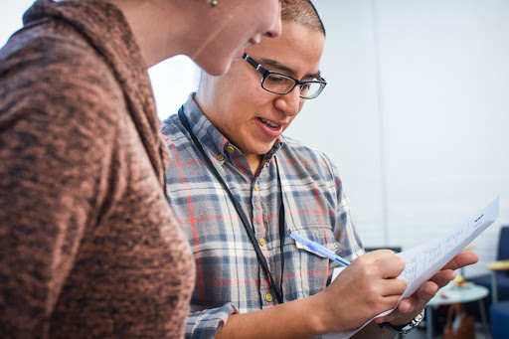
Voter contact best practices

Slide 4
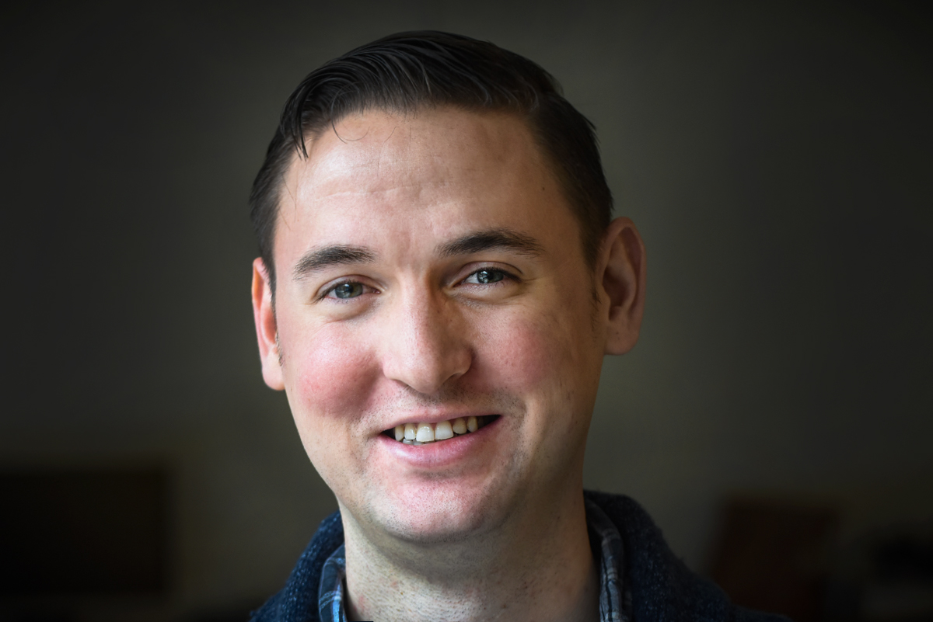
Bobby Brady-Sharp
OFA Field Director
@bobbyhtx

Slide 5
Tweet today using #OFAFellows

Slide 6
Week 2: Key takeaways

Slide 7
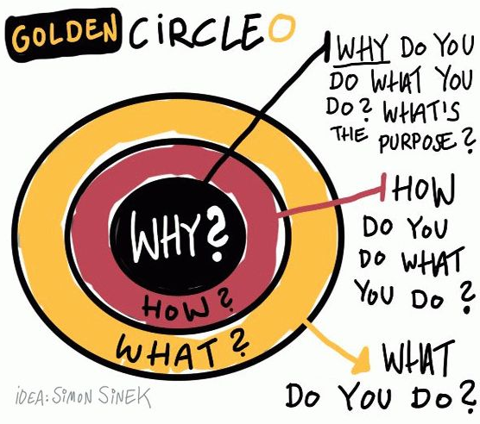
Notes:
7:23- 7:26 [3 minutes]
[TRACI]
Discussion of WHY, HOW, WHAT
What we to convey is that if you start with your belief and communicate your WHY, it will resonate with people in the way a WHAT never can. So, the order is important here as well – you need to start with your WHY in order to be able to start to build a connection based on shared values, then move outward.
Because the WHY is what moves YOU – it is the core thing that makes you tick. It is your reason to get out of bed. It’s the thing that you might have subconsciously operated with but not likely articulated out loud
HOW: ‘How’ is your theory of change – it is the way that you believe your why can come into the world
WHAT: ‘What’ is the thing that you are now doing as a result of your how – it is your specific actions associated with your theory of change.
In politics, we frequently start with WHAT which is not how you can easily connect with people – it tends to be superficial and can feel inauthentic.
If we take this model presented by Simon, then you can see how it shakes out with organizations as well. Here’s a couple of examples to compare and contrast.

Slide 8
Putting it all together:
The framework of your why
Critical incident
What is a critical incident that leads to what you believe and why?
Values
What values are present underneath your critical incident and why?
Practice
How will you practice communicating your values in way that resonates with diverse groups of people?
Notes:
ADRIENNE

Slide 9
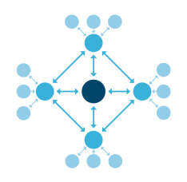
The Snowflake
Model
1
Structured to empower leadership and delegation of responsibilities.
2
Clear lines of communication and coordination.
3
Working in harmony to accomplish a unifying goal.
Notes:
That’s great! You all have a lot of ideas as to what can happen if you appoint captains to help make your dinner party a success. Here are some ideas, some of which we already covered:
There are clear lines of communication— you are communicating with your captains and getting updates from them. Your captains are making sure their helpers are doing what needs to be done to make your party a success.
There are sustainable ratios—your only have to direct a few people and your captains only have to direct a few people.
The structure can handle change without overwhelming one person. If one of the helpers can no longer attend your dinner party, the captain can make sure that someone else covers for that person. The structure can handle change without overwhelming one person.
It empowers others—people want to help you out! Let them help, but don’t let them overwhelm you by using the snowflake structure.
We call this the Snowflake Model of leadership and this is what OFA uses to organize.
[discussion question] How do you see this being used in the organizing world?

Slide 10
GUIDED WORKSHEET
Voter contact best practices
bit.ly/VC_worksheet
Notes:
If you’d like to follow along, here is a guided worksheet to use. We will also email this out in our recap after this training.

Slide 11
Your learning journey
Where we’ve been and where we’re going
Week 1: Welcome to organizing
Week 2: Leading with your values & telling your personal story
Week 3: Voter contact best practices
Week 4: Digital organizing
Week 5: Event management
Week 6: Tying it all together

Slide 12
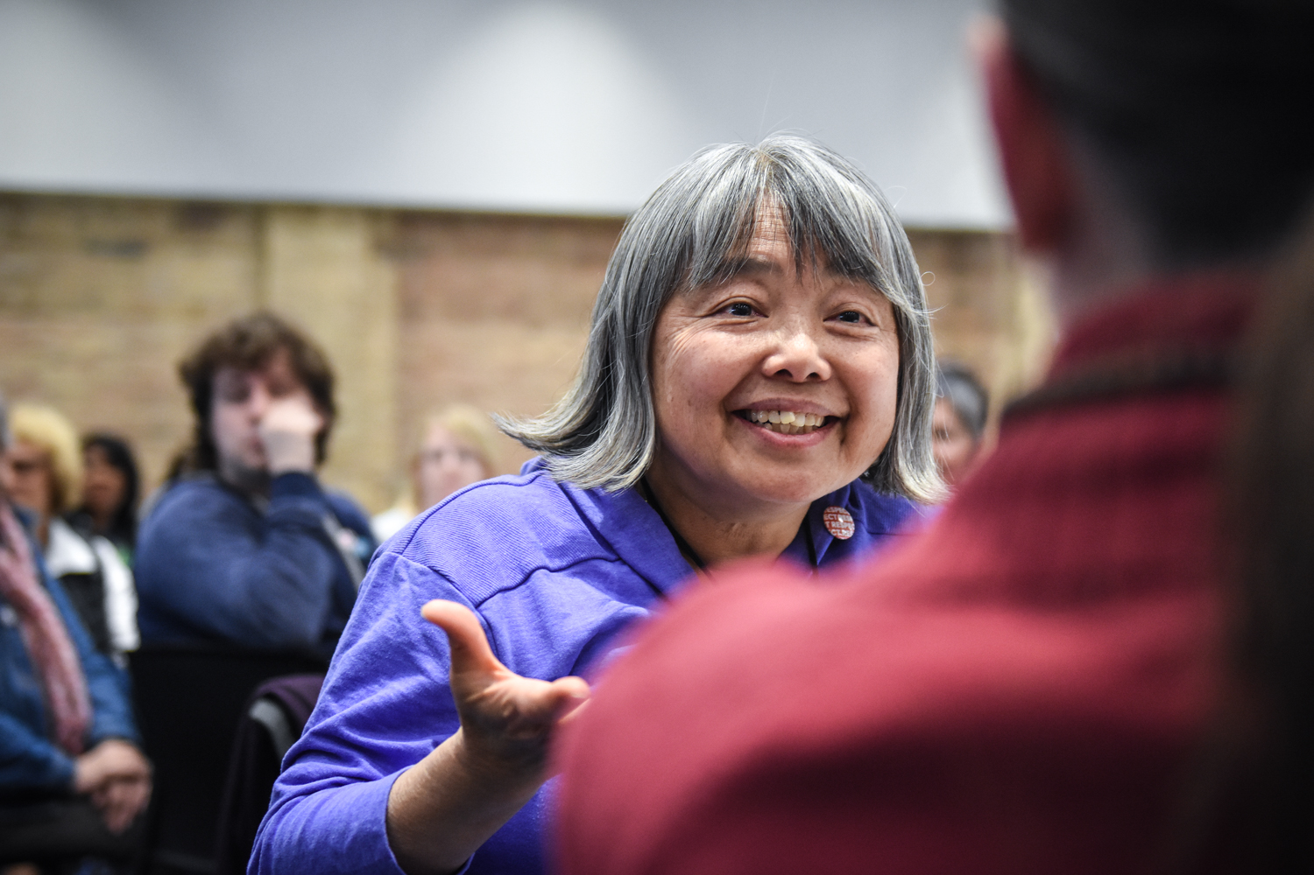
Talking to voters

Slide 13
1
Appreciate the impact elections have on the issues we care about
Goals for
this session
2
Develop an understanding of the core types of voter engagement, and when and how to use them.
3
Be ready to apply the skills we’ve learned in effective and powerful conversations in the months to come!
Notes:
7:08- 7:10 (2 MINUTES)
We have three main goals for tonight! You should read the goals nearly word-for-word but also add in your talking points or way that you understand the goals as well. Don’t get caught up in spending too much time here though!

Slide 14
Agenda
Talking to voters: What’s at stake
The challenge: Quality vs. Quantity
Three types of voter contact
Turnout conversations
Debrief & next steps
Notes:
7:10- 7:11 (1 MINUTE)
This is our agenda for the day! It will help us to accomplish the goals we laid out in the previous slide. First, we’ll talk about what makes persuasion difficult and the challenges we face in having effective conversations. Next, we’ll begin to learn how to speak from our values using the “why, how, what” framework. We’ll then look at a few case studies and examples to see how this plays out in different areas of our life (not just politics!). We’ll spend some time practicing and giving feedback, and then wrap up and close.

Slide 15
Shout out!
Why are elections important for our community?
Notes:
7:28- 7:28 [0 minutes]
Now let’s talk about the How.

Slide 16
But in order for people to make a difference on a campaign, those campaigns need to reach tens of thousands of voters.
Notes:
7:27- 7:27 [0 minutes]
Let’s start with the why -- ballot initiatives, campaigns, electoral; applicable to any of the issues that we work on and care about

Slide 17
And that’s a challenge.
Notes:
7:27- 7:27 [0 minutes]
Let’s start with the why

Slide 18
Because it’s not just the number of people we reach…
Notes:
7:27- 7:27 [0 minutes]
Let’s start with the why

Slide 19
But how effectively we communicate with them.
Notes:
7:27- 7:27 [0 minutes]
Let’s start with the why

Slide 20
Agenda
Talking to voters: What’s at stake
The challenge: Quality vs. Quantity
Three types of voter contact
Turnout conversations
Debrief & next steps
Notes:
7:10- 7:11 (1 MINUTE)
This is our agenda for the day! It will help us to accomplish the goals we laid out in the previous slide. First, we’ll talk about what makes persuasion difficult and the challenges we face in having effective conversations. Next, we’ll begin to learn how to speak from our values using the “why, how, what” framework. We’ll then look at a few case studies and examples to see how this plays out in different areas of our life (not just politics!). We’ll spend some time practicing and giving feedback, and then wrap up and close.

Slide 21
Quality vs. Quantity
By the numbers
Notes:
7:27- 7:27 [0 minutes]
Let’s break down the golden circle!

Slide 22
Example 1
Notes:
7:27- 7:27 [0 minutes]
Let’s break down the golden circle!

Slide 23
Example 1: Low quality, high quantity
Let’s say a campaign needs 500 new votes in order to win the election. There are 4 weeks left until election day. We can reach out to 300 people per day.
How do campaigns get there?
Notes:
7:27- 7:28 [1 minutes]
Spend a little time reading through each of these key points.

Slide 24
Example 1: Low quality, high quantity
1.) # of votes needed: 500
2.) # of days left until election: 28
Quality: In this example, our quality is low; we only talk to 10% of the people we attempt to reach, and only 10% of the people we talk to will vote for us.
Quantity: How many people will we need to attempt to reach?
Let’s say a campaign needs 500 new votes in order to win the election. There are 4 weeks left until election day. We can reach out to 300 people per day.
How do campaigns get there?
Notes:
7:27- 7:28 [1 minutes]
Spend a little time reading through each of these key points.

Slide 25
Example 1: Low quality, high quantity
1.) # of votes needed: 500
2.) # of days left until election: 28
3.) Contact rate: 10%
4.) Contact-to-vote rate: 10%
50,000 people attempted x 10% contact rate = 5,000 people reached
5,000 people reached x 10% voting rate = 500 votes
Let’s say a campaign needs 500 new votes in order to win the election. There are 4 weeks left until election day. We can reach out to 300 people per day.
How do campaigns get there?
Notes:
7:27- 7:28 [1 minutes]
Spend a little time reading through each of these key points.

Slide 26
Example 1: Low quality, high quantity
1.) # of votes needed: 500
2.) # of days left until election: 28
3.) Contact rate: 10%
4.) Contact-to-vote rate: 10%
50,000 people attempted x 10% contact rate = 5,000 people reached
5,000 people reached x 10% voting rate = 500 votes
Let’s say a campaign needs 500 new votes in order to win the election. There are 4 weeks left until election day. We can reach out to 300 people per day.
Campaigns need to attempt to reach 50,000 people to get 500 votes. At 300 people per day, this would take us 167 days!
Notes:
7:27- 7:28 [1 minutes]
Spend a little time reading through each of these key points.

Slide 27
Example 2
Notes:
7:27- 7:27 [0 minutes]
Let’s break down the golden circle!

Slide 28
Example 2: high quality, low quantity
Let’s say a campaign needs 500 new votes in order to win the election. There are 4 weeks left until election day.
How do we get there?
Notes:
7:27- 7:28 [1 minutes]
Spend a little time reading through each of these key points.

Slide 29
Example 2: high quality, low quantity
1.) # of votes needed: 500
2.) # of days left until election: 28
Quality: In this example, our quality is very high; we talk to 25% of the people we attempt to reach, and 25% of the people we talk to end up voting for us.
Quantity: The problem is we are now much slower on our outreach. Instead of 300 people a day, we can only attempt 100 per day.
Let’s say a campaign needs 500 new votes in order to win the election. There are 4 weeks left until election day.
How do we get there?
Notes:
7:27- 7:28 [1 minutes]
Spend a little time reading through each of these key points.

Slide 30
Example 2: high quality, low quantity
1.) # of votes needed: 500
2.) # of days left until election: 28
3.) Contact rate: 25%
4.) Contact-to-vote rate: 25%
8,000 people attempted x 25% contact rate = 2,000 people reached
2,000 people reached x 25% voting rate = 500 votes
Let’s say a campaign needs 500 new votes in order to win the election. There are 4 weeks left until election day.
How do we get there?
Notes:
7:27- 7:28 [1 minutes]
Spend a little time reading through each of these key points.

Slide 31
Example 2: high quality, low quantity
1.) # of votes needed: 500
2.) # of days left until election: 28
3.) Contact rate: 25%
4.) Contact-to-vote rate: 25%
8,000 people attempted x 25% contact rate = 2,000 people reached
2,000 people reached x 25% voting rate = 500 votes
Let’s say a campaign needs 500 new votes in order to win the election. There are 4 weeks left until election day.
Now we only need to attempt to reach 8,000 people to get 500 votes. But at 100 people attempted per day, this would take us 80 days!
Notes:
7:27- 7:28 [1 minutes]
Spend a little time reading through each of these key points.

Slide 32
How do we combine quality and quantity?
Notes:
7:28- 7:28 [0 minutes]
Now let’s talk about the How.
Why do we want to do this in the first place? We need to reach a certain critical mass of people that are with you on the issue; depending on what that number is, that drive the decisions on quantity vs. quality
If you have a low quality contact of just going to the door, the stickiness doesn’t last, persistence

Slide 33
We must combine persuasive conversations with voter contact best practices!
Notes:
7:28- 7:28 [0 minutes]
Now let’s talk about the How.

Slide 34
Agenda
Talking to voters: What’s at stake
The challenge: Quality vs. Quantity
Three types of voter contact
Turnout conversations
Debrief & next steps
Notes:
7:10- 7:11 (1 MINUTE)
This is our agenda for the day! It will help us to accomplish the goals we laid out in the previous slide. First, we’ll talk about what makes persuasion difficult and the challenges we face in having effective conversations. Next, we’ll begin to learn how to speak from our values using the “why, how, what” framework. We’ll then look at a few case studies and examples to see how this plays out in different areas of our life (not just politics!). We’ll spend some time practicing and giving feedback, and then wrap up and close.

Slide 35
Three types of voter contact
1
Door-to-door canvassing
2
Phonebanking
3
High-traffic canvassing
Notes:
7:29 – 7:30 (0 Minutes)
Spend a little time reading through each of these key points.

Slide 36
Three types of voter contact
1
Walking through a neighborhood and speaking directly with voters and community members.
2
Phonebanking
3
High-traffic canvassing
Notes:
7:29 – 7:30 (0 Minutes)
Spend a little time reading through each of these key points.

Slide 37
Three types of voter contact
1
Walking through a neighborhood and speaking directly with voters and community members.
2
Calling voters and community members alongside other volunteers at a specified location.
3
High-traffic canvassing
Notes:
7:29 – 7:30 (0 Minutes)
Spend a little time reading through each of these key points.

Slide 38
Three types of voter contact
1
Walking through a neighborhood and speaking directly with voters and community members.
2
Calling voters and community members alongside other volunteers at a specified location.
3
Talking to voters and community members in high-traffic public spaces, like on campuses, churches, events, etc.
Notes:
7:29 – 7:30 (0 Minutes)
Spend a little time reading through each of these key points.
High traffic campaigns – immigration and what is happening in congress as an example

Slide 39
Door-to-door canvassing
The why

Slide 40
Door-to-door canvassing
1
We meet people where they are at; allows us to reach hundreds of people we would have no other way of contacting.
The why

Slide 41
Door-to-door canvassing
1
We meet people where they are at; allows us to reach hundreds of people we would have no other way of contacting.
The why
2
It is a face-to-face conversation! Which is the most effective way to have powerful conversations.

Slide 42
Door-to-door canvassing
1
We meet people where they are at; allows us to reach hundreds of people we would have no other way of contacting.
The why
2
It is a face-to-face conversation! Which is the most effective way to have powerful conversations.
3
Develops trust with the community; you are willing to go out and meet with real people.

Slide 43
Door-to-door canvassing
The challenge

Slide 44
Door-to-door canvassing
While door-to-door canvassing is the most effective way to meet the community, it also takes the most amount of time, energy, and resources.
The challenge

Slide 45
Shout out!
Who has done door-to-door canvassing? What has been your experience with it?
Notes:
7:28- 7:28 [0 minutes]
Now let’s talk about the How.

Slide 46
Phonebanking
The why

Slide 47
Phonebanking
1
We are able to reach a much larger amount of people than door-to-door canvassing.
The why

Slide 48
Phonebanking
1
We are able to reach a much larger amount of people than door-to-door canvassing.
The why
2
At the same time we are still able to have effective conversations in many cases.

Slide 49
Phonebanking
1
We are able to reach a much larger amount of people than door-to-door canvassing.
The why
2
At the same time we are still able to have effective conversations in many cases.
3
Allows us to reach places we otherwise wouldn’t be able to due to distance, difficulty of getting there, etc.

Slide 50
Phonebanking
While phonebanking greatly increases our capacity for outreach, they are generally lower contact rates, less effective conversations, and overall more challenging than in-person conversations.
The challenge

Slide 51
Shout out!
Who has participated in a phonebank? What has been your experience with it?
Notes:
7:28- 7:28 [0 minutes]
Now let’s talk about the How.

Slide 52
High-traffic canvassing
The why

Slide 53
High-traffic canvassing
1
We meet people where they are at! And have the potential to talk to many more people than in traditional door-knocking.
The why

Slide 54
High-traffic canvassing
1
We meet people where they are at! And have the potential to talk to many more people than in traditional door-knocking.
The why
2
Also allows for developing strong partnerships with churches, community groups, organizations.

Slide 55
High-traffic canvassing
1
We meet people where they are at! And have the potential to talk to many more people than in traditional door-knocking.
The why
2
Also allows for developing strong partnerships with churches, community groups, organizations.

Slide 56
High-traffic canvassing
While high-traffic canvassing is great for in-person conversations with potentially a high number of people, they generally have less time to talk then when at their home and also it’s more hit or miss in terms of finding quality high-traffic areas.
The challenge

Slide 57
Shout out!
What is your experience with high-traffic canvassing?

Slide 58
Agenda
Talking to voters: What’s at stake
The challenge: Quality vs. Quantity
Three types of voter contact
Turnout conversations
Debrief & next steps

Slide 59
Turnout conversations

Slide 60
Non supporter
Sporadic
Non supporter
Non-voting
Non supporter
Notes:
Campaigns are strategic – all voting information is public
Track by area
Orient folks to this chart
Types of doors that people are knocking on

Slide 61
Non supporter
Sporadic
Non supporter
Non-voting
Non supporter
Notes:
Campaigns are strategic – all voting information is public
Track by area
Orient folks to this chart

Slide 62
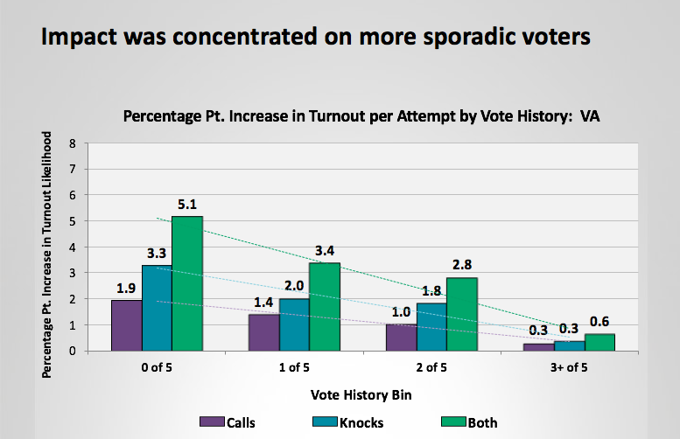
Notes:
Orient folks to what this slide is showing – statically significance to that target group - 5% could be a huge change if the race is close
Calls and knocks to make a difference – research shows face-t—face contact generally yields high turnout

Slide 63
Accountability to vote
Reminds voters of the norm of voting Increases the likelihood that someone will vote
Why turnout conversations?
*Source: Analyst Institute
Notes:
Why do we force on these conversations to begin with

Slide 64
Accountability to vote
Reminds voters of the norm of voting Increases the likelihood that someone will vote
Pledging to vote
Voters who pledge to vote are more likely to turnout than those who don’t intentionally do so
Why turnout conversations?
*Source: Analyst Institute

Slide 65
Accountability to vote
Reminds voters of the norm of voting Increases the likelihood that someone will vote
Pledging to vote
Voters who pledge to vote are more likely to turnout than those who don’t intentionally do so
Vote planning
Vote planning effectively cuts past “fast thinking” reactions of voters in conversations. A majority of sporadic voters will say “yes I will vote,” but may not intentionally plan to
Why turnout conversations?
*Source: Analyst Institute

Slide 66
A GOTV CONVERSATION FRAMEWORK:
Remind voters of early vote, VBM, etc…
Notes:
Here is our framework
There is an election coming up!!

Slide 67
A GOTV CONVERSATION FRAMEWORK:
Help voters make a plan

Slide 68
Help voters make a plan
You should prompt voters to think about their plan for voting—don’t ask yes/no questions!
What day will you vote?
How are you getting to your polling place?
What time of day will you vote?
Are you going with someone?

Slide 69
It can feel awkward…
Notes:
7:21 – 7:22 [1 MINUTE]
2018 is a chance for our voice to be heard, to turn back the tide back towards progress and restore our democracy. OFA’s mission is to create a vibrant and participatory democracy, and to do that we need to have thousands of powerful conversations this year that motivate people to get involved and make a difference at the ballot box.

Slide 70
But it can increase a voters chance by this much!
Notes:
7:21 – 7:22 [1 MINUTE]
2018 is a chance for our voice to be heard, to turn back the tide back towards progress and restore our democracy. OFA’s mission is to create a vibrant and participatory democracy, and to do that we need to have thousands of powerful conversations this year that motivate people to get involved and make a difference at the ballot box.

Slide 71
Notes:
WOW!

Slide 72
A GOTV CONVERSATION FRAMEWORK:
Ask voters to verbalize their reasons

Slide 73
Voters commit and verbalize their reasons
Having voters verbalize their reasons to vote helps voters self-rationalize their decision increases their chances to turn-out

Slide 74
Voters commit and verbalize their reasons
Having voters verbalize their reasons to vote helps voters self-rationalize their decision increases their chances to turn-out
Get voter commitment—they should verbalize that they will vote in their vote plan or you can have them sign a commit to vote card!

Slide 75
A GOTV CONVERSATION FRAMEWORK:
Don’t focus on candidates or issues
Notes:
This is just for GOTV conversations!!!
You do for other kinds of conversations

Slide 76
Don’t focus on candidates or issues
The goal is to increase turnout
The Analyst Institute has found that voters view candidate/issue information as an attempt to get them to vote in a certain way and not as a reminder to vote!
Easy solution – Confirm that they are supporter at the beginning of the conversation
Notes:
Strong propensity to feel manipulated - wants to make this decision on their on – connect to values or civic duty or suggest a tool where folks can get ready for voting

Slide 79
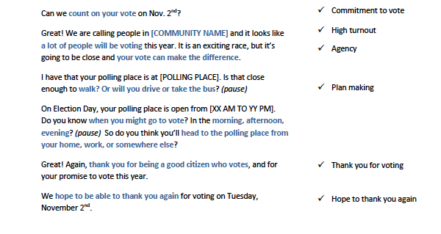

Slide 81
Agenda
Talking to voters: What’s at stake
The challenge: Quality vs. Quantity
Three types of voter contact
Turnout conversations
Debrief & next steps
Notes:
7:10- 7:11 (1 MINUTE)
This is our agenda for the day! It will help us to accomplish the goals we laid out in the previous slide. First, we’ll talk about what makes persuasion difficult and the challenges we face in having effective conversations. Next, we’ll begin to learn how to speak from our values using the “why, how, what” framework. We’ll then look at a few case studies and examples to see how this plays out in different areas of our life (not just politics!). We’ll spend some time practicing and giving feedback, and then wrap up and close.

Slide 82
Debrief
Which voter contact technique comes easiest to you?
What are you most excited about?
What do you think will be the most challenging?
Notes:
3 MINUTES
Answer questions in the chat box!

Slide 83
Next steps
Notes:
1 MINUTE
TRACI + ADRIENNE
OFA -- TRACI
1) December 7: Redistricting call with NDRC
2) MLK DAY OF SERVICE = VR: Email organizing@ofa.us if you would like to get involved with voter registration
3) JOIN THE NEXT CALL
Link to put in chat box: https://zoom.us/webinar/register/WN_tUkjIhBnTGSSGPhQ1MQgaQ

Slide 84
Slack!
bit.ly/FellowsJoinSlack

Slide 85
OFA
Thank you for joining today’s webinar.
Please fill out the survey below and give us
your feedback on today’s training.
bit.ly/Summer3-2018

