Slide 1


Welcome
We will begin at 7:30 pm Central Time.
Notes:
This work is licensed under the Creative Commons Attribution-NonCommercial 4.0 International License. To view a copy of this license, visit http://creativecommons.org/licenses/by-nc/4.0/ or send a letter to Creative Commons, PO Box 1866, Mountain View, CA 94042, USA

Slide 2

OFA Community
Engagement Fellowship
Summer 2018 / #OFAFellows
Notes:
WELCOMEEEEEEE !

Slide 3
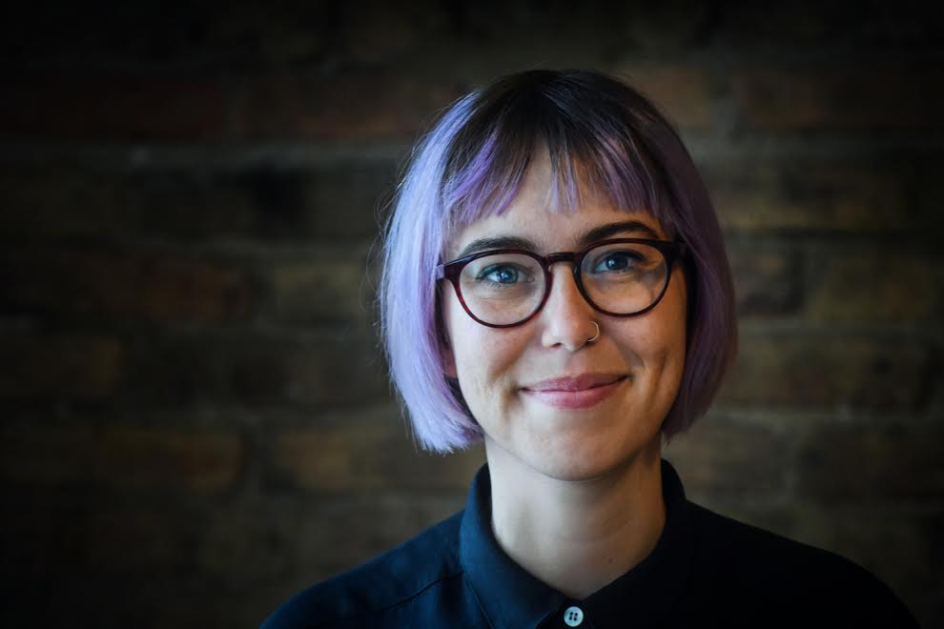
Alexis Conavay
@AlexConavay
Training Manager
Notes:
Fun facts –
I’m from Jupiter Florida
Master’s in WGS – I’m really passionate about trying to create a more equitable world
Before coming to OFA – I organized young people in CPS; worked in the education dept of IHMEC; worked as a researcher for DePaul university
Now I teach a pop culture class at one of the community colleges in Chicago
I come from a family of park rangers and teachers and it has fueled my passion for learning and teaching.
I was born in key west.

Slide 4

Goals for today
1
Develop a sense of belonging with each other, OFA, and the communities we are forming.
Align on the purpose, scale, and scope for the Fellowship, and the resources you’ll have at your disposal.
Analyze root problems in our community and propose a way to address it.
2
3
Notes:
We’ve got three goals that will be guiding us tonight.

Slide 5
Agenda
Intro and welcome
Framing the learning journey
Your fellowship resources
Seeing ourselves as change-makers
Identifying root challenges
Debrief and close

Slide 6
Share out!
In the chat box, share your name, where you live, and which issues you are most passionate about.

Slide 7
Agenda
Intro and welcome
Framing the learning journey
Your fellowship resources
Seeing ourselves as change-makers
Identifying root challenges
Debrief and close

Slide 8
You’re joining something big.
We accepted over 450 applicants from across the country for the summer fellowship.
Fellows represent 43 states.
Over 47% of fellows are new to organizing (less than 1 year of experience).
Notes:
You are part of something bigger
2 Mins
But accomplishing these goals will only happen if you know that you are part of something bigger
Alongside you, this week begins a fellowship of 450 across the country.
You are joining a legacy of thousands of people who took this step to get involved and make change in their community.
This fellowship will be valuable to you whether you are interested in doing community organizing or working on campaigns in the future

Slide 9
Notes:
Here is where we come from. If you’ve ever doubted that there are folks across the country who care about what you care about take stock in this map. I read through nearly 900 applications and what I saw was people who were feeling deeply provoked by the gun violence in this country or the familiar separation at the border. Or, more locally, about access to affordable and fresh foods, or economic opportunity for folks historically disenfranchised. Climate change
See this map makes me so certain that the folks in this fellowship are the people that are going to be making a big impact. Like you all are the right people.

Slide 10
Tweet today using #OFAFellows
Notes:
Over the span of this week hundreds of fellows will be starting this journey along with you! Using social media to share out your learning and what you are excited about is a great way to build connections that span the country. It is also a super great way to show your personal networks what you’re working on. Who knows, maybe someone will be inspired by you and begin their own organizing journey!

Slide 11
OFA’s core purpose

Slide 12
To create a more accessible and participatory democracy

Slide 13
Your learning journey
Week 1: Welcome to organizing
Notes:
Tonight we are going to provide some tools so you can name root problems in you community and propose a way to address it. We are also going to cover how to situate your issue within the larger political ecosystem

Slide 14
Your learning journey
Week 1: Welcome to organizing
Week 2: Leading with your values & telling your personal story
Notes:
Next week we’ll dive into a compelling way of telling your personal story and leading with your values. This will also allow you to listen for other people’s values.

Slide 15
Your learning journey
Week 1: Welcome to organizing
Week 2: Leading with your values & telling your personal story
Week 3: Voter contact best practices
Notes:
In week three we’ll dive into some practical skills you’ll need to organize in 2018. Week 3 is where you’ll be able to see how your values can connect you with potential voters you interact with.

Slide 16
Your learning journey
Week 1: Welcome to organizing
Week 2: Leading with your values & telling your personal story
Week 3: Voter contact best practices
Week 4: Digital organizing
Notes:
Week 4 – Digital organizing is a powerful storytelling tool and will be a huge asset to your community organizing and a value skill set if you decide to work on a campaign

Slide 17
Your learning journey
Week 1: Welcome to organizing
Week 2: Leading with your values & telling your personal story
Week 3: Voter contact best practices
Week 4: Digital organizing
Week 5: Event management
Notes:
Event management – OFA is build by folks that have been organizing for years. We are the folks that worked to get president Obama elected – we want to share our best practices with you

Slide 18
Your learning journey
Week 1: Welcome to organizing
Week 2: Leading with your values & telling your personal story
Week 3: Voter contact best practices
Week 4: Digital organizing
Week 5: Event management
Week 6: Tying it all together
Notes:
Here is where we will link up your learning and talk about what is next for you. How to stay involved with OFA and how to apply these skills moving forward in your community.

Slide 19
2018 is an incredibly important year
Notes:
There is so much at stake around the issues and things we have fought for. The stakes of this year, and the 2018 midterms, are high. We have an opportunity to hold our elected officials accountable on these issues and ensure that district lines are representative of the communities they are meant to serve.
A massive tax-scam, endless schemes to sabotage affordable health care, thousands of young immigrants left in limbo, and a complete failure to address the epidemic of gun violence in our country …
This November, we're fighting back at the ballot box -- we are Organizing for '18.

Slide 20
Organizing for ’18
Notes:
We’re so excited to be ramping up this program and we’re going to be honing on key races that will have a direct impact on the direction all of these issues move in.
In November, control of the House of Representatives is in the balance. We have the chance to put the issues we care about—gun violence prevention legislation, protecting DREAMers, climate action, and protecting health care—front and center in the midterm election.
Constituents in these Congressional Districts have been ill-served by Representatives who have acted as rubber stamps for the Trump agenda—on health care, immigration, guns, and big tax giveaways to the wealthy. OFA volunteers will be working to engage voters in these key districts to make sure we elect representatives who will stand up for their constituents.
We are also working closely with Eric Holder’s redistricting effort to end partisan gerrymandering, and end the practice of politicians picking their voters, instead of the other way around. Even though new districts won’t be drawn until 2020, that fight is already happening this year through key gubernatorial and state legislative campaigns.
In dozens of House districts, state-level races, and ballot initiatives, OFA is harnessing our digital and grassroots resources this year to fight for change. We will be building volunteer-led teams to work on the ground and represent OFA in collaboration with summer fellows, local partner groups, and local campaigns.
If you live in one of our target areas we’ll be in touch with how you can apply your skills in real time.

Slide 21
Fellows projects

Slide 22
Fellows projects
Fellows will identify a root problem facing their community, and will strategize how to make an impact and address these challenges.
The weekly assignments will help fellows build towards this final project. By program’s end, fellows will be ready to take their first steps towards implementing this plan, which typically will be an outreach or mobilizing event to raise awareness or take action on the addressing the issue.
The scale and scope should reflect your capacity.
Notes:
You are part of something bigger
2 Mins
But accomplishing these goals will only happen if you know that you are part of something bigger
Alongside you, this week, we are onboarding fellows in 28 programs and we have fellows from 24 states across the country. Together you make up the spring 2018 OFA Fellowship Class.
Even though you will work locally here, you will join weekly online trainings with the rest of your class.

Slide 23

What are you most eager to learn
about during the fellowship?
Type in the chat box and tweet using #OFAFellows

Slide 24
What are you most nervous about in the fellowship?
Type in the chat box

Slide 25
Agenda
Intro and welcome
Framing the learning journey
Your fellowship resources
Seeing ourselves as change-makers
Identifying root challenges
Debrief and close

Slide 26
Fellows program webpage:
https://www.ofa.us/get-trained/fellows-resources/
Notes:
Recordings, resources, homework
I’m holding office hours during this fellowship to make sure you all feel supported and have a place to ask questions!

Slide 27
Want to talk to us?
fellows@ofa.us

Slide 28

Logistics
We will meet every Wednesday for 90 minutes. If you cannot attend, email fellows@ofa.us.

Slide 29

Logistics
We will meet every Wednesday for 90 minutes. If you cannot attend, email fellows@ofa.us.
This is an interactive training.

Slide 30
Logistics
We will meet every Wednesday for 90 minutes. If you cannot attend, email fellows@ofa.us.
This is an interactive training.
A recording of this video will be available on the Fellows website following this training.

Slide 31

Logistics
We will meet every Wednesday for 90 minutes. If you cannot attend, email fellows@ofa.us.
This is an interactive training.
A recording of this video will be available on the Fellows website following this training.
Tweet using #OFAFellows.

Slide 32
Agenda
Intro and welcome
Framing the learning journey
Your fellowship resources
Seeing ourselves as change-makers
Identifying root challenges
Debrief and close

Slide 33
Organizers are change-
makers. They are leaders
who take action.
Notes:
To start, we need to define the term. At the root of it, organizers are people who take strategic action in their community. They can communicate a vision of the future they want to see. We believe that you have to see yourself as part of the community you want to improve/organize – this is the only way you will know the needs, the resources, who is missing from the table

Slide 34
Notes:
I want to take a minute and talk about this photo. Why do you think we would show this photo to a new fellowship cohort?

Slide 35
We utilize everything
we have to organize.
There are many entry
points to organizing.

Slide 36
What qualities do you possess that make
you a good organizer?
What skills do you have that makes you able
to address the health of your community?
Type in the chat box
Notes:
Let’s sing our praises. This is a supremely talented and powerful group – what makes you great for this?

Slide 37
Agenda
Intro and welcome
Framing the learning journey
Your fellowship resources
Seeing ourselves as change-makers
Identifying root challenges
Debrief and close

Slide 38
Finding your thing
Passion
Notes:
The first step to finding what your thing it: What are you passionate about. We start here because it will fuel your soul and is often how you manifest what type of future you want to see in the world.

Slide 39
Finding your thing
Passion
Need
Notes:
What does your community need in relationship with your passion?

Slide 40
Finding your thing
Passion
Skill
Need
Notes:
What are you talented at that you can provide to this work?

Slide 41
Four steps to identify a root problem
1
How do we define a healthy community? How do we know it when we see it?
Notes:
Here are some big questions that will help you identify what is operating in your community.

Slide 42
Four steps to identify a root problem
1
How do we define a healthy community? How do we know it when we see it?
What resources are our communities currently lacking? What challenges are they facing?
2

Slide 43
Four steps to identify a root problem
1
How do we define a healthy community? How do we know it when we see it?
What resources are our communities currently lacking? What challenges are they facing?
Why do they lack these resources? Why are they facing these challenges?
2
3

Slide 44
Four steps to identify a root problem
1
How do we define a healthy community? How do we know it when we see it?
What resources are our communities currently lacking? What challenges are they facing?
Why do they lack these resources? Why are they facing these challenges?
What can we do about it? What resources do we have?
2
3
4

Slide 45
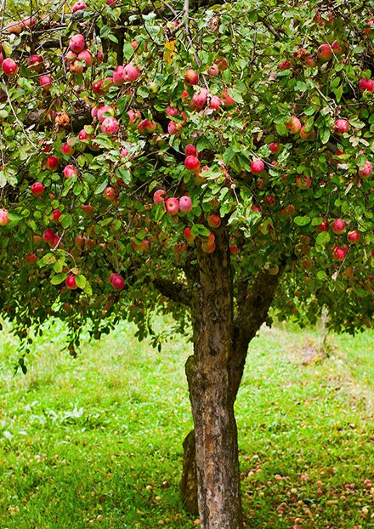
Defining an issue ecosystem
An issue ecosystem is “the cumulative environment surrounding a political issue
or candidate.”
The goal of issue campaigns is to create the conditions necessary for decision makers to
enact the change you wish to see.

Slide 46
Defining an issue ecosystem
What are the major components of most issue ecosystems?
Let’s list out a few!
Notes:
Where do your elected officials stand on the issue that you care about?
When is the next election that impacts this issue?
Are there other organizations that are organizing around this issue?
Who holds political capital in your community?

Slide 47
Questions to ask when choosing decision makers:
What is our organizing capacity?
Is there current legislation on this issue?
  If so, what decision makers must we influence to be successful?
  If not, what else can we do to make an impact that matters?
Are there other organizations/groups working on this issue?
Notes:
Where do your elected officials stand on the issue that you care about?
When is the next election that impacts this issue?
Are there other organizations that are organizing around this issue?
Who holds political capital in your community?

Slide 48
Our goal:
To create the conditions for decision makers to take action on the issue we care about.
Notes:
This year is particularly important to get active and get organized – many of the issues that you are named in your application will be directly impacted by the results of this midterm election – the state and federal races, ballot initiatives campaigns

Slide 49
What is a problem you want to address in your community?
Who is missing from the conversation?
Type in the chat box
Notes:
In creating a more participatory and accessible democracy, ask yourself who is missing from this issue and the conversation around this issue.

Slide 50
Agenda
Intro and welcome
Framing the learning journey
Your fellowship resources
Seeing ourselves as change-makers
Identifying root challenges
Debrief and close

Slide 51
What questions do you have?
Type in the chat box or email fellows@ofa.us

Slide 52
Tweet your key takeaway
#OFAFellows
Notes:
Over the span of this week hundreds of fellows will be starting this journey along with you! Using social media to share out your learning and what you are excited about is a great way to build connections that span the country. It is also a super great way to show your personal networks what you’re working on. Who knows, maybe someone will be inspired by you and begin their own organizing journey!

Slide 53
Weekly assignment:
Due Wednesday, July 25
1
What is a problem that’s affecting the health of your community?
What is an issue that can make an impact on this problem?
What your indicators of success around making progress on this issue?
With this in mind – what type of capstone project do you think best fits the problem you’re trying to address?
2
3
4

Slide 54
Thanks for joining the training!
Please fill out the evaluation on today’s training using the link below:
bit.ly/Summer1-2018
Email fellows@ofa.us with any questions.

