Slide 1
Effective conversations
Part 3: Your theory of change:
Why, how, what
Elizabeth Erickson OFA Training Director @LizzGErickson/
Alexis Conavay Training Manager @AlexConavay
We will begin the training at 8 p.m. ET / 7 p.m. CT
Notes:
This work is licensed under the Creative Commons Attribution-NonCommercial 4.0 International License. To view a copy of this license, visit http://creativecommons.org/licenses/by-nc/4.0/ or send a letter to Creative Commons, PO Box 1866, Mountain View, CA 94042, USA

Slide 2
GUIDED WORKSHEET
Indicators for why, how, and what
Bit.ly/why2what
Notes:
If you’d like to follow along, here is a guided worksheet to use. We will also email this out in our recap after this training.

Slide 3
Learning series
Week 1: Effective listening
Week 2: Know your ‘why’
Week 3: Your theory of change
Week 4: Motivational interviewing
Week 5: Voter contact best practices
Notes:
Here is where we’ve been and where we are going

Slide 4
#OFAction
Notes:
We’ve often heard that you feel very connected in the chatbox.
There are hundreds of people on this call – tweeting your key takeaways is a great way to continue to meet others from all across the country and stay connected.

Slide 5
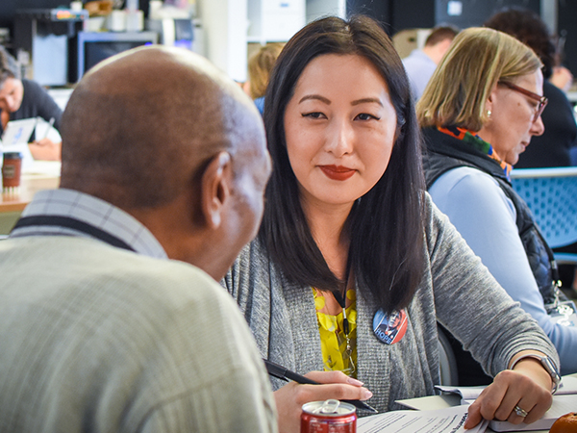
Your theory of change
Notes:
From the last session, you worked on being able to identify your ‘why’. We worked through the importance of finding your why, as well as ways to identify your why. If you weren’t able to join us, we will have a quick recap at the beginning of this call as well as delve into examples of what this looks like in practice, and when using the framework is most effective.

Slide 6
GOAL FOR THIS SESSION
Feel confident using the ‘why, how, what’ framework to talk to your neighbors
Notes:
This is our big goal for today. We want you to feel confident and comfortable with when and how to use this framework. Tonight we are going to dig into when to move from each piece of the golden circle.

Slide 7
Agenda
Recap – Knowing your why
Why, how, what (and when to use it)
Close and next steps
Notes:
Here’s how we are going to do it! We want to make sure, in such an important year, that we really dig into our theory of change.

Slide 8
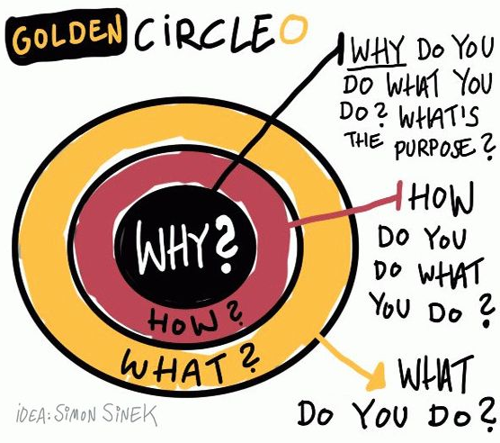
Notes:
Last week we watched a TED talk segment by Simon Sinek on ‘knowing your why’ Simon Sinek is a writer and does marketing research and he found something really interested when he was working/studying companies. The most compelling company approached their marketing differently. They started with the ’why’ of the company rather than what they produced. GAME-CHANGER
WHY: ‘Why’ is what moves you – it is the core thing that makes you tick.
HOW: ‘How’ is your theory of change – it is the way that you believe your why can come into the world
WHAT: ‘What’ is the thing that you are now doing as a result of your how – it is your specific actions associated with your theory of change.
This totally applies to our organizing! You can use this when you’re talking to someone politically different, similar, or if you have a particular action in mind. Tonight we’ll go through examples of each of these scenarios.
When you use this framework, you are trying to transform a way that a person looks at something – you are typically trying to connect with their values and have them connect with yours. At the root of this is relationship building.

Slide 9
Your why
1
This is your cause, your purpose, your belief. The thing that drives you most.
2
We are able to connect to each other more deeply through values and beliefs.
3
This is the hardest part of ourselves to understand clearly.
Notes:
[1 minute]
Spend a little time reading through each of these key points.
I think of this as: what keeps you up at night or what makes you tick. It’s the thing that you might have subconsciously operated with but not likely articulated out loud
This is the hardest part because we are taught in our society that being vulnerable is dangerous or too risky – we believe this is our we share our humanity. We connect with our vulnerabilities – it is actually really strong to share with folks and it inspires people. You follow folks that have inspired you – think about anyone that has gotten your support, have they ever gotten it without sharing their values and story vulnerably?

Slide 10
Your how
1
This is your strategy, the way that you bring your “why” into being.
2
Your how should explain the way in you which you or your organization live out your values.
3
We sometimes call this our “theory of change.”
Notes:
[1 minute]
Spend a little time reading through each of these key points.
This is your roadmap and plan – this is your vision of how the why comes into the world.
The ‘why’ actualized– rooted in the values that are grounding your why – they should feel aligned

Slide 11
Your what
1
Your what is what you do; the actions you take each day.
2
This is the easiest part of ourselves to understand, but the least convincing to motivate others.
3
Use your “why” and “how” to motivate people to join your “what!”
Notes:
[1 minute]
Spend a little time reading through each of these key points.
Your what is super practical
.
This is the realm that people typically live in – this feels safe. Folks should feeling motivated by your why and how before moving to your what – Do not automatically start with your why, even if you believe you might align politically
Are my actions leading to the change I want to see, are they adding up to the world I imagine in my ’why’ and ‘how’.
‘What’ is the thing that you are now doing as a result of your how – it is your specific actions associated with your theory of change.

Slide 12
Recap: the framework of your why
Critical incident
What is a critical incident that leads to what you believe and why?
Values
What values are present underneath your critical incident and why?
Practice
How will you practice communicating your values in way that resonates with diverse groups of people?
Notes:
[1 minute]
One way is using the critical incident framework, sleuthing for values underneath it, and then communicating it effectively.
Critical incident: ask yourself, when was the first time you remember standing up for something that you believed in? Really think about the FIRST time that happened because that was when you likely solidified your belief around a particular value. This is an early memory – critical in shaping our values and what we care about. Experiences that are deeply rooted (maybe you didn’t act out this value perfectly the first time)
Last week we talked about how to identify your ’why’ this week we are going to dig into how to get to your ’how’ and ‘what’

Slide 13
Notes:
[4 minutes]
Here is a clip of Steve Jobs’ delivering a graduation commencement speech. Watch and listen for the ‘why’ in this speech and what values are underneath with Steve Jobs is saying
This video is 3:40

Slide 14
QUESTION 1:
What is Steve Jobs’ why?
Notes:
[2 minutes]
Read out responses in the chatbox

Slide 15
QUESTION 2:
What values are underneath his why?
Notes:
[2 minutes]
Read out responses in the chatbox

Slide 16
QUESTION 3:
How does he communicate it?
Does it resonate?
Notes:
[2 minutes]
Read out responses in the chatbox

Slide 17
You have to understand your why and be genuinely curious about your neighbor’s why.
Notes:
[1 minute]
At the root of it you…
Try to ask yourself this: How would we, as organizers maybe canvassing, try to connect with someone like Steve Jobs – what might compel him to get involved? What values would we share that would bring him into our why. Likely innovation and empathy and accessibility to that innovation (we see these living out with apple – alignment with his why and the things he made).

Slide 18
It’s not enough to know
your why—you have to identify
a how, and then your what.
Notes:
BUT
The skill here is to be nimble in conversations that require different things – we deeply want to see our why articulated into the world in a powerful way. We want to make enduring change in this country so being able to effectively communicate ‘why, how, and what’ is super powerful
It’s not enough to know your why -- you have to identify a how that flows out of your why, and then your what.
Be nimble in conversations that require different things
We want to use today to walk through indicators in a conversation that show when you are ready to move from why, to how, to what, and give as many examples as we can throughout it as it applies to organizing

Slide 19
Agenda
Recap – Knowing your why
Why, how, what (and when to use it)
Close and next steps
Notes:
We’ll go over when to use aspects of this framework and indicators of when to use each piece
And with that, LIZ!

Slide 20
SCENARIO 1
Conversation with
someone you’re not politically aligned with
Notes:
You are talking to someone, and realize they are not aligned politically with you. You may be canvassing, you may be talking to your neighbor, you may be at a city council meeting
Different belief or political systems, seemingly at odds
Trying to communicate to find a common ground

Slide 21
This could happen during…
A dinner or happy hour with friends, family, and colleagues
Canvassing or phonebanking
At work or school during lunch
Notes:
We have these kind of conversations …..
Talk to people that have different beliefs
It is really important at this stage is stay with your why and communicate clearly what makes you tick
I’ll give an example about how I would use this if I were communicating my why to someone that disagrees with me – in the core I communicated

Slide 22
Stay with why
Notes:
Story example 1: Facilitator shares ‘why’ with the group
It’s important at this stage to stay with your why -→ Communicate your values.
EXAMPLE (share the person in mind)
That is where the difference is: Hone in on connecting to the core aspect of the ‘why’. It helps shrink the opposing views if you can align on the core why and values rooted in it. If you start with the what you’ve already pushed them back into their
This can feel super vulnerable – I felt vulnerable communicating this to you all since we don’t know each (you likely know a part of my story and that connects us more deeply than if I said a ‘what’ of mine)
After story: This can feel vulnerable and uncomfortable. It is hard. I felt vulnerable communicating this with you all since we don’t know each other very well.
You likely now, however, know my story and why I do what I do, and that connects us.

Slide 23
3 minutes
If you were different politically:
What about my ‘why’ resonates with you?
What questions would you ask me?
How would you use my why if you were talking with me?
Reflection
Notes:
We have a few minutes to have reactions to my why
I used this critical incident framework
Put on the hat that you differ from me politically – we are trying this out. What about my why resonates with you
How would that conversation continue
Fundamentally communicate the values then this is an entry point where to start there instead of deeply entrenched

Slide 24
Things to
figure out
What is their cause?
What is their belief?
Why do they do what they do?
Notes:
Listen for these when someone is communicating what makes them tick
If folks misheard my Why – make sure you figure this out when listening to my why

Slide 25
Things to communicate
Your belief
Your cause
Your why
Notes:
Same for you when you are communicating
See the connections – where that came from

Slide 26
You know to
stay with why when
you don’t know their values…
Notes:
We need to stay with our why when the values aren’t clear.

Slide 27
... or you haven’t
fully communicated
your own.

Slide 28
SCENARIO 2
Conversation with someone you are politically aligned with, but you believe change happens differently.
Notes:
You are talking to someone, and realize they are not aligned politically with you. You may be canvassing, you may be talking to your neighbor, you may be at a city council meeting
Let’s go to our second scenario – different beliefs with how change happens. They might think change happens in a certain way that differs from your understanding of change
Align and build community

Slide 29
This could happen during…
Conversations with close friends
Working with partner organizations in the progressive community
When you speak to folks who have similar views, but don’t believe change can happen through our democracy
You find someone didn’t vote in their local election
Canvassing or even volunteering with other people
Notes:
• This is where facts are helpful
• This can be painful because we feel that we’re supposed to be on the same
Difference in the best way forward
Example: local organizing with community organizations or public pressure in the press on the state level – the why is similar but the how is in direct conflict
This happens a lot in spaces we’re in – this one can be painful too because you’re like wait we are supposed to be on the same side --- key into motivational interviewing to talk about the the discrepancies. Facts are helpful here

Slide 30
Align with why,
move to how
Notes:
Story example 2: Facilitator shares ‘why’, ‘how’ with the group
Understand how the ’why’ operates in the world – that is the HOW. Want to show how you got to the ‘how’ – what is that rooted; where it is coming from

Slide 31
3 minutes
What about the ‘how’ resonates with you?
If you believed politically like me, what would you be curious about in my belief of how change happens?
Reflection

Slide 32
Things to figure out for “how”
How do they believe change happens?
How can you communicate to them how change happens?
Notes:
Be able to communicate this clearly and effectively – aligning here on strategy. We want to make change in community with others so when we are aligning it can be collaborative ?[]

Slide 33
”How” is the strategy
for bringing your
“why” into being.

Slide 34
SCENARIO 3
Conversation with someone
you are politically aligned with, and typically think change happens the same way.

Slide 35
This could happen during…
Your fellows cohort, campus groups, chapter meeting
During book club
In your place of worship
Digitally
At your city council meeting

Slide 36
Align with why, move to how, end with what
Notes:
Story example 1: Facilitator shares ‘why’, how, what with the group’’
In the why – of course I care about this
Live on ‘what’

Slide 37
3 minutes
How do you feel seeing it all together?
Are you compelled by what she is asking you to do?
Reflection

Slide 38
Things to figure out for “what”
What can you ask them to do or join?
If they were to do this action, what would happen?
Notes:
Don’t want to assume that we are automatically in this scenario -

Slide 39
GUIDED WORKSHEET
Indicators for why, how, and what
Bit.ly/why2what

Slide 40
Let’s practice

Slide 41
Agenda
Recap – Knowing your why
Why, how, what (and when to use it)
Close and next steps

Slide 42
Debrief
Which phase of the framework comes easily to you?
Which technique do you respond most well to?

Slide 43
Debrief
What types of organizing do you see
this framework fitting into?

Slide 44
And finally…
With November 2018 coming up,
in what ways will you apply this framework to your own work?
Notes:
TWEEEEEET

Slide 45
Next session

Slide 46
Effective conversations
Part 4: Motivational interviewing
June 20 at 8 p.m. ET/7 p.m. CT
Notes:
Give date/time of next training

Slide 47
Team ’18
ofa.bo/team18lead
Notes:
We will also run a Team’ 18 Leadership program, where you will have the opportunity to build volunteer teams on behalf of OFA. You will have the opportunity to coach, mentor, and develop organizers who live in target areas.
OFA will support you in your work by doing what we know best—providing training, coaching, and mentorship to make sure you are prepared to take on this fight.
Sign-up to join Team ‘18 now!!:http://bit.ly/ofa18
Canvassing, phone banking, talking to family and friends

Slide 48
OFA
Thank you for joining today’s training.
Please fill out the survey below and give us
your feedback on today’s training.
bit.ly/effectiveconvo_WHW

