Slide 1
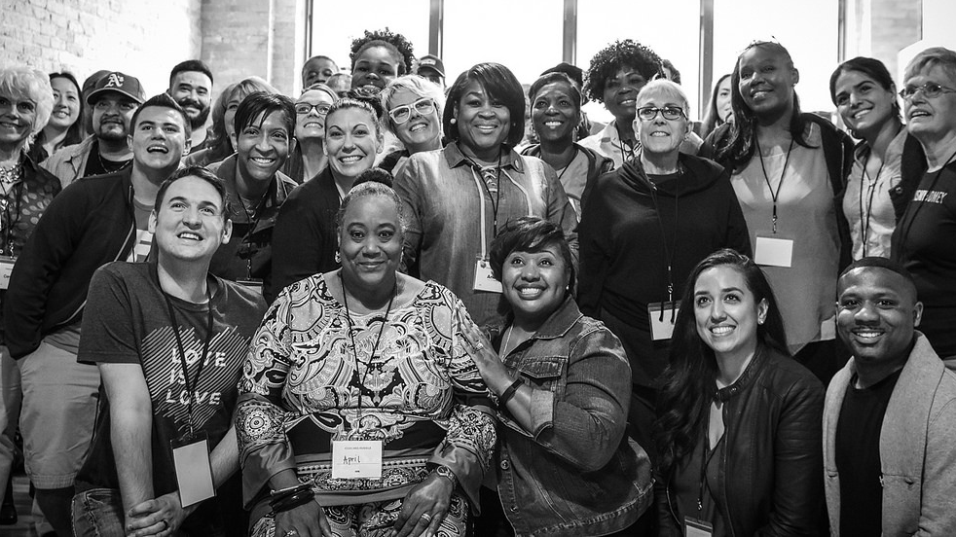


SPRING 2018
Fellows Leaders
We will begin the training at 8 p.m. ET / 7 p.m. CT
Notes:
This work is licensed under the Creative Commons Attribution-NonCommercial 4.0 International License. To view a copy of this license, visit http://creativecommons.org/licenses/by-nc/4.0/ or send a letter to Creative Commons, PO Box 1866, Mountain View, CA 94042, USA

Slide 2
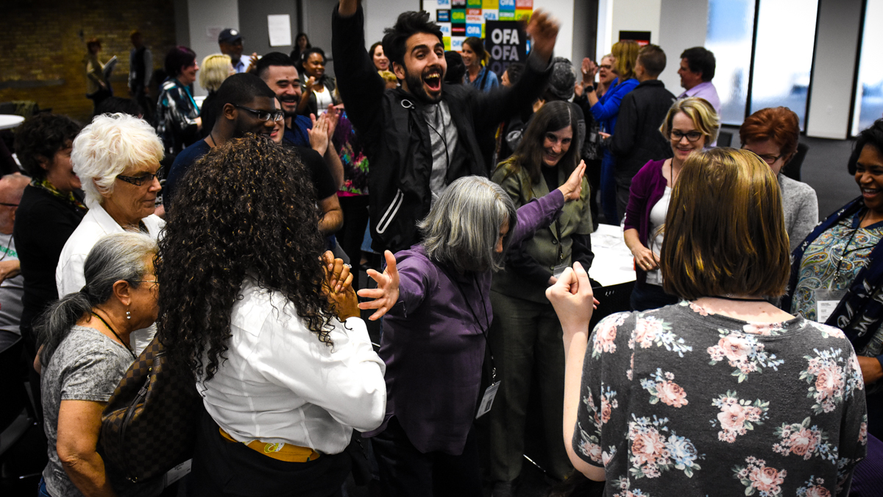
SPRING 2018 OFA FELLOWS LEADERS
Part 4: Facilitation best practices
Bobby Brady-Sharp / OFA Training Projects Manager

Slide 3
GOALS FOR THIS SESSION
Review fellows orientation curriculum

Slide 4
GOALS FOR THIS SESSION
Learn and practice facilitation best practices

Slide 5
GOALS FOR THIS SESSION
Internalize fellows orientation curriculum over the next two weeks

Slide 6


Recruitment update
Week 4
Bit.ly/apptrack2018

Slide 7
#OFAFellows

Slide 8
What does it mean to “internalize” curriculum?

Slide 9

Facilitation best practices

Slide 10
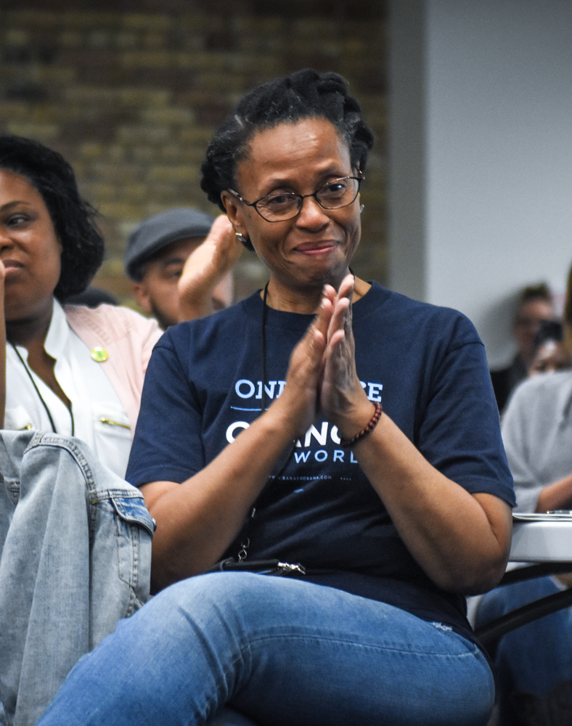
Being a good facilitator is both a skill and an art.
Notes:
Coercion induces change, while leadership influences change

Slide 11
Facilitation has 3 basic principles:

Slide 12

Principles of facilitation
A facilitator is a guide to the process, not the seat of wisdom and knowledge
Facilitation focuses on how people participation, not just on what gets achieved
Facilitators seek to create an inclusive space where everyone has a voice…not necessarily a comfortable or “safe” space

Slide 13
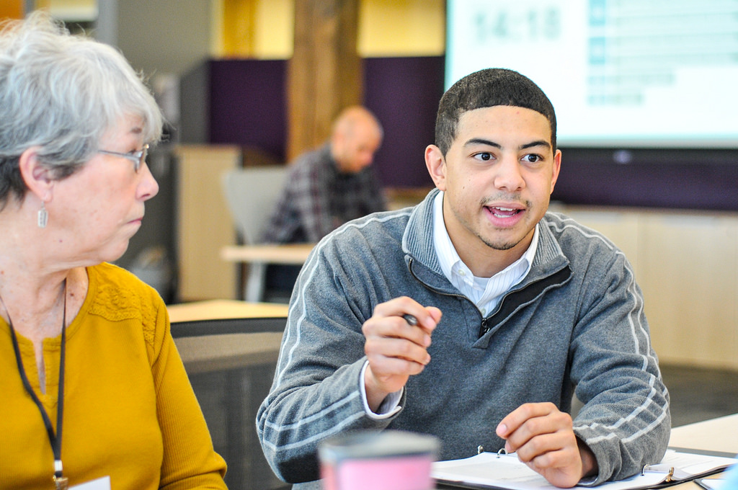
DO’s for facilitators

Slide 14
DO’S FOR FACILITATORS:
Internalize the training materials

Slide 15
DO’S FOR FACILITATORS:
Know your audience

Slide 16
DO’S FOR FACILITATORS:
Make your audience feel safe and heard

Slide 17
DO’S FOR FACILITATORS:
Be flexible

Slide 18
DO’S FOR FACILITATORS:
Keep the discussion on target

Slide 19
DO’S FOR FACILITATORS:
Model behavior you want your group to employ

Slide 20
DO’S FOR FACILITATORS:
Use encouraging body language, voice, words

Slide 21
DO’S FOR FACILITATORS:
Give positive feedback for joining the discussion

Slide 22
DO’S FOR FACILITATORS:
Be aware of reactions, feelings (active response)

Slide 23
DO’S FOR FACILITATORS:
Open-ended questions

Slide 24
DO’S FOR FACILITATORS:
Control your biases

Slide 25
DO’S FOR FACILITATORS:
Be open to disagreement

Slide 26
DO’S FOR FACILITATORS:
Keep your mouth shut as much as possible!

Slide 27
DON’Ts for facilitators

Slide 28
DON’TS FOR FACILITATORS:
Don’t let individuals or small groups dominate

Slide 29
DON’TS FOR FACILITATORS:
Don’t let one viewpoint override others without merit

Slide 30
DON’TS FOR FACILITATORS:
Don’t make assumptions (on culture, backround, race, etc…)

Slide 31
DON’TS FOR FACILITATORS:
Don’t be the font of all wisdom

