Slide 1
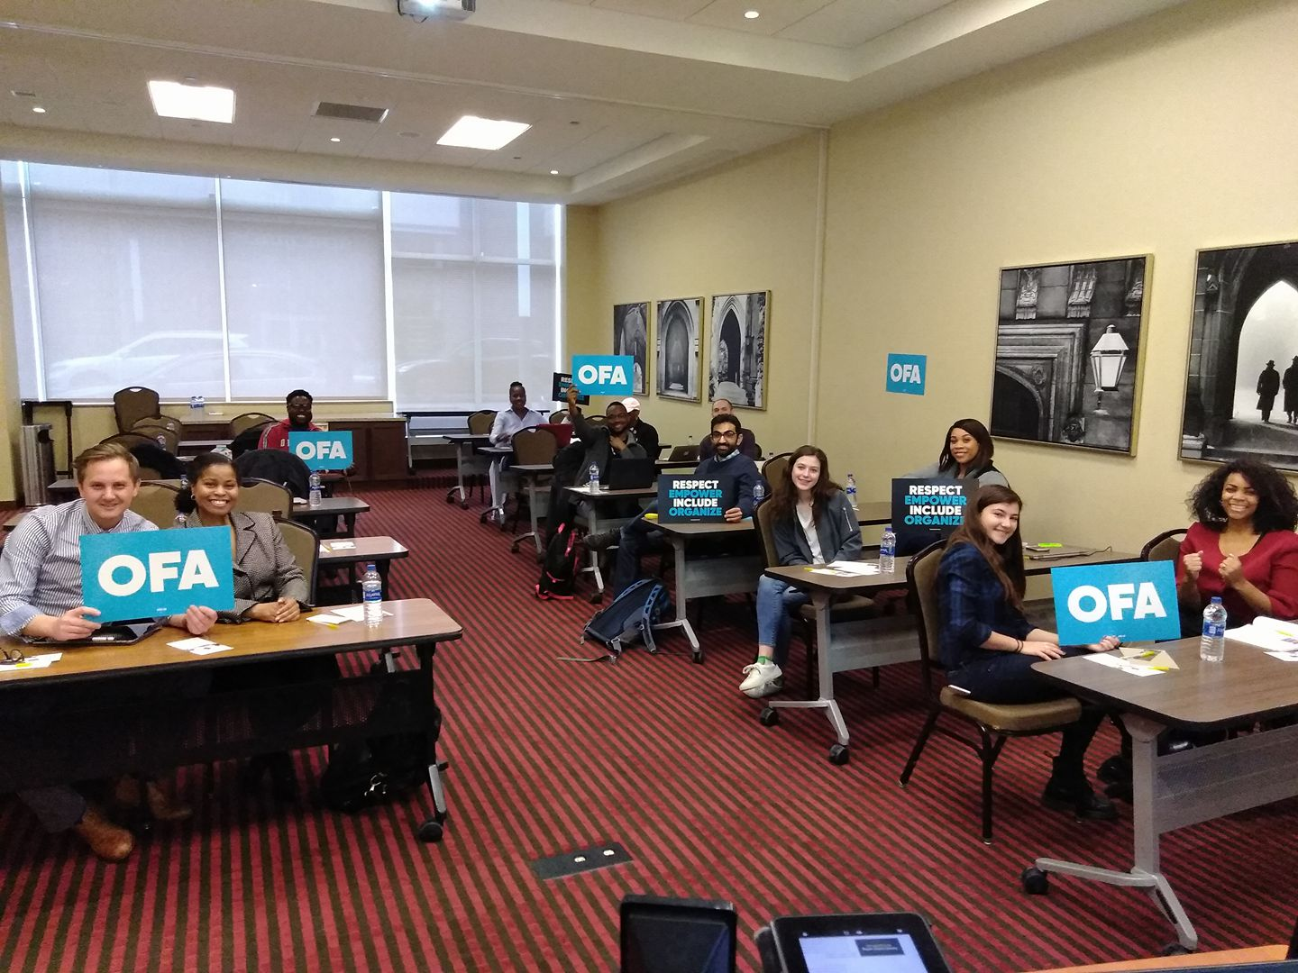


WORKSHOP SESSION
Local Issue Advocacy
Elizabeth Erickson / OFA Training Director
We will begin the training at 8:30 p.m. ET / 5:30 p.m. PT
Notes:
This work is licensed under the Creative Commons Attribution-NonCommercial 4.0 International License. To view a copy of this license, visit http://creativecommons.org/licenses/by-nc/4.0/ or send a letter to Creative Commons, PO Box 1866, Mountain View, CA 94042, USA
Express appreciation for joining

Slide 2
“The harder the conflict, the more glorious
the triumph.”
THOMAS PAINE

Slide 3

2 minutes
As we are closing out the series, you are likely reflecting on the growth you have made on your issue.
What are you most proud of so far? Type your answer in the chat box.
Opening
Notes:
Type answers into the chat box

Slide 4


Guided worksheet

Slide 5
Our learning journey
Week 1: Introductions; advocacy overview
Week 2: Workshop
Week 3: Foundations of coalition building
Week 4: Workshop
Week 5: Identifying legislation

Slide 6
Our learning journey
Week 6: Workshop
Week 7: Writing your campaign plan
Week 8: Workshop
Week 9: Running into barriers
Week 10: Closing synthesis and next steps

Slide 7
Synthesize the content covered in our local issue advocacy series
Evaluate the next steps on your campaign plan
Goal for
this session
1
2

Slide 8
Tonight’s
agenda
 | Opening Synthesis of learning journey Outcomes of local issue advocacy Breakouts Closing

Slide 9
TOPIC 1:
Coalition building
Notes:
5 words to describe this topic
Choose the most important word
Defend it to the group

Slide 10
Best practices
1
Look for people with the resources you need
Ask for advice
Show up – relationships are everything
Brainstorm contacts
Work together builds relationships
Partnerships and coalitions are everything
2
3
4
5
6

Slide 11
TOPIC 2:
Policy landscape
Notes:
5 words to describe this topic
Choose the most important word
Defend it to the group

Slide 12
1
Strategic research around your issue matters.
Use one another; use experts.
Don’t spend time crafting your own legislation if you don’t have to.
Key takeaways
2
3
Notes:
We seek the find the current status around our issues:
For research : for what being discussed at the policy level? Learn the history of the legislation and why the conversation is where it is at this moment in time.
For people: What are other people working on? What are other group’s priorities? What is the change you want to see happen? Don’t just say, ‘utility company’ – who is talking to who at the utility company?
Crafting legislation -- don’t do it, there are sometimes model ordinances (SIX -- state innovation exchange). We are not typically legislation experts – and we don’t have to be.

Slide 13
TOPIC 3:
Campaign planning
Notes:
5 words to describe this topic
Choose the most important word
Defend it to the group

Slide 14
Building the framework
1
An achievable, measurable, and problem-solving goal.
A strategy that provides the roadmap for success.
Effective tactics that accomplish your goal through the strategy you’ve developed.
2
3

Slide 15
TOPIC 4:
Overcoming barriers
Notes:
5 words to describe this topic
Choose the most important word
Defend it to the group

Slide 16
Best practices
  Accentuate the positive
  Live by your values
  Plan for small wins
  Look for the good in others
  Be creative
  Be persistent and patient

Slide 17
Tonight’s
agenda
 | Opening Synthesis of learning journey Outcomes of local issue advocacy Breakouts Closing

Slide 18
Organizer continuum
No engagement
Minimal engagement & awareness
Participation
Leadership
Changing the system
Notes:
No engagement: actions, causes, beliefs
Actions
Lack of voting in city/state/federal elections
No reading of news (passive)
Not talking to people with different ideas
Beliefs
“Government doesn’t affect me. I cannot effect government”
“Politics are corrupt anyway”
Causes
Systematically/historically not allowed in politics; disenfranchised. No matter who is in office, status quo doesn’t really change
Minimal engagement/ awareness
Actions
Reading news and alarmed/irritated/aware of what is going on
Likely siloed with news sources
Attends some community events
Beliefs
Change can come, but not for a long time
Thinks about issues that are important in some way
Causes
Reading material that supports their own world view
Lack of understanding of how city government is set up and works
Challenges (none listed, so what do you think challenges are for someone who is “Aware”
OFA programs that are best suited for this level
Participation
Actions
Member of a community group (ie church, alumni, sorority, sports, clubs -- book, quilt, etc)
Regularly attends/participates in events, phone banks, online actions, etc
Know they care
Intimately aware of how their life is set up
Beliefs
Change comes from ordinary people who care
“If not me, who?”
Causes
Believes they are leaders
Educated
Understands the ways to raise their own voice
Leadership
Actions
Recruits people to join them
Lead local chapters for change
Have a theory about change comes to a community
Aware of key change levers
Beliefs
“I am a key change lever”
Causes
Have had some success in getting something passed/changed for a positive impact
Changing the system
Actions
Make laws, policies, decisions that help overall representation in our government
Deep understanding of theory of change, including reasons why groups are disenfranchised
Beliefs
Power sharing is good for a sustainable democracy
Thinks that government is good
Causes
Other people give them authority

Slide 19
1
Equip individuals with the skills to identify root problems in their community, and propose a campaign plan addressing these root problems.
To identify all the components of successful coalitions, and apply these elements of building a coalition in their community
To explain current legislation surrounding their issue, and take appropriate action
To analyze the barriers and challenges that we face as we implement our campaign plans, and persevere strategically
The develop a community of learners that support, push, challenge, and celebrate each other
2
3
4
5

Slide 20
Success
Notes:
Link to indicators of success on worksheet

Slide 21
INIDCATORS OF SUCCESS
GOAL | INDICATOR OF SUCCESS | OUTCOME
Identify root problems affecting the health of your community | 10 campaign plans written | 3 campaign plans written
Build successful coalitions | Participating at events, coalitions, summits | 80% active participation with coalitions and summits
Explain policy around current issue | Actively taking resolutions from other cities | 50% with policy questions
Analyze barriers faced | 80% participation over the course of the series | 60% retention of people during course of series

Slide 22
Questions?

Slide 23
Tonight’s
agenda
 | Opening Synthesis of learning journey Outcomes of local issue advocacy Breakouts Closing

Slide 24
Group norms

Slide 25
Norm 1:
Develop an ethic of sharing.

Slide 26
Norm 2:
It’s okay to question. Asking
for why; asking for evidence; receive feedback in kind.

Slide 27
Norm 3:
No one is above critique,
no one is below dignity.

Slide 28
Norm 4:
Respect, Empower, Include.

Slide 29
Norm 5:
Step up; step back.

Slide 30
20 minutes
Groups of three
Decide who is person A, B, C
Person A: What actions have I taken as a result of what I have learned?
Person B & C: 1 affirmation, 1 question
Switch after 5 minutes
Group Protocol

Slide 31
Group share

Slide 32
Tonight’s
agenda
 | Opening Synthesis of learning journey Outcomes of local issue advocacy Breakouts Closing

Slide 33

Debrief
What is most helpful moving forward?
How can OFA stay connected on your issue?

Slide 34
Thank you for joining
today’s webinar.
Please fill out the survey below and give us
your feedback on today’s training.
bit.ly/PostLIA

