Slide 1
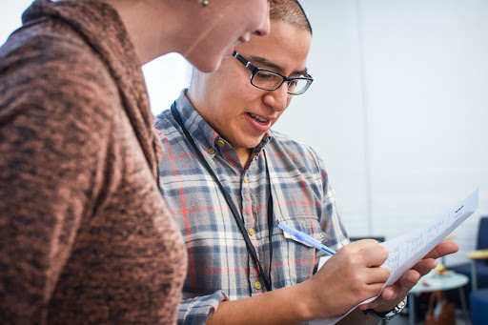
WORKSHOP SESSION
Local Issue Advocacy
Elizabeth Erickson / OFA Training Director
We will begin the training at 8:30 p.m. ET / 5:30 p.m. PT
Notes:
This work is licensed under the Creative Commons Attribution-NonCommercial 4.0 International License. To view a copy of this license, visit http://creativecommons.org/licenses/by-nc/4.0/ or send a letter to Creative Commons, PO Box 1866, Mountain View, CA 94042, USA
Express appreciation for joining, and that I have looked over the homework that some people have sent and am really excited to dig through some of it

Slide 2
“The best way to not feel hopeless is to get up and do something. If you go out and make some good things happen, you will fill the world with hope, and you will fill yourself with hope.”
BARACK OBAMA

Slide 3
2 minutes
Did anyone take any steps this week to build their coalition, or learn more about their issue?
Share your steps in the chat box, and be ready to share!
Opening
Notes:
Type answers into the chat box

Slide 4
Guided worksheet

Slide 5
Participants will assess where they are in their issue implementation
Participants will identify their next steps in building a coalition
Participants will apply feedback from the group protocol to their issues
Participants will feel a sense of community with the group.
Goal for
this session
1
2
3
4

Slide 6
Tonight’s
agenda
 | Opening Assessment of issue implementation Review of coalition best practices Workshop modeling Workshop groups Closing
Notes:
Share purpose of the workshop model -- we will have less content more time to push each other

Slide 7
#OFAction

Slide 8
Our learning journey
Week 1: Introductions; advocacy overview
Week 2: Workshop
Week 3: Foundations of coalition building
Week 4: Workshop
Week 5: Identifying legislation

Slide 9
Our learning journey
Week 6: Workshop
Week 7: Writing your campaign plan
Week 8: Workshop
Week 9: Running into barriers
Week 10: Closing synthesis and next steps

Slide 10
Tonight’s
agenda
 | Opening Assessment of issue implementation Review of coalition best practices Workshop modeling Workshop groups Closing
Notes:
Share purpose of the workshop model -- we will have less content more time to push each other

Slide 11
Issue Assessment

Slide 12
Issue Assessment
Issue statement
Coalition building
Legislation
Timeline
Implementation

Slide 13
Issue statement

Slide 14
Coalition building

Slide 15
Legislation

Slide 16
Timeline

Slide 17
Implementation

Slide 18
Tonight’s
agenda
 | Opening Assessment of issue implementation Review of coalition best practices Workshop modeling Workshop groups Closing
Notes:
Share purpose of the workshop model -- we will have less content more time to push each other

Slide 19
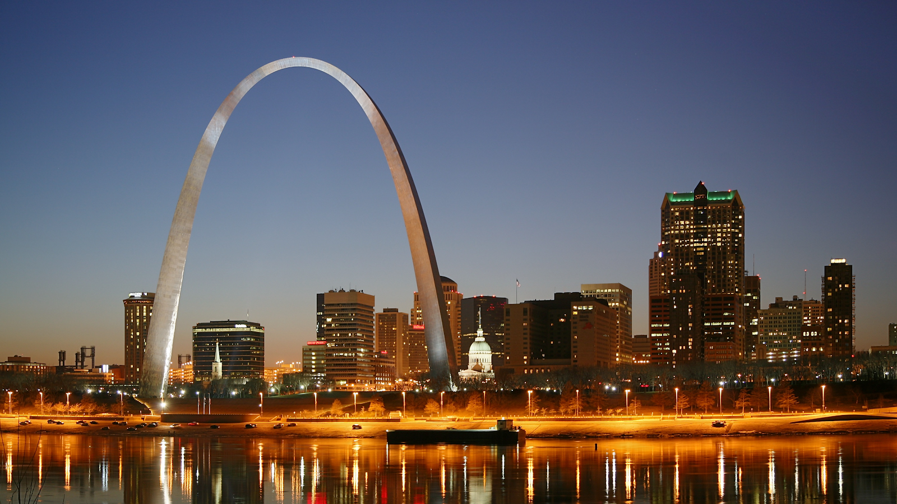
Resolution 124

Slide 20
Best practices
1
Look for people with the resources you need
Ask for advice
Show up – relationships are everything
Brainstorm contacts
Work together builds relationships
Partnerships and coalitions are everything
2
3
4
5
6

Slide 21
A tapestry of connections

Slide 22
Tonight’s
agenda
 | Opening Assessment of issue implementation Review of coalition best practices Workshop modeling Workshop groups Closing
Notes:
Share purpose of the workshop model -- we will have less content more time to push each other

Slide 23
Group norms

Slide 24
Norm 1:
Develop an ethic of sharing.

Slide 25
Norm 2:
It’s okay to question. Asking
for why; asking for evidence; receive feedback in kind.

Slide 26
Norm 3:
No one is above critique,
no one is below dignity.

Slide 27
Norm 4:
Respect, Empower, Include.

Slide 28
Norm 5:
Step up; step back.

Slide 29
Tonight’s
agenda
 | Opening Assessment of issue implementation Review of coalition best practices Workshop modeling Workshop groups Closing

Slide 30
20 minutes
Groups of three
Decide who is person A, B, C
Person A: Answers to the above assessment
Person B & C: 1 glow; 1 grow
Group Protocol
Notes:
Person A: Sharing context of problem, timeline, issue, and why you deeply care about it
Person B & C: 3 affirmations, 2 questions, 1 underlying assumption that is being made

Slide 31
Example

Slide 32
Group share

Slide 33
Tonight’s
agenda
 | Opening Assessment of issue implementation Review of coalition best practices Workshop modeling Workshop groups Closing

Slide 34
Debrief
What did I learn today?
What am I leaving committing to
now go, do, understand?

Slide 35
Logistics
Coalition survey
Homework- Options
A recording of this call will be
available later this week; recap sent out Thursday
Email and tweet!

Slide 36
Homework

Slide 37
Next session

Slide 38
Thank you for joining
today’s webinar.
Please fill out the survey below and give us
your feedback on today’s training.
bit.ly/
Notes:
Express appreciation, thank them for joining; express importance of joining each time

