Slide 1
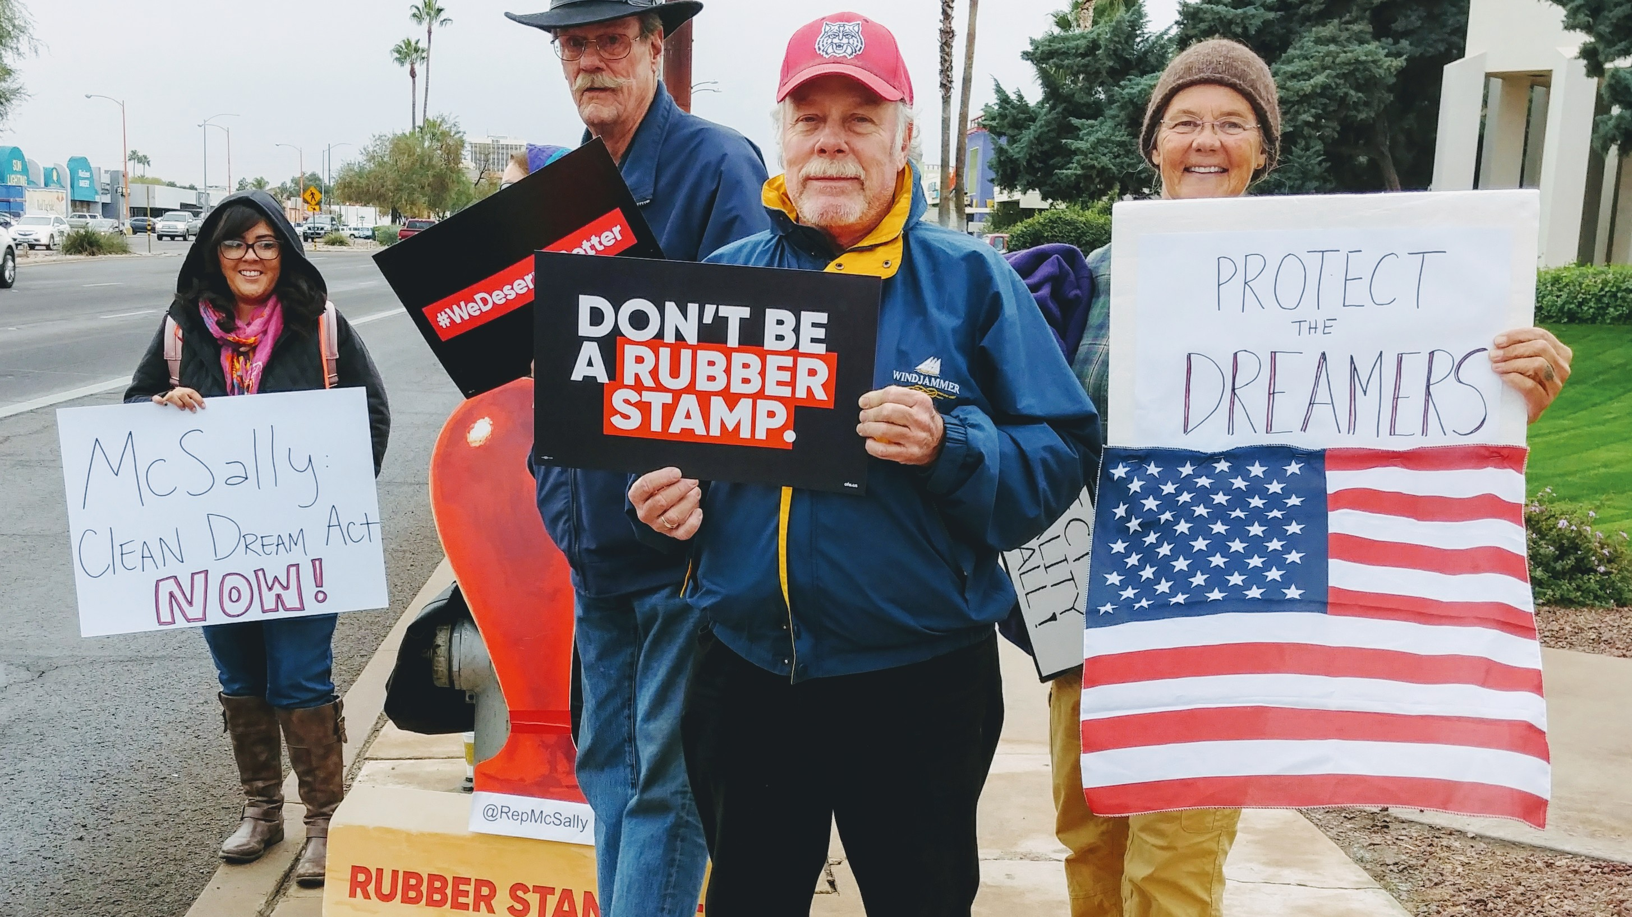


Local Issue Advocacy
Traci Wile / OFA Community Engagement Director
Elizabeth Erickson / OFA Training Director
We will begin the training at 8:30 p.m. ET / 7:30 p.m. CT
Notes:
This work is licensed under the Creative Commons Attribution-NonCommercial 4.0 International License. To view a copy of this license, visit http://creativecommons.org/licenses/by-nc/4.0/ or send a letter to Creative Commons, PO Box 1866, Mountain View, CA 94042, USA
Liz
Welcome to the training

Slide 2
“A good compromise, a good piece of legislation, is like a good sentence; or a good piece of music. Everybody can recognize it. They say, ‘Huh. It works. It makes sense.”
BARACK OBAMA

Slide 3
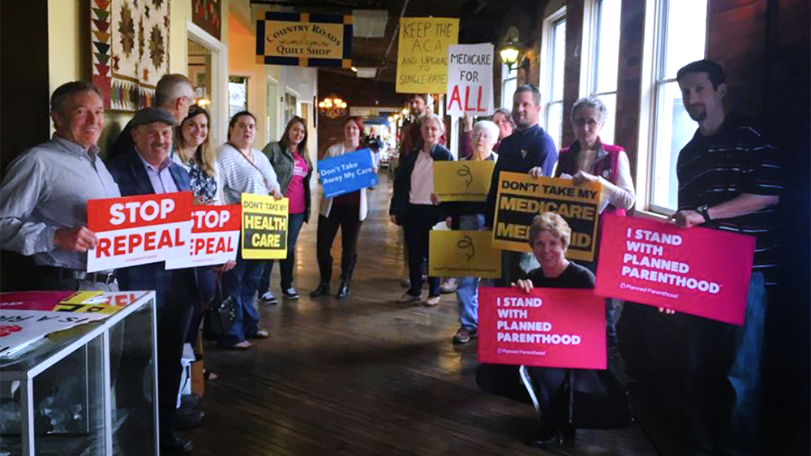
Policy landscape
Notes:
As community organizers, what’s our value add to a coalition?
Align people’s abilities with what is needed to influence

Slide 4

Describe common practices in identifying policy around your local issue campaign
Apply best practices in researching policy
Feel a sense of community with the group
Goal for
this session
1
2
3

Slide 5
Tonight’s
agenda
 | Welcome Content analysis Skill analysis Synthesis Closing

Slide 6


Guided worksheet

Slide 7
Learning Journey

Slide 8
Our learning journey
Week 1: Introductions; advocacy overview
Week 2: Workshop
Week 3: Foundations of coalition building
Week 4: Workshop
Week 5: Identifying policy

Slide 9
Our learning journey
Week 6: Workshop
Week 7: Writing your campaign plan
Week 8: Workshop
Week 9: Running into barriers
Week 10: Closing synthesis and next steps

Slide 10
How we envision policy

Slide 11
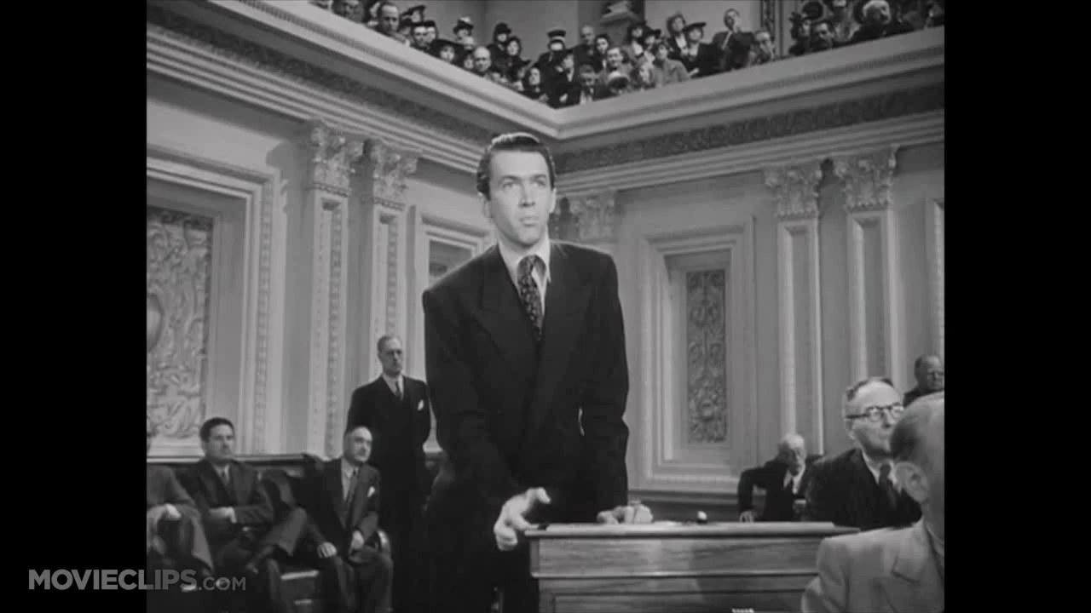
Legislation can sometimes feel like this…

Slide 12
What policy work
usually looks like
Notes:
Type your answer in the chat box

Slide 13

Notes:
Type your answer in the chat box

Slide 14
A note on this point …
Notes:
Traci: There is no one right way to do this -- we are going to give as many examples and practices as we can, but a key part in learning this is doing it, and going down as many routes as you can until you have a grasp of the landscape.
Traci: Everyone has a different thing that works for them - what can we give people that is helpful and works for them, does not have to be a solitary exercise, best way to do this is set up a group that already thinks about this and ask them questions.
Traci: Different kinds of questions require different kinds of answers, and different kinds of answers require different kinds of research to ferret them out. Knowing what you need is the first step.
You want to be an informed coalition participant – do your research

Slide 15
Tonight’s
agenda
 | Welcome Content analysis Skill analysis Synthesis Closing

Slide 16
Policy landscape:
What has happened, what is happening, and what people are talking about around your issue

Slide 17
CONTENT ANALYSIS:
Analyzing writing
on legislation
Notes:
If the answer you're looking for is one of known fact - What's the chemical composition of a certain substance? What effects does it have on humans? - then you're probably going to find it by looking through books or articles in a library, or by consulting an expert.

Slide 18
Analyzing
writing on
policy
City government website
State government website
Newspaper articles (bonus—look up who is cited!)
Online articles (bonus—look up who is cited!)

Slide 19
CONTENT ANALYSIS:
People resources

Slide 20
People resources
Organizing study circles
Identifying what your coalition has found and investigated
City council meetings—look at the agenda, review previous agendas, go to an upcoming city council meeting
Role of experts
Notes:
Organizing study circles: A study circle is a group of 8 to 12 people who meet regularly over a period of weeks or months to address a critical public issue in a democratic, collaborative way. Participants examine the issue from many points of view and identify areas of common ground. They emerge with recommendations for action that will benefit the community. Some examples from study circles conducted around the country include youth mentoring programs; new hiring policies; citywide diversity celebrations; a multiracial "unity choir;" and a new state law reforming the corrections system in Oklahoma.

Slide 21
CONTENT ANALYSIS:
Proposals

Slide 22
Proposals
Identify proposals that other groups have passed through city government—look at their language, edit for your own use
Notes:
At this point – we should NOT be crafting our own legislation on anything we are working on. Look to other groups working on this issue, or check out SIX – state innovation exchange
You don’t have to be writing your own legislation -- ‘no points for originality’ jack shapiro

Slide 23
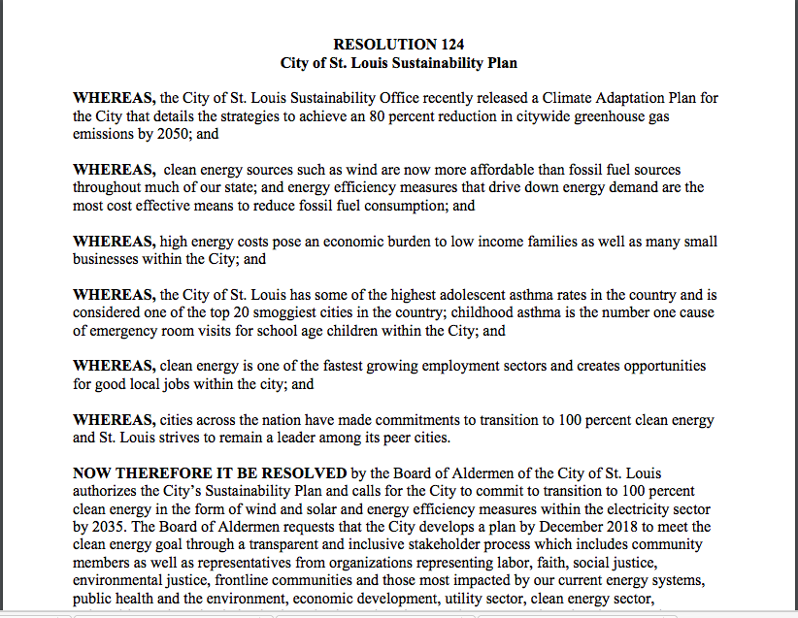
Resolution
124
Notes:
-- note – what city did Mr. Page take this language from?
Sierra club provides support for this legislation

Slide 24
1
Strategic research around your issue matters.
Use one another; use experts.
Don’t spend time crafting your own legislation if you don’t have to.
Key takeaways
2
3
Notes:
We seek the find the current status around our issues:
For research : for what being discussed at the policy level? Learn the history of the legislation and why the conversation is where it is at this moment in time.
For people: What are other people working on? What are other group’s priorities? What is the change you want to see happen? Don’t just say, ‘utility company’ – who is talking to who at the utility company?
Crafting legislation -- don’t do it, there are sometimes model ordinances (SIX -- state innovation exchange). We are not typically legislation experts – and we don’t have to be.

Slide 25
Research writing on legislation
Brainstorm!
1
Content analysis
2
Research experts on the content
Spend 3 minutes brainstorming what you need to do with legislation on your issue. You can use suggestions on the right to help guide you!
3
Find legislation passed in other cities
4
Attend a city council meeting
5
Organize a study circle

Slide 26
Group share

Slide 27
Tonight’s
agenda
 | Welcome Content analysis Skill analysis Synthesis Closing

Slide 28
Skill analysis
How to read between the lines
How to read the press
How to verify your information
Notes:
How to ‘read between the lines’
What are people saying about this type of legislation? What are they not saying about legislation?
What are their interests or motivations?
How to ‘read the press’
They typically do synthesizing work for an audience -- you want to go back and flesh out what they are not saying, or go to the sources
How to verify your information
Use as many believable sources as possible. The more people who can say, "Yes, that's right," the more backup you'll have if someone challenges your arguments. You also want to use credible sources to get your information.

Slide 29
Reflection
Skill analysis
What skill do you want to grow in as you research legislation and talk to others?
What is your timeline?
1
How to read between the lines
2
How to read the press
3
How to verify your information

Slide 30
Group share

Slide 31
Tonight’s
agenda
 | Welcome Content analysis Skill analysis Synthesis Closing

Slide 32
A tapestry of connections

Slide 33
15 minutes
Volunteer shares their issue, why they care about it, and what they have done to understand the legislation around their issue
Group feedback: What could they do next? Given what we learned today, what could they do to understand the policy landscape more deeply?
Group feedback & application
Keep in mind:
Content analysis
Skill analysis
Proposals

Slide 34
Tonight’s
agenda
 | Welcome Content analysis Skill analysis Synthesis Closing

Slide 35

Debrief
What are you taking away from tonight’s call?
What would be helpful for the next call?

Slide 36




Logistics
Survey
Homework- Sent in email
A recording of this call will be
available later this week; recap sent out Thursday
Email and tweet!

Slide 37
Homework

Slide 38
Next session
Notes:
Put in homework link – where they should put the answers to their work (slack?)
Give google drive link

Slide 39
Thank you for joining
today’s webinar.
Please fill out the survey below and give us
your feedback on today’s training.
http://bit.ly/LegislationLIA

