Slide 1
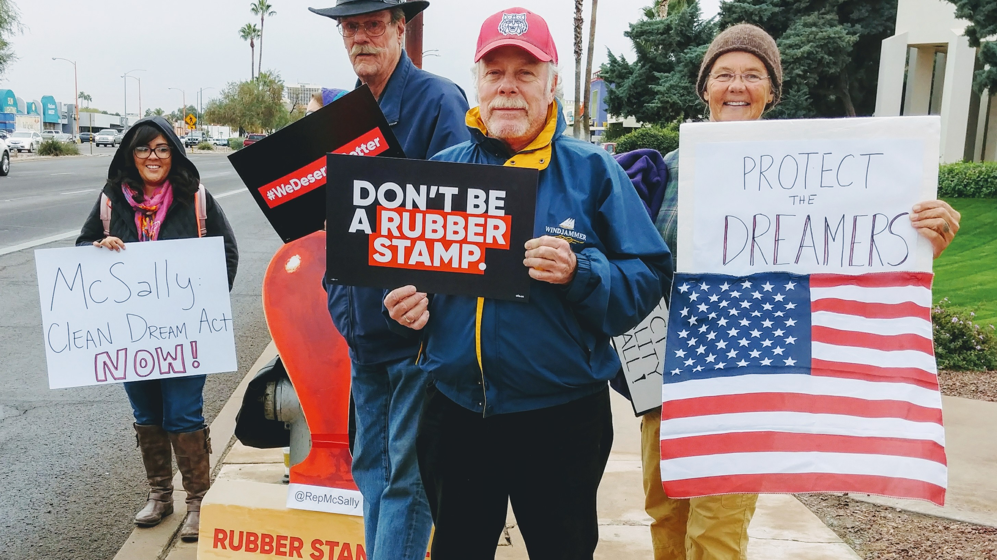


Local Issue Advocacy
Jack Shapiro / OFA Director of Policy & Campaigns
Elizabeth Erickson / OFA Training Director
We will begin the training at 8:30 p.m. ET / 7:30 p.m. CT
Notes:
This work is licensed under the Creative Commons Attribution-NonCommercial 4.0 International License. To view a copy of this license, visit http://creativecommons.org/licenses/by-nc/4.0/ or send a letter to Creative Commons, PO Box 1866, Mountain View, CA 94042, USA
Liz
Welcome to the training

Slide 2
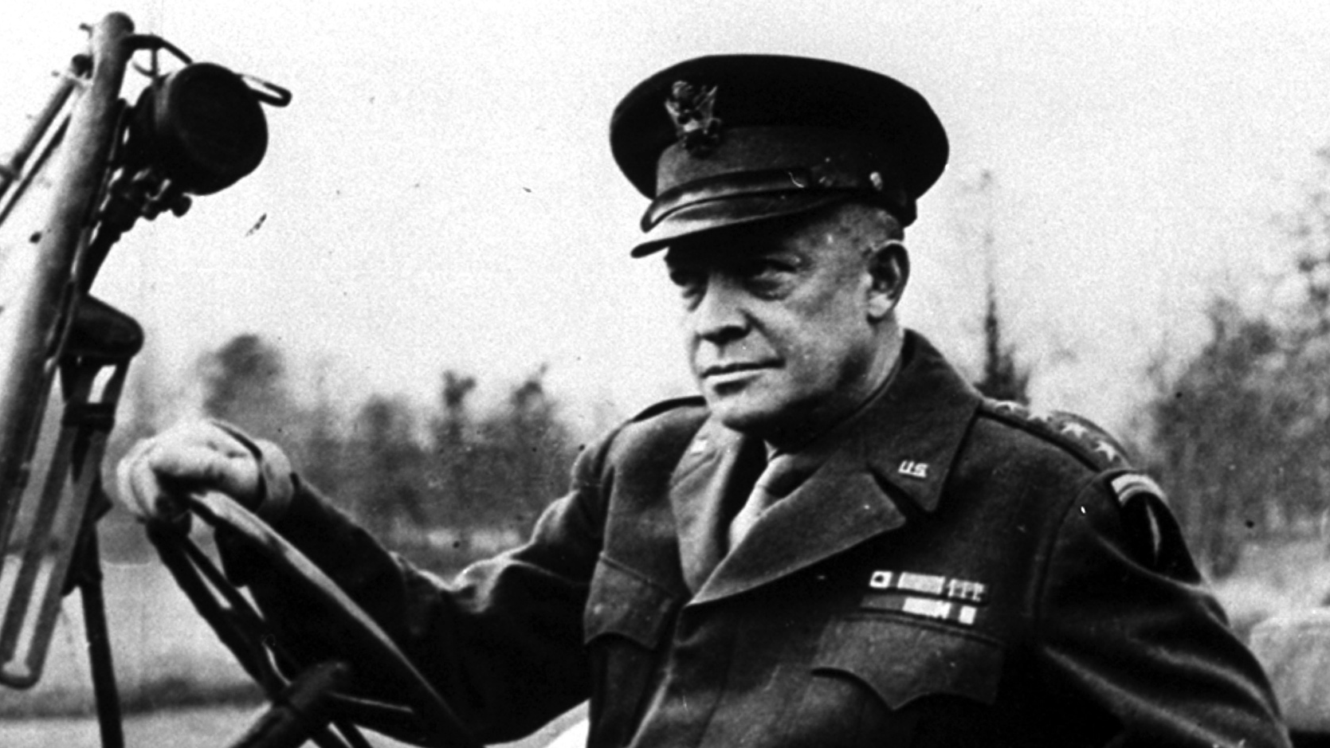
“
Plans are nothing… Planning is everything.”
— Dwight Eisenhower
Notes:
US commander in Europe during WW2 – planned the D day invasion – not only figures below, but had to be a surprise
150,000 troops (24,000 paratroopers) - almost 1M by the end of June
7,000 naval craft, 2,200 aircraft
over 50 miles of coast
Then a president later

Slide 3
Planning is everything.
Why do you think he said that?
Notes:
But he also said that planning is everything, and he said that because planning is a chance for us to be rigorous in thinking through our campaign, and how we can be successful in tackling some of these really challenging problems. A lot of these problems are tough -- if they were easy, someone else would have come along and solved them, right?

Slide 4
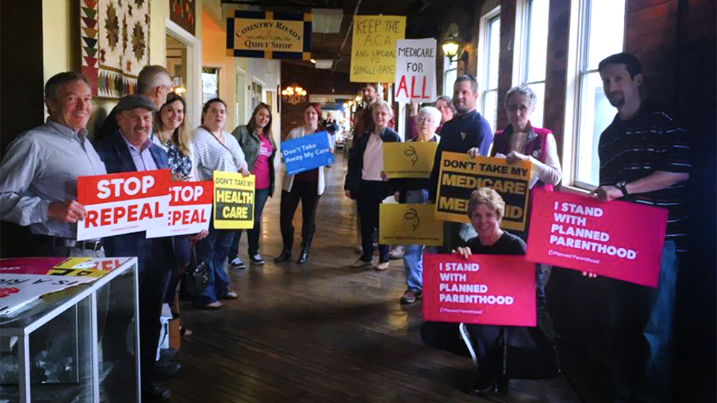
Crafting your
campaign plan
Notes:
Mention -- 1:1s have been wonderful this past week with you -- loved hearing where you are at with your issue
Noticed that a lot of people are wondering, where do I take the next step?

Slide 5

Goals for this session
1
Understand the framework for developing strategic plans, particularly within your local issue campaign.
2
Apply framework to your own campaign plan

Slide 6
Tonight’s
agenda
 | Welcome Goals, Strategy, Tactics framework Campaign plan template Q & A Closing

Slide 7


Guided worksheet

Slide 8
Learning Journey

Slide 9
Our learning journey
Week 1: Introductions; advocacy overview
Week 2: Workshop
Week 3: Foundations of coalition building
Week 4: Workshop
Week 5: Identifying policy

Slide 10
Our learning journey
Week 6: 1:1 with Liz
Week 7: Writing your campaign plan
Week 8: Workshop
Week 9: Running into barriers
Week 10: Closing synthesis and next steps
Notes:
Plan isn’t the point – the planning is the point – the process, the exercise – doing all the work is what prepares you to go into the work of local issue politics
If it feels hard, it is hard

Slide 11
Tonight’s
agenda
 | Welcome Goals, Strategy, Tactics framework Campaign template Q & A Closing

Slide 12
Framework for
strategic planning

Slide 13
Building the framework

Slide 14
Building the framework
First and foremost, your plan needs a unifying vision. This is your reason for being!

Slide 15
Building the framework
First and foremost, your plan needs a unifying vision. This is your reason for being!
The unifying vision isn’t a goal to be achieved in weeks, months, or even years. It is your deepest, most central guiding purpose as an individual.

Slide 16
Building the framework
First and foremost, your plan needs a unifying vision. This is your reason for being!
The unifying vision isn’t a goal to be achieved in weeks, months, or even years. It is your deepest, most central guiding purpose as an individual.
From this vision, we can start building out the individual components of strategic plans.

Slide 17
Building the framework
What are some examples of unifying visions that you’ve seen in other organizations, companies, individuals, or campaigns?

Slide 18
Building the framework
1
A goal.
A strategy.
Tactics.
2
3

Slide 19
Building the framework
1
An achievable, measurable, and problem-solving goal.
A strategy.
Tactics.
2
3

Slide 20
Building the framework
1
An achievable, measurable, and problem-solving goal.
A strategy that provides the roadmap for success.
Tactics.
2
3

Slide 21
Building the framework
1
An achievable, measurable, and problem-solving goal.
A strategy that provides the roadmap for success.
Effective tactics that accomplish your goal through the strategy you’ve developed.
2
3

Slide 22
Montgomery Bus Boycotts
Notes:
https://www.youtube.com/watch?v=FE6Yvy--5aw

Slide 23

Notes:
Goal – end segregation on buses
Strategy – non-violent civil disobedience paired with litigation – bus boycotting
Tactics – get station wagons, have routes to work, talk in churches to recruit

Slide 24
OFA Example
OFA seeks to create a more accessible and participatory democracy.
One of our major campaigns 2017: Prevent repeal of Obamacare
Strategy: Raise up personal stories of people benefitting from Obamacare
Tactics: Press events in target senator’s offices; office visits sharing personal stories; emails to representatives; blog posts sharing volunteer stories
Notes:
One of OFA’s major campaigns last year:
Goal – prevent repeal of Obamacare
Strategy – raise up personal stories
Tactics – press events in target senators districts, office visits telling our stories , emails, blog posts

Slide 25
Now we’ll dive into
each component of
strategic plans

Slide 26
Setting a proper goal
Strategic planning

Slide 27
A goal is a target.
Without one, you’ll never hit the bull’s eye!

Slide 28
Good goals are measurable, realistic, and solve a challenge.
Notes:
It’s okay for a goal to be modest – it’s okay for one council person to recognize a thing, getting a meeting – these are okay (holding an event that you invite people to)
Move your issue forward, you still have the relationships you have built

Slide 29
Quotes on goals
“Be stubborn about your goals, and flexible about your methods.”
“Success is not built on success. It’s built on failure. It’s built on frustration. Sometimes it’s built on catastrophe.”

Slide 30
Developing a strategy
Strategic planning

Slide 31
What is a strategy?

Slide 32
A strategy is the roadmap to success and answers the question: How we will achieve our goal?

Slide 33
What is a tactic?

Slide 34
Tactics are the actions you take to get you to your goal. They always follow the roadmap laid out by your strategy.

Slide 35
Muhammad Ali vs. George Foreman
Defining Goal, Strategy, Tactics

Slide 36
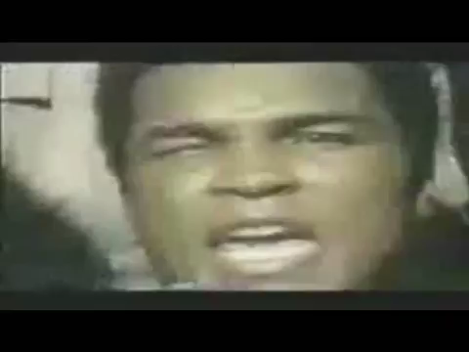
Notes:
Goal – in boxing – win
Strategy – was to tie George Forman out
Tactics – play defensive – box defensively, take punishment to tire him out

Slide 37
Goal, strategy, tactics

Slide 38
Goal, strategy, tactics
1
What was Muhammad Ali’s goal in this fight?

Slide 39
Goal, strategy, tactics
1
What was Muhammad Ali’s goal in this fight?
What was his strategy?
2

Slide 40
Goal, strategy, tactics
1
What was Muhammad Ali’s goal in this fight?
What was his strategy?
What were his tactics?
2
3

Slide 41
Goal, strategy, tactics
1
What was Muhammad Ali’s goal in this fight?
What was his strategy?
What were his tactics?
2
The Rope-A-Dope!
3

Slide 42
Creating a proper strategy

Slide 43
Creating a strategy

Slide 44
Creating a strategy
A proper strategy in a political context should answer three key questions.

Slide 45
Creating a strategy
1
What institution, authorizing authority, or decision maker has the ability to enact the change you wish to see?

Slide 46
Creating a strategy
1
What institution, authorizing authority, or decision maker has the ability to enact the change you wish to see?
On which decision makers, core constituencies, people will you focus your influence?
2

Slide 47
Creating a strategy
1
What institution, authorizing authority, or decision maker has the ability to enact the change you wish to see?
On which decision makers, core constituencies, people will you focus your influence?
What is your message, and how will you communicate that in order to motivate these decision makers, constituencies, or people to action?
2
3

Slide 48
To enact change and achieve our goals we need to influence decision-makers.

Slide 49
To motivate these decision makers to action, we need messaging that resonates with their self-interest.

Slide 50
Politicians have certain motivations
What motivates this type of decision maker?

Slide 51
Politicians have certain motivations
Reelection
Their legacy
Finances
Future of the institution
Constituent base

Slide 52
Voters have certain motivations
What motivates this type of decision maker?

Slide 53
Political organizations have certain motivations
What motivates this type of decision maker?

Slide 54
Some key takeaways…

Slide 55
Does my strategy align
with my goal?

Slide 56
Could we realistically
reach the goal through
this strategy?
Notes:
Plausible, but not guaranteed

Slide 57
Can I explain how the
chosen strategy will lead to
the determined goal?

Slide 58
Any questions on strategy?

Slide 59
Tackling tactics
Strategic planning

Slide 60
Tactics are the actions you take to get you to your goal. They always follow the roadmap laid out by your strategy.
Notes:
Example of one that does not follow the roadmap laid out by your strategy – make specific
If your strategy is trying to show your decision maker there is support in the community, doing a highly pressure event will not lead you to your goal

Slide 61
Effective tactics share two traits
Effective Tactic
Supports Strategy
Worthwhile Use Of Resources
=
+
Common pitfalls:
“It’ll work because we’re right”
Tactic is strong, but target doesn’t notice
Tactic gets on target’s radar but doesn’t support strategy or motivate them
Tactic distracts from overall strategy
Notes:
There are two major elements to an effective tactic…
For example
-- presenting target with a white paper refuting their public statements and correcting their errors
-- volunteers rally outside reps office, but nobody takes pictures or uses social media
-- unfurling a big banner from a bridge getting press

Slide 62
Examples of tactics
1
Television ads
Press conferences & rallies
Town halls & forums
Office visits & phone calls
Social media
6
Earned media events
Distributing printed literature
Community engagement events
Public speeches
Training & education
2
7
3
8
4
9
5
10

Slide 63
The tactics we choose
are part of the
issue ecosystem

Slide 64







An issue ecosystem is the environment
surrounding a decision maker.
Notes:
Elected officials and other decision makers are constantly surrounded by messages from people asking them to take one stand or another on an issue. They receive these messages through a variety of mediums and from a variety of voices.
Decision makers are surrounded by many issue ecosystems every day. If you and your partner organizations are not part of an issue ecosystem around a decision maker, the opposition is filling that space with their message or the issue is not on the target’s radar.

Slide 65
Our goal:
To create the conditions for decision makers to take action on the issue we care about.

Slide 66
One tactic alone
does not persuade a decision maker.
Notes:
We can’t just count on one of these methods of communicating to our elected officials if we are going to create an effective issue ecosystem. It can’t be JUST Letters to the Editor in the local newspaper, or JUST Facebook comments. It has to be a combination of things that keep popping up onto the elected official’s radar on an ongoing basis.

Slide 67
It takes a combination
of strategically-planned tactics to ensure your message is heard.
Notes:
As an OFA volunteer, you are going to contribute to the ecosystem. You can’t create the whole ecosystem on your own – it’s going to take a whole coalition of folks to do that. But you will contribute to the issue ecosystem around a Decision Maker.

Slide 68
Tonight’s
agenda
 | Welcome Goals, Strategy, Tactics framework Campaign template Q & A Closing

Slide 69
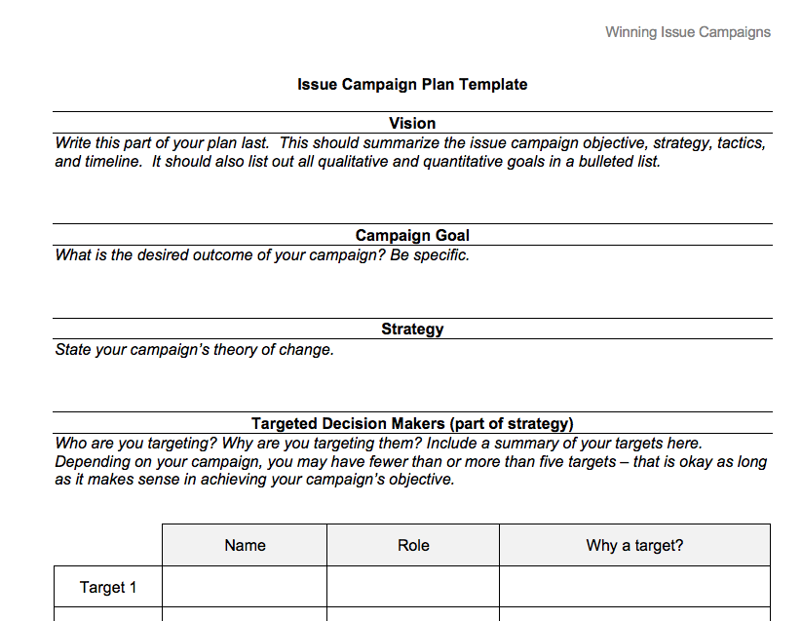

Slide 70
Tonight’s
agenda
 | Welcome Goals, Strategy, Tactics framework Campaign template Q & A Closing

Slide 71
Q&A with
Jack Shapiro

Slide 72
Tonight’s
agenda
 | Welcome Goals, Strategy, Tactics framework Campaign template Q & A Closing

Slide 73

Debrief
What are you taking away from tonight’s call?
What would be helpful for the next call?

Slide 74


Logistics
Survey
Homework- Sent in email
A recording of this call will be
available later this week; recap sent out Thursday
Email and tweet!

Slide 75
Homework

Slide 76
Next session
Notes:
Put in homework link – where they should put the answers to their work (slack?)
Give google drive link

Slide 77
Thank you for joining
today’s webinar.
Please fill out the survey below and give us
your feedback on today’s training.
http://bit.ly/campaignLIA

