Slide 1
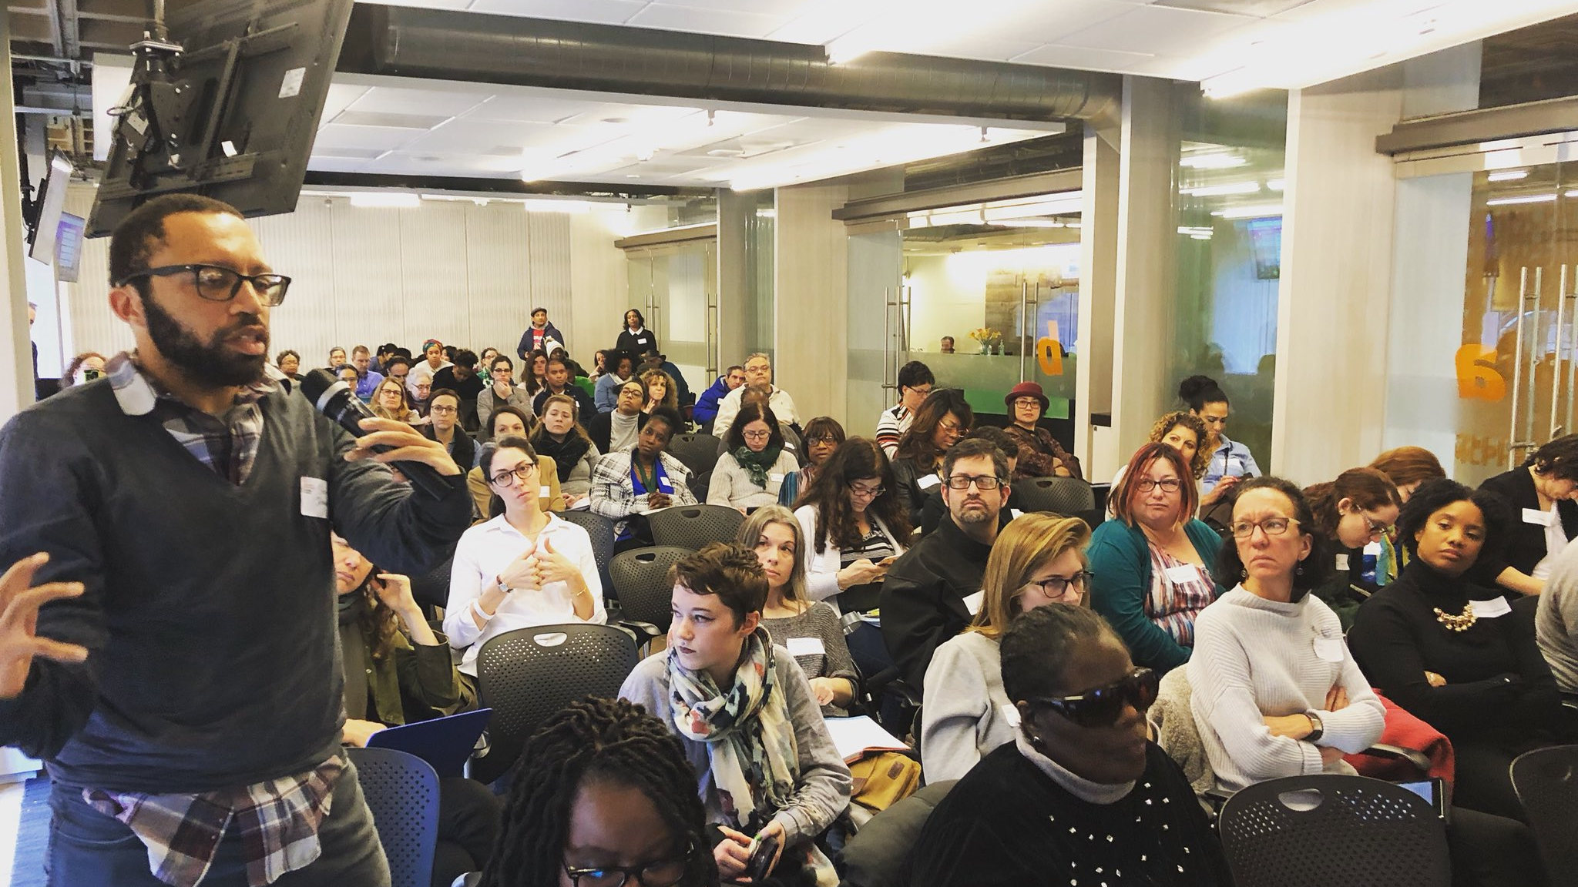


Local Issue Advocacy
Elizabeth Erickson / OFA Training Director
We will begin the training at 8:30 p.m. ET / 7:30 p.m. CT
Notes:
This work is licensed under the Creative Commons Attribution-NonCommercial 4.0 International License. To view a copy of this license, visit http://creativecommons.org/licenses/by-nc/4.0/ or send a letter to Creative Commons, PO Box 1866, Mountain View, CA 94042, USA
Liz
Welcome to the training

Slide 2
“We cannot tell what may happen in this strange medley of life. But we can decide what happens in us- how we can take it, and what we can do with it – and that is what counts in the end.”
JOSEPH FORT NEWTON
Notes:
American Baptist minister in the late 1880s

Slide 3
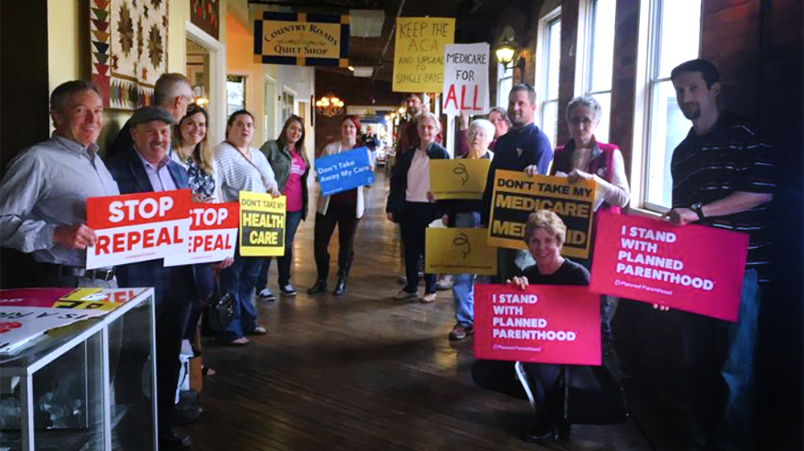
Persevering through
barriers

Slide 4

Identify common barriers local issue advocates run into during the course of their campaign
Analyze best practices for overcoming those barriers
Apply best practices to an example case study issue campaign plan
Goals for
this session
1
2
3

Slide 5


Guided worksheet

Slide 6
Tonight’s
agenda
 | Welcome Common challenges From the mouths of volunteers Case study Closing

Slide 7
Learning Journey

Slide 8
Our learning journey
Week 1: Introductions; advocacy overview
Week 2: Workshop
Week 3: Foundations of coalition building
Week 4: Workshop
Week 5: Identifying the policy landscape

Slide 9
Our learning journey
Week 6: Workshop
Week 7: Writing your campaign plan
Week 8: Workshop
Week 9: Persevering through barriers
Week 10: Closing synthesis and next steps

Slide 10
ANNOTATE THIS SLIDE

Slide 11
Tonight’s
agenda
 | Welcome Common challenges From the mouths of volunteers Case study Closing

Slide 12
CHALLENGE #1
Territorialism
Notes:
Examples of Chicago (south side), campus organizing in Kansas
There is a lot underneath this – fear of lack of relevance, fear of lack of wisdom of new people that are coming in

Slide 13
 | Emotional intelligence (Goleman) Knowing the interests of the group (Alinksy) Stay involved in the long game Choose your battles Establish your reputation for the long-term organizing work Keep asking until a group disagrees with you
Antidotes
Notes:
Emotional intelligence – talking to people at a values level, importance of analyzing what is underneath
– Alinksy – what are their interests? What motivates them? Agenda, speaking 1st

Slide 14
Components of EQ
 | Self-Awareness Self-Regulation Social skills Empathy Motivation

Slide 15
THE PROCESS OF EMOTIONAL AGILITY:
Step 1: Show up

Slide 16
Show up
Don’t run!—Face emotions and behaviors willingly
Be curious as to what you’re feeling and thinking
Learn to work with your thoughts
Recognize your patterns—know when you’re rigid or have repetitive thinking

Slide 17
THE PROCESS OF EMOTIONAL AGILITY:
Step 2: Step-out

Slide 18
Step-out
Become an anthropologist – detach from your thoughts and emotions
Name the emotion and the thoughts it is causing you to have
Recognize your emotion as “critical data”—recognize that it may not be leading you to the right conclusion

Slide 19
THE PROCESS OF EMOTIONAL AGILITY:
Step 3: Walk Your Why

Slide 20
Walk your why
Focus on your core values and most important goals by asking these questions:
  Is my response going to serve me and my organization in the long-term as well as short- term?

Slide 21
Walk your why
Focus on your core values and most important goals by asking these questions:
  Will it help me steer others in a direction that furthers our collective purpose?

Slide 22
Walk your why
Focus on your core values and most important goals by asking these questions:
  Am I taking a step toward being the leader I most want to be and living the life I most want to live?

Slide 23
THE PROCESS OF EMOTIONAL AGILITY:
Step 4: Make tweaks, Move on

Slide 24
CHALLENGE #2
What to do when your issue is not being discussed

Slide 25
 | Patience Political community is often small Persistence Planning and preparation
Antidotes
Notes:
Patience -- people talk about certain things for a reason, don’t talk about certain things for a reason
Political community might be small -- alderman might be the same for the past 20 years
Be persistent and be patient
Planning and preparation -- take advantage when opportunity arises (scott pruitt example, new council person, someone resigns (Leading advocate against the EPA agenda, claimed there is no evidence for climate change.. Climate activists had planned for a long time what to do with his credibility when the moment came)

Slide 26
CHALLENGE #3
Measuring success

Slide 27
 | Goal Strategy Tactics
Antidotes
Notes:
Goal -- could be developing a coalition, group attendance, engagement
Strategy to get decision makers on board
Tactics: Build relationships with decision makers, hold redistricting trainings

Slide 28
What challenge are you running into?
Territorialism
Issue not addressed
Hard to measure success

Slide 29
Tonight’s
agenda
 | Welcome Common challenges From the mouths of volunteers Case study Closing

Slide 30
“Use your strengths”
Martha Clark
Notes:
What strengths OFA brings? Trainings

Slide 31
“Have recurring
running meetings”
James Page
Notes:
What do not know? Who does that make you want to connect with?

Slide 32
“Document your progress”
Kyoko Takayama

Slide 33
“Checklist of tools”
Paul Geenen
Notes:
Sign in sheet, OFA flyer, template for petitions, business cards for leads, using facebook and twitter to share information

Slide 34
Best practices
  Accentuate the positive
  Live by your values
  Plan for small wins
  Look for the good in others
  Be creative
  Be persistent and patient

Slide 35
Questions or additions?

Slide 36
Tonight’s
agenda
 | Welcome Common challenges From the mouths of volunteers Case study Closing

Slide 37
Case study
http://bit.ly/casestudyLIA
Reading time!
Notes:
https://docs.google.com/document/d/1PjNO02v5C1Ko6jJImw_9IXYFteA6DlUgZssJHU2DhRE/edit

Slide 38
Bit.ly/casestudyLIA

Slide 39
Case study
Taking everything we have learned, if you were coaching Carol, what is THE THING she should focus on?

Slide 40
Keep in mind
1
Issue statement
Building coalitions
Identifying the policy landscape
Campaign planning – goal, strategy, tactics
Emotional intelligence & perseverance
2
3
4
5

Slide 41
Group share

Slide 42
Tonight’s
agenda
 | Welcome Common challenges From the mouths of volunteers Case study Closing

Slide 43

Debrief
What are you taking away from tonight’s call?
What would be helpful for the final call?

Slide 44



Logistics
Campaign plan, sending next steps
A recording of this call will be
available later this week; recap sent out Thursday
Email and tweet!

Slide 45
Next session
Notes:
Final session!

Slide 46
Thank you for joining
tonight’s webinar!

