Slide 1
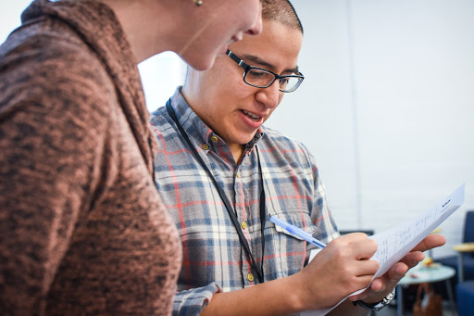


WORKSHOP SESSION
Local Issue Advocacy
Elizabeth Erickson / OFA Training Director
We will begin the training at 8:30 p.m. ET / 5:30 p.m. PT
Notes:
This work is licensed under the Creative Commons Attribution-NonCommercial 4.0 International License. To view a copy of this license, visit http://creativecommons.org/licenses/by-nc/4.0/ or send a letter to Creative Commons, PO Box 1866, Mountain View, CA 94042, USA
Express appreciation for joining

Slide 2
“The great social justice changes in our country have happened when people came together, organized, and took direct action. It is this right that sustains and nurtures our democracy today.”
DOLORES HUERTA
Notes:
American labor leader and civil rights activist, co-founder of national farmworkers association (later UFW

Slide 3

2 minutes
Last week, we worked on our campaign plan.
Have any questions come up for you that you would like to ask Jack for our Q&A?
Opening
Notes:
Type answers into the chat box

Slide 4


Guided worksheet

Slide 5
Our learning journey
Week 1: Introductions; advocacy overview
Week 2: Workshop
Week 3: Foundations of coalition building
Week 4: Workshop
Week 5: Identifying legislation

Slide 6
Our learning journey
Week 6: Workshop
Week 7: Writing your campaign plan
Week 8: Workshop
Week 9: Running into barriers
Week 10: Closing synthesis and next steps

Slide 7
Assess where you are in your campaign planning process
Identify weak areas of your plan
Get feedback on the next steps of your plan
Feel a sense of community with the group.
Goal for
this session
1
2
3
4

Slide 8
Tonight’s
agenda
 | Opening Review campaign plan content Q & A with Jack Workshop modeling Workshop groups Closing

Slide 9
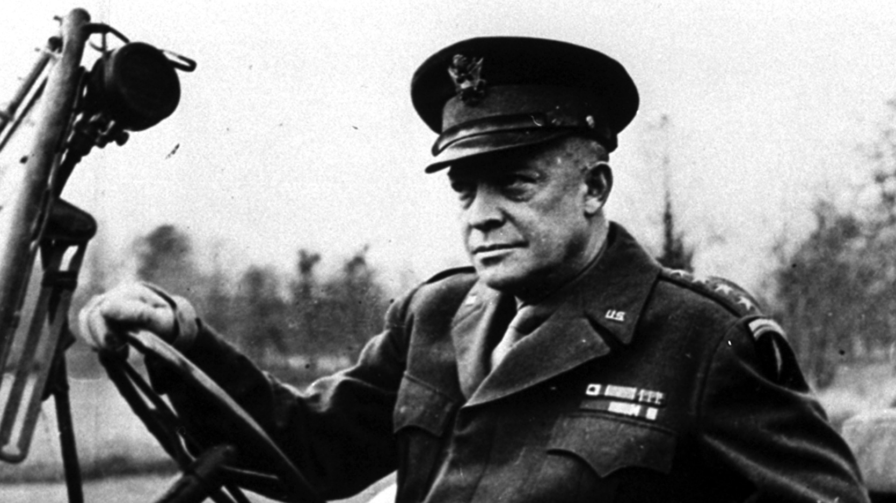
“
Plans are nothing… Planning is everything.”
— Dwight Eisenhower
Notes:
US commander in Europe during WW2 – planned the D day invasion – not only figures below, but had to be a surprise
150,000 troops (24,000 paratroopers) - almost 1M by the end of June
7,000 naval craft, 2,200 aircraft
over 50 miles of coast
Then a president later

Slide 10
Building the framework
1
A goal.
A strategy.
Tactics.
2
3

Slide 11
Building the framework
1
An achievable, measurable, and problem-solving goal.
A strategy.
Tactics.
2
3

Slide 12
Building the framework
1
An achievable, measurable, and problem-solving goal.
A strategy that provides the roadmap for success.
Tactics.
2
3

Slide 13
Building the framework
1
An achievable, measurable, and problem-solving goal.
A strategy that provides the roadmap for success.
Effective tactics that accomplish your goal through the strategy you’ve developed.
2
3

Slide 14
Good goals are measurable, realistic, and solve a challenge.
Notes:
It’s okay for a goal to be modest – it’s okay for one council person to recognize a thing, getting a meeting – these are okay (holding an event that you invite people to)
Move your issue forward, you still have the relationships you have built

Slide 15
A strategy is the roadmap to success and answers the question: How we will achieve our goal?

Slide 16
Tactics are the actions you take to get you to your goal. They always follow the roadmap laid out by your strategy.

Slide 17
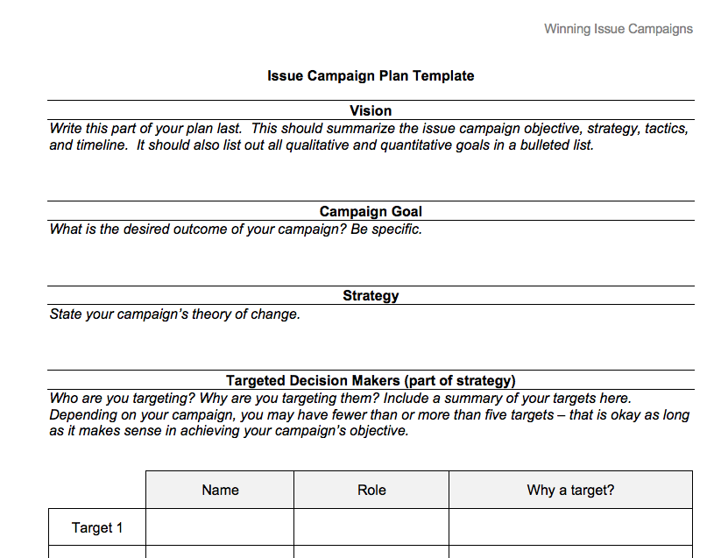

Slide 18
Reflection
1
What part of writing your campaign plan has been difficult?
Where is your campaign plan strong?
What questions do you have?
2
3

Slide 19
Tonight’s
agenda
 | Opening Review campaign plan content Q & A with Jack Workshop modeling Workshop groups Closing

Slide 20
Q&A with
Jack Shapiro

Slide 21
Tonight’s
agenda
 | Opening Review campaign plan content Q & A with Jack Workshop modeling Workshop groups Closing

Slide 22
A tapestry of connections

Slide 23
Group norms

Slide 24
Norm 1:
Develop an ethic of sharing.

Slide 25
Norm 2:
It’s okay to question. Asking
for why; asking for evidence; receive feedback in kind.

Slide 26
Norm 3:
No one is above critique,
no one is below dignity.

Slide 27
Norm 4:
Respect, Empower, Include.

Slide 28
Norm 5:
Step up; step back.

Slide 29
Tonight’s
agenda
 | Opening Review campaign plan content Q & A with Jack Workshop modeling Workshop groups Closing

Slide 30
20 minutes
Groups of three
Decide who is person A, B, C
Person A: Share your goal, strategy, and tactics for your campaign plan, and area that has been difficult
Person B & C: 1 affirmation, 1 question
Group Protocol

Slide 31
Group share

Slide 32
Tonight’s
agenda
 | Opening Review campaign plan content Q & A with Jack Workshop modeling Workshop groups Closing

Slide 33

Debrief
What did I learn today?
What am I leaving committing to
now go, do, understand?

Slide 34




Logistics
Survey
Homework- Options
A recording of this call will be
available later this week; recap sent out Thursday
Email and tweet!

Slide 35
Homework

Slide 36
Next session

Slide 37
Thank you for joining
today’s webinar.
Please fill out the survey below and give us
your feedback on today’s training.
http://bit.ly/campaignLIA
Notes:
Express appreciation, thank them for joining; express importance of joining each time

