Slide 1
Choosing Advocacy Tactics
Notes:
This work is licensed under the Creative Commons Attribution-NonCommercial 4.0 International License. To view a copy of this license, visit http://creativecommons.org/licenses/by-nc/4.0/ or send a letter to Creative Commons, PO Box 1866, Mountain View, CA 94042, USA

Slide 2
Goals for
this session
Understand what an issue ecosystem is and how it drives an issue campaign
1
2
Be able to identify what kind of actions motivate elected officials to take certain stances on issues
3
Feel confident choosing effective tactics to encourage elected officials to take the action you want to see

Slide 3
Agenda
for this
session
Issue Ecosystem 101
Persuading Elected Officials
Choosing Effective Tactics
Debrief

Slide 4
An issue ecosystem is the environment
surrounding a decision maker.
Notes:
Elected officials and other decision makers are constantly surrounded by messages from people asking them to take one stand or another on an issue. They receive these messages through a variety of mediums and from a variety of voices.
Decision makers are surrounded by many issue ecosystems every day. If you and your partner organizations are not part of an issue ecosystem around a decision maker, the opposition is filling that space with their message or the issue is not on the target’s radar.

Slide 5
Our goal:
To create the conditions for decision makers to take action on the issue we care about.
Notes:
To achieve our goal, we must have the right combination of tactics, voices, and messages to make a decision maker take action on the issue we care about

Slide 6
Conditions for a healthy
issue Ecosystem
Variety of
tactics
Variety of
voices
Appealing
messages

Slide 7
Using multiple tactics—press, digital, and in-person—ensures that your message is heard by the decision maker and shows him or her that people who care about your issue are everywhere. Tactics that are strategically spaced on a calendar keep the issue popping on the decision maker’s radar.
Variety of
tactics

Slide 8
Multiple groups working on an issue shows more support for that issue and each organization contributes its unique voice to the conversation on the issue.
Variety of
voices

Slide 9
All decision makers are motivated by something. It is the job of you and your partner organizations to figure out what that motivation is and how to appeal to it.
Appealing
Messages

Slide 10
Agenda
for this
session
Issue Ecosystem 101
Persuading Elected Officials
Choosing Effective Tactics
Debrief
Notes:
Now that we know the basics of what an issue ecosystem is, let’s dig in on how to operate within one to maximize our chances for elected officials taking the action we want them to take

Slide 11
We need elected officials
to vote our way.
Notes:
We need elected officials to vote in certain ways in order to enact the right policy.
This goes for any level of government– from members of Congress down to city councils
As such, we need to treat certain elected officials as persuadable voters-– but first we need to win their support

Slide 12
We need elected officials
to vote our way.
What motivates them?
Notes:
We have to appeal to their motivations. What might some of their motivations be?
[Lead the participants in a popcorn discussion about what kinds of things elected officials might be motivated by. Write their ideas in a list on butcher paper/white board at the front of the room. Steer them in the right direction. Below are a few ideas of the kind of track they should be on:
Desire to be in the mainstream
Desire to be liked by constituents
Desire to hold higher office
Desire to stand up for strongly held beliefs.]
These are all great ideas. Now, imagine I’m a state senator and I am particularly motivated by [use an idea from the board], what do I need to be convinced of in order to take the stance you want me to take?
[Ask participants for their ideas on this, and take a few comments before revealing the answer. Acknowledge those who were on the right track.]
That’s right – I need to be convinced that taking the stance you want me to take can actually give me that thing that I want.
And an effective issue campaign is going to create a bunch of different avenues for communicating that point to me.

Slide 13
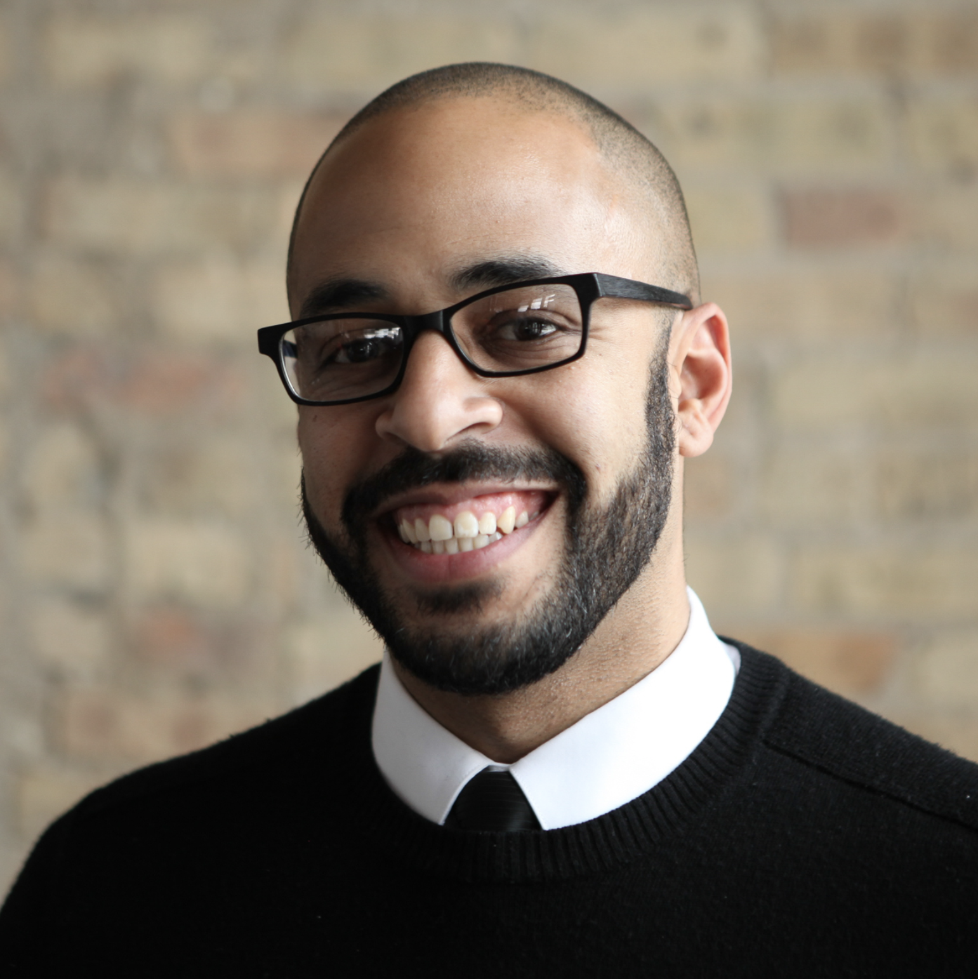
Meet State Senator David Mendez
Moderate
No previous public statements
Pro-business
Positive, mainstream image in the state
Represents high share of independents
Notes:
In order to demonstrate this, I want you to visualize something with me. Imagine I’m a state senator, and I serve in a state that is often mocked nationally as “backward,” which a number of national businesses have threatened to boycott.
There is a bill on marriage equality coming up for a vote in the state legislature.
[Animation cue] I’m a moderate state senator, and
[Animation cue] I’ve never made any public statements on this topic.
[Animation cue] I also ran as a pro-business candidate, and I promised to work hard to restore my state’s positive image,
[Animation cue] In order to attract businesses and tourism.
[Animation cue] I also serve a district that is made up of 45% Republicans, 40% Democrats, and 15% Independents.

Slide 14
Letters to the Editor
“Marriage equality will put our state on the right side of history”
Notes:
The day before the vote, I wake up in the morning and read the newspaper. There, I see a Letter to the Editor titled “Senator Mandez, Marriage Equality will put our state on the right side of history,” where the writer identifies herself as an Independent voter from my district.

Slide 15
Calls to the office regarding marriage equality
184 support
61 against
Notes:
Then, he goes into his office, where he gets a morning briefing from his staff. In that briefing, they tell him that yesterday, our office got 245 calls from constituents, with 184 of them in support of marriage equality.

Slide 16
Social media
Flooded Facebook with comments
56 @mentions on twitter
187 emails
Notes:
They also tell me that my Facebook page has been flooded by comments urging me to vote yes on the bill because it will help my state’s economy, with no “anti” comments. I’ve also received 56 @mentions on twitter about the topic, with 48 of them showing a picture of me arm in arm with a very conservative state senator who frequently makes national news for backwards and regressive remarks, asking if I will side with him or with the people.
equality.

Slide 17
Rallies outside of office
Message: “we want equality! It’s good for the economy!”
Notes:
Then, I leave my office to go to a meeting with a constituent group, and as I’m leaving, I see about a dozen demonstrators outside my office chanting “We want equality, it’s good for the economy!” and there is a local news van pulling up to the curb.

Slide 18
Earned media events
“Passing marriage equality will
bring jobs to our state and help my business, so I hope State Senator Mendez supports it”
-Small Business Owner
Notes:
And then that night when I go home, I see this group in the background on the nightly news. In the foreground, there’s a local business owner giving an interview, citing a statistic that passing marriage equality would bring jobs to my state and that is why he hopes I will vote yes on the bill.

Slide 19
We put issues on elected
leaders’ radar.
Notes:
Ashley
So throughout my day, I have taken in all this data that tells me independent voters support marriage equality, that the majority of my constituents want me to support marriage equality, that marriage equality will help local businesses and the economy, and that the best thing I can do to maintain my image as a mainstream, pro-business moderate is to support it.
I’d like to pose a question to you: HOW did that information make it onto my radar? [Call on a few participants to share their thoughts.]
That’s right – it didn’t happen on accident. It came onto my radar because of the issue organizers out there who worked really hard to make sure that the slice of reality I am experiencing throughout my day actually MATCHES with that bigger picture reality of my district. If the issue organizers in support of marriage equality had stayed quiet, then the issue organizers AGAINST marriage equality would have filled that space with deceptive messages to convince me the best thing I can do to maintain my image as a mainstream, pro-business moderate is to vote against it.
Ecosystem metaphor: We call that slice of reality surrounding an elected official an “ecosystem.” It’s all about creating the conditions for the outcome that you want. So if you think about a fruit tree as an example: a tree needs a lot of different conditions to line up in order for it to grow and produce a fruit. It needs the right amount of sunlight and water, and needs the right kind of nutrients in the soil – and it needs all of those things in tandem with one another. Even if it gets PLENTY of water, but no sunlight and the wrong soil, it won’t grow. Even if that water was the best, most perfectly pH balanced water out there.
Similarly, we can’t just count on one of these methods of communicating to our elected officials if we are going to create an effective issue ecosystem. It can’t be JUST Letters to the Editor in the local newspaper, or JUST Facebook comments. It has to be a combination of things that keep popping up onto the elected official’s radar on an ongoing basis.
As an OFA volunteer, you are going to contribute to the ecosystem. You can’t create the whole ecosystem on your own – it’s going to take a whole coalition of folks to do that. But you will contribute to the issue ecosystem around a Decision Maker.
We will talk a lot more about that later, but for now, let’s talk more about what these different methods are for communicating to your elected official.

Slide 20
One tactic alone
does not persuade
a decision maker.

Slide 21
It takes a combination
of strategically-planned tactics to ensure your message is heard.

Slide 22
Agenda
for this
session
Issue Ecosystem 101
Persuading Elected Officials
Choosing Effective Tactics
Debrief

Slide 23
Communicating with
an elected official
Press
Online
Directly
Notes:
Through the press,
Online,
And Directly.
In organizing, any time we set out to communicate with an elected official via one of these methods, we call it an action.
In the example I shared before, what were some of the ways I was reached via the press?
[Call on participants to share their thoughts and write answers on the board. Answers should include LTE and Nightly News.]
What were some of the ways I was reached online?
[Call on participants to share their thoughts and write answers on the board. Answers should include Facebook and Twitter]
What were some of the ways I was reached directly?
[Call on participants to share their thoughts and write answers on the board. Answers should include the Phone Calls and Demonstrators Outside My Office]

Slide 24
Influencing Sen. Mendez
If you were hosting an Earned Media event to convince State Sen. Mendez to support this issue, what would it look like? How would it attract the press? How would it persuade him?
Note: for this example, you cannot
host the event anywhere he can see
it in person.
Moderate
No previous public statements
Pro-business
Positive, mainstream image in the state
Represents high share of independents
Notes:
Think again about the basics I shared about myself as an imaginary state senator.
Now imagine you’d like to get a story published in the local news that convinces me to support this issue. You’ll want to host something we call an Earned Media event. We call it earned media because you are getting media coverage for free on the news – as opposed to paying for an advertisement. The way you “earn” news coverage is by doing something so noteworthy that news outlets actually WANT to do a story on it.
What kind of event can you hold that would get the attention of the press AND get my attention as your elected official? For this example, imagine you cannot host your event anywhere where I will see it in person.
You have five minutes to come up with some ideas, and then report back.
[If your group is five or fewer people, allow the whole group to work together. If it is more than five people, split people up into small groups of no more than five people each.]
[After five minutes have passed, ask each group to describe the earned media events they would plan. Write key notes on the board/butcher paper.]

Slide 25
Influencing Sen. Mendez
Now imagine I can’t see your event in person, and there is no news outlet anywhere near you, so you can’t gain my attention via earned media.
What is your event like?
Moderate
No previous public statements
Pro-business
Positive, mainstream image in the state
Represents high share of independents
Notes:
Okay great – now imagine you’d like to get my attention, but there’s no way I will see your event in person, AND there is no news outlet anywhere near you, so you don’t have the method of Earned Media to get me to hear your voice. What do you do then?
[Give the group five minutes to work on their ideas.]
[After five minutes have passed, ask each group to describe what they would do. Write key notes on the board/butcher paper.
These are all great ideas – and it’s okay if it was difficult.

Slide 26
Agenda
for this
session
Issue Ecosystem 101
Persuading Elected Officials
Choosing Effective Tactics
Debrief

Slide 27
Goals
Debrief
1
Understand what an issue ecosystem is and how it drives an issue campaign
What was your biggest “aha” moment?
2
Be able to identify what kind of actions motivate elected officials to take certain stances on issues
Why do you think this is important?
Feel confident choosing effective tactics to encourage elected officials to take the action you want to see
What is the next thing you’d like to do as part of an issue ecosystem?
3
Notes:
On the left side of this slide you’ll see the goals we set out to accomplish at the beginning of this session.
I would just love to hear some of your thoughts and key takeaways
First of all, what was your biggest “aha” moment? Who would like to share?
[Call on 1-2 people]
Secondly, why do you think this is important?
[Call on 1-2 people]
And finally, what is the next thing you’d like to know in order to decide which part of the ecosystem you want to focus on this season?
[Call on 1-2 people.]

Slide 28
Goals
Key takeaways
1
Understand what an issue ecosystem is and how it drives an issue campaign
An issue ecosystem is the slice of reality surrounding an elected official and must persuade him/her to take a stance on the issue
2
Be able to identify what kind of actions motivate elected officials to take certain stances on issues
An effective action appeals to an elected official’s motivations, either through the press, online, or directly
3
Feel confident choosing effective tactics to encourage elected officials to take the action you want to see
We have prepared action toolkits for you that walk you through how to be effective action takers. Find them at bit.ly/ActionToolkits
Notes:
I hope that if nothing else, you take away the following three things:
First is that an issue ecosystem is the slice of reality surrounding an elected official, and must persuade him/her to take a certain stance on an issue.
Secondly, an effective action appeals to an elected official’s motivations either through the press, online, or directly.
And finally, this is only the beginning of your learning journey around the issue ecosystem. We have action toolkits that will help us through each step of the process. You can find them at: bit.ly/ActionToolkits (the link is case sensitive)

