Slide 1



OFA 2017 Fall Fellows Leader
Fall 2017
Bobby Brady-Sharp, Training Projects Manager
Notes:
This work is licensed under the Creative Commons Attribution-NonCommercial 4.0 International License. To view a copy of this license, visit http://creativecommons.org/licenses/by-nc/4.0/ or send a letter to Creative Commons, PO Box 1866, Mountain View, CA 94042, USA

Slide 2

Agenda
Intro and announcements
Conflict components
Reframing
Analyzing conflict
Close and HW

Slide 3




Logistics
We will meet for 90 minutes
You will need a pen and paper or means of taking notes
A recording of this call will be
available later this week.
Please tweet -- #OFAFellows

Slide 4
Goals
1
Define conflict and your normal outcomes and processes in dealing with it
Relate conflict to potential conflicts with your fellows and your teams, and reflect on how you will respond to them
Analyze case/studies and videos to increase your understanding of conflict
2
3

Slide 5
Housekeeping items

Slide 6

Defining conflict

Slide 7
Conflict is…
A part of life
Usually uncomfortable
Can be managed in destructive or constructive ways
Is often complex – as in, not black and white

Slide 8
Conflict:
”Exists whenever incompatible activities occur, where one party is interfering, disrupting, obstructing, or in some way making another party’s actions less effective.”
– Morton Deutsch

Slide 9
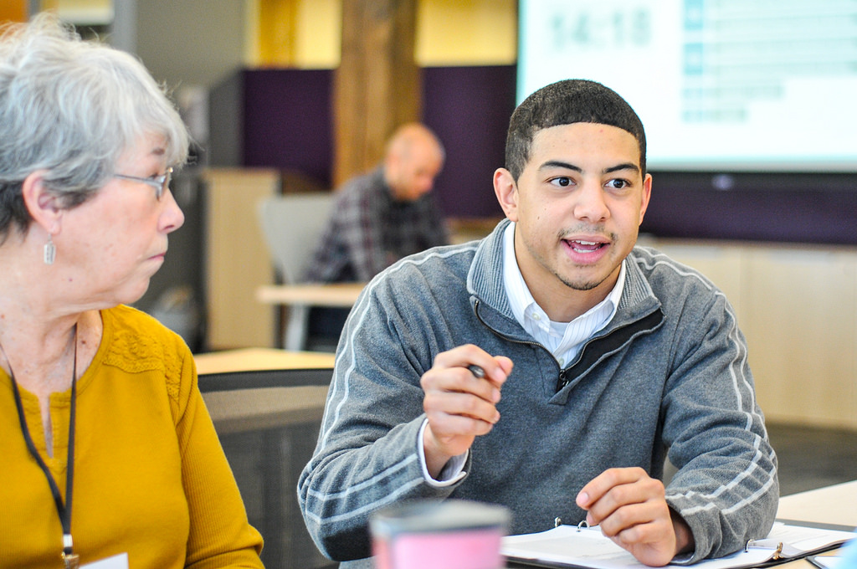
Dual-Concern Model
(Morton Deutsch)

Slide 10
The Dual-Concern model of conflict resolution is concerned with outcomes of a conflict.

Slide 11
Competing
Collaborating
Assertiveness
Compromising
Avoiding
Accommodating
Cooperativeness

Slide 12
Emotional restraint
Emotional expressiveness
Direct
1. Discussion
2. Engagement
Indirect
3. Accommodation
4. Dynamic

Slide 13
Conflict components

Slide 14
Influencing Factor
Worldview (and culture) – Paradigm for interpreting the world.
Situation – Environment, place, time, power dynamics, social context
*Choice Point – What can I do to create an atmosphere conducive to collaboration?

Slide 15
Framing Factors
Position – Demands people make, stances people take (What)
Needs – Underlying reason for the stance (Why)
Reframe– What is the problem really about? (needs)\
Alternatives: creative choices vs. acting out of habit

Slide 16
Reframing conflict—
a basic model

Slide 17
Conflict
A’s position
B’s position
Coaching
Why is this happening?
COMMON GROUND
A’s needs
B’s needs
Directing
Reframing Question:
How can we meet the priority needs of A, while at the same time meet the priority needs of B? What is this conflict REALLY about?

Slide 18
A’s position
B’s position
Coaching

Slide 19
Conflict
A’s position
B’s position
Coaching

Slide 20
Conflict
A’s position
B’s position
Coaching
Why is this happening?
A’s needs
B’s needs
Directing

Slide 21
Conflict
A’s position
B’s position
Coaching
Why is this happening?
COMMON GROUND
A’s needs
B’s needs
Directing

Slide 22
Conflict
A’s position
B’s position
Coaching
Why is this happening?
COMMON GROUND
A’s needs
B’s needs
Directing
Reframing Question:
How can we meet the priority needs of A, while at the same time meet the priority needs of B? What is this conflict REALLY about?

Slide 23
Reframing question:
How can we meet the priority needs of A, while still meeting the priority needs of B?

Slide 24
Reframing questions
Takes time
Creates alternatives and options to resolve the conflict
This an example of not compromising – At a root level, each person has a need for X,Y,Z

Slide 25
In order to effectively reframe the conflict, you will need to ask probing questions.

Slide 26
Probing is critical as a mediator —the goal is to surface underlying needs, feelings, and concerns.

Slide 27
Once you get to the root
of the conflict, a good mediator will align intent and impact of each party through informing the needs.

Slide 28
“So it seems to me that the problem is actually that A has a need for X, and B has a need for Y.”

Slide 29
A CONFLICT RESOLUTION FRAMEWORK:
Beginning

Slide 30
Beginning resolution
Set Context
Build warm climate – are you creating a situation that is good for all parties?
Establish rapport
Identify influencing factors

Slide 31
A CONFLICT RESOLUTION FRAMEWORK:
Middle

Slide 32
Middle
resolution
Identify each parties positions/issues
Probe for underlying concerns, feelings, and need
Push both parties to begin reframing conflict towards their needs
Paraphrase content and feelings being heard

Slide 33
A CONFLICT RESOLUTION FRAMEWORK:
End

Slide 34
End
resolution
Reaffirm reframing of issues to needs level
Creatively and collaboratively brainstorm possibilities to resolve the conflict
Decide on a mutually beneficial agreement

Slide 35
15 minutes
What is the issue?
What are the needs of each person?
What is the reframing question?
What is the informing statement?
Group Discussion of Conflicts

Slide 36


Slide 37
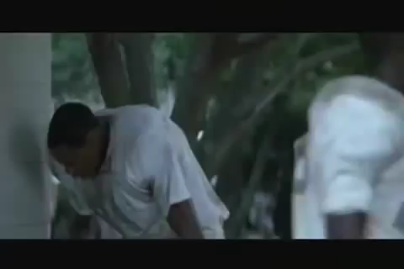

Slide 38
15 minutes
What is the issue?
What are the needs of each person?
What is the reframing question?
What could have been done to avoid this situation?
What is the informing statement?
Breakout
Bit.ly/Conflictstudy2

Slide 39
Key takeaways
1
Conflict just is – it is neither good nor bad

Slide 40
Key takeaways
1
Conflict just is – it is neither good nor bad
Conflict, when unaddressed, will lead to outcomes that could have been averted
2

Slide 41
Key takeaways
1
Conflict just is – it is neither good nor bad
Conflict, when unaddressed, will lead to outcomes that could have been averted
When a conflict arises, you will begin to have tools and resources to resolve and mediate it
2
3

Slide 42
Key takeaways
1
Conflict just is – it is neither good nor bad
Conflict, when unaddressed, will lead to outcomes that could have been averted
When a conflict arises, you will begin to have tools and resources to resolve and mediate it
Conflicts are VERY unlikely to be resolved over email, text, or voicemail. They should be discussed and mediated
2
3
4

Slide 43
OFA Training
Thank you for joining today’s webinar.
Check the your recap email for a copy of the material covered
today, including a video and audio recording of the webinar.
Email fellows@ofa.us with any questions.

