Slide 1
OFA 2017 Fall Fellows Leader
Fall 2017
Bobby Brady-Sharp, Training Projects Manager
Notes:
This work is licensed under the Creative Commons Attribution-NonCommercial 4.0 International License. To view a copy of this license, visit http://creativecommons.org/licenses/by-nc/4.0/ or send a letter to Creative Commons, PO Box 1866, Mountain View, CA 94042, USA

Slide 2
Agenda
Intro and announcements
Dual-Concern Model
Intercultural Conflict Style Inventory
Unmet needs
Close and HW

Slide 3
Logistics
We will meet for 90 minutes
You will need a pen and paper or means of taking notes
A recording of this call will be
available later this week.
Please tweet -- #OFAFellows

Slide 4
Goals
1
Define conflict and your normal outcomes and processes in dealing with it
Relate conflict to potential conflicts with your fellows and your teams, and reflect on how you will respond to them
Analyze case/studies and videos to increase your understanding of conflict
2
3

Slide 5
Housekeeping items

Slide 6
Alexis Conavay
Organizing Coordinator

Slide 7
Defining conflict

Slide 8
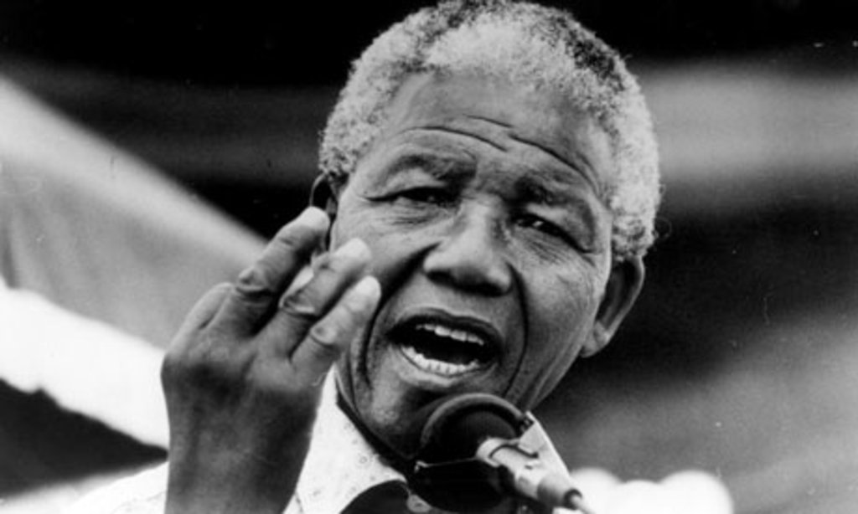
“Never, never and never again shall it be that this beautiful land will again experience the oppression of one by another.”
- Nelson Mandela

Slide 9
“True reconciliation does not consist in merely forgetting the past.”
- Nelson Mandela

Slide 10
Conflict is…
A part of life

Slide 11
Conflict is…
A part of life
Usually uncomfortable

Slide 12
Conflict is…
A part of life
Usually uncomfortable
Can be managed in destructive or constructive ways

Slide 13
Conflict is…
A part of life
Usually uncomfortable
Can be managed in destructive or constructive ways
Is often complex – as in, not black and white

Slide 14
Conflict– ”Exists whenever incompatible activities occur, where one party is interfering, disrupting, obstructing, or in some way making another party’s actions less effective.” – Morton Deutsch

Slide 15
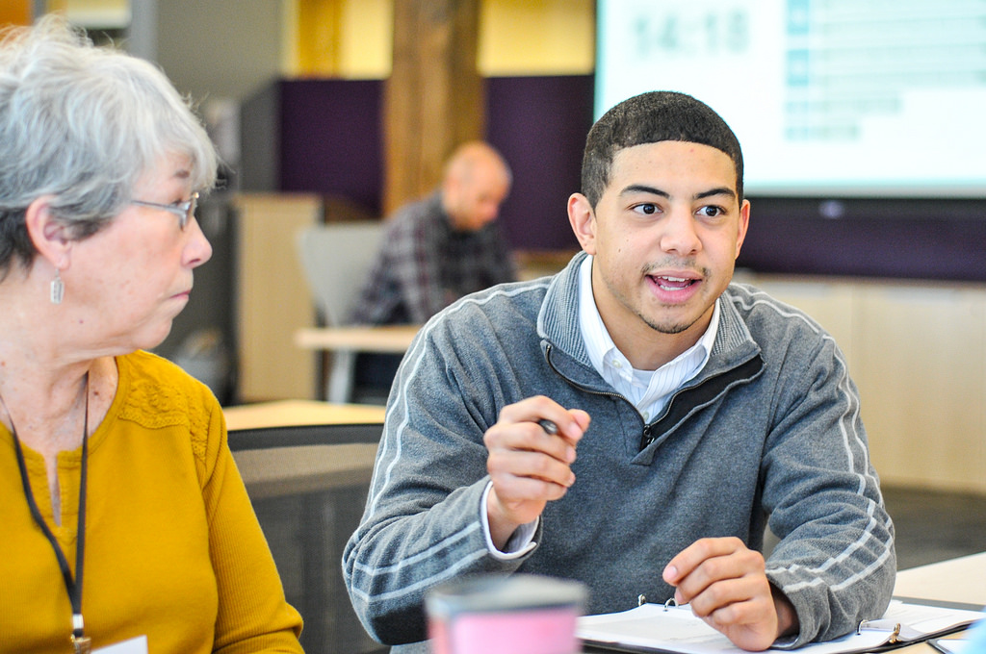
Dual-Concern Model
(Morton Deutsch)

Slide 16
The Dual-Concern model of conflict resolution is concerned with outcomes of a conflict.

Slide 17
Competing
Collaborating
Compromising
Assertiveness
Avoiding
Accommodating
Cooperativeness

Slide 18
Competing
Collaborating
Compromising
Assertiveness
Avoiding
Accommodating
Cooperativeness

Slide 19
Competing
Assertive and Uncooperative
High-concern only to your individual personal goals
“My way or the highway” mentality
Archetype – Pounding fist on the table

Slide 20
Competing
Collaborating
Compromising
Assertiveness
Avoiding
Accommodating
Cooperativeness

Slide 21
Competing
Assertive and Uncooperative
Delaying of conflict resolution
Delegating controversial decisions
Accepting default decisions
Not wanting to hurt anyone’s feelings
Usually a bad default – but can be appropriate in impossible situations
Avoiding
Unassertive and uncooperative

Slide 22
Competing
Collaborating
Compromising
Assertiveness
Avoiding
Accommodating
Cooperativeness

Slide 23
Competing
Assertive and Uncooperative
High concern for other’s goals
Interested in preserving relationship
Described as “yielding”
Avoiding
Unassertive and uncooperative
Accommodating
Unassertive and cooperative

Slide 24
Competing
Collaborating
Compromising
Assertiveness
Avoiding
Accommodating
Cooperativeness

Slide 25
Competing
Assertive and Uncooperative
Intermediate concern for people’s goals and cooperation
Everyone expected to give up something
Good for fixed resources (time)
Mediocre agreement – generally temporary (band-aid fix)
Avoiding
Unassertive and uncooperative
Accommodating
Unassertive and cooperative
Compromising
Intermediate

Slide 26
Competing
Collaborating
Compromising
Assertiveness
Avoiding
Accommodating
Cooperativeness

Slide 27
“Our way”
Takes into account implicit bias and everyone’s needs better than other outcomes
Focus on how to overcome long-term conflict
Important in complex conflicts
Competing
Assertive and Uncooperative
Avoiding
Unassertive and uncooperative
Collaborating
Assertive and cooperative
Accommodating
Unassertive and cooperative
Compromising
Intermediate

Slide 28
10 minutes
Think of a recent conflict – what is the conflict and what was the end result?
Enter them in this google form, but DON’T submit yet.
Breakout: Read, reflect, discuss
Resources:
Definitions:
bit.ly/dualconcern
Form to fill out: bit.ly/conflictleaders

Slide 29
Competing
Collaborating
Compromising
Assertiveness
Avoiding
Accommodating
Cooperativeness

Slide 30
International Conflict Style Inventory (ICS) (Mitchell R. Hammer (2003))

Slide 31
ICS Inventory
Process oriented

Slide 32
ICS Inventory
Process oriented
Culturally dependent

Slide 33
ICS Inventory
Process oriented
Culturally dependent
Designed to help you understand approaches for dealing with conflict when interacting with others

Slide 34
Emotional restraint
Emotional expressiveness
1. Discussion
2. Engagement
Direct
3. Accommodation
4. Dynamic
Indirect

Slide 35
1. Discussion
2. Engagement
3. Accommodation
4. Dynamic
Verbally direct, emotionally restrained

Slide 36
1. Discussion
2. Engagement
3. Accommodation
4. Dynamic
Verbally direct, emotionally restrained
Strengths
Confronts problems
Gives elaborate arguments, maintains calm

Slide 37
1. Discussion
2. Engagement
3. Accommodation
4. Dynamic
Verbally direct, emotionally restrained
Strengths
Confronts problems
Gives elaborate arguments, maintains calm
Weaknesses
Difficulty reading between the lines
Unfeeling

Slide 38
1. Discussion
2. Engagement
3. Accommodation
4. Dynamic
Verbally direct, emotionally restrained
Strengths
Confronts problems
Gives elaborate arguments, maintains calm
Weaknesses
Difficulty reading between the lines
Unfeeling
Verbally direct, emotionally expressive

Slide 39
1. Discussion
2. Engagement
3. Accommodation
4. Dynamic
Verbally direct, emotionally restrained
Strengths
Confronts problems
Gives elaborate arguments, maintains calm
Weaknesses
Difficulty reading between the lines
Unfeeling
Verbally direct, emotionally expressive
Strengths
Provides detailed explanations
Expresses opinion
Shows feeling

Slide 40
1. Discussion
2. Engagement
3. Accommodation
4. Dynamic
Verbally direct, emotionally restrained
Strengths
Confronts problems
Gives elaborate arguments, maintains calm
Weaknesses
Difficulty reading between the lines
Unfeeling
Verbally direct, emotionally expressive
Strengths
Provides detailed explanations
Expresses opinion
Shows feeling
Weaknesses
Appears dominating/rude
Too focused on one’s own feelings

Slide 41
1. Discussion
2. Engagement
3. Accommodation
4. Dynamic
Verbally direct, emotionally restrained
Strengths
Confronts problems
Gives elaborate arguments, maintains calm
Weaknesses
Difficulty reading between the lines
Unfeeling
Verbally direct, emotionally expressive
Strengths
Provides detailed explanations
Expresses opinion
Shows feeling
Weaknesses
Appears dominating/rude
Too focused on one’s own feelings
Verbally indirect, emotionally restrained

Slide 42
1. Discussion
2. Engagement
3. Accommodation
4. Dynamic
Verbally direct, emotionally restrained
Strengths
Confronts problems
Gives elaborate arguments, maintains calm
Weaknesses
Difficulty reading between the lines
Unfeeling
Verbally direct, emotionally expressive
Strengths
Provides detailed explanations
Expresses opinion
Shows feeling
Weaknesses
Appears dominating/rude
Too focused on one’s own feelings
Verbally indirect, emotionally restrained
Strengths
Considers alternatives
Control emotions
Sensitive to feelings

Slide 43
1. Discussion
2. Engagement
3. Accommodation
4. Dynamic
Verbally direct, emotionally restrained
Strengths
Confronts problems
Gives elaborate arguments, maintains calm
Weaknesses
Difficulty reading between the lines
Unfeeling
Verbally direct, emotionally expressive
Strengths
Provides detailed explanations
Expresses opinion
Shows feeling
Weaknesses
Appears dominating/rude
Too focused on one’s own feelings
Verbally indirect, emotionally restrained
Strengths
Considers alternatives
Control emotions
Sensitive to feelings
Weaknesses
Difficulty with one’s own opinion
Seen as dishonest

Slide 44
1. Discussion
2. Engagement
3. Accommodation
4. Dynamic
Verbally direct, emotionally restrained
Strengths
Confronts problems
Gives elaborate arguments, maintains calm
Weaknesses
Difficulty reading between the lines
Unfeeling
Verbally direct, emotionally expressive
Strengths
Provides detailed explanations
Expresses opinion
Shows feeling
Weaknesses
Appears dominating/rude
Too focused on one’s own feelings
Verbally indirect, emotionally restrained
Strengths
Considers alternatives
Control emotions
Sensitive to feelings
Weaknesses
Difficulty with one’s own opinion
Seen as dishonest
Verbally indirect, emotionally expressive

Slide 45
1. Discussion
2. Engagement
3. Accommodation
4. Dynamic
Verbally direct, emotionally restrained
Strengths
Confronts problems
Gives elaborate arguments, maintains calm
Weaknesses
Difficulty reading between the lines
Unfeeling
Verbally direct, emotionally expressive
Strengths
Provides detailed explanations
Expresses opinion
Shows feeling
Weaknesses
Appears dominating/rude
Too focused on one’s own feelings
Verbally indirect, emotionally restrained
Strengths
Considers alternatives
Control emotions
Sensitive to feelings
Weaknesses
Difficulty with one’s own opinion
Seen as dishonest
Verbally indirect, emotionally expressive
Strengths
3rd party
Observations skilled
Emotional display

Slide 46
1. Discussion
2. Engagement
3. Accommodation
4. Dynamic
Verbally direct, emotionally restrained
Strengths
Confronts problems
Gives elaborate arguments, maintains calm
Weaknesses
Difficulty reading between the lines
Unfeeling
Verbally direct, emotionally expressive
Strengths
Provides detailed explanations
Expresses opinion
Shows feeling
Weaknesses
Appears dominating/rude
Too focused on one’s own feelings
Verbally indirect, emotionally restrained
Strengths
Considers alternatives
Control emotions
Sensitive to feelings
Weaknesses
Difficulty with one’s own opinion
Seen as dishonest
Verbally indirect, emotionally expressive
Strengths
3rd party
Observations skilled
Emotional display
Weaknesses
Rarely gets to the bottom of the conflict or the point

Slide 47
Emotional restraint
Emotional expressiveness
1. Discussion
2. Engagement
Direct
3. Accommodation
4. Dynamic
Indirect

Slide 48
Conflict viewed with needs

Slide 49
Generally, when conflict arises, it correspond to anger.

Slide 50
Anger– ”Strong feeling of displeasure, annoyance in reaction to insult, injury, and injustice.”

Slide 51
Anger generally masks primary feelings, which are connected unmet needs.

Slide 52
So when we are in conflict, we are disregarding each other’s needs and making assumptions about others (think implicit bias).

Slide 53
Anger volcano
Violence Rage
Anger
Feelings
Unmet needs

Slide 54
10 minutes
What are some anger triggers for you?
What feelings are underneath these triggers when you feel angry?
What needs correspond to those triggers?
Enter them in this google form and chat in the chatbox. You must enter 1 anger trigger, then can submit.
Breakout: Chat, Reflect, chatbox
Resources:
Form to fill out: bit.ly/conflictleaders

Slide 55
Technical – What stood out to you most?
Practical – How do you think your biggest key takeaway applies to how you view and handle conflict?
Emancipatory – What situations do you need to actively work on in terms of how you respond to conflict to be a better leader?
5 minutes
DEBRIEF

Slide 56
Key takeaways
1
Conflict just is – it is neither good nor bad

Slide 57
Key takeaways
1
Conflict just is – it is neither good nor bad
Conflict, when unaddressed, will lead to outcomes that could have been averted
2

Slide 58
Key takeaways
1
Conflict just is – it is neither good nor bad
Conflict, when unaddressed, will lead to outcomes that could have been averted
When a conflict arises, you will begin to have tools and resources to resolve and mediate it
2
3

Slide 59
Key takeaways
1
Conflict just is – it is neither good nor bad
Conflict, when unaddressed, will lead to outcomes that could have been averted
When a conflict arises, you will begin to have tools and resources to resolve and mediate it
Conflicts are VERY unlikely to be resolved over email, text, or voicemail. They should be discussed and mediated
2
3
4

Slide 60
Leadership assignment, due September 5:
Read –
Peter T. Coleman on “The first few minutes of mediation”
Ann Porteus on “Conflict Mediation Guidelines”
Apply –
This week, you will be in conflict at some point – when you are, take a pause and identify the feelings and unmet needs corresponding to that conflict.
Once you’ve done this, try and identify the other person’s feelings and unmet needs in the conflict
Write an account and share with Bobby at rbrady@ofa.us

Slide 61
OFA Training
Thank you for joining today’s webinar.
Check the your recap email for a copy of the material covered
today, including a video and audio recording of the webinar.
Email fellows@ofa.us with any questions.

