Slide 1

Welcome
We will begin at 7:30 p.m. Central Time.
Call in for audio. You need to register
for a pin and phone number.
Register here
Notes:
This work is licensed under the Creative Commons Attribution-NonCommercial 4.0 International License. To view a copy of this license, visit http://creativecommons.org/licenses/by-nc/4.0/ or send a letter to Creative Commons, PO Box 1866, Mountain View, CA 94042, USA

Slide 2


Delegation

Slide 3


What is effective delegation?
Type in the chat box
Press 1 on your phone

Slide 4
Effective delegation is managing by distributing responsibilities and communicating clearly.

Slide 5

Goals
1
Understand what makes a great manager and the characteristics of effective management
Be able to manage fellows by delegating effectively and engaging in collaborative management
Feel comfortable accomplishing success by managing your team effectively
2
3

Slide 6
Agenda
Bad, good, and great managers
The delegation cycle
Practice the delegation cycle
Debrief and Close
Notes:
Bad

Slide 7
From your experience, what
makes a bad manager?
Type in the chat box
Press 1 on your phone
Notes:
Bad Manager Script:
Manager: I was going to do this myself, but then I realized that I’m too busy, so I thought I’d ask you, even though you’ve never done anything like this before. I don’t really have a lot of time to talk right now, but I have to give a presentation to a bunch of college kids about climate change. Would you sketch out some talking points for me?
Team member: Well, I don’t really know much about climate change or who the audience is or what you want to say.
Manager: Well, you’re young, just like them. I’m sure you can figure it out. There are lots of resources somewhere in those documents I send you every week. Just look it up, come up with a power point, and get back to me.
Team member: A power point? I’ve never made one before.
Manager: Well you’ve seen them, haven’t you? That’s how we do things here. We just throw you into the pool and hope you figure out how to swim. That’s how I learned and I’m sure you can do it too.
Followed by quick discussion: Has anyone ever had an experience like this before? What would you tell the bad manager about how to mend her ways?

Slide 8
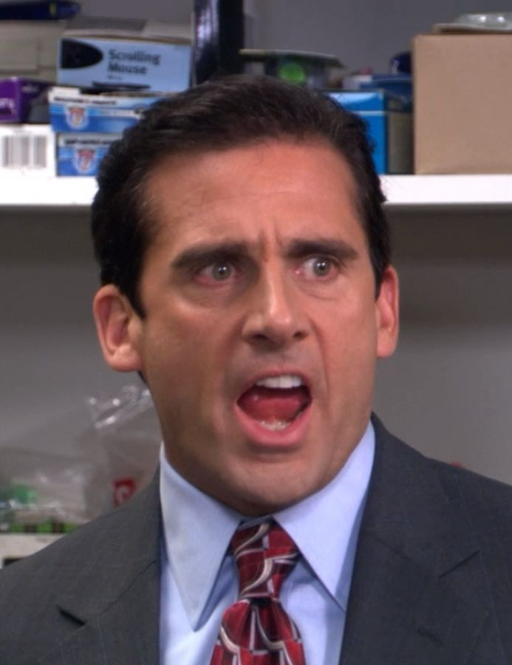
Bad managers
tell people what
to do.
Notes:
Before we talk about good and great managers, what could the bad manager have done differently?

Slide 9
Qualities of a
Good Manager
Explains the “why” and explains the reasons behind goals and team actions
Helps team members find resources to deliver on their tasks or goals
Is aware of learning gaps among team members and assesses need for training
Notes:
The difference between and Good Manager and a Great manager is that Great Managers involve people in decision making and improvement process and (call on people to read each bullet point)….

Slide 10
Qualities of a
Good Manager
Qualities of a
Great Manager
Explains the “why” and explains the reasons behind goals and team actions
Helps team members find resources to deliver on their tasks or goals
Is aware of learning gaps among team members and assesses need for training
Sets time to strategize as a team
Asks questions to assess needs, instead of determining alone
Asks team members for input
Institutes regular check-ins
Includes repeat backs at the end of every meeting
Notes:
The difference between and Good Manager and a Great manager is that Great Managers involve people in decision making and improvement process and

Slide 11

Great managers
involve people.
Notes:
Let’s take a couple minutes to share some examples of collaborative management – times when either your manager involved you in the decision making or improvement process, or an example of when you did that with a volunteer you managed.
Think about: FTP, putting the trainings together (like this one), what else?

Slide 12
Agenda
Bad, good, and great managers
The delegation cycle
Practice the delegation cycle
Debrief and Close

Slide 13
The Vicious Cycle
Guide More
Do Less
Do everything yourself
Ask someone else to do it
Notes:
So you’re tired of doing everything yourself so you decide to tell someone else to do it. [ball ‘monkey’ moves from left to right]
The result is sub-par, late, and full of typos.
So you end up redoing it yourself which means you spent twice the hours on the same amount of work or, in the fast paced world of campaigns, more likely you make due with less than perfect work. [ball ‘monkey’ moves left]
You vow never to delegate “anything important” again.
But then your workload builds up and you get tired of doing everything yourself so you decide to delegate. [ball ‘monkey’ moves right again]
More typos… [moves right]
Well, you get the idea. But there is a third way [ball moves down]

Slide 14
The Vicious Cycle
Guide More
Do Less
Do everything yourself
Ask someone else to do it
Notes:
So you’re tired of doing everything yourself so you decide to tell someone else to do it. [ball ‘monkey’ moves from left to right]
The result is sub-par, late, and full of typos.
So you end up redoing it yourself which means you spent twice the hours on the same amount of work or, in the fast paced world of campaigns, more likely you make due with less than perfect work. [ball ‘monkey’ moves left]
You vow never to delegate “anything important” again.
But then your workload builds up and you get tired of doing everything yourself so you decide to delegate. [ball ‘monkey’ moves right again]
More typos… [moves right]
Well, you get the idea. But there is a third way [ball moves down]

Slide 15
The Vicious Cycle
Guide More
Do Less
Do everything yourself
Ask someone else to do it
Notes:
So you’re tired of doing everything yourself so you decide to tell someone else to do it. [ball ‘monkey’ moves from left to right]
The result is sub-par, late, and full of typos.
So you end up redoing it yourself which means you spent twice the hours on the same amount of work or, in the fast paced world of campaigns, more likely you make due with less than perfect work. [ball ‘monkey’ moves left]
You vow never to delegate “anything important” again.
But then your workload builds up and you get tired of doing everything yourself so you decide to delegate. [ball ‘monkey’ moves right again]
More typos… [moves right]
Well, you get the idea. But there is a third way [ball moves down]

Slide 16
The Vicious Cycle
Guide More
Do Less
Do everything yourself
Ask someone else to do it
Notes:
So you’re tired of doing everything yourself so you decide to tell someone else to do it. [ball ‘monkey’ moves from left to right]
The result is sub-par, late, and full of typos.
So you end up redoing it yourself which means you spent twice the hours on the same amount of work or, in the fast paced world of campaigns, more likely you make due with less than perfect work. [ball ‘monkey’ moves left]
You vow never to delegate “anything important” again.
But then your workload builds up and you get tired of doing everything yourself so you decide to delegate. [ball ‘monkey’ moves right again]
More typos… [moves right]
Well, you get the idea. But there is a third way [ball moves down]

Slide 17
The Vicious Cycle
Guide More
Do Less
Do everything yourself
Ask someone else to do it
Notes:
So you’re tired of doing everything yourself so you decide to tell someone else to do it. [ball ‘monkey’ moves from left to right]
The result is sub-par, late, and full of typos.
So you end up redoing it yourself which means you spent twice the hours on the same amount of work or, in the fast paced world of campaigns, more likely you make due with less than perfect work. [ball ‘monkey’ moves left]
You vow never to delegate “anything important” again.
But then your workload builds up and you get tired of doing everything yourself so you decide to delegate. [ball ‘monkey’ moves right again]
More typos… [moves right]
Well, you get the idea. But there is a third way [ball moves down]

Slide 18
Why Delegate?
1
One person cannot do everything
Helps empower your leaders
Personal growth for the leaders and members
Create ownership among team members
2
3
4
Notes:
So we know that great managers delegate because…One person can’t do everything, it empowers your leaders (and remember successful leaders create more leaders!), it provides a growth opportunity for others and it strengthens the team.
It also prevents burnout
Can anyone share a time when they successfully delegated and recruited owners, collaborators and helpers

Slide 19
The Delegation Process
Agree on expectations: Ensure that your team member understands what it is they need to achieve.
Stay engaged: Make sure that the work is on track to succeed before it’s too late.
Create accountability and learning: Reinforce responsibility for good and bad results, and draw lessons for the future.
Adapt: Situational leadership!
Notes:
4 steps – that they should take when delegating.

Slide 20
Do you ever feel like
you ask someone to do something like this …

Slide 21

Notes:
Why is it so important to begin the delegation process by agreeing on clear expectation:
PINTEREST FAILS

Slide 22
But instead you get this?

Slide 23
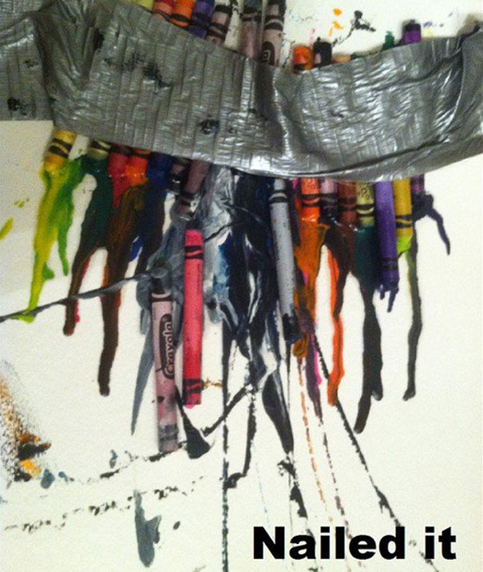
Notes:
Why is it so important to begin the delegation process by agreeing on clear expectation: -- TRANSLATION CHALLENGE – You think you’ve been entirely clear, but somehow the person hears something entirely different and interprets your clear expectations in a unique and unintended way.
PINTEREST FAILS

Slide 24
THE DELEGATION PROCESS:
Step 1: Agree on expectations
Notes:
What do we mean by that? You want to get clear on the outcomes. Most impt thing to do well – if you do one thing – get really clear on what success looks like, what would it take to delight you. Getting clear on outcomes frees you up from micromanaging, shows your staff member where you’re trying to get, allows them to figure out the how.

Slide 25
WHAT
What does success look like on this?
What is the desired outcome?
WHO
Who should be involved?
WHEN
When is the project due?
WHERE
Where might the team member go for resources?
WHY
Why does this work matter?
Notes:
Go through each and point out that delegation is a discussion, not a dictation.
Often you may have a vision of what you’re looking for in your head (say, here you’ve got this vision of a picture-perfect house you want someone to build), and so you want to take the type up front to convey that vision of success.
The key is discussion

Slide 26
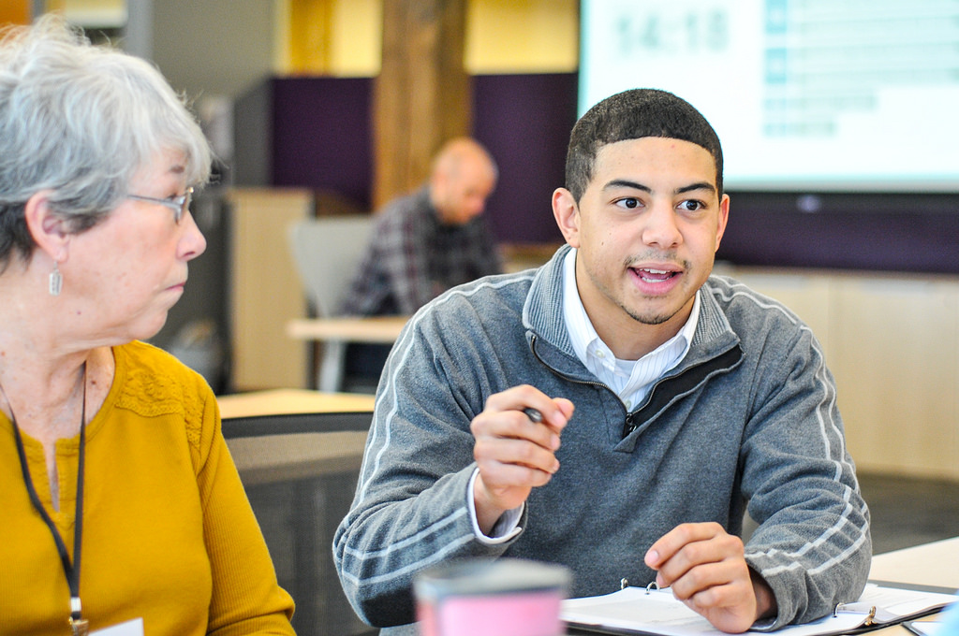
The repeat-back

Slide 27
So that you get this
when you ask for it …

Slide 28
Notes:
Why is it so important to begin the delegation process by agreeing on clear expectation:
PINTEREST FAILS

Slide 29
Instead of this …

Slide 30
Notes:
Why is it so important to begin the delegation process by agreeing on clear expectation: -- TRANSLATION CHALLENGE – You think you’ve been entirely clear, but somehow the person hears something entirely different and interprets your clear expectations in a unique and unintended way.
PINTEREST FAILS

Slide 31
How can we make sure repeat-
backs are not awkward?
Type in the chat box
Press 1 on your phone

Slide 32
Agenda
Bad, good, and great managers
The delegation cycle
Practice the delegation cycle
Debrief and Close

Slide 33
15 minutes
Working with a partner, think about a task you need to delegate to a member of your team.
Roleplay with your partner on the scenario where you agree on expectations using the 5 W’s.
Make sure to close the role-play by repeating back.
Switch off!
Roleplay
5 W’s:
WHAT
WHO
WHEN
WHERE
WHY

Slide 34
THE DELEGATION PROCESS:
Step 2: Stay engaged
Notes:
What do we mean by that? You want to get clear on the outcomes. Most impt thing to do well – if you do one thing – get really clear on what success looks like, what would it take to delight you. Getting clear on outcomes frees you up from micromanaging, shows your staff member where you’re trying to get, allows them to figure out the how.

Slide 35
Staying Engaged
Even long after a discussion and repeat back, team members might deliver different results than what you expect.
The most common way managers fail at delegating is by not staying involved to check on progress.

Slide 36
THE DELEGATION PROCESS:
Step 3: Create accountability and learning

Slide 37
Create Accountability and Learning
Recognize effort and celebrate success.
Debrief to learn what went well, as well as opportunities for improvement.
And always remember – don’t punish the whole class.

Slide 38
THE DELEGATION PROCESS:
Step 4: Adapt situational leadership
Notes:
What do we mean by that? You want to get clear on the outcomes. Most impt thing to do well – if you do one thing – get really clear on what success looks like, what would it take to delight you. Getting clear on outcomes frees you up from micromanaging, shows your staff member where you’re trying to get, allows them to figure out the how.

Slide 39
WHAT DO WE MEAN BY ADAPT?
Delegation will only ultimately yield expected results if the team member is ready to deliver.

Slide 40
Skill
Assign projects based on the skill level of the team member
Will
Consider what the team member likes or dislikes before assigning the project
Difficulty/Importance
Assign your most important and difficult tasks to your most skilled team members
Adapt – Situational Leadership

Slide 41
Supporting
Coaching
Delegating
Directing
Developing skills
High energy
Developing skills
Low energy
Mastered skills
Low energy
Mastered skills
High Energy
Notes:
Once the Team Member is confident in his/her ability to do the work, and know they can do it, they reach Development Stage 4: High Competence and High Commitment.
At this point the direction is low, and supportive behavior is minimal. You no longer have to tell the Team Member how to do the work, nor have to be constantly checking to make sure that the Team Member is encouraged. At this point you begin to Delegate. The Team Member and Manager agree on a project and the Team Member implements. The Manager checks-in, but do not provide step by step guidance b/c the Team Member knows what to do, and is confident in doing.

Slide 42
Agenda
Bad, good, and great managers
The delegation cycle
Practice the delegation cycle
Debrief and Close

Slide 43
Debrief
Type in the chat box
Press 1 on your phone
Notes:
00:11 – 00:16 [5 min] – Caleb
Trainer’s Notes: Learners will have 3 minutes to complete the activity. The facilitator will lead a pop-corn debrief for 2 minutes.
Review activity instructions
Set timer (Aquiles)
Debrief activity for 3 minutes (Caleb)
What was one of your key goals?
How would you accomplish that goal online?
Trainer’s Notes: Learners will likely provide wrong answers, since they have not been trained on digital tactics yet. But by throwing them in the deep end of the pool, they are realizing that there is a connection of sorts, which we will further explore throughout the training.

Slide 44
Recruitment: Grassroots Tactics

Slide 45
Goals for today
Learn best practices for recruiting people to attend your event
Be able to develop a Hard Ask
Feel comfortable recruiting for your upcoming event
1
2
3

Slide 46
Agenda
Assessing your audience
The Hard Ask
Debrief
Next steps
Notes:
00:18 – 00:19 [1 min] – Aquiles
[Broad Goals] Review post-training agenda
We cannot cover everything you will need to know today.
That is why we have a post-training agenda for you
Review key dates and webinars

Slide 47
You get what you ask for, and not much of what you do not.

Slide 48
The Hard Ask
5 Step Formula
Know your audience
Build urgency
Ask for something specific
Ask and shut up
Be persistent

Slide 49
Weekly assignment, due April 4:
You fellows will need to draft a recruitment plan and should specify their:
Attendance goals
The type of audience they would like to recruit
The hard asks they can use to recruit their audience
Download assignment

Slide 50
Next steps
Conduct your team meeting and fill-out the report back form.
Office hours: sign-up for a slot.
Save the date: May 19-21 Volunteer Leaders Summit
Review your fellows HW assignments and give feedback.

Slide 51
OFA Training
Thank you for joining today’s webinar.
Check the Fellows Manager Bookshelf for a copy of the material covered
today, including a video and audio recording of the webinar.
Email fellows@ofa.us with any questions.

