Slide 1
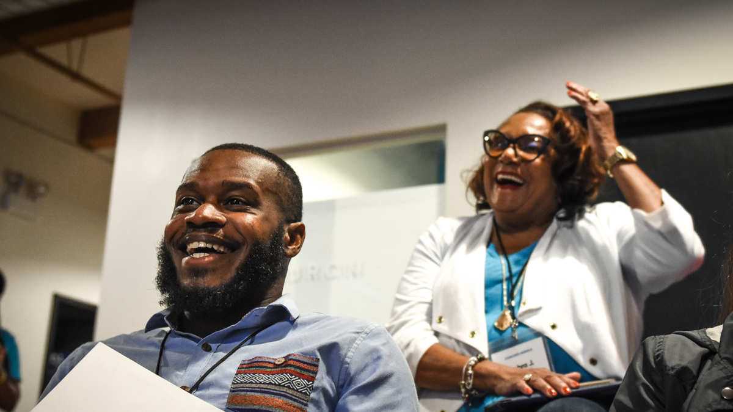
Local Issue Advocacy
Jennifer Warner / OFA National Organizing Director
Elizabeth Erickson / OFA Training Director
We will begin the training at 8:30 p.m. ET / 7:30 p.m. CT
Notes:
This work is licensed under the Creative Commons Attribution-NonCommercial 4.0 International License. To view a copy of this license, visit http://creativecommons.org/licenses/by-nc/4.0/ or send a letter to Creative Commons, PO Box 1866, Mountain View, CA 94042, USA
Liz
Welcome to the training

Slide 2
“If we have no peace, it is because we have forgotten that we belong to each other.”
—MOTHER THERESA
Notes:
Liz

Slide 3
WE ARE OFA
Local Issue Advocacy
Foundations of Coalition Building

Slide 4
Understand the foundations of effective coalition building
Apply these foundations to generate a plan to build a coalition
Feel a sense of community with the group
Goal for
this session
1
2
3

Slide 5
Tonight’s
agenda
 | Welcome Case Study Q & A with Mr. Page Synthesis Closing

Slide 6
WE MUST KNOW THESE ANSWERS DEEPLY.
Question | Rating
Who is affected by the issue?
What are the consequences of the issue?
What is the economic impact of the issue?
What are the barriers?
What are the resources?
What is the history of the issue in your community?

Slide 7
What have you learned about your issue since our workshop last week?
Notes:
Type your answer in the chat box

Slide 8
Learning Journey

Slide 9
Our learning journey
Week 1: Introductions; advocacy overview
Week 2: Workshop
Week 3: Foundations of coalition building
Week 4: Workshop
Week 5: Identifying legislation

Slide 10
Our learning journey
Week 6: Workshop
Week 7: Writing your campaign plan
Week 8: Workshop
Week 9: Running into barriers
Week 10: Closing synthesis and next steps

Slide 11
Guided worksheet
BIT.LY HERE

Slide 12
Tonight’s
agenda
 | Welcome Case Study Q & A with Mr. Page Synthesis Closing

Slide 13
Case study
Resolution 124

Slide 14
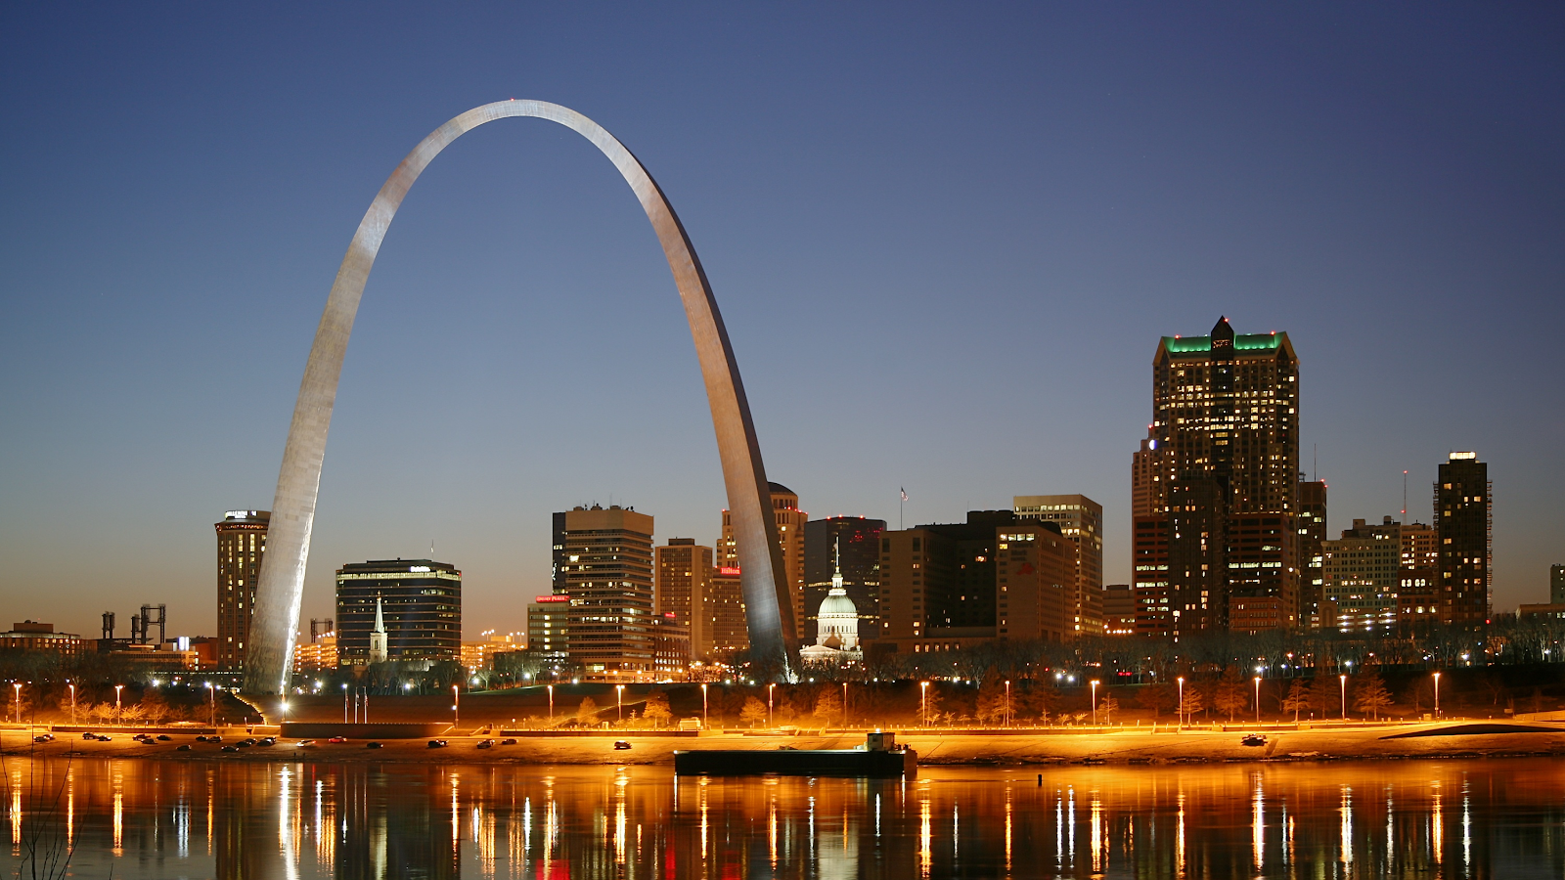
Welcome to St. Louis
Notes:
City of St. Louis – 400,000 people, economic hub
Home to Peabody Coal and Arch Coal – largest private sector coal companies in the world
‘gateway’ for us to explore local issue advocacy campaign ran by a coalition fighting against climate change and FOR clean energy (connect back to issues being a solution statement)

Slide 15
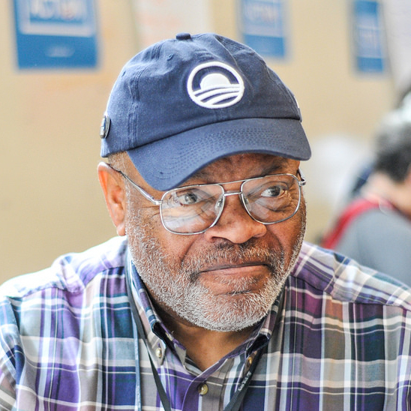
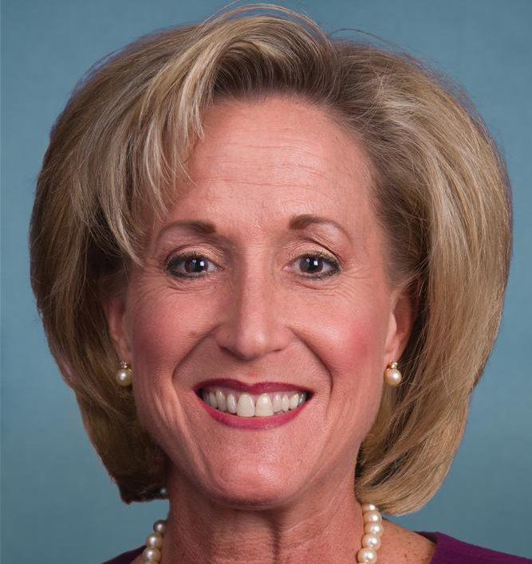
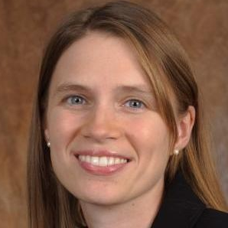
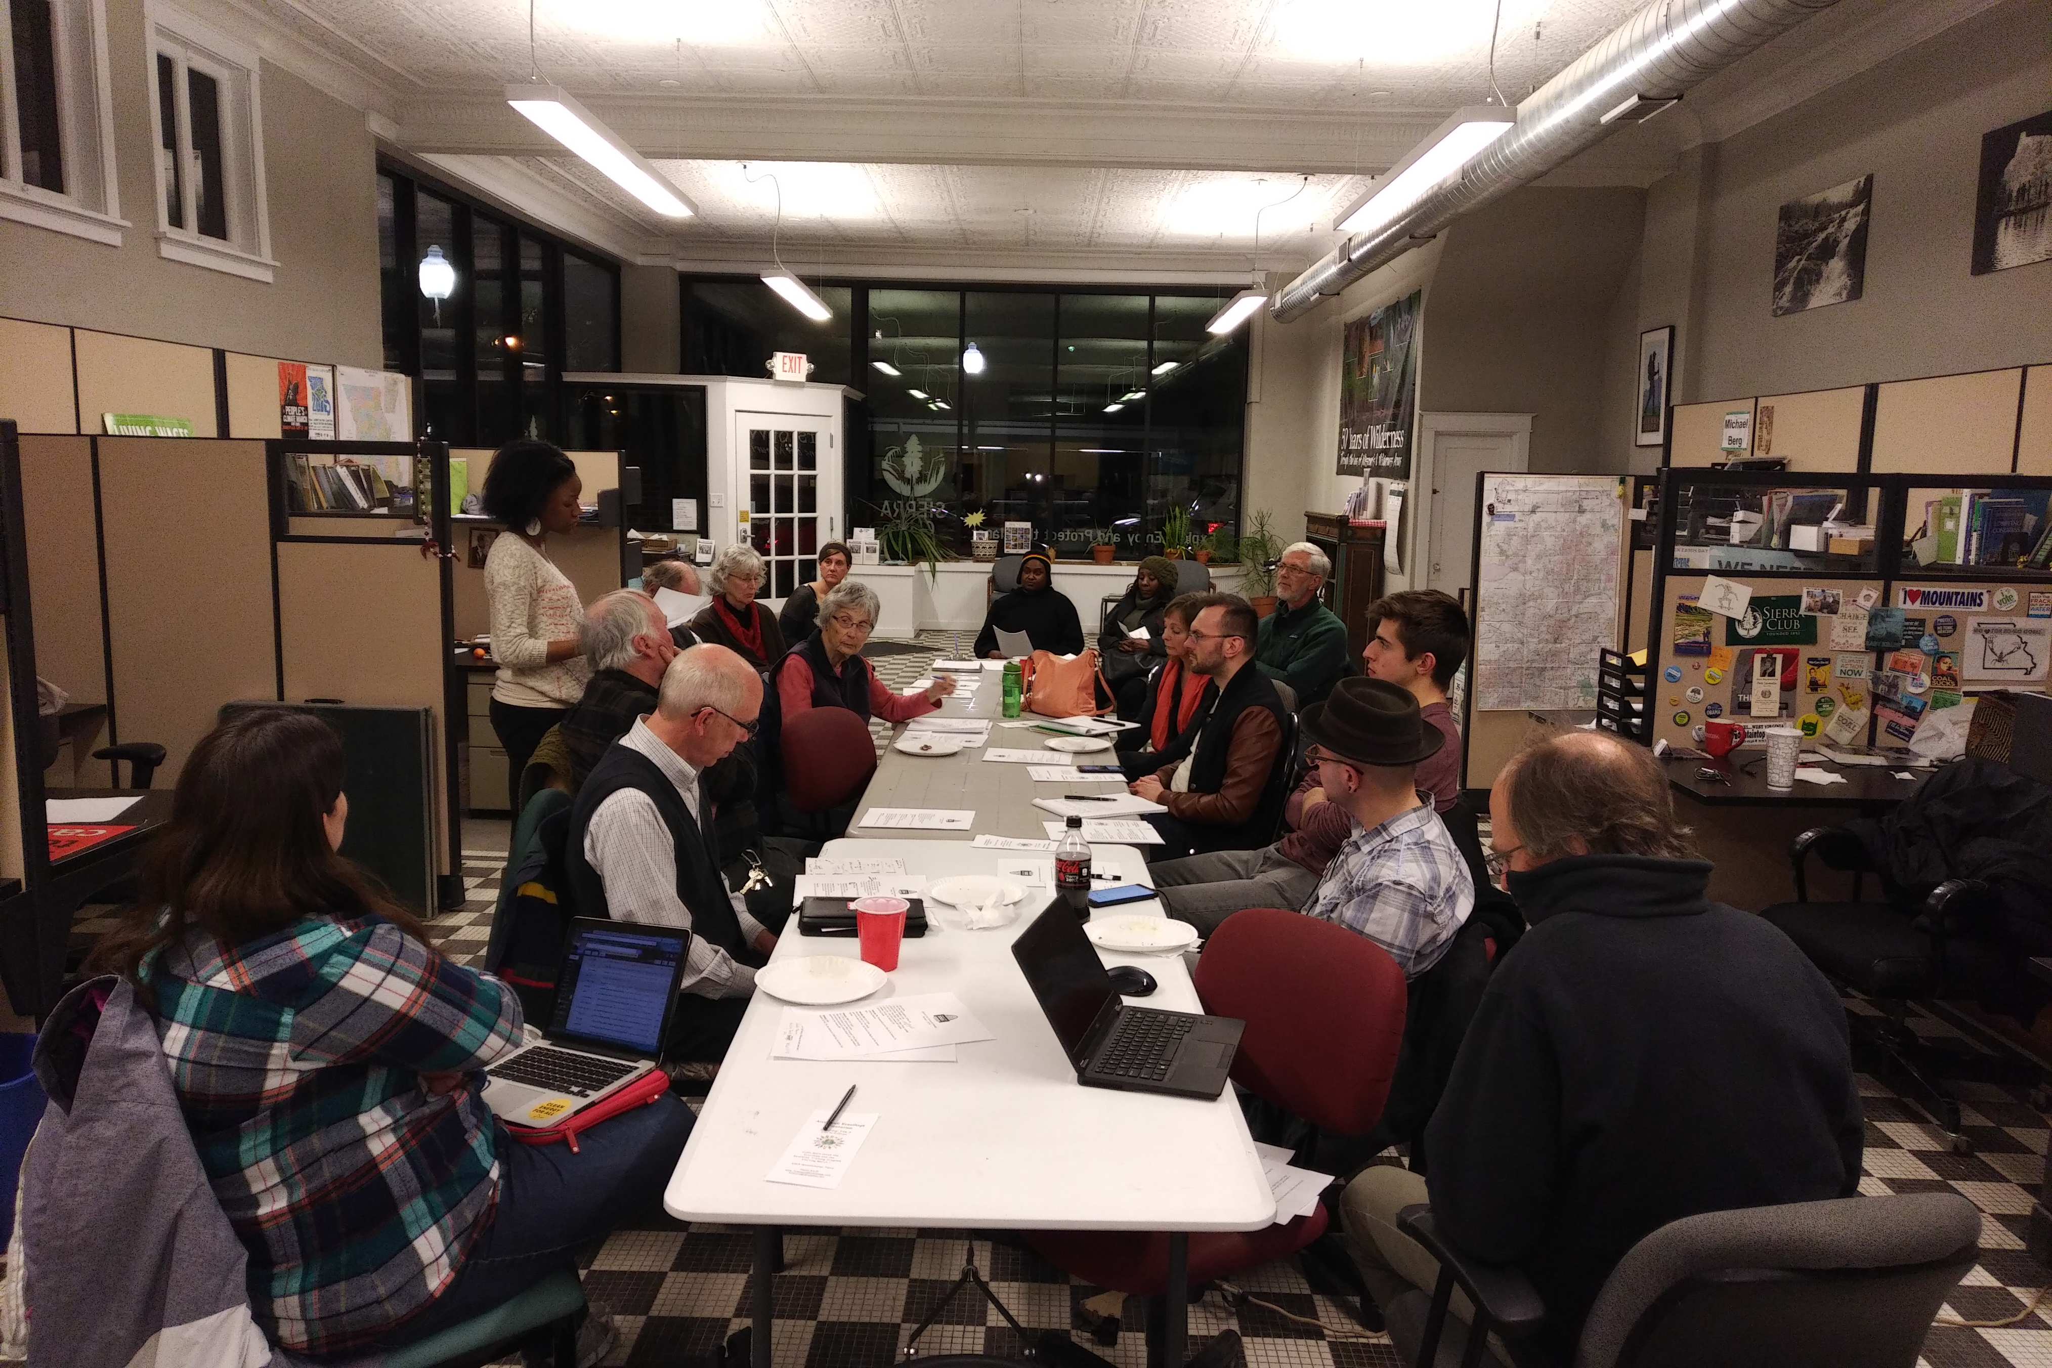
Key Players
James Page
Ann Wagner
Heather Navarro
Notes:
James Page—James Page is the OFA St. Louis Chapter leader. He is also a member of the OFA Board of Directors and Advisory Board, with a particular focus on grassroots engagement. James collaborates with regional progressive partners to focus on his chapter’s organizing work on national, state, regional, and community issues. He was instrumental in participating in the coalition to pass Resolution 124.
Congresswoman Ann Wagner— Congresswoman Wagner is a member of the Republican party, representing Missouri’s 2nd district. Elected in 2012, she represents a Republican leaning district, and co-sponsored a bill that would forbid sending money to the UN to study climate change. In short, she has been identified as a climate denier.
Lewis Reed—Lewis Reed is the first first black man to be elected president of the Board of Aldermen for St. Louis. Originally elected to the city’s 6th ward in 1999, Reed has a special focus on revitalizing and growing his community. He served as the primary sponsor for Resolution 124.
Heather Navarro—Heather Navarro is the alderwoman for St. Louis’ 28th ward, serving since July of 2017. In addition to her role as Alderwoman, Navarro has served as executive director of the Missouri Coalition for the Environment since 2013. Under her leadership, her organization worked with coalition members like James Page towards the passage of Resolution 124. After her election, Alderwoman Navarro signed on as a co-sponsor on Resolution 124.
Missouri Clean Energy Coalition—The Missouri Clean Energy Coalition consists of around 17 different political, environmental, scientific, farming, and interfaith organizations. A broad coalition formed to, “grow our clean and renewable energy economy to reduce fossil fuel pollution, address climate change, and create jobs,” the coalition represents groups such as Sierra Club (represented by Andy Knot), OFA St. Louis (represented by Ken Denson and James Page), and the Missouri Coalition for the Environment (represented by Heather Navarro).

Slide 16
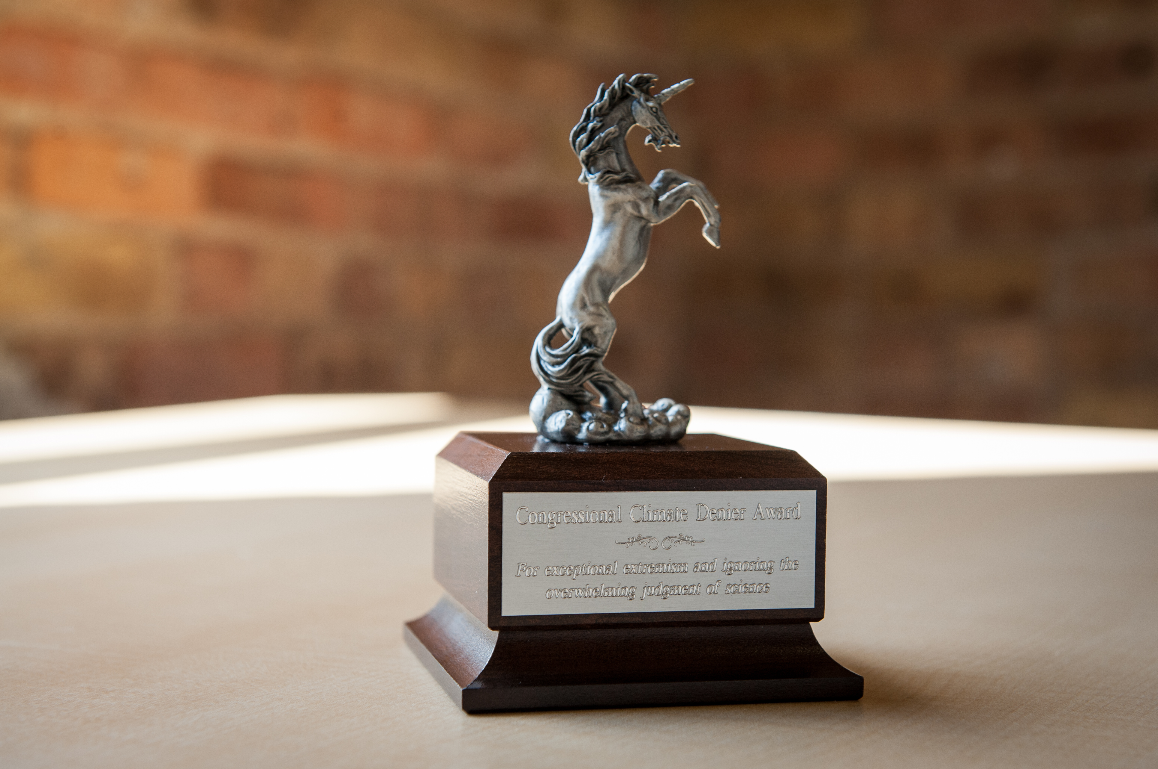
Prelude: climate deniers campaign
Notes:
In 2013, OFA launched a campaign to call out Climate Deniers serving on the state and federal levels of government. The premise was that even though, “97% of climate scientists agree that climate change is real and man-made...too many of our elected officials deny the science of climate change.” [citation] OFA made it a key mission to call out climate deniers, and to hold them to account for their positions, votes, and policies.
That year, OFA St. Louis Chapter Leader James Page—alongside OFA St. Louis Climate Lead Ken Denson—organized volunteers to begin to put pressure on recently-elected Congresswoman Ann Wagner of MO-02, a known climate denier.
Initially, James Page led a group of volunteers on an office visit, where they presented Congresswoman Wagner’s staff with a copy of the 1st National Climate Assessment.
In addition to office visits, he and his team used the following tactics:
Climate denier rallies—OFA St. Louis used signs, pamphlets, lectures, and speeches to generate earned media and attempt to hold Congresswoman Wagner to account.
Town halls— OFA St. Louis attended town halls with Congresswoman Wagner to attempt to highlight the issue of climate change.
Social media— OFA St. Louis used Facebook and Twitter to promote events, as well as tweet/facebook at Congresswoman Wagner.
Presenting climate denier unicorns—A special part of the OFA Climate Denier campaign, OFA St. Louis presented Congresswoman Wagner’s office which reads: “Congressional Climate Denier Award—For exceptional extremism and ignoring the overwhelming judgement of science.”

Slide 17
The result…
Notes:
All of their work and actions culminated in an event that Congresswoman Wagner had been invited to. In preparation for the event, volunteers made signs calling her out as a climate denier, but when the event began, she had decided not to show up.
The result: many people were angry she didn’t show up, taking to social media to express their dismay. Initially, James identified this as a win. It felt good that negative attention was being shown to Wagner on social media.
But was it a win? Did it move the needle on the issue of climate change?
After taking a moment to stop and think, Mr. Page came to a disheartening conclusion—despite their best efforts, and despite how good their tactics felt at times, they weren’t generating wins or moving the needle.
It was time to re-tool, assess the results, and evolve. James didn’t want to do events just to feel good. He needed to change up the strategy and tactics to yield actual wins.

Slide 18
Know the story of your city and assess the efficacy of your current actions.

Slide 19
What are you doing that currently feels good but is not leading to change?

Slide 20
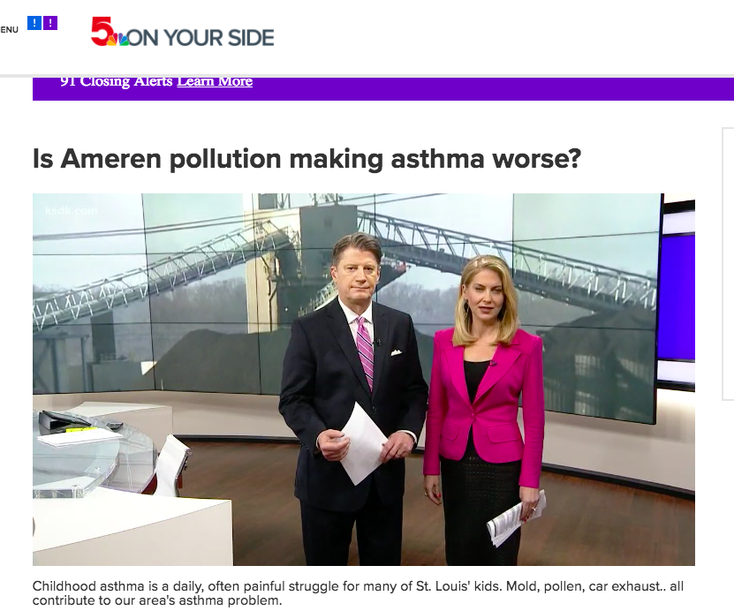
Changing the strategy
Notes:
James Page decided to re-tool OFA St. Louis’ efforts towards something they could move the needle on—he decided to go local—away from Republican leaning MO-02 to his home district of Democratic leaning MO-01.
Knowing the impact of companies like Peabody Coal, Arch Coal, and Ameren on his community and the environment, he decided to move towards a resolution that moved St. Louis to 100% clean energy by 2035—the resolution to be called Resolution 124.
OFA St. Louis, however, was made up of a passionate group of volunteers—some holding jobs, all taking care of families and personal affairs, and many without the technical expertise on the issue of clean energy. They knew they couldn’t do it alone—they needed a coalition of partners.
Knowing this, they enlisted the help of Andy Knot (Sierra Club) and Heather Navarro (Missouri Coalition for the Environment).
James Page, Ken Denson, Andy Knot, Heather Navarro, and others had to begin pooling their knowledge of organizations, elected officials, and key players in the community.

Slide 21
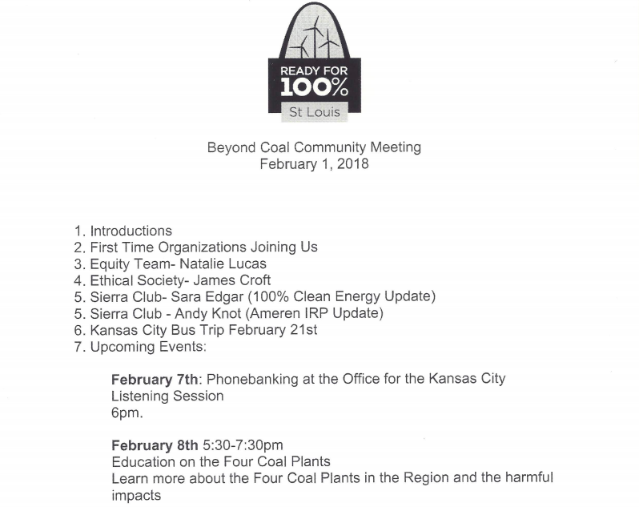
Example Agenda
Notes:
Knowing the need to build a strong coalition in support of clean energy in St. Louis, OFA St. Louis held brainstorming sessions. During these sessions, they:
Put together names of organizations each individual felt familiar with and had connections to
Researched and calendered each group’s upcoming meetings
Planned to show up at these meetings to build relationships with individuals representing the organizations and make asks to support clean energy
James says that if there was ever a lesson learned from brainstorming, it’s that you can’t simply brainstorm. You must show up—relationships are everything and start anywhere.
By the end of brainstorming and planning on building the coalition, it was wide and diverse, representing everyone from the NAACP to faith-based groups and farming communities.

Slide 22
But what kind of coalition?

Slide 23
But what kind of coalition?
 | Overwhelming Application of gentle pressure Well organized Logical Benefit the community Build relationships with elected officials over time
Notes:
The coalition has to be overwhelming—It should represent the broad society of the community as a whole, including political, faith-based, economic based, and social groups.
The coalition built to support Resolution 124 represents a large coalition of environmental, political, faith-based, academic, and scientific interests across St. Louis. It is the Missouri Clean Energy Coalition:
Missouri Coalition for the Environment ;Missouri Sierra Club; Renew Missouri ;Jewish Environmental Initiative: a committee of the Jewish Community Relations Council of St.Louis; Missouri Interfaith Power & Light ; Ethical Society of St. Louis; Mid-Missouri Peaceworks/Missourians for Safe Energy; Labadie Environmental Organization; Union of Concerned Scientists; Central Reform Congregation; Earthdance Farms; Women’s Voices Raised for Social Justice; Populists in Action; 350KC; Organizing for Action – Missouri; Shir Hadash Reconstructionist Community; Climate Parents
Has to apply gentle pressure—The coalition should use tactics that build relationships with elected officials, community members, and businesses to build supports—as opposed to those tried earlier (i.e. Climate denier unicorns)
The coalition should be well organized—The coalition should have an ultimate goal, a strategy behind that goal, and tactics that assist that strategy. Division of labor should focus on the expertise of each representative in the coalition. Coalitions should be honest on knowledge and resources they are missing and seek to gain them from different sources.
GOAL: To propose and pass Resolution 124, committing St. Louis to transfer to 100% clean, renewable energy by 2035.
The objective should be logical—The objective (or goal) should be won that can move the needle on the problem the community faces.
The coalition should benefit with the community—The goal should be one that solves a problem for the community and the coalition at the same time.
The coalition should build relationships with elected official over time—The coalition should seek to identify key decision makers it can build relationships with, collaborate on the goal with, and ultimately move the needle on the issue with.

Slide 24
Begin building relationships with community members, elected officials, and organizations.

Slide 25
What groups are you working with?
What demographics do they represent?
Notes:
https://ctb.ku.edu/en/table-of-contents/assessment/promotion-strategies/start-a-coaltion/main
Search -- ‘how do you start a community coalition?”
Put together a core group

Slide 26
A lack of expertise
Notes:
The coalition was built and the goal was set, but something was missing. James Page and his colleagues had begun the legwork towards passing Resolution 124, but they lacked strategy that utilized the expertise of folks who organized before them, and of professional policy wonks who knew every minute detail of the the issue at hand.
To be sure, it can feel jarring to invite a paid expert from “outside” your community to join your coalition—but as James found, their coalition lacked the very legislative experience they needed.
They had organizing experience, but they needed they nitty gritty expertise on the issue that only certain groups and professionals can give.
Holding true to the principle that their coalition should be well-organized, they invited paid staff and groups with that experience to assist them.
***
The strategy
Unlike the days of presenting Congresswoman Wagner with a climate denier unicorn statue, James and the coalition knew that they needed a strategy that would assist the goal they had set out to accomplish.
They settled on this strategy to achieve their goal of passing Resolution 124:
Look for people with resources that you need—I.E. paid staff with a special focus in legislative experience
Ask for advice—Focus on asking community member, organizations, and businesses for advice. In the case of Resolution 124, the coalition asked city officials which alderpersons would be good to work with.
Show up—Show up at any meeting where you can build relationships with decision makers, partners, or local experts.
Don’t reinvent the wheel—The St. Louis coalition didn’t reinvent the wheel. They researched similar resolutions that were passed in other cities around the country.
Rely on other’s strengths where you lack expertise—OFA St. Louis relied on the Sierra Club to help craft and give recommendations on Resolution 124.
Build relationships with key decision makers—Build relationships with the local government officials you need to pass your proposal or move the needle on it. The St. Louis coalition built relationships with alderpersons who eventually were asked to, and did, sponsor Resolution 124.

Slide 27
A lack of expertise
Look for people with the resources you need
Don’t reinvent the wheel
Show up

Slide 28
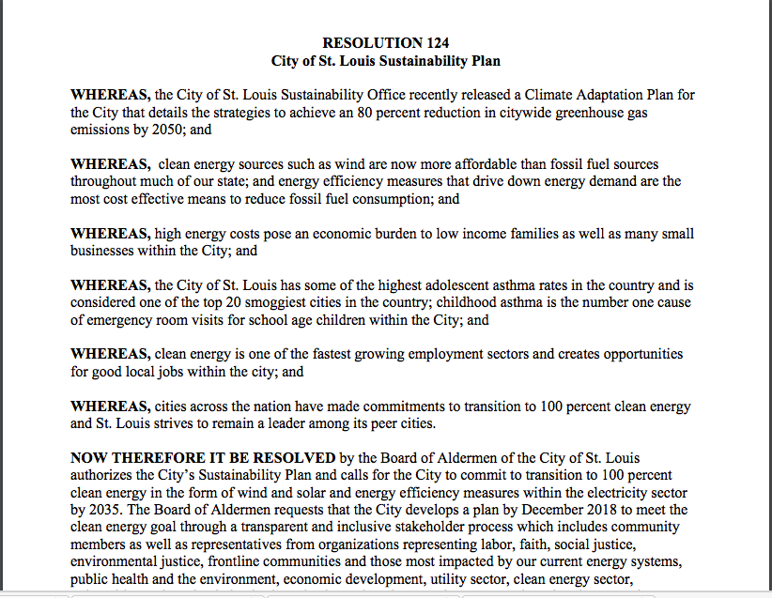
Resolution 124
Notes:
-- note – what city did Mr. Page take this language from?

Slide 29
Gain knowledge on your issue and set your strategy

Slide 30
Insert application
Notes:
What do not know? Who does that make you want to connect with?

Slide 31
A tapestry of connections
Notes:
With the right strategy, you’ll get some detractors…and some friends too
Ameren, Arch Coal, and Peabody Coal were quick to invest in efforts to oppose the burgeoning coalition. The coalition, however, was overwhelming by this point.
Tactically, the coalition had asked city officials about alderpersons they should build relationships with around their goal, and begun building those relationships. One such alderperson they began building a relationship with is Lewis E. Reed, President of the Board of Aldermen of the City of St. Louis. In 2017, after being presented with the proposal for the resolution, and with the weight of the coalition to collaborate with him, Mr. Reed proposed the resolution officially before the Board of Aldermen.
That is not to say that the coalition came upon this outcome seamlessly.
Every single individual and group had to rely upon their expertise and relationships—and to show up in those relationships with that expertise—in order to succeed.
James Page, for example, relied on a group he leads called the, “Holy Ground Collaborative.” The Holy Ground Collaborative is a highly diverse group of faith based organizations consisting of Jewish, Unitarian, Episcopal, Presbyterian, and more faiths. Had Mr. Page not engaged this group to join the coalition, it wouldn’t have been interfaith.
Heather Navarro, for example, relied on her deep roots in the environmental community, and her ties to St. Louis, to bring in a diverse array of expertise to the coalition. Had Mrs. Navarro not engaged her contacts to join the coalition, it might not have included the expertise and gravitas it needed.
All this to be said—each individual and organization brings a tapestry of personal relationships with it.

Slide 32
The conclusion
On October 27th, Resolution 124 passed the Board of Aldermen of the City of St. Louis.
Notes:
On October 27, 2017, Resolution 124 passed the Board of Aldermen of the City of St. Louis.
It was sponsored by President of the Board of Aldermen Lewis E. Reed and included 11 co-sponsors (including Heather Navarro).
It is a resolution—triumphant to the cause of fighting climate change—passed in a singular moment, but only made possible by the hard work over years by those dedicated to seeing its passage.
Artifacts:
NBC Article
Agenda—Beyond Coal Meeting
Social media post and hashtags
https://twitter.com/KenDensonSTL/status/906180534396739584
#STL100
#readyfor100
#showmecleanenergy

Slide 33
1
Look for people with the resources you need
Ask for advice
Show up – relationships are everything
Brainstorm contacts
Working together builds relationships
Partnerships and coalitions are everything
Best practices
2
3
4
5
6

Slide 34
Tonight’s
agenda
 | Welcome Case Study Q & A with Mr. Page Synthesis Closing

Slide 35
Q&A with Mr. Page

Slide 36
Tonight’s
agenda
 | Welcome Case Study Application of key concepts Synthesis Closing

Slide 37
Insert homework picture

Slide 38
Reflection
Think about what brought you to this work.
How would you currently describe the problem that your community is facing?
How would you describe the issue you are working on?
Type your answers on this google doc, and be ready to share!
Notes:
https://docs.google.com/document/d/1NKggKvk23eDVo9pHrd4WMwo7MKWaq5gtbmRwGJF8H10/edit

Slide 39
Group share

Slide 40
Tonight’s
agenda
 | Welcome Case Study Q & A with Mr. Page Synthesis Closing

Slide 41
Debrief
What is your next step in building a coalition?
What challenges do you foresee?

Slide 42
Next session
Notes:
Put in homework link – where they should put the answers to their work (slack?)
Give google drive link

Slide 43
Thank you for joining
today’s webinar.
Please fill out the survey below and give us
your feedback on today’s training.
bit.ly/

