Slide 1
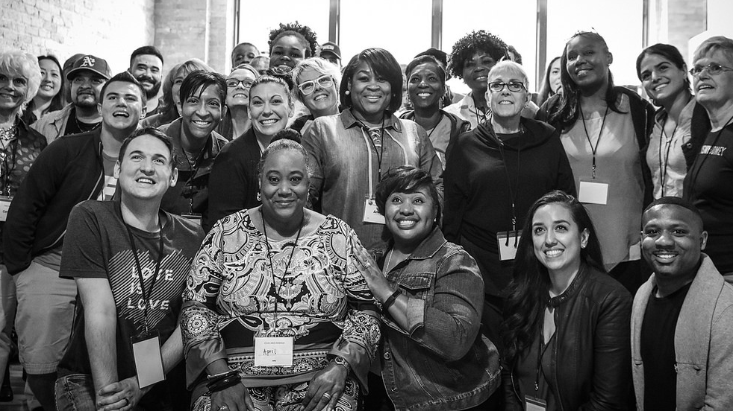


SPRING 2018
Fellows Leaders
We will begin the training at 8 p.m. ET / 7 p.m. CT
Notes:
This work is licensed under the Creative Commons Attribution-NonCommercial 4.0 International License. To view a copy of this license, visit http://creativecommons.org/licenses/by-nc/4.0/ or send a letter to Creative Commons, PO Box 1866, Mountain View, CA 94042, USA

Slide 2
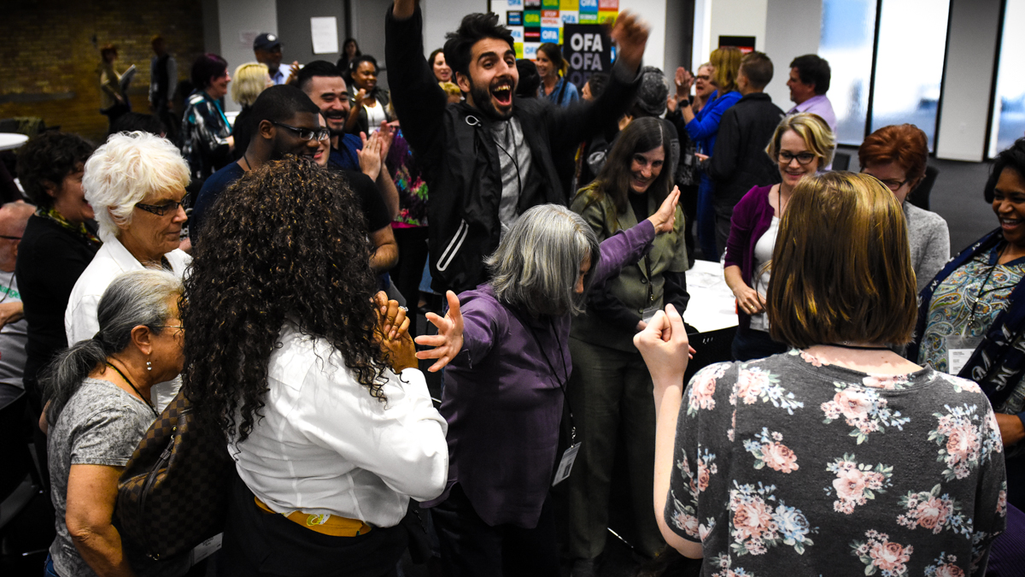
SPRING 2018 OFA FELLOWS LEADERS
Part 7: Group Dynamics
Kevin Lane / OFA Training Projects Manager

Slide 3
GOALS FOR THIS SESSION
Align on Fellows projects and answer your questions

Slide 4
GOALS FOR THIS SESSION
Understand the role that group dynamics plays in the function of our teams

Slide 5
GOALS FOR THIS SESSION
Be able to apply skills and ideas from group dynamics to solve team challenges

Slide 6

Agenda
Aligning on fellows projects
Social roles in groups
Leadership in multicultural groups
Next steps & close

Slide 7
Fellows Projects

Slide 8
Learning journey
1
Identifying root challenges
2
Strategies for local impact
3
Leadership in action
4
Cultivating community
5
Building coalitions
6
Tying it all together
Notes:
https://goo.gl/forms/9i1kaoTOVNhzFajN2

Slide 9
PROCESS
Identify the root challenge

Slide 10
PROCESS
Turn the challenge into an organizing issue

Slide 11
PROCESS
Develop a strategy and the skills needed to implement it

Slide 12
PROCESS
Implement the plan!

Slide 13
A few caveats…

Slide 14
Questions?

Slide 15
Program Tracker
Notes:
https://docs.google.com/spreadsheets/d/1pOgR1IRtCSkEVyEans2mqeZd-O1A9xZGLg_ZLVf4S7I/edit#gid=2145009909

Slide 16
Agenda
Aligning on fellows projects
Social roles in groups
Leadership in multicultural groups
Next steps & close

Slide 17
Working in groups

Slide 18
Hypothesis:
Race, ethnicity, personal attitudes, cultural values, beliefs, and styles of conflict resolution will be negatively related to group effectiveness during the initial phases of group development because of the costs of working with the complexity of differences for many individuals.

Slide 19
What are your thoughts?

Slide 20
Social roles in groups

Slide 21
What is a role?

Slide 22
What is a role?
1.) A character assigned or assumed.
2.) A socially expected behavior pattern.
3.) A function or part performed especially in a particular operation or process.

Slide 23
What is a role?
In addition, there are often added assumptions, perceptions, and attitudes ascribed to those who take up the various social roles in groups due to the social and cultural context in which the group takes place.

Slide 24
What is a role?
Role differentiation is the vehicle by which group members manage their conflicts, ambivalence, and tasks.
In other words, there is inherent anxiety in all groups that must be managed.

Slide 25
Social roles in groups
Person-in-role
Individual members assume roles based on personality, temperament, and basic assumption functioning.
Some of these decisions are conscious, and some are unconscious.
An individual’s role is often characterized by personality and temperament, is characterized by race, culture, stereotypes, and projections.

Slide 26
Social roles in groups
Differentiation amongst members
Three distinct categories
Dominant / submissive
Friendly / unfriendly
Instrumentally controlled / emotionally expressive.

Slide 27
Social roles in groups
Differentiation amongst members
Social roles are part of a groups structure and it’s purpose.
They emerge as both defensive and adaptive mechanisms.
The defense is against anxiety, and the adaptation to delineate, isolate, or contain conflicts, and provide psychological security.

Slide 28
Common Role Types

Slide 29
The Leader

Slide 30
The Leader
Often possesses an affinity for leadership and speaking in groups.
They function as they spokesperson, are task-oriented, and initiate topics for discussion.
Often, leaders have physical resemblance to societal images of leadership (male, white, tall, strong, loud).

Slide 31
The Follower

Slide 32
The Follower
Groups need both leaders and followers in order to function. They are often symbiotic to each other.
Characterized by dependence, acceptance, silence, support.
It can often be an unconscious reaction to anxiety surrounding authority. Dependent and accepting behaviors are often connected to a need to elicit approval.

Slide 33
The Rebel

Slide 34
The Rebel / Alternative Leader
This role has many of the same characteristics of leadership role, but is more overtly in competition, behaviorally, with the formal leader.
A variety of members may take up this role, but it’s function is primarily to present alternative leadership.
It expresses dissatisfaction, anxiety, frustration as an outlet.

Slide 35
The Mediator

Slide 36
The Mediator
This role is focused on cohesion, harmony, group building, and maintenance.
Often characterized by abrupt change of subject or shifts in focus of content.
The emergence of the mediator role indicates the group’s need to develop a pattern of engaging in and managing conflict.

Slide 37
The Scapegoat

Slide 38
The Scapegoat
This role is the most feared and disliked. The scapegoat emerges in response to the group’s need to avoid anxiety and is intricately connected to issues relating to the group’s survival.
The scapegoat absorbs the unwanted, undesired aspects of the group’s unconscious processes. It rids the group of it’s unwanted, negative aspects.
Racial-cultural aspects play an important role in scapegoating.

Slide 39
Role types
Where have you seen these roles emerge in your own work or groups?
How might you manage them as a Fellows Leader?

Slide 40
Agenda
Aligning on fellows projects
Social roles in groups
Leadership in multicultural groups
Next steps & close

Slide 41
Strategies for leading in multicultural groups

Slide 42
Hypothesis:
Race, ethnicity, personal attitudes, cultural values, beliefs, and styles of conflict resolution will be negatively related to group effectiveness during the initial phases of group development because of the costs of working with the complexity of differences for many individuals.

Slide 43
Six prerequisites for leadership
Notes:
https://goo.gl/forms/9i1kaoTOVNhzFajN2

Slide 44
Six prerequisites for leadership
Ability to be reflective and self-examining.
Notes:
https://goo.gl/forms/9i1kaoTOVNhzFajN2

Slide 45
Six prerequisites for leadership
Ability to be reflective and self-examining.
Leaders further learning, with authoritative relations.
Notes:
https://goo.gl/forms/9i1kaoTOVNhzFajN2

Slide 46
Six prerequisites for leadership
Ability to be reflective and self-examining.
Leaders further learning, with authoritative relations.
Genuine curiosity about what’s happening in the group.
Notes:
https://goo.gl/forms/9i1kaoTOVNhzFajN2

Slide 47
Six prerequisites for leadership
Ability to be reflective and self-examining.
Other’s experience are as valid as your own.
Leaders further learning, with authoritative relations.
Genuine curiosity about what’s happening in the group.
Notes:
https://goo.gl/forms/9i1kaoTOVNhzFajN2

Slide 48
Six prerequisites for leadership
Ability to be reflective and self-examining.
Other’s experience are as valid as your own.
Leaders further learning, with authoritative relations.
Work collaboratively with experiences of others.
Genuine curiosity about what’s happening in the group.
Notes:
https://goo.gl/forms/9i1kaoTOVNhzFajN2

Slide 49
Six prerequisites for leadership
Ability to be reflective and self-examining.
Other’s experience are as valid as your own.
Leaders further learning, with authoritative relations.
Work collaboratively with experiences of others.
Genuine curiosity about what’s happening in the group.
Capacity to be vulnerable in service of one’s own learning and group learning.
Notes:
https://goo.gl/forms/9i1kaoTOVNhzFajN2

Slide 50
Debrief
What three competencies resonate most with you? Least with you?
Describe a situation when you’ve used one or some of these compentecies in working with a group.

Slide 51
Agenda
Aligning on fellows projects
Social roles in groups
Leadership in multicultural groups
Next steps & close

Slide 52
Next Steps

Slide 53
Fellows Homework

Slide 54
Weekly meeting
Your group should have identified a challenge and should be constructing their organizing issue by the end of this week!

Slide 55
Questions?

Slide 56
Thank you!

Slide 57
OFA Training
Thank you for joining today’s webinar.
Check the Fellows Leader website for a copy of the material covered
today, including a video and audio recording of the webinar.
Email fellows@ofa.us with any questions.

