Slide 1
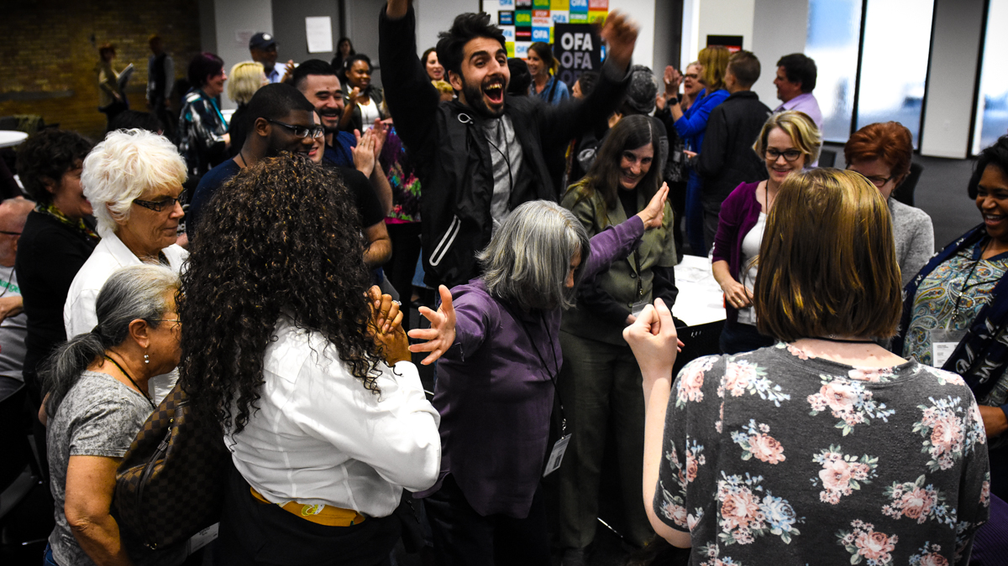


Local Issue Advocacy
Elizabeth Erickson / OFA Training Director
We will begin the training at 8 p.m. ET / 7 p.m. CT
Notes:
This work is licensed under the Creative Commons Attribution-NonCommercial 4.0 International License. To view a copy of this license, visit http://creativecommons.org/licenses/by-nc/4.0/ or send a letter to Creative Commons, PO Box 1866, Mountain View, CA 94042, USA
Enthusiastic welcome
Introduction of Liz -- hopeful optimist, educator by training, activist by luck
Transitions – one of my beliefs is the quote on the next slide --

Slide 2
“Never doubt that a small group of thoughtful, committed citizens can change the world.”

Slide 3
“Indeed, it is the only thing that ever has.”
—MARGARET MEAD

Slide 4

Identify all the components of local advocacy work
Express that local change is possible and necessary for this point in time
Feel a sense of community with the group
Goal for
this session
1
2
3

Slide 5
Tonight’s
agenda
 | Welcome and Introductions Local organizing examples Expectations & overview Applying advocacy – problems and issues Synthesis Closing & next steps

Slide 6


Guided worksheet
BIT.LY HERE

Slide 7
When was the first time
you remember observing
your community change
for the better?
Notes:
What happened? What were the circumstances? Type your answer in the chat box.
Connect answers to the ‘WHY’ of OFA – next slide

Slide 8
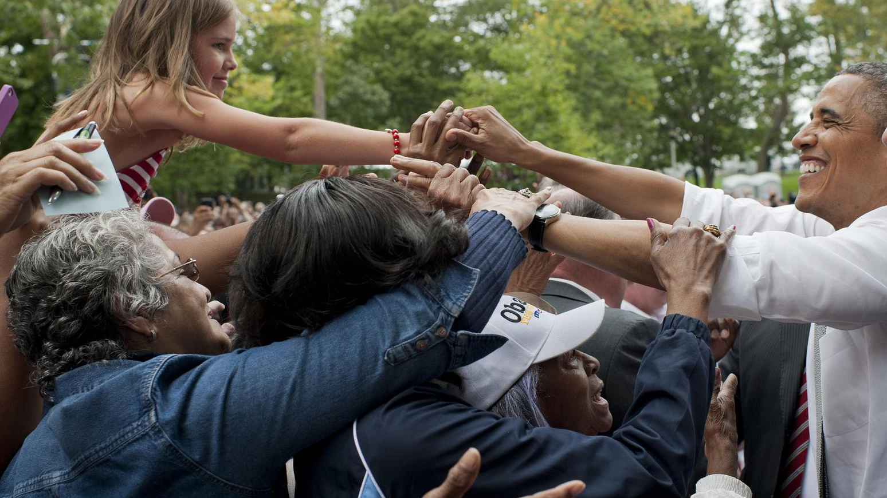
WE ARE OFA
Local Issue Advocacy
Foundations
Notes:
OFA believes that every voice matters in our democracy, and that every person can make a difference
Most of our country’s conversation is limited to national issues- or elections that come around every two to four years
Not only is our country’s conversation limited to national issues, but there are indicators that show minimal engagement with city elections - A study with CityLab found that only 15% of voters turn out for city elections
Too many urgent issues are caught up in gridlock in Washington- we have the opportunity to be effective organizers at the local level and make huge change locally
We only need to look back a few years to see what can happen historically

Slide 9
Tonight’s
agenda
 | Welcome and Introductions Local organizing examples Expectations & overview Applying advocacy – problems and issues Synthesis Closing & next steps

Slide 10
Local Level Examples
Montgomery Bus Boycott
Little Village Coal Plants
South Carolina Buses
Notes:
Local organizing has implications for national issues-
Montgomery Bus Boycott, -- planned and took a long time -- time, patience to pull off
countless fights for fair housing, clean air and water, fighting for a living wage- these all affect the health of the community, and we can be working towards them RIGHT NOW.
http://www.thestate.com/news/politics-government/article194949324.html
The health of your community is important - the act of doing civic engagement increases social connection and fabric of a community

Slide 11
What makes you excited
as you think about working
at a local level?
Be ready to share your name, city, and answer to the above question with the group.

Slide 12
Tonight’s
agenda
 | Welcome and Introductions Local organizing examples Expectations & overview Applying advocacy – problems and issues Synthesis Closing & next steps

Slide 13
Goals

Slide 14
1
Equip individuals with the skills to identify root problems in their community, and propose a campaign plan addressing these root problems.

Slide 15
1
Equip individuals with the skills to identify root problems in their community, and propose a campaign plan addressing these root problems.
To identify all the components of successful coalitions, and apply these elements of building a coalition in their community
2

Slide 16
1
Equip individuals with the skills to identify root problems in their community, and propose a campaign plan addressing these root problems.
To identify all the components of successful coalitions, and apply these elements of building a coalition in their community
To explain current legislation surrounding their issue, and take appropriate action
2
3

Slide 17
1
Equip individuals with the skills to identify root problems in their community, and propose a campaign plan addressing these root problems.
To identify all the components of successful coalitions, and apply these elements of building a coalition in their community
To explain current legislation surrounding their issue, and take appropriate action
To analyze the barriers and challenges that we face as we implement our campaign plans, and persevere strategically
2
3
4

Slide 18
1
Equip individuals with the skills to identify root problems in their community, and propose a campaign plan addressing these root problems.
To identify all the components of successful coalitions, and apply these elements of building a coalition in their community
To explain current legislation surrounding their issue, and take appropriate action
To analyze the barriers and challenges that we face as we implement our campaign plans, and persevere strategically
The develop a community of learners that support, push, challenge, and celebrate each other
2
3
4
5

Slide 19
We believe in your leadership.
Notes:
We believe in your leadership - this group is hand picked for this development, and we are tailoring this training to be the right thing at the right time
You will be getting specific feedback and support from our staff on your planning
We hope to develop this group as a cohort - a place that you can come to for support, ideas, brainstorming, pushing, hopefulness

Slide 20
Our learning journey
Week 1: Introductions; advocacy overview
Week 2: Workshop
Week 3: Foundations of coalition building
Week 4: Workshop
Week 5: Identifying legislation

Slide 21
Our learning journey
Week 6: Workshop
Week 7: Writing your campaign plan
Week 8: Workshop
Week 9: Running into barriers
Week 10: Closing synthesis and next steps

Slide 22
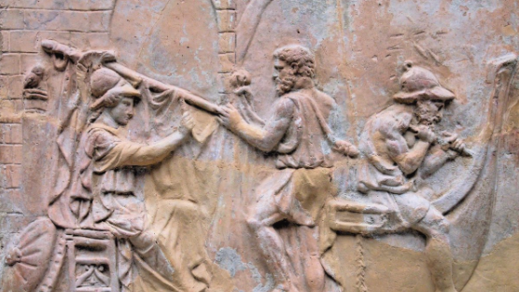
STRATEGY METAPHOR
Greek helmsman
Notes:
Plans are nothing, planning is everything-you will have workshopped an issue in your community and know the players, the decision makers, and as you start to work on your plan and implement it, your plans will likely change. The planning process is you setting yourself up to make good decisions and respond to development
Issues are not a static thing that are permanent- they change constantly
Guidance and tools to gather and interpret information they need to make change at a local level; they will gain skills as they practice
Example: raft on the river - looking down the river, analyzing the currents -- that is the skill
you will have created a campaign plan to address an issue you care about -- we are all about you being the most effective organizers you can be, pushing your leadership development, pushing for efficacy to make real, lasting change

Slide 23
Questions?

Slide 24
Tonight’s
agenda
 | Welcome and Introductions Local organizing examples Expectations & overview Applying advocacy – problems and issues Synthesis Closing & next steps

Slide 25
In the beginning,
the organizer’s first job
is to create the issue
or problems.
Notes:
- Put it into focus – find quote that talks about problems and issue

Slide 26

What do we mean by advocacy?
Cause
Advocacy is an active promotion of a cause or principle
Actions
Advocacy involves actions that lead to a selected goal
Community
Effective advocacy uses the strengths of community members

Slide 27
Advocacy usually involves
getting government, business, schools, or large institutions
to correct an unfair or harmful situation affecting people
in the community.
Community Tool Box

Slide 28
Understanding the issue
Recognizing allies
Essential Components
Advocacy usually involves getting government, business, schools, or large institutions to correct an unfair or harmful situation affecting people in the community.
Landscape of legislation
Developing
a plan for advocacy

Slide 29
Understandingthe issue
Essential Components
Advocacy usually involves getting government, business, schools, or large institutions to correct an unfair or harmful situation affecting people in the community.

Slide 30
Problems vs. Issues

Slide 31
Problems =
Broad areas of concern
Examples: unaffordable health care,
pollution, unemployment

Slide 32
Issues =
Solution or partial solution to a problem
Example: enacting a local
clean energy plan
Notes:
Some people have the luxury of choosing the problems on which they work. For others, the problem chooses them and can’t be avoided no matter how long or difficult the effort (ex: poverty, an oil spill both ‘choose’ people)
Individuals must still choose the issue. They must define a solution to the problem.
Issues: Solution or partial solution to a problem
Example: enacting a local clean energy plan

Slide 33
Reflection
Think about what brought you to this work.
  How would you currently describe the problem that your community is facing?
  How would you describe the issue you are working on?
  Type your answers on this google doc, and be ready to share!
Notes:
https://docs.google.com/document/d/1NKggKvk23eDVo9pHrd4WMwo7MKWaq5gtbmRwGJF8H10/edit

Slide 34
Breakouts
Notes:
7:10- 7:11
Why we need to have effective conversations – the time is NOW to understand our neighbors and understand the things that compel them

Slide 35
Indicators of good issues….
Result in the improvement of people’s lives
Make people aware of their own power
Be winnable
Be widely felt
Be deeply felt
Be easy to understand
Have a clear decision maker
Have a clear time frame
Be consistent with your values and vision

Slide 36
Group share

Slide 37
Tonight’s
agenda
 | Welcome and Introductions Local organizing examples Expectations & overview Applying advocacy – problems and issues Synthesis Closing & next steps

Slide 38
Debrief
What ways do you want
to narrow your issue?
What challenges do you foresee?

Slide 39
Next session
Notes:
Put in homework link – where they should put the answers to their work (slack?)
Give google drive link

Slide 40
Thank you for joining
today’s webinar.
Please fill out the survey below and give us
your feedback on today’s training.
bit.ly/AdvocacyBeliefs

