Slide 1


Welcome
Fall 2017 Campus Organizing Academy
We’ll get started at 8:00 pm Eastern Time
Notes:
This work is licensed under the Creative Commons Attribution-NonCommercial 4.0 International License. To view a copy of this license, visit http://creativecommons.org/licenses/by-nc/4.0/ or send a letter to Creative Commons, PO Box 1866, Mountain View, CA 94042, USA

Slide 2

OFA Campus Organizing Academy
Fall 2017
Kevin Lane, Training Projects Manager

Slide 3
Mission not impossible:
Achieving big goals

Slide 4
Recap & updates

Slide 5


Defining an issue ecosystem
The issue ecosystem is the set of conditions surrounding an issue: current policy, public opinion, decision makers positions, political capital, etc.
The goal of issue campaigns is to influence these conditions so that decision makers enact the change you wish to see.

Slide 6
Building the framework
1
An achievable, measurable, and problem-solving goal.
A strategy that provides the roadmap for success.
Effective tactics that accomplish your goal through the strategy you’ve developed.
2
3

Slide 7
Looking
ahead
1
Meet your Campus Coach and set-up your first 1:1 conversation.
Think about what you want to accomplish during the program.
For your second 1:1, come up with a clear goal to achieve in the Academy.
2
3

Slide 8
Program expectations
Attend 4/6 online trainings (with make-ups)
At least four 1:1 meetings with your coach
Submit an organizer project plan
Notes:
00:07 – 00:09 [2 min] – Ashley
[Broad Goals] Present core goals of the Fellowship program.
Today you are standing on the shoulders of giants – some of those giants are in the room today.
The Fellowship program you will run has two core goals:
Coach and train new organizers – the program identifies people who want to earn introductory level organizing skills. Throughout the program they learn tactics and strategies to organize effectively. Many Fellows go on to organize as volunteer leaders with OFA or other organizations. Others become professional organizers. Regardless of where they go next, the program gives them a broad view of organizing.
The second goal is to grow and support chapter structure. If the day after the program ends the fellows are not part of your chapter, or they did not help the chapter meet its goals, then the program failed to meet an important goal. Today you will focus a lot on how to make sure you are running a program that not only trains high quality Fellows, but also helps your chapter meet its goals.

Slide 9
Issues, politics, elections
OFA is a non-partisan issue advocacy organization
We cannot coordinate with or support organizations that focus on electoral or party specific work.
We can work with issue focused groups
We can train individuals that are a part of political groups, but we cannot sponsor, provide resources, or direct guidance on supporting political groups.

Slide 10
Questions?

Slide 11
Katie Robbins
Regional Organizing Manager

Slide 12
Meet each other!

Slide 13

8 minutes
Small groups
Things to share:
Name and where you’re from
School you’re attending
A big goal you have for this year

Slide 14

Debrief
Raise your hand or type in the chat box

Slide 15
Achieving big goals:
Case studies

Slide 17
Learning
Determination
Vision

Slide 18
What are your examples?

Slide 19
Setting the right goal

Slide 20
A goal is a target. Without one, you’ll never hit the bull’s eye!

Slide 21
Good goals are measurable, realistic, and solve a challenge.

Slide 22
Quotes on goals
“If it doesn’t challenge you, it won’t change you.”
“Set your goals high, and don’t stop till you get there.”
“Set goals that excite you and scare you at the same time.”
“Be stubborn about your goals, and flexible about your methods.”
“Success is not built on success. It’s build on failure. It’s build on frustration. Sometimes it’s build on catastrophe.”

Slide 23
Aim for the 50/50 mark

Slide 24
Setting a proper goal
1
Imagine you are a member of a new student group, Climate Action NOW.
Your group is holding its first meeting and deciding on its goals for the year.
Read through the goals and analyze them based on their measurability, feasibility, and if they solve a challenge.
Small groups
2
3

Slide 25
Pass a university resolution that commits 50% of roof space an all new buildings and 25% on current buildings for solar panels.
Pass a resolution that forces the university to divest from fossil fuels by the end of 2018.
Pass a resolution that commits the university to using more renewable energy sources, like wind and solar.
Pass a resolution that forces the university to analyze its current carbon footprint and publish the results.

Slide 26
Pass a university resolution that commits 50% of roof space an all new buildings and 25% on current buildings for solar panels.
Pass a resolution that forces the university to divest from fossil fuels by the end of 2018.
Pass a resolution that commits the university to using more renewable energy sources, like wind and solar.
Pass a resolution that forces the university to analyze its current carbon footprint and publish the results.

Slide 27
Pass a university resolution that commits 50% of roof space an all new buildings and 25% on current buildings for solar panels.
Pass a resolution that forces the university to divest from fossil fuels by the end of 2018.
Pass a resolution that commits the university to using more renewable energy sources, like wind and solar.
Pass a resolution that forces the university to analyze its current carbon footprint and publish the results.

Slide 28
Pass a university resolution that commits 50% of roof space an all new buildings and 25% on current buildings for solar panels.
Pass a resolution that forces the university to divest from fossil fuels by the end of 2018.
Pass a resolution that commits the university to using more renewable energy sources, like wind and solar.
Pass a resolution that forces the university to analyze its current carbon footprint and publish the results.

Slide 29
Setting a proper goal
Small groups
What goal did you choose, and why?
Did you make any edits to the goal?
Did you pick something else entirely?

Slide 30
So you want to run a campaign?
Katie Robbins

Slide 31
The “Big Picture” goal
The first step in developing a campaign is determining the “big picture” goal. What do you need to achieve to be successful?
In elections, it’s getting 50%+1 votes.
On issues, it can be a number of things.

Slide 32
Building in benchmarks
Benchmark goals are the stepping stones to measure progress and keep you on track.
They also serve to build a proper ramp towards achieving your big, ambitious goal.
Benchmarks take into account: time, capacity, additional resources.

Slide 33
Katie’s example

Slide 34
Get on “A” on your term paper

Slide 35
Get on “A” on your term paper
Waiting until 9pm the night before a paper is due is not the best way to achieve your goal.

Slide 36
Get on “A” on your term paper
Waiting until 9pm the night before a paper is due is not the best way to achieve your goal.
Instead, you build in benchmarks:

Slide 37
Get on “A” on your term paper
Waiting until 9pm the night before a paper is due is not the best way to achieve your goal.
Instead, you build in benchmarks:
Pick a topic for the paper
Read & take notes all source materials
Complete your first draft
Edits, revisions, and peer review
Final draft complete
Spot-check any typos, spelling errors, etc.
Get an A!

Slide 38
Proper benchmarks

Slide 39
Proper benchmarks
1
Benchmarks too should be measurable, realistic, and oriented towards solving challenges.
They timelines that make sense given your overarching goal.
They help track performance, and allow you to pace yourself over time.
Are adjustable!
2
3
4

Slide 40
Shout out
When have you used benchmarks?

Slide 41
Organizer ramp

Slide 42
Organizer ramp
How do we get there?
1.) Team building benchmarks
2.) Outreach benchmarks
We need thousands of constituents to call, pressure, rally, and take action on this issue. One organizer can’t do it alone.
Big picture goal:
Convince Congresswoman Robins to vote “no” on HR 365

Slide 43
Organizer ramp
Team building benchmarks
Team building starts first and continues to increase quickly over the first few weeks of the campaign.
Outreach benchmarks
Outreach goals start very low to allow you to build up your team. They increase quickly once your team has been built.
Big picture goal:
Convince Congresswoman Robins to vote “no” on HR 365

Slide 44
Organizer ramp
Ultimately, it is the outreach actions that will get you to the big picture goal.
But you can’t do the proper outreach without the right size team and capacity.
Both your team building and outreach goals need to follow an increasing ramp.
Big picture goal:
Convince Congresswoman Robins to vote “no” on HR 365

Slide 45
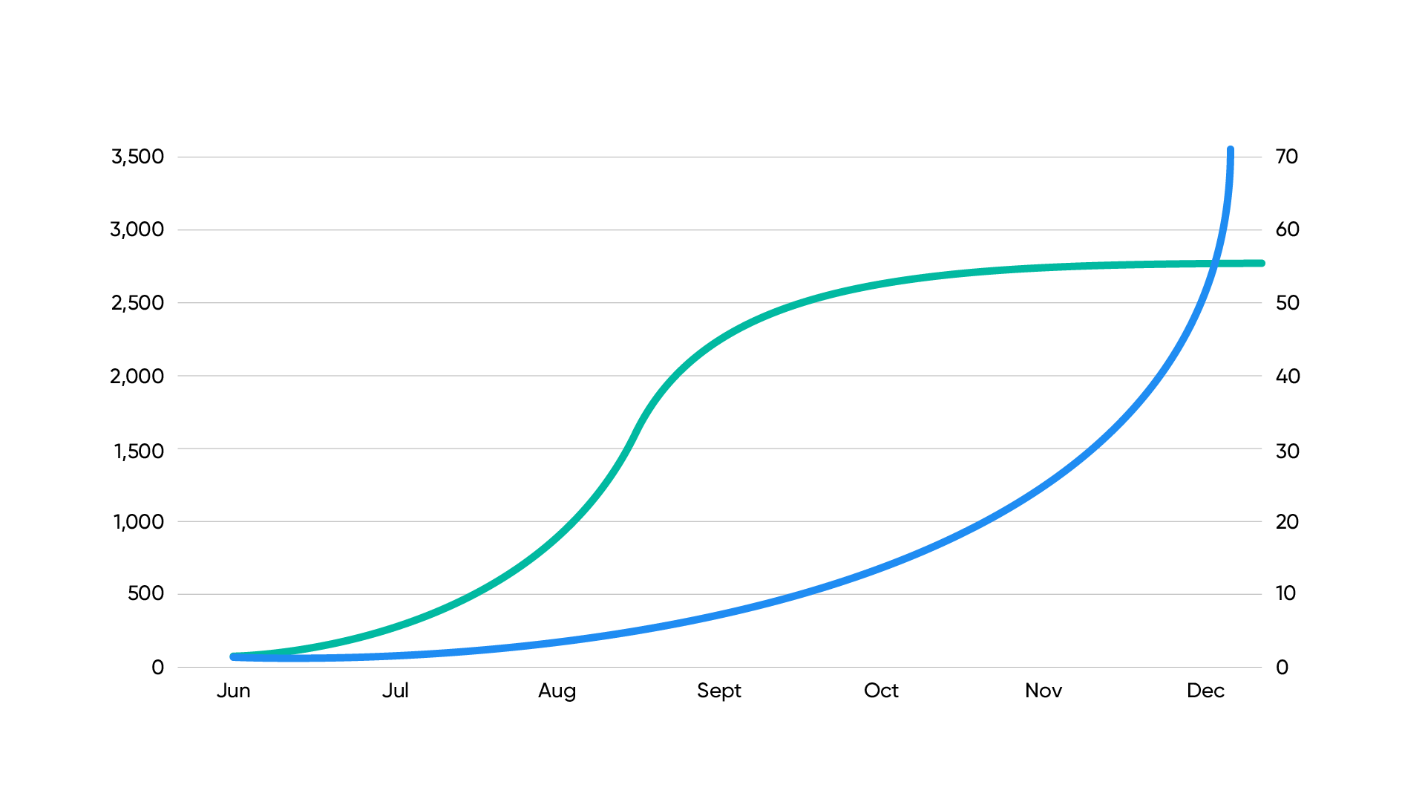
Monthly Campaign Goals
Outreach attempts
Active volunteers
Team building
Outreach

Slide 46
Putting it all together

Slide 47
1
Pass a university resolution that commits 50% of roof space an all new buildings and 25% on current buildings for solar panels.
2
Pass a resolution that forces the university to divest from fossil fuels by the end of 2018.
3
Pass a resolution that commits the university to using more renewable energy sources, like wind and solar.
4
Pass a resolution that forces the university to analyze its current carbon footprint and publish the results.

Slide 48
Debrief
Raise your hand or type in the chat box

Slide 49
Next steps & close

Slide 50


Join us on Slack!

Slide 51
Next call:
Thursday, October 12
7pm Central Time

Slide 52
Any questions?

Slide 53
Thank you!

