Slide 1


Welcome
Fall 2017 Campus Organizing Academy
We’ll get started at 8:00 pm Eastern Time
Notes:
This work is licensed under the Creative Commons Attribution-NonCommercial 4.0 International License. To view a copy of this license, visit http://creativecommons.org/licenses/by-nc/4.0/ or send a letter to Creative Commons, PO Box 1866, Mountain View, CA 94042, USA

Slide 2

OFA Campus Organizing Academy
Fall 2017
Kevin Lane, Training Projects Manager

Slide 3
Welcome & introductions

Slide 4
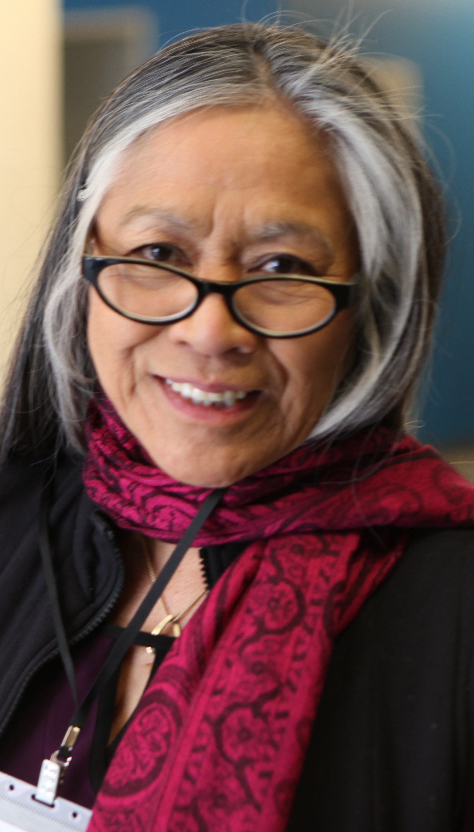

Meet our Coaches
OFA Volunteer Leaders:
Belinda Burroughs, VA
Hope Busto-Keyes, HI
Kathy Carter, IL
Verdell Clark, MD
Denise Fernandes, NJ
Mauricio Jimenez, FL
Cameron Greer, TX
Susanne Huttner, CA
Jakob Lineberry, MO
Howard Matis, CA
Monique Navarro, TX
Amanda Nicholson, NY
Sharmaine Olay, CA
Wannetta Phillips, NJ
Mary Studley, IN

Slide 5
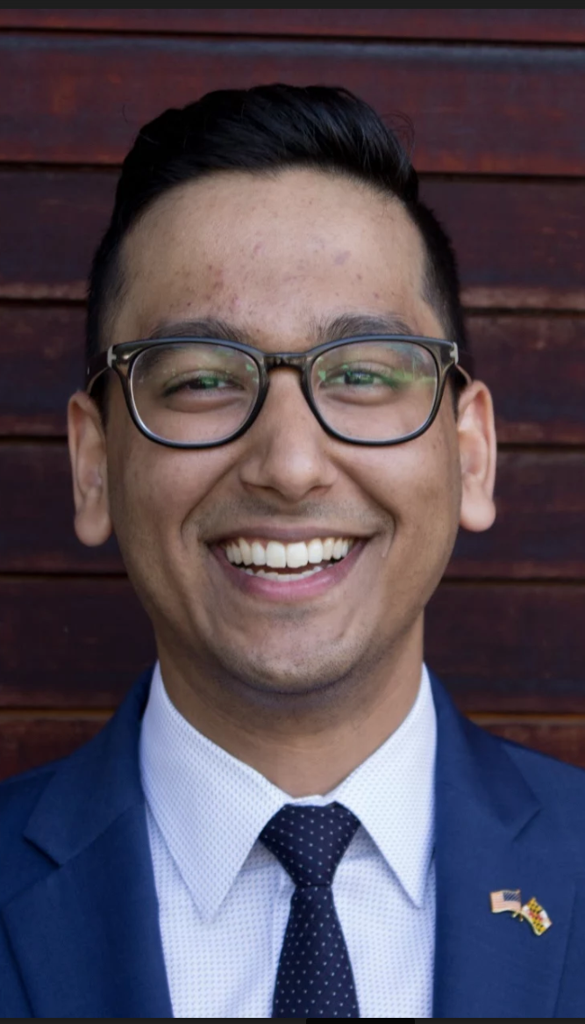
Meet our Coaches
OFA Alumni:
Patrick Burton, DC
Michael Ceraso, CA
Thomas DeLoach, CA
Mona DeQuis, MI
Ashwani Jain, MD
Leah Kellgren, CA
Neal Morgan, CA
Vanessa Jimenez-Browne, CA
Andrea Nemecek, IA
David Pena, NM
Robin Schmidt, WI
Rachel Schneider, IL
Christine Senteno, DC
Jerron Totten, NC
Joel Wanger, MD

Slide 6
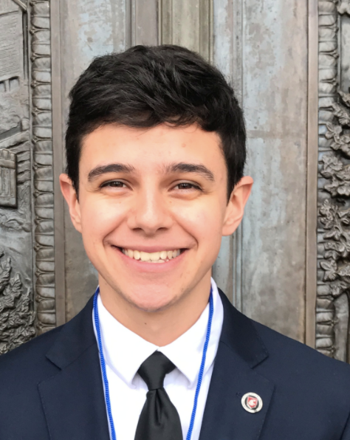
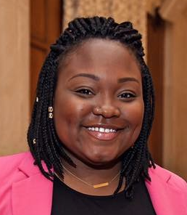
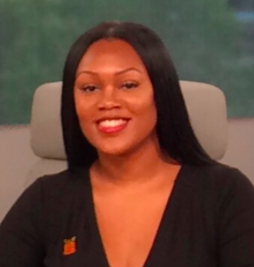
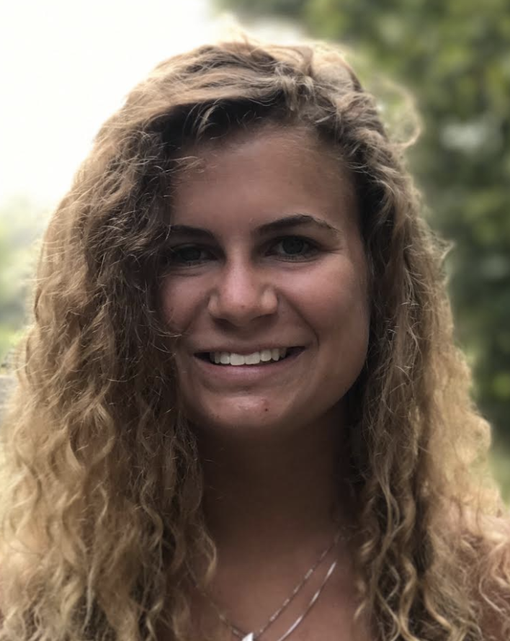
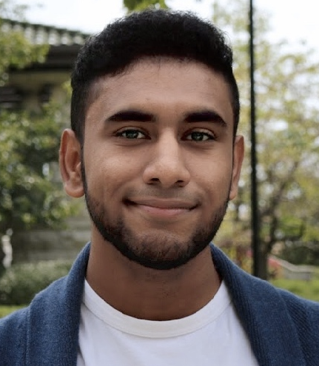
Campus Organizing Academy: Fall 2017
64 students from 29 different states.
Over 50 campuses! Undergrad, graduate, and some high school students in the program.
All campus leaders and the next generation of progressive organizers!

Slide 7
Meet each other!

Slide 8

8 minutes
Group Activity
Things to share:
Name and where you’re from
Area(s) of study or interest
A fun fact about yourself
Anything else!

Slide 9

Share
Type in the chat box or raise your hand

Slide 10
Norms and expectations

Slide 11




Logistics
We will meet for 90 minutes
Send technology questions
to organizing@ofa.us.
A recording of this training will be
available later this week.
It’s cool if you tweet—use #OFAction.
Notes:
00:01 – 00:03 [2 min] – Aquiles
Before we get started, let’s review some logistics

Slide 12
Goals for the Academy
1
Gain a deeper understanding of the strategic framework for organizing effective campaigns.
Develop concrete organizing skills and leadership through trainings and your campus coach.
Begin to see ourselves as organizing leaders within the progressive movement.
2
3

Slide 13
Your goals?
Type in the chat box or raise your hand

Slide 14
Program expectations
Attend 4/6 online trainings (with make-ups)
Notes:
00:07 – 00:09 [2 min] – Ashley
[Broad Goals] Present core goals of the Fellowship program.
Today you are standing on the shoulders of giants – some of those giants are in the room today.
The Fellowship program you will run has two core goals:
Coach and train new organizers – the program identifies people who want to earn introductory level organizing skills. Throughout the program they learn tactics and strategies to organize effectively. Many Fellows go on to organize as volunteer leaders with OFA or other organizations. Others become professional organizers. Regardless of where they go next, the program gives them a broad view of organizing.
The second goal is to grow and support chapter structure. If the day after the program ends the fellows are not part of your chapter, or they did not help the chapter meet its goals, then the program failed to meet an important goal. Today you will focus a lot on how to make sure you are running a program that not only trains high quality Fellows, but also helps your chapter meet its goals.

Slide 15
Program expectations
Attend 4/6 online trainings (with make-ups)
At least four 1:1 meetings with your coach
Notes:
00:07 – 00:09 [2 min] – Ashley
[Broad Goals] Present core goals of the Fellowship program.
Today you are standing on the shoulders of giants – some of those giants are in the room today.
The Fellowship program you will run has two core goals:
Coach and train new organizers – the program identifies people who want to earn introductory level organizing skills. Throughout the program they learn tactics and strategies to organize effectively. Many Fellows go on to organize as volunteer leaders with OFA or other organizations. Others become professional organizers. Regardless of where they go next, the program gives them a broad view of organizing.
The second goal is to grow and support chapter structure. If the day after the program ends the fellows are not part of your chapter, or they did not help the chapter meet its goals, then the program failed to meet an important goal. Today you will focus a lot on how to make sure you are running a program that not only trains high quality Fellows, but also helps your chapter meet its goals.

Slide 16
Program expectations
Attend 4/6 online trainings (with make-ups)
At least four 1:1 meetings with your coach
Submit an organizer project plan
Notes:
00:07 – 00:09 [2 min] – Ashley
[Broad Goals] Present core goals of the Fellowship program.
Today you are standing on the shoulders of giants – some of those giants are in the room today.
The Fellowship program you will run has two core goals:
Coach and train new organizers – the program identifies people who want to earn introductory level organizing skills. Throughout the program they learn tactics and strategies to organize effectively. Many Fellows go on to organize as volunteer leaders with OFA or other organizations. Others become professional organizers. Regardless of where they go next, the program gives them a broad view of organizing.
The second goal is to grow and support chapter structure. If the day after the program ends the fellows are not part of your chapter, or they did not help the chapter meet its goals, then the program failed to meet an important goal. Today you will focus a lot on how to make sure you are running a program that not only trains high quality Fellows, but also helps your chapter meet its goals.

Slide 17
Issues, politics, elections
OFA is a non-partisan issue advocacy organization
We cannot coordinate with or support organizations that focus on electoral or party specific work.
We can work with issue focused groups.
We can train individuals that are a part of political groups, but we cannot sponsor, provide resources, or direct guidance on supporting political groups.

Slide 18
Why organize? Why now?

Slide 19
The issue ecosystem

Slide 20

Defining an issue ecosystem
The issue ecosystem is the set of conditions surrounding an issue: current policy, public opinion, decision makers positions, political capital, etc.
The goal of issue campaigns is to influence these conditions so that decision makers enact the change you wish to see.

Slide 21
Make your interests
align with the self-interest
of decision makers.

Slide 22
Make your interests
align with the self-interest
of decision makers.
(or seem to align)

Slide 23
Health care
Health care reform has been top political issue for decades. It is a dynamic and ever-changing issue ecosystem.

Slide 24
8 minutes
Raise your hand or type in the chat box to share
Consider an issue ecosystem for an issue you care about:
Who are the key decision makers?
How much political capital / will exists?
Where does the public stand?
What forces are working against you? For you?

Slide 25
Issue campaigns

Slide 26
Building the framework
1
A goal.
A strategy.
Tactics.
2
3

Slide 27
Building the framework
1
An achievable, measurable, and problem-solving goal.
A strategy.
Tactics.
2
3

Slide 28
Building the framework
1
An achievable, measurable, and problem-solving goal.
A strategy that provides the roadmap for success.
Tactics.
2
3

Slide 29
Building the framework
1
An achievable, measurable, and problem-solving goal.
A strategy that provides the roadmap for success.
Effective tactics that accomplish your goal through the strategy you’ve developed.
2
3

Slide 30
Montgomery Bus Boycotts
Notes:
https://www.youtube.com/watch?v=FE6Yvy--5aw

Slide 31


Slide 32
Debrief
Type in the chat box or raise your hand

Slide 33

Rubber Stamp
Reps
OFA’s long-term campaign to hold elected officials accountable to the will of their constituents and better serve the their districts.

Slide 34
Building the framework
1
An achievable, measurable, and problem-solving goal.
A strategy that provides the roadmap for success.
Effective tactics that accomplish your goal through the strategy you’ve developed.
2
3

Slide 35
Next steps

Slide 36
Campus Organizer Backpack

Slide 37
Setting up your first 1:1
Campus coaches will be assigned to you by Thursday, September 21.
I will introduce you via email. You and your coach should schedule your first 1:1 conversation by Thursday, September 28.

Slide 38
bit.ly/democampus

Slide 39
Next call:
Thursday, September 28
8pm Eastern Time

Slide 40
Any questions?

