Slide 1
Welcome
Fall 2017 Campus Organizing Academy
We’ll get started at 8:00 pm Eastern Time
Notes:
This work is licensed under the Creative Commons Attribution-NonCommercial 4.0 International License. To view a copy of this license, visit http://creativecommons.org/licenses/by-nc/4.0/ or send a letter to Creative Commons, PO Box 1866, Mountain View, CA 94042, USA

Slide 2
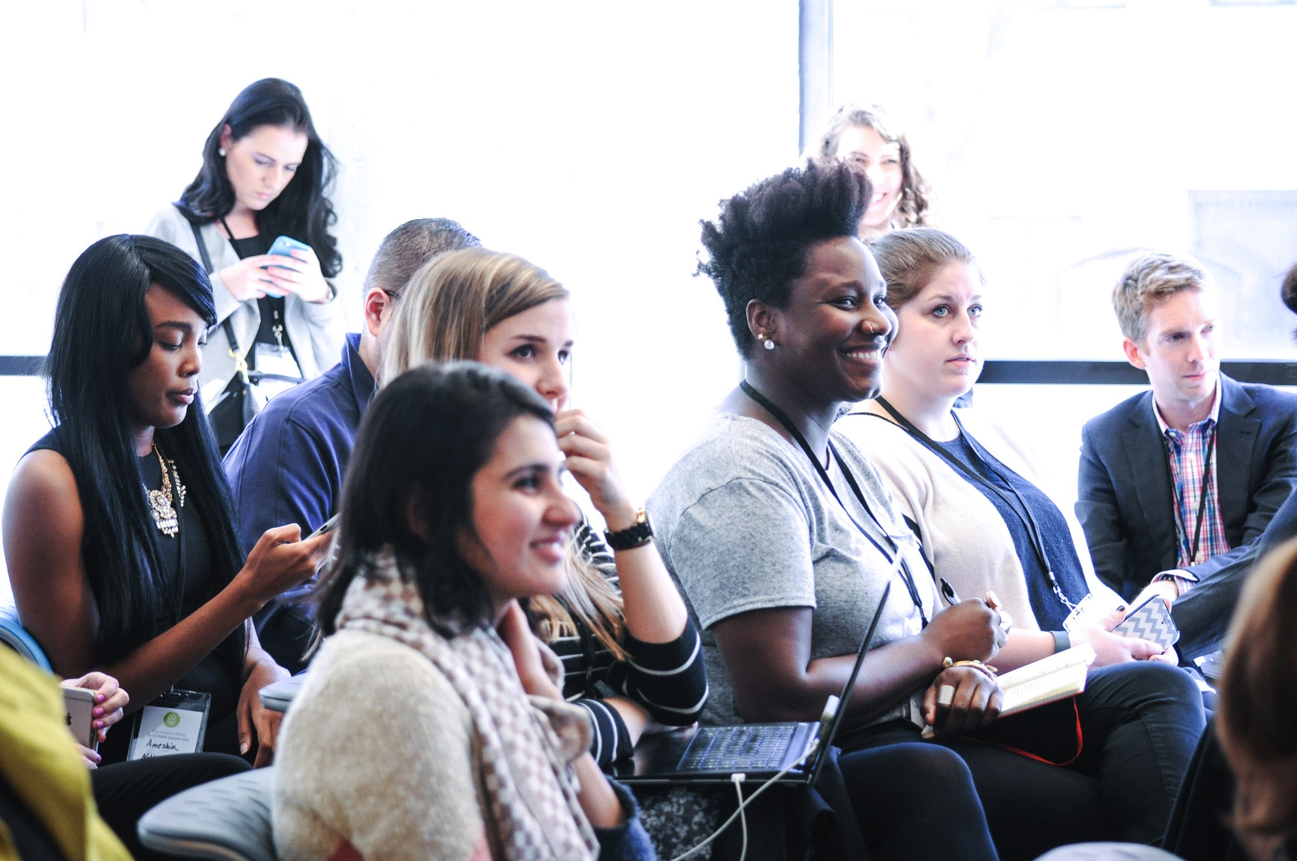
Digital organizing:
Memes to Mobilization

Slide 3
#OFACampus
@klane228

Slide 4
Jonathan Kibort
Digital Organizing Strategist

Slide 5
Meet each other!

Slide 6
5 minutes
Partner activity
Things to share:
Name and where you’re from
Your biggest role model
Your favorite food

Slide 7
The 3 M’s of Digital

Slide 8
What do digital programs do?
Type in the chat box or
raise your hand

Slide 9
The 3 M’s

Slide 10
The 3 M’s
Money

Slide 11
The 3 M’s
Money
Message

Slide 12
The 3 M’s
Money
Message
Mobilization

Slide 13
For today’s training we’ll focus on two of these: message and mobilization.

Slide 14
Crafting your message

Slide 15
At the core of any relationship is one thing:

Slide 16
At the core of any relationship is one thing:
Trust.

Slide 17
If you do not trust a brand, or organization, you are likely not going to take action or respond.

Slide 18
And if your list does not trust you, you have no chance at mobilizing them to action.

Slide 19
Building trust

Slide 20
Building trust
Authenticity

Slide 21
Building trust
Authenticity
Relevance

Slide 22
Building trust
Authenticity
Relevance
Efficacy

Slide 23
Mobilizing to action

Slide 24
To be able to mobilize we first must organize!

Slide 25
Mobilizing & organizing
What’s the difference?

Slide 26
Mobilize for the moment
When you mobilize, you’re flex your muscle—using your strategic and tactical know how to force answers or action from decision-makers. It’s where you move the needle on the issues.

Slide 27
Organize for
longevity
Your organizing efforts nourish the team that makes your advocacy possible. That includes you, your volunteers, your community, and the partners you work with.

Slide 28
What’s the power of social media?
Type in the chat box

Slide 29
How do we mobilize & organize on social media?
Type in the chat box
Notes:
How do you use it?

Slide 30
Facebook has 1.86 billion users in the world.

Slide 31
Twitter reports having more than 300 million monthly active users
and 500 million Tweets sent daily.

Slide 32
Twitter is best for mobilizing.
Your audience is the public. Unless you have made your account private, everyone can see what you’re communicating—including potential recruits, representatives, and reporters.

Slide 33
Mobilizing on Twitter:
Photos of events—evidence of your strength
Videos—of town halls, personal stories, etc. Implicit ask is to share to spread the message
Using a representative’s handle—directing content at decision-makers
Notes:
https://twitter.com/paulgeenen/status/859093131647758336
https://twitter.com/paulgeenen/status/859110364948168704
NOTE: Photos. Calls to action. (Implicit) actions to take.

Slide 34
Mobilizing on Twitter:
Catchy soundbites—Saying something provocative (but respectful!) to draw attention
Calls to action—such as links to a call tool, letter-to-the-editor tool, enrollment website
Usually, hashtags—strategically inserts your message into a conversation to start/influence the narrative
Notes:
https://twitter.com/paulgeenen/status/859093131647758336
https://twitter.com/paulgeenen/status/859110364948168704
NOTE: Photos. Calls to action. (Implicit) actions to take.

Slide 35
Organizing on Twitter:
Retweeting/quote tweeting—Help others spread their message
Shout-outs—Give credit, build others up
Replying—Chat (and others can follow along)
Direct messaging (“DM-ing”)—Chat more in-depth
Twitter lists—Filter out the noise and keep up with your people
Notes:
https://twitter.com/jalakoisolomon/status/856664266279202816

Slide 36
Mobilizing on Facebook is trickier.
Pages—showcasing action, strength
Photos—evidence
Facebook live—videos that give onlookers a window into what’s going on
Your audience is usually your network only.

Slide 37
Facebook is better for organizing, but still not the best.
Groups—for conversations
Manifestos—to recruit
Lists—to make asks of people from specific walks in your life
Events—eh, not great. Can be shared, sure, but unreliable
Notes:
tus/856664266279202816

Slide 38
Facebook is a mobilizing/organizing blend.
Your audience is usually not the public. As such, your posts speak mainly to those in your network only; those connections could be good hot leads, but they’re all you’re working with. Mobilize and organize accordingly.

Slide 39
Debrief

Slide 40
Next call:
Thursday, November 9
8pm Eastern Time

Slide 41
Any questions?

Slide 42
Thank you!

