Slide 1


Welcome
Fall 2017 Campus Organizing Academy
We’ll get started at 8:00 pm Eastern Time
Notes:
This work is licensed under the Creative Commons Attribution-NonCommercial 4.0 International License. To view a copy of this license, visit http://creativecommons.org/licenses/by-nc/4.0/ or send a letter to Creative Commons, PO Box 1866, Mountain View, CA 94042, USA

Slide 2
Tackling Tactics:
Tying it all Together

Slide 3
Welcome & intros

Slide 4
DeAndre Jones
Regional Organizing Manager

Slide 5


5 minutes
Partner Activity
Things to share:
Name and where you’re from
School you’re attending
Your favorite place

Slide 6
Your Learning Journey

Slide 7
Your Learning Journey
1
The Issue With Organizing: Building The Proper Framework
Mission Not Impossible: Achieving Big Goals
Organizing Strategy: A Roadmap To Success
2
3

Slide 8
Your Learning Journey
4
Digital Organizing: Memes To Mobilization
Passion Into Action: Telling Your Story
Tackling Tactics: Tying It All Together
5
6

Slide 9
Your Learning Journey
4
Digital Organizing: Memes To Mobilization
Passion Into Action: Telling Your Story
Tackling Tactics: Tying It All Together
5
Submit your graduation form by November 27!
I’ll be sending it out tomorrow morning
6

Slide 10
Tackling Tactics

Slide 11
Tactics are the actions you take to get you to your goal. They always follow the roadmap laid out by your strategy.

Slide 12

What are some effective organizing tactics?
Type in the chat box or raise your hand

Slide 13
Effective Tactics
1
Signature drives
Press conferences & rallies
Town halls & forums
Office visits & phone calls
Digital organizing
6
Film screenings
Panel discussions
Community engagement events
Trainings & house parties
2
7
3
8
4
9
5
Notes:
00:07 – 00:09 [2 min] – Ashley
[Broad Goals] Present core goals of the Fellowship program.
Today you are standing on the shoulders of giants – some of those giants are in the room today.
The Fellowship program you will run has two core goals:
Coach and train new organizers – the program identifies people who want to earn introductory level organizing skills. Throughout the program they learn tactics and strategies to organize effectively. Many Fellows go on to organize as volunteer leaders with OFA or other organizations. Others become professional organizers. Regardless of where they go next, the program gives them a broad view of organizing.
The second goal is to grow and support chapter structure. If the day after the program ends the fellows are not part of your chapter, or they did not help the chapter meet its goals, then the program failed to meet an important goal. Today you will focus a lot on how to make sure you are running a program that not only trains high quality Fellows, but also helps your chapter meet its goals.

Slide 14
Effective Tactics
An effective tactic appeals to a decision maker’s motivations.
There are three ways to communicate with decision makers:
Press
Online
Directly

Slide 15






An issue ecosystem is the environment
surrounding a decision maker.
Notes:
Elected officials and other decision makers are constantly surrounded by messages from people asking them to take one stand or another on an issue. They receive these messages through a variety of mediums and from a variety of voices.
Decision makers are surrounded by many issue ecosystems every day. If you and your partner organizations are not part of an issue ecosystem around a decision maker, the opposition is filling that space with their message or the issue is not on the target’s radar.

Slide 16
Our goal:
To create the conditions for decision makers to take action on the issue we care about.

Slide 17
Case studies

Slide 18
Persuading David Mendez
Moderate
No previous public statements
Pro-business
Positive, mainstream image in the state
Represent a high share of independents

Slide 19
We need elected officials
to vote our way.
Notes:
We need elected officials to vote in certain ways in order to enact the right policy.
This goes for any level of government– from members of Congress down to city councils
As such, we need to treat certain elected officials as persuadable voters-– but first we need to win their support

Slide 20
We need elected officials
to vote our way.
What motivates them?
Notes:
We have to appeal to their motivations. What might some of their motivations be?
[Lead the participants in a popcorn discussion about what kinds of things elected officials might be motivated by. Write their ideas in a list on butcher paper/white board at the front of the room. Steer them in the right direction. Below are a few ideas of the kind of track they should be on:
Desire to be in the mainstream
Desire to be liked by constituents
Desire to hold higher office
Desire to stand up for strongly held beliefs.]
These are all great ideas. Now, imagine I’m a state senator and I am particularly motivated by [use an idea from the board], what do I need to be convinced of in order to take the stance you want me to take?
[Ask participants for their ideas on this, and take a few comments before revealing the answer. Acknowledge those who were on the right track.]
That’s right – I need to be convinced that taking the stance you want me to take can actually give me that thing that I want.
And an effective issue campaign is going to create a bunch of different avenues for communicating that point to me.

Slide 21
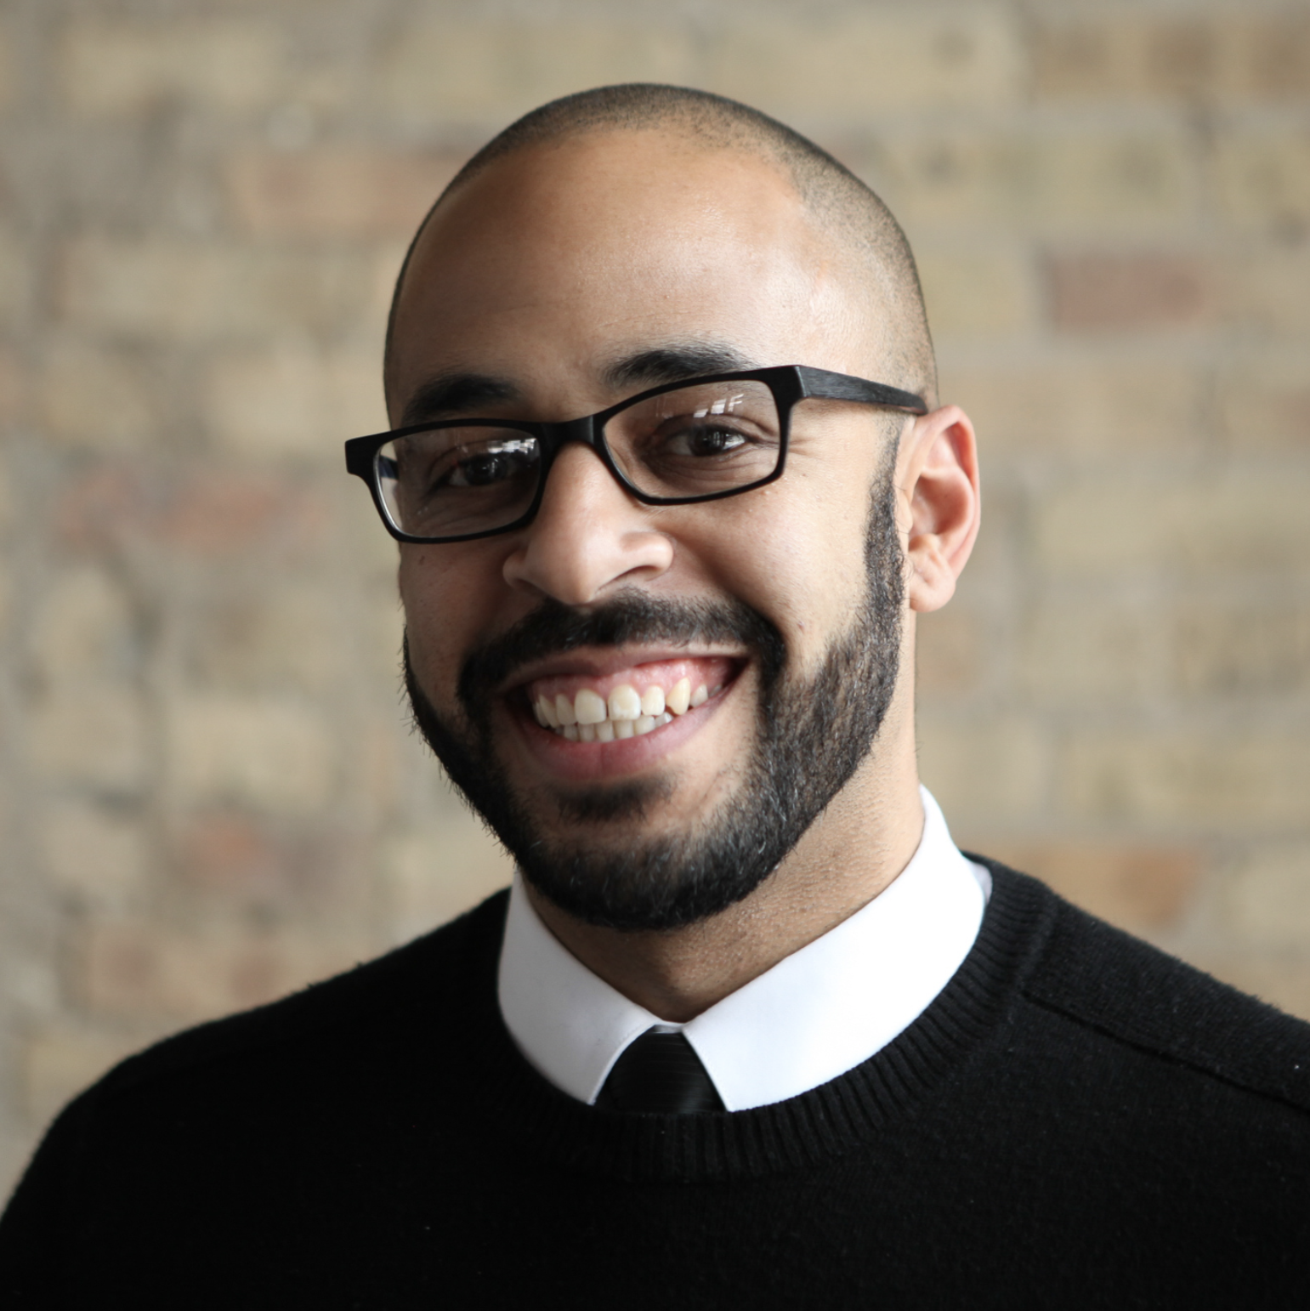
Meet Senator David Mendez
Moderate
No previous public statements
Pro-business
Positive, mainstream image in the state
Represents high share of independents
Notes:
In order to demonstrate this, I want you to visualize something with me. Imagine I’m a state senator, and I serve in a state that is often mocked nationally as “backward,” which a number of national businesses have threatened to boycott.
There is a bill on marriage equality coming up for a vote in the state legislature.
I’m a moderate state senator, and
I’ve never made any public statements on this topic.
I also ran as a pro-business candidate, and I promised to work hard to restore my state’s positive image,
In order to attract businesses and tourism.
I also serve a district that is made up of 45% Republicans, 40% Democrats, and 15% Independents.

Slide 22
Letters to the Editor
“Protecting the ACA will
put our state on the right
side of history.”
Notes:
The day before the vote, I wake up in the morning and read the newspaper. There, I see a Letter to the Editor titled “Senator Mandez, Marriage Equality will put our state on the right side of history,” where the writer identifies herself as an Independent voter from my district.

Slide 23

Office phone calls
312 against
938 support ACA
Notes:
Then, he goes into his office, where he gets a morning briefing from his staff. In that briefing, they tell him that yesterday, our office got 245 calls from constituents, with 184 of them in support of marriage equality.

Slide 24
Social media
Flooded Facebook with comments
56 @mentions on Twitter
187 emails
Notes:
They also tell me that my Facebook page has been flooded by comments urging me to vote yes on the bill because it will help my state’s economy, with no “anti” comments. I’ve also received 56 @mentions on twitter about the topic, with 48 of them showing a picture of me arm in arm with a very conservative state senator who frequently makes national news for backwards and regressive remarks, asking if I will side with him or with the people.
equality.

Slide 25
Rallies outside of office
Message: “the ACA is here to stay!”
Notes:
Then, I leave my office to go to a meeting with a constituent group, and as I’m leaving, I see about a dozen demonstrators outside my office chanting “We want equality, it’s good for the economy!” and there is a local news van pulling up to the curb.

Slide 26
Earned media events
“Thanks to Obamacare, I was able to obtain coverage while having a pre-existing condition. I will no longer have that protection under this new law.”
-Small Business Owner
Notes:
And then that night when I go home, I see this group in the background on the nightly news. In the foreground, there’s a local business owner giving an interview, citing a statistic that passing marriage equality would bring jobs to my state and that is why he hopes I will vote yes on the bill.

Slide 27
We put issues on elected
leaders’ radar.
Notes:
So throughout my day, I have taken in all this data that tells me independent voters support marriage equality, that the majority of my constituents want me to support marriage equality, that marriage equality will help local businesses and the economy, and that the best thing I can do to maintain my image as a mainstream, pro-business moderate is to support it.
I’d like to pose a question to you: HOW did that information make it onto my radar? [Call on a few participants to share their thoughts.]
That’s right – it didn’t happen on accident. It came onto my radar because of the issue organizers out there who worked really hard to make sure that the slice of reality I am experiencing throughout my day actually MATCHES with that bigger picture reality of my district. If the issue organizers in support of marriage equality had stayed quiet, then the issue organizers AGAINST marriage equality would have filled that space with deceptive messages to convince me the best thing I can do to maintain my image as a mainstream, pro-business moderate is to vote against it.
Ecosystem metaphor: We call that slice of reality surrounding an elected official an “ecosystem.” It’s all about creating the conditions for the outcome that you want. So if you think about a fruit tree as an example: a tree needs a lot of different conditions to line up in order for it to grow and produce a fruit. It needs the right amount of sunlight and water, and needs the right kind of nutrients in the soil – and it needs all of those things in tandem with one another. Even if it gets PLENTY of water, but no sunlight and the wrong soil, it won’t grow. Even if that water was the best, most perfectly pH balanced water out there.

Slide 28
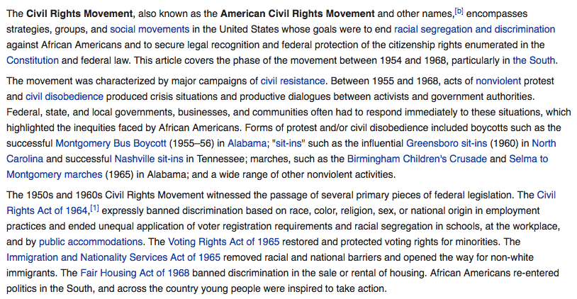
Civil Rights Movement
Notes:
In order to demonstrate this, I want you to visualize something with me. Imagine I’m a state senator, and I serve in a state that is often mocked nationally as “backward,” which a number of national businesses have threatened to boycott.
There is a bill on marriage equality coming up for a vote in the state legislature.
I’m a moderate state senator, and
I’ve never made any public statements on this topic.
I also ran as a pro-business candidate, and I promised to work hard to restore my state’s positive image,
In order to attract businesses and tourism.
I also serve a district that is made up of 45% Republicans, 40% Democrats, and 15% Independents.

Slide 29
One tactic alone
does not persuade
a decision maker.
Notes:
We can’t just count on one of these methods of communicating to our elected officials if we are going to create an effective issue ecosystem. It can’t be JUST Letters to the Editor in the local newspaper, or JUST Facebook comments. It has to be a combination of things that keep popping up onto the elected official’s radar on an ongoing basis.

Slide 30
It takes a combination
of strategically-planned tactics to ensure your message is heard.
Notes:
As an OFA volunteer, you are going to contribute to the ecosystem. You can’t create the whole ecosystem on your own – it’s going to take a whole coalition of folks to do that. But you will contribute to the issue ecosystem around a Decision Maker.

Slide 31
12 minutes
Individual Reflection
Think about the issue important to you. Keeping in mind your goal and strategy, answer the following:
What are the tactics you will use to achieve your goal?
How will you diversify and schedule them to maximize their impact?
What message are you conveying with your tactics?

Slide 32
12 minutes
Individual Reflection
Think about the issue important to you. Keeping in mind your goal and strategy, answer the following:
What are the tactics you will use to achieve your goal?
How will you diversify and schedule them to maximize their impact?
What message are you conveying with your tactics?

Slide 33
Debrief
Type in the chat box or raise your hand

Slide 34
Working with partners

Slide 35
Establishing Partnerships
Three keys to building new partnerships

Slide 36
Establishing partnerships
Three keys to building new partnerships
Do your research

Slide 37
Establishing partnerships
Three keys to building new partnerships
Do your research
Hold 1:1 meetings

Slide 38
Establishing partnerships
Three keys to building new partnerships
Do your research
Hold 1:1 meetings
Find coalition tables

Slide 39
What is a coalition table?
1
Recurring meeting of individuals, representative from groups and community organizations with common interests and goals.
Provides space for updates and discussion on messaging, calendars, and tactics.
Concludes with agreed upon actions and next steps.
2
3

Slide 40
Breaking into a table
Identify key decision makers. Ask!
Become a regular and contribute.
Bring the doughnuts or host the space.
Sweep the floor. Do the tough jobs.
Under promise, over deliver.
Notes:
00:07 – 00:09 [2 min] – Ashley
[Broad Goals] Present core goals of the Fellowship program.
Today you are standing on the shoulders of giants – some of those giants are in the room today.
The Fellowship program you will run has two core goals:
Coach and train new organizers – the program identifies people who want to earn introductory level organizing skills. Throughout the program they learn tactics and strategies to organize effectively. Many Fellows go on to organize as volunteer leaders with OFA or other organizations. Others become professional organizers. Regardless of where they go next, the program gives them a broad view of organizing.
The second goal is to grow and support chapter structure. If the day after the program ends the fellows are not part of your chapter, or they did not help the chapter meet its goals, then the program failed to meet an important goal. Today you will focus a lot on how to make sure you are running a program that not only trains high quality Fellows, but also helps your chapter meet its goals.

Slide 41
Shout out
Type in the chat box or raise your hand

Slide 42
Managing partnerships
Notes:
00:07 – 00:09 [2 min] – Ashley
[Broad Goals] Present core goals of the Fellowship program.
Today you are standing on the shoulders of giants – some of those giants are in the room today.
The Fellowship program you will run has two core goals:
Coach and train new organizers – the program identifies people who want to earn introductory level organizing skills. Throughout the program they learn tactics and strategies to organize effectively. Many Fellows go on to organize as volunteer leaders with OFA or other organizations. Others become professional organizers. Regardless of where they go next, the program gives them a broad view of organizing.
The second goal is to grow and support chapter structure. If the day after the program ends the fellows are not part of your chapter, or they did not help the chapter meet its goals, then the program failed to meet an important goal. Today you will focus a lot on how to make sure you are running a program that not only trains high quality Fellows, but also helps your chapter meet its goals.

Slide 43
Managing partnerships
Reinforce your guiding theory of change
Notes:
00:07 – 00:09 [2 min] – Ashley
[Broad Goals] Present core goals of the Fellowship program.
Today you are standing on the shoulders of giants – some of those giants are in the room today.
The Fellowship program you will run has two core goals:
Coach and train new organizers – the program identifies people who want to earn introductory level organizing skills. Throughout the program they learn tactics and strategies to organize effectively. Many Fellows go on to organize as volunteer leaders with OFA or other organizations. Others become professional organizers. Regardless of where they go next, the program gives them a broad view of organizing.
The second goal is to grow and support chapter structure. If the day after the program ends the fellows are not part of your chapter, or they did not help the chapter meet its goals, then the program failed to meet an important goal. Today you will focus a lot on how to make sure you are running a program that not only trains high quality Fellows, but also helps your chapter meet its goals.

Slide 44
Managing partnerships
Reinforce your guiding theory of change
Negotiate
Notes:
00:07 – 00:09 [2 min] – Ashley
[Broad Goals] Present core goals of the Fellowship program.
Today you are standing on the shoulders of giants – some of those giants are in the room today.
The Fellowship program you will run has two core goals:
Coach and train new organizers – the program identifies people who want to earn introductory level organizing skills. Throughout the program they learn tactics and strategies to organize effectively. Many Fellows go on to organize as volunteer leaders with OFA or other organizations. Others become professional organizers. Regardless of where they go next, the program gives them a broad view of organizing.
The second goal is to grow and support chapter structure. If the day after the program ends the fellows are not part of your chapter, or they did not help the chapter meet its goals, then the program failed to meet an important goal. Today you will focus a lot on how to make sure you are running a program that not only trains high quality Fellows, but also helps your chapter meet its goals.

Slide 45
Managing partnerships
Reinforce your guiding theory of change
Negotiate
Don’t always be right
Notes:
00:07 – 00:09 [2 min] – Ashley
[Broad Goals] Present core goals of the Fellowship program.
Today you are standing on the shoulders of giants – some of those giants are in the room today.
The Fellowship program you will run has two core goals:
Coach and train new organizers – the program identifies people who want to earn introductory level organizing skills. Throughout the program they learn tactics and strategies to organize effectively. Many Fellows go on to organize as volunteer leaders with OFA or other organizations. Others become professional organizers. Regardless of where they go next, the program gives them a broad view of organizing.
The second goal is to grow and support chapter structure. If the day after the program ends the fellows are not part of your chapter, or they did not help the chapter meet its goals, then the program failed to meet an important goal. Today you will focus a lot on how to make sure you are running a program that not only trains high quality Fellows, but also helps your chapter meet its goals.

Slide 46
Managing partnerships
Reinforce your guiding theory of change
Negotiate
Don’t always be right
Never burn a bridge
Notes:
00:07 – 00:09 [2 min] – Ashley
[Broad Goals] Present core goals of the Fellowship program.
Today you are standing on the shoulders of giants – some of those giants are in the room today.
The Fellowship program you will run has two core goals:
Coach and train new organizers – the program identifies people who want to earn introductory level organizing skills. Throughout the program they learn tactics and strategies to organize effectively. Many Fellows go on to organize as volunteer leaders with OFA or other organizations. Others become professional organizers. Regardless of where they go next, the program gives them a broad view of organizing.
The second goal is to grow and support chapter structure. If the day after the program ends the fellows are not part of your chapter, or they did not help the chapter meet its goals, then the program failed to meet an important goal. Today you will focus a lot on how to make sure you are running a program that not only trains high quality Fellows, but also helps your chapter meet its goals.

Slide 47
Managing partnerships
Reinforce your guiding theory of change
Negotiate
Don’t always be right
Never burn a bridge
Under promise, over deliver
Notes:
00:07 – 00:09 [2 min] – Ashley
[Broad Goals] Present core goals of the Fellowship program.
Today you are standing on the shoulders of giants – some of those giants are in the room today.
The Fellowship program you will run has two core goals:
Coach and train new organizers – the program identifies people who want to earn introductory level organizing skills. Throughout the program they learn tactics and strategies to organize effectively. Many Fellows go on to organize as volunteer leaders with OFA or other organizations. Others become professional organizers. Regardless of where they go next, the program gives them a broad view of organizing.
The second goal is to grow and support chapter structure. If the day after the program ends the fellows are not part of your chapter, or they did not help the chapter meet its goals, then the program failed to meet an important goal. Today you will focus a lot on how to make sure you are running a program that not only trains high quality Fellows, but also helps your chapter meet its goals.

Slide 48
Managing partnerships
Reinforce your guiding theory of change
Negotiate
Don’t always be right
Never burn a bridge
Under promise, over deliver
Know your role
Notes:
00:07 – 00:09 [2 min] – Ashley
[Broad Goals] Present core goals of the Fellowship program.
Today you are standing on the shoulders of giants – some of those giants are in the room today.
The Fellowship program you will run has two core goals:
Coach and train new organizers – the program identifies people who want to earn introductory level organizing skills. Throughout the program they learn tactics and strategies to organize effectively. Many Fellows go on to organize as volunteer leaders with OFA or other organizations. Others become professional organizers. Regardless of where they go next, the program gives them a broad view of organizing.
The second goal is to grow and support chapter structure. If the day after the program ends the fellows are not part of your chapter, or they did not help the chapter meet its goals, then the program failed to meet an important goal. Today you will focus a lot on how to make sure you are running a program that not only trains high quality Fellows, but also helps your chapter meet its goals.

Slide 49
Managing partnerships
Reinforce your guiding theory of change
Negotiate
Don’t always be right
Never burn a bridge
Under promise, over deliver
Know your role
Develop trust
Notes:
00:07 – 00:09 [2 min] – Ashley
[Broad Goals] Present core goals of the Fellowship program.
Today you are standing on the shoulders of giants – some of those giants are in the room today.
The Fellowship program you will run has two core goals:
Coach and train new organizers – the program identifies people who want to earn introductory level organizing skills. Throughout the program they learn tactics and strategies to organize effectively. Many Fellows go on to organize as volunteer leaders with OFA or other organizations. Others become professional organizers. Regardless of where they go next, the program gives them a broad view of organizing.
The second goal is to grow and support chapter structure. If the day after the program ends the fellows are not part of your chapter, or they did not help the chapter meet its goals, then the program failed to meet an important goal. Today you will focus a lot on how to make sure you are running a program that not only trains high quality Fellows, but also helps your chapter meet its goals.

Slide 50
1:1 partner meetings
Notes:
00:07 – 00:09 [2 min] – Ashley
[Broad Goals] Present core goals of the Fellowship program.
Today you are standing on the shoulders of giants – some of those giants are in the room today.
The Fellowship program you will run has two core goals:
Coach and train new organizers – the program identifies people who want to earn introductory level organizing skills. Throughout the program they learn tactics and strategies to organize effectively. Many Fellows go on to organize as volunteer leaders with OFA or other organizations. Others become professional organizers. Regardless of where they go next, the program gives them a broad view of organizing.
The second goal is to grow and support chapter structure. If the day after the program ends the fellows are not part of your chapter, or they did not help the chapter meet its goals, then the program failed to meet an important goal. Today you will focus a lot on how to make sure you are running a program that not only trains high quality Fellows, but also helps your chapter meet its goals.

Slide 51
1:1 partner meetings
1
Establish a share purpose
Bond over stories
Identify a key connection
Develop the strategy
Make the hard ask & next steps
2
3
4
5
Notes:
00:07 – 00:09 [2 min] – Ashley
[Broad Goals] Present core goals of the Fellowship program.
Today you are standing on the shoulders of giants – some of those giants are in the room today.
The Fellowship program you will run has two core goals:
Coach and train new organizers – the program identifies people who want to earn introductory level organizing skills. Throughout the program they learn tactics and strategies to organize effectively. Many Fellows go on to organize as volunteer leaders with OFA or other organizations. Others become professional organizers. Regardless of where they go next, the program gives them a broad view of organizing.
The second goal is to grow and support chapter structure. If the day after the program ends the fellows are not part of your chapter, or they did not help the chapter meet its goals, then the program failed to meet an important goal. Today you will focus a lot on how to make sure you are running a program that not only trains high quality Fellows, but also helps your chapter meet its goals.

Slide 52
Questions?

Slide 53
Next steps

Slide 54
Submit your graduation request form
Will be sent be tomorrow, November 17
Due back by Monday, November 27
Letters mailed out by Monday, December 4
Reach out to me for any questions!
Notes:
00:07 – 00:09 [2 min] – Ashley
[Broad Goals] Present core goals of the Fellowship program.
Today you are standing on the shoulders of giants – some of those giants are in the room today.
The Fellowship program you will run has two core goals:
Coach and train new organizers – the program identifies people who want to earn introductory level organizing skills. Throughout the program they learn tactics and strategies to organize effectively. Many Fellows go on to organize as volunteer leaders with OFA or other organizations. Others become professional organizers. Regardless of where they go next, the program gives them a broad view of organizing.
The second goal is to grow and support chapter structure. If the day after the program ends the fellows are not part of your chapter, or they did not help the chapter meet its goals, then the program failed to meet an important goal. Today you will focus a lot on how to make sure you are running a program that not only trains high quality Fellows, but also helps your chapter meet its goals.

Slide 55
Thank you!

